Slide 1
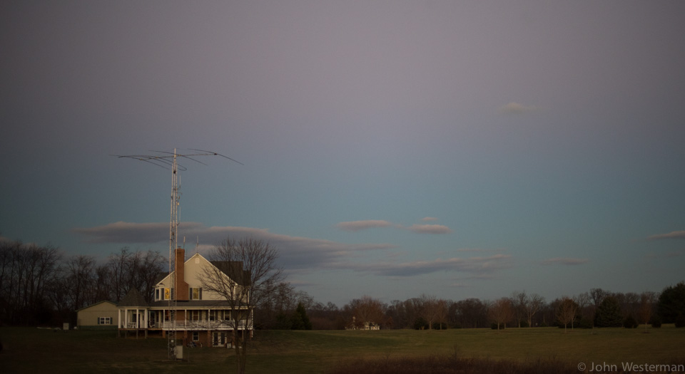
HF Digital Operation
A Presentation by
John Westerman
W5ODJ

Slide 2
Digital Operation - Agenda
Digital Modes
Digital Operation Tips
Individual components of digital kit
Details of how to sew system together
Questions
Live demonstration
30 minutes

Slide 3
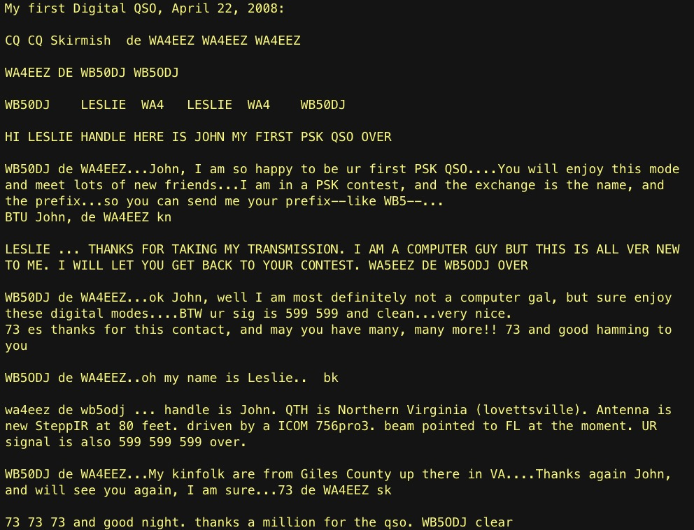

Slide 4
Digital Operation
All digital communications use USB.
Most radios want to use “D” (digital) mode; D(igital) mode will mute microphone input.
Digital in most bands requires very little power (<= 25 watts), esp. when band is active/open.
Digital modes consume consistent power as compared to CW or voice SSB.
Computer will open carrier and transmit, even idle, 100% of the time.

Slide 5
Digital Operation
Shorthand follows CW
  K = “Over”
  KN = “Over to N0GQ”
  SK = “End of transmission”
  BK = “Break”
  CQ = “Calling all stations”
Anything works!
Don’t get caught up in semantics; no one cares.
Observe the flow; get in and fumble around.

Slide 6
Digital Operation - Power
It is best to use only the power you need at all times. You will be very surprised what you can do with 5 watts using OLIVIA protocol.
If low power doesn’t do the job often aggressive power won’t either.
Unnecessary high power in digital mode wastes bandwidth.
It is obvious when used (“splatter”) and does nothing for readability of your transmission.

Slide 7
Digital Operation - VNC
VNC (“Virtual Network Computing”) is common remote control software
Use any computer as a client; Access Raspberry Pi remotely. Works well with VPN Works on any OS including phones and tablets.
Let Pi computer focus on very few tasks; removing these tasks from your computer.
RPi uses very little power in idle mode. I leave powered on.
Use this setup with multiple radios; each with their own control computer. I use two; one on IC7610, the other IC7300. Each have their own antenna

Slide 8
Digital Operation - LARG Nets
LARG DIGITAL NETS
    Digital Watering Hole
      Sunday night, 19:30 local time
      In winter 80 meters is used.
      Center frequency 3582.75 kHz
      Olivia 500/8 mode
      USB-D Mode 3581.25 kHz + 1500 Hz for center
      Reference: https://k4lrg.org/nets/
  CW
      The original digital mode
      Tuesday nights 20:00 local time

Slide 9
Digital Operation - Frequencies
Frequencies
    Many! See ARRL Band plan
    40 meters: 7.040 Mhz (±)
    40 meters: 7.078 Mhz (JS8Call)
    20 meters 14.070 Mhz (±)
  Reference LARG web site:
  https://k4lrg.org/nets/digital-modes/
Get out there and listen around!

Slide 10
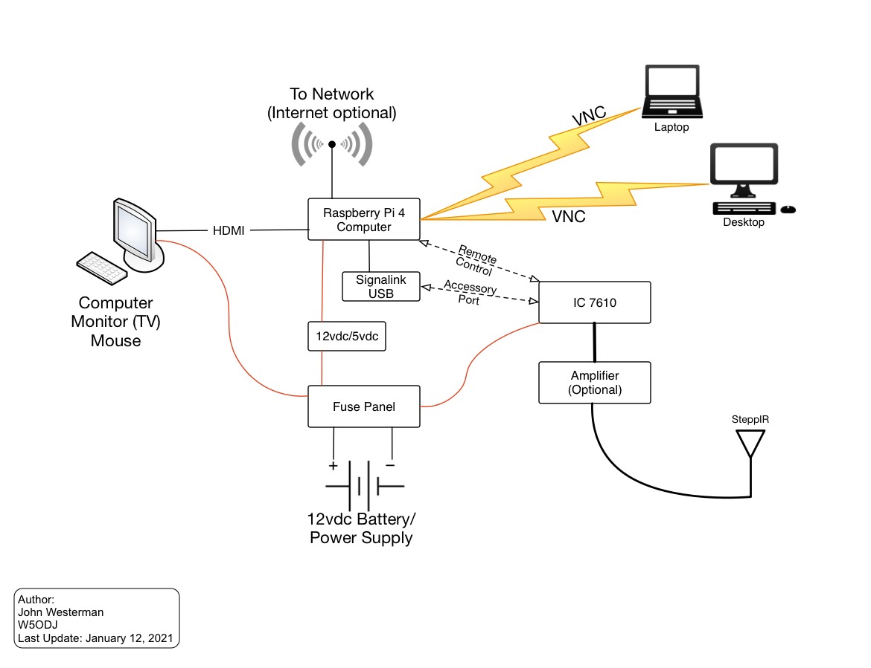
Digital Operation - Design

Slide 11
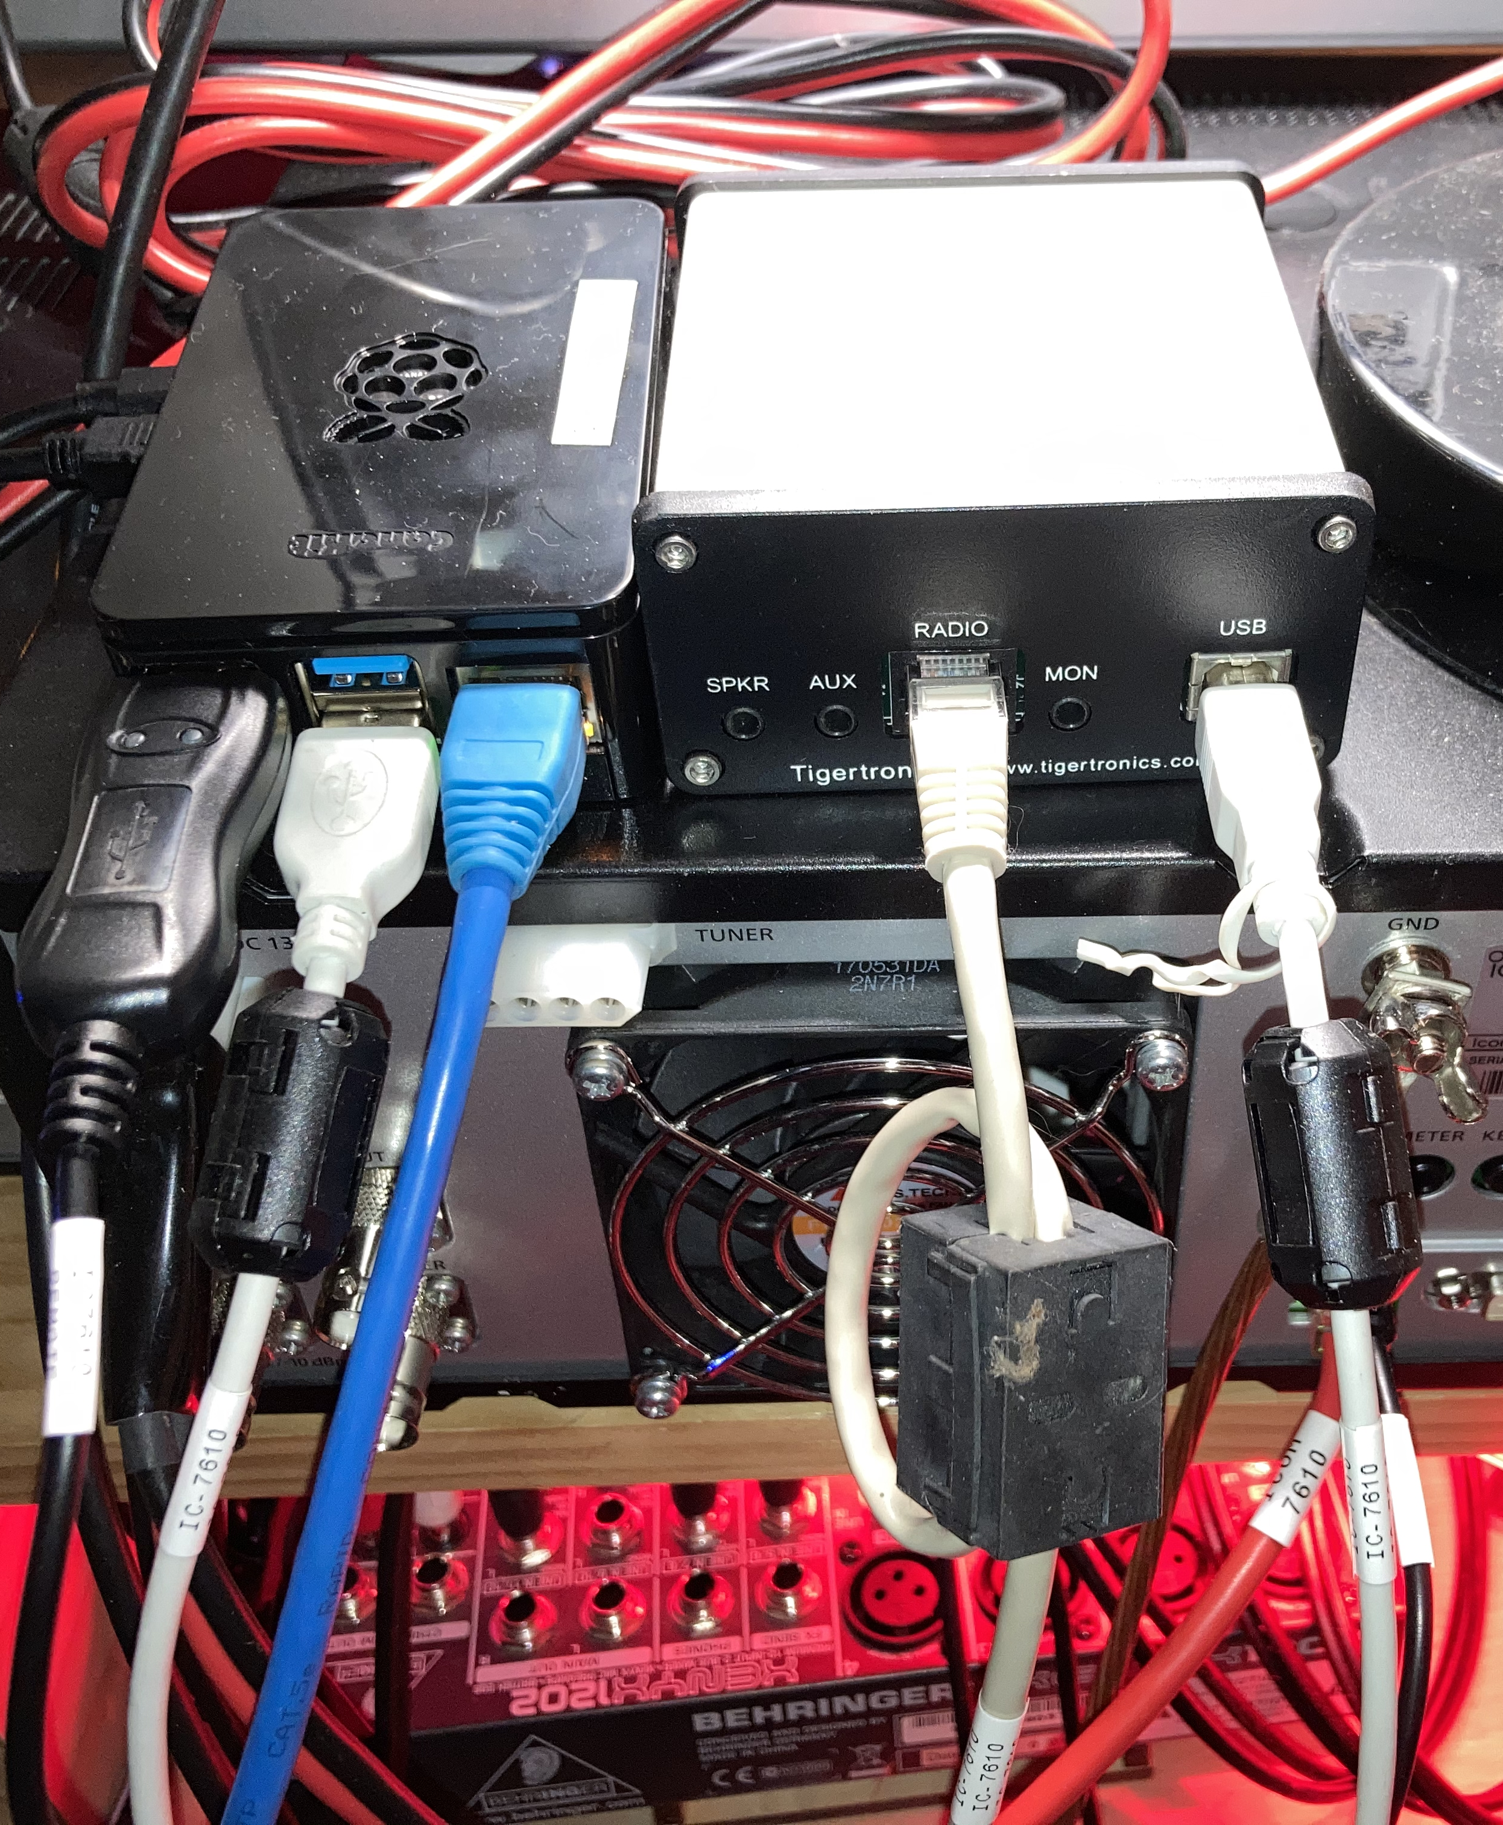
Digital Operation – IC7610 Setup

Slide 12
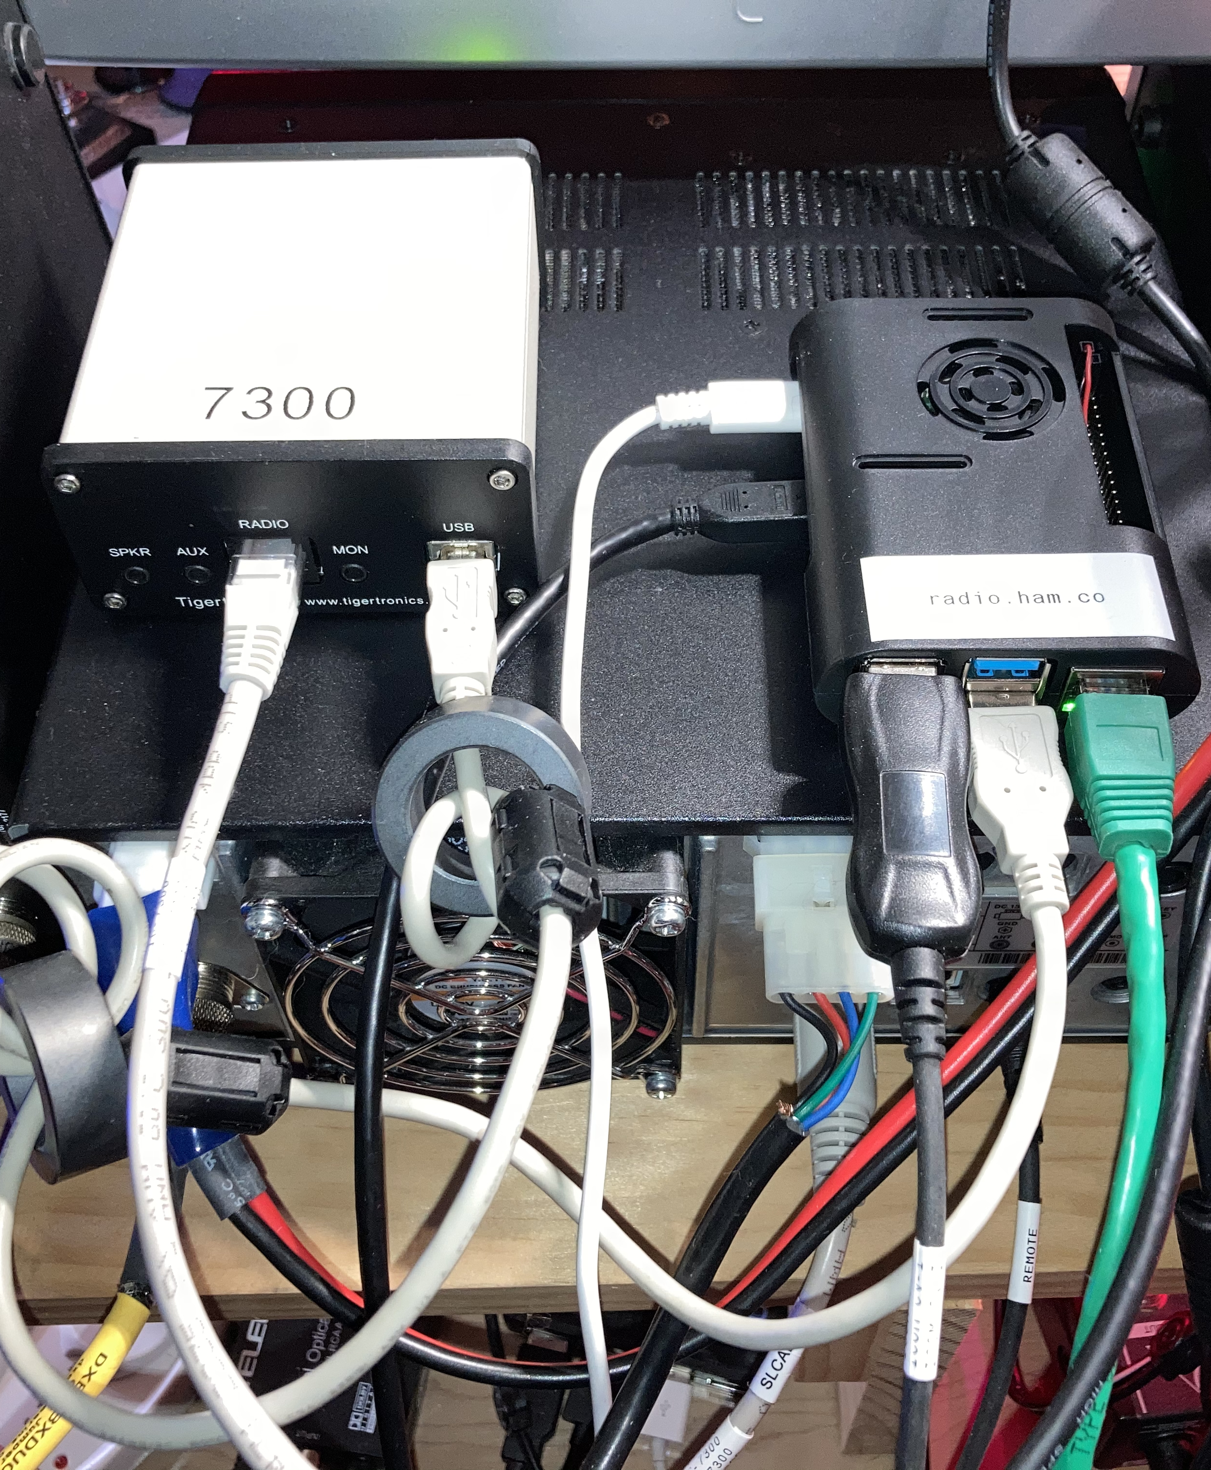
Digital Operation – IC7300 Setup

Slide 13
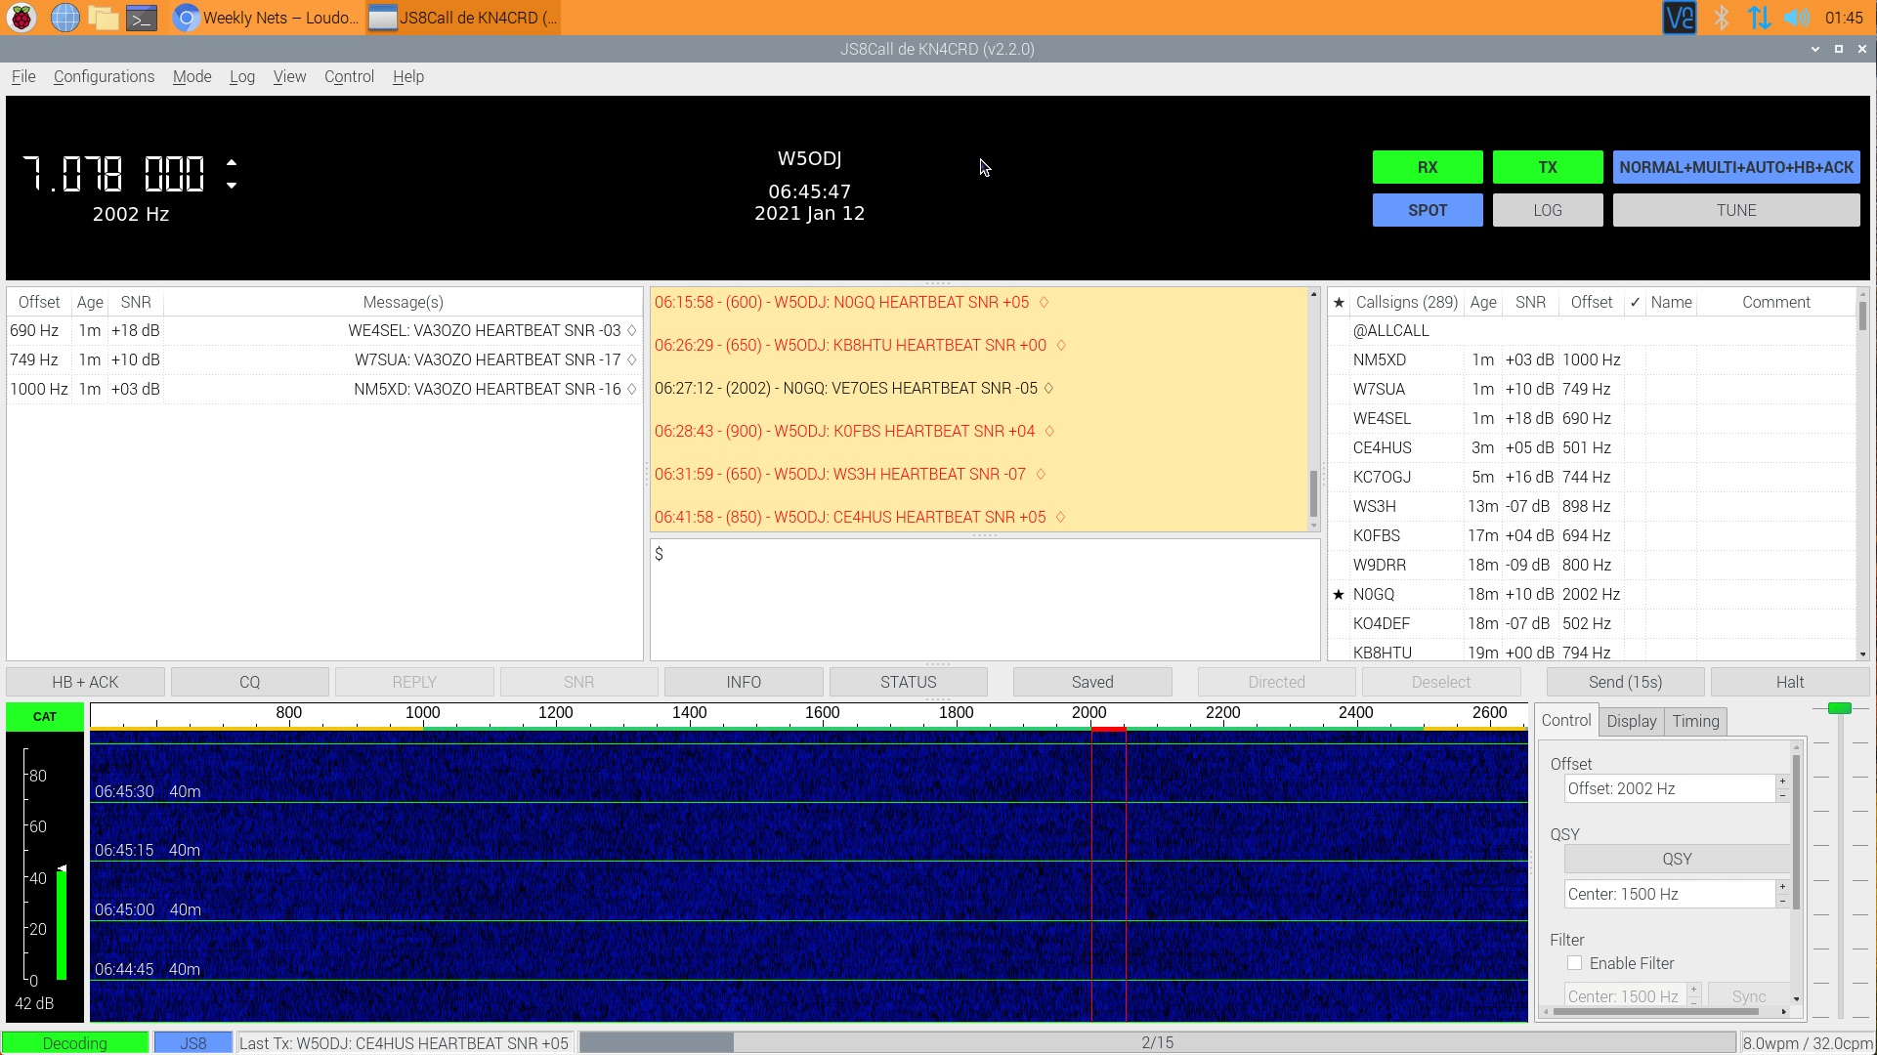
JS8 Operation

Slide 14
Live Demo
Raspberry Pi 4
Remote VNC control
JS8Call digital software
Antenna tuned for 40 meters; 7.078 Mhz
25 watts
IC-7610 set for USB-D mode
      Digital modes always use USB
      D(igital) mode will mute microphone input

Slide 15
The end...
Thank you!

