Slide 1
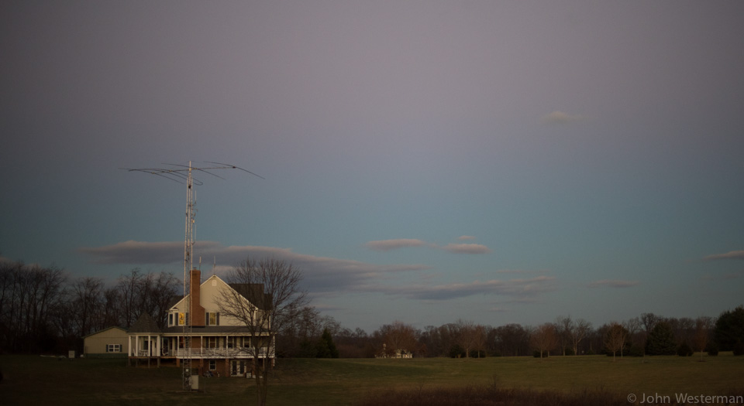
The LARG Website
A Presentation by
John Westerman
W5ODJ

Slide 2
The LARG Website - Agenda
This will be interactive! (get out your cell phone)
In the beginning … there was nothing
The history and those that created it
The transition
The latest website – The commercial option
Questions
Live demonstration
30 minutes

Slide 3
LARG Website History
The oldest history I could find is for our club is from 1994. This would make LARG 29 years old as of today (2023).
The first elected officials came in 1995
  Gary Quinn - NC4S, President
  John Unger - W3GOI (then), Vice President (Now W4AU)
  Larry Macionski WA2AJQ, Secretary
  Dale Cabaniss KD4LSL, Treasurer
  Jason Kmak KE4GUK, Field Day committee Chairman
There was no website to the best of my knowledge. Only a printed newsletter. John Unger was the first “Newsletter Editor” in addition to VP. This is a new role created in 1995.
Some context:
  The Internet was “invented by Al Gore” in 1995-ish.
  AOL Ran from 2001-2009. HTML became a standard in 1999.

Slide 4
LARG Website History
Around 1997 Norm Styer (AI2C) [SK] created the “Webmaster” role.
Norm Developed the LARG website with Adobe “Dreamweaver”.
  Dreamweaver was a high-end HTML, website developer tool created by Macromedia in 1997 and developed by them until Macromedia was acquired by Adobe Systems in 2005.
  Highly configurable, programmable interface that was developed on a powerful desktop and “pushed” to a website where content was delivered to the masses.
  Server-side programming for various platforms
  Coding in special scripting language for different operating systems and web servers
  Ah, those were the days!!
Norm must have spent 1000’s of hours in this role in his lifetime. The website was crisp, fast and he made updates daily depending on what was going on in the world (and solar system) as it related to LARG. It was always updated with the most relevant data. He was all over it.
The website will replace the printed newsletter in 2009 (After 14 years in print).
Website hosted by volunteer(s) within LARG.

Slide 5
LARG Website History
In 2012 Norm’s health would take a turn.
Norm asked me (W5ODJ) to co-op the Secretary role he assumed in 2011 while he worked through his health issues (I didn’t feel like I had enough experience to take on this role so he promised he would teach me).
W5ODJ assumed the Secretary role in 2013.
Norm would remain Webmaster until March 13, 2015.
Ben Packard (N3FQ) would take over Webmaster role in 2015
At some point the Secretary role would assume the role of Webmaster (not sure when … 2017-2018 probably).
It would become clear quickly that building a website, keeping it current and relevant, backed up, secure, etc. is not easy. It will take a lot of planning, work and maintenance by more than one person.

Slide 6
LARG Website History
It was decided by many involved in the website next steps that the current Dreamweaver derived content would not be changed.
Instead, it would be kept in a read-only state into perpetuity.
Partially in honor of all the hard work by Norm Styer (AI2C).
Mostly because no one could figure out how to do the things Norm did for so long and so well. It must have been a full-time job for him!! It is no kidding complicated and delicate.
You can find this website here: https://history.k4lrg.org/
Its is fun, informative and still used by many around the globe. Once it went down and we received e-mail asking when it would come back up. I find myself there often.
It will not change. Feel free to go out and explore.

Slide 7
The New Site
Many iterations were made to figure out what was best for the club. (Adobe MUSE, etc.). MUSE was discontinued soon after implementing. We must find a supportable solution to use!
100% of content still came through secretary.
Single point of contact and single point of failure.
Very time consuming to maintain.
Large ask of the Secretary role.
No one would volunteer to take this project on as a separate task.
The website is much more than just a website:
  Schedule
  Reflector
  Document store
  File repository
  And more!

Slide 8
The New Site
It was decided that the best use of the site and content would be for it to be 100% collaborative all members of the club.
It was decided that LARG should own the domain and control the domain name through the leadership (elected and board).
It was decided that a new committee should be formed at some point. Enter the LARG IT committee. A budget is created.
Collectively decided that the LARG “BRAND” should be commercialized and managed by many … not by one.
https://k4lrg.org/ was transferred to a registrar controlled by the IT committee under the auspices of the board of directors.
Content is database derived and managed by WordPress.
Content is hosted in Docker container infrastructure within an AWS EC2 instance at AWS Web Hosting.
Crypto certificate is managed by LetsEncrypt.
Content is TLS encrypted over the Internet (Encrypted).

Slide 9
The New Site
Yes, things changed drastically. Yes, the backend is reasonably complicated by non-IT pros. But it is all well managed.
Being commercially deployed and managed by many created a site that can live into perpetuity, managed by many simultaneously, contributed to by anyone and otherwise become the “voice” and presence of the club as a whole, not just by one person.
That said, it is not particularly complicated to managed this standard platform.
The site uses commercially available tools, known and supported by both volunteers and industry.
Built entirely on a well understood, highly available and supported platform.
Complexity is in the back-end. Not complex at all on the surface. All this is by design. We wanted it to be easy for anyone to contribute.

Slide 10
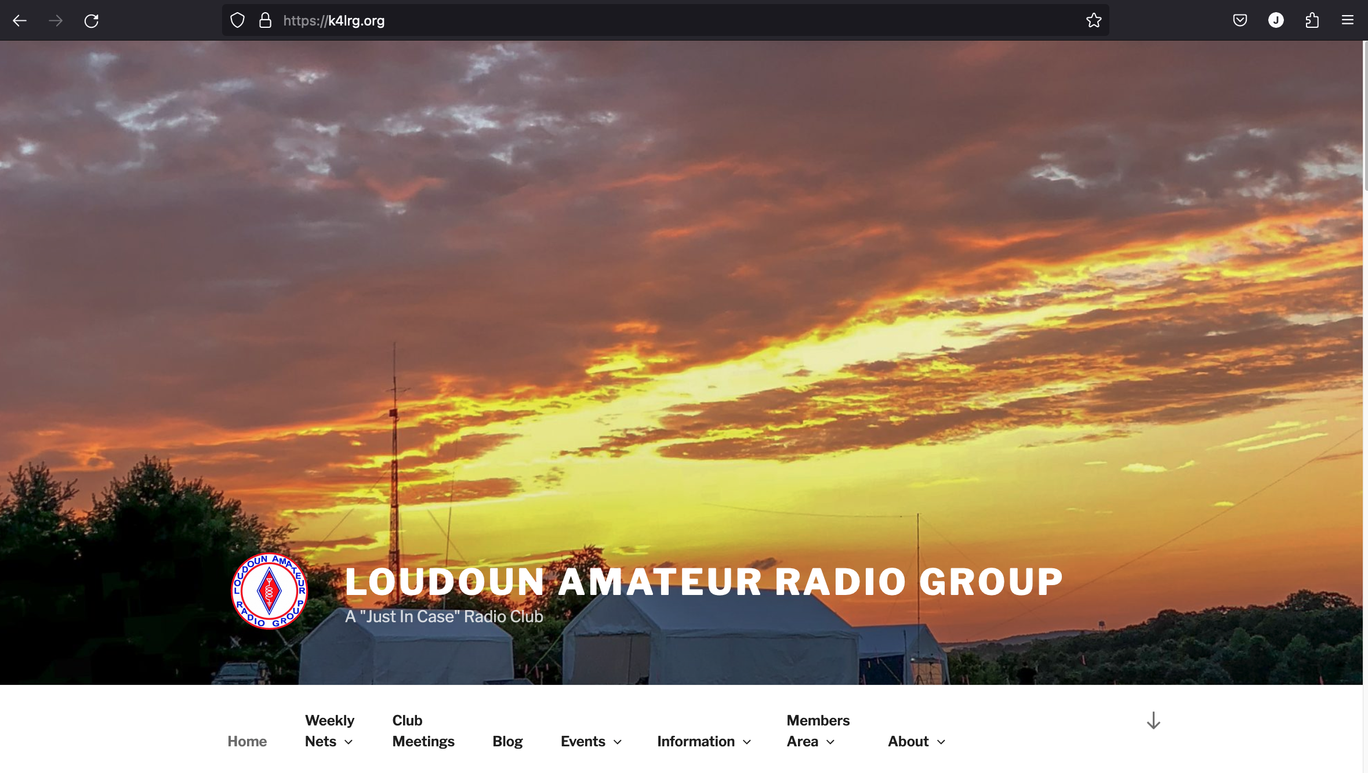
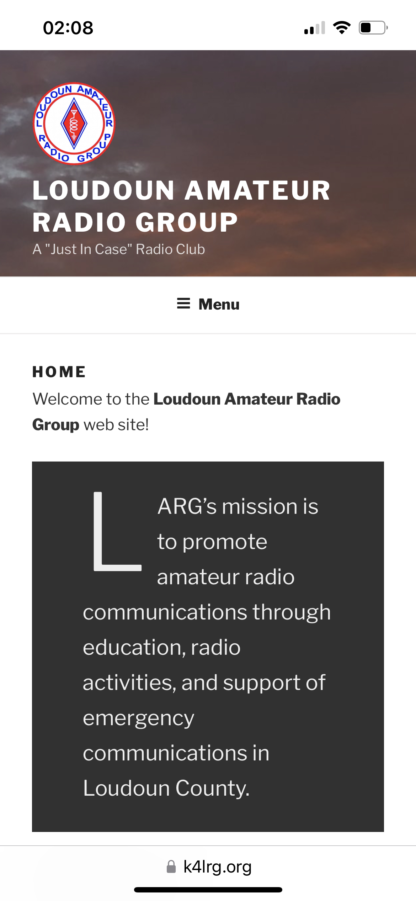
The End Result

Slide 11
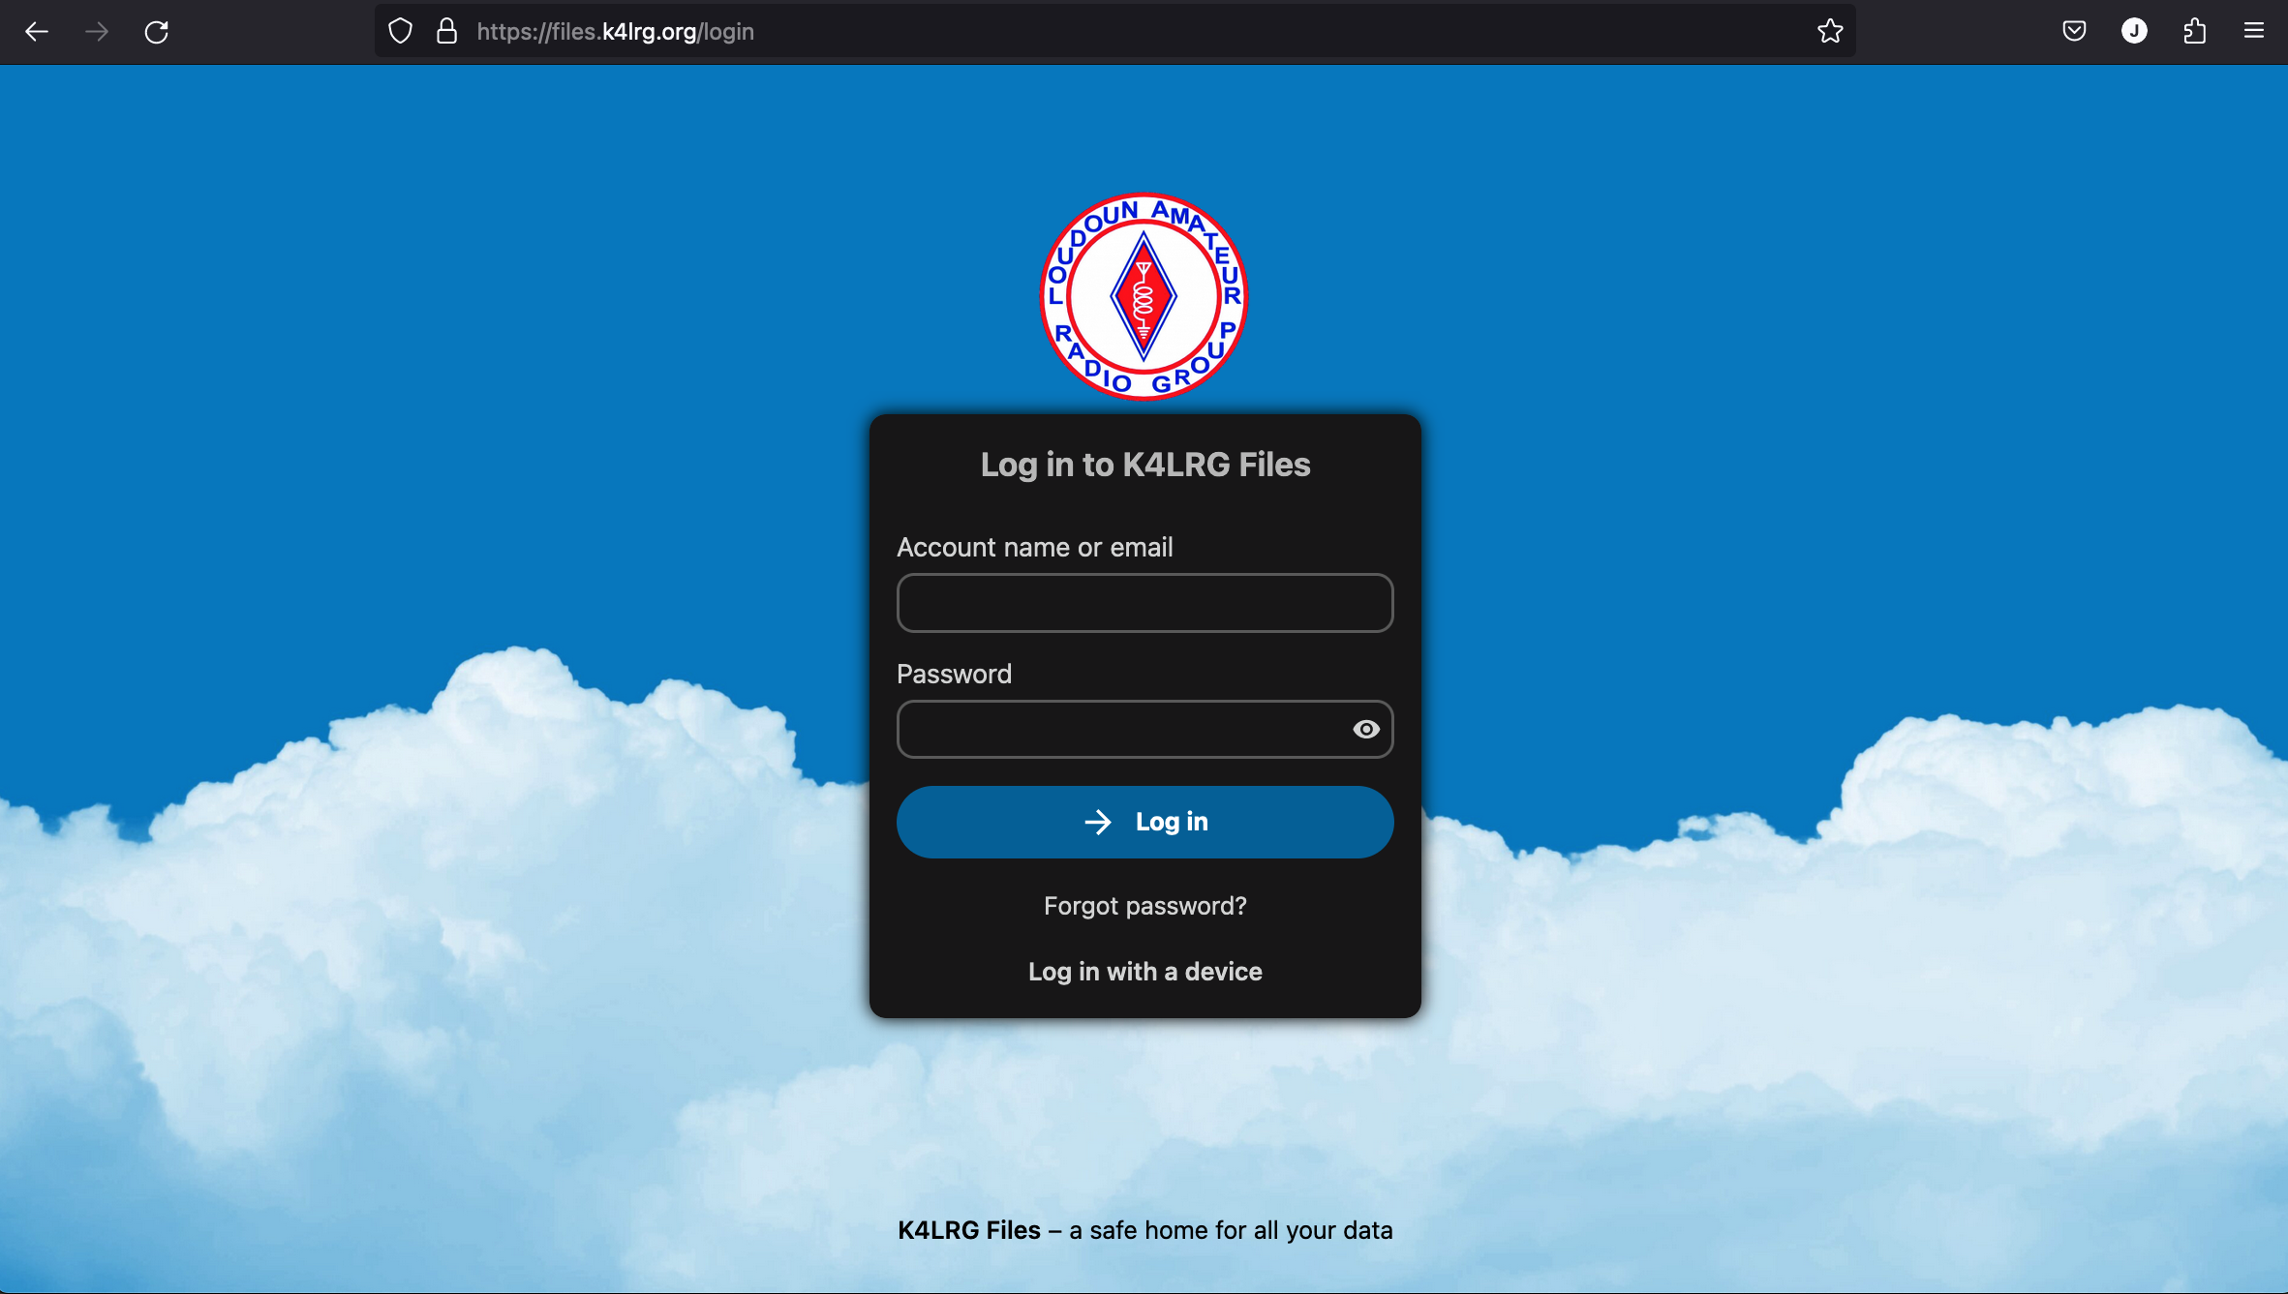
Contribution is Key
There are a few ways to contribute.
  The old way still exists
    (Members Area then Members Only Area)
  There is a new way to contribute to any page, add new pages, update existing information, etc.
    (Members Area then Contribute)
  There is a way to put file into the file store (repo). (https://files.k4lrg.org/)

Slide 12
Demonstration
Navigation
Authentication
  The old way
  The new way
  What you can to with each
Making edits real time
  Markup Language
  100% done with a web browser (computer, laptop, iPhone, Tablet, etc.)
End results – Immediately live online!
Contributing – The best part

Slide 13
The end...
Please provide feedback if you have some. All comments welcome to improve content of this message and website.
Be sure and get out to: https://k4lrg.org/
You will find this presentation there (will send link to everyone)
Please sign up to contribute. If you are an IT expert, consider joining the IT committee and lending a hand. All remote work using latest cloud technology. 100% Linux delivered.
73 de W5ODJ SK
Thank you!

