Slide 1
Signals
for Amateur Radio
Jeff - KØZR

Slide 2
Signals
Earliest beginnings were
Beats on a drum (cave man days)
Puffs of smoke ( Indian days)
Wave a flag to the left or the right
Presence or absence of a voltage ( Morse “clicks”)
…
Modulation – a term birthed in the earliest days of radio
Simplest form: amplitude, frequency, or phase of a carrier is varied in accordance with the sound waves or other intelligence to be transmitted
Carrier is the signal vehicle used to convey the information

Slide 3
Advances in Communication
Technology rarely advances in complexity or capability without some market driving force
Increased efficiency of data transmission
Improved error-free transmission
Higher volume of data passed per unit time
Conservation of limited frequency spectrum
SWAP: size, weight and power of hardware
Manufacturability, affordability of hardware

Slide 4
A Journey Through Communications
Morse Code
AM and SSB
NBFM – narrowband FM
Standard FM
Noise and its impacts
Digital Waveforms – constellation diagrams
BPSK – binary phase shift keying
QPSK – quadrature phase shift keying
Coding
FT8

Slide 5
Morse Code
Series of ON/OFF tones
The “code” itself was designed to:
Expedite letters used most frequently
Minimize overall character length while accommodating the 26 basic latin letters
Promote intelligibility
Offer a level of noise/interference immunity
A “Dit” is one time unit in length
A “Dash” is three time units in length
Interelement gap is one time unit or “Dit” in length

Slide 6
Morse Code - 2
The shorter the “dit”
Wider channel bandwidth required
More noise enters the channel
Channel bandwidth places upper limit on the dit-dah rate possible
Transmitter and receiver among the simplest possible
Receiver determines presence/absence of signal
Distinguish sequence of dots and dashes
In 2005 a Belarus amateur transmitted 230 Morse code marks of mixed text in one minute

Slide 7
Morse Code - 3
Using the Dit-Dash timing principles of Morse a mathematical expression for the time required to send “LARG” was quickly developed
1 Morse word is 5 characters
20 WPM (words per minute) equates to 100 characters in a minute
Required bandwidth is simply 1/(time of one bit)
This is a rudimentary approximation for comparison only

Slide 8
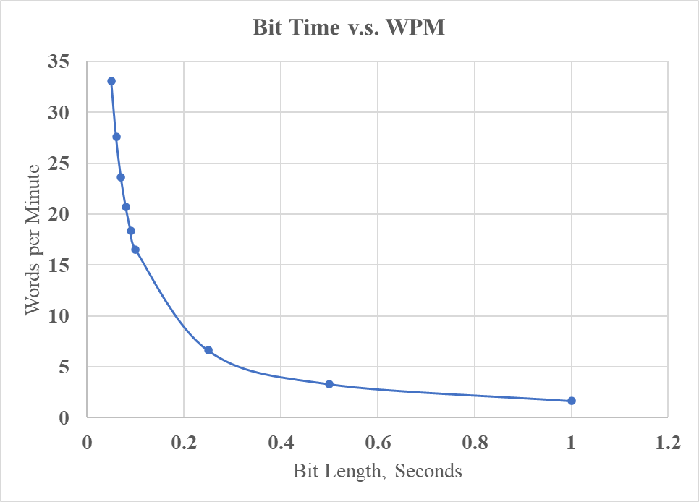
Morse Code - 4
The shorter the bit the
higher the code rate
Bandwidth increases
proportionately to code rate

Slide 9
Morse Code - 5
Using information presented, a code rate of 20 WPM requires 12.5 Hz of bandwidth
Compare this to what is needed for standard SSB
10 log₁₀(12.5) = 10.97 dB-Hz [CW]
10 log₁₀(2700) = 34.31 dB-Hz [SSB]
CW enjoys 23.34 dB-Hz advantage over SSB
Actually more because of intelligibility issues
A CW signal utilizes its bandwidth much more efficiently than SSB
The Morse receiver is very complex – a human ear that can decipher Morse code

Slide 10
AM and SSB
Amplitude Modulation (AM) was the first of the true modulations invented
Simple hardware for transmitter
Simple hardware for receiver
Spectrally very inefficient
Modulation efficiency, the power actually embodying the intelligence on the signal, is poor
$E= \frac{\left\langle m^{2}\left.(t)\right\rangle \right.}{1+\left\langle m^{2}\left.(t)\right\rangle \right.}×$ 100% The highest efficiency possible is 50% for a square wave
AM requires ~ 6 kHz bandwidth while SSB ~ 2.7 kHz
ALL the power in a SSB signal goes into the sidebands to represent the intelligence
66% of the power in AM is in the do-nothing carrier
No wasted power in a carrier for SSB

Slide 11
NBFM – 2m and 70 cm FM
All handhelds use narrowband FM
Closely related to AM and SSB mathematically
NBFM is simple, offers good noise immunity, and signal is not overly wide
Carrier Modulation
Carrier
Standard AM/SSB
NBFM
Modulation at 90º
Integral to any FM receiver is a limiter which
attenuates atmospheric and manmade noise

Slide 12
Standard FM
Frequency modulation more complex; greater bandwidth required; must be optimized
Frequency modulation index is
$β_{f}$= $\frac{∆F}{B}$
98% of total power is contained in the BW ${BW}_{T}=2\left(β+1\right)B$
where B is the bandwidth of the modulating signal
Known as Carson’s Rule
FM signals have carriers and optimum modulation indexes reduce the amount of power wasted there
The zeroth order Bessel function determines the amount of carrier power present

Slide 13
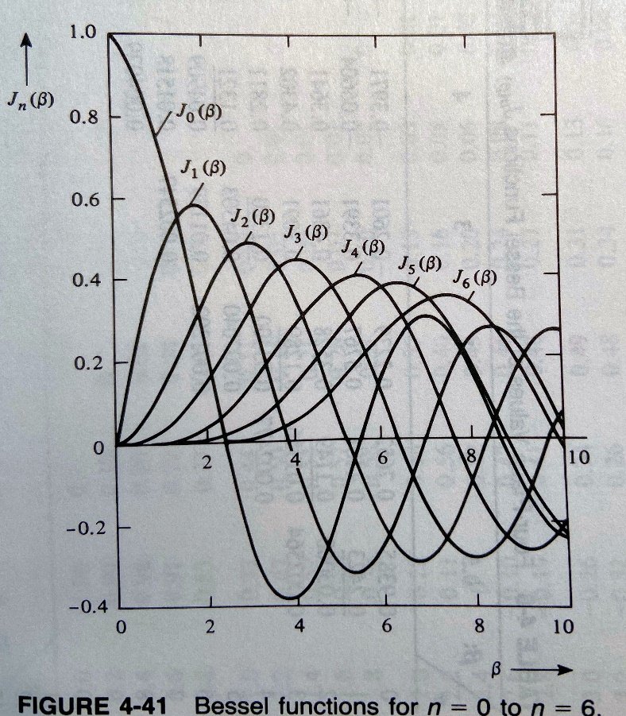
Standard FM - 2
Power in a FM signal is described by a summation of Bessel functions:
Each J_{n} term is a Bessel function;
J₀ determines the size of the carrier
Mod indices of 2.4, 5.52, etc. produce zero power in the carrier
Best use of the transmitted power

Slide 14
Noise
Just like death and taxes, noise is always with us in comm systems
Noise is the nemesis of all communication systems
Standard, untainted noise is called white noise
If passed through a filter or changed by electronic circuits, can become a different type of noise, colored noise, which has different statistical properties
The radio/channel designer must:
Structure the channel to limit noise
Devise modulation formats which offer improved noise immunity, even corrections for errors caused by noise
Modulation formats which are more tolerant to nonlinearities in amplifiers or nonlinear phase found in most filters
Some processing inherently makes noise worse
Any operation that takes the derivative of the signal generates noise

Slide 15
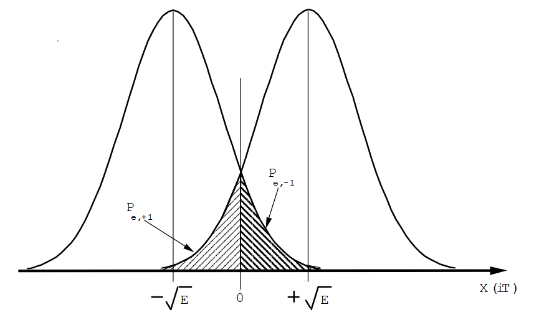
A Digression into BPSK
The simplest type of digital signal today (not counting CW) is BPSK – binary phase shift keying
A signal constellation diagram for BPSK is
-1
+1
Perfect, noise-free BPSK
-1
+1
BPSK With Noise

Slide 16
A Digression into BPSK - 2
How can a “-1” be received:
A “-1” is actually transmitted
A “+1” is actually transmitted and erroneously interpreted as a “-1”
A “+1” signal incorrectly interpreted as “-1”

Slide 17
A Digression into BPSK - 3
How can a “+1” be received:
A “+1” is actually transmitted
A “-1” is actually transmitted and erroneously interpreted as a “+1”
A “-1” signal incorrectly interpreted as “+1”

Slide 18
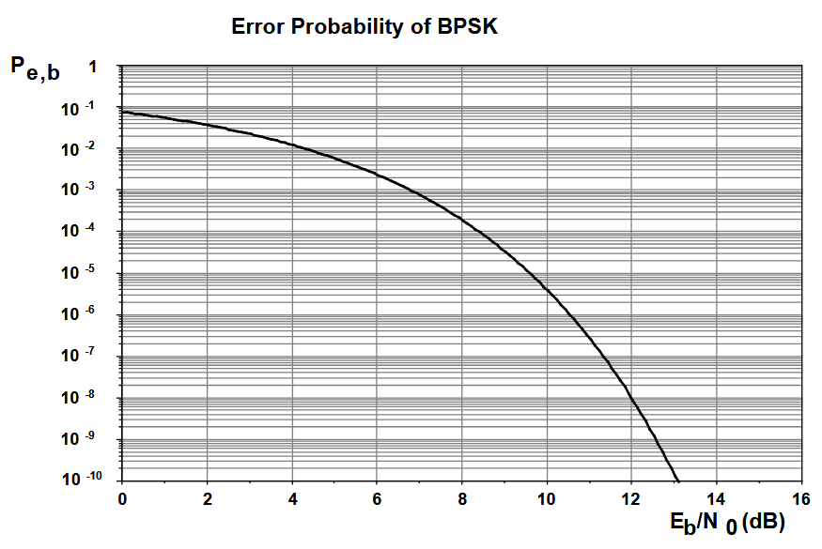
A Digression into BPSK - 4
The probability of obtaining an error is:
A “-1” is sent but interpreted as a “+1”
A “+1” is sent but interpreted as a “-1”
$P_{E}$ = $P_{\text{1|0}}+P_{\text{0}\text{|}1}$ (Prob of error)

Slide 19
BPSK and Noise
In all digital signaling, decision boundaries are integral to demodulating the data
Signal to the left is interpreted as a “-1”
Signal to the right is interpreted as a “1”
-1
+1
Hard decision boundary
Advanced demodulation techniques use soft decision boundaries

Slide 20
More than BPSK
BPSK is the simplest; today much more complex formats such as 64 – QAM (quadrature amplitude modulation) or 64-PSK (phase shift keying)
000111
With more complex signal constellations,
one “point” can convey much more
information
As shown, each point conveys 6-bits of information
Increased sensitivity to phase and amplitude
inaccuracies ( and noise )
001100

Slide 21
Increasing Channel Throughput
Using a more complex “alphabet” or signal constellation enables more rapid data transmission
Integrity of the channel becomes increasingly important with more complex constellations
Phase linearity
Amplitude linearity
Noise of all types to include phase noise
Manner in which signals are filtered
Accuracy of frequency sources for sampling and frequency translation

Slide 22
Nothing is Free
In the late 1940’s several researchers identified the limitations on the amount of data that can be passed through a channel
These limitations are true today
Generally called the Shannon Capacity Theorem
Error-free transmission can be achieved at any rate lower than the capacity predicted
No one has “beaten” the capacity theorem although modern techniques are getting closer and closer
C = bits/sec W = bandwidth E_{b} = energy per bit

Slide 23
Channel Coding
Of great importance in today’s digital signaling is coding:
Encode a signal to be more tolerant of nonideal conditions
Grey codes, 8b10b coding, Manchester, differential, Trellis, etc., etc.
Augment intelligence with a FEC – forward error correction code
Adds “overhead” to the signal BUT can self-correct some bit errors as they occur
Many, many types:
BCH
Reed-Solomon
Convolutional
Trellis
Viterbi
Turbo
Codes can be layered on top of one another; adds security
Without knowledge of the “key code”, cannot decipher it

Slide 24
What About FT8?
Imagine two situations where you, the receiver, must determine when the letter “E” ( a dot ) is sent in Morse code
Time length = 60 seconds
Time length = 7.5 seconds
In low to marginal signal conditions, noise and other interference is present, increasing the chances an incorrect detection occurs in the 60 seconds
In FT8 due to very accurate time keeping, your receiver knows to listen to only 7.5
seconds and disregards the other 52.5. This improves the error rate and allows
signal levels to be even lower in strength
* Numbers chosen only to illustrate principles

Slide 25
What About FT8 - 2?
FT8 works by sending signals in 15-second-blocks with 12.64 seconds of transmission time and 2.36 seconds of decode time
This allows FT8 transmission to support up to 13 characters
FT8 employs 8-FSK (frequency shift keying) format in a signal bandwidth of only 50 Hz.
Standard FSK (RTTY) uses two tones separated by 170 Hz
FT8 also employs forward error correction (FEC) coding
Signals are “pre-encoded” such that at the receiver they are more accurately received
Some FECs can self-correct one or possibly two mistakes; the more the correction the more overhead embodied in the coded signal
Accurate time stamps are critical to successful FT8
A wandering computer clock will instantly cease FT8 reception/transmission

