Slide 1
Road Trips
Radio Gear
ARRL Field Day
Notes:
Copyright © 2022, 2023 KS1G Permission to Copy & Use in non-commercial Amateur Radio Presentations. All rights reserved.

Slide 2
Disclaimer:
These are just my observations and experiences…this information may be familiar.
Notes:
Copyright © 2022, 2023 KS1G Permission to Copy & Use in non-commercial Amateur Radio Presentations. All rights reserved.

Slide 3
About Me:
Jeremiah Machado / K4HCO
Senior Cybersecurity Specialist for the U.S. Senate
My Past life….23 years in Law Enforcement
(U.S. Army CID / U.S. Capitol Police)
Originally from Klamath Falls, Oregon
Been in the DMV over 15 years
Currently live in Haymarket, Virginia

Slide 4
Road Trips

Slide 5
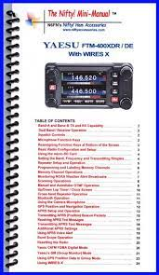
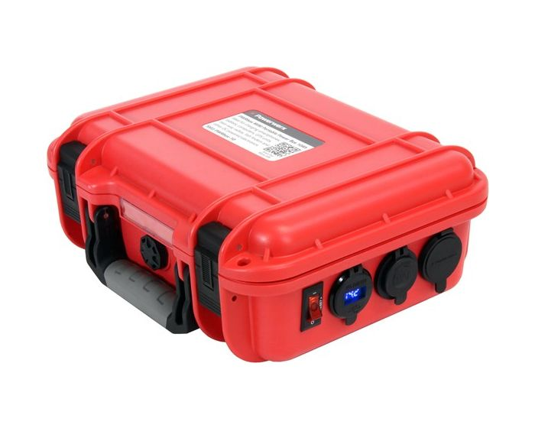
Prepare for your trip:
Planned Route / Planned Rest Stops
Repeaters along the route
Repeaterbook
RT Systems
Instructions for your radio(s)
Nifty Guides
Backup power (if necessary)
Solar Power Generator Battery Box
Powerwerx Battery Box?
Planned Activities
POTA
SOTA
Field Day?

Slide 6
Programming Repeaters
Sources:
Repeaterbook
Repeaterbook Application (Android / iPhone)
ARRL Website
Online Search

Slide 7
Repeater Map

Slide 8
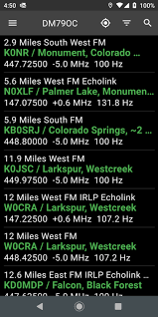
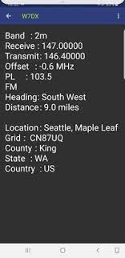
Repeaterbook Application:
Available for Android and iPhone
Search Feature
Sorts the closest repeater on top
Great for tablets in your vehicle

Slide 9
Activities Enroute:
Safety first!
Turn the knob…see what you can hear.
Change to the next repeater down the road.
Dual VFO is very helpful
Go Box in the trunk(?)
Work additional Bands (220Mhz)
Monitor 146.52 / 70cm

Slide 10
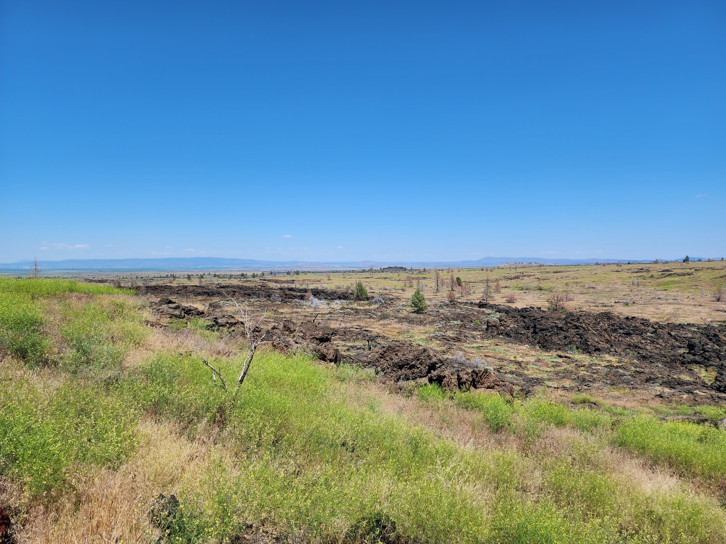
Parks on the Air (POTA) / Summits on the Air (SOTA):
POTA / SOTA Websites
Plan your stops
Expect to spend extra time
Plan for things to go wrong
Environmental Conditions
Plan for the worst (rain / sun)
Bugs(?)
Band Conditions (They just sucked!)
Altitude
Lava Beds National Monument, Tule Lake, California

Slide 11
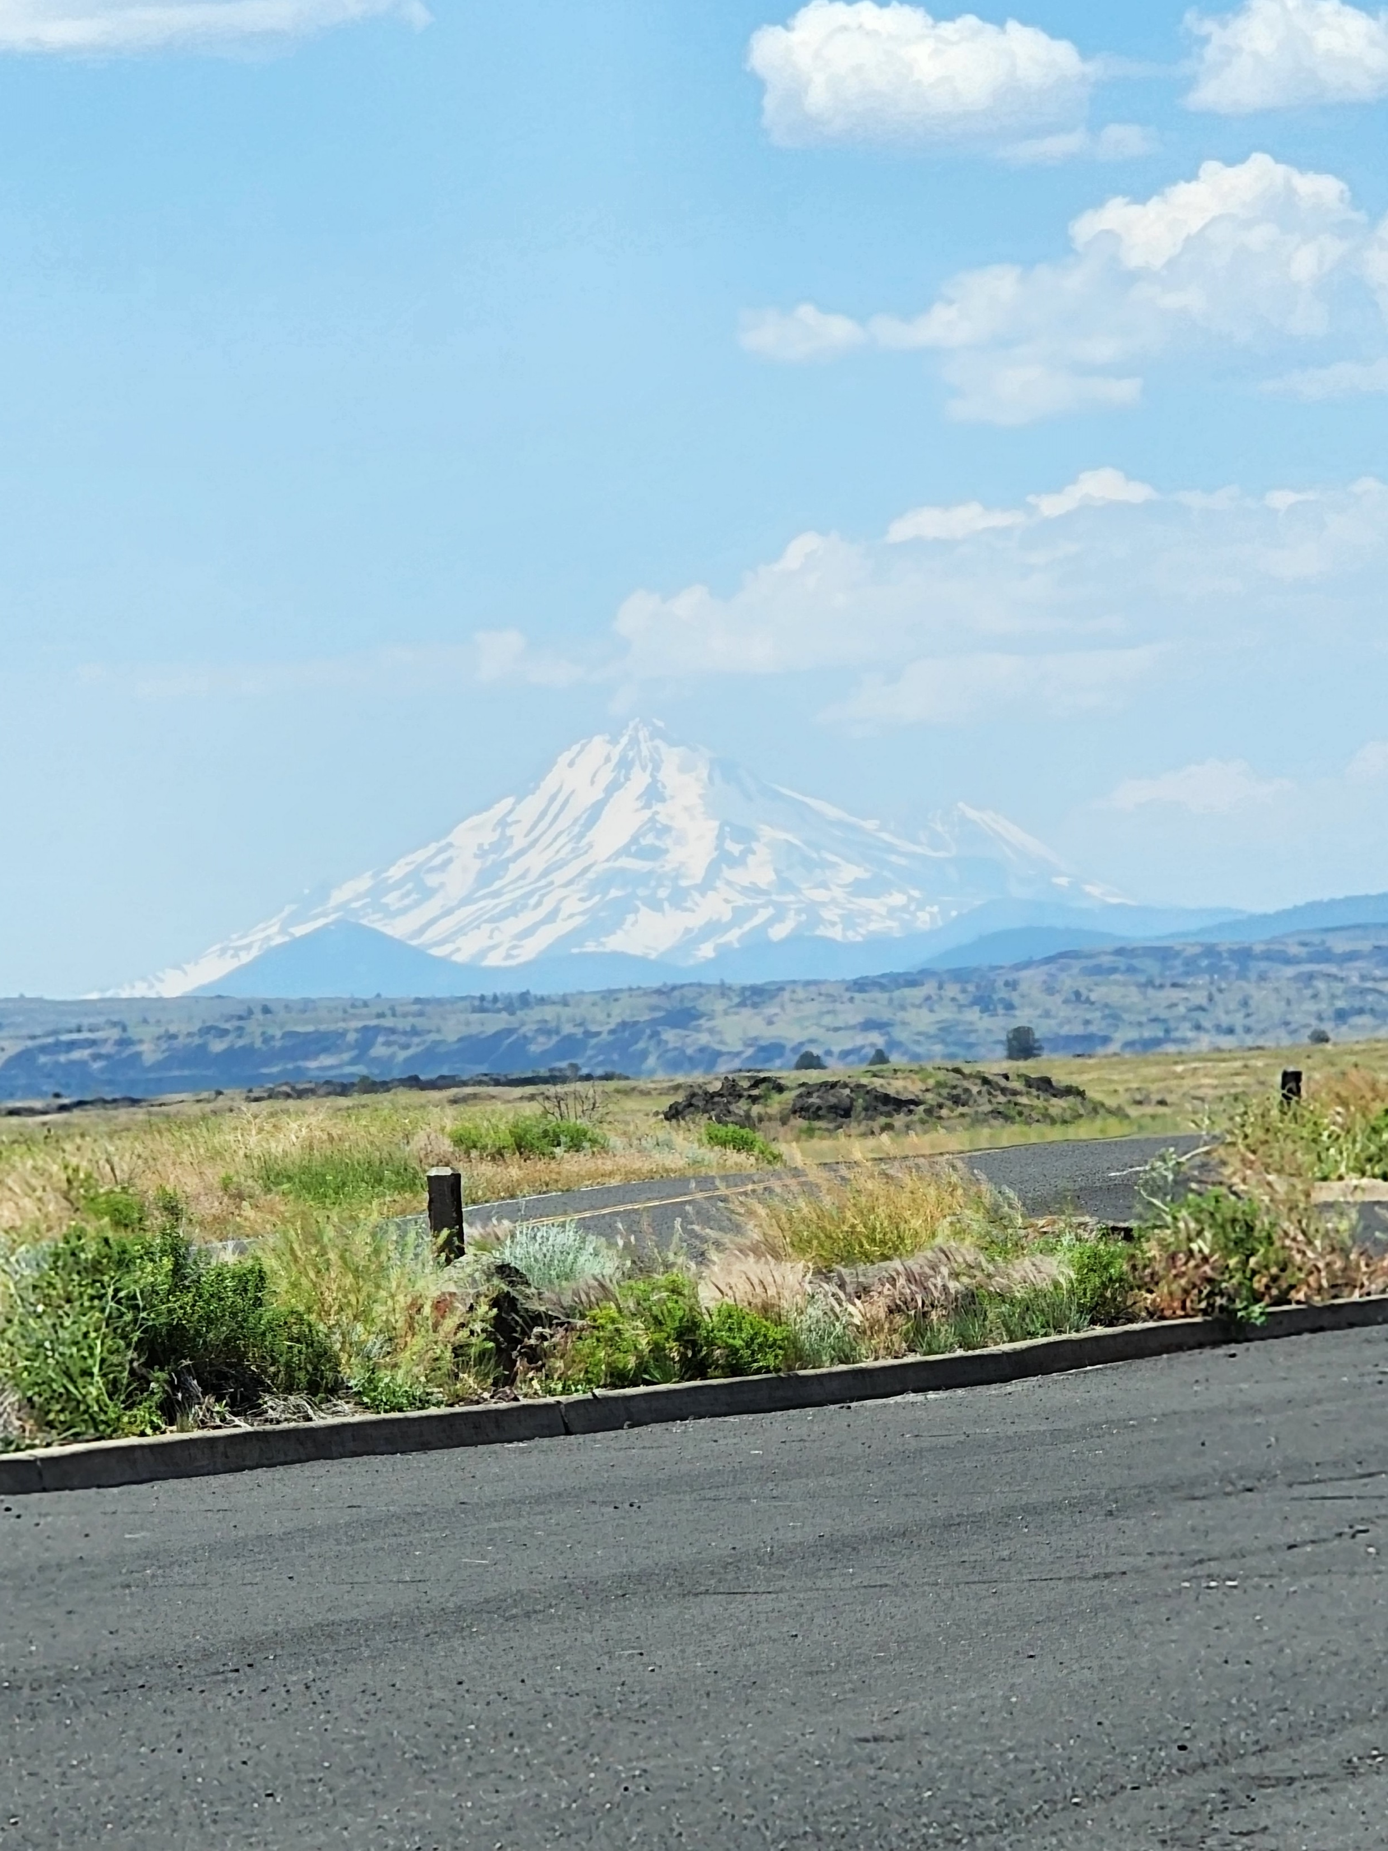
Mount Shasta, California, as seen from the Lava Beds N.M.

Slide 12
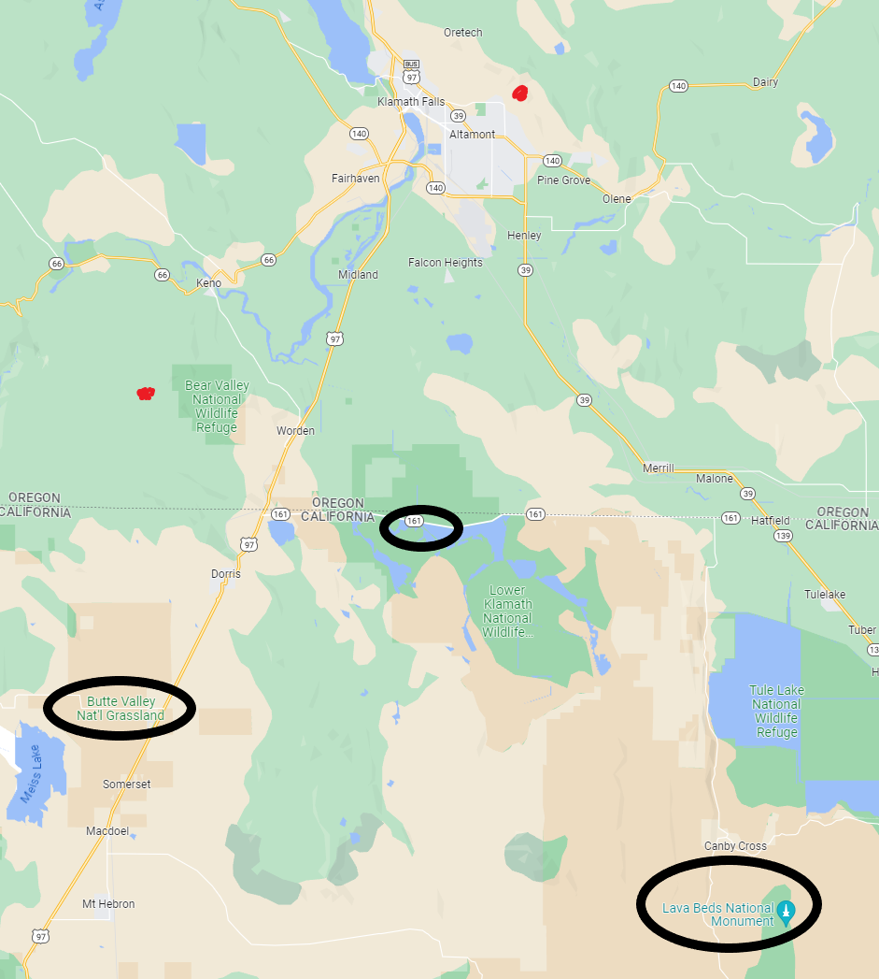
POTA Locations:

Slide 13
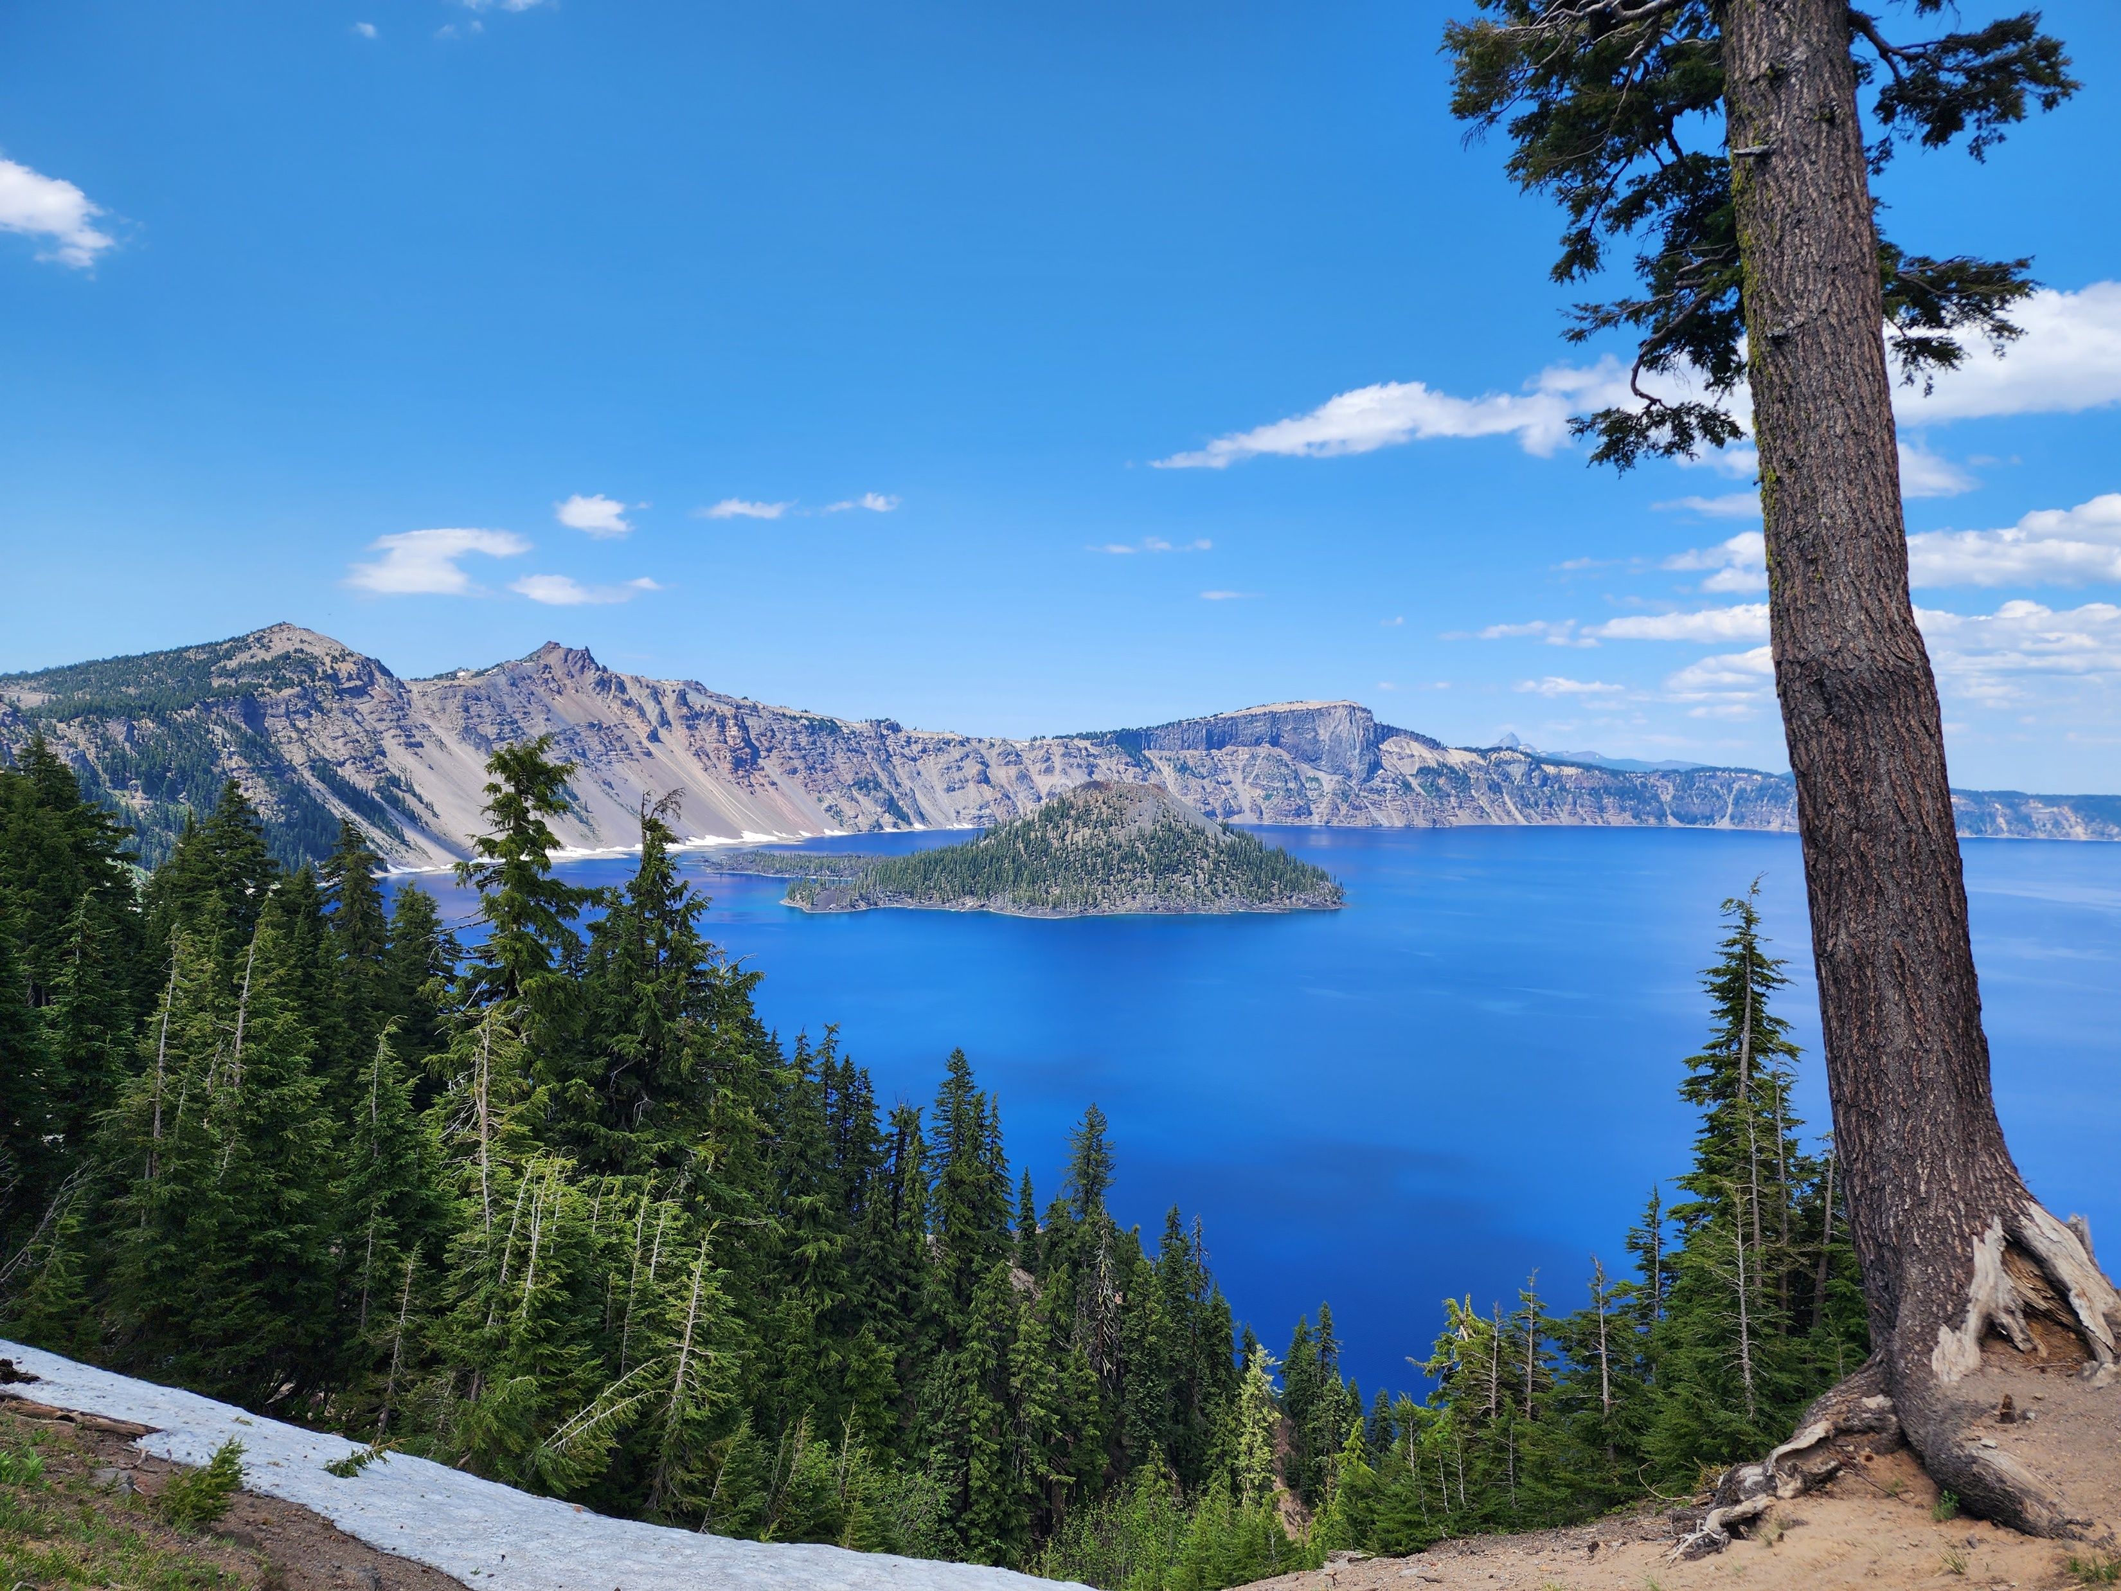
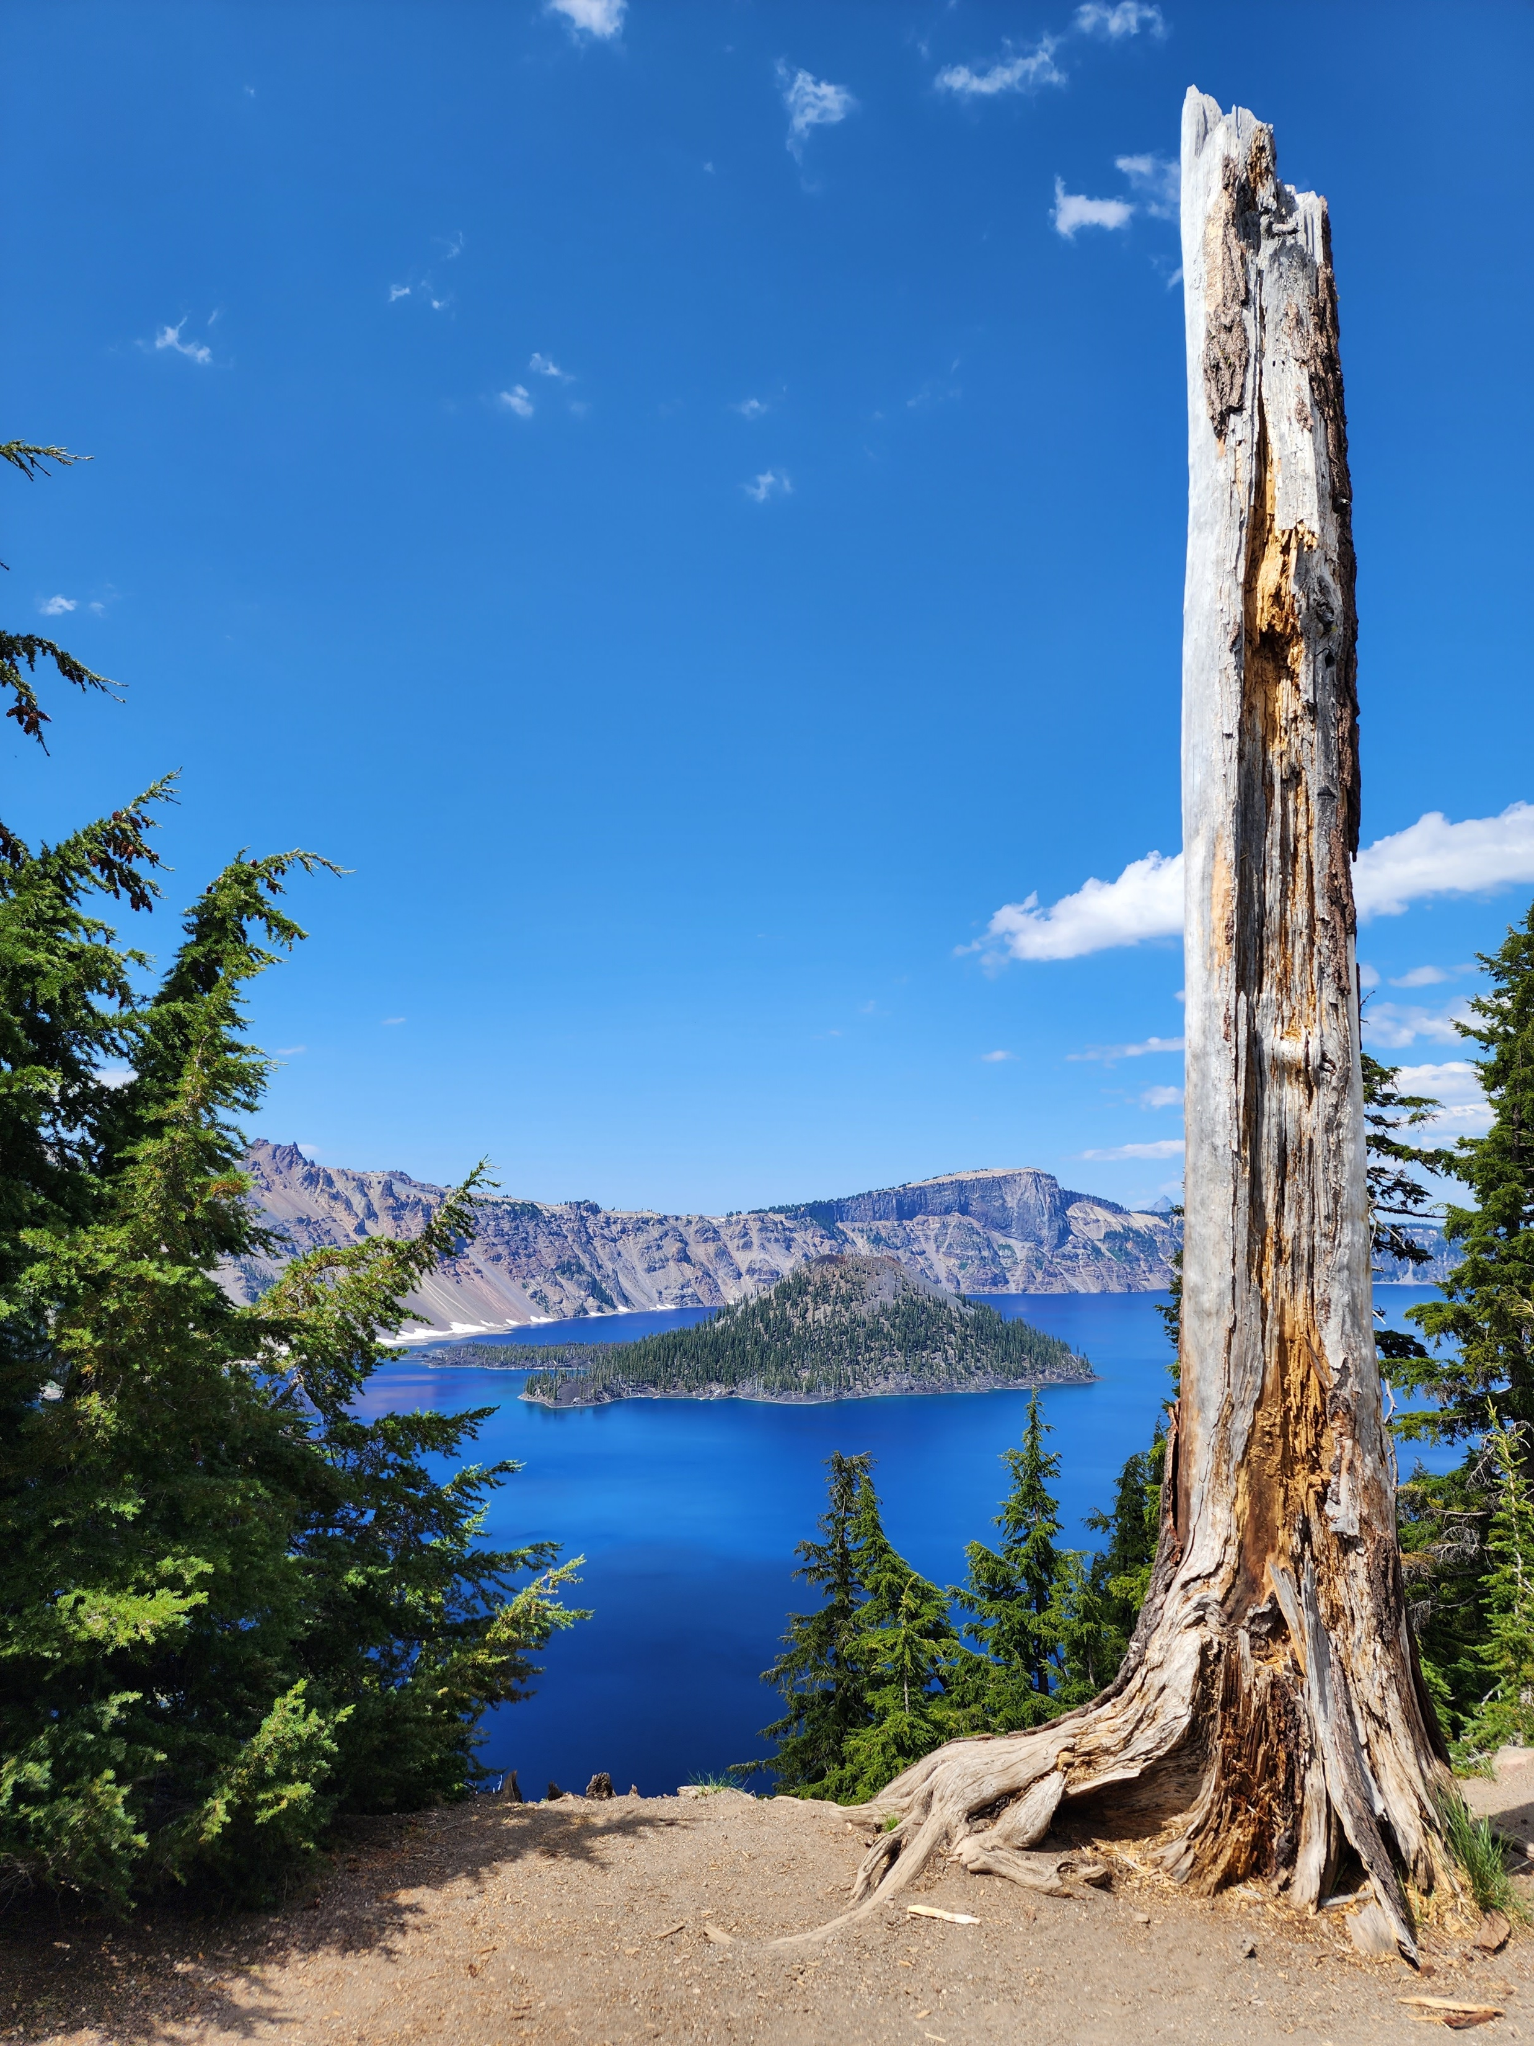
Local Attractions:
Crater Lake National Park, Oregon

Slide 14
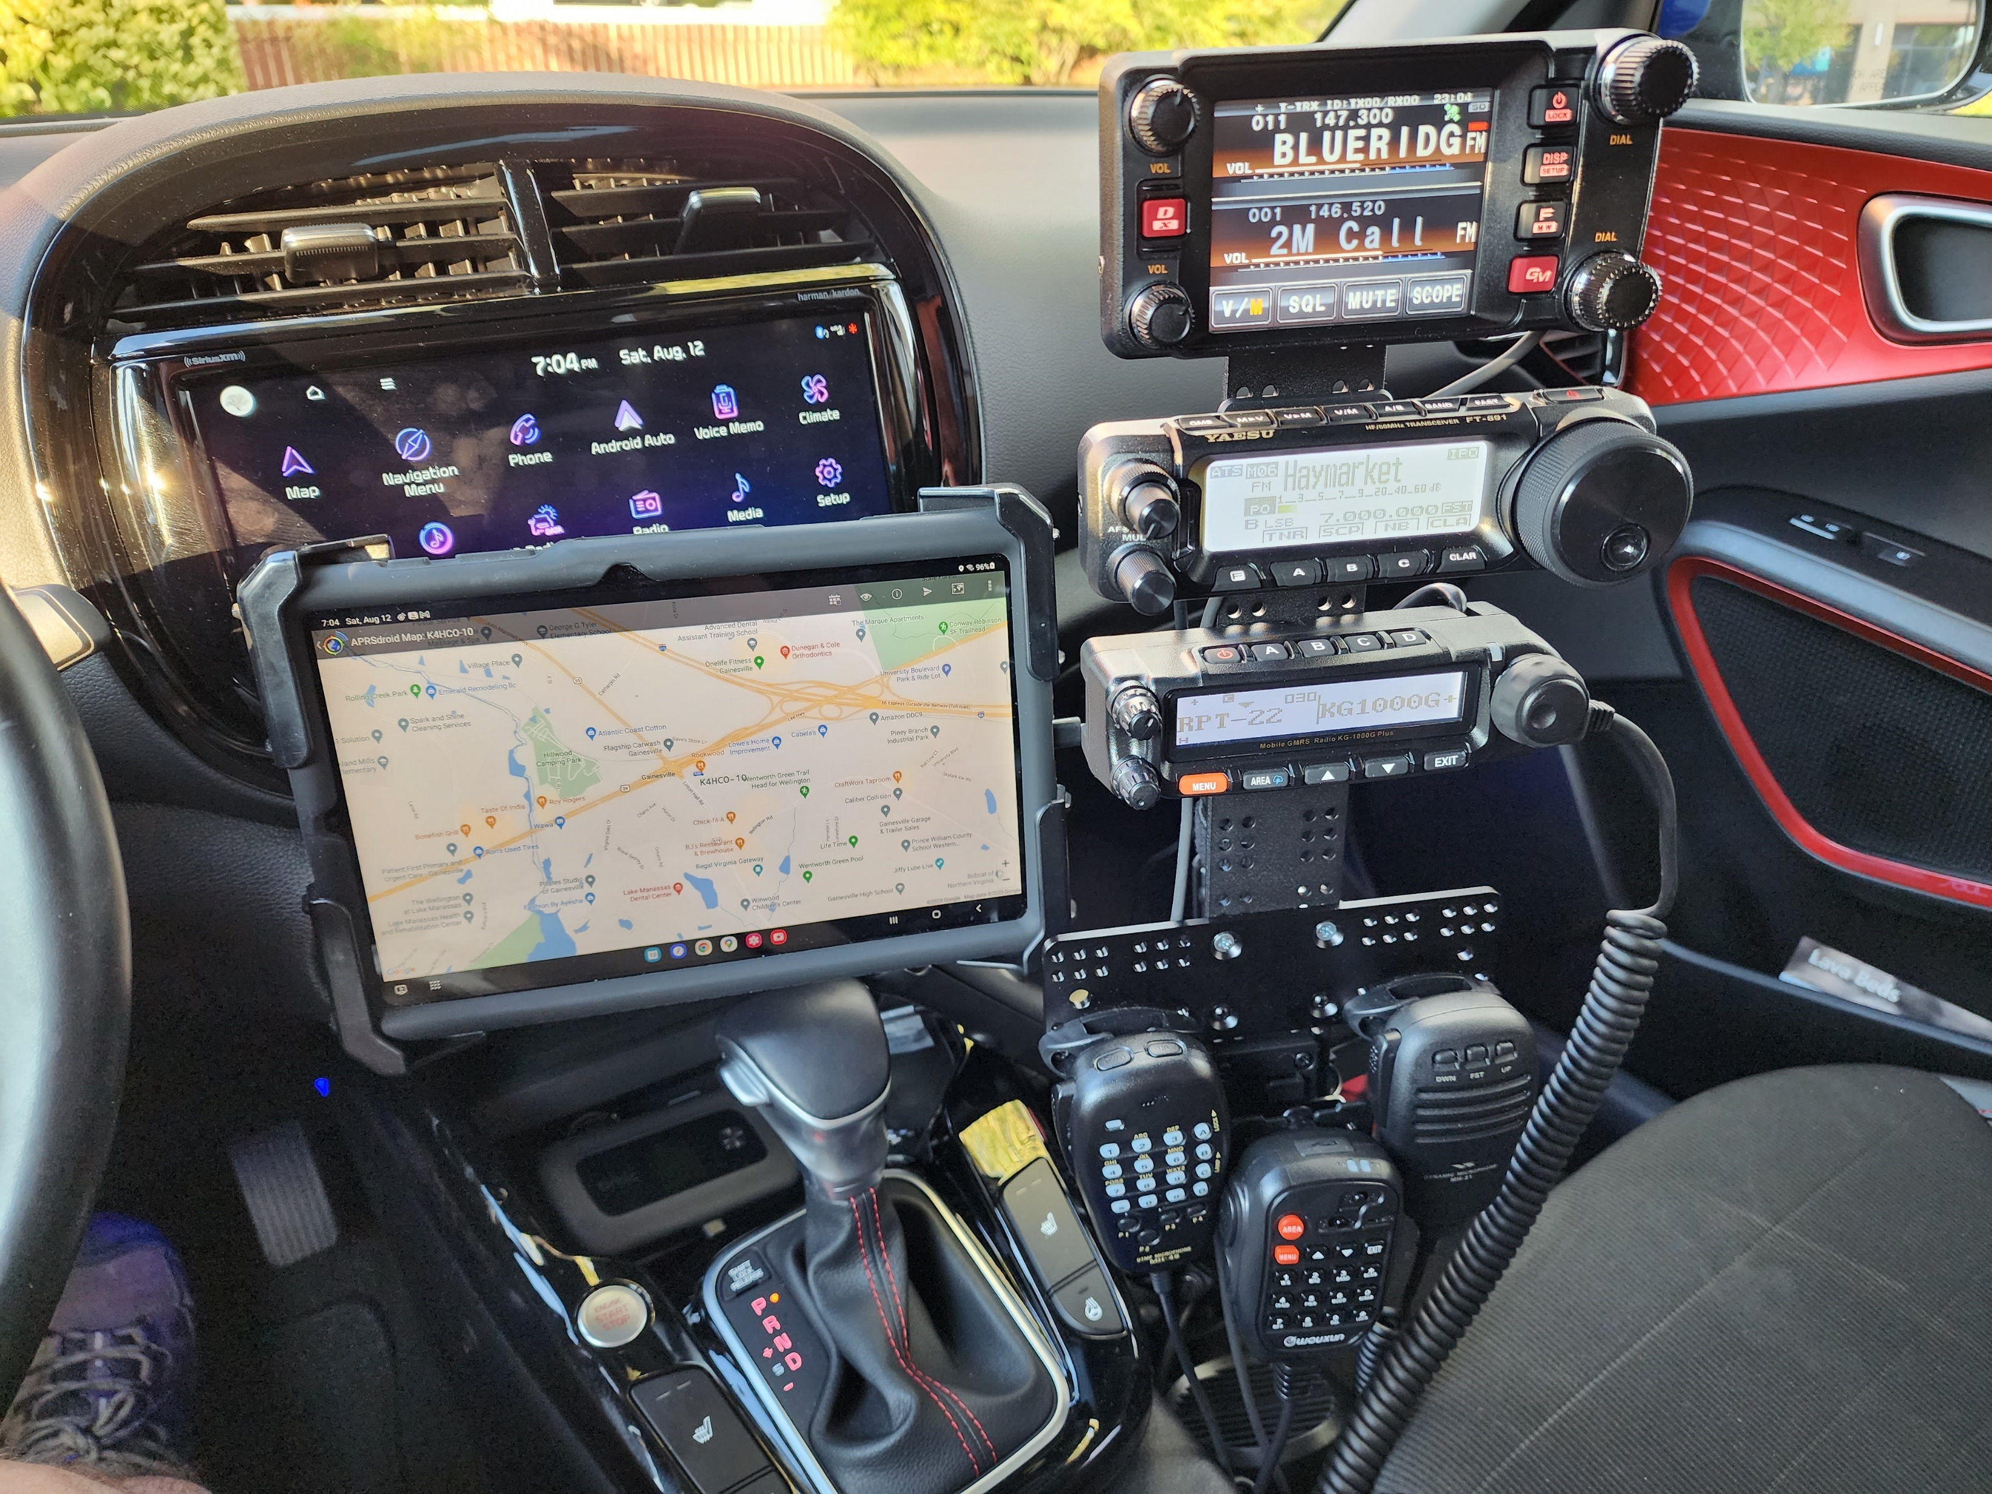
Radio Gear
Mobile Radios
VHF / UHF
HF
220Mhz
GMRS(?)
APRS
Amplifier(?)
Tablet mount
Ensure it is stable / less vibration
Safety considerations
Fuse blocks
RigRunners

Slide 15
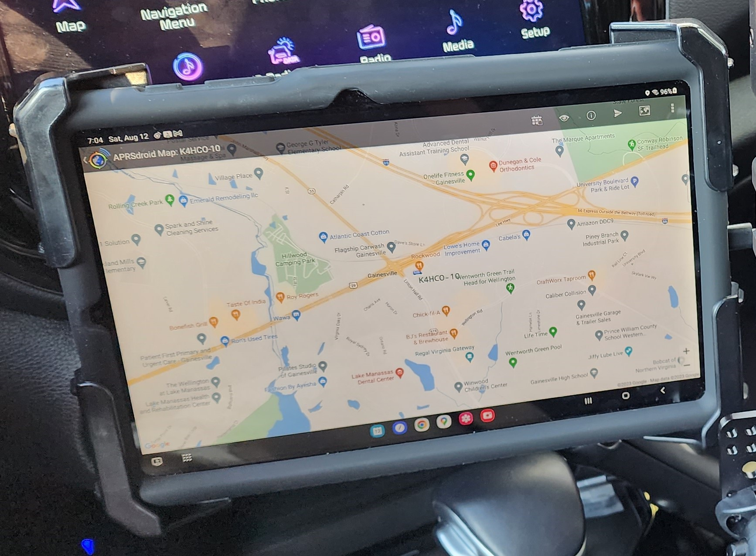
APRS
Useful for family to track your movements
The further West you go, the less iGates there will be
Consider using a mobile internet hotspot and using APRS-IS
More frequent updates via cell towers
Mobile map via tablet (APRSDroid)

Slide 16
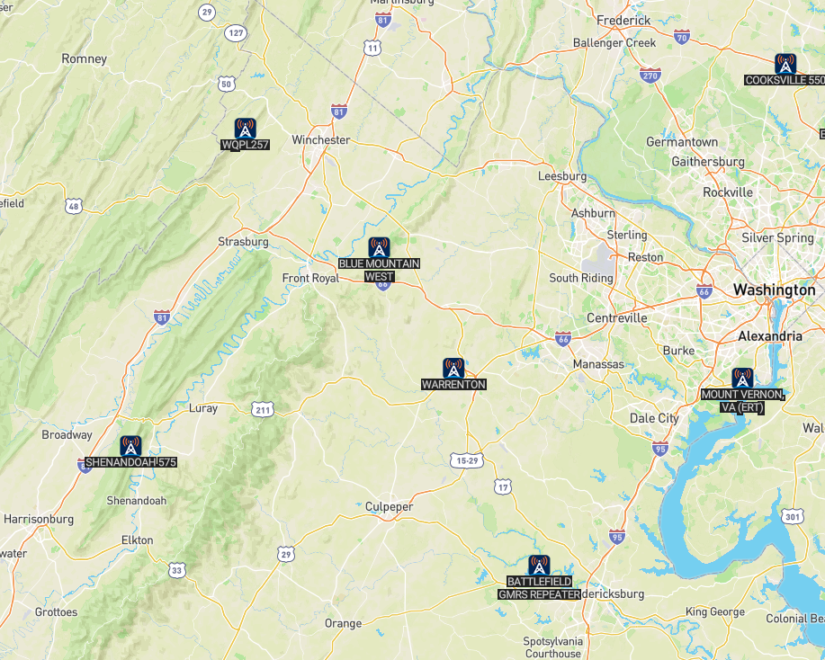
GMRS (?)
Good option for travel
Popular with the overland crowd (Colorado / Texas)
Truckers are starting to utilize
There are repeaters as well
Useful option for EMCOMM
Similar vehicle setup as HAM radios
License ($35 one time fee) can be used by your family as well

Slide 17
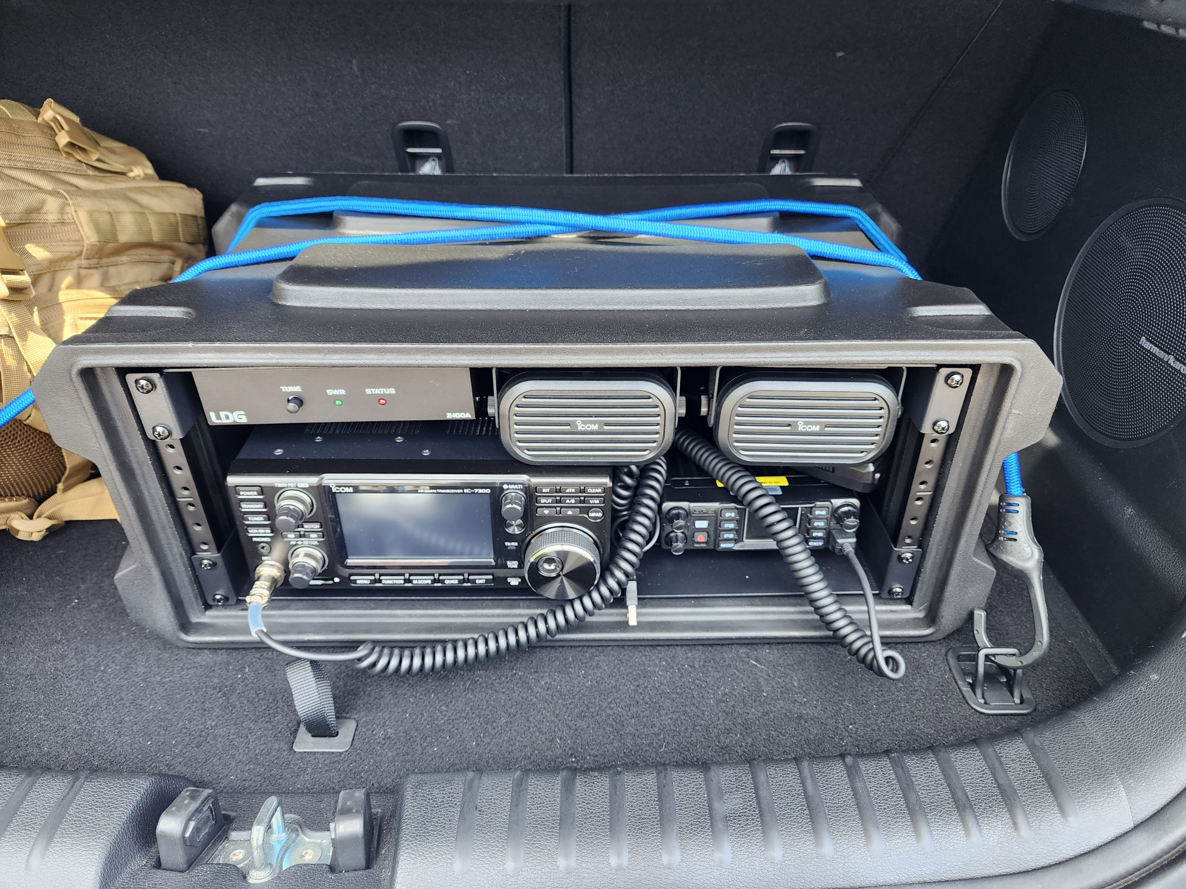
Go-Box Setup
Portable shack-in-a-box
Create yourself
Purchase online
Design limited only to your imagination
Great for EMCOMM
Can be used in conjunction with your vehicle
From trunk
From the back seat
From your passenger seat
Remote speaker mic

Slide 18
Go-Box Considerations:
Power Supply
Battery Run
Internal DC Power Supply (heavy)
Power cables
Solar plug in?
Rack mounts
Speakers
Connections and Cables
Grill on back for mounting
Microphone hangers
Dedicated Data cables
Can be changed as need / constantly evaluate needs

Slide 19
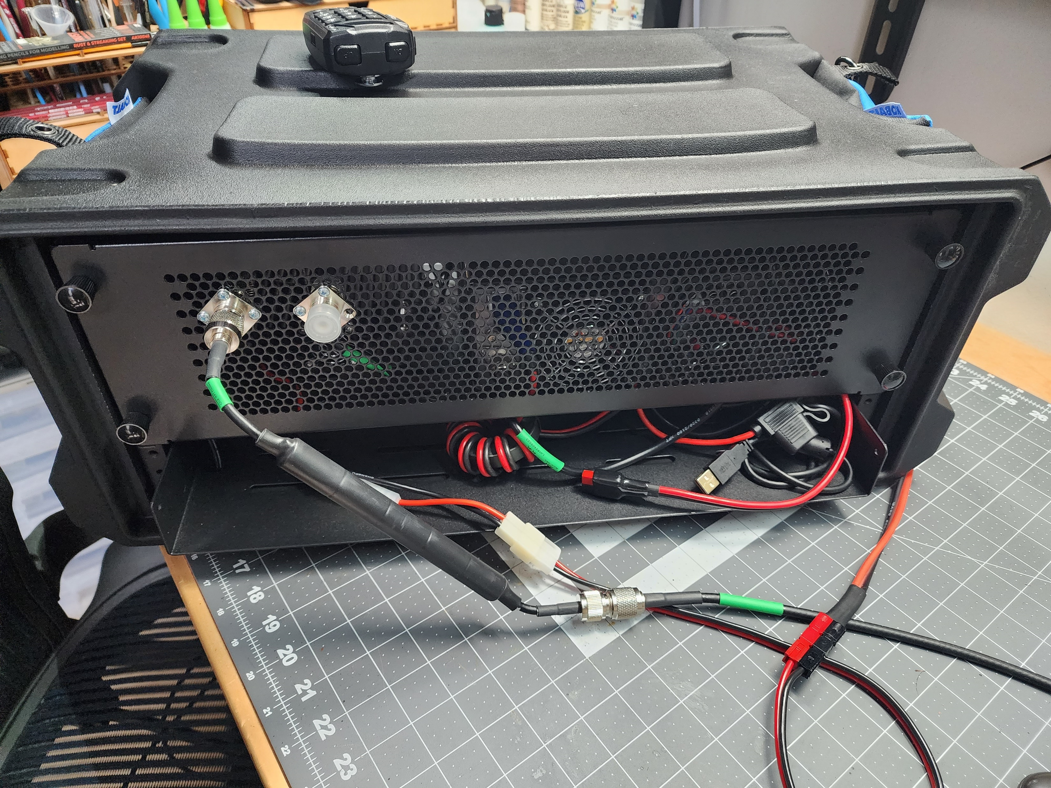
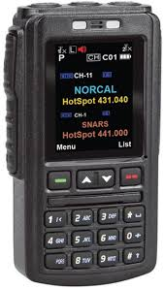
Go-Box Considerations:

Slide 20
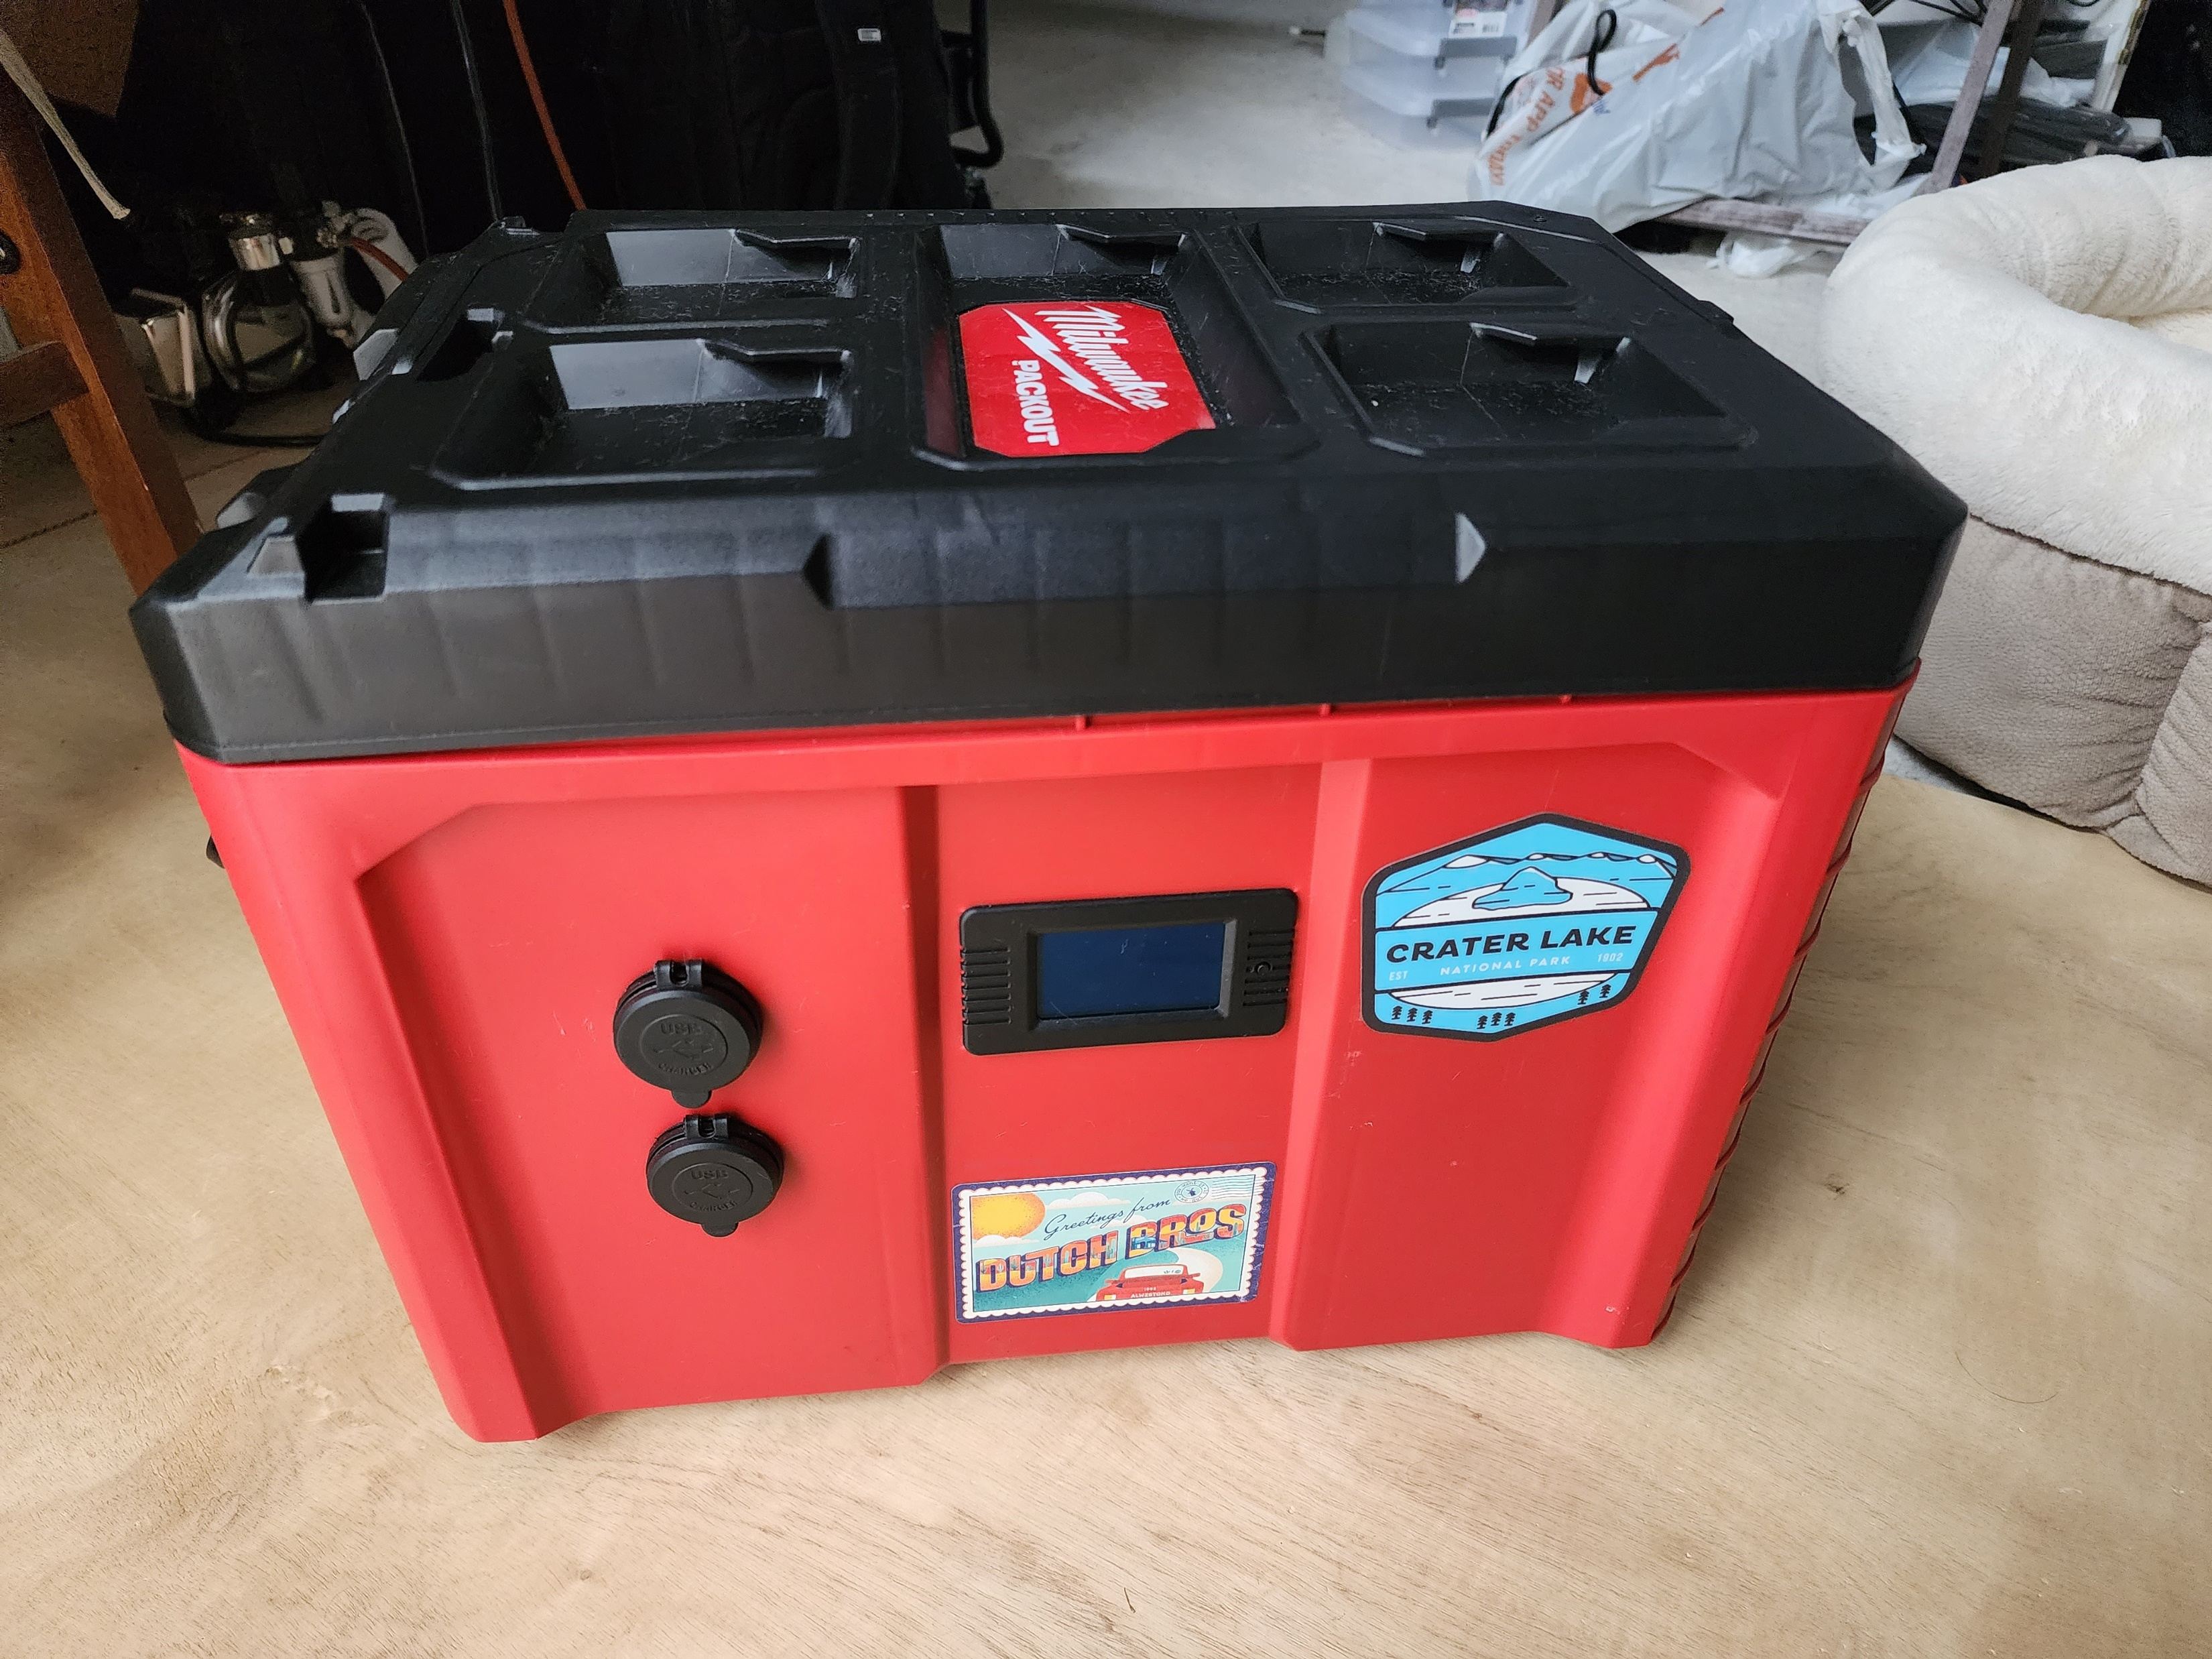
Solar Power Generator Box
Great for EMCOMM
Portable
Design only limited by your imagination
When combined with Solar Panels, provides a lot of sustainable power
Great backup power for your road trip / charge devices

Slide 21
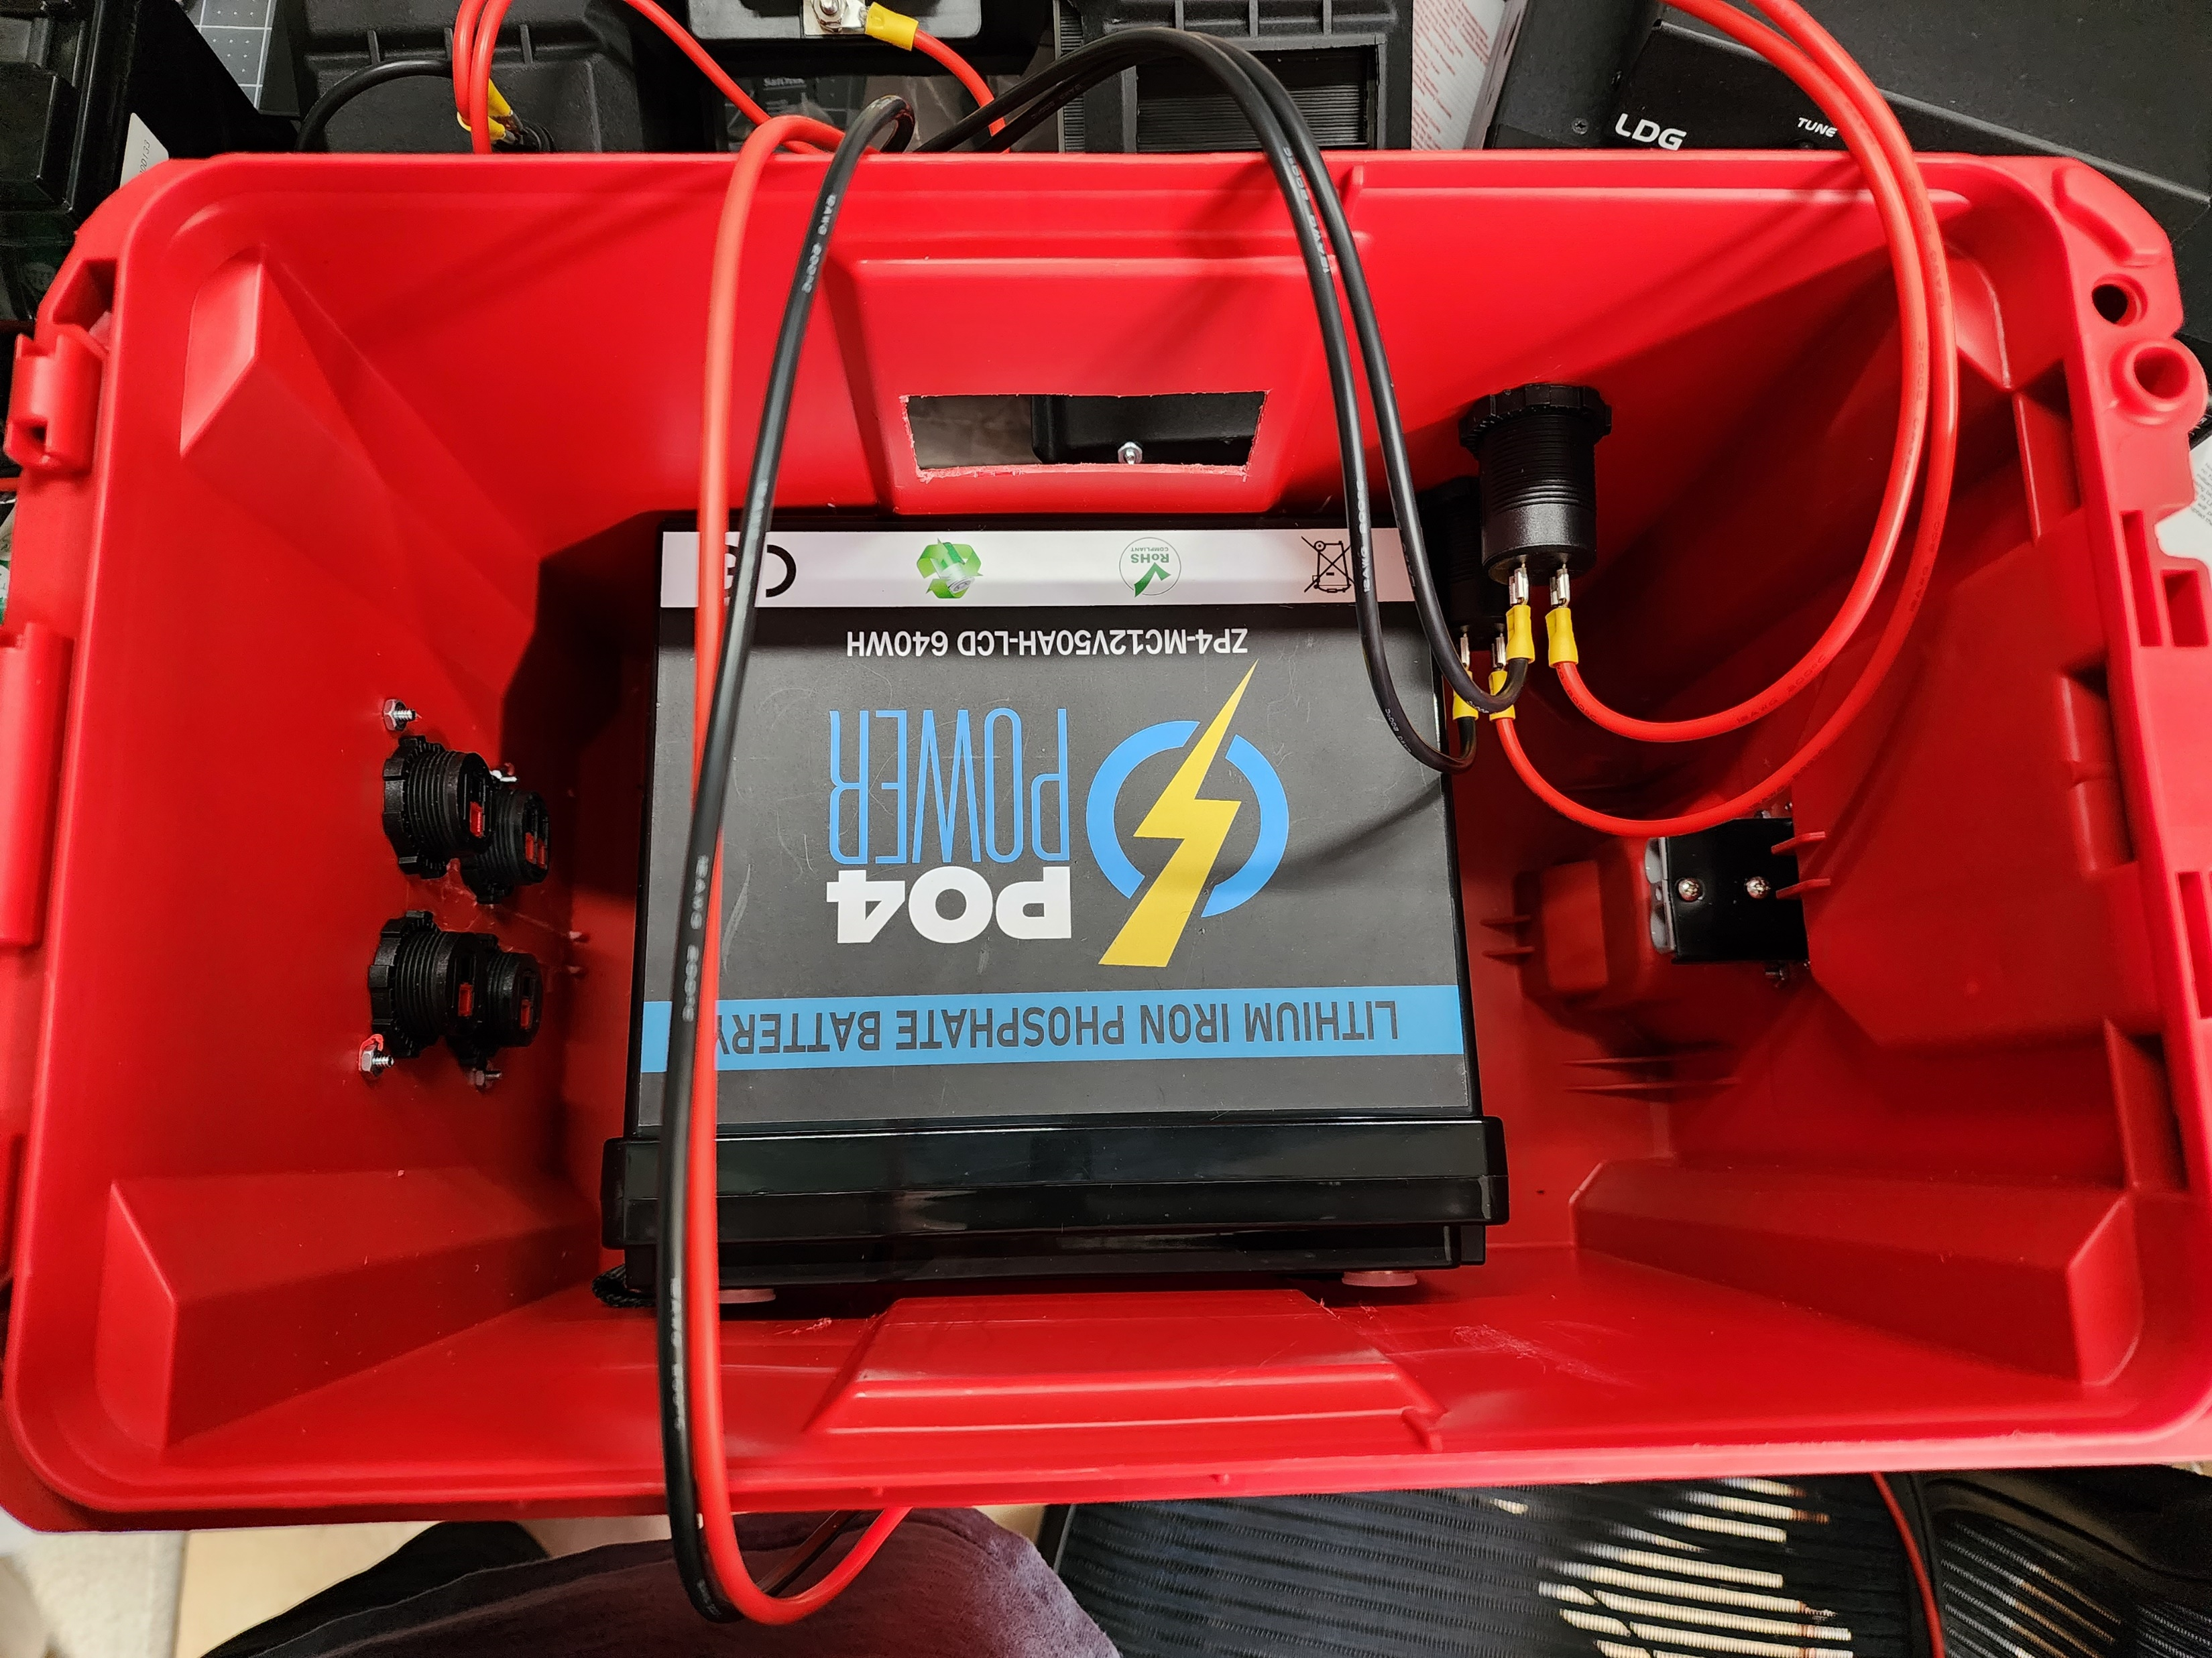
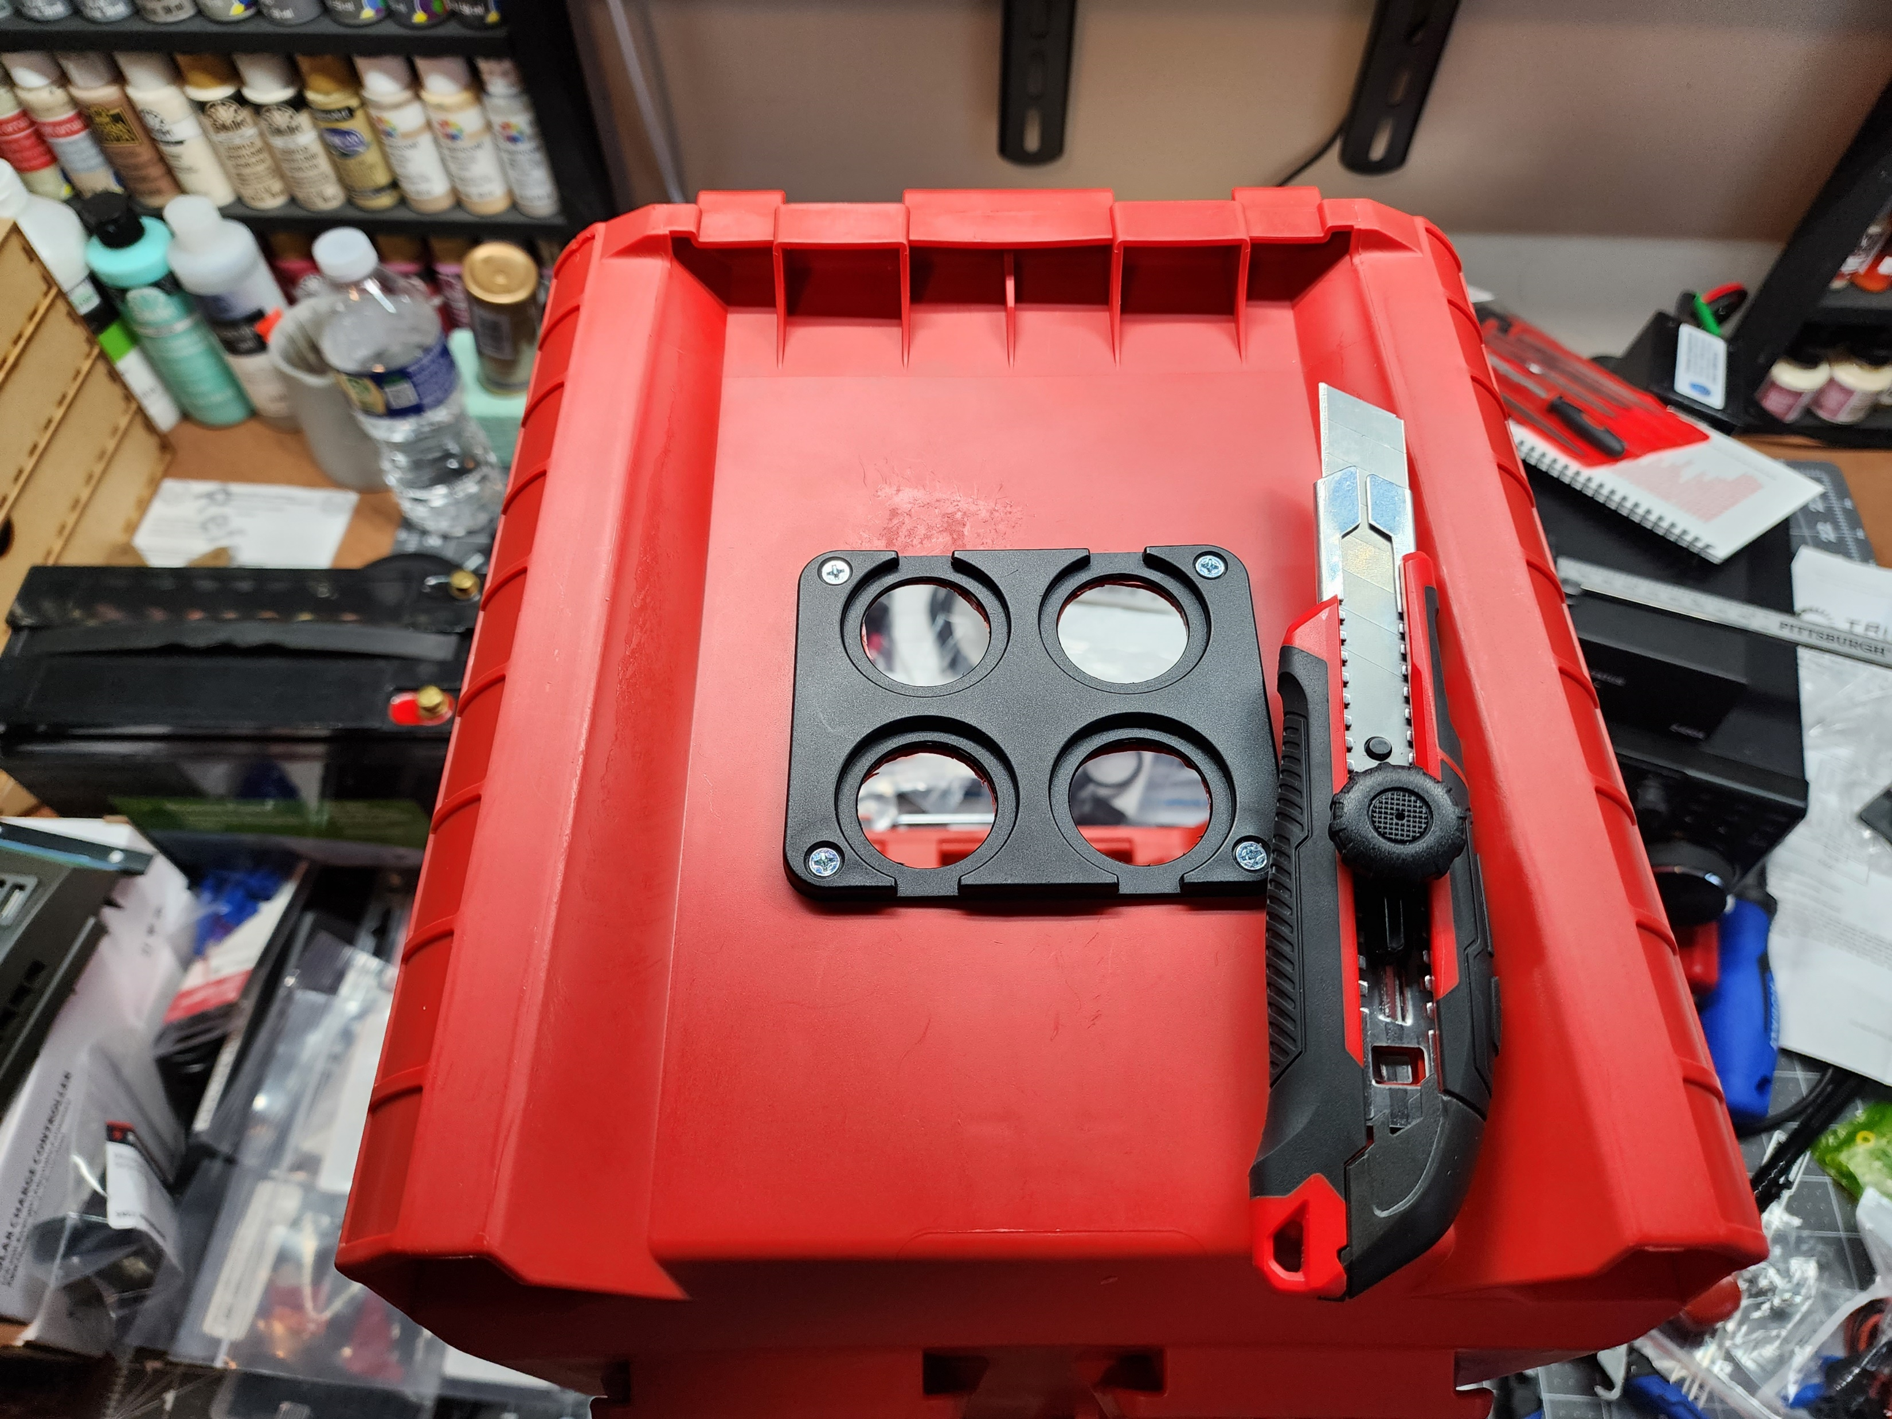
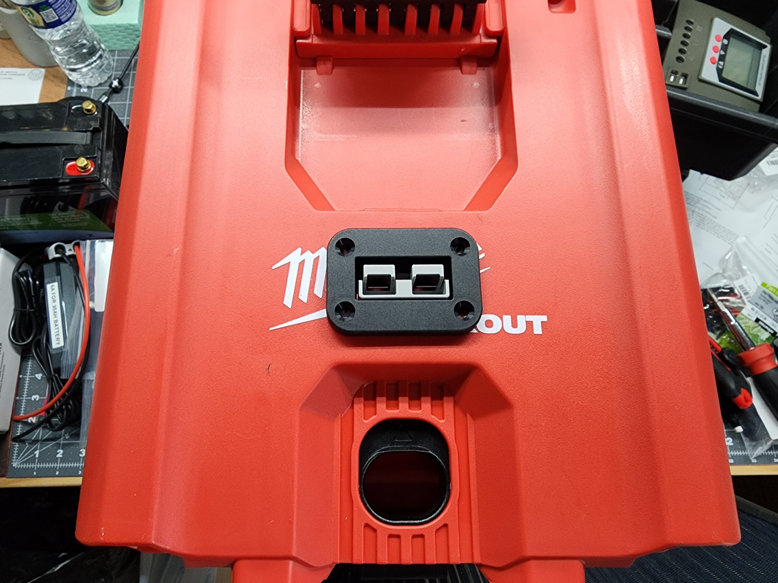
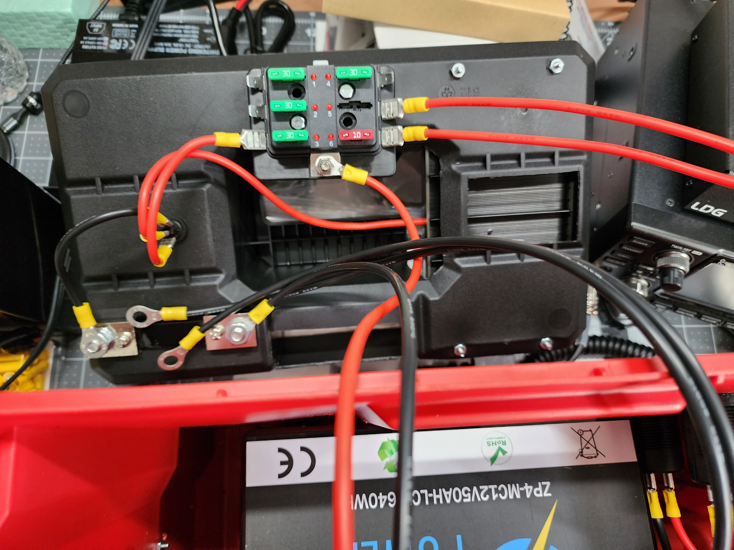
Solar Power Generator Box Considerations:
Fuse Block
USB Charging Ports
Solar Panel Charge Controller
Switches to manage battery drain
Battery Monitor Device
Battery Sized for your needs

Slide 22
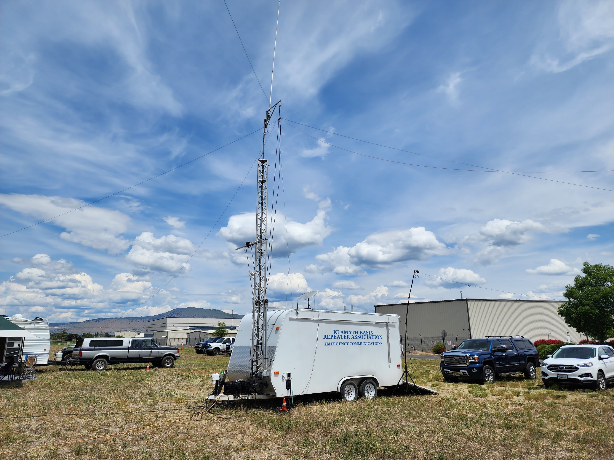
ARRL Field Day
Special thanks to the Klamath Basin Amateur Radio Association (KBARA), Klamath Falls, Oregon.
www.w7vw.org
1st Field Day Exercise
Very warm and welcoming group of HAMs

Slide 23
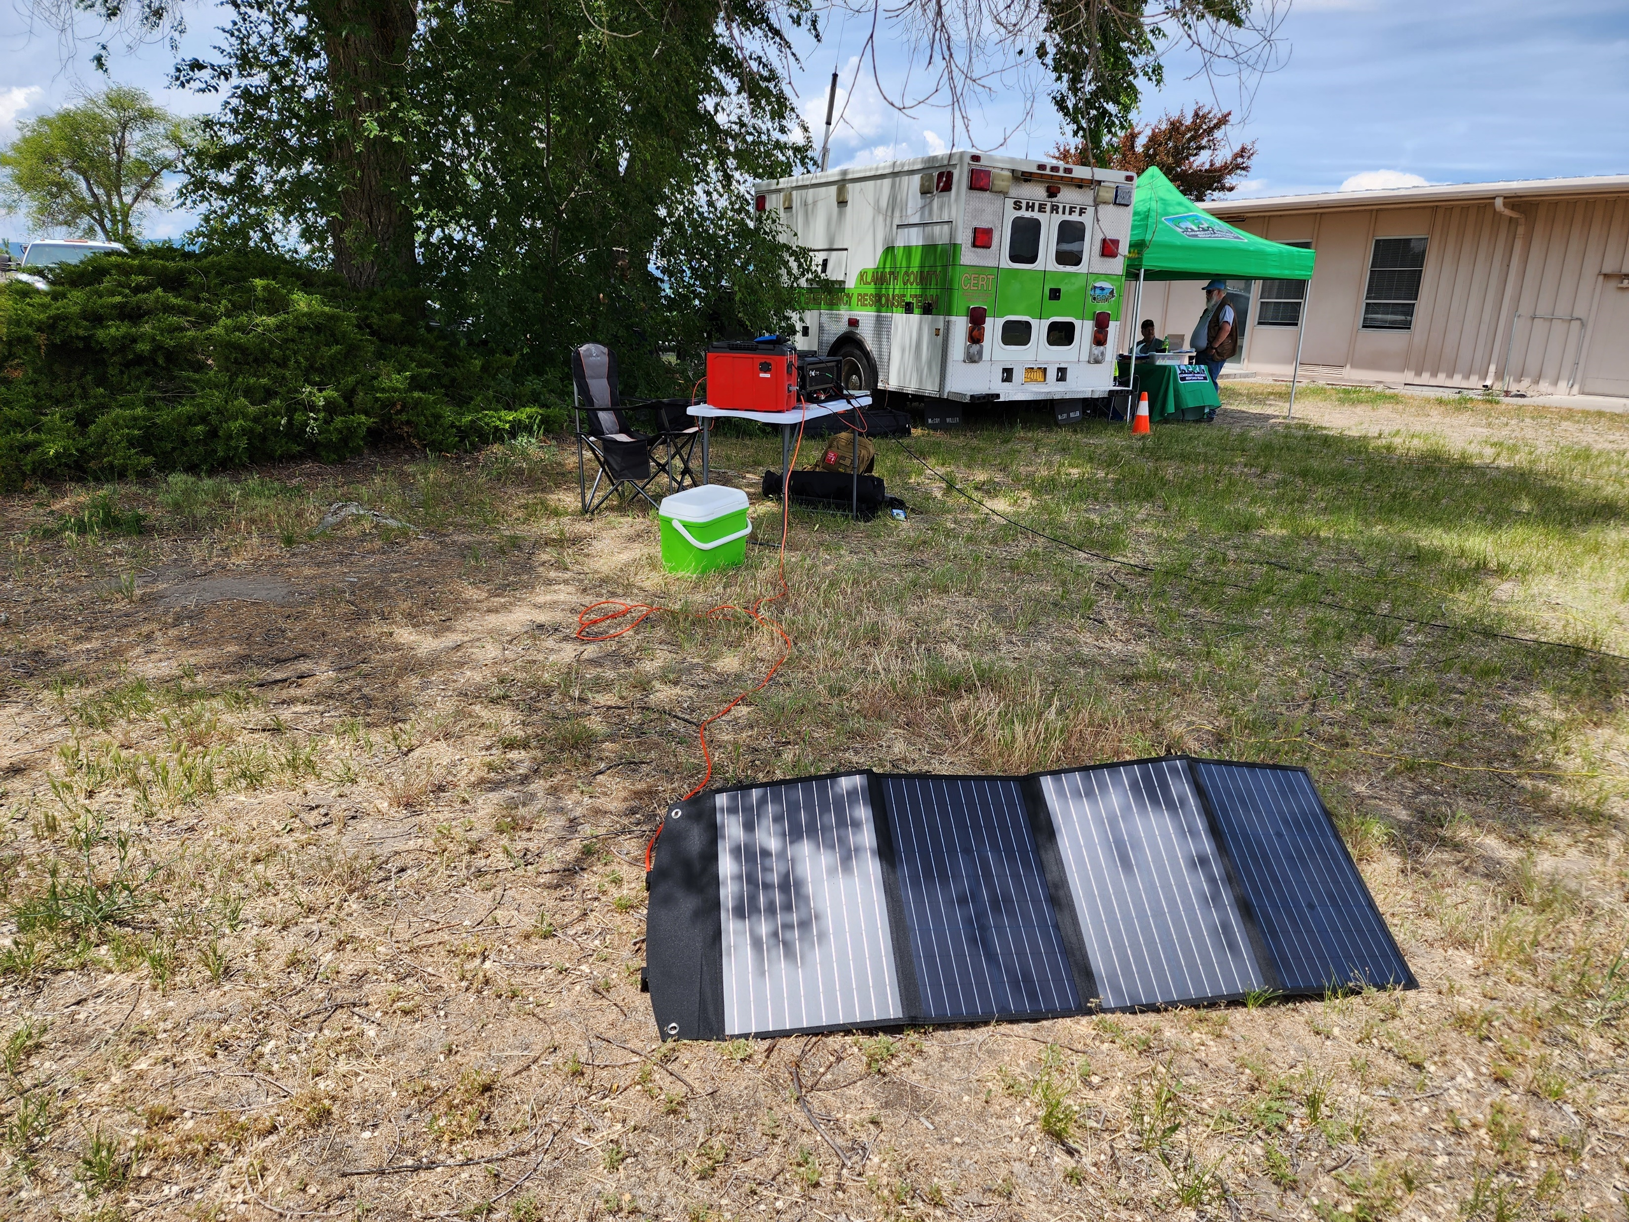
ARRL Field Day
Digital / Satellite Modes were the order of the day.
Band conditions were horrible!
Location was next to the Airport
Personnel on site were out of this world:
Former Movie Set Engineer
Electrical Engineer
Co-located exercise with the local County CERT Team.

Slide 24
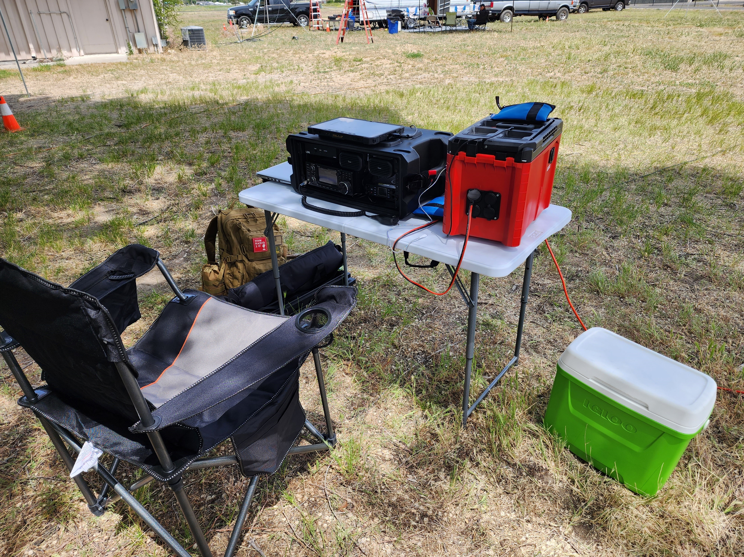
ARRL Field Day
Gear work perfectly all day!
Digital Mode group logging (forgot the name of the log software)
Weather was perfect but hot!
CERT Team provided me a canopy…many thanks!

Slide 25
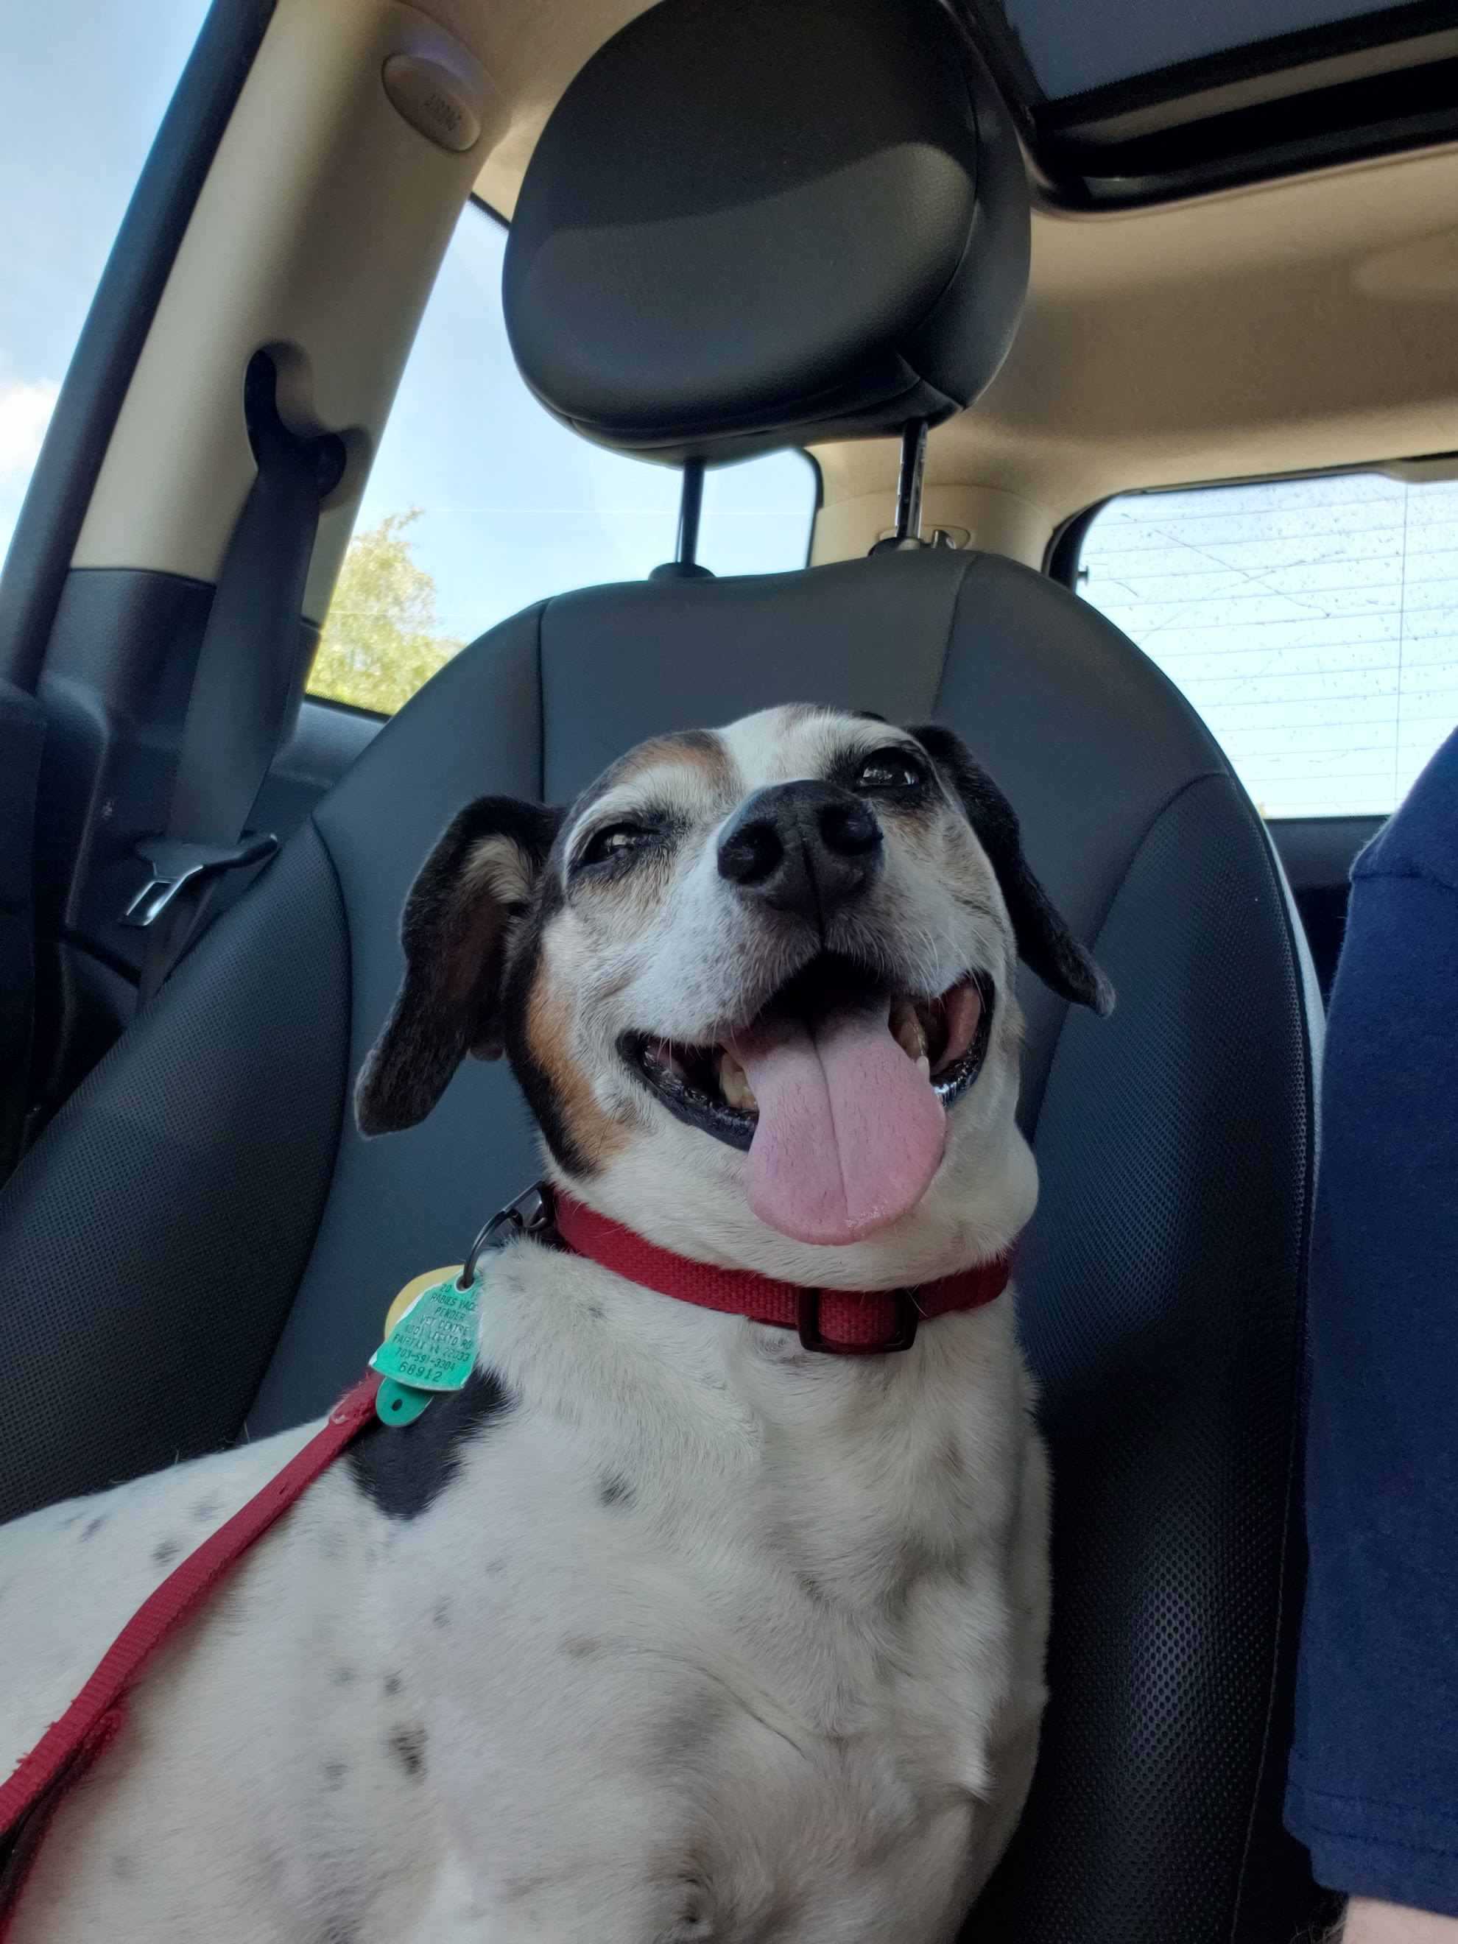
Questions ?

