Slide 1
Yet Another Go Box (This is Mine)
Steve Greene, KS1G
LARG November 18, 2023

Slide 2
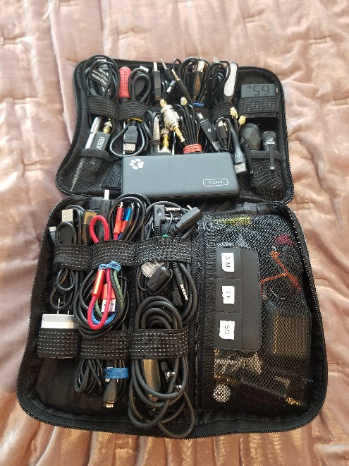
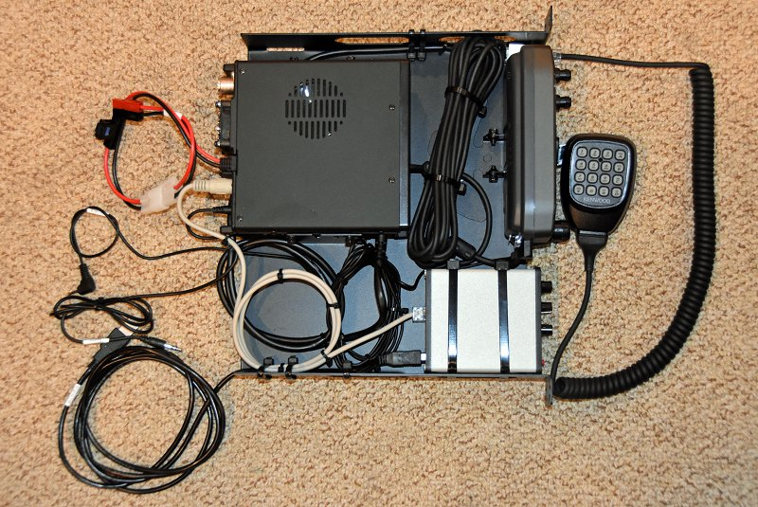
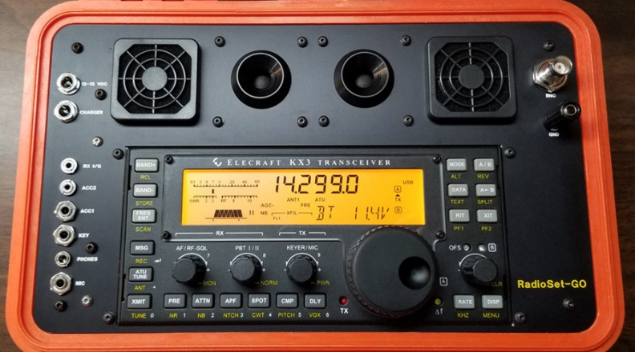
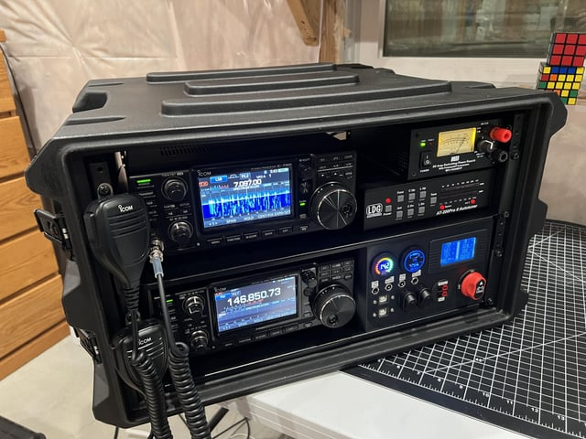
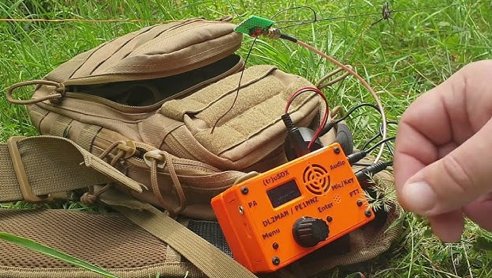
“Go Kit” / “Go Box”
Go Kit: A collection of ham radio gear you can grab and go; a complete station in a transportable package
Go Box: Same stuff packaged so you can operate w/o assembly

Slide 3
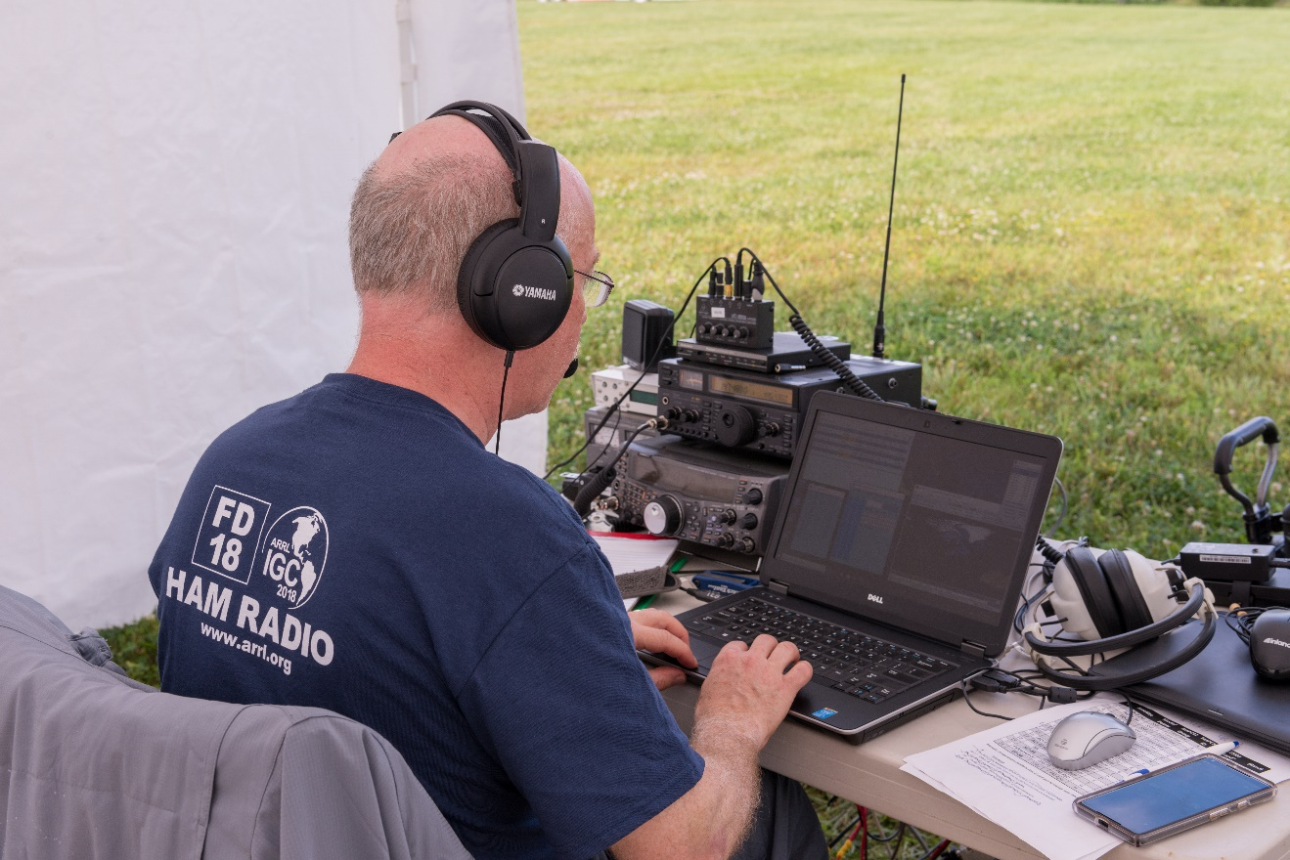
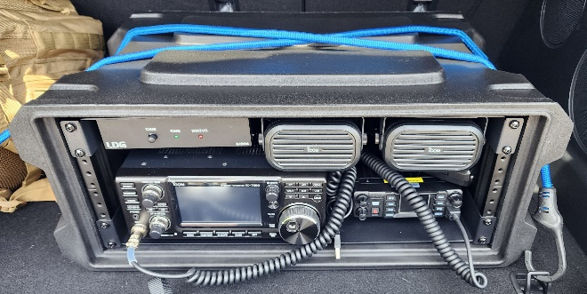
Why?
STOP! Tearing station apart for Field Day, Public Service Events, Travel
STOP! Rebuilding station after Field Day, Public Service Events, Travel
STOP! Fixing connections, settings just to get on the air
GO! Grab-and-Go!
GO! Protect my gear
GO! Inspired by Field Day, Reston Century stations, K4HCO’s Go-Box talk at August LARG meeting

Slide 4
What Did I Want?
HF station in a box (bonus if VHF & UHF)
All modes – CW, SSB, Digital, FM
Up to 100W TX
Work with variety of antennas
Minimal setup at operating site
Protect equipment from environment during transport, storage
Hand-carry, car transport

Slide 5
Use Gear I Already Have
FT-857 Transceiver
High-capacity battery, sort-of boxed
Familiarity with small single-board PCs
Weather-resistant hard case

Slide 6
So, What Did I Do?
Already Had:
FT-857 in mobile mount
Separated control head, Raam Mount
DigiKey interface
HF “Apache” 3800 hard case
Separate Battery Box
Wireless keyboard, mouse for computer
Portable Display (or VNC to tablet)
Bought for this project:
LDG Z-100 Plus 100W auto-tuner
ATOPNUC Single Board x86 computer
Power Distribution

Slide 7
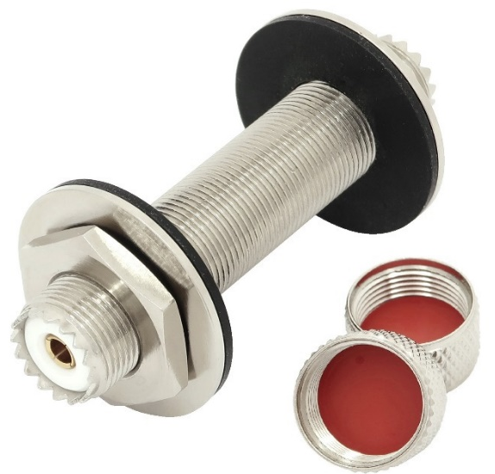
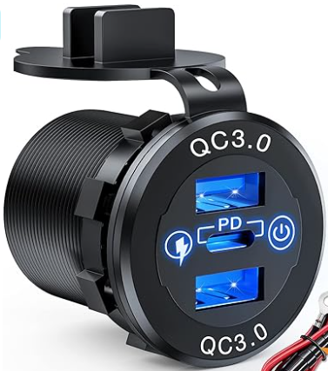
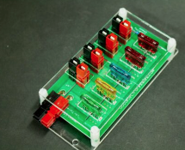
Other Bits & Pieces
Coax Feed Throughs – Max Gain Systems
4 port “Rig Runner” with side input – electro-resales (Ebay)
Multi-port QC/PD USB Charger
Hole Saw, Step Drill
Nuts, bolts, coax, hook-up wire, …
Label everything!

Slide 8
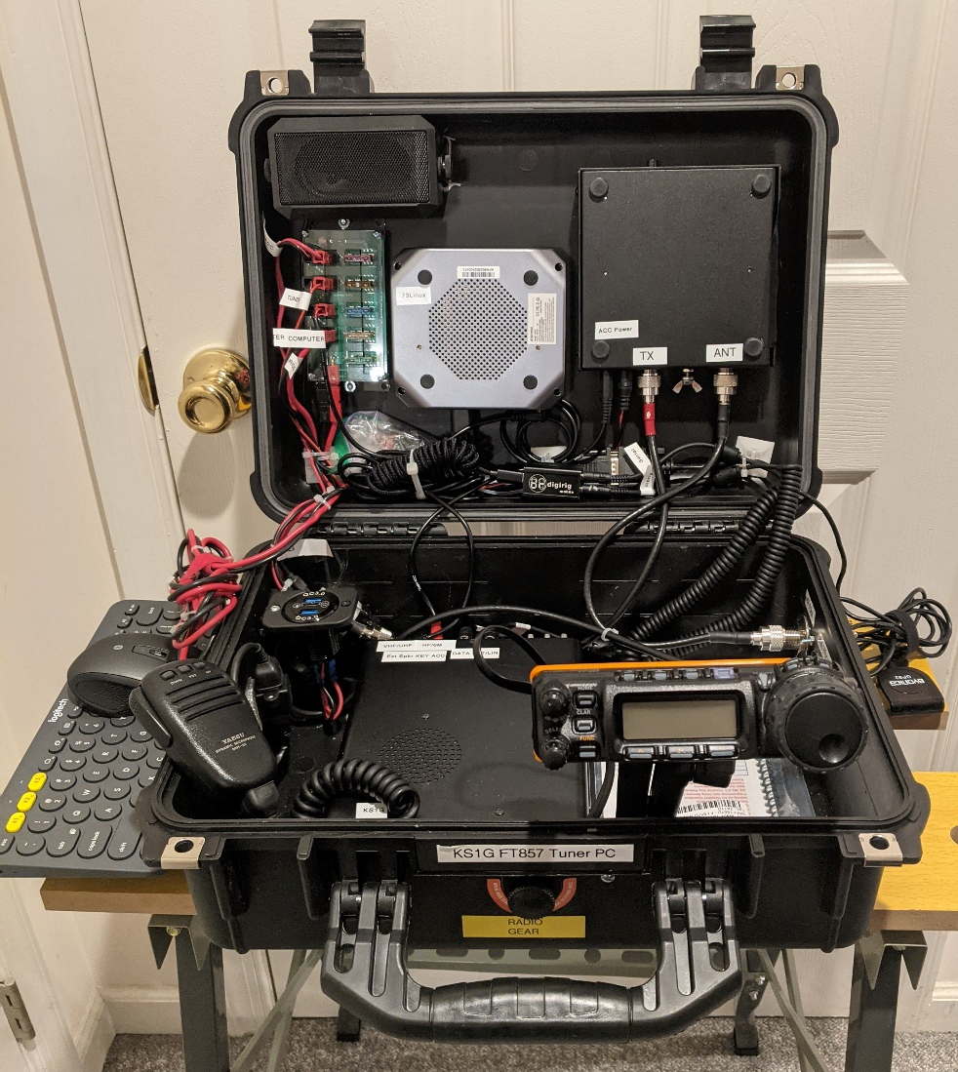
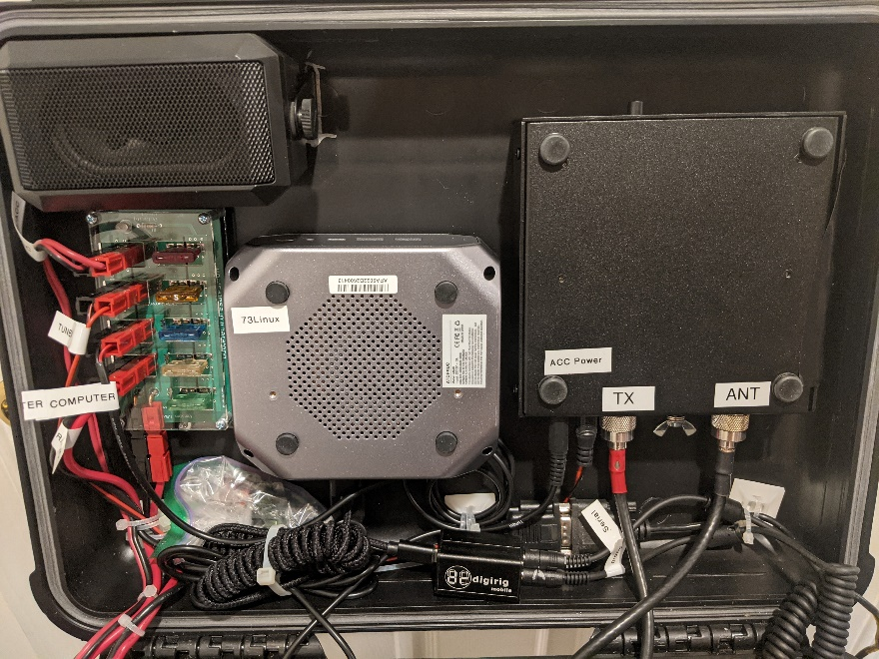
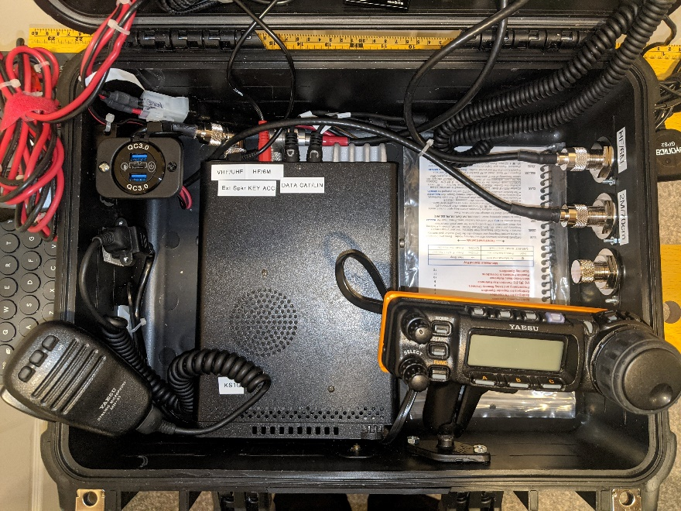
I Think it Turned Out Pretty Nice!

Slide 9
Battery Box
High capacity 60AH LiFePO4 battery
Master Fuse/Circuit breaker
Power monitor
Fuse Block (bought for this project)
PowerPoles for Radios/high current devices
USB Ports
Charging Port
HF “Apache” 2800 hard case
Or self-contained: I can just fit a 12AH battery in the radio case

Slide 10
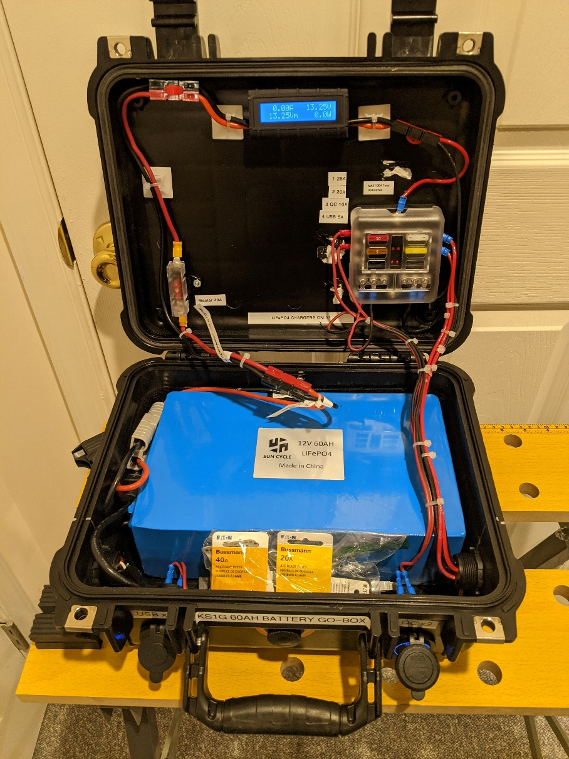
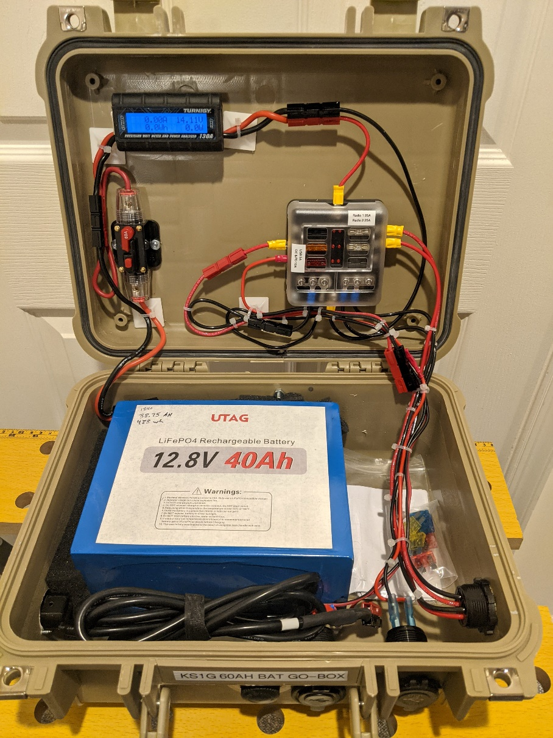
Battery Boxes (I built two)

Slide 11
About the Computer & Software
ATOPNUC Single Board x86 computer
Runs on 12V DC!
Wifi, Bluetooth, video on USB-C
O/S: Linux Mint
KM4ACK “73 Linux” (successor to “Build A Pi”)
Hotspot, “headless” with remote access via VNC
GPS support
FL Suite: FLDigi, FLRig, etc.
WSJT-X
YAAC APRS, Direwolf
WinLink (Pat Client) & VARA modems
Logging
…more

Slide 12
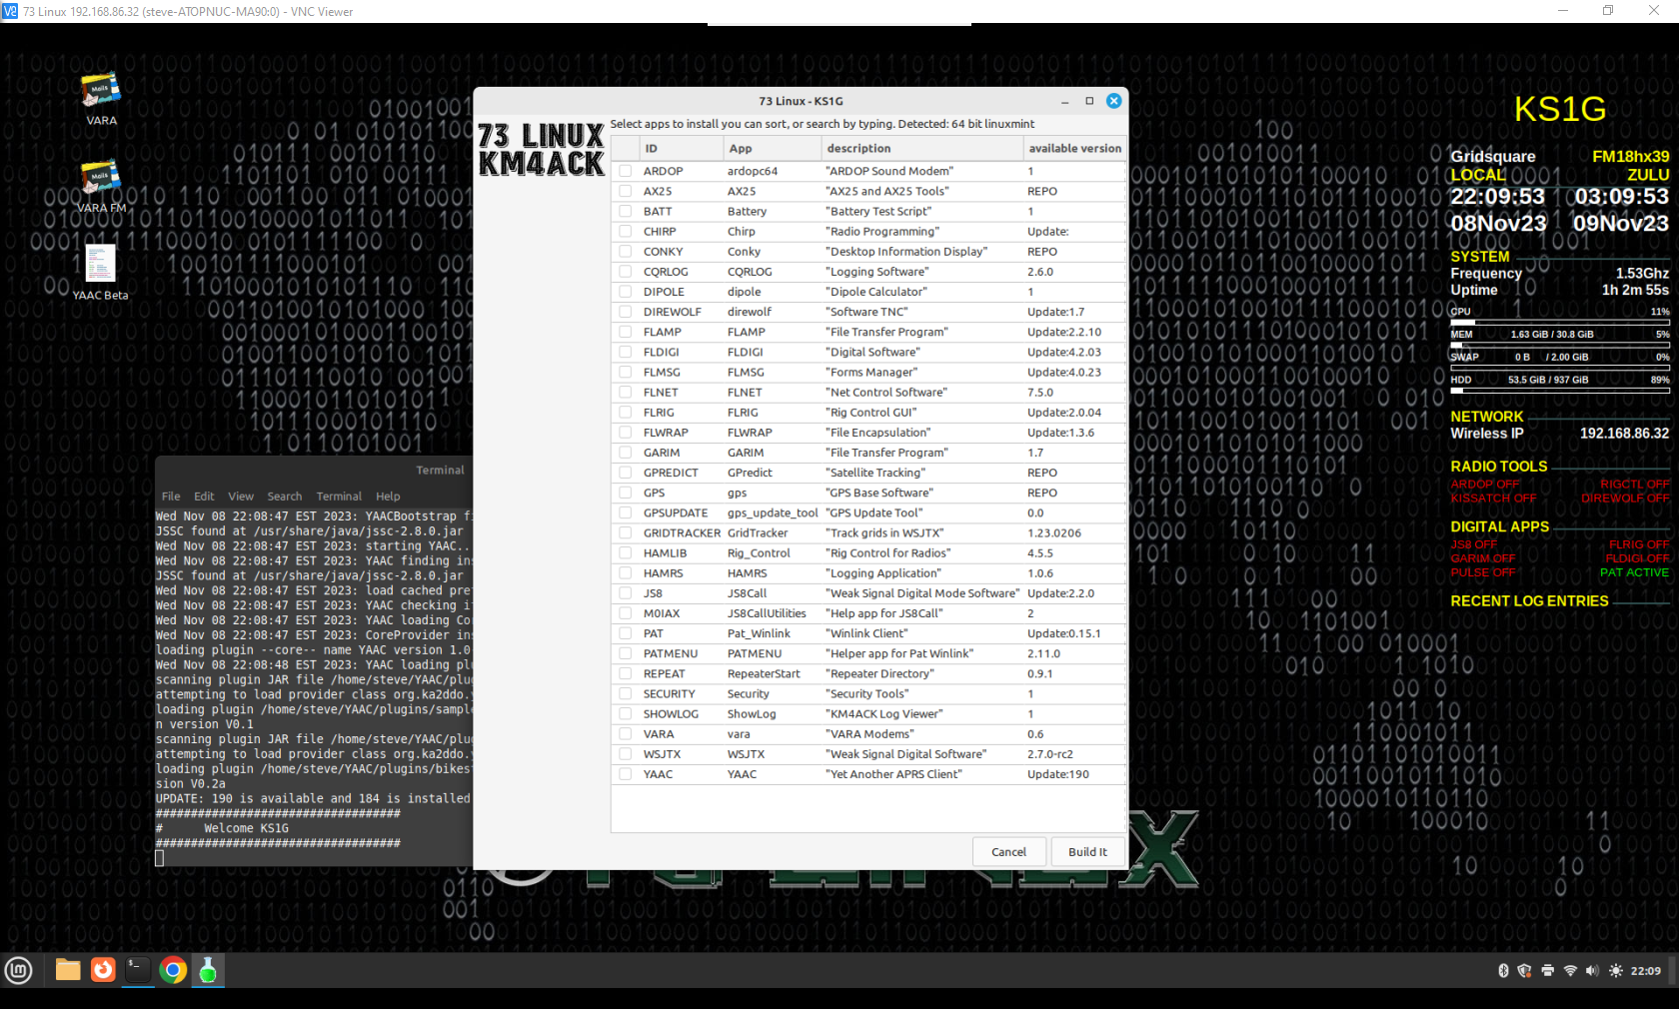
73 Linux (Screenshot)

Slide 13
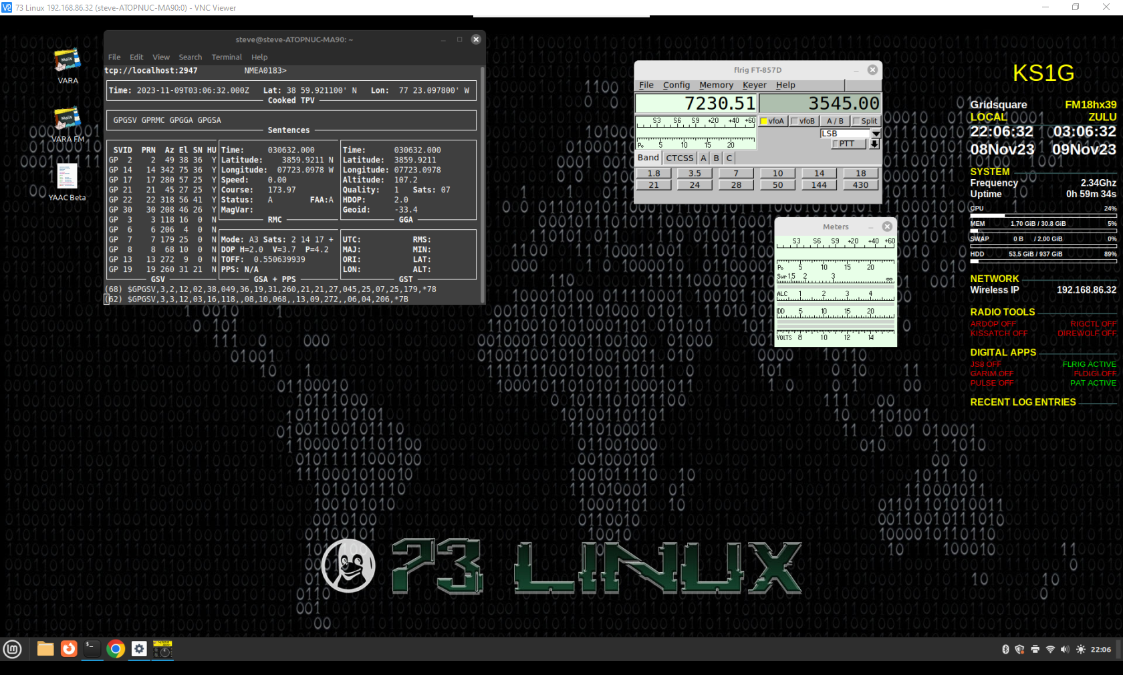
73 Linux (Screenshot)

Slide 14
What’s Next?
(More) Practice operating from home station, backyard/driveway
Work on antenna selection
Plan and do portable and local POTA ops
Do I want to do this for satellites?

Slide 15
73s & Thanks!
de KS1G

Slide 16
Vendors & Sources for Go-Box Components
Tuner: LDG Z100 Plus
Ebay: Power Distribution “electro-resales”; RJ45 extension (FT857 mic)
DigiRig: Computer-radio interface and FT-857 cables
Amazon:
ATOPNUC Mini PC Ubuntu, AMD A9 9400Single Board x86 computer
Nilight Quick Charge Socket PD Type C and QC3.0 Dual USB Charger
DaierTek 12V Fuse Block 6 Way with LED Indicator Light 12 Volt Fuse Box ATO/ATC
ZAXIDALER Rectangular External Communications Speaker
NECABLES 2Pack RJ12 6P6C Male to Male Straight Wired for Both Data and Voice Use
Max Gain Systems – Coax feedthrough kit with large gaskets, washers, nuts 7518-UHF-BC-3-PRO (3” feedthrough kit)
Powerwerx: PowerPoles, panel mount sockets
Cases: Harbor Freight: “Apache” 3800 (Radio box) and 2800 (Battery boxes)

