Slide 1
Amateur Radio Astronomy
AND
My 16.4 Meter
Serendipitous Opportunity
Gary L. Memory

Slide 3
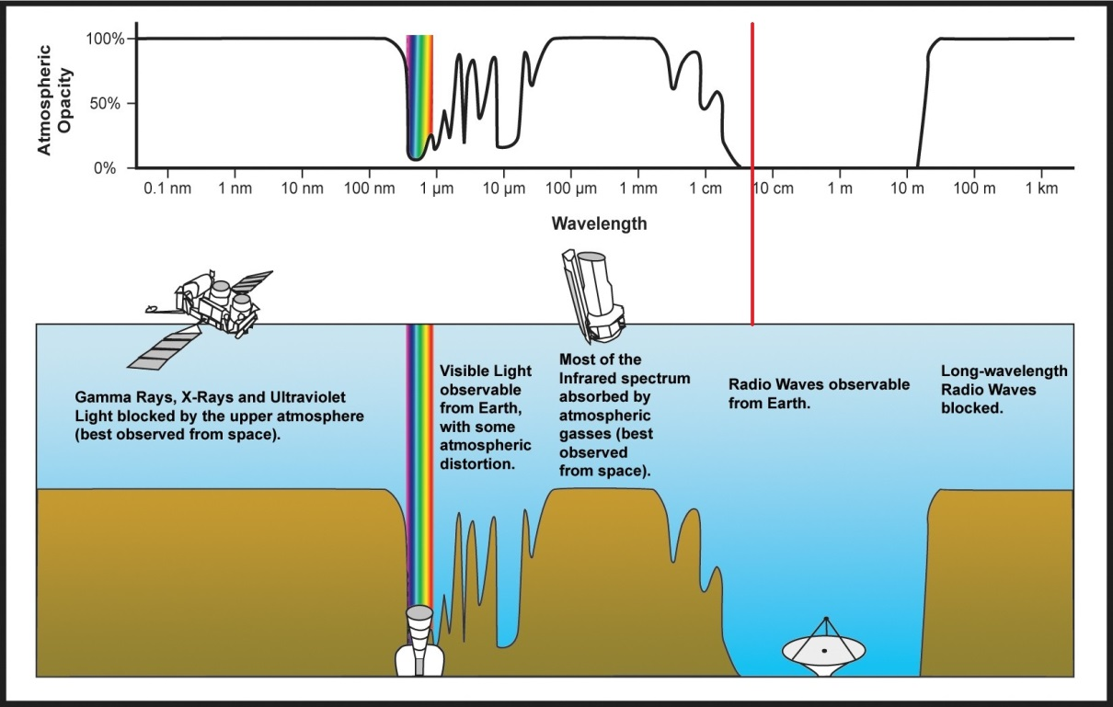
~7.4 cm

Slide 4
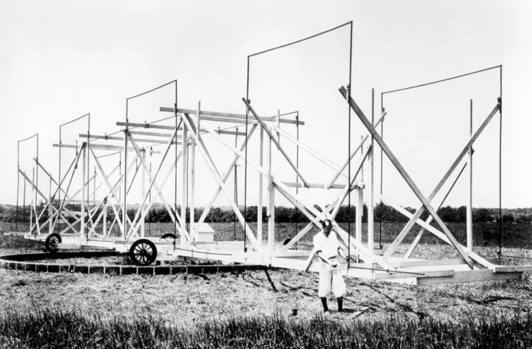

Slide 5
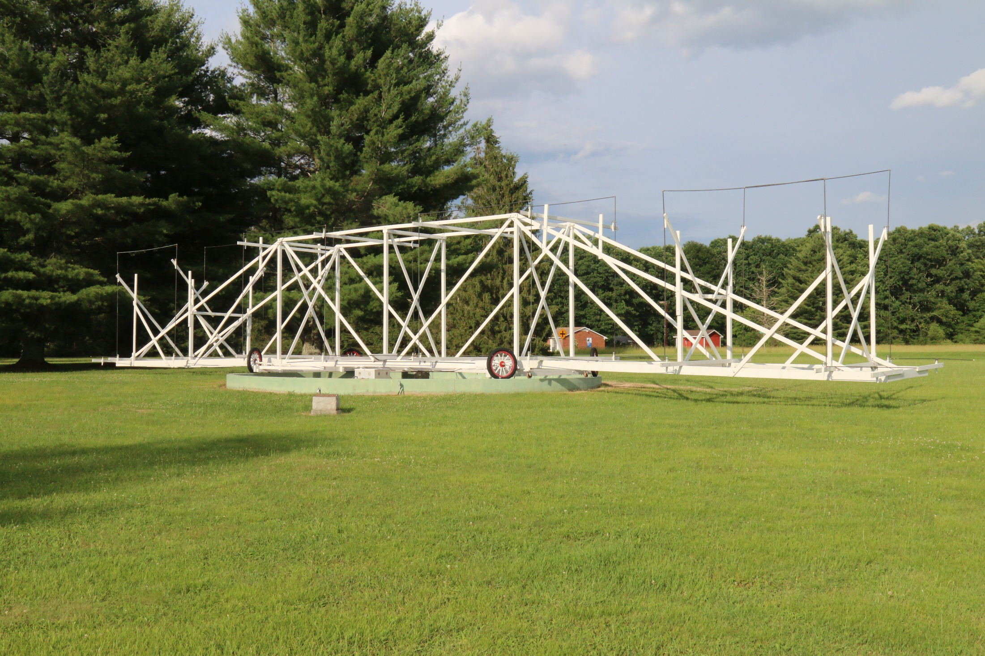

Slide 6
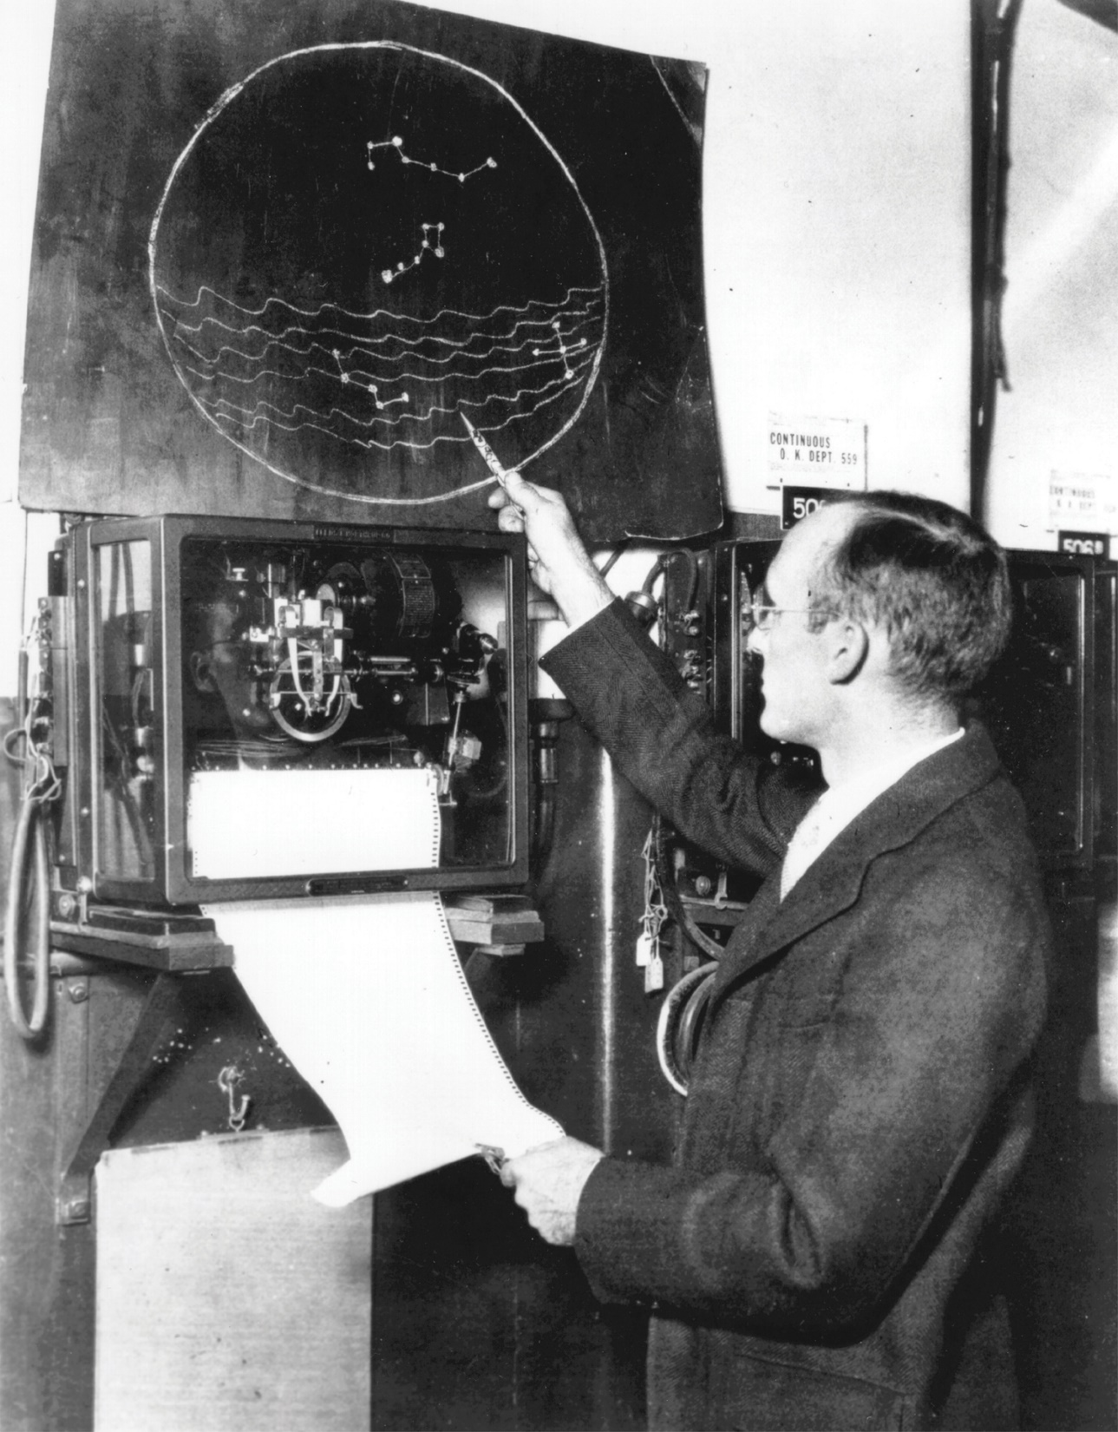

Slide 7
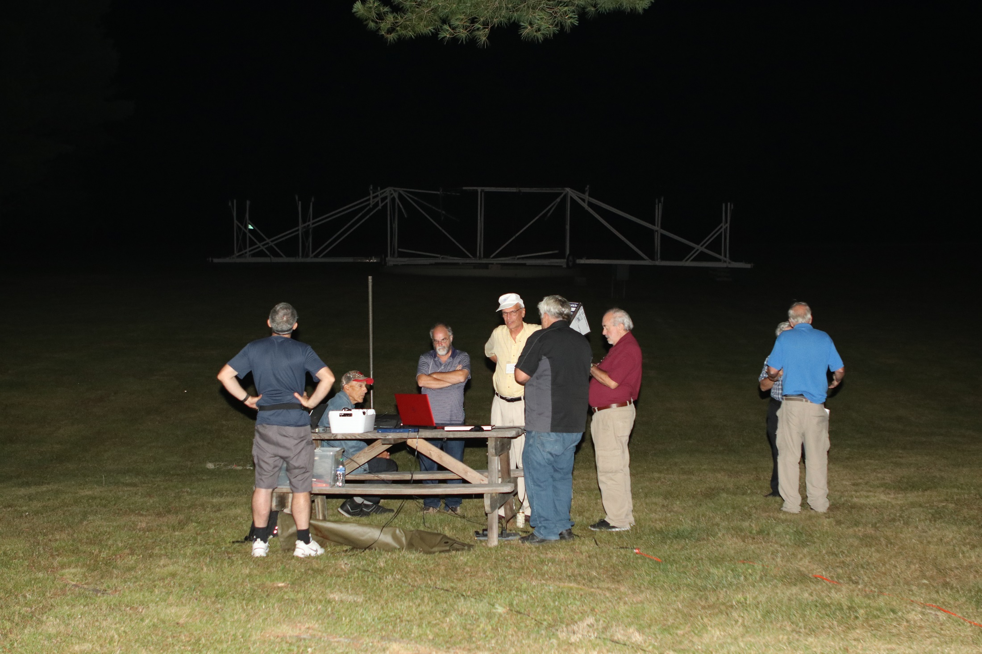

Slide 8
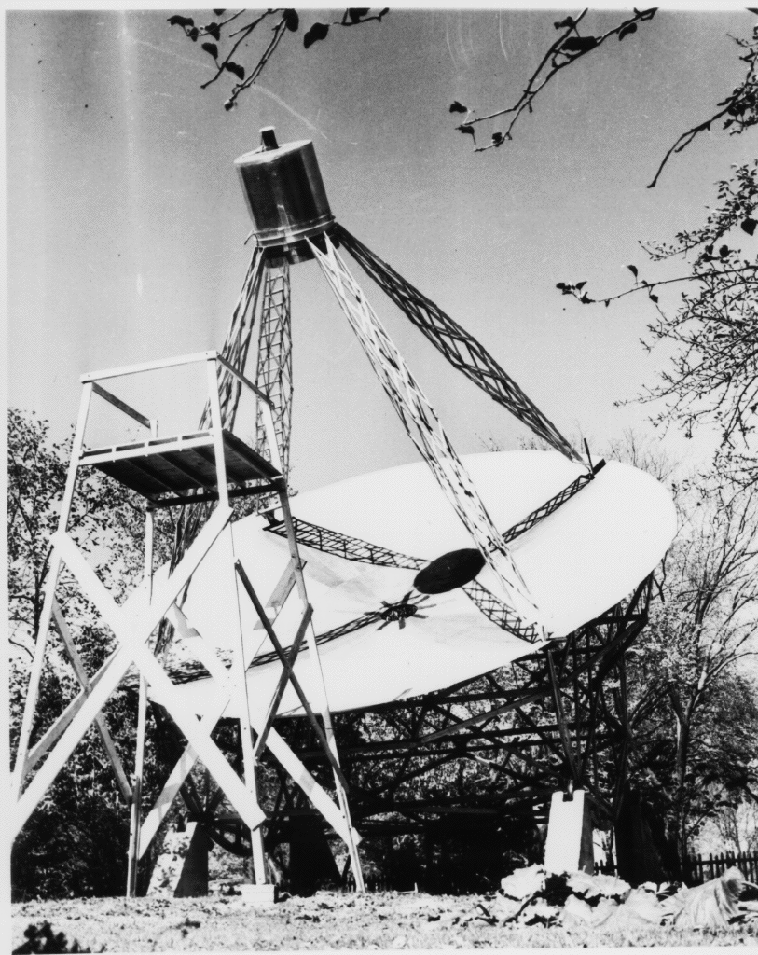
W9FGZ
Grote Reber

Slide 9
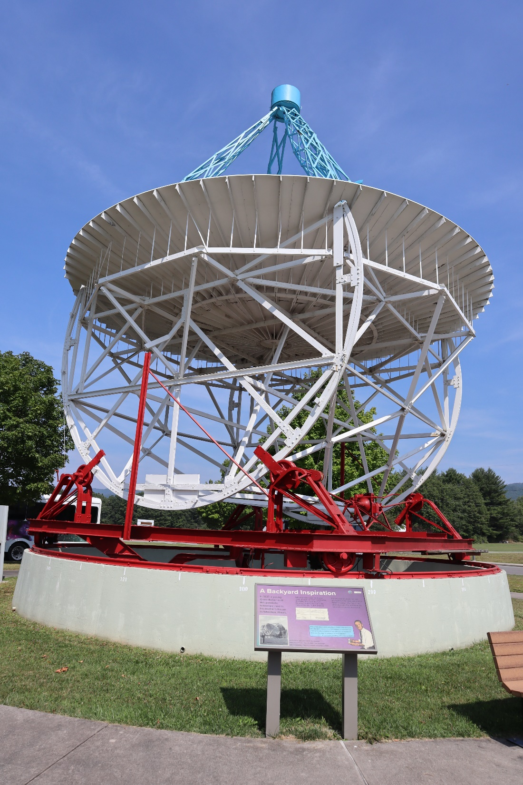

Slide 10
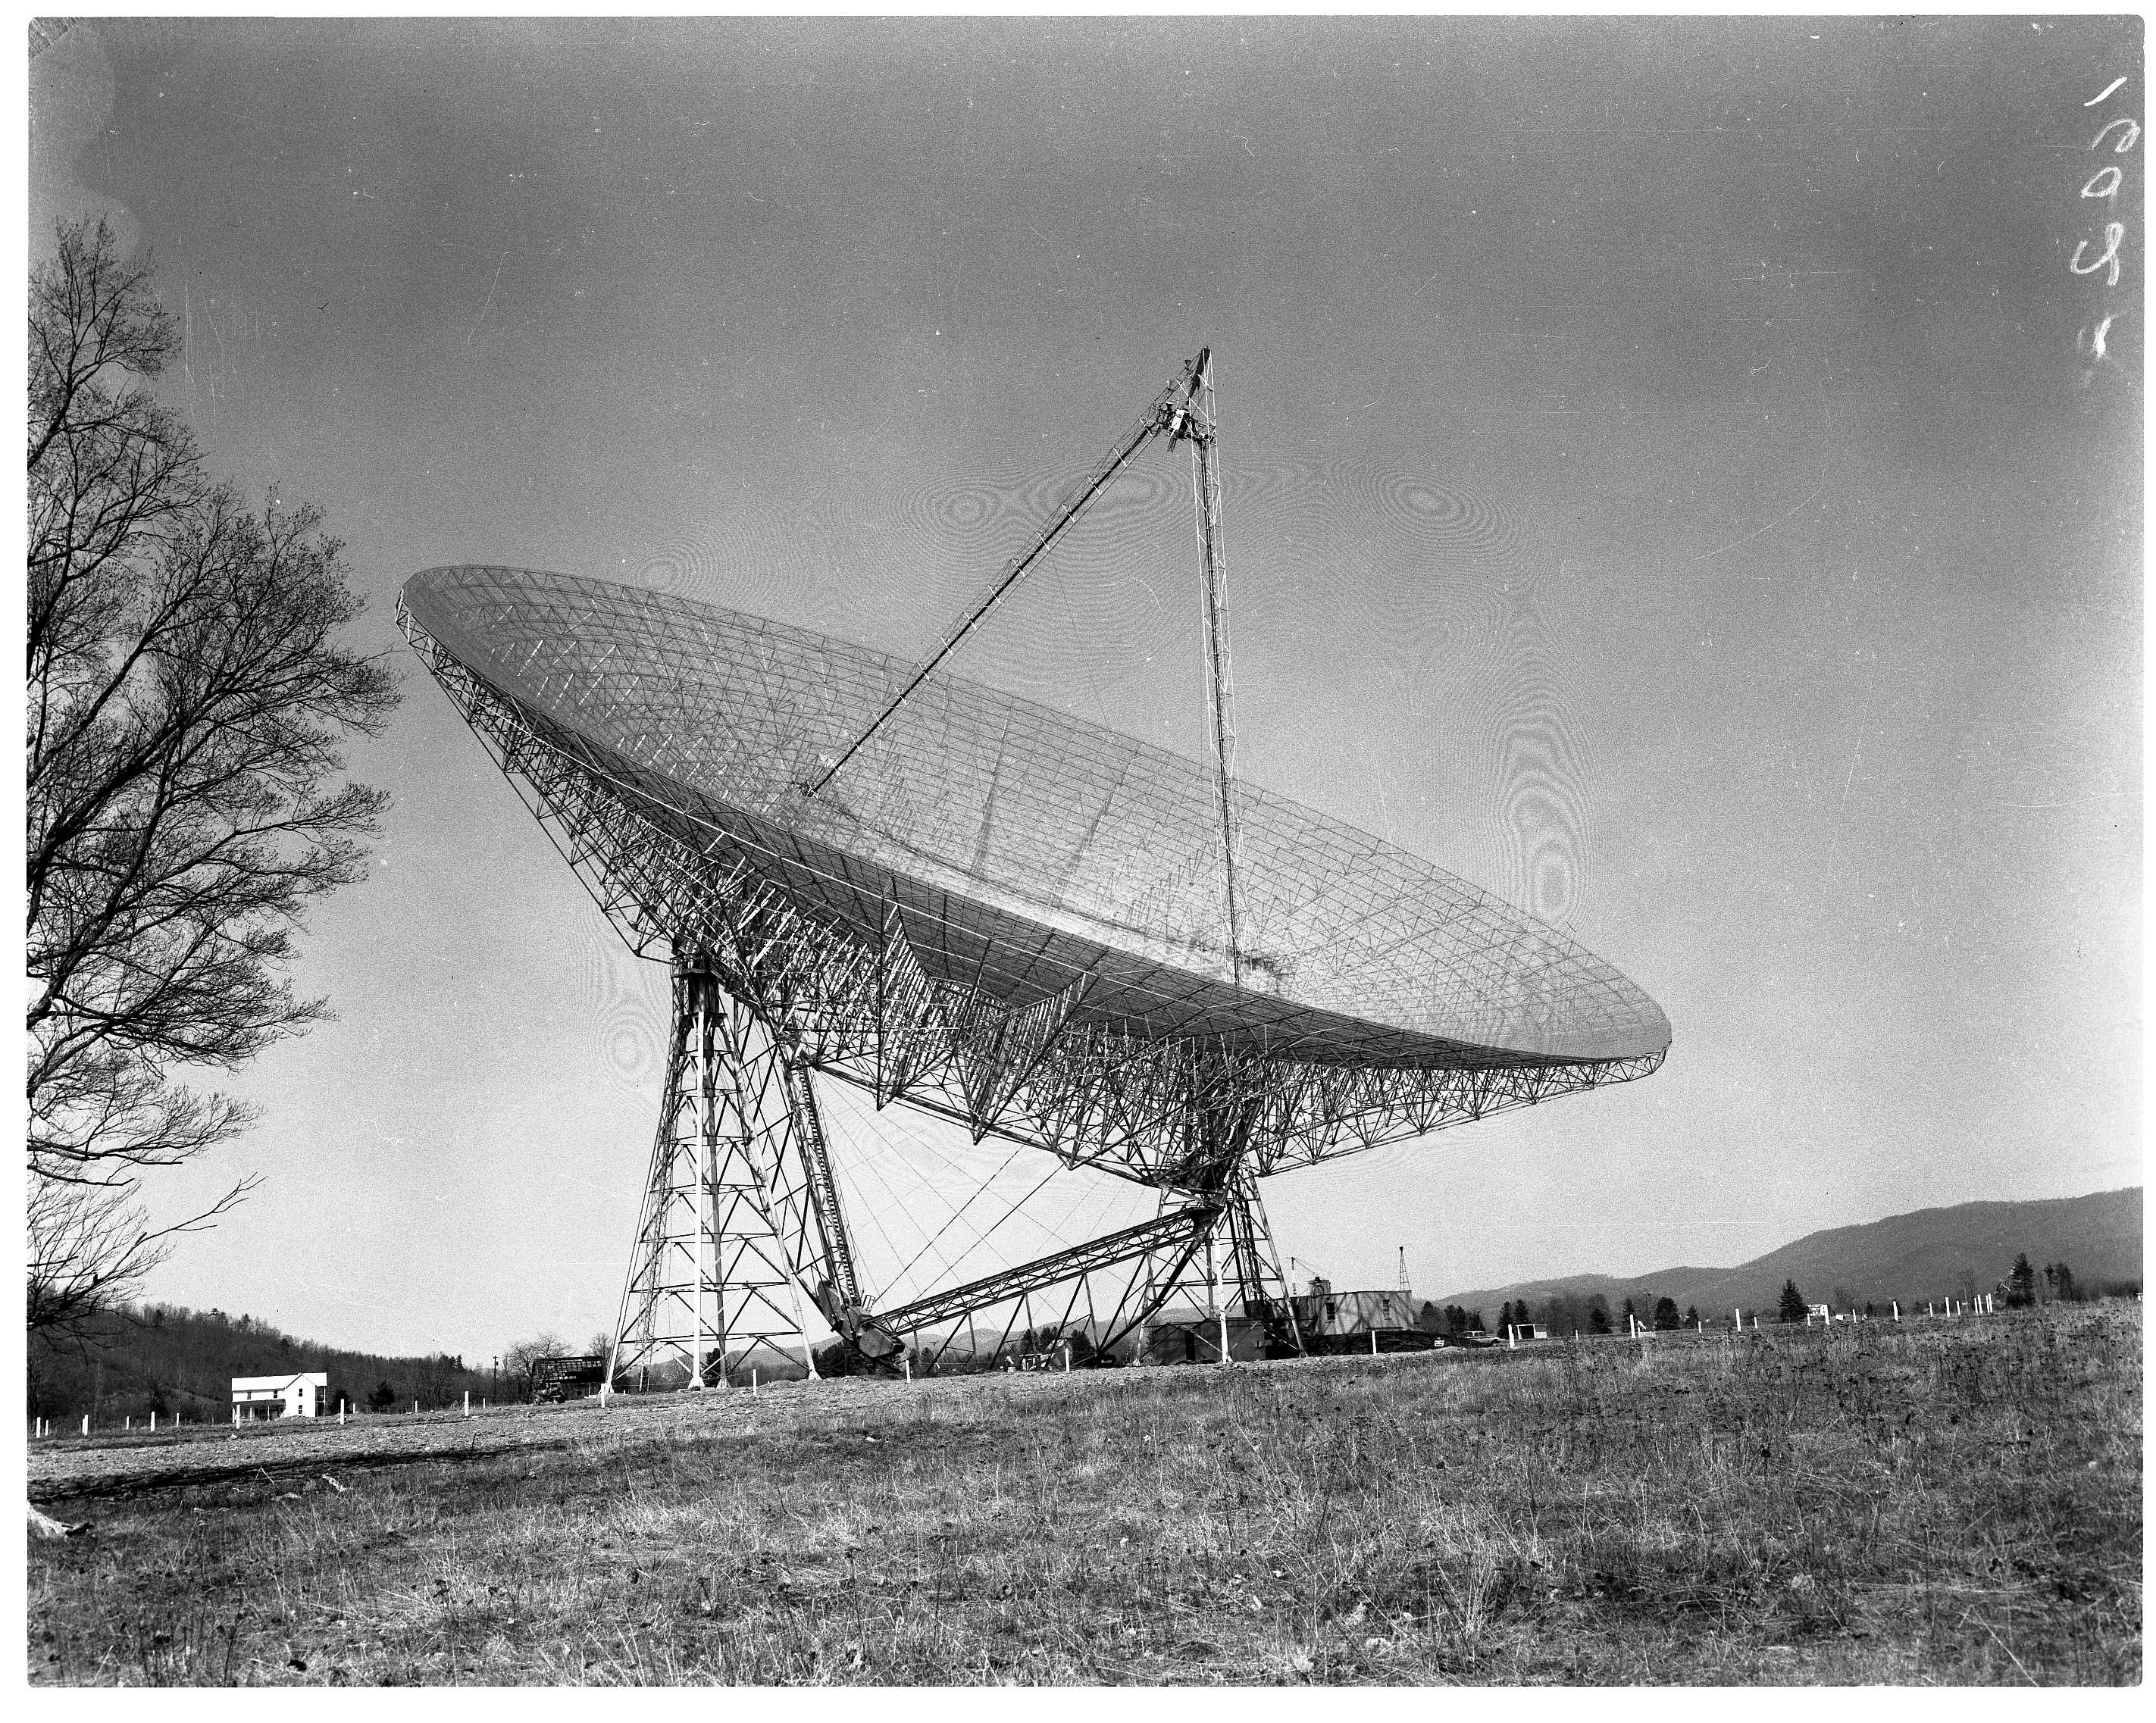

Slide 11
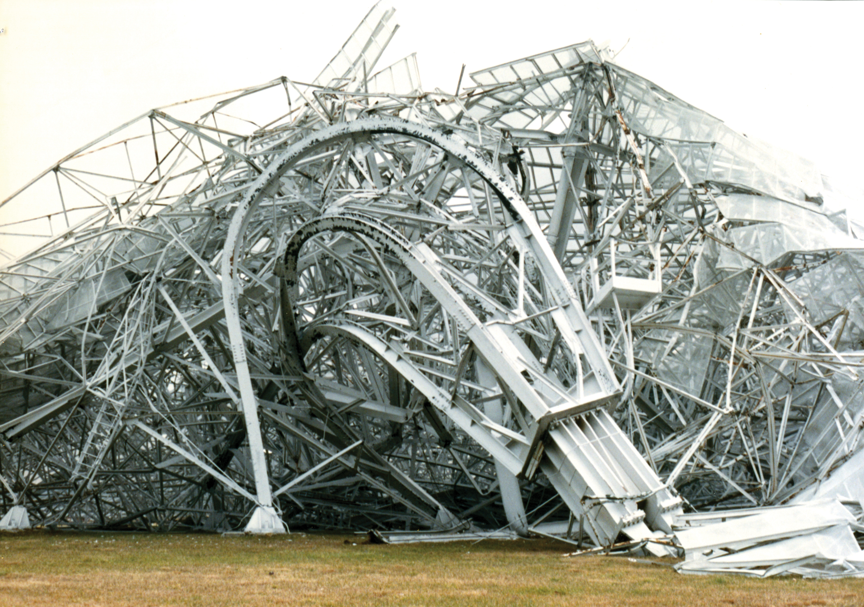

Slide 12
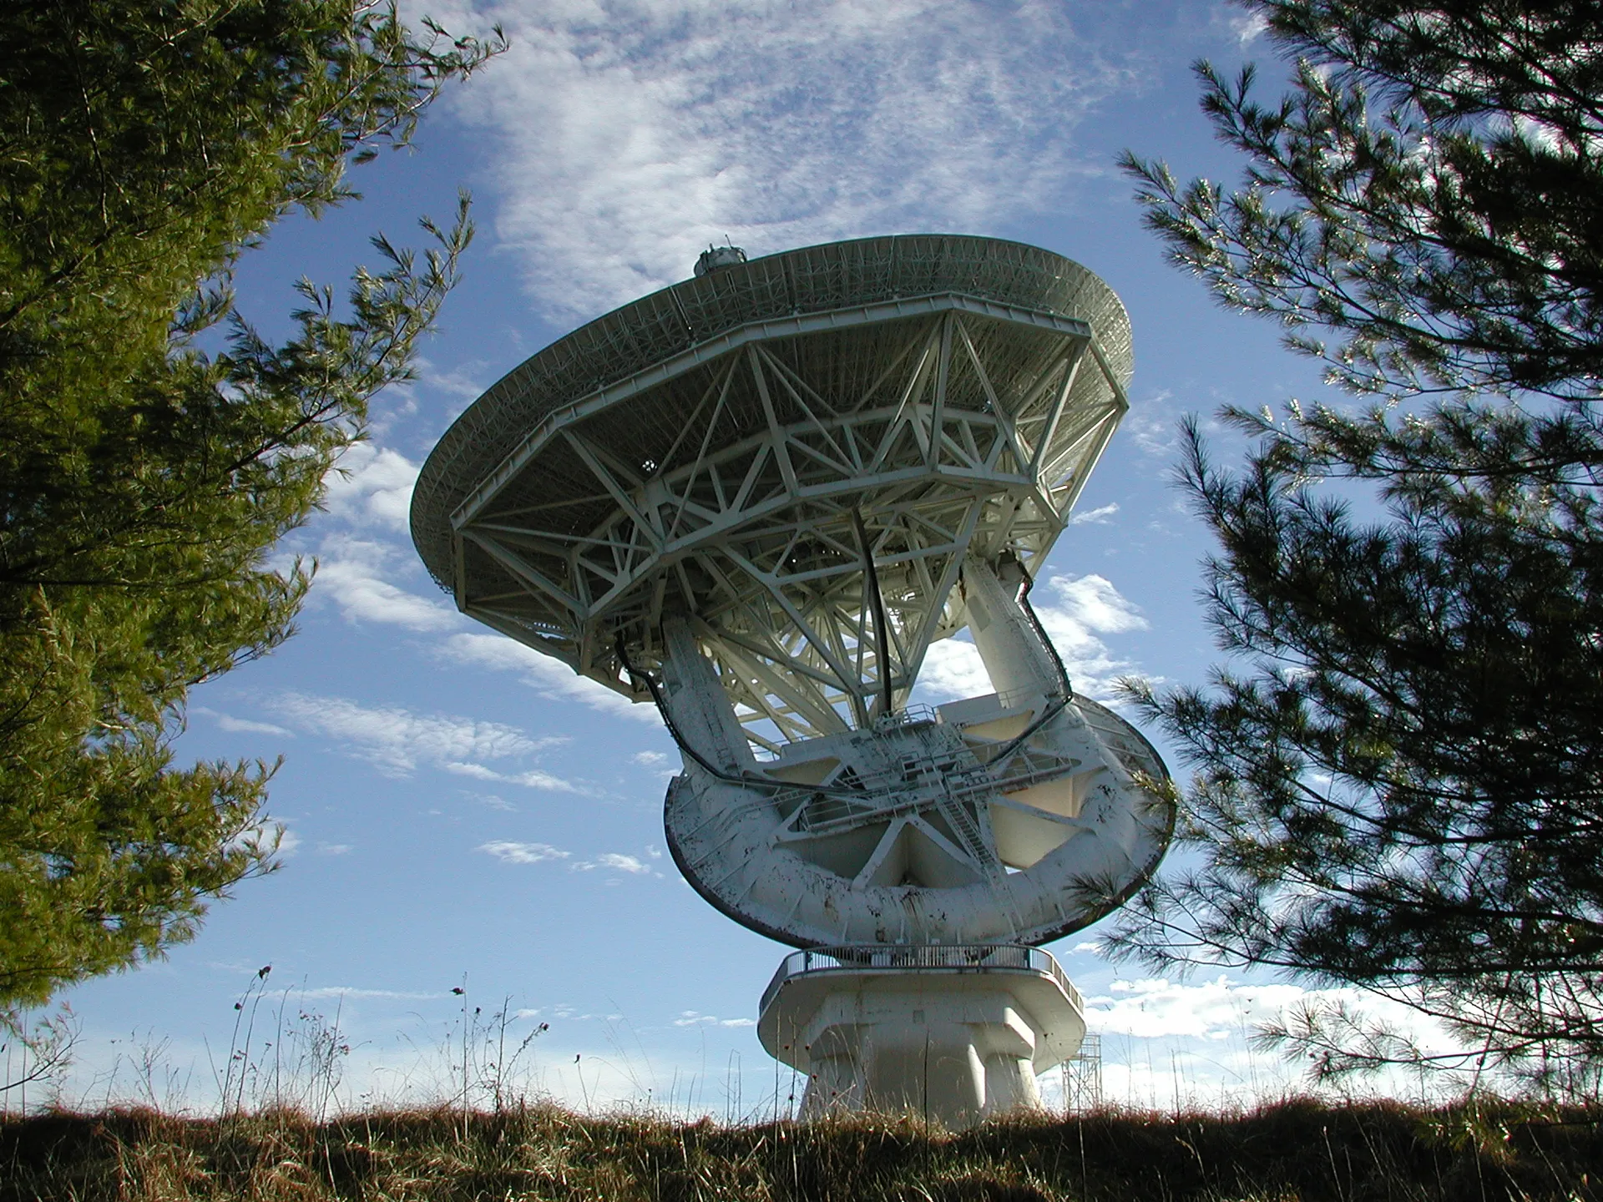

Slide 13
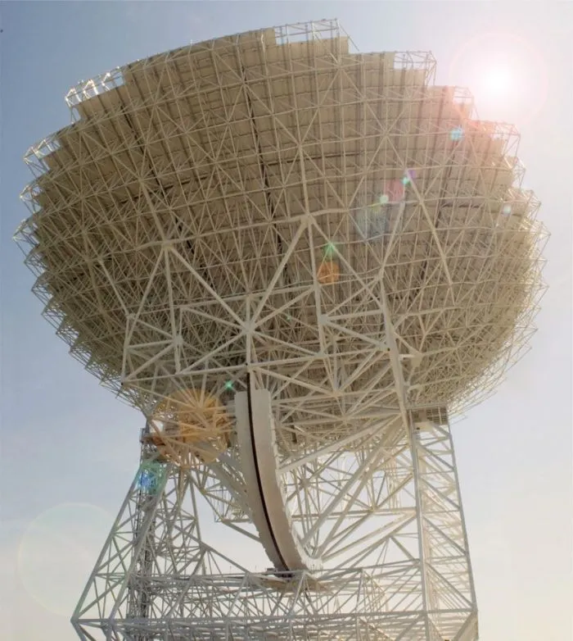

Slide 14
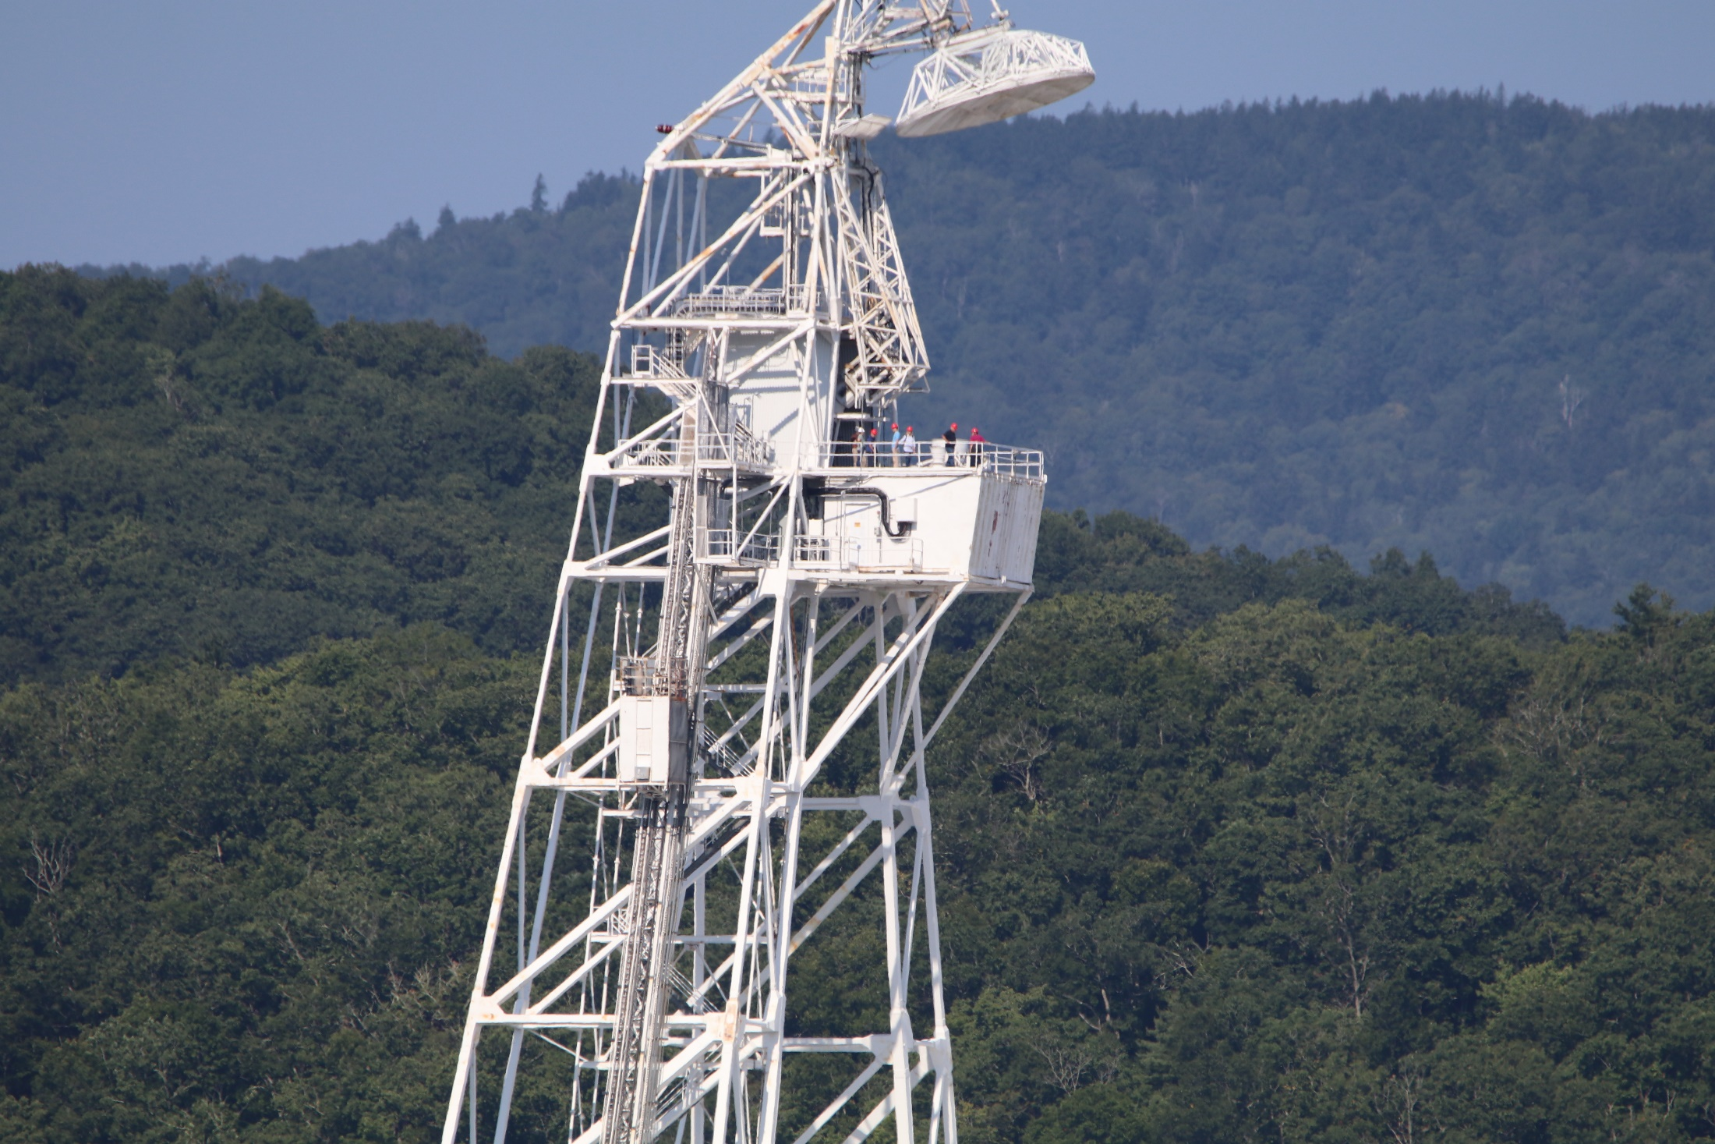

Slide 15
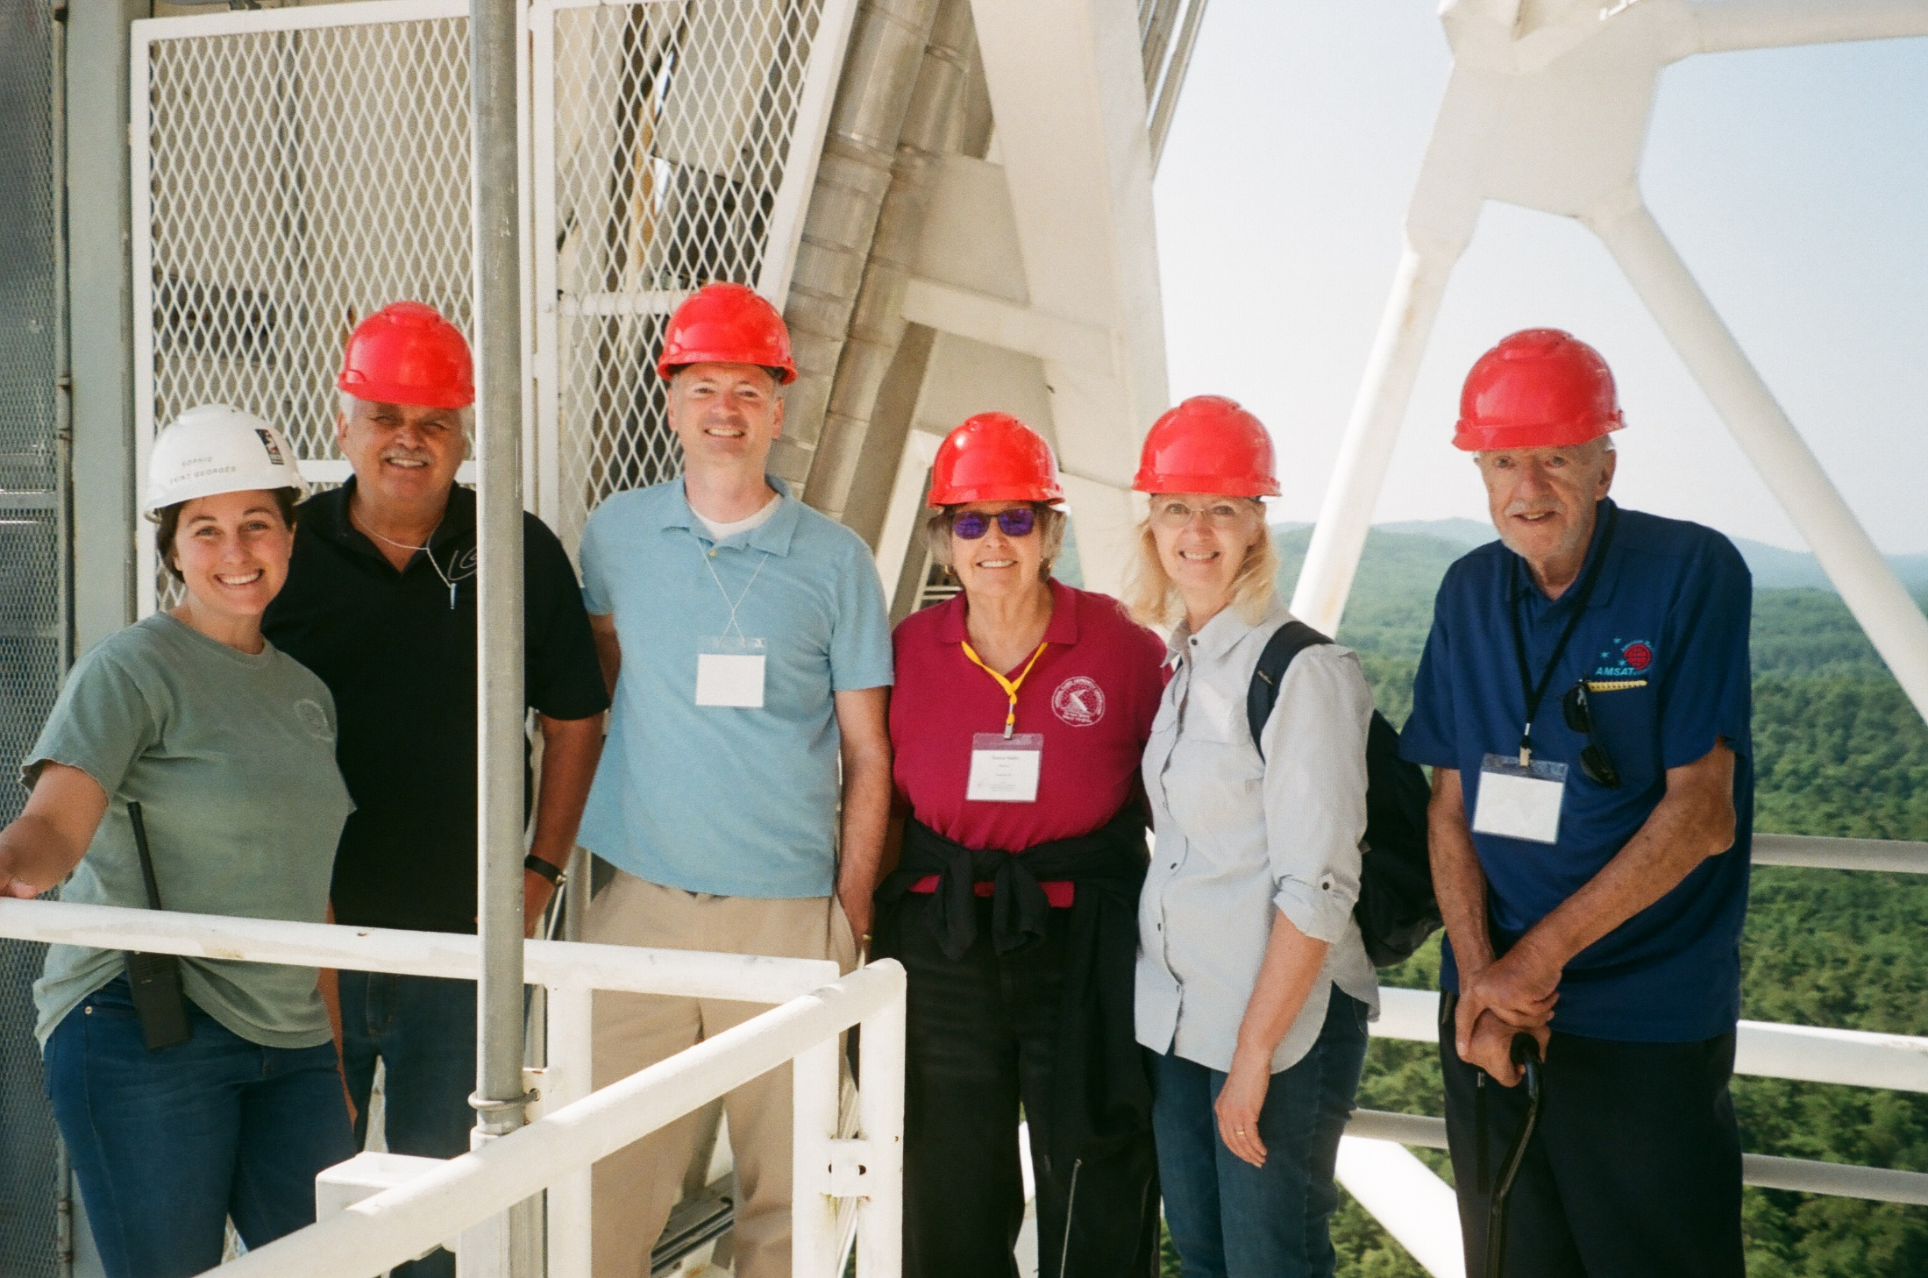

Slide 16
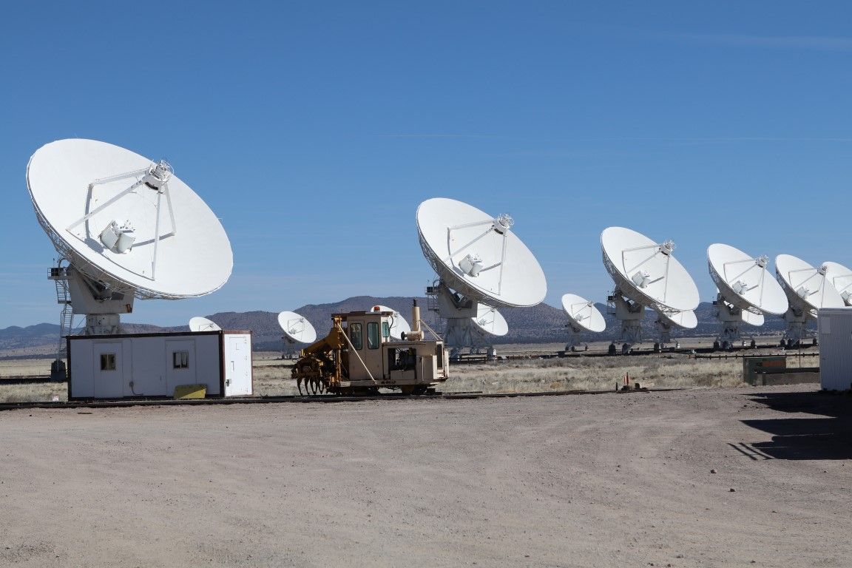

Slide 17
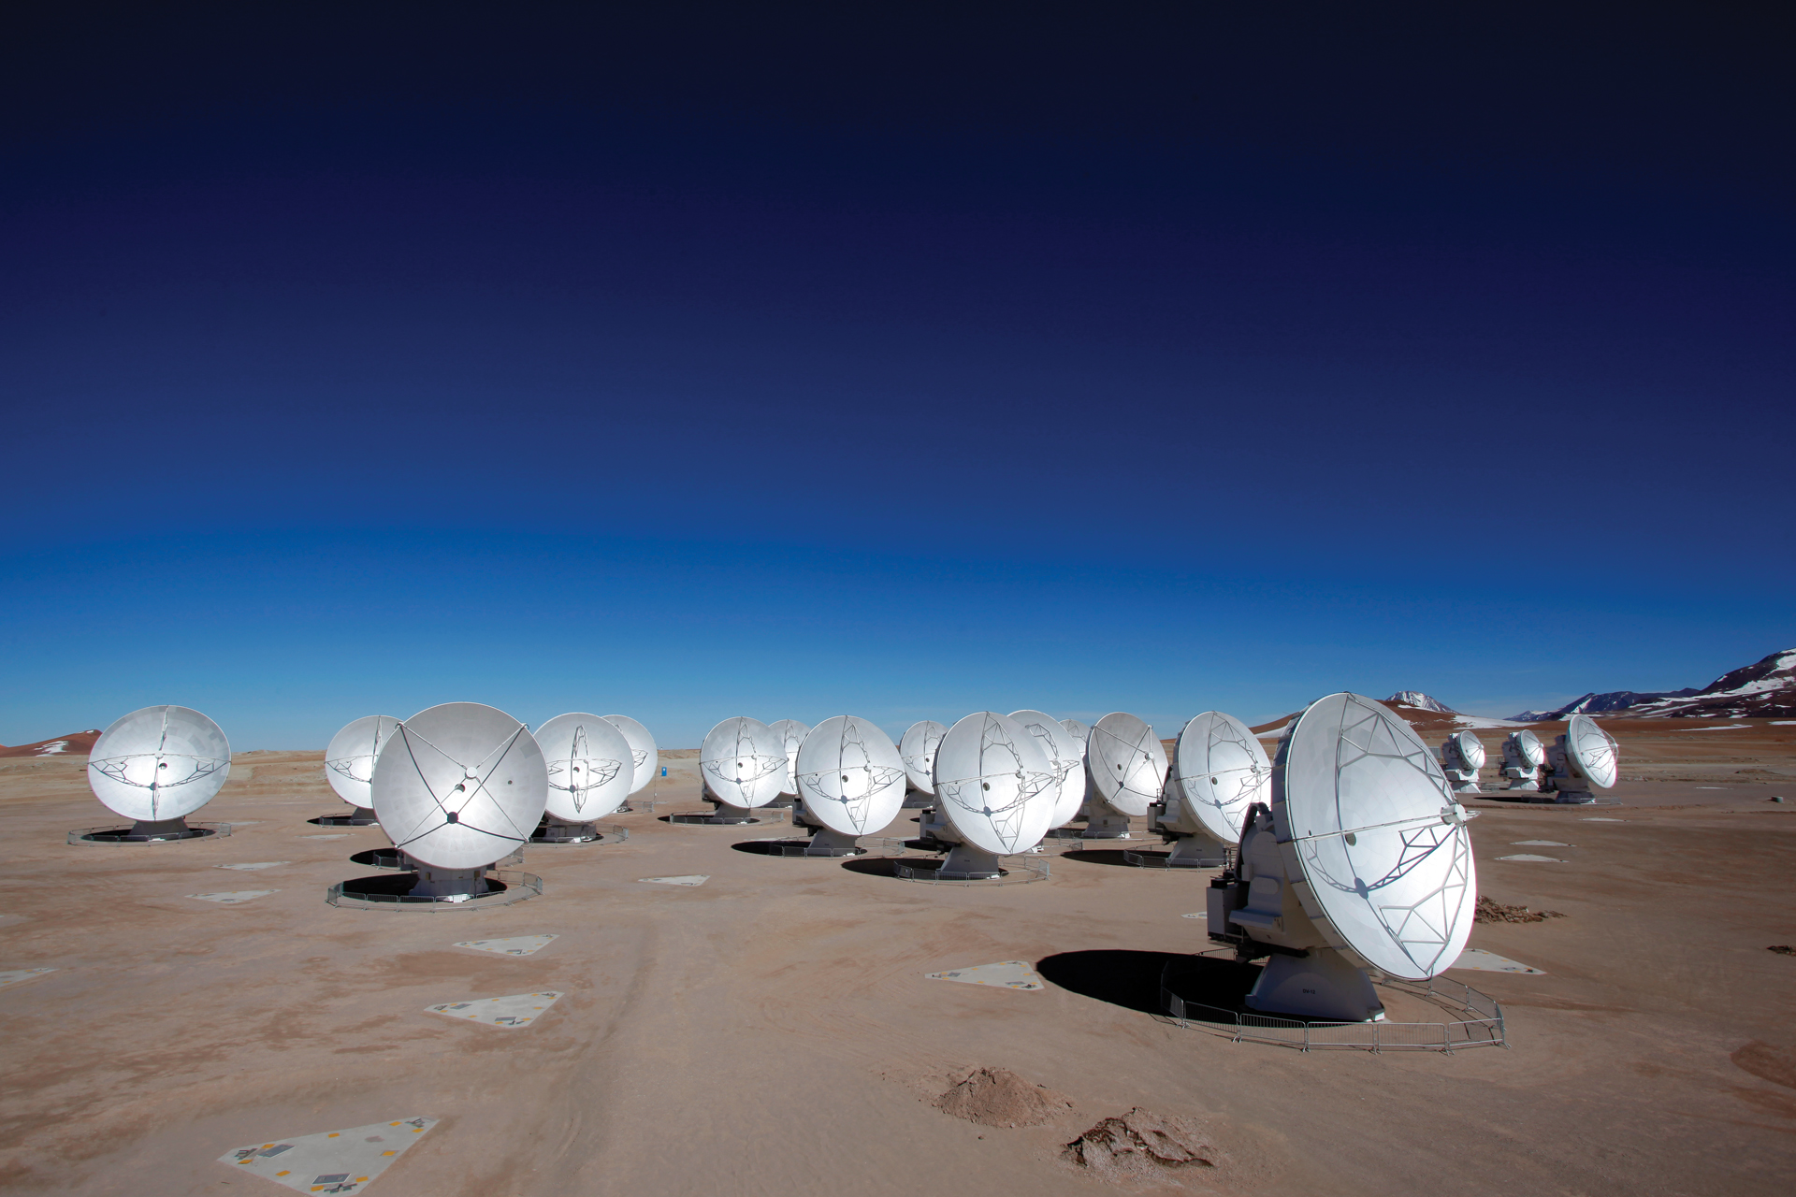

Slide 18
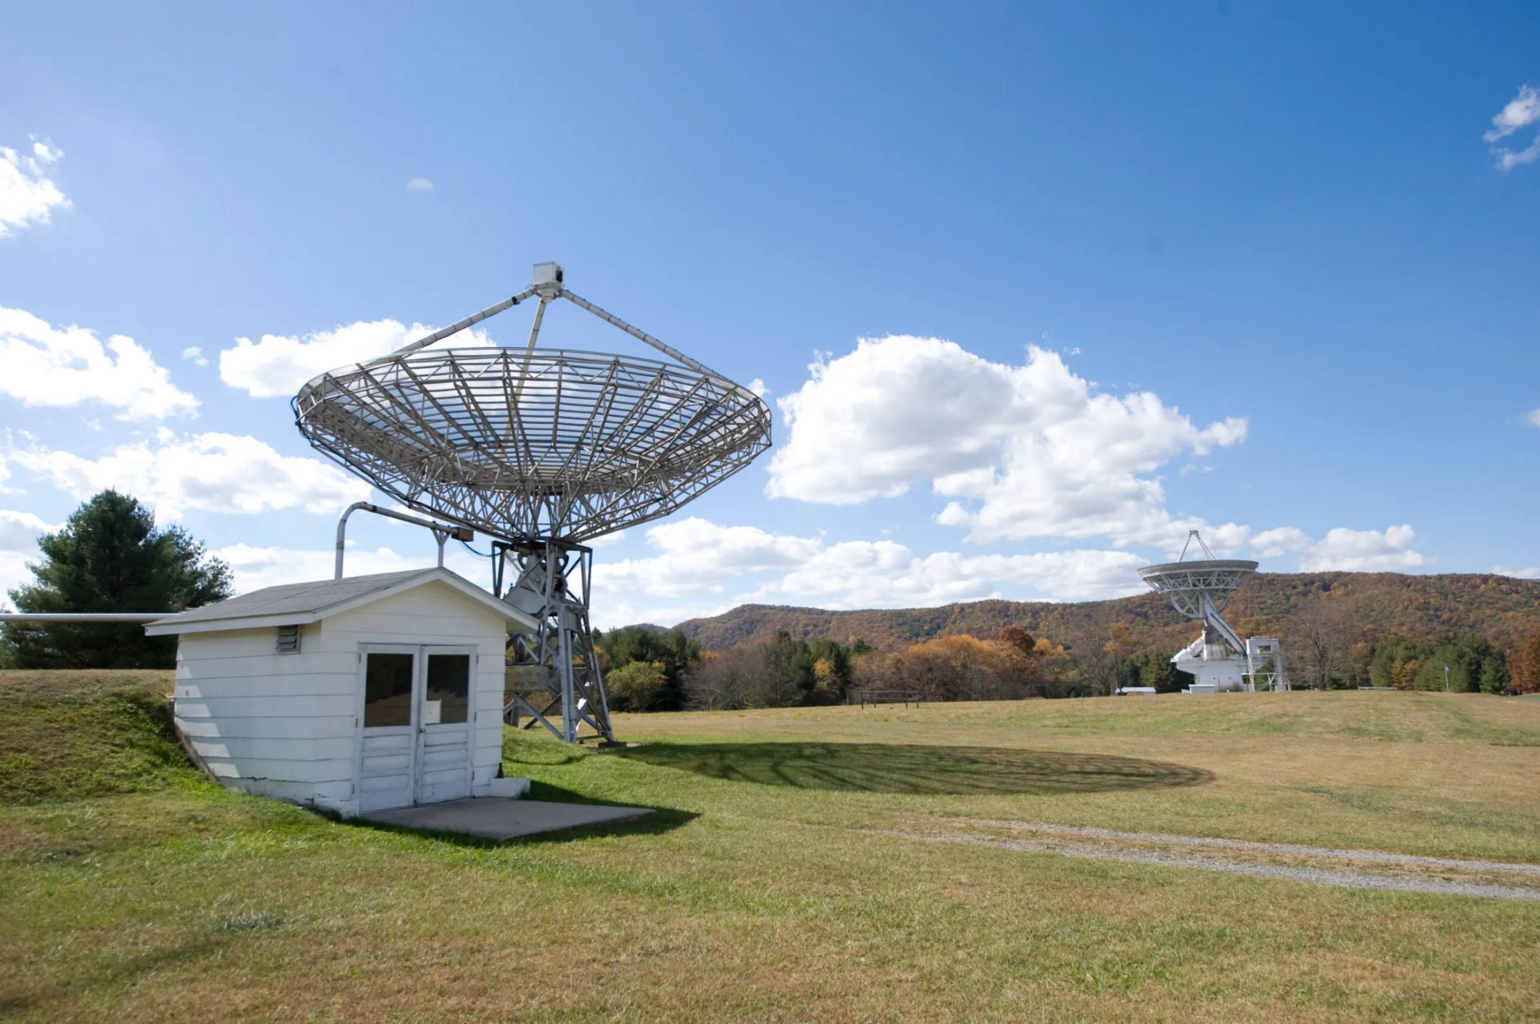

Slide 19
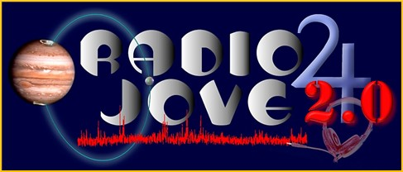
The Radio JOVE Project 2.0
radiojove.gsfc.nasa.gov
Chuck Higgins, Middle Tennessee State University
Chuck Higgins¹, Shing Fung², James Thieman³, Leonard Garcia⁴ , James Gass⁵, Richard Flagg⁶, Jim Sky⁷, Larry Dodd⁸, David Typinski⁹, Francisco Reyes¹⁰, James Brown¹¹, Thomas Ashcraft¹², Wes Greenman¹³, S. Blair¹⁴, and John Cox¹⁵
Citizen Scientists
¹Dept. of Physics & Astronomy, MTSU, Murfreesboro, TN 37132, ²ITMPL/NASA GSFC, Greenbelt MD 20771, ³UMBC/NASA GSFC, Greenbelt MD 20771, ⁴SGT/NASA GSFC, Greenbelt MD 20771, ⁵CNSP/NASA GSFC, Greenbelt MD 20771, ⁶RF Associates, Honolulu, HI 96826, ⁷Radio Sky Publishing, Louisville, KY, 40214, ⁸K4LED, 101science.com, Jasper, GA 30143, ⁹AJ4CO Observatory, High Spring, FL 32655, ¹⁰Department of Astronomy, University of Florida, Gainesville, FL 32611, ¹¹Hawks Nest Radio Astronomy Observatory, Industry, PA 15052, ¹²Heliotown Observatory, Lamy, NM 87540, ¹³LGM Radio Alachua, Alachua, FL 32615, ¹⁴Dalton State College, Dalton, GA, 30720, ¹⁵Easley, SC, 29640
Radio JOVE uses hands-on radio astronomy to help people learn and do science.
Citizen Science is defined as a form of open collaboration in which individuals or organizations participate voluntarily in the scientific process in various ways. (NASA SMD Policy Document SPD-33)

Slide 20
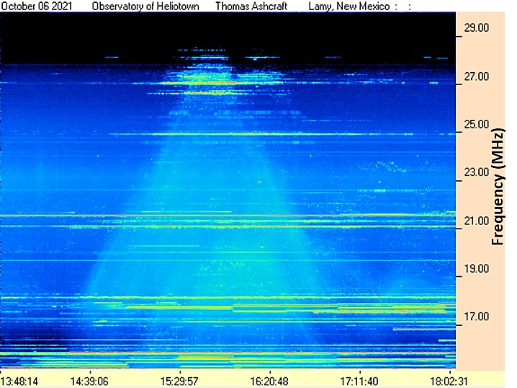
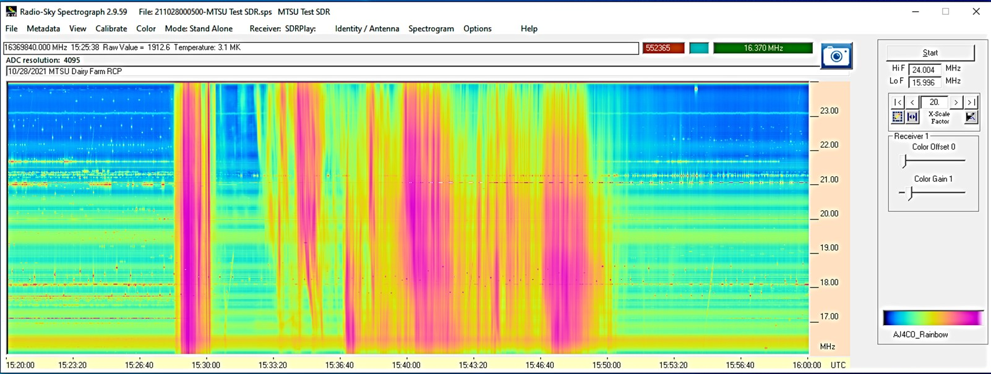
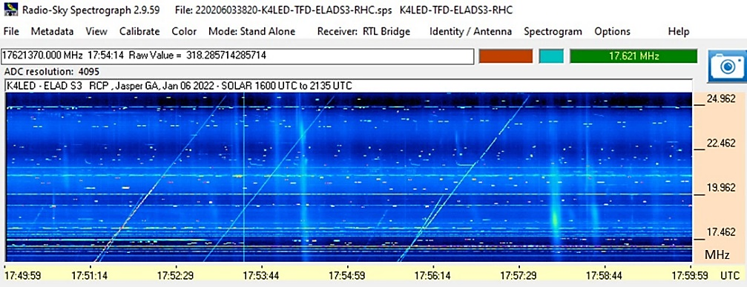
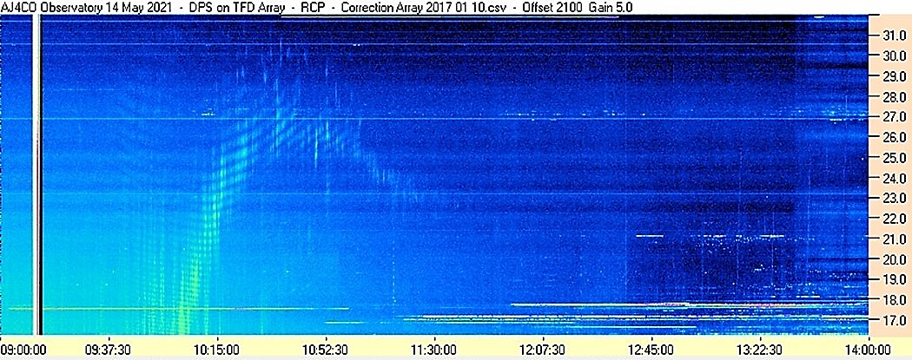
Example Observations
Terrestrial propagation
Solar
bursts
Calibration
Jupiter
bursts
Radar
Sweepers
Solar
bursts
Example Radio JOVE frequency-time spectrograms of terrestrial, solar, and Jupiter radio bursts seen by different observers. Terrestrial “TP” propagation from lightning (T. Ashcraft), solar bursts (C. Higgins), Jupiter Io-B event (D. Typinski), and solar bursts and terrestrial radar sweepers (L. Dodd).

Slide 21
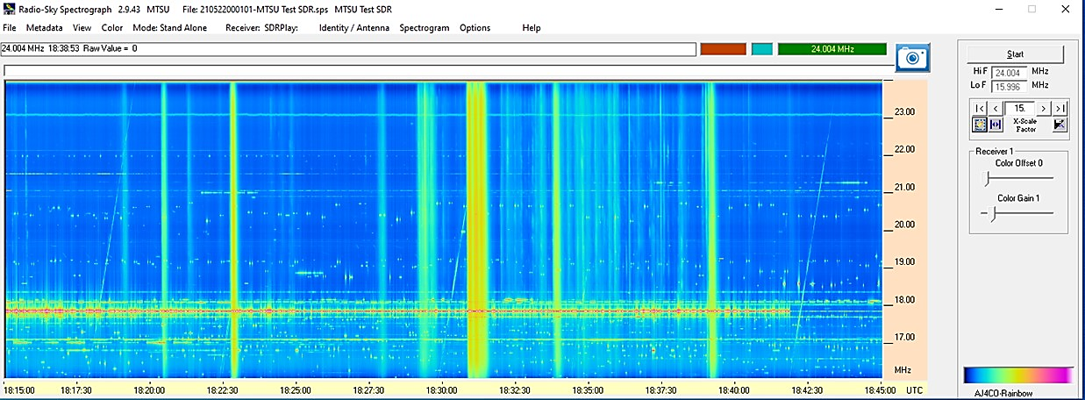
Radio JOVE 2.0 Summary
Radio JOVE 2.0 is active and using SDR radios
Developing training modules to help participants
Stay connected with an email listserv
Email Listserv on Groups.io: https://groups.io/g/radio-jove
Updated Website + Data Archive
Observing campaign for 2023 and 2024 solar eclipses
Join Us: https://radiojove.gsfc.nasa.gov/joinin.php
Old
New
We are looking for amateurs to become citizen scientists
Thank you!
Solar Bursts 05/22/21, Top: Radio JOVE Bottom: SDRPlay RSP1A, MTSU Dairy Farm, Murfreesboro, TN
Contact Chuck Higgins chiggins@mtsu.edu

Slide 22
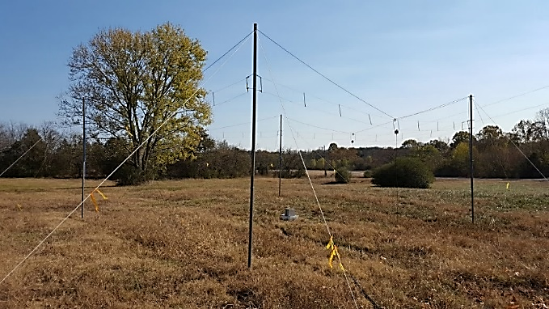
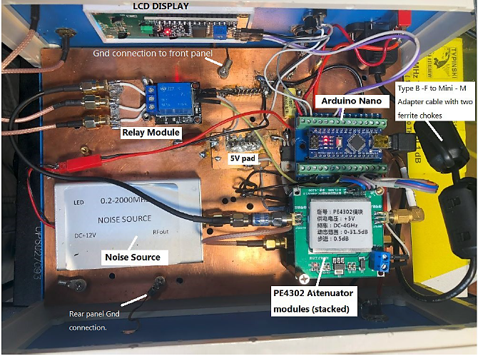
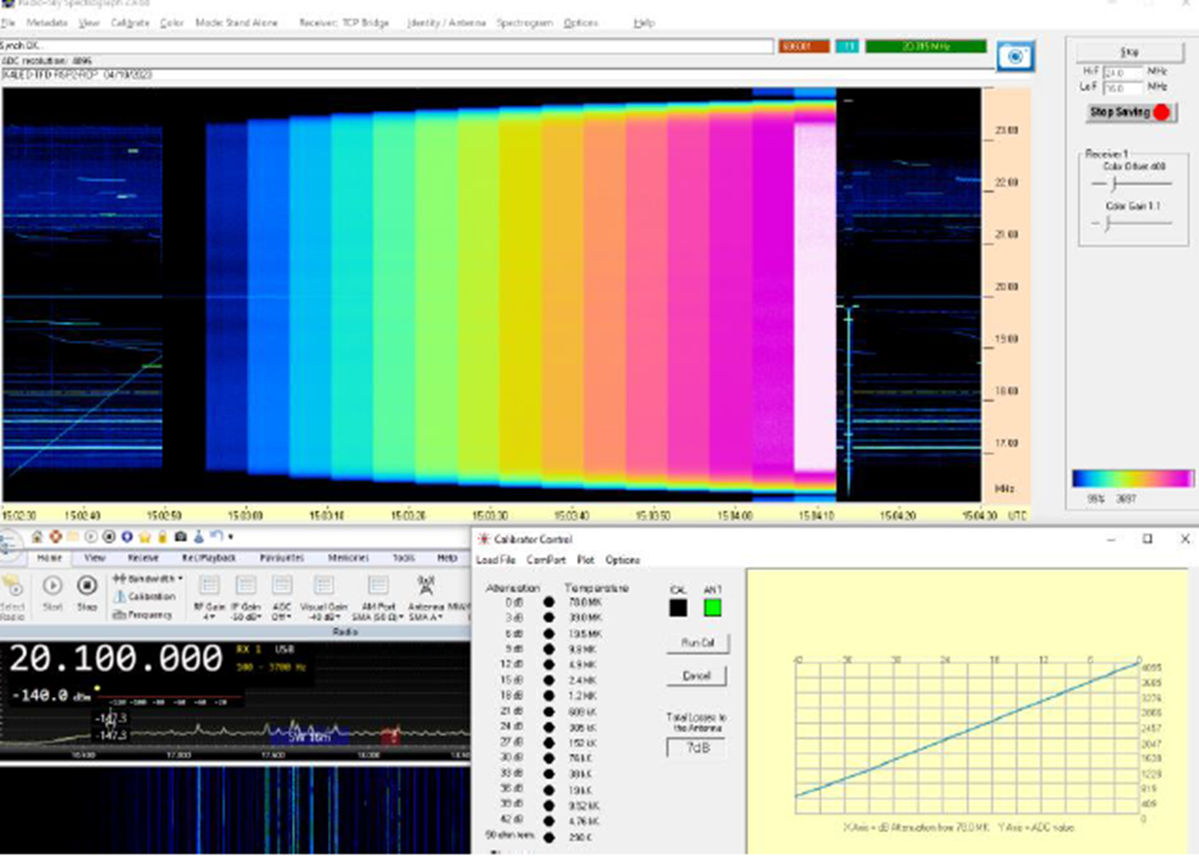
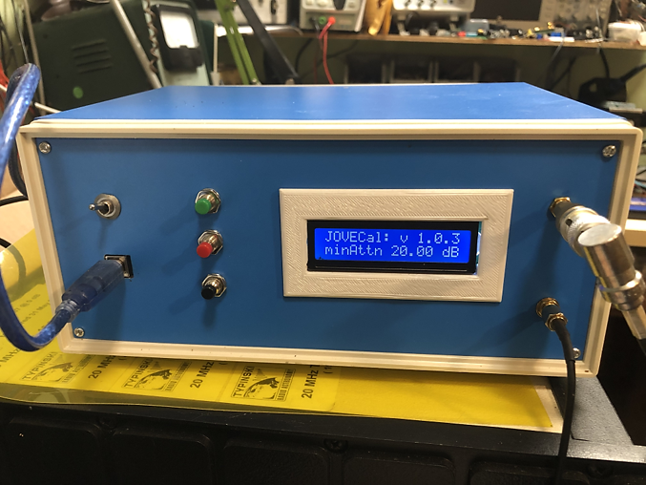
Advanced Hardware
A Terminated Folded Dipole (TFD) Square Array
Wide band antennas
Polarization Measurements
GPS Timing
Multi-Step Calibration
Multistep Calibrator
JOVE CAL 1 DIY Step Calibrator
Parts Cost $125.00
Calibrator Control Panel in RSS
showing the response of an SDRplay

Slide 23
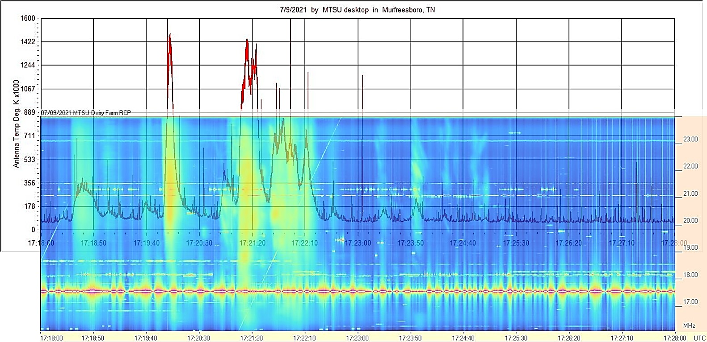
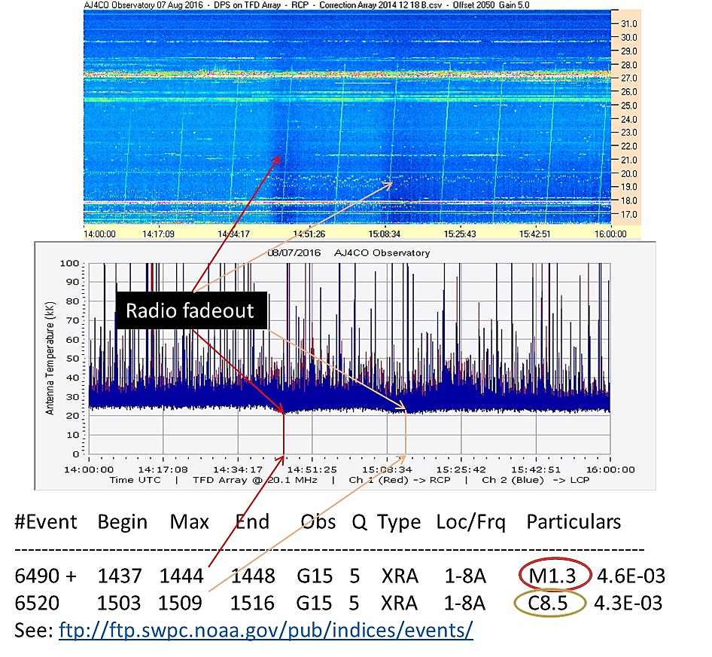
Example Observations
Solar
bursts
Radio
Fadeouts
Solar bursts on a calibrated Radio JOVE 1.1 20 MHz receiver overlayed onto a Radio JOVE 2.0 frequency-time spectrogram (C. Higgins), and radio fadeout ionosphere disturbances associated with M- and C-class solar flares (D. Typinski).

Slide 24
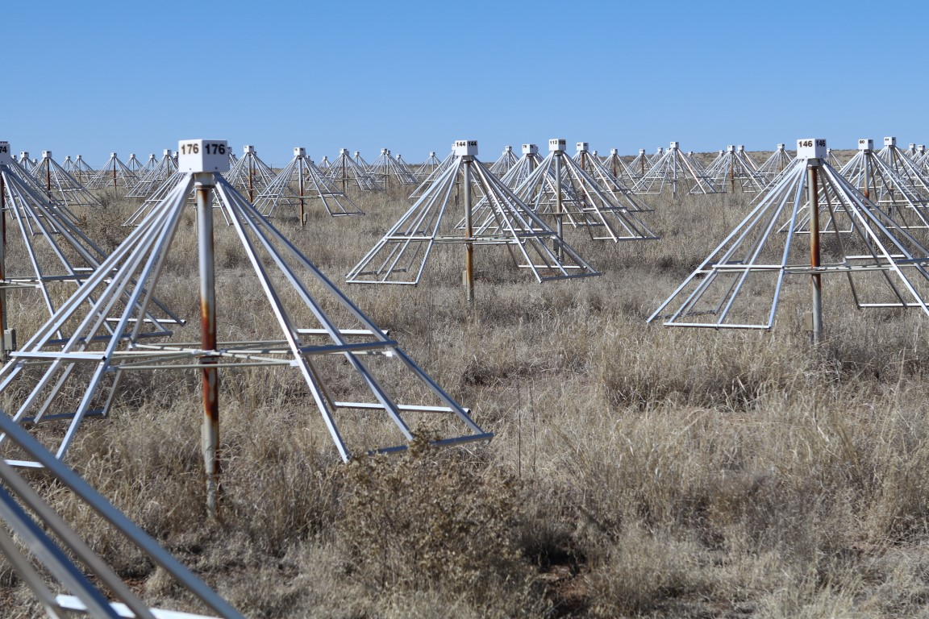

Slide 25
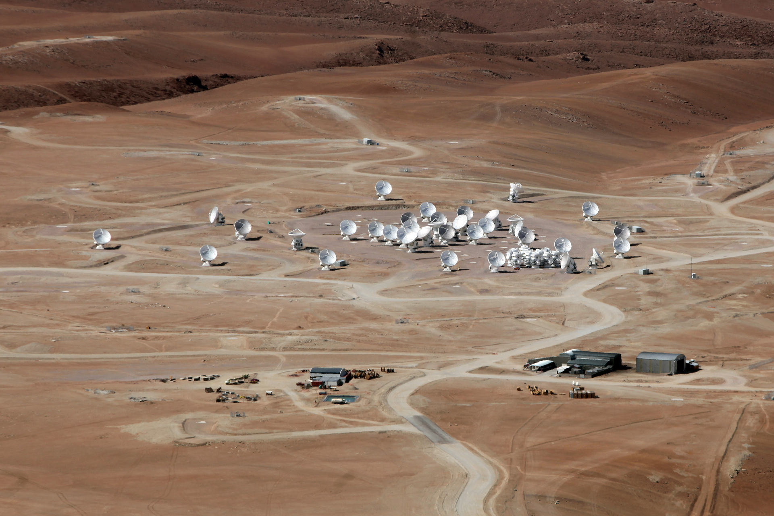

Slide 26
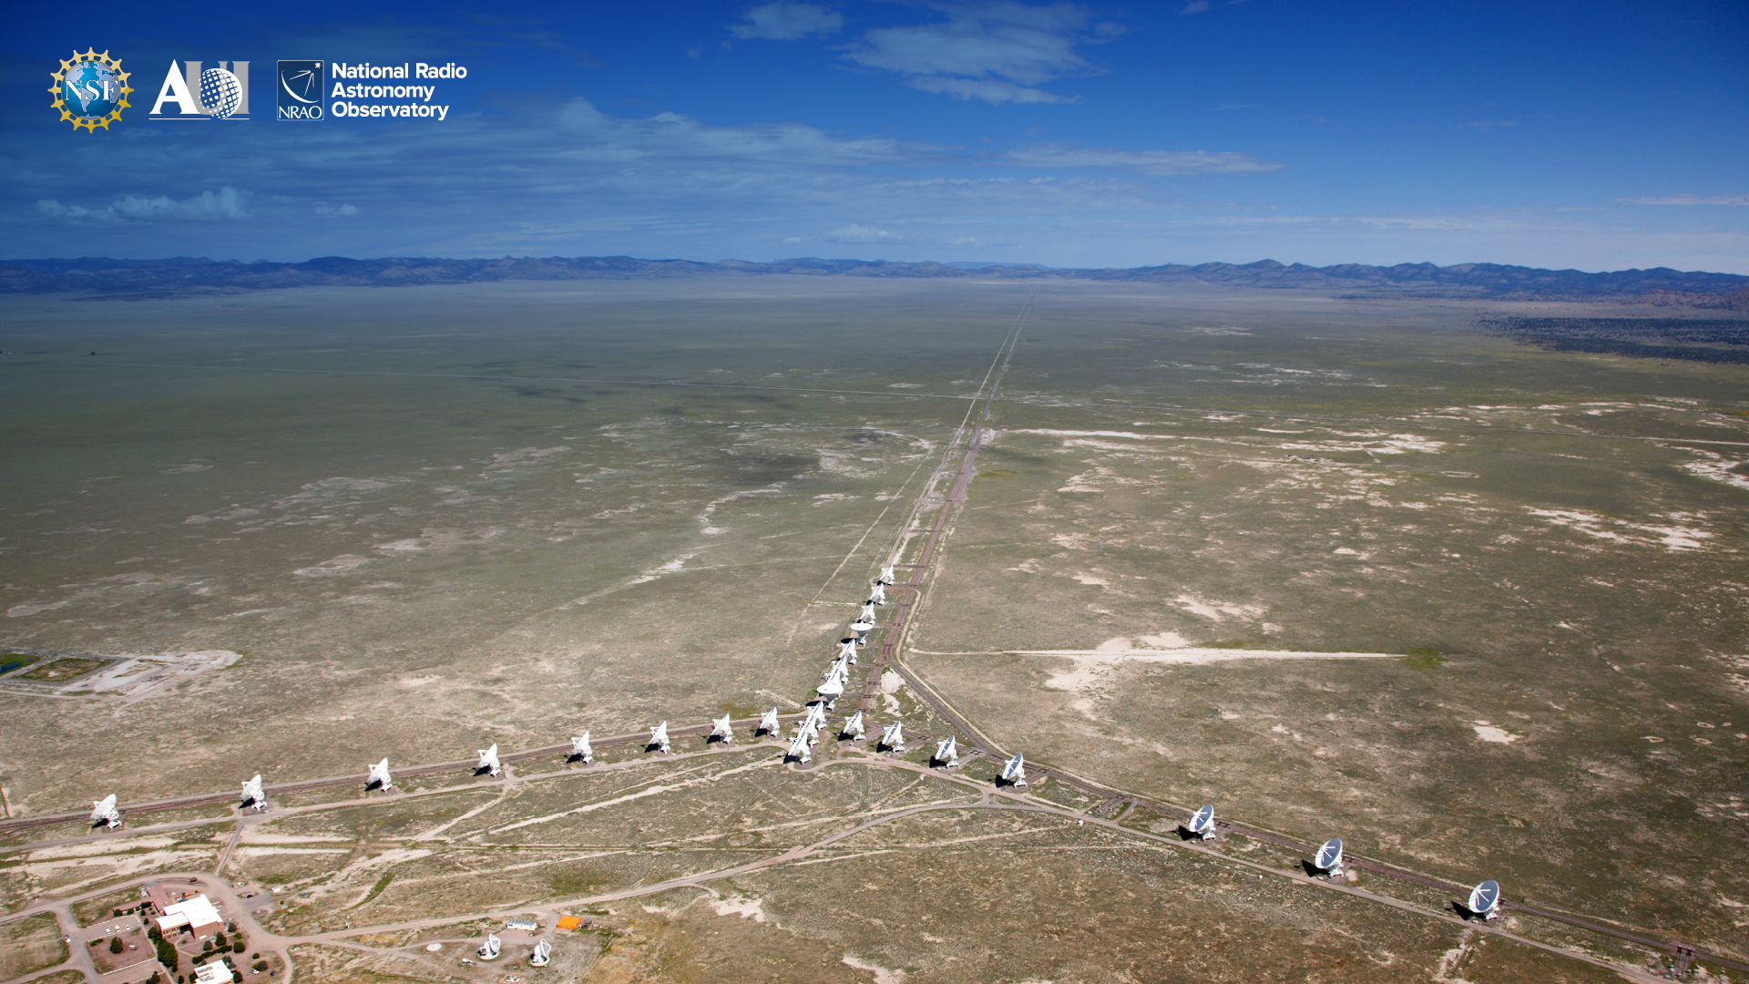

Slide 27
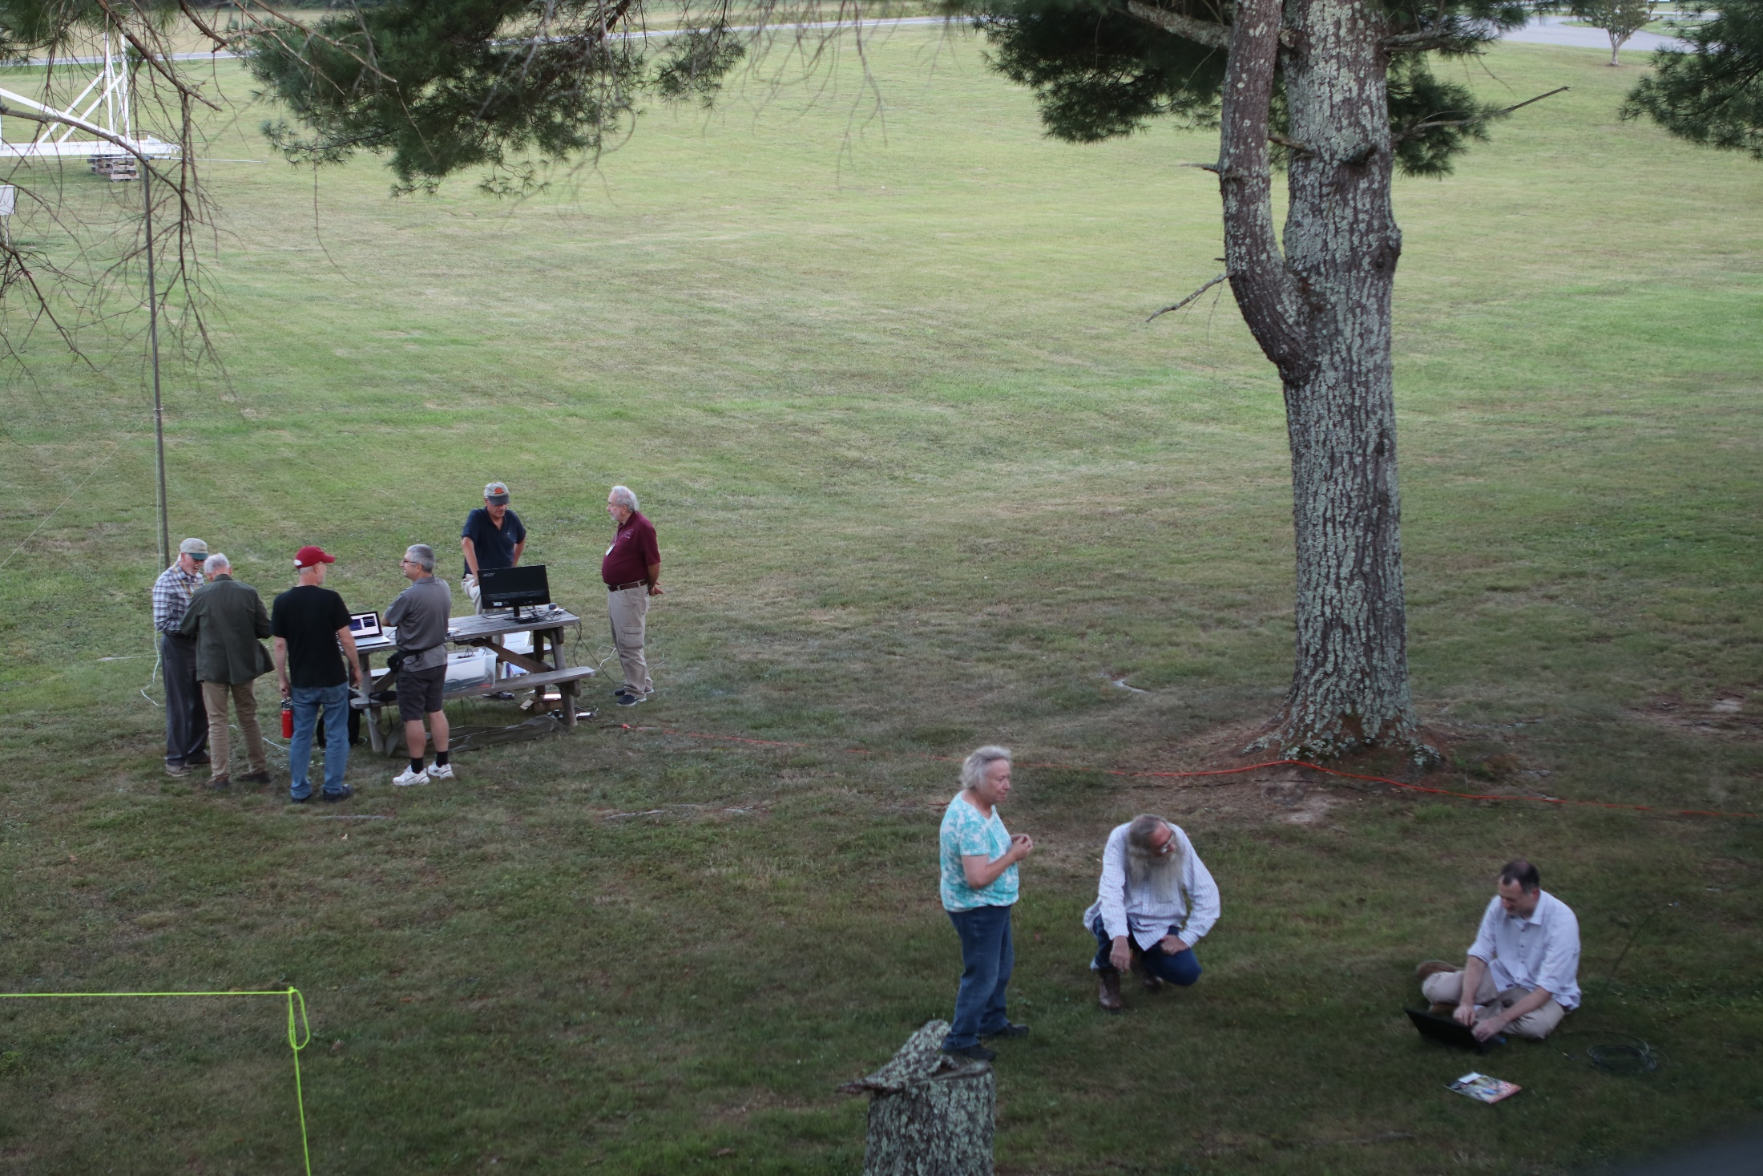
SARA
Society of Amateur Radio Astronomers

Slide 28
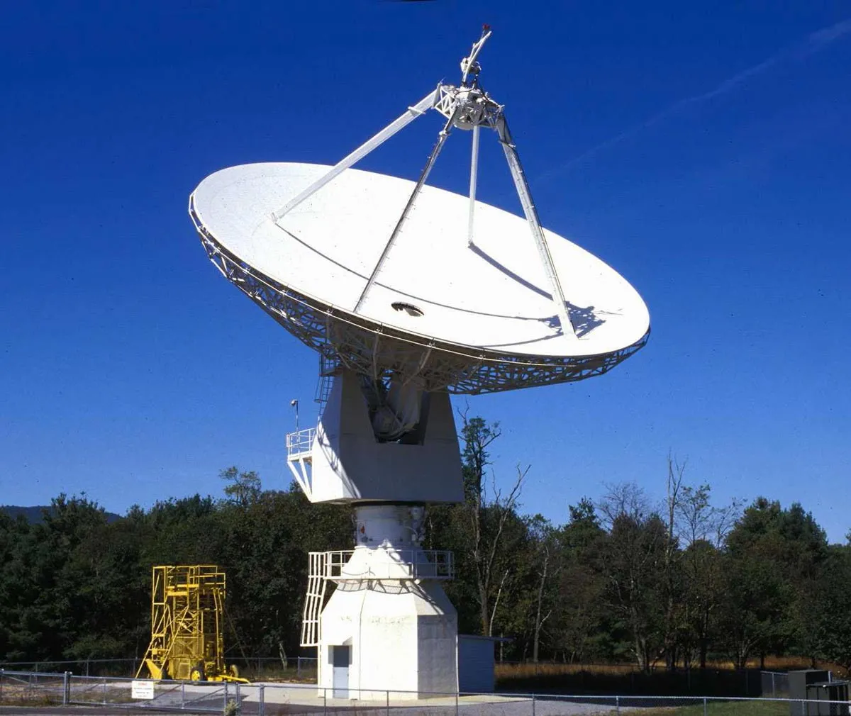

Slide 29
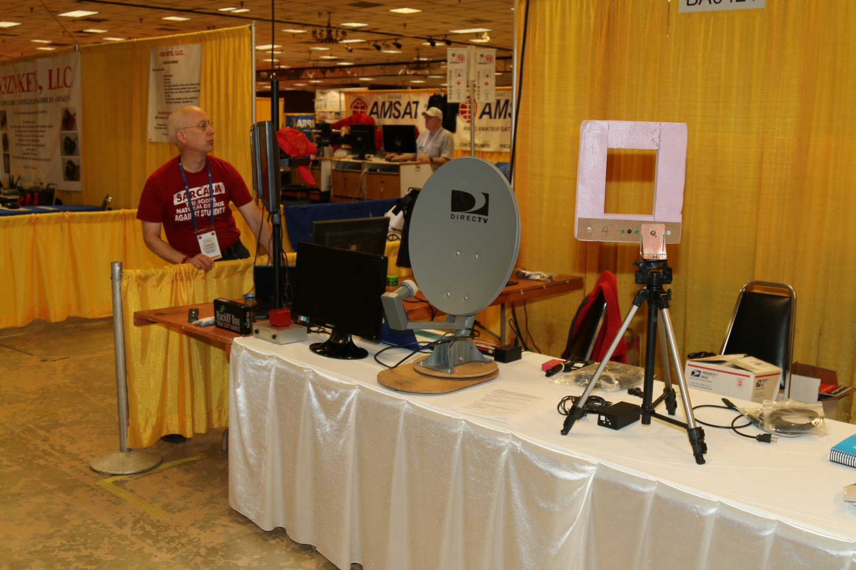
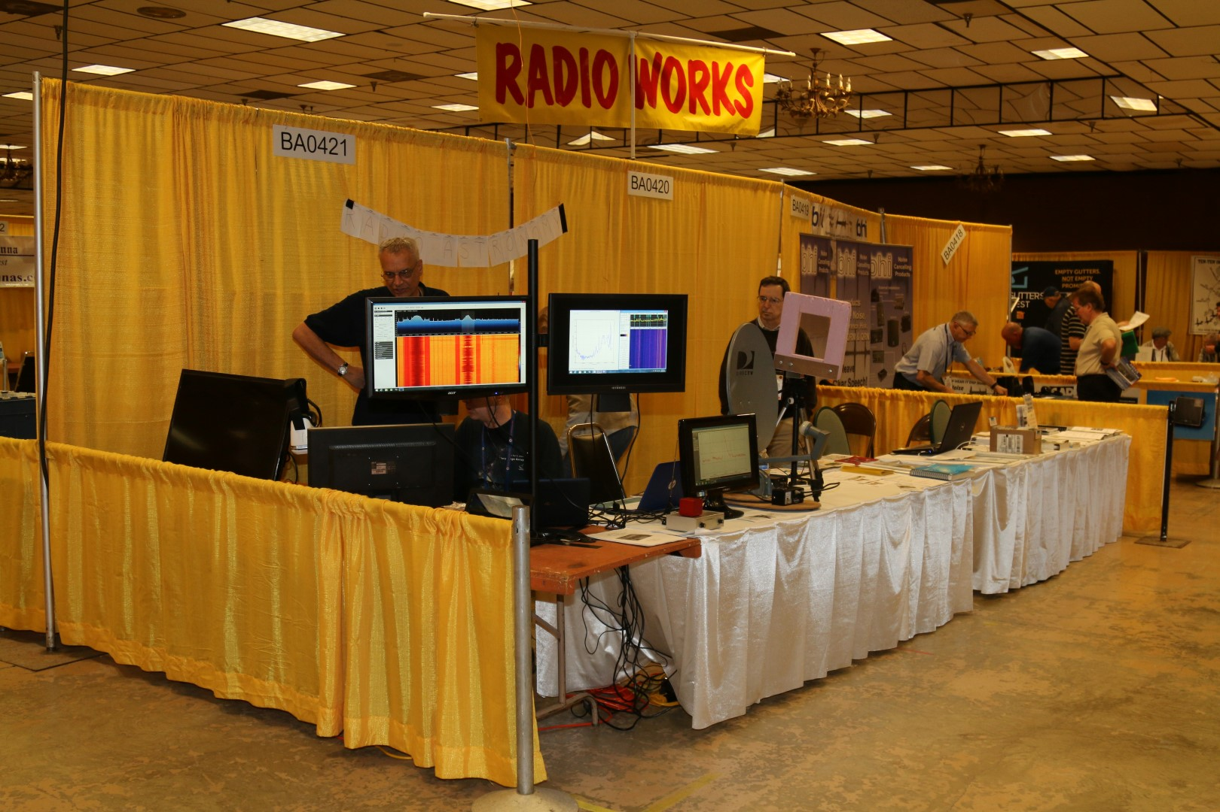

Slide 30
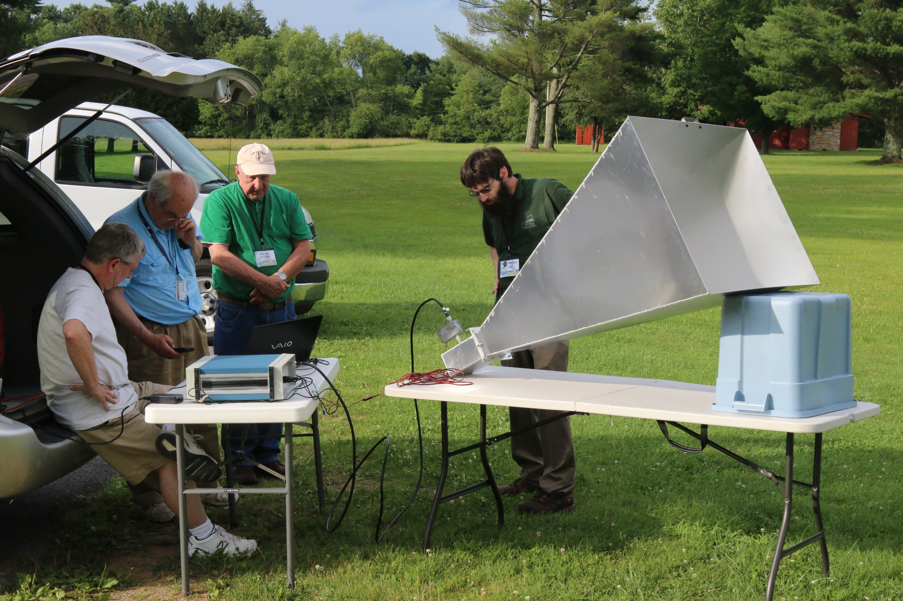

Slide 31
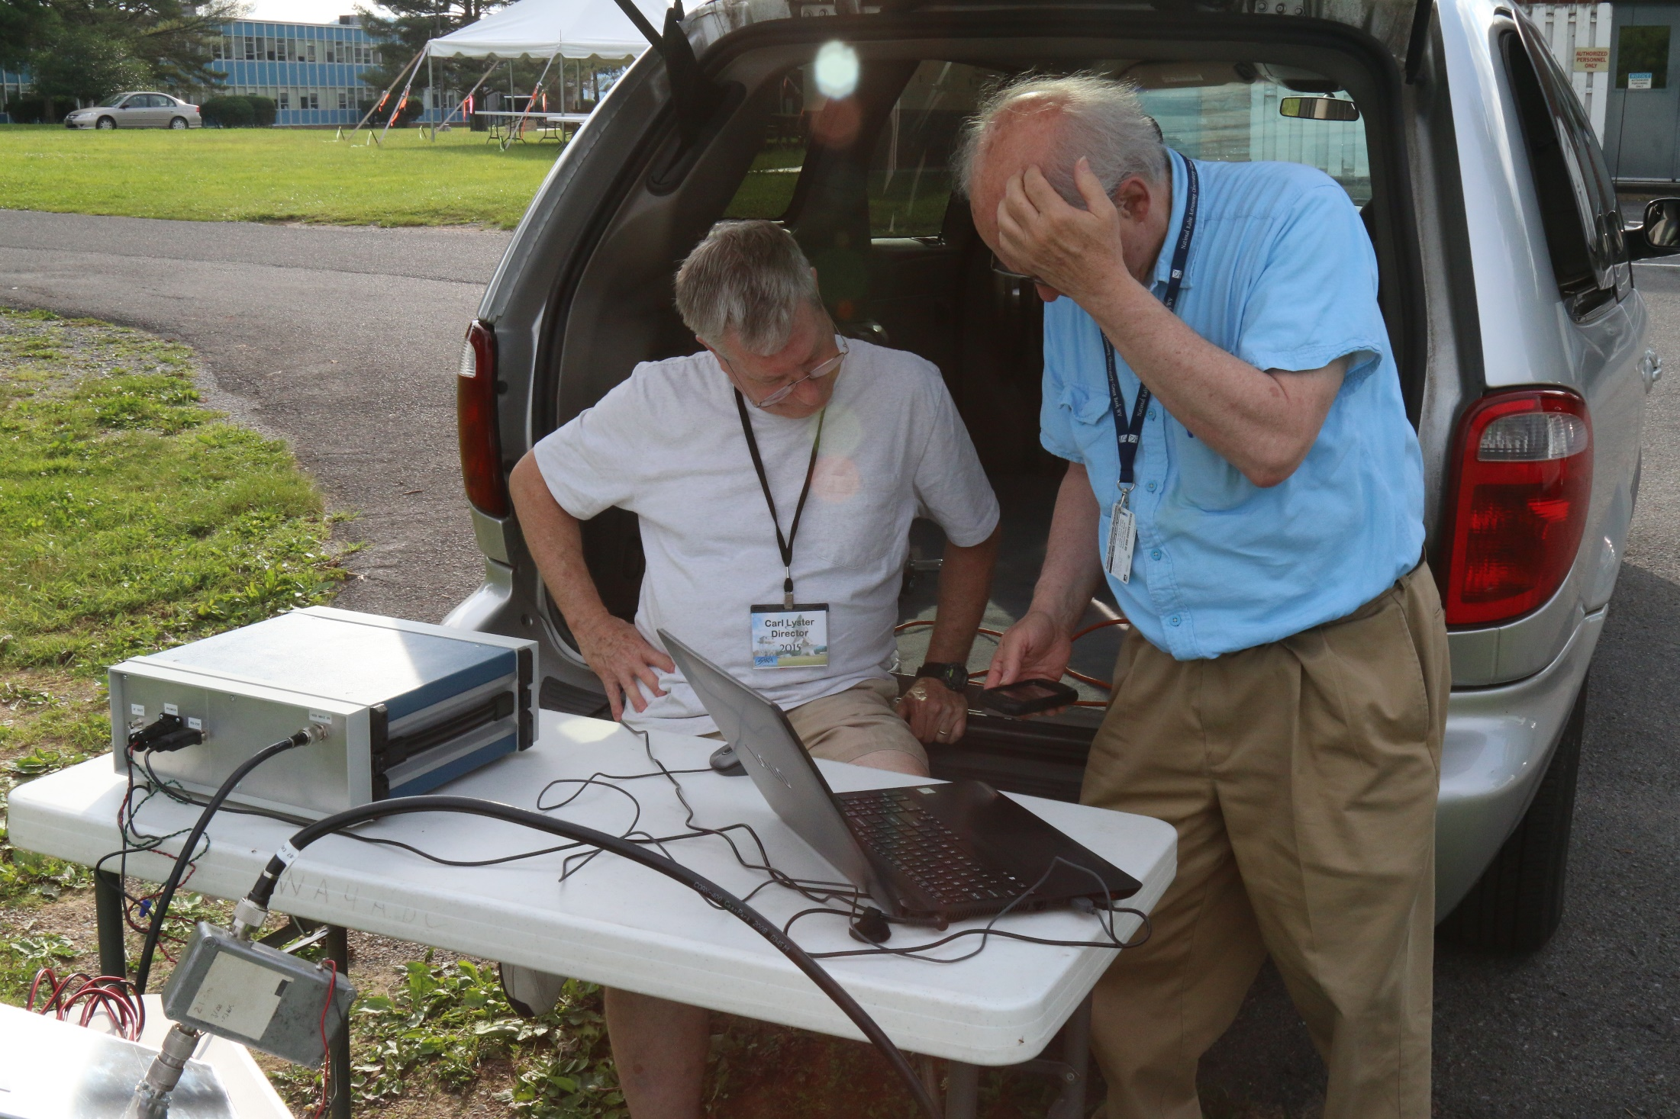

Slide 33
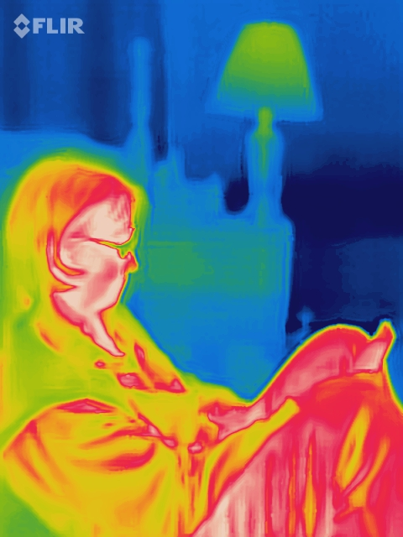

Slide 34
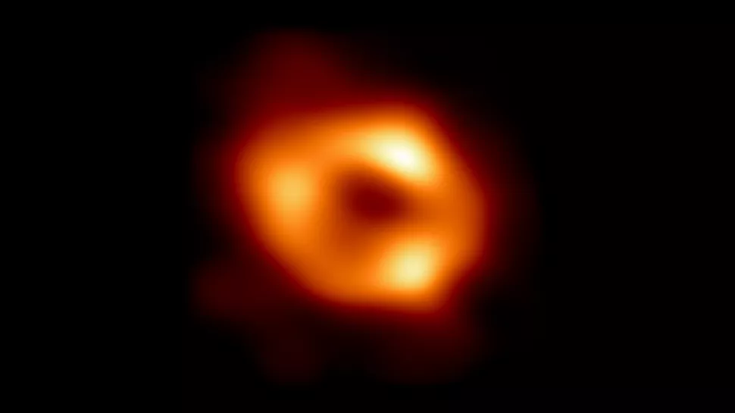

Slide 35
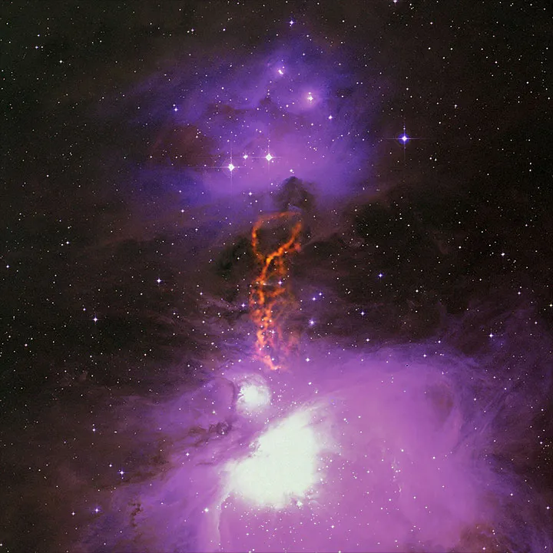

Slide 36
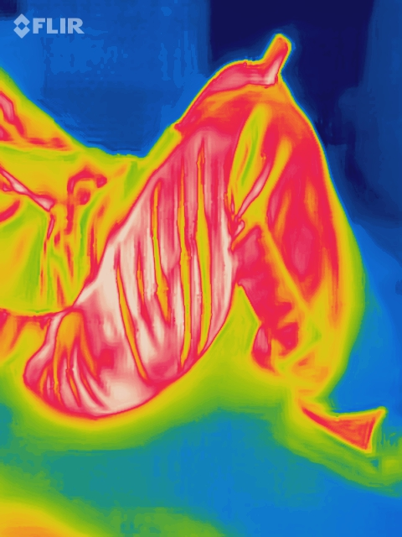

Slide 37
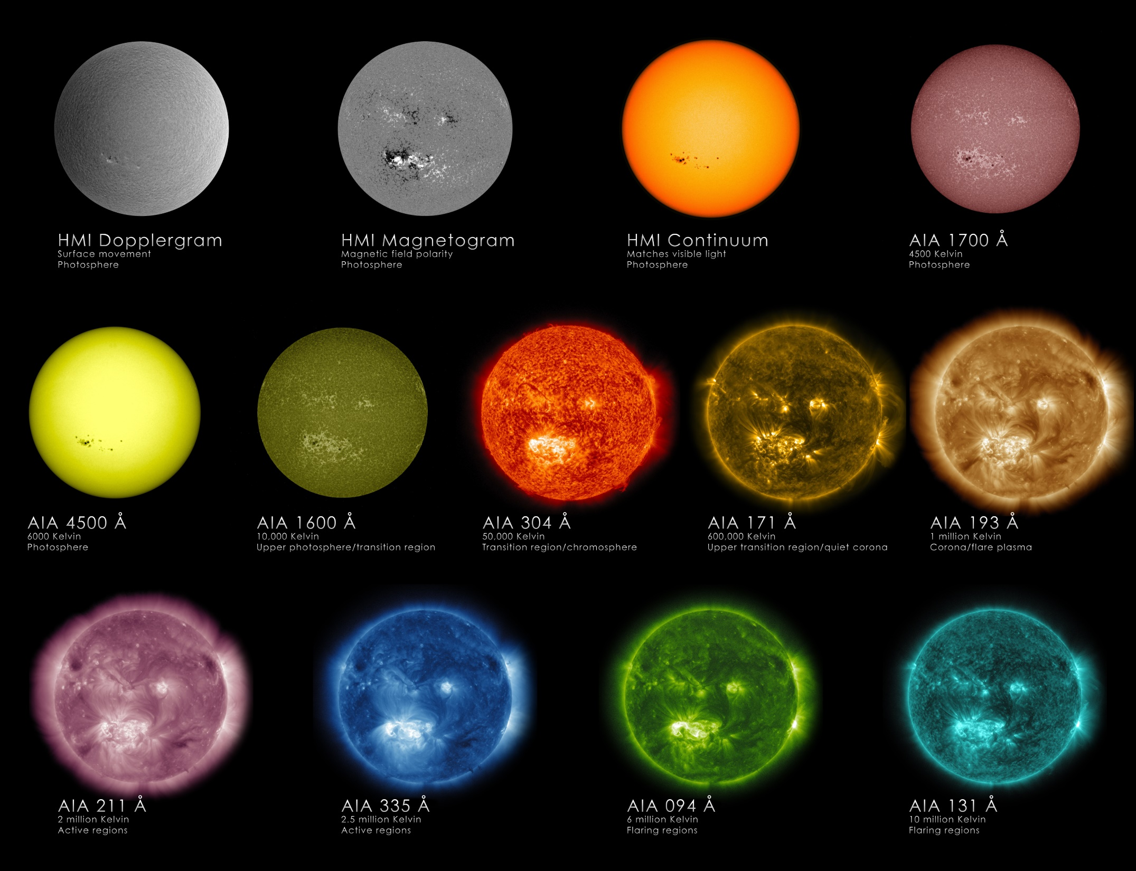

Slide 38
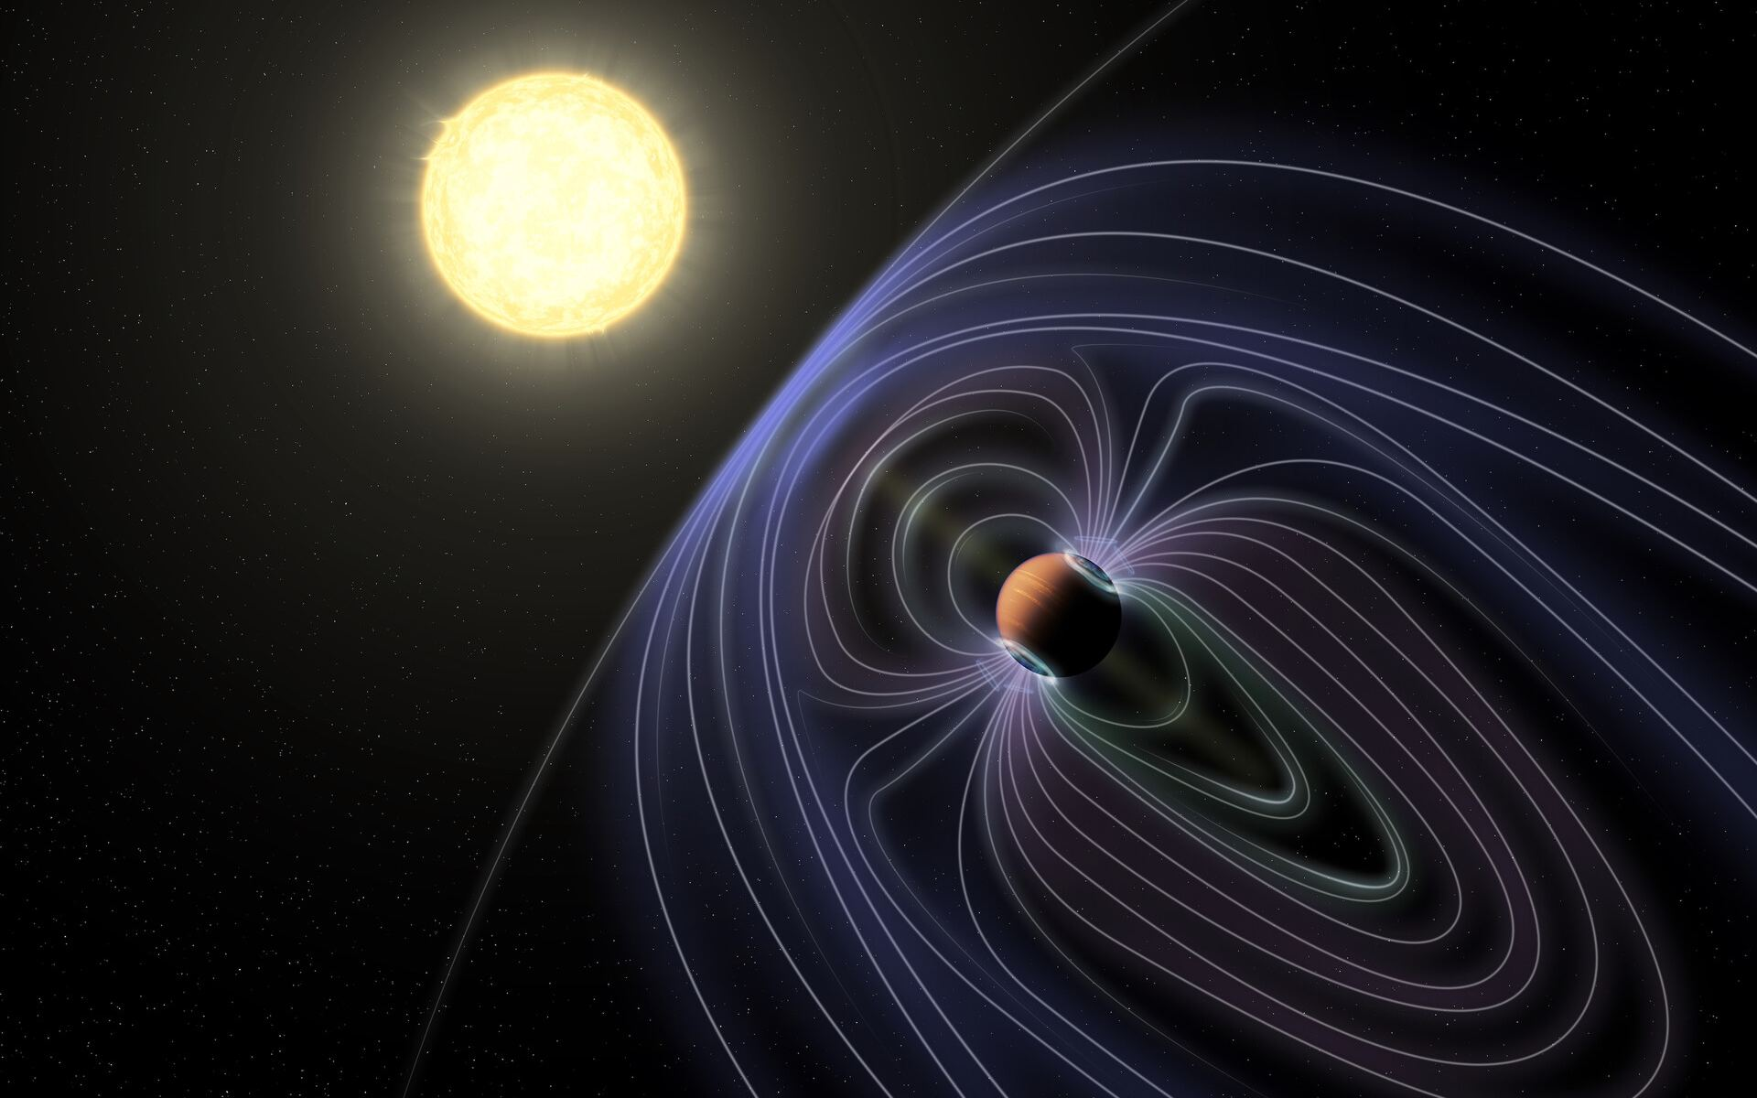

Slide 39
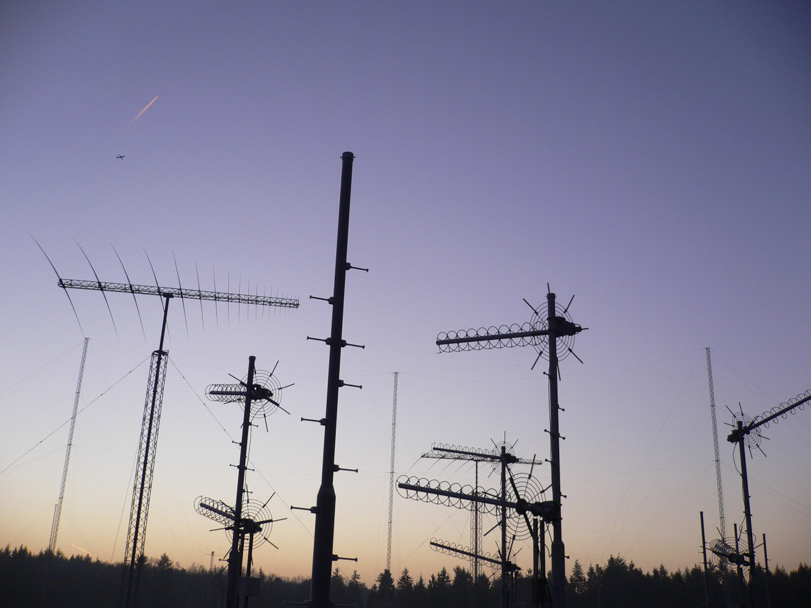
C-BAND Radio Astronomy

Slide 40
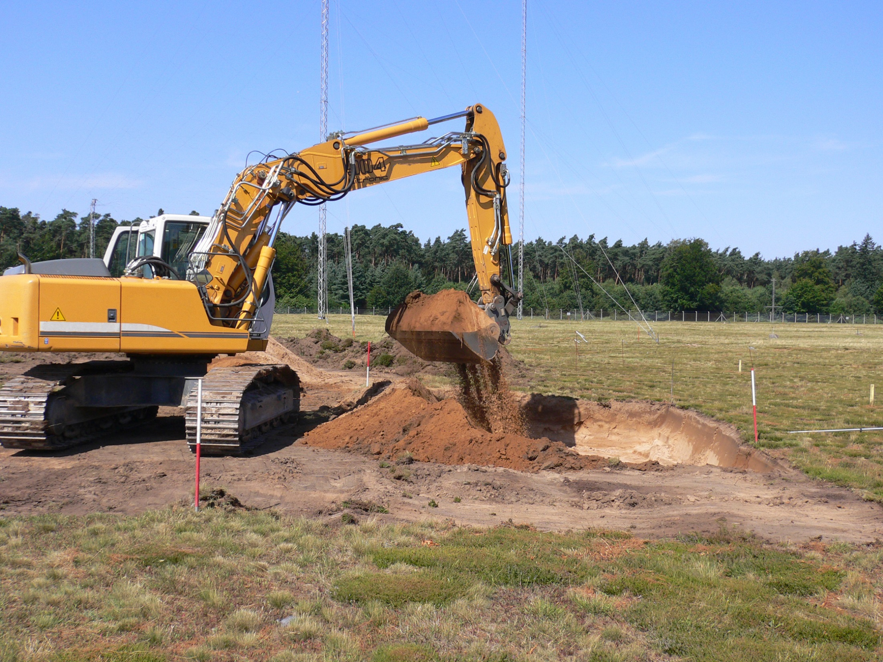

Slide 41
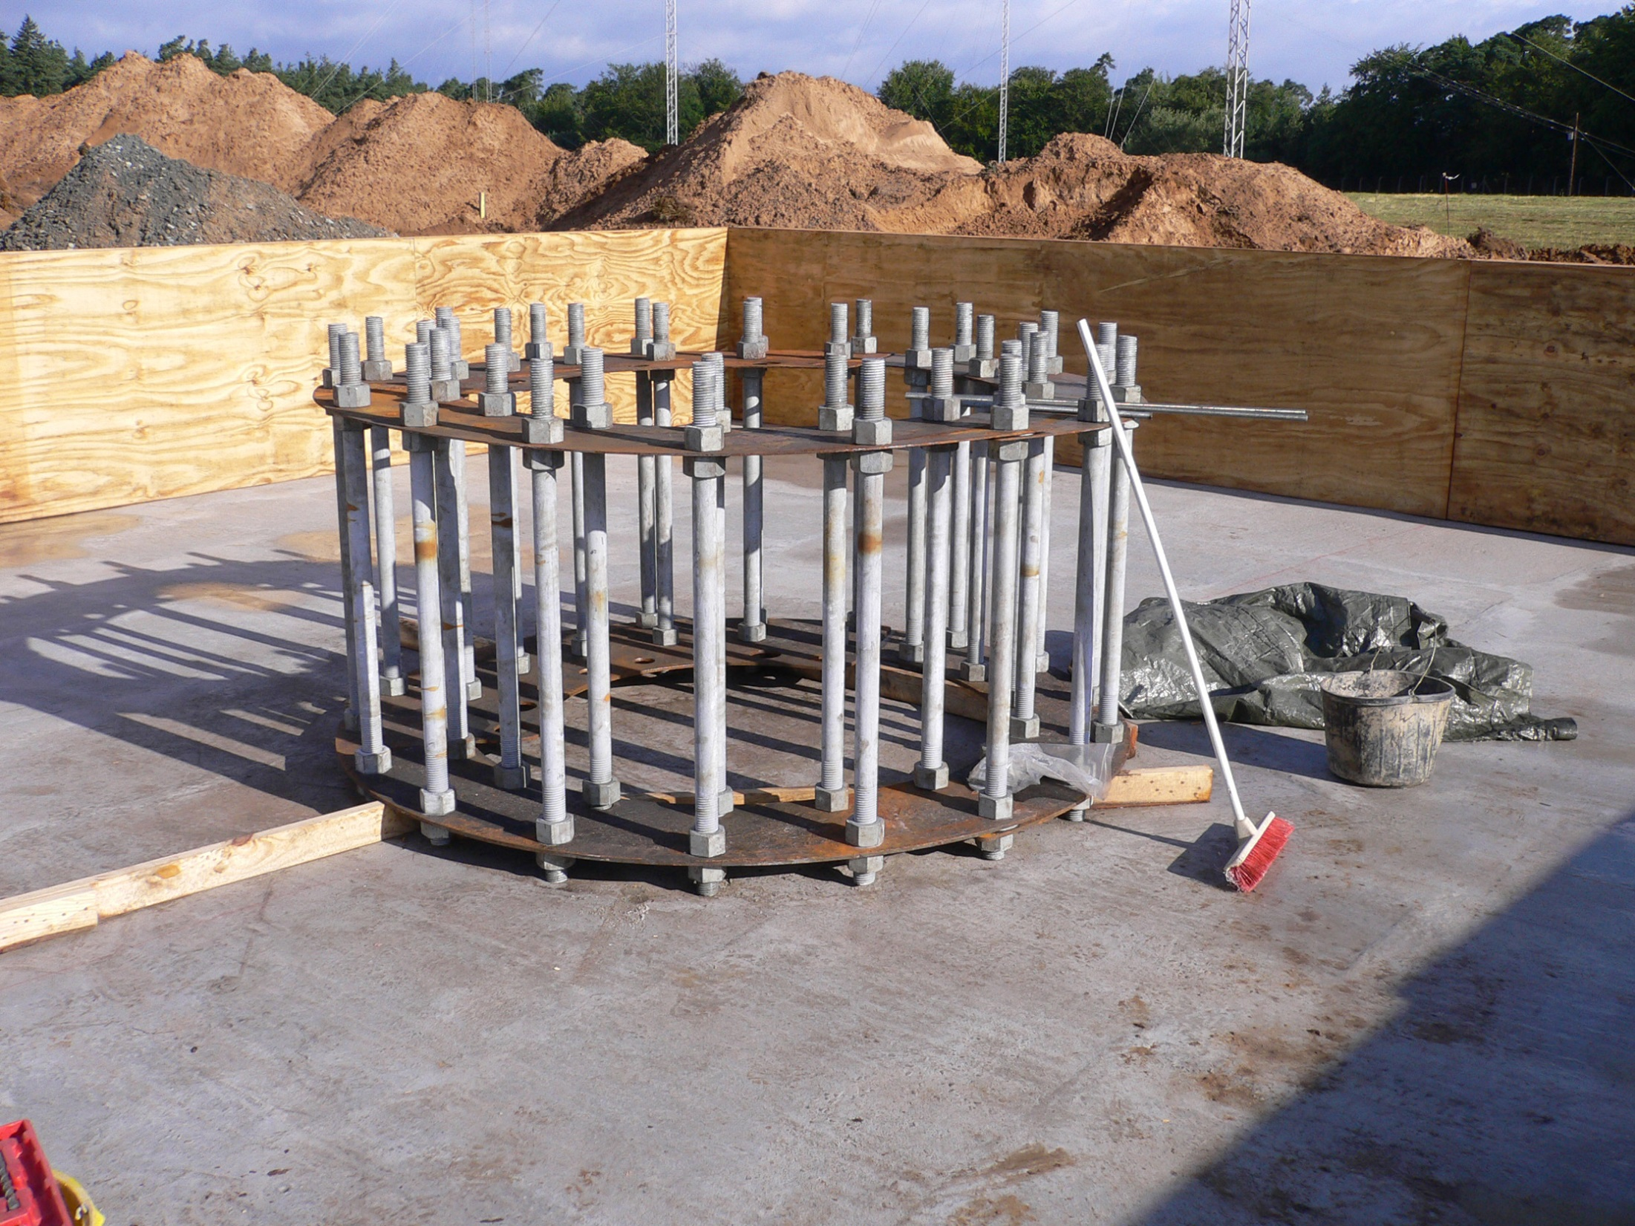

Slide 42
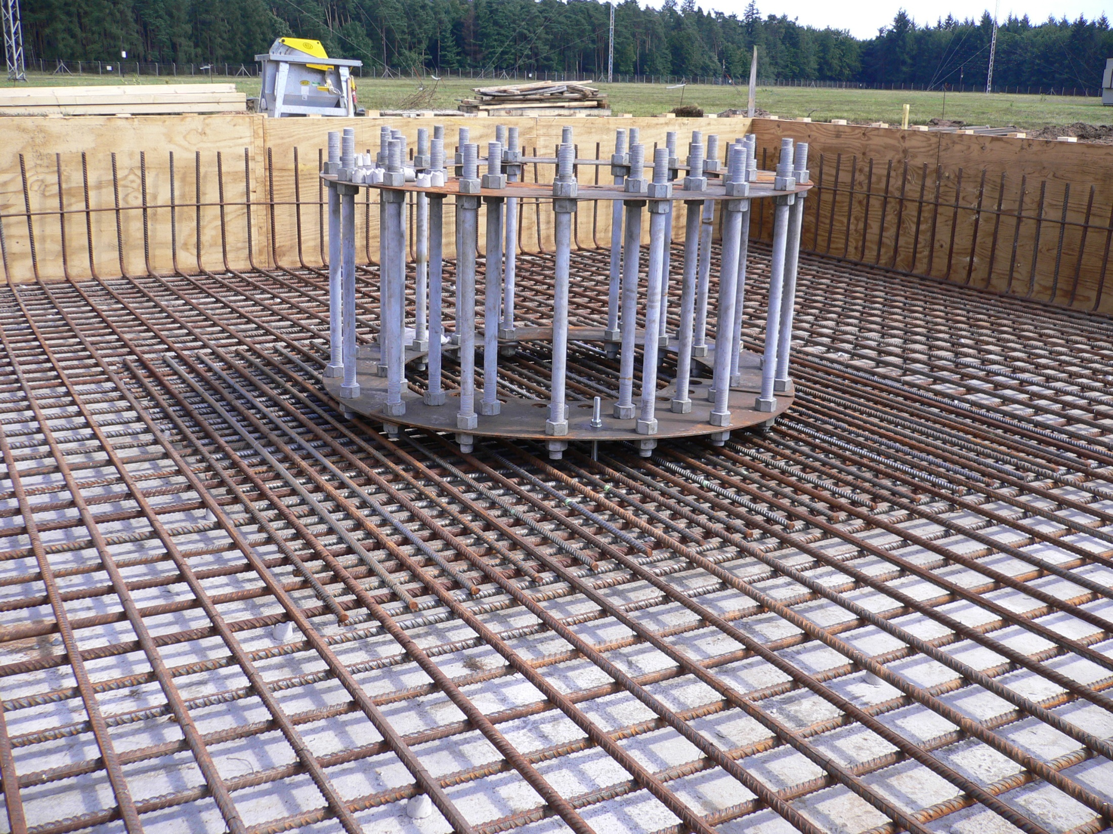

Slide 43
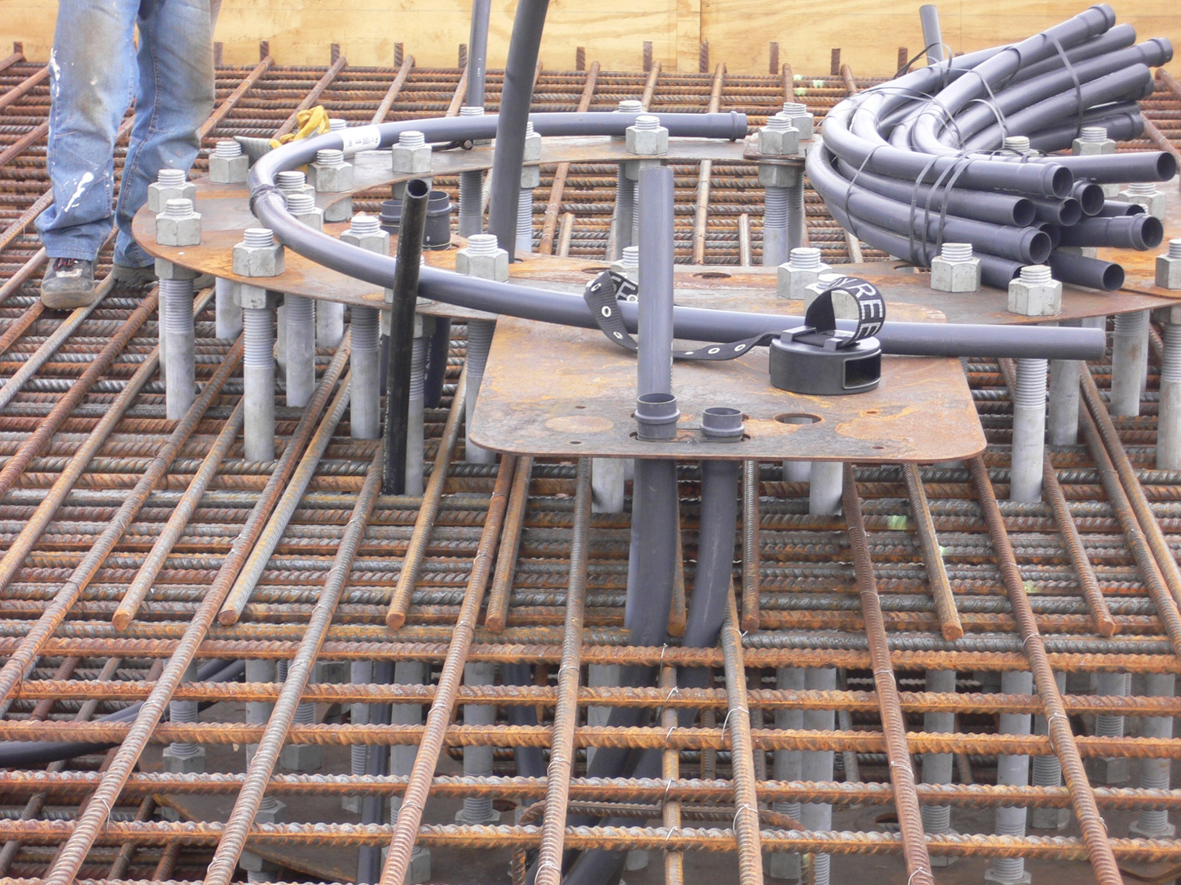

Slide 44
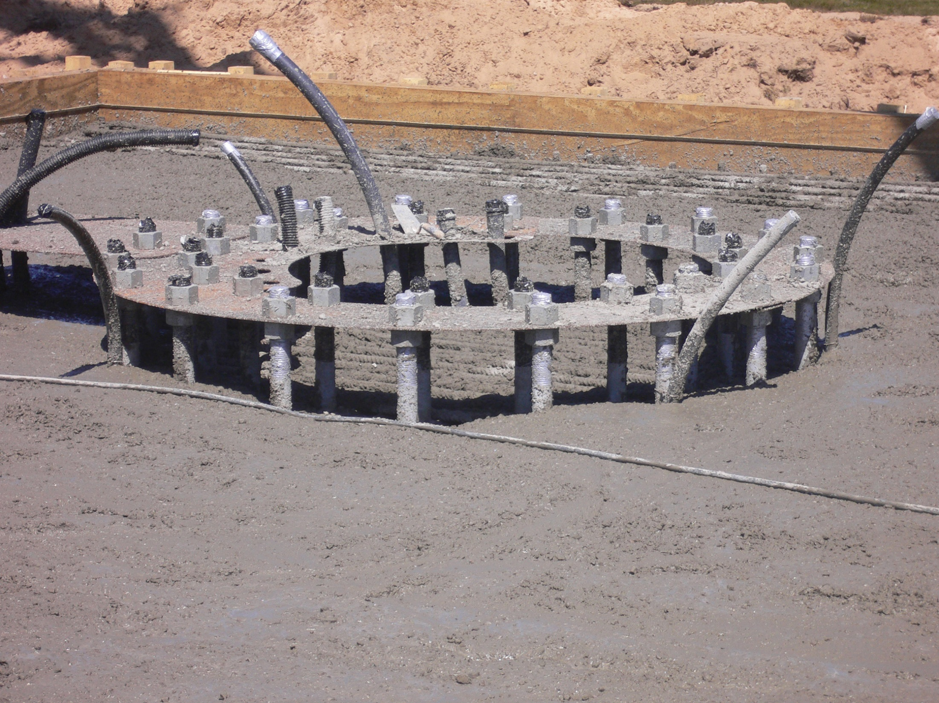

Slide 45
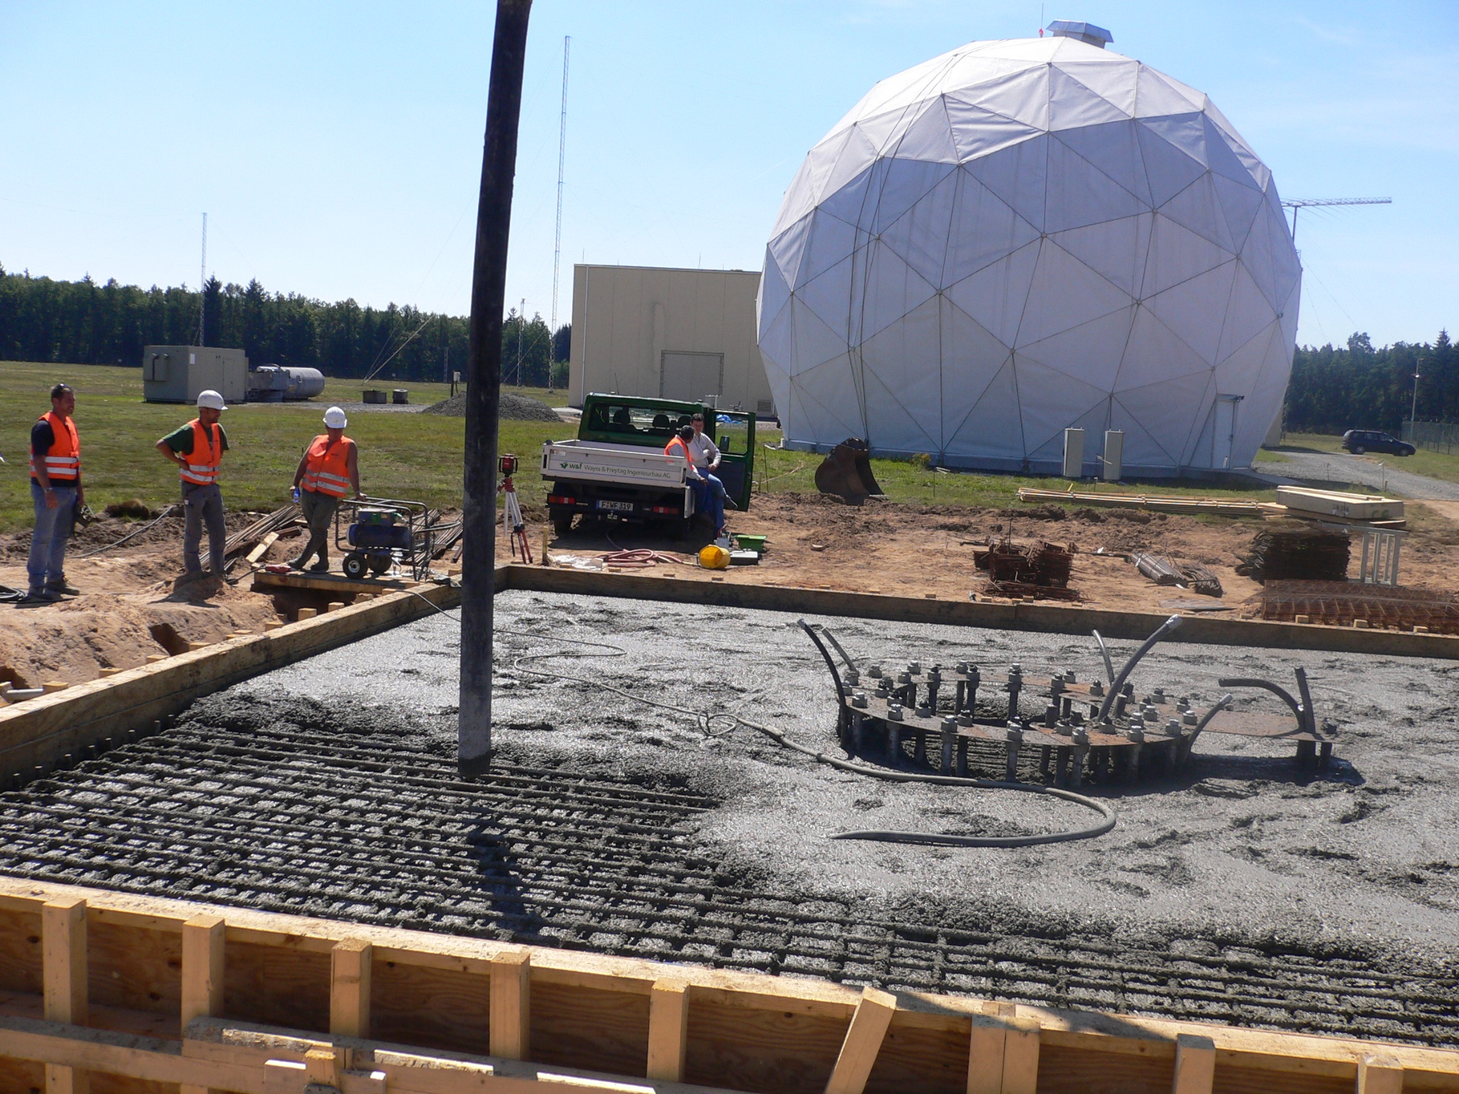

Slide 76
~7.4 cm

Slide 77
EQUIPMENT SETUP LIST
DISH LNA – Heliax to equipment shed @ C-BAND
Broadband commercial comm receiver tuned to C-BAND
Receiver IF output Centered 125 MHz – 200 MHz BW
Boonton model 92EA millivolt meter – Rear DC/Analog output
1 MHz to 1.2 GHz BW probe
DATAQ DI-158/U A/D conversion/interface
DATAQ WINDAQ software – recording and analysis
Toughbook Laptop
Audio recording/processing – Adobe Audition

Slide 78
File: 123007 1343 125 4025 34 29 L 1
Start: 12/30/2007 08:43:15
End: 12/31/2007 08:39:21
Target: 12/30/2007 21:40:37
Duration: 23:56:06
File Time: 12/31/2007 7:39 AM

Slide 80
File: 123107 1507 125 4020 34 29 L 1
Start: 12/31/2007 10:05:41
End: 01/01/2008 10:01:47
Target: 12/31/2007 21:36:35
Duration: 23:56:06
File Time: 1/1/2008 9:01 AM

Slide 82
File: 123107 1507 125 4020 34 29 L 2
Start: 01/01/2008 10:01:47
End: 01/02/2008 09:43:32
Target: 01/01/2008 21:32:42
Duration 23:41:45
File Time: 1/2/2008 8:43 AM

Slide 84
File: 122307 1853 125 4020 34 29 L 1
Start: 12/23/2007 13:53:24
End: 12/24/2007 13:49:30
Target: 12/23/2007 22:08:03
Duration: 23:56:06
File Time: 12/24/2007 1:49 PM

Slide 87
QUESTIONS?

