Slide 1
Virginia QSO Party Logging and Scoring
K2BFY HENRY

Slide 2
Virginia QSO Party Mission
Enable participants to have an enjoyable experience and get the highest possible scores.
Therefore, the log scoring process is in line with what the majority of participants put into their logs, except where the QSO committee disagrees.

Slide 3
Virginia QSO Party Goal
Our goal is to beat PA by having more participation in Virginia.
Last year PA received 648 logs and Virginia received 637 logs

Slide 4
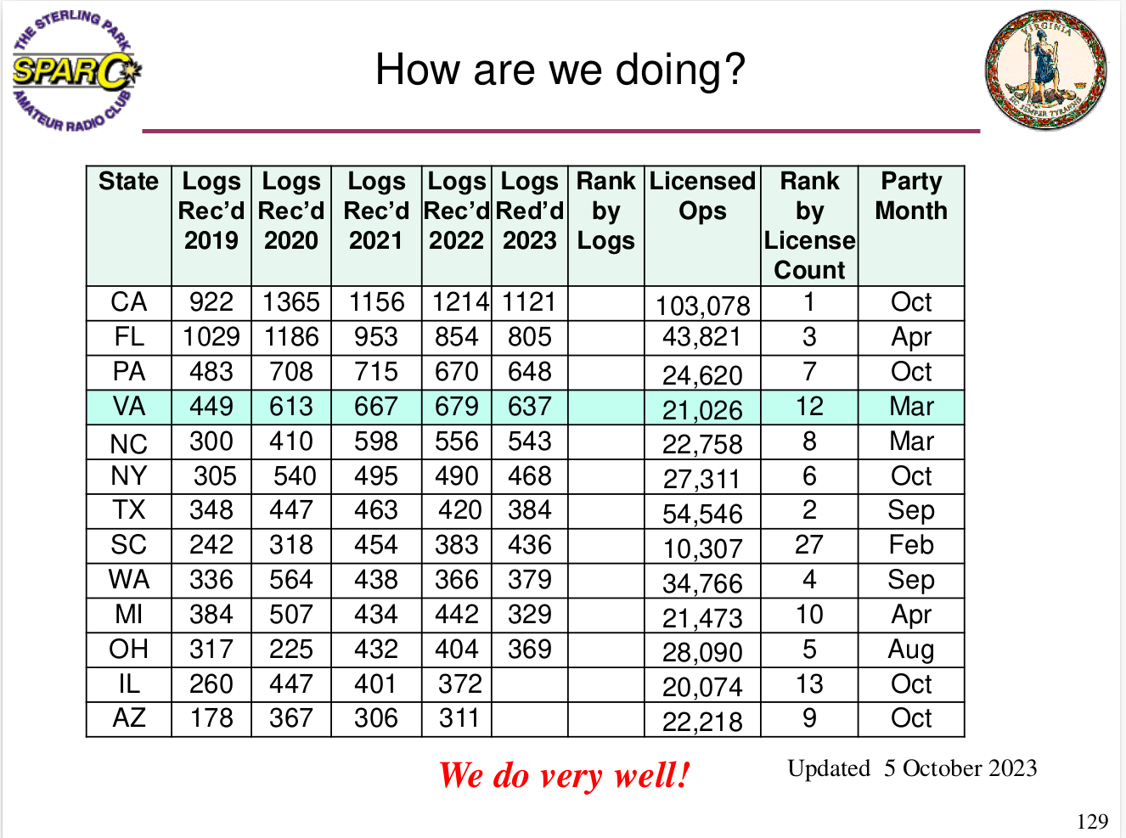

Slide 5
The scoring software contains a knowledge base with over 1,300,000 records.
There are close to 200 decisions in the algorithms required to calculate the score for one log.
This is all done with less than 2000 lines of code.
For comparison, Microsoft Windows is about 50 million lines of code.
Contest scoring algorithms are tribal knowledge.

Slide 6
The scoring software contains a knowledge base with over 1,300,000 records.
There are close to 200 decisions in the algorithms required to calculate the score for one log.
This is all done with less than 2000 lines of code.
For comparison, Microsoft Windows is about 50 million lines of code.
Contest scoring algorithms are tribal knowledge.
What could go wrong?

Slide 7
The fcculs “database” comprises most of the 1,300,000 records in the vqp database.
The Jim Reisert, AD1C, amateur radio country files consists of about 30,000 records. AD1C participates
in the Virginia QSO Party.
The vqp knowledge base is about 750 records that contain information that is specific to the Virginia QSO party.
All of this data reduced the number of lines of code required from about 10,000 lines to less than 2,000.

Slide 8
Every year I discover some arcane scoring rule that I missed, so I add a new rule to the scoring software. This could go on for an infinite number of years.
Infinity

Slide 9
Every year I discover some log error that I did not anticipate, so I add a new rule to the scoring software. This could go on for an infinite number of years.
errors

Slide 10
The database has 84 tables.
The database has 48 stored procedures.
The database SQL code implements close to 200 contest rules.

Slide 11
The database has 84 tables.
The database has 48 stored procedures.
The database SQL code contains close to 200 contest rules.
What could go wrong?

Slide 12
I created a database application to solve Wordle.
The database has 1 table.
There is 1 line of code.
It comes up with the correct solution every time even if only 3 letters in the word of the day are known.

Slide 13
I created a database application to solve Wordle.
The database has 1 table.
There is 1 line of code.
It comes up with the correct solution every time even if only 3 letters in the word of the day are known.
The QSO Party scoring software has 84 tables and 2000 lines of code.
What is wrong with this picture?

Slide 14
Virginia QSO Party Logging and Scoring
The contest is not over when you power off your transmitter.
What about the accuracy of your log?

Slide 15
Read the contest rules
qsl.net/sterling
SPARC Website

Slide 16
This is from the SPARC website for the 2023 QSO Party
Cabrillo Notes:
For Virginia Stations, mobiles, expeditions and rovers shall indicate LOCATION as VA MOBILE.
For example:
LOCATION: VA MOBILE
The CATEGORY-STATION shall be MOBILE, EXPEDITION, or ROVER.
For example:
CATEGORY-STATION: MOBILE
CATEGORY-STATION: EXPEDITION
CATEGORY-STATION: ROVER

Slide 17
Read the Cabrillo log format
https://wwrof.org/cabrillo/
Cabrillo Website

Slide 18
Check your log for errors
START-OF-LOG: 3.0
X-SO1R: YES
LOCATION: LDN
CALLSIGN: K2BFY
CATEGORY-BAND: 40M
CATEGORY-MODE: PH
CATEGORY-OPERATOR: SINGLE-OP
CATEGORY-POWER: LOW
(or NY or WV, etc. or DX or VA MOBILE)
(This should match your callsign in the QSO: records
(or ALL or some other band)

Slide 19
Check your log for errors
CATEGORY-STATION: FIXED
(or MOBILE or ROVER or EXPEDITION)
IF CATEGORY-STATION is missing, we cannot score the log.
This is a fatal error!

Slide 20
CATEGORY-OVERLAY: YOUTH
( or ROOKIE or TECH or EXTRA, etc. )
CATEGORY-TRANSMITTER: ONE
CERTIFICATE: YES
CLAIMED-SCORE: 42
CLUB: SPARC, LARG
CONTEST: Virginia QSO Party
CREATED-BY: gedit
NAME: Henry Weidman
ADDRESS: 123 My Street
ADDRESS: My City, Mars, 999
EMAIL: k2bfy@arrl.net
OPERATORS: K2BFY
For US stations, we get the address from the fcculs “database.”

Slide 21
Punctuation allowed in the Cabrillo file
: - / @
Space Colon Dash Slash At
Use anything else at your own risk because it could result in your log not being scored due to the fact that the scoring software may not handle any other punctuation.

Slide 22
Club Name Entries for LARG
LARG
Loudoun Amateur Radio Group
Loudoun Amateur Radio Group (LARG)
Loudoun Amateur Radio Group LARG
Loudoun ARC
Loudoun ARG
Loudoun ARG LARG
Loudoun County ARC
K4LRG
Could we just use LARG ???

Slide 23
QSO RECORDS
Note: Some callsigns in the following partial logs
have been changed, in order to protect
the people who submitted the logs.
I only want to show some log errors so that
we will not repeat these log errors.

Slide 24
QSO RECORDS
QSO: 40M PH 2023-03-18 1420 K2BFY 1 LDN W1AW 20 LDN
QSO: 40M PH 2023-03-18 1425 K2BFY 2 LDN K4CGY 33 ALB
QSO: 40M PH 2023-03-18 1430 K2BFY 3 LDN NX3A 47 SHE
QSO: 40M PH 2023-03-18 2022 K2BFY 4 LDN W4EO 510 FAU
QSO: 40M PH 2023-03-19 1422 K2BFY 5 LDN WB4MJF 446 ARL
QSO: 40M PH 2023-03-19 1429 K2BFY 6 LDN AJ4LN 329 LDN
QSO: 40M PH 2023-03-19 1435 K2BFY 7 LDN W4RKC 148 WIX
END-OF-LOG:
Note: US callsigns are searched for in the fcculs database, and callsigns that are
not found there, probably due to a typing error, will be
rejected. Last year, there were 477 callsign errors.

Slide 25
QSO RECORDS
Note: The Cabrillo log standard states that the fields of data in the
QSO records must start and end at specific character
locations. We do not require that for the Virginia QSO Party.
However we do require that the 11 fields of data are in the
order shown here.
freq/ ------your---------- --------other-----------
tag band mode date time call num qth call num qth
QSO: 40M PH 2023-03-19 1435 K4ABC 7 PAG K2BFY 148 LDN

Slide 26
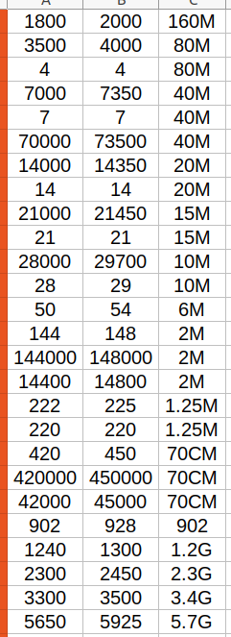
Frequency to Band
Conversion

Slide 27
Cabrillo: freq is frequency or band
1800 or actual frequency in kHz
3500 or actual frequency in kHz
7000 or actual frequency in kHz
14000 or actual frequency in kHz
21000 or actual frequency in kHz
28000 or actual frequency in kHz
50
70
144
222
432
902
1.2G
2.3G
3.4G
5.7G

Slide 28
Cabrillo
160M
80M
40M
20M
15M
10M
6M
4M
2M
222
432
902
1.2G
2.3G
3.4G
5.7G
VA QSO Party
160M
80M
40M
20M
15M
10M
6M
N/A
2M
1.25M
70CM
902
1.2G
2.3G
3.4G
5.7G
Correct Band
Nomenclature

Slide 29
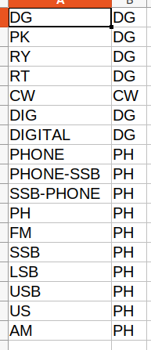
CATEGORY-MODE: Should be PH, CW, or DG
The mode table contains the data shown in the screenshot.
Note that the correct modes are CW, DG, and
PH.

Slide 30
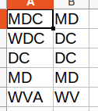
Note that DC and MD are now separate entities.
The preferred log entries are DC, MD, or the
special case for WV is WVA.
This is just another one of the 28 VA QSO Party specific knowledge base files.

Slide 31
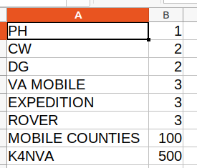
Note that MOBILE, EXPEDITION, and ROVER
have the same number of points.
Bonus station K4NVA is worth 500 points.
MOBILE, EXPEDITION, and ROVER stations receive 100 points for each city/county they
operate from.
From a scoring perspective, MOBILE, EXPEDITION, and ROVER stations are scored the same.

Slide 32
Note that AK and HI are considered countries.

Slide 33
Other knowledge base files include:
- U.S. 2 letter state abbreviations
- Virginia 3 letter city/county abbreviations
- Country prefix list
- Canadian Province list
- Cabrillo log format specification
- Names of radio clubs that have participated in the contest
- fcculs data
- List of Radio Clubs in the fcculs “database” (23452) (NOT USED)

Slide 34
Output files include:
- vqp.log (List of all log errors, indexed by callsign
- vqp.qth (List of all QTH abbreviations and country names)
- vqp.rpt (How the score was calculated for each log)
- vqp.csv (The report that is published on the SPARC website)
- vqpMetaData.csv
(numQso,counties,provinces,states,territories,dx,cw,ph,dg,fixed,mobile)
- countyMetaData.csv (Number of QSOs in each Virginia city/county)
- scoreReport.csv (Individual scores for all logs)
We have a very sophisticated database system

Slide 35
QSO RECORDS
QSO: 40M PH 2023-03-18 1420 K2BFY 1 LDN W1AW 20 LDN
QSO: 40M PH 2023-03-18 1425 K2BFY 2 LDN K4CGY/AE 33 ALB
QSO: 40M PH 2023-03-18 1430 K2BFY 3 LDN NX3A/9 47 IL
QSO: 40M PH 2023-03-18 2022 K2BFY 4 LDN W4EO/R 510 FAU
QSO: 40M PH 2023-03-19 1422 K2BFY 5 LDN WB4MJF/E 446 ARL
QSO: 40M PH 2023-03-19 1429 K2BFY 6 LDN AJ4LN 329 LDN
QSO: 40M PH 2023-03-19 1435 K2BFY 7 LDN W4RKC/M 148 WIX
END-OF-LOG:
We don’t care if a station is /AE or /9.
/R and /E stations are scored the same as /M.

Slide 36
QSO RECORDS
QSO: 40M PH 2023-03-18 1420 K2PFF 1 LDN KP4ABO 20 NC
QSO: 40M PH 2023-03-18 1425 K2PFF 2 LDN KP4AAM 33 HI
QSO: 40M PH 2023-03-18 1430 K2PFF 3 LDN KP4AI 47 AK
QSO: 40M PH 2023-03-18 2022 K2PFF 4 LDN KP4AAC 510 DX
QSO: 40M PH 2023-03-19 1422 K2PFF 5 LDN KP4AA 446 DX
QSO: 40M PH 2023-03-19 1429 K2PFF 6 LDN KP4ANG 329 MA
QSO: 40M PH 2023-03-19 1435 K2PFF 7 LDN KP4AIC 148 LDN
QSO: 40M PH 2023-03-19 1435 K2PFF 8 LDN 2R0TMR 123 LDN
END-OF-LOG:
KP4 Calls are Puerto Rico

Slide 37
EXAMPLE QTH ERRORS
VE3KOT 60 DX
K4Z 155 DUM
K4CGY 3 003
VE9VIC 90 NX
BK1BIF 14 VT
W4CA 124 BATH
CF3A 774 DX
NOTE: CF3A is a Canadian call sign therefore the QTH
should be the province abbreviation. This also
applies to VE3KOT.
In over 600 logs, there were 169 QTH errors and 477
CALLSIGN errors.

Slide 38
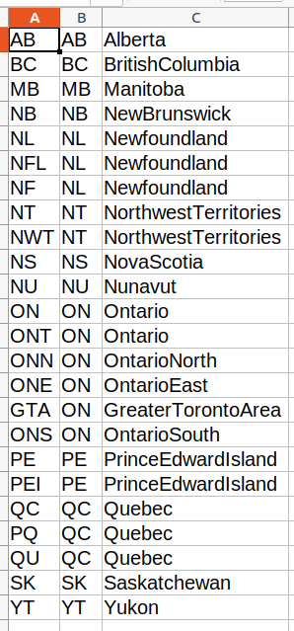
Canadian Province Abbreviations
A: Logged Abbreviation
B: Correct Abbreviation
C: Province Name

Slide 39
Some Callsign (vqp.rpt)
category FIXED
club NONE
Score Calculation
qso 1178
cw 205
ph 779
va mobile 194
bad 82
qso points 1771
Multipliers
counties 106
states 43
provinces 4
countries 5
city_county_10 0
mult 158
Bonus Points
mobile_counties ( 00) 0
bonus Stations 0
This station lost points due to bad QSO records. A large number of the QSO records had
a Virginia county abbreviation of PWC, probably instead of PRW. There were also a large number of duplicate QSO records. Used N1MM logging program.

Slide 40
QSO: 14000 CW 2023-03-19 2041 W?XXX 1942 CRA LA8OM 0049 LA
Note that LA8OM is not a Lousiana station, it is DX located in Norway
This is another good example of a QSO entry that could have been easily fixed if someone had checked their log file.
Don’t forget to check the log header items:
CATEGORY MODE: CW
Also, even though this station stated that the mode was CW, there was one phone
contact in the log so the mode should have been MIXED.

Slide 41
QSO: 21018 CW 2023-03-18 1813 A9XX/4 0321 LDN HK4/KC1XX 0227 DX
Notes:
(1) There is no reason to enter your callsign/4. The log header already states
your location.
(2) The correct method to enter someone working in a foreign state is shown.

Slide 42
QSO: 21018 CW 2023-03-18 1813 A9XX 0321 LDN KC1XX 0227
Notes:
(1) What is wrong with this QSO: record?

Slide 43
QSO: 21018 CW 2023-03-18 1813 A9XX 0321 LDN KC1XX 0227
Notes:
(1) What is wrong with this QSO: record?
(2) The qth column is missing

Slide 44
Notes:
(1) Last year there were a total of 84707 QSOs.
(2) There were 477 bad callsigns. US calls are
checked for validity by searching for the
callsign in the fcculs database. This is a very
low error rate. Not bad if the errors
are not in your log.
(3) Try to type correct callsigns into your log and
do not type:
K92XXX for example.

Slide 45
STX,3,Staunton
FCX,4,Falls Church
ESS,9,Essex
EMX,12,Emporia
WAX,13,Waynesboro
SUS,19,Sussex
PBX,19,Petersburg
CHA,25,Charlotte
DAX,30,Danville
PRG,35,Prince George
COX,37,Colonial Heights
NRX,37,Norton
GOO,40,Goochland
KWM,42,King William
LUN,46,Lunenburg
LYX,46,Lynchburg
BVX,48,Buena Vista
FRX,48,Franklyn
DIN,49,Dinwiddie
RIX,50,Richmond
GRA,50,Grayson
KQN,55,King & Queen
HAL,57,Halifax
CHX,58,Charlottsville
GIL,58,Giles
POX,62,Portsmouth
GAX,64,Galax
HBX,65,Harrisonburg
GLO,74,Glouchester
BCH,77,Buchanan
BOT,77,Botetourt
NEW,78,New Kent
CLN,80,Caroline
RIC,83,Richmond
WIS,84,Wise
LEX,87,Lexington
TAZ,87,Tazewell
RUS,89,Russell
WMX,96,Williamsburg
BRU,99,Brunswick
Counties with the fewest
contacts last year.

Slide 46
WAS,470,Washington
CPX,480,Chesapeake
AMH,483,Amherst
MON,487,Montgomery
YOR,525,York
ACC,529,Accomack
CVX,542,Covington
VBX,583,Virginia Beach
ARL,658,Arlington
ALB,695,Albemarle
BED,717,Bedford
PAG,739,Page
ORG,787,Orange
JAM,787,James City
AUG,820,Augusta
FBX,869,Fredericksburg
RHM,872,Rockingham
WYT,895,Wythe
SHE,895,Shenandoah
FRA,930,Franklin
KGE,1038,King George
PUL,1065,Pulaski
CHE,1078,Chesterfield
NUM,1084,Northumberland
FRE,1095,Frederick
CUL,1130,Culpeper
HAN,1204,Hanover
LAN,1424,Lancaster
PRW,2143,Prince William
LDN,2464,Loudoun
FFX,2785,Fairfax County
FAU,4225,Fauquier
Counties with the most
contacts last year.

Slide 47
THE END
QUESTIONS

