Slide 1
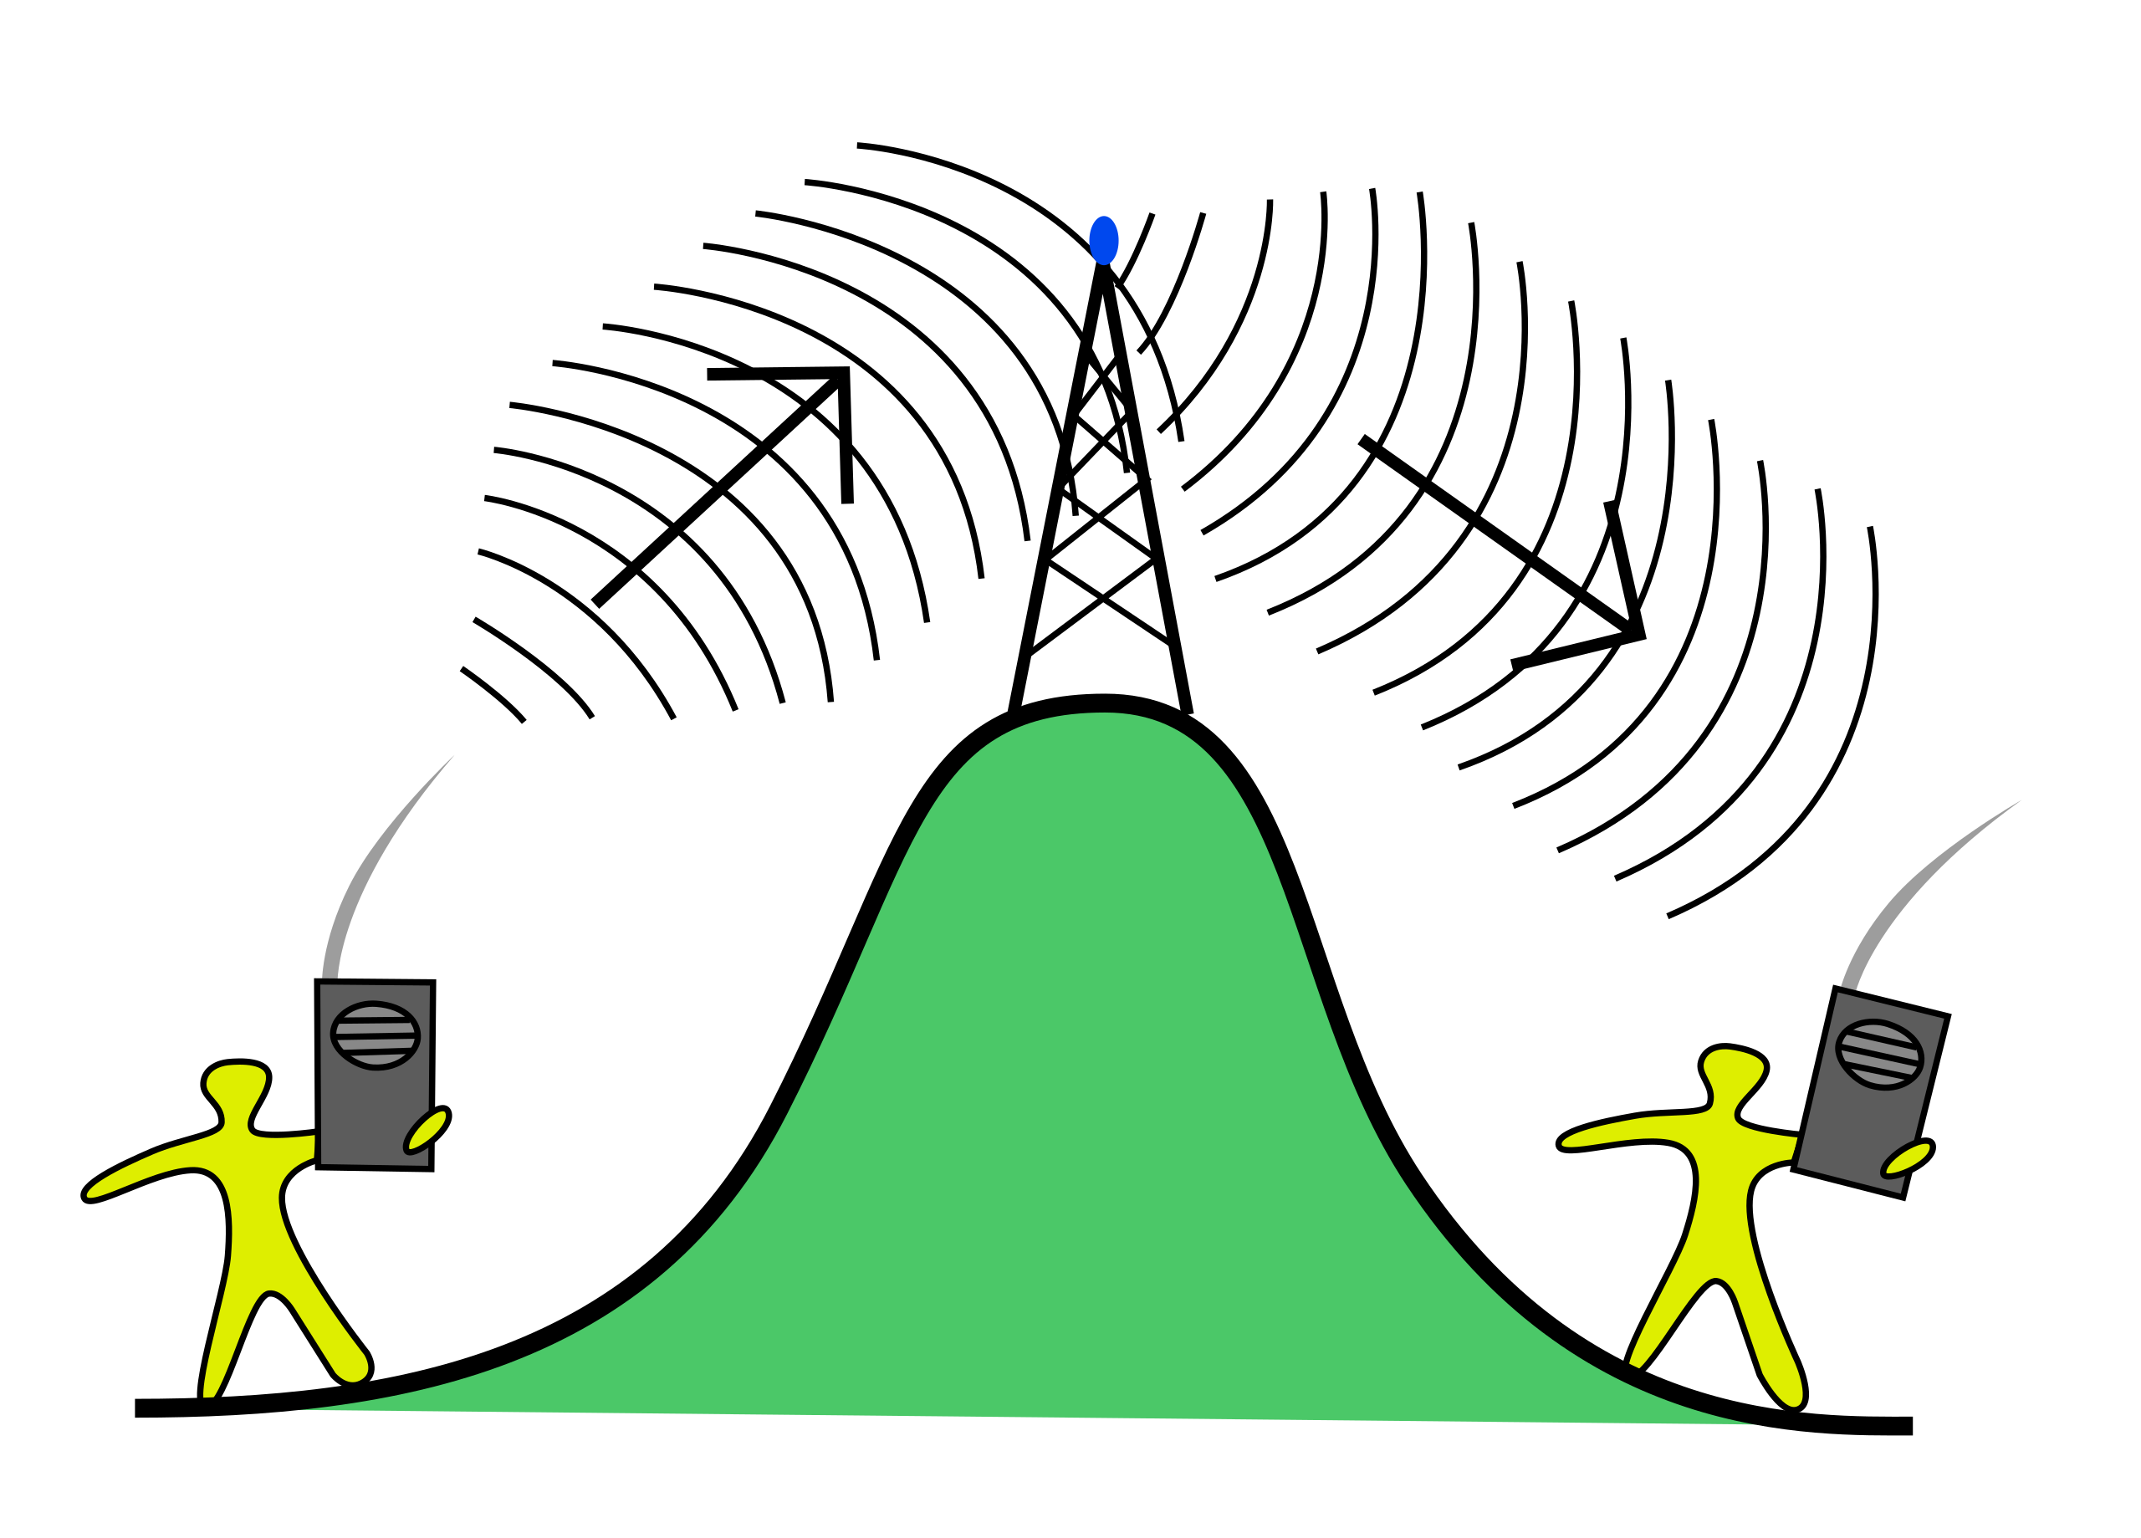
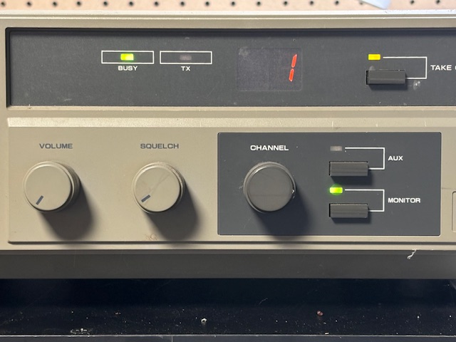
Welcome to the WA4 TXE repeater OVERVIEW
5
This Photo by Unknown Author is licensed under CC BY-NC

Slide 2
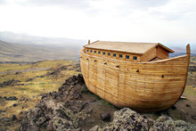
TITANIC BUILT BY “EXPERTS”-NOAHS ARK BUILT BY AMATEURS

Slide 3
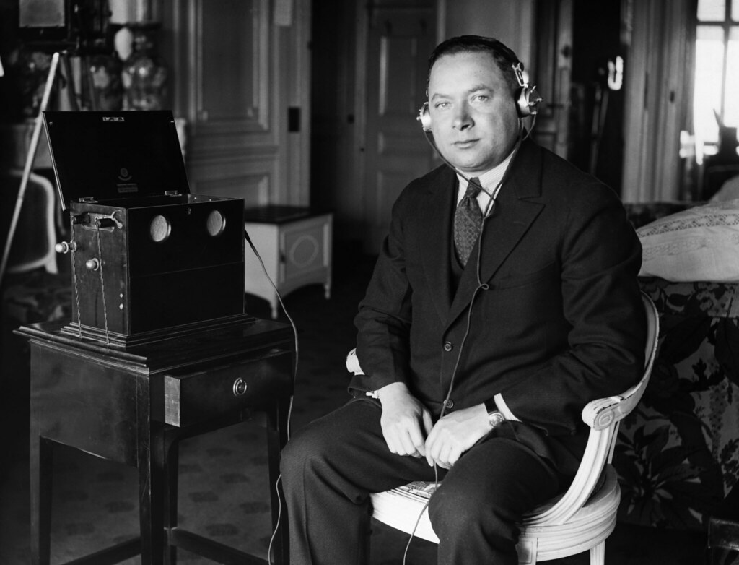
TITANIC DISTRESS CALL HEARD BY AMATEUR DAVID SARNOFF USING HOME BUILT EQUIPMENT

Slide 4
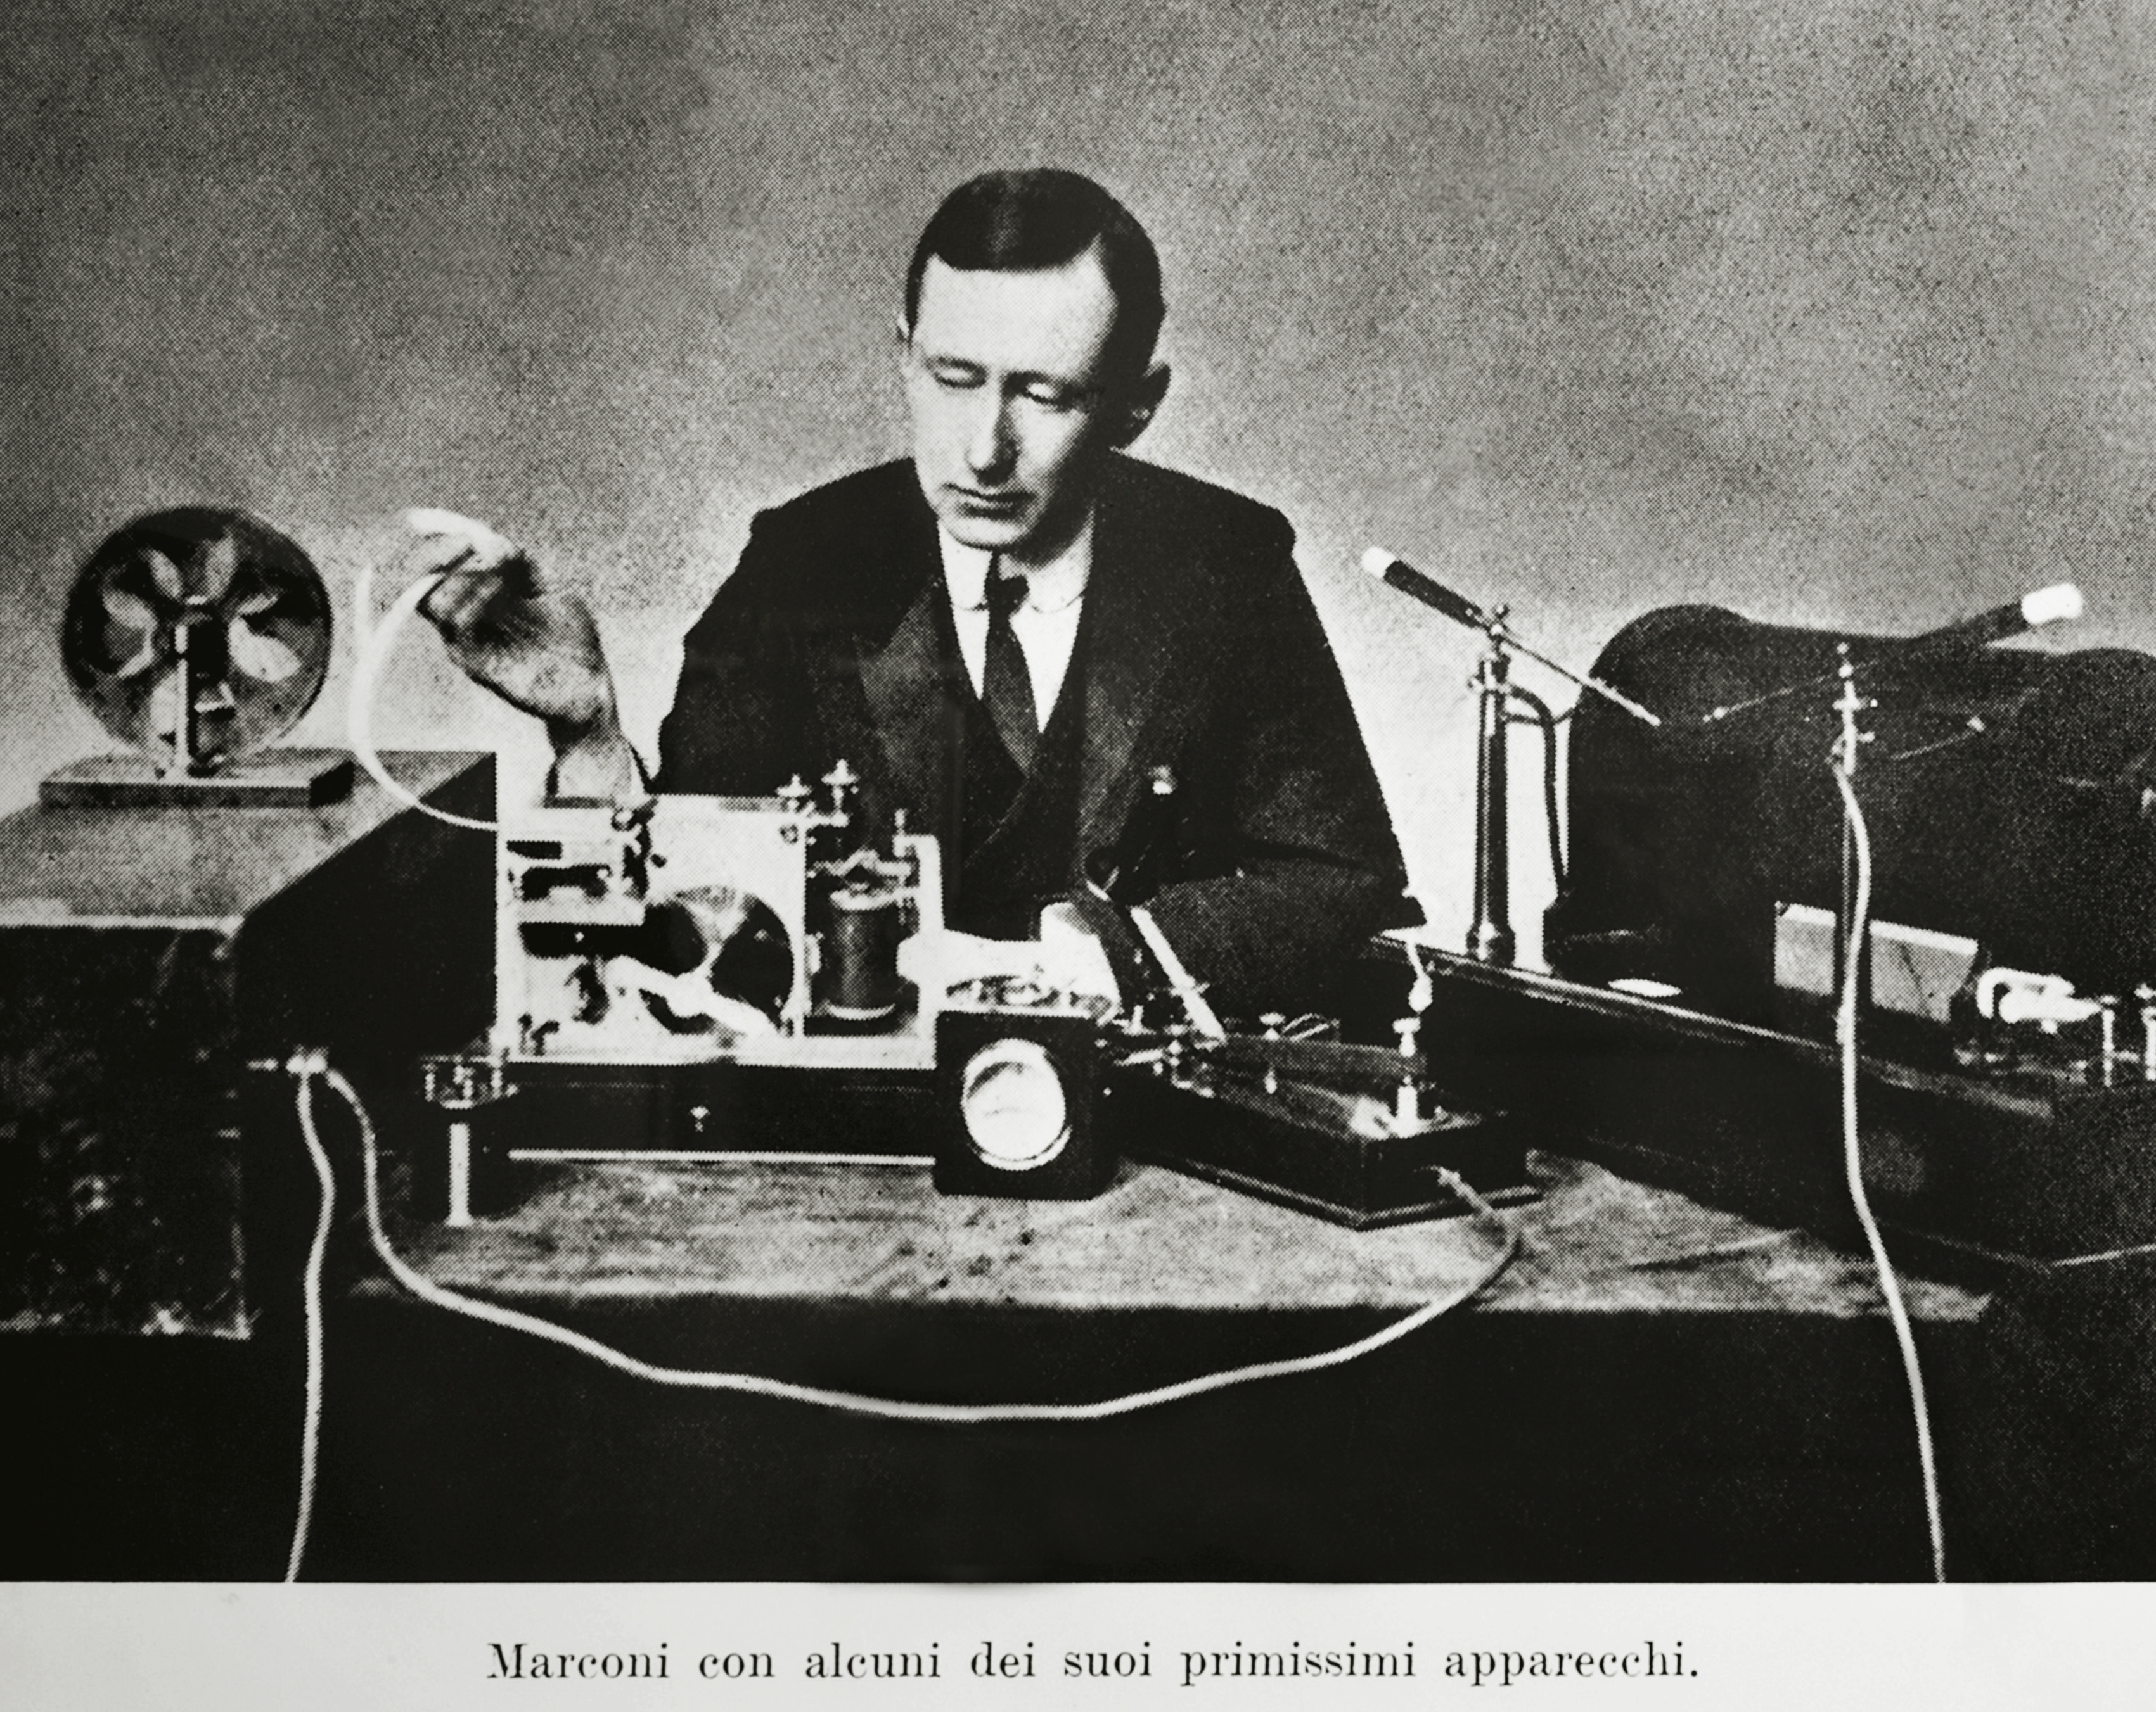
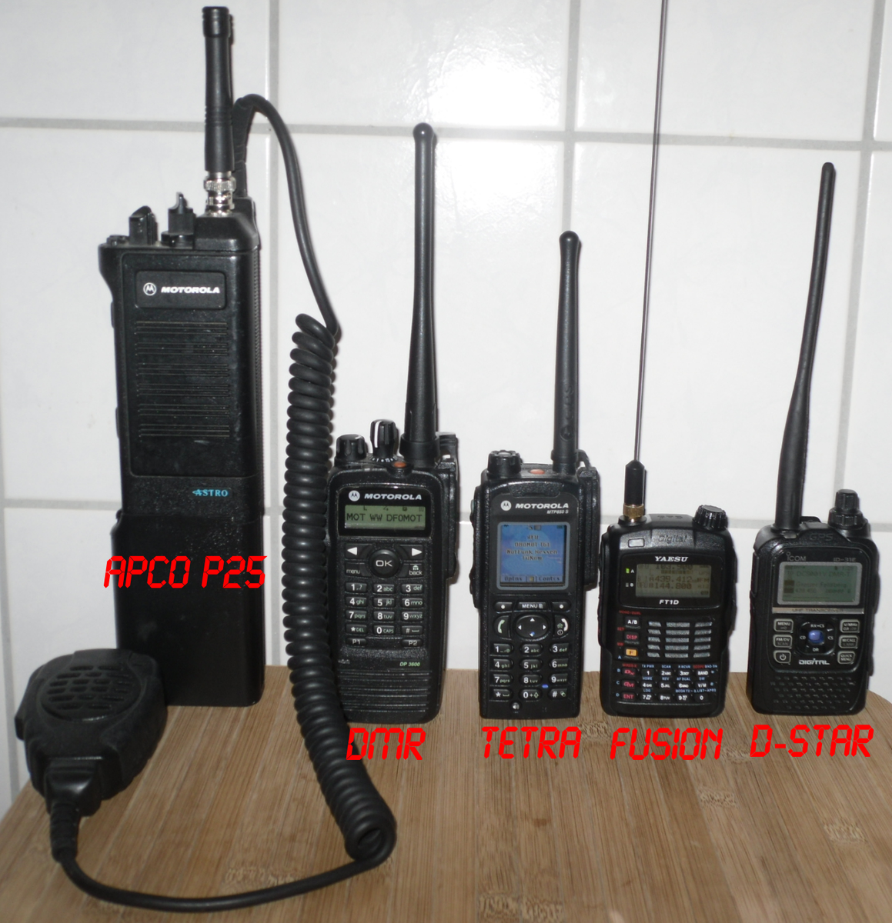
Technology has evolved
5 tips for a simpler way toork
This Photo by Unknown Author is licensed under CC BY-NC
This Photo by Unknown Author is licensed under CC BY-SA-NC

Slide 5
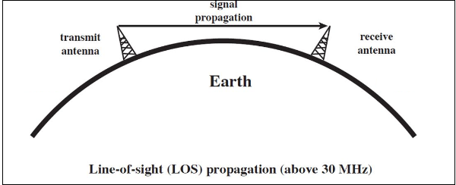
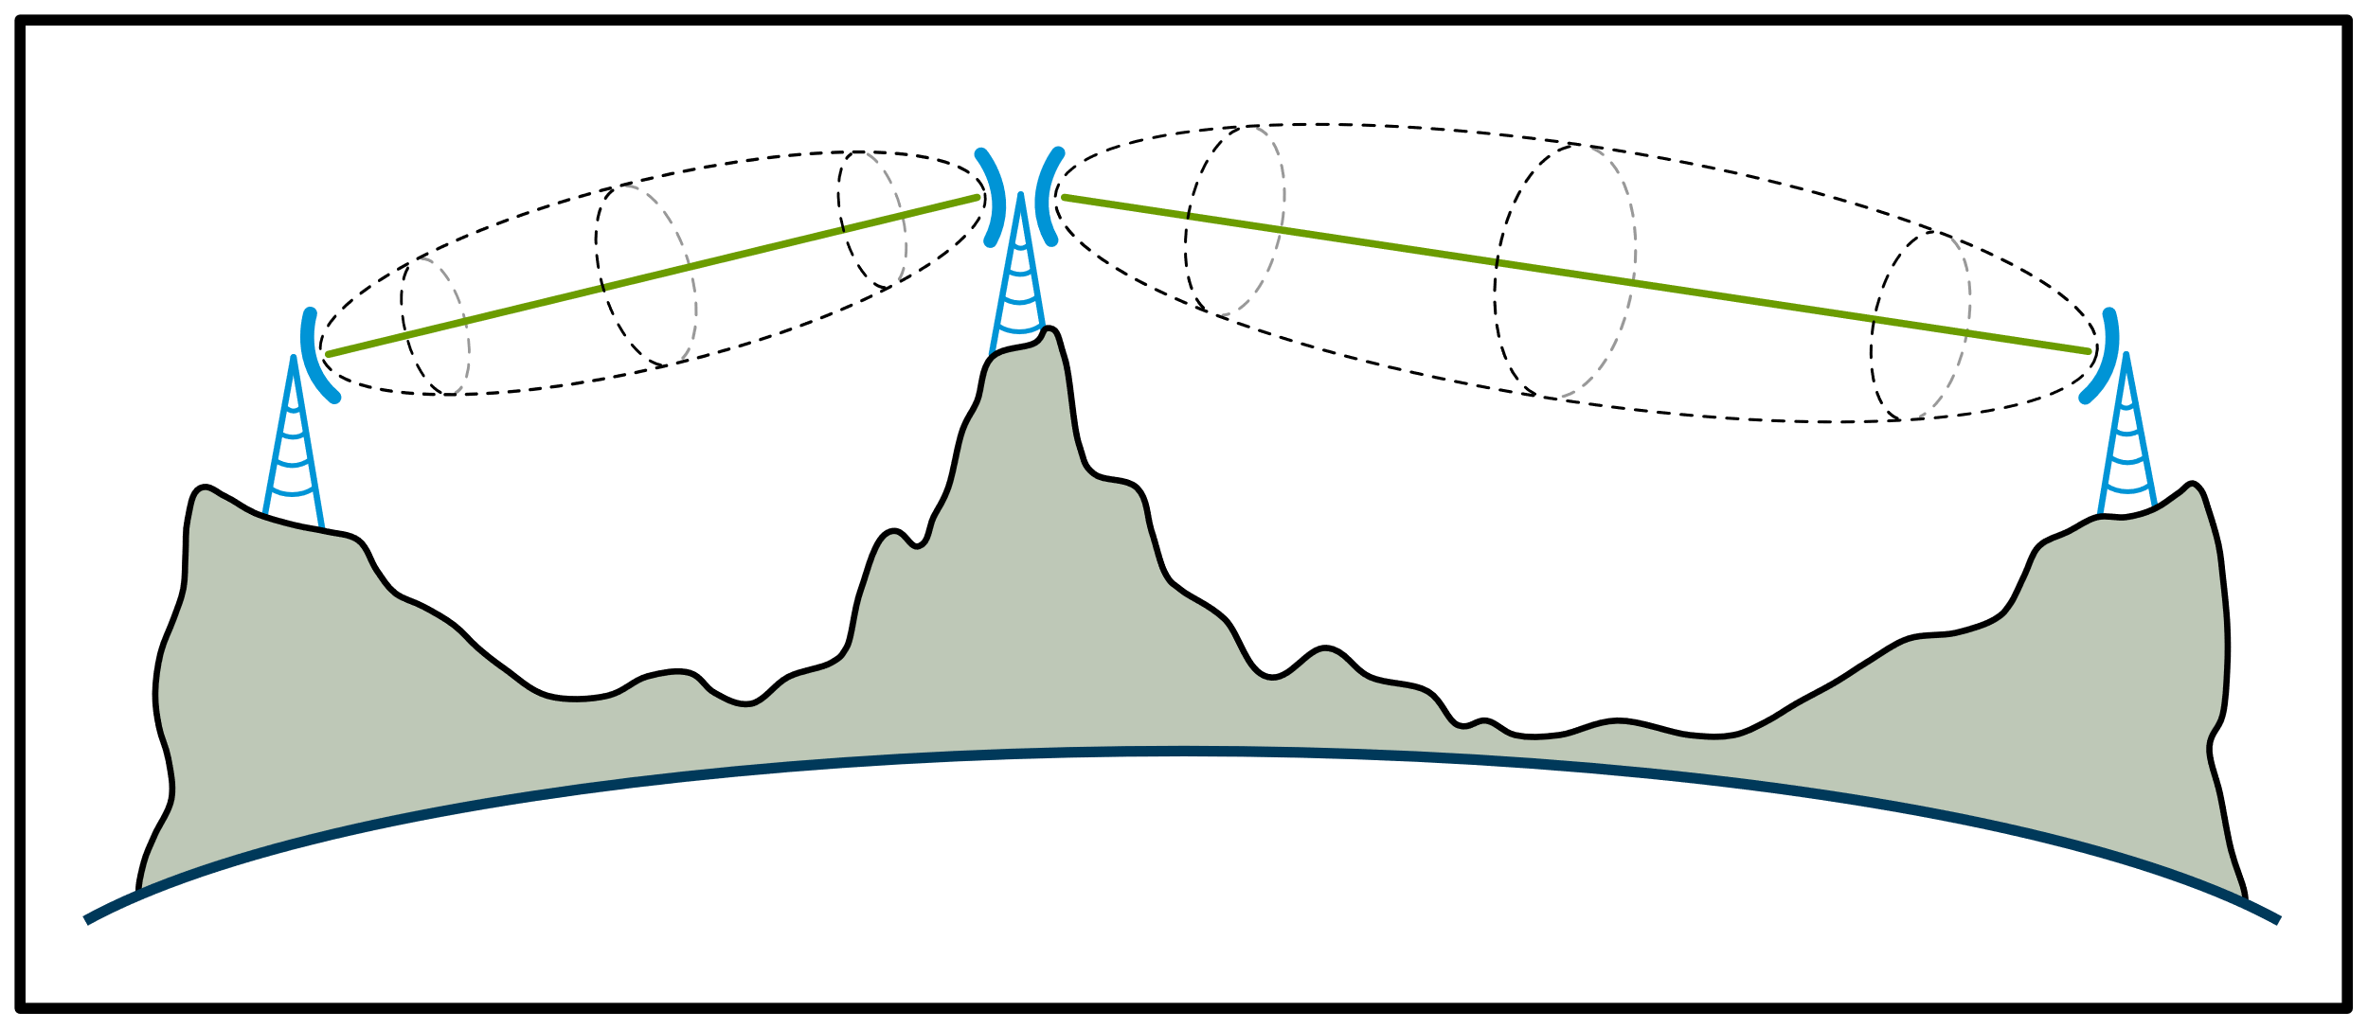
The repeater COVERAGE AREA issue Line of sight
146.700
146.850-
This Photo by Unknown Author is licensed under CC BY-SA
This Photo by Unknown Author is licensed under CC BY-SA

Slide 6
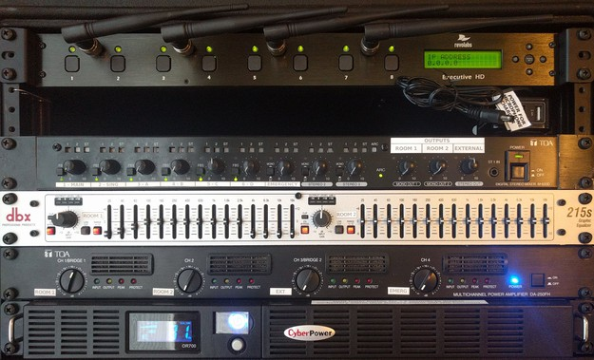
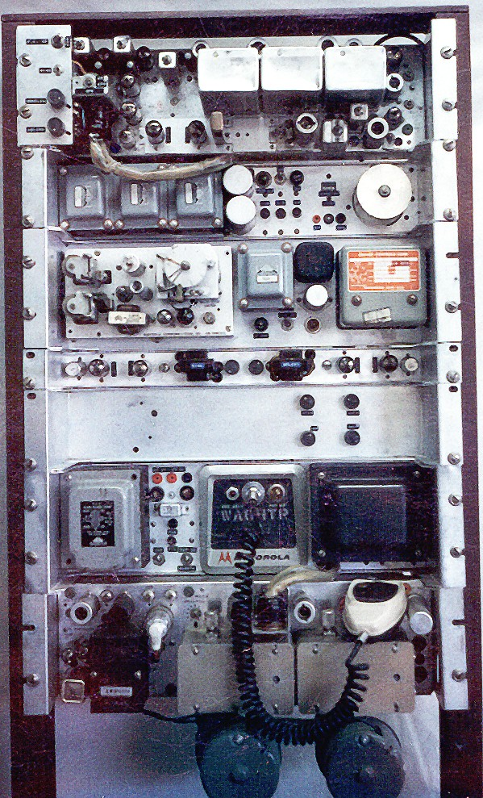
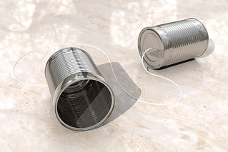
The first wa4txe repeater 1975 50 watts ( (most of the time) but it worked
This Photo by Unknown Author is licensed under CC BY
This Photo by Unknown Author is licensed under CC BY-SA

Slide 7
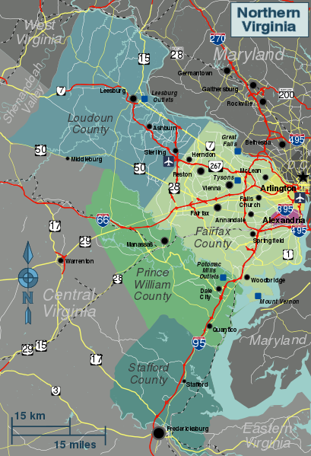
The first wa4txe repeater COVERAGE AREA Sterling Va –Tysons ( maybe)
This Photo by Unknown Author is licensed under CC BY-SA

Slide 8
The repeater requirement increase COVERAGE AREA issue Line of sight & terrain
This Photo by Unknown Author is licensed under CC BY-SA

Slide 9
The repeater COVERAGE AREA how it all works together
THERE ARE THREE SITES :
Leesburg VA
Purcellville
Charles Town WV
1
Purcellville
146.700
146.850-
This Photo by Unknown Author is licensed under CC BY-SA

Slide 10
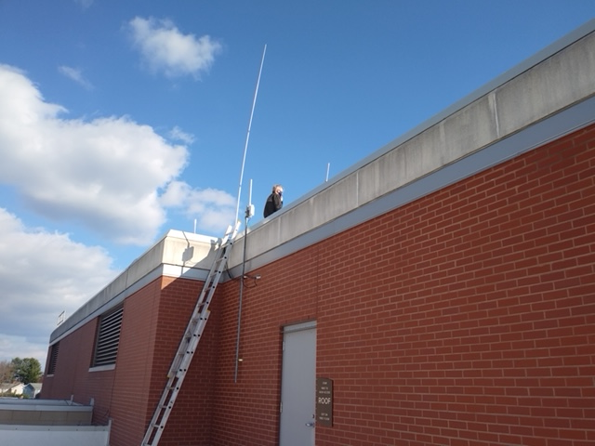
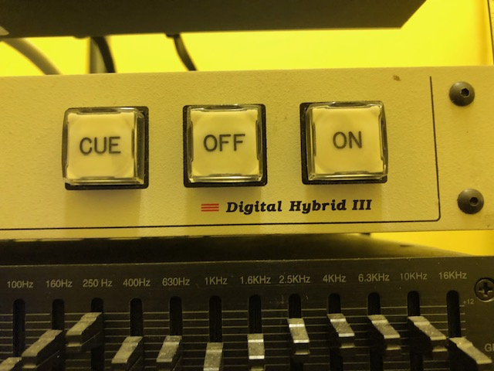
The Leesburg receiver and equipment compliment
2.UHF RECEIVERS( LINKS)
2. VHF RECIEVERS (INPUT) ( MONITOR) BACKFEED
WEATHER ALERT
RECEIVER
1 2
146.700
BACKFEED AUDIO TO 146.850
This Photo by Unknown Author is licensed under CC BY-SA

Slide 11
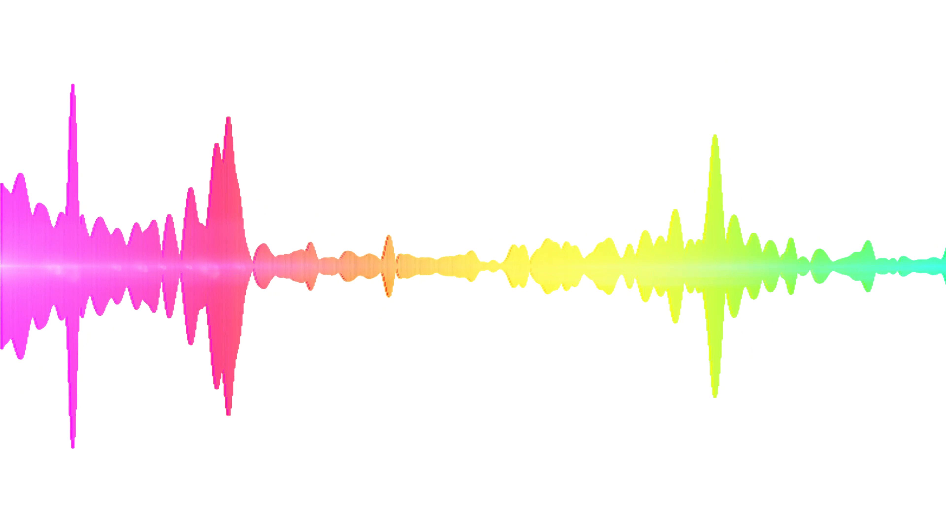
The repeater SIGNAL PATH USES RF , FIBER AND ANALOG PHONE INTERFACES
1
PURCELLVILLE
146.10 INPUT
146.850-
This Photo by Unknown Author is licensed under CC BY-NC
This Photo by Unknown Author is licensed under CC BY-SA

Slide 12
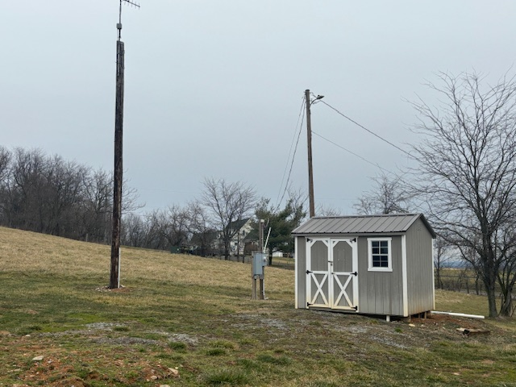
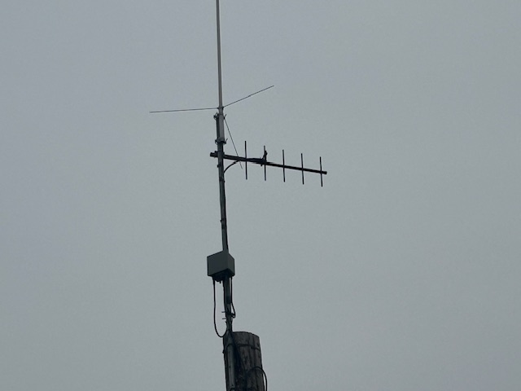
The PURCELLVILLE REMOTE and equipment compliment
PROVIDES LIMITED SPLIT SITE OPERATION CAPABILITY TO IMPROVE 146.700 RECEIVE RANGE, WHILE PROTECTING NEAR FIELD HT USE IN LEESBERG
1 2
146.700

Slide 13
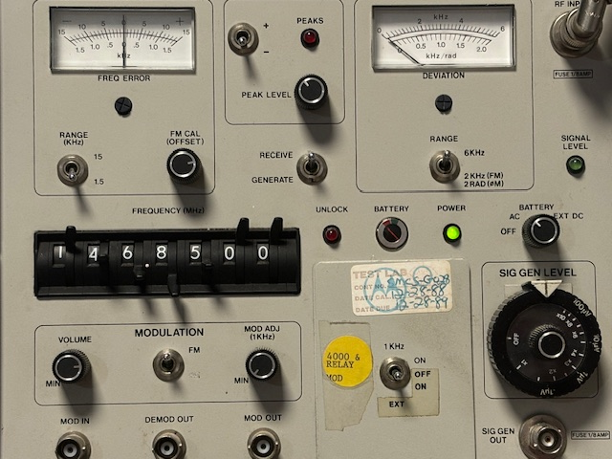
Test and measurement critical for continued operation
1 2
146.700

Slide 14
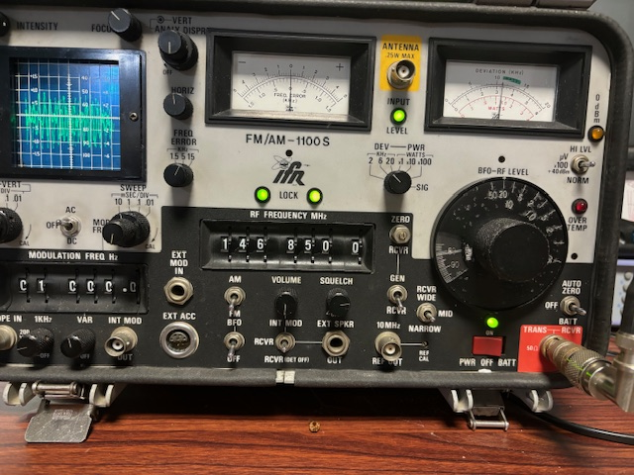
Test and measurement critical
1 2
146.700

Slide 15
The PURCEIVELLE REMOTE and equipment compliment
THINGS YOU NEED TO KNOW
PROVIDES LIMITED SPLIT SITE OPERATION CAPABILITY TO IMPROVE 146.700 RECEIVE RANGE, WHILE PROTECTING NEAR FIELD HT USE IN LEESBERG
1 2
146.700

Slide 16
The PURCEIVELLE REMOTE and equipment compliment
THE SYSTEM DOES NOT HAVE A HANG TIME
PROVIDES LIMITED SPLIT SITE OPERATION CAPABILITY TO IMPROVE 146.700 RECEIVE RANGE, WHILE PROTECTING NEAR FIELD HT USE IN LEESBERG
1 2
146.700

Slide 17
The PURCEIVELLE REMOTE and equipment compliment
KEYING MICK WILL NOT VERIFY YOU SIGNAL
PROVIDES LIMITED SPLIT SITE OPERATION CAPABILITY TO IMPROVE 146.700 RECEIVE RANGE, WHILE PROTECTING NEAR FIELD HT USE IN LEESBERG
1 2
146.700

Slide 18
The PURCEIVELLE REMOTE and equipment compliment
USE MICK PAD DIAL 1114 TO TEST YOUR RADIO
PROVIDES LIMITED SPLIT SITE OPERATION CAPABILITY TO IMPROVE 146.700 RECEIVE RANGE, WHILE PROTECTING NEAR FIELD HT USE IN LEESBERG
1 2
146.700

Slide 19
The PURCEIVELLE REMOTE and equipment compliment
USE MICK PAD DIAL 5 AND ANY NUMBERS AFTER WILL BE REPEATED
PROVIDES LIMITED SPLIT SITE OPERATION CAPABILITY TO IMPROVE 146.700 RECEIVE RANGE, WHILE PROTECTING NEAR FIELD HT USE IN LEESBERG
1 2
146.700

Slide 20
The PURCEIVELLE REMOTE and equipment compliment
PL IS NOT REQUIRED BUT IS ON REPEATER OUTPUT 77Hz
PROVIDES LIMITED SPLIT SITE OPERATION CAPABILITY TO IMPROVE 146.700 RECEIVE RANGE, WHILE PROTECTING NEAR FIELD HT USE IN LEESBERG
1 2
146.700

Slide 21
The PURCEIVELLE REMOTE and equipment compliment
73s FOLKS DE
WA4TXE
PROVIDES LIMITED SPLIT SITE OPERATION CAPABILITY TO IMPROVE 146.700 RECEIVE RANGE, WHILE PROTECTING NEAR FIELD HT USE IN LEESBERG
1 2
146.700

