Slide 1
“Speaker to Space People”
Hillsboro Charter Academy ARISS Contact After Action Report
Megan Tucker KQ4MAM
Steve Greene KS1G
Loudoun Amateur Radio Group (LARG) January Meeting, 1/18/25

Slide 2
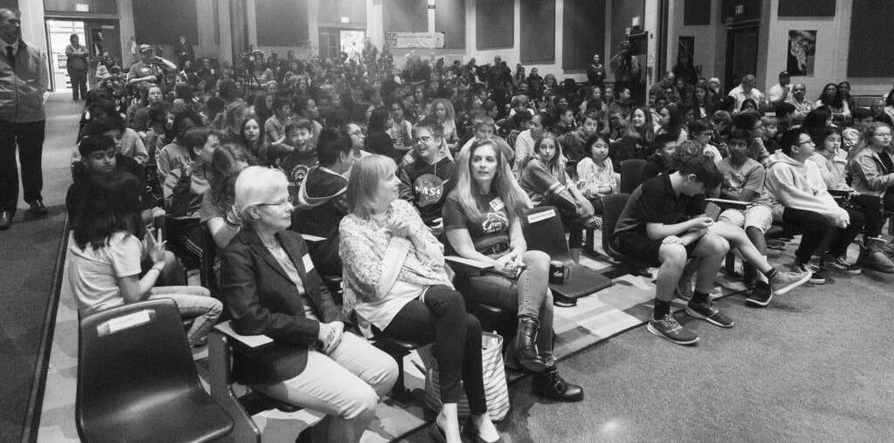
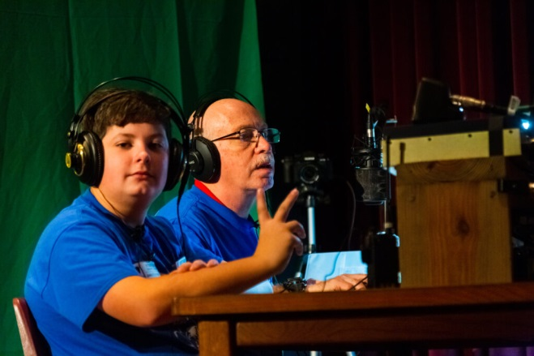
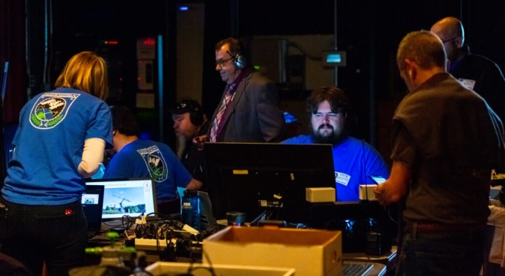
First, A little history…
October 2019: Farmwell Station Middle School – Direct Contact
February 2021: Sterling Middle School – Multipoint Telebridge

Slide 3
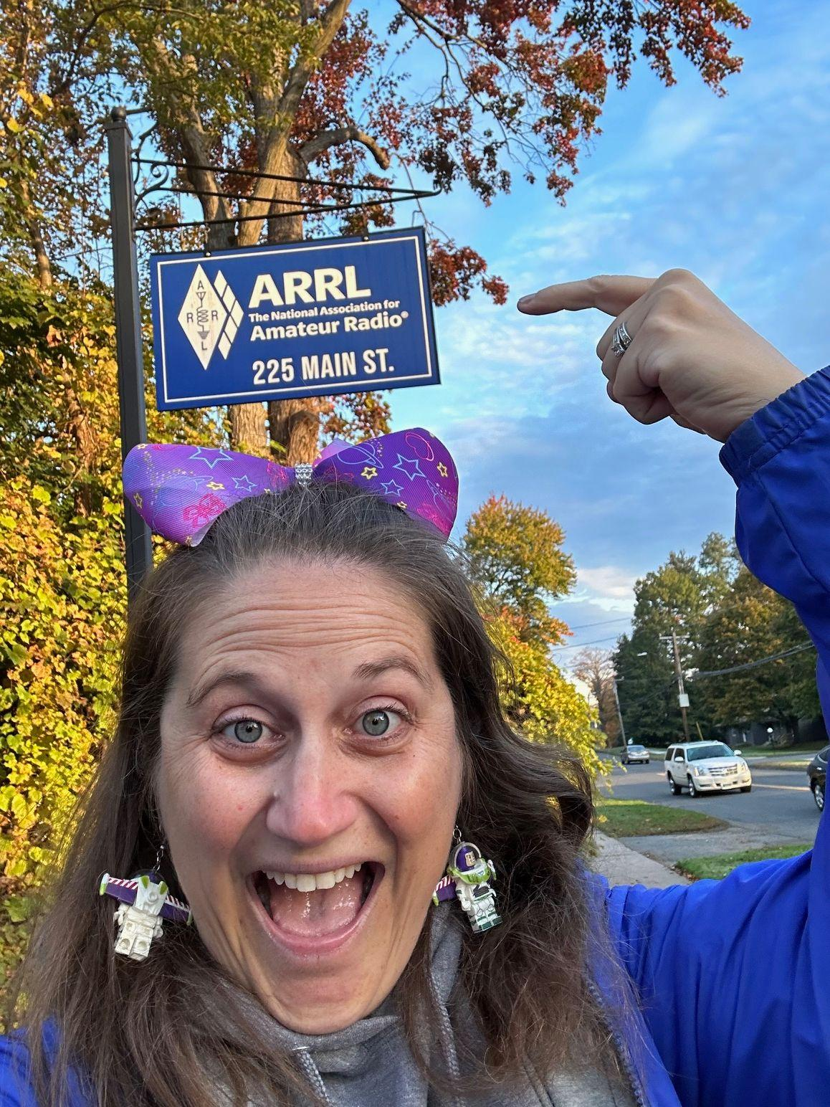
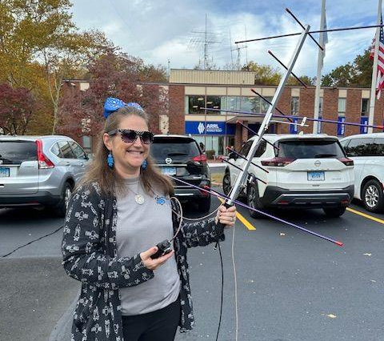
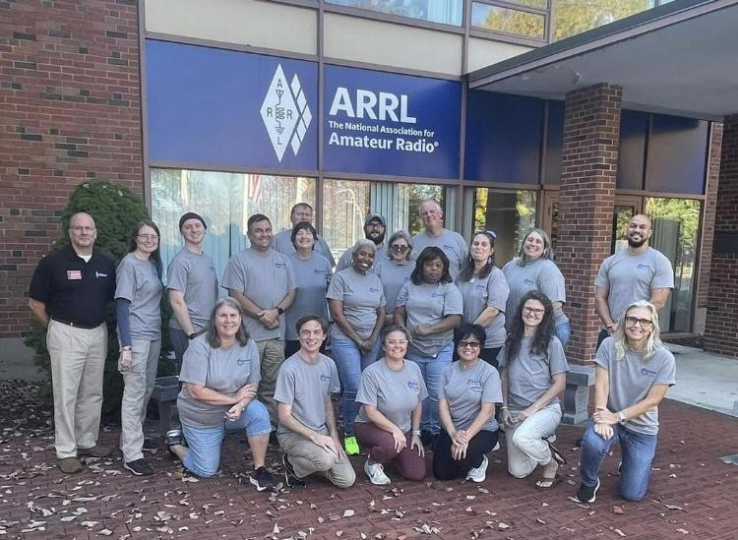
How Megan Got Interested
Personal Story
My “Why”
ARRL Radio Waves December 2024
Experiences at ARRL Teacher Institute (T1/T3)
Notes:
Megan

Slide 4
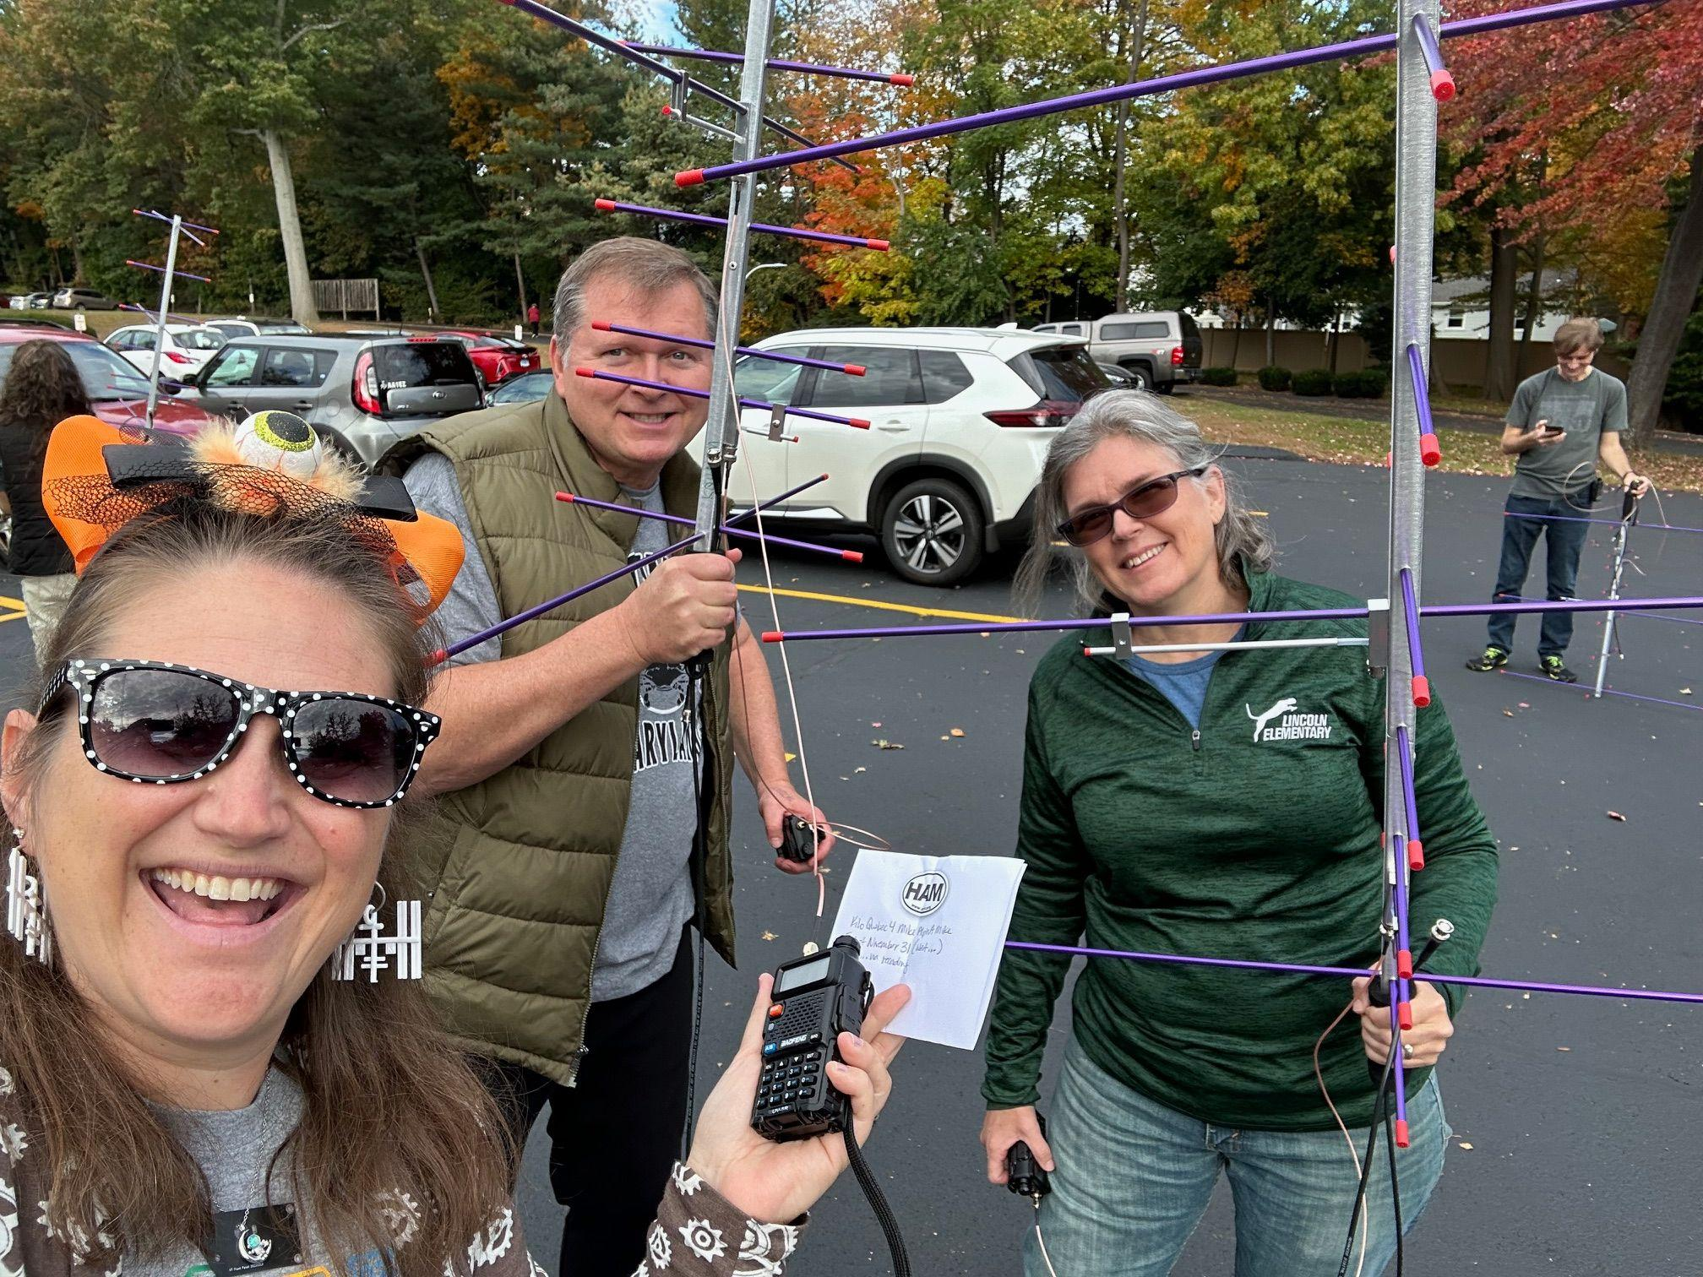
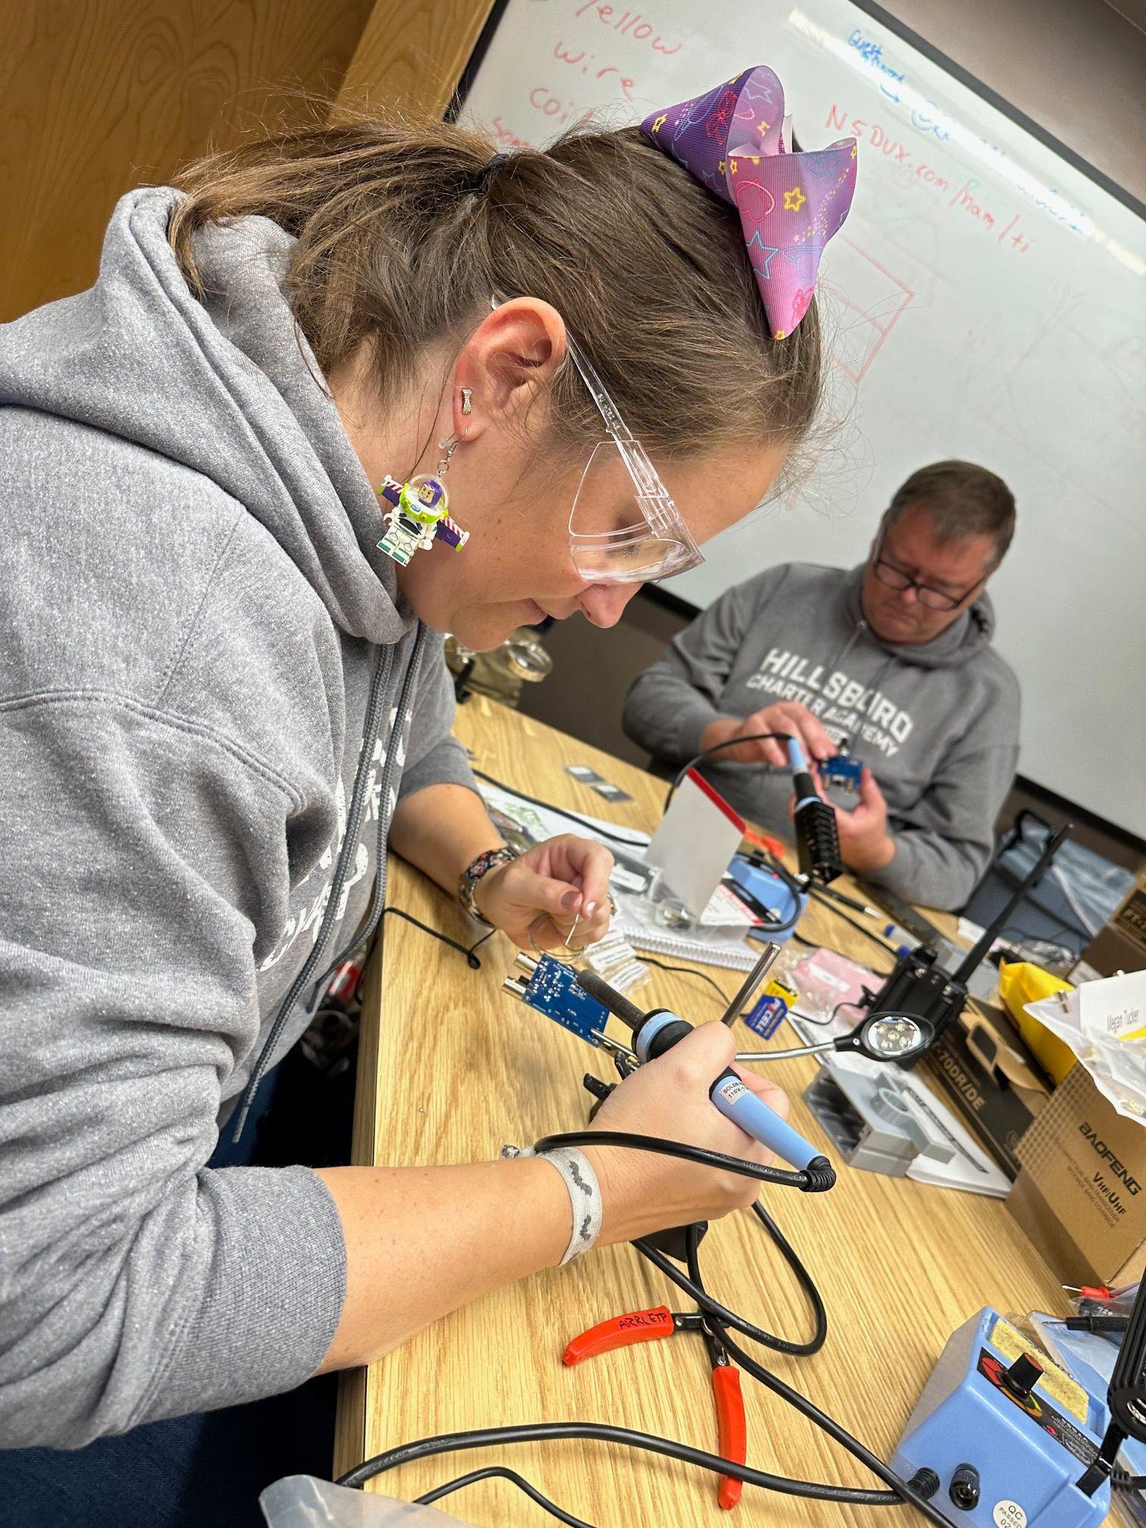
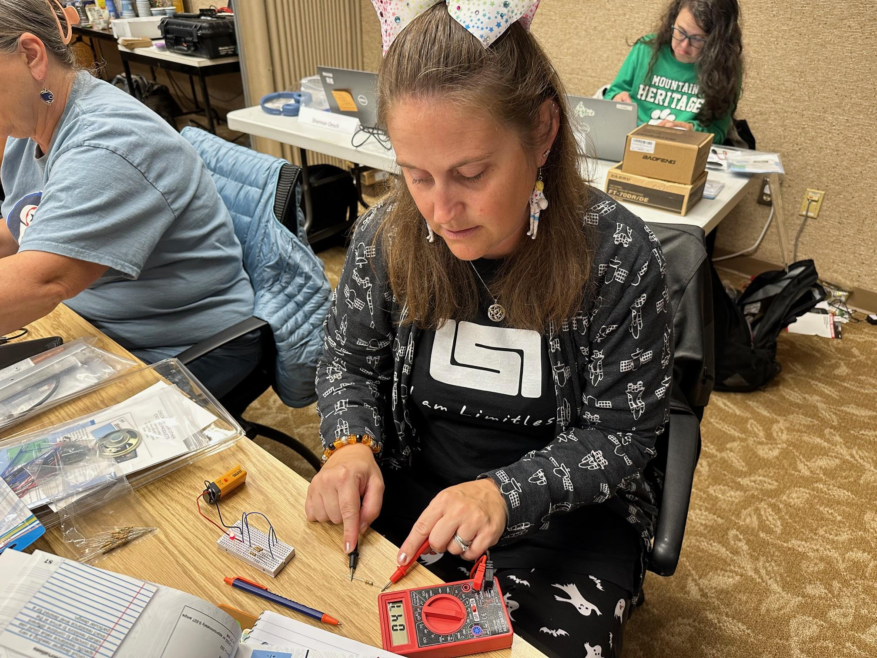
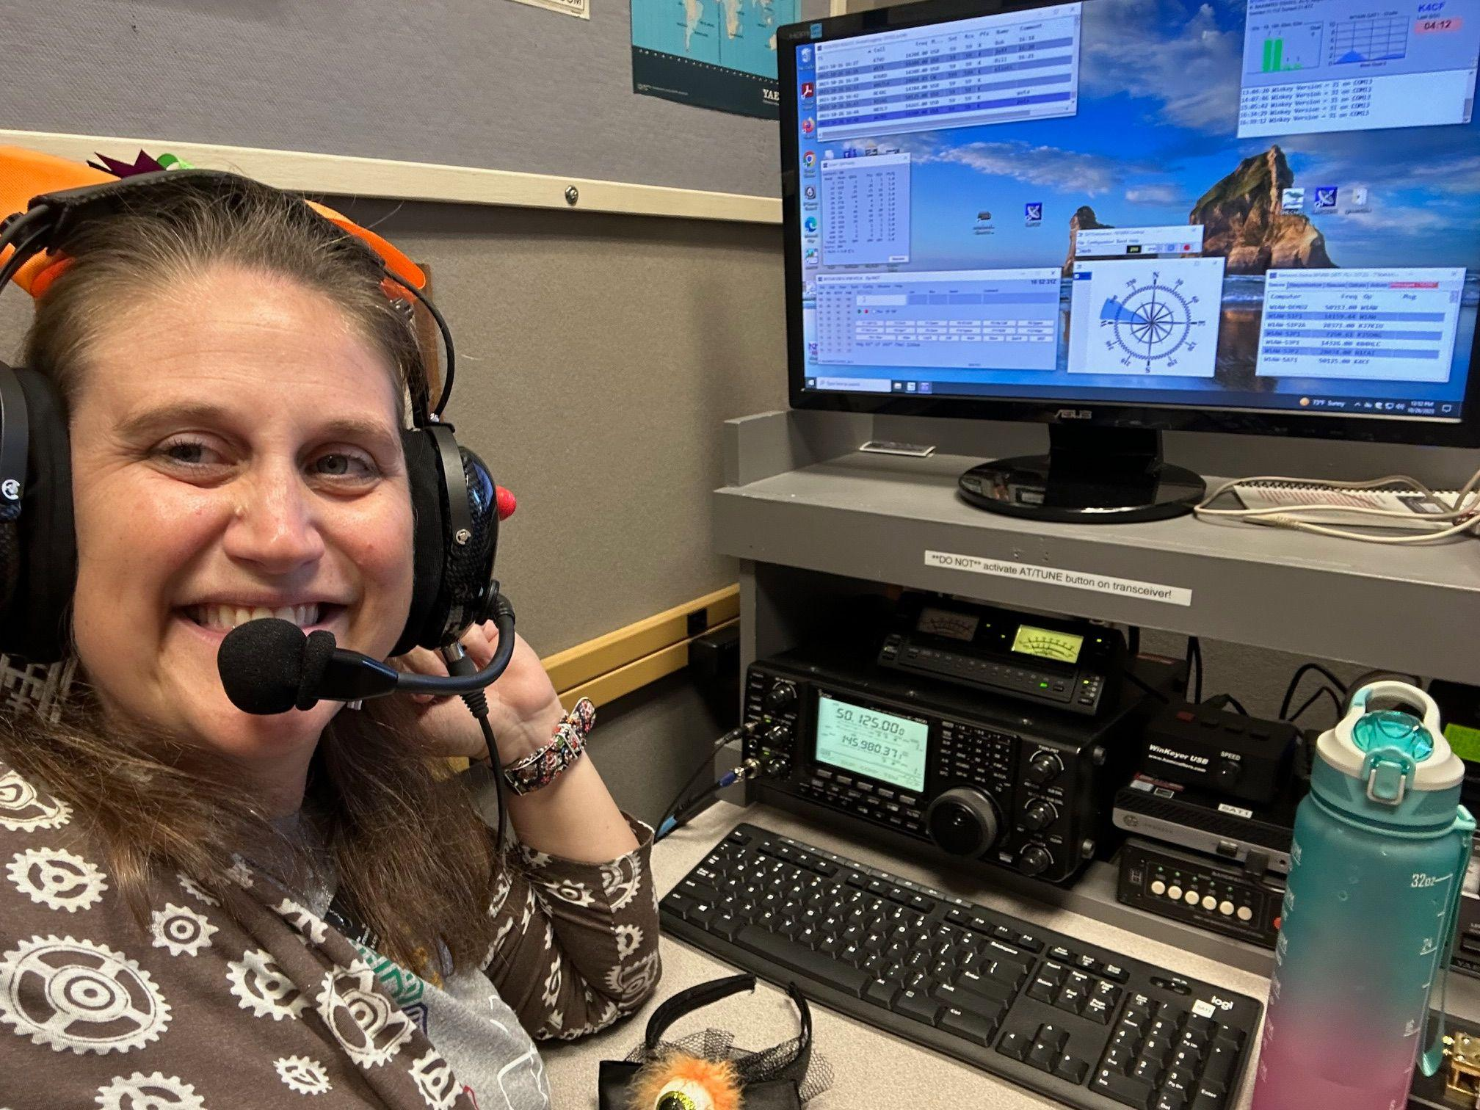
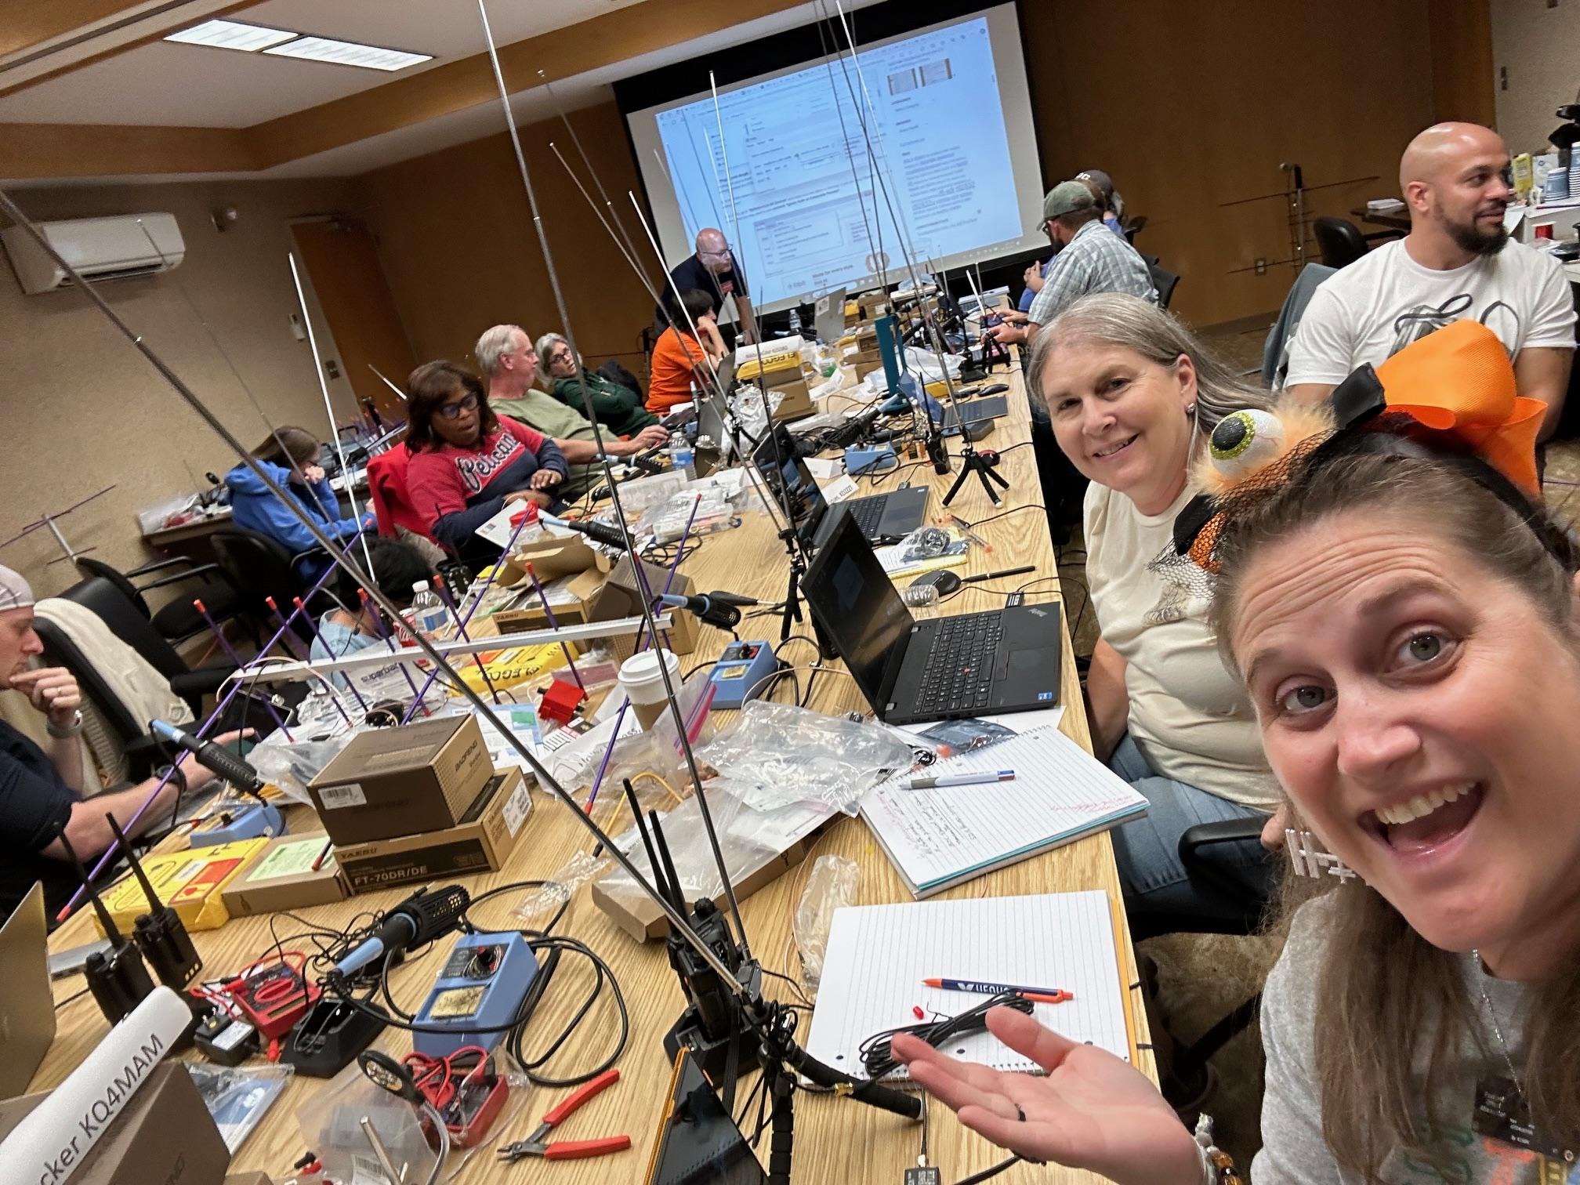
TI 1: Satellite Signals, SSTV/ISS Reception,
Resistors/Multimeters and Soldering
Notes:
Megan

Slide 5
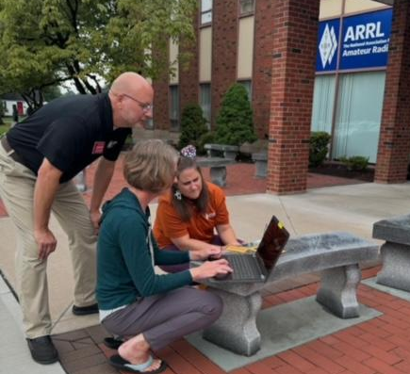
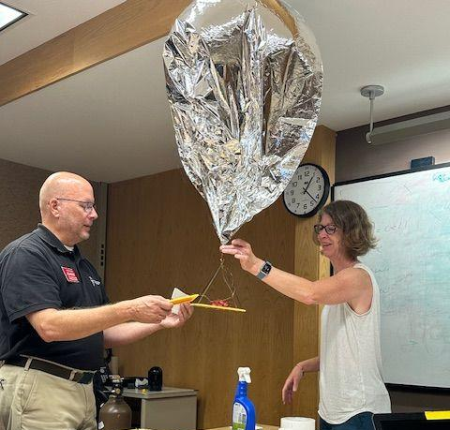
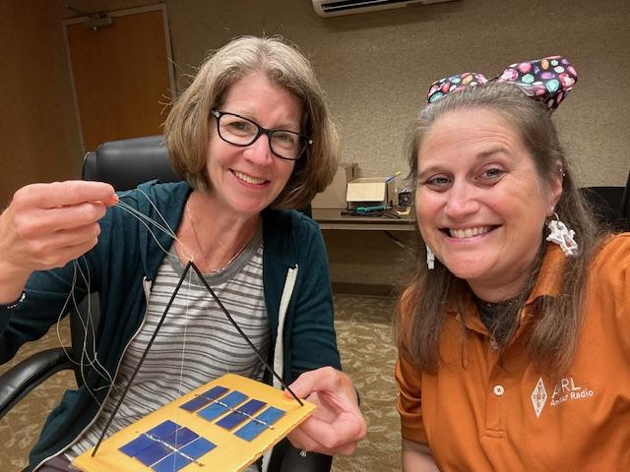
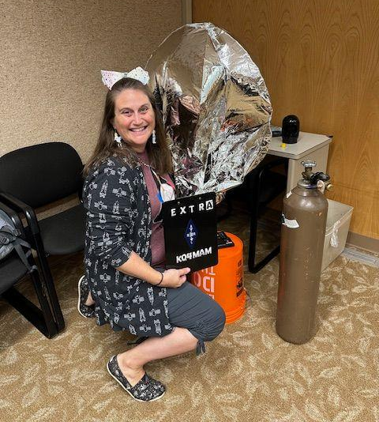
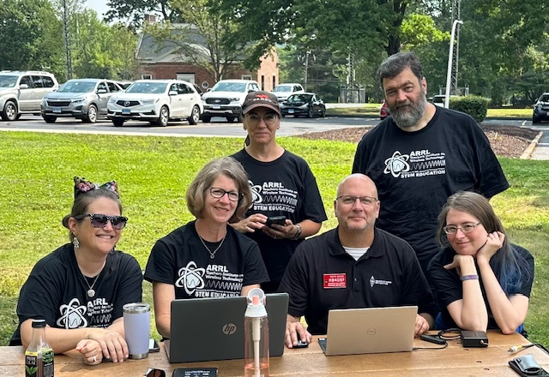
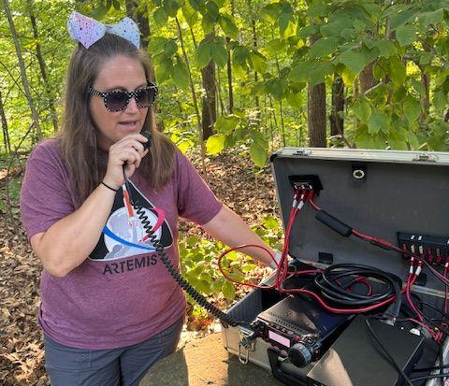
TI-3: Space Weather/ Pico Ballooning, POTA
Notes:
Megan

Slide 6
Megan Approaches LARG
January or February 2024 LARG meeting (I think)
LARG: HECK YES!
Write the proposal
HCA – Education Plan
Based on Flight Funday Classes and Flight Funday Fest as well as school theme of “Inspiring Ingenuity”
LARG – Radio Plan
Started with the proposals for Farmwell Station and Sterling MS contacts
Site Survey
Terrain Analysis (mind “the Gap”)
8 Commitment Letters - 7 Nonprofits in addition to LARG
ARRL, AFA, CAP, ISS National Lab, LSI, Town of Hillsboro, Superlative Events

Slide 7
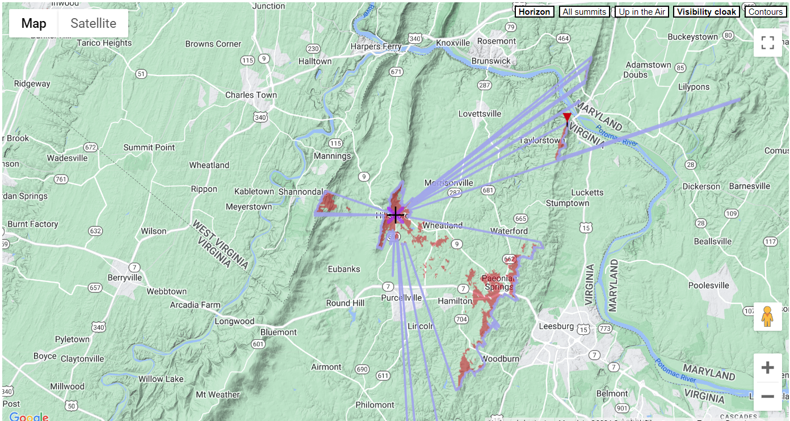
Minding “The Gap”
“The Gap”
5-7 deg
Estimated up to 90 seconds before ISS would rise above the ridgeline (reality was closer to 60 seconds, very glad for those extra 30 seconds!)
https://www.heywhatsthat.com/?view=MAX7MXL4

Slide 8
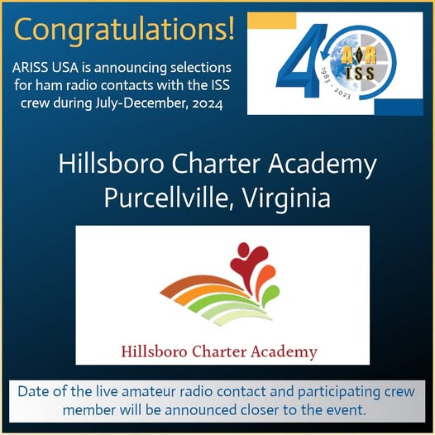
We get news!
ARISS: HCA is accepted for a DIRECT CONTACT!
Social Media Post: https://www.facebook.com/share/p/18sDcWDtq2/
Mentors assigned
Education: Kathy Lamont, KM4TAY, Woodbridge, VA
Radio: Bob Kopke, AA6TB
Tentatively scheduled for week of December 9, 2024

Slide 9
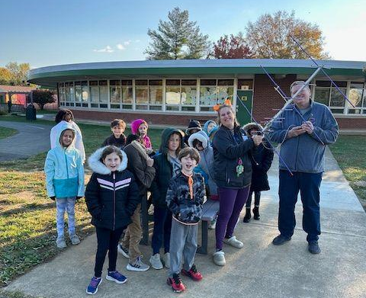
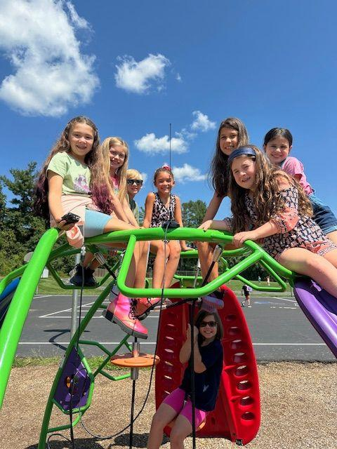
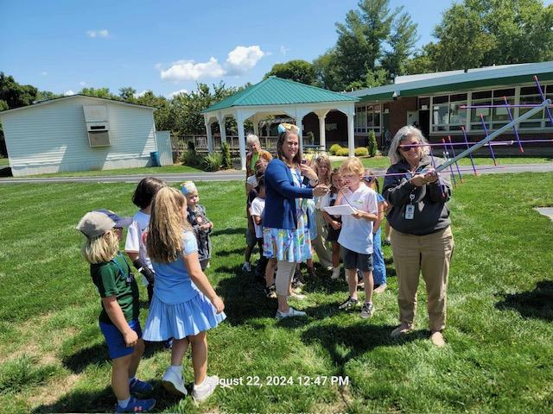
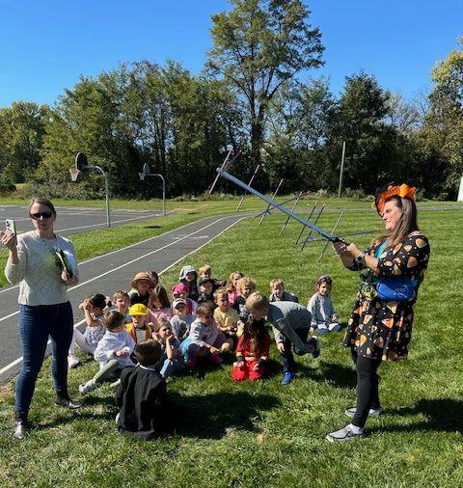
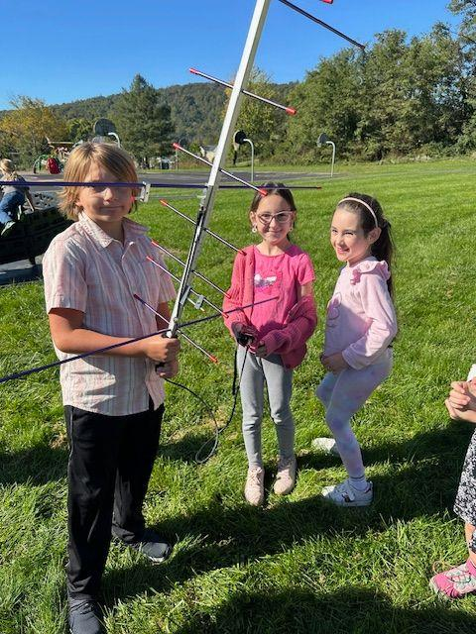
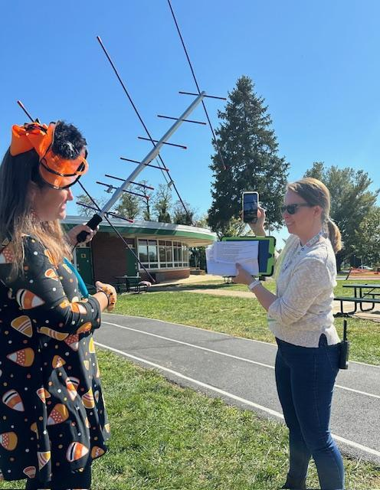
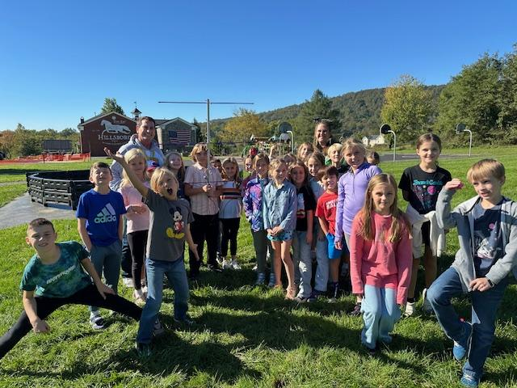
HCA Education Program and Preparations:
Classroom Integration
Notes:
Megan

Slide 10
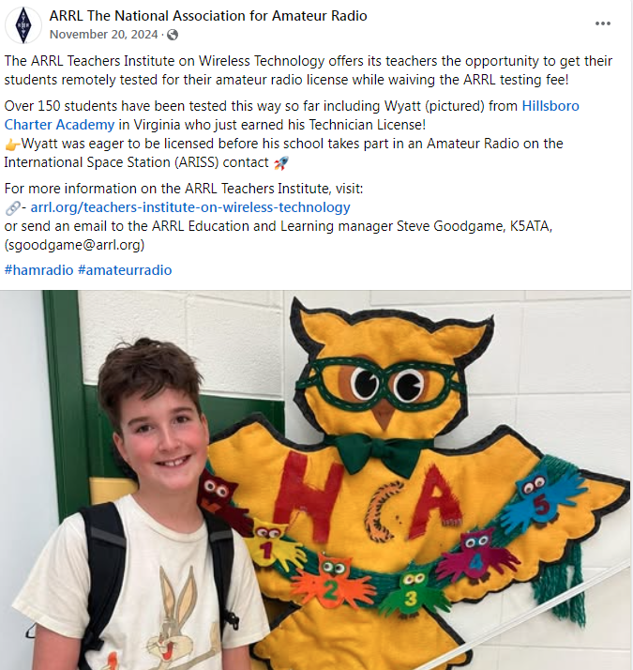
Wyatt, HCA 5th Grader, Gets LICENSED!
Social Media Post from ARRL!!!!
https://www.facebook.com/share/p/1DtTVqTgXJ/

Slide 11
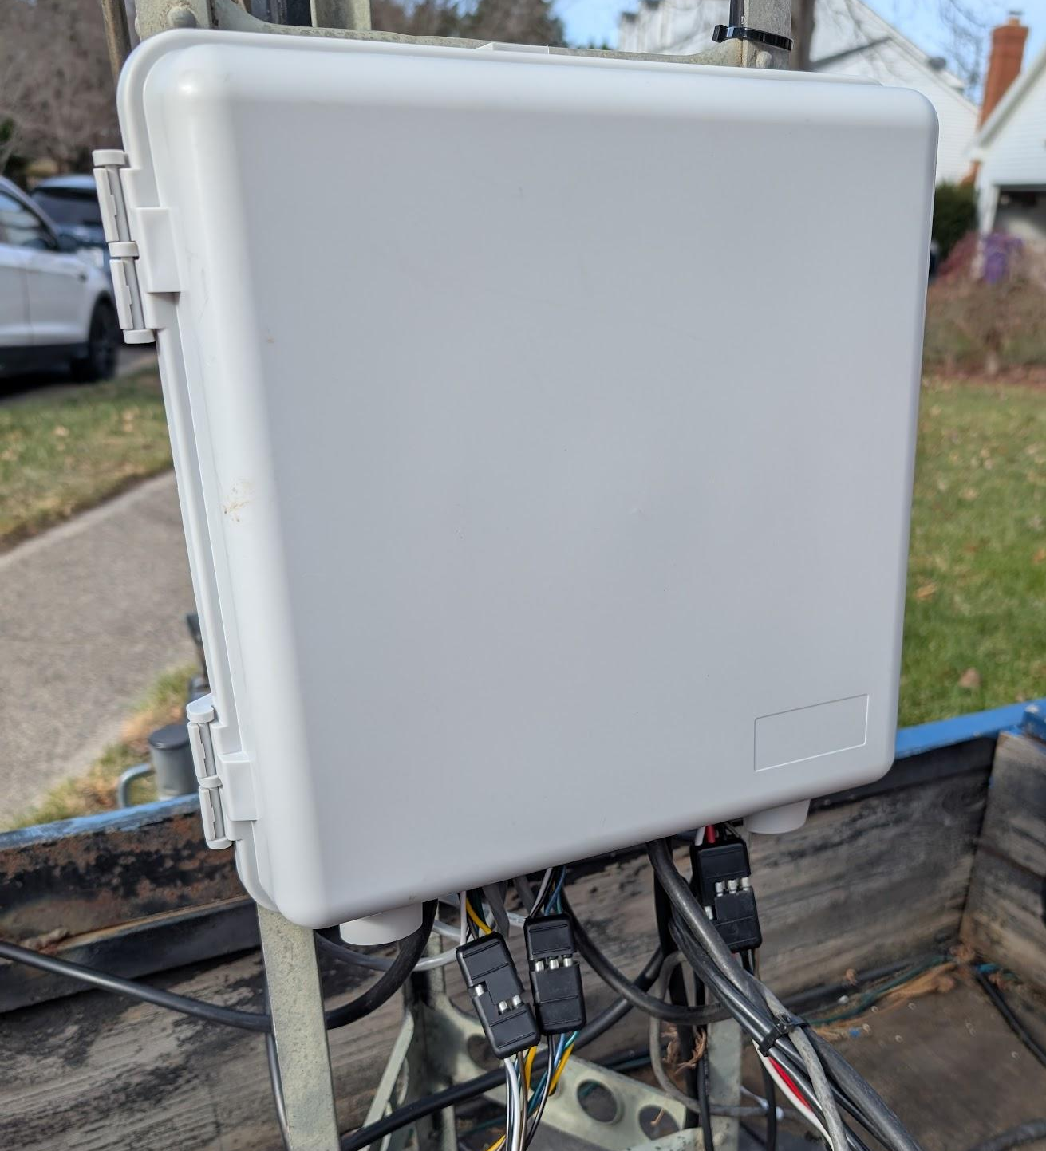
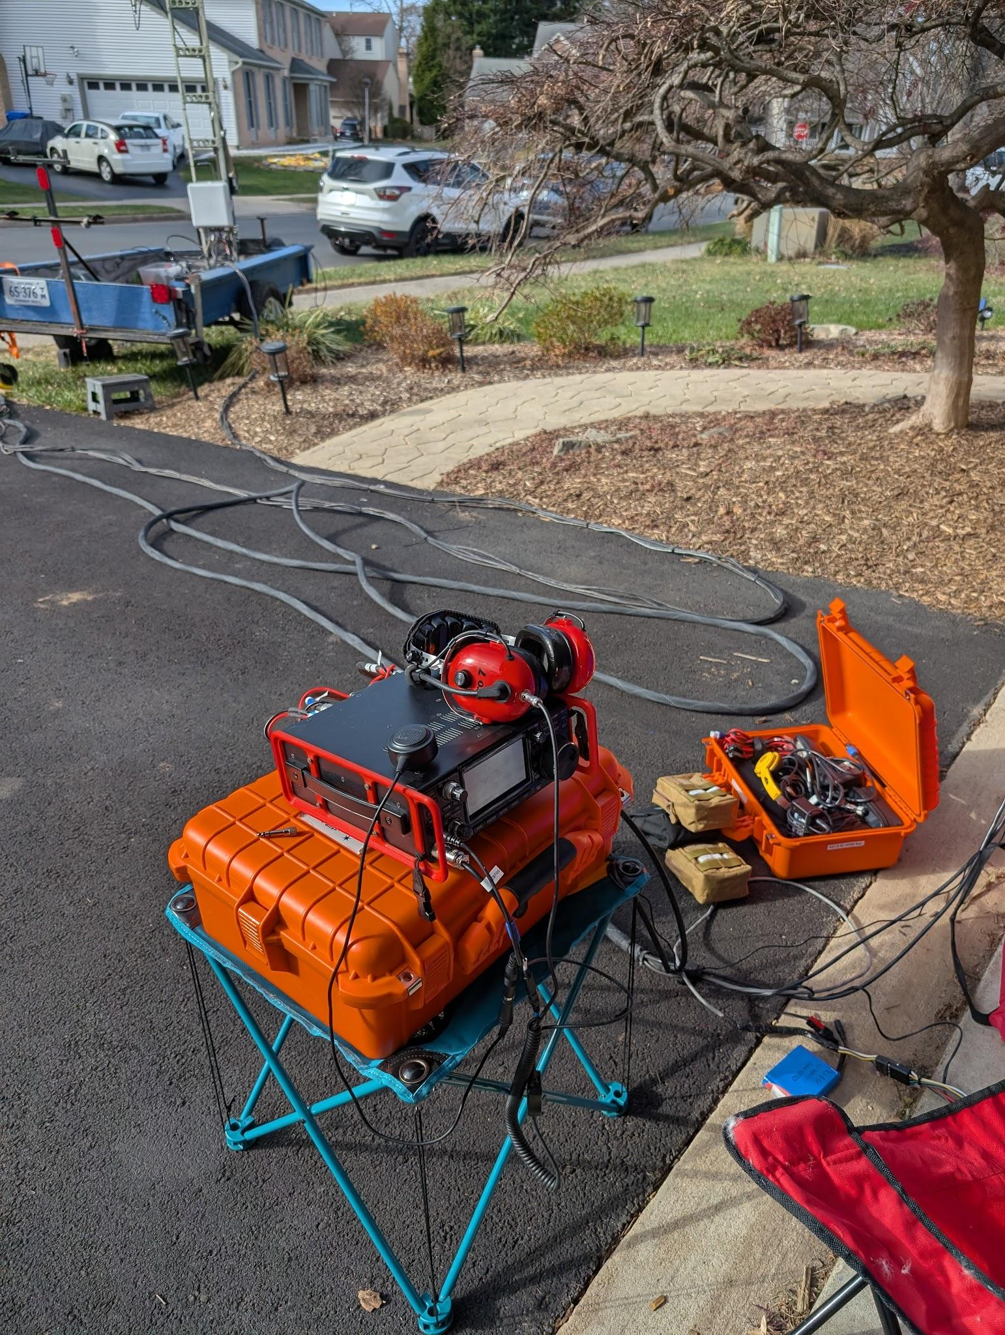
Preparing the Radio Gear
Antenna Repairs Needed!
Field Day – 2M antenna shows a > 10:1 SWR!
Tested, Disassembled, Cleaned the entire driven element system
Replaced the phasing harnesses
Replaced one of the driven element assemblies
Re-Tested – All Good!
Trailer
Add Junction Box for antenna, rotator, and preamp cables - easier separation of cables for testing and storage
Extension cables for rotators, preamps
A/V Integration
Test radios with XLR inputs, Brian’s audio gear

Slide 12
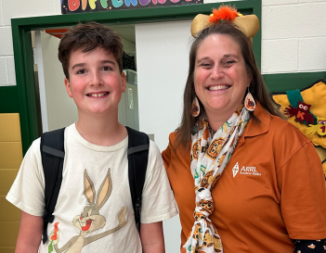
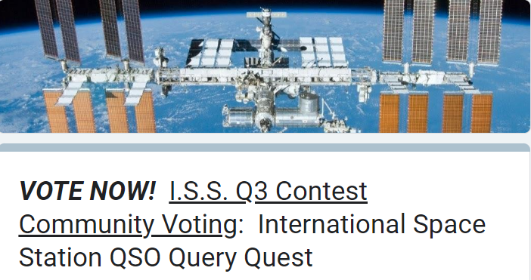
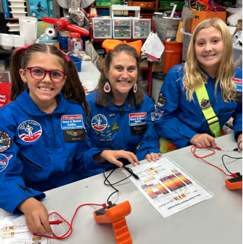
HCA Gets Ready
STEAM/E3 Program and Flight Funday
H.A.M. Radio Club (THANK YOU, N4PD!)
Questions for our Astronaut
QSO Query Quest Community Outreach
Flight Funday Fest: December 6, 2024

Slide 13
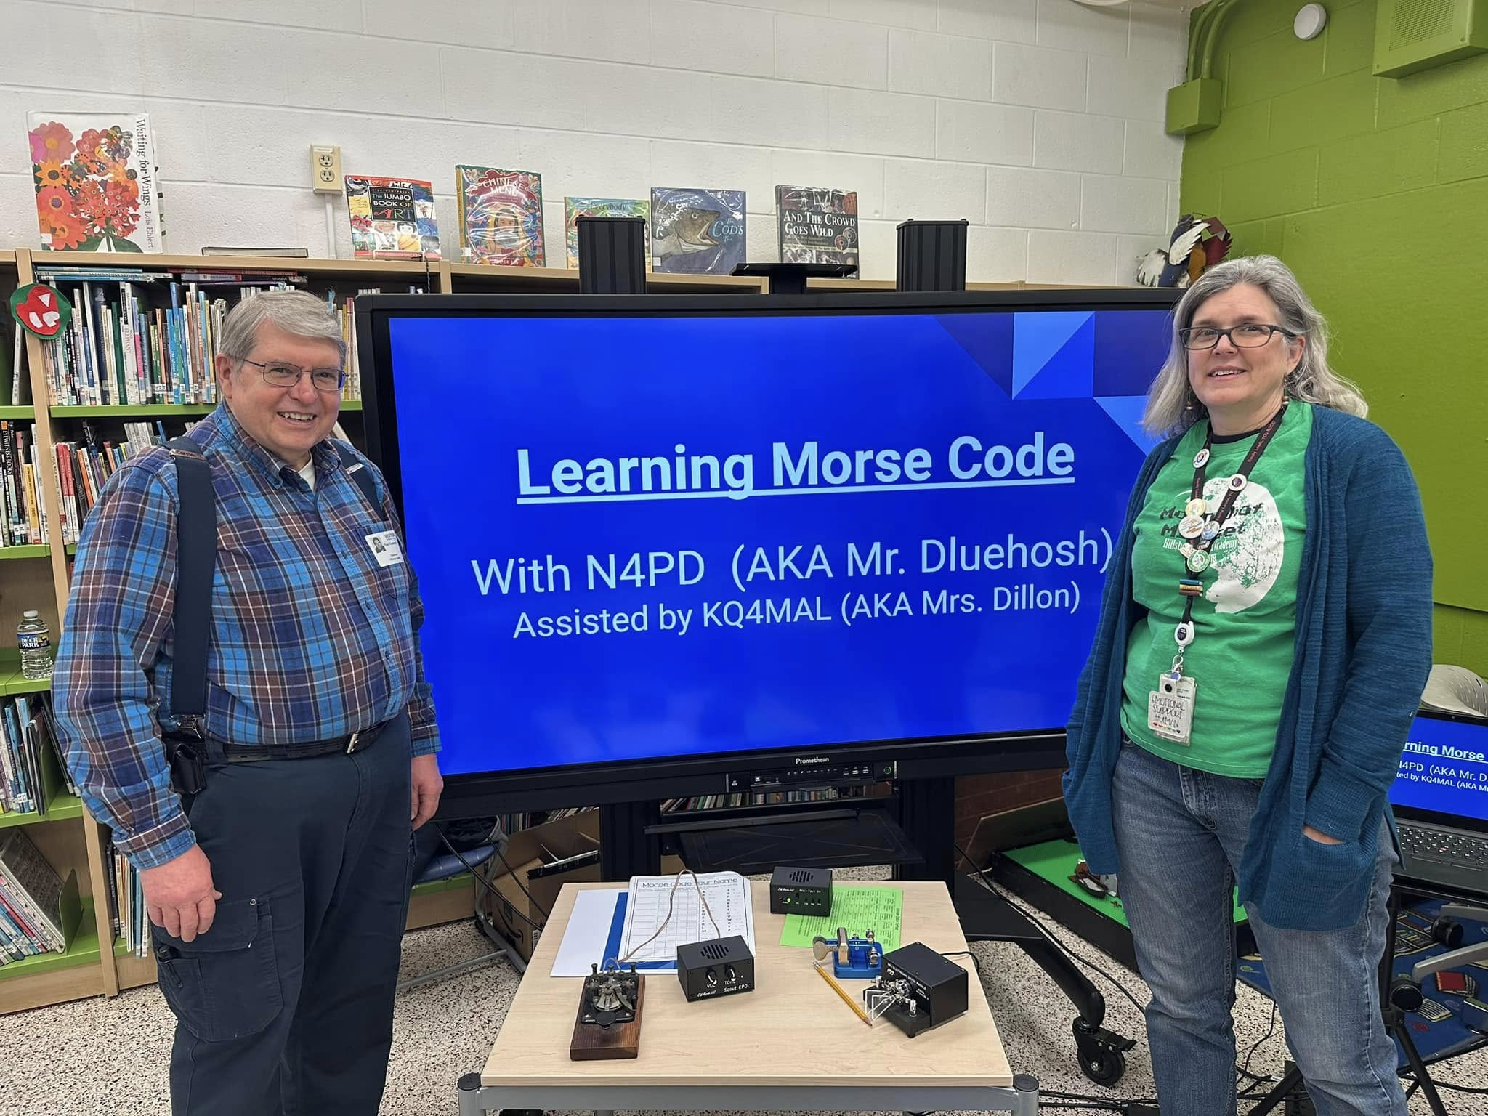
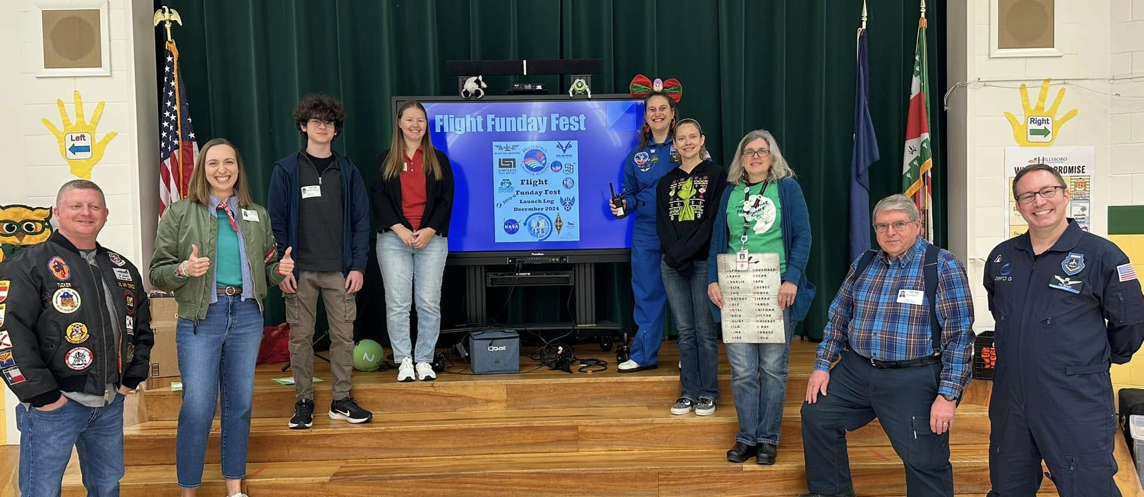
Flight Funday Fest with a RADIO Flair!
💡 Morse Code Basics led by Paul Dluehosh and Paula Dillon of LARG
✈️ RC Plane Demonstrations with Zachary Hargreaves, an HCA Alumni and Woodgrove H.S. Senior
🌌Zero-G Flight Trainer with Tim Bailey
📡 ADS-B (Automatic Dependent Surveillance-Broadcast) with Hannah Rust and Brian Tucker
🏈✈️ From Footballs to Flight with Civil Air Patrol CAP Aerospace Education led by Katie Moeser
💡 CubeSats Exploration with Ashley Burch
Social Media Posts
https://www.facebook.com/share/p/1C2Jb3KMQk/
https://www.facebook.com/share/p/1AsAmNUB4N/
https://www.facebook.com/share/p/1KTqqeuPy3/
https://www.facebook.com/share/p/19JkpUFUuu/

Slide 14
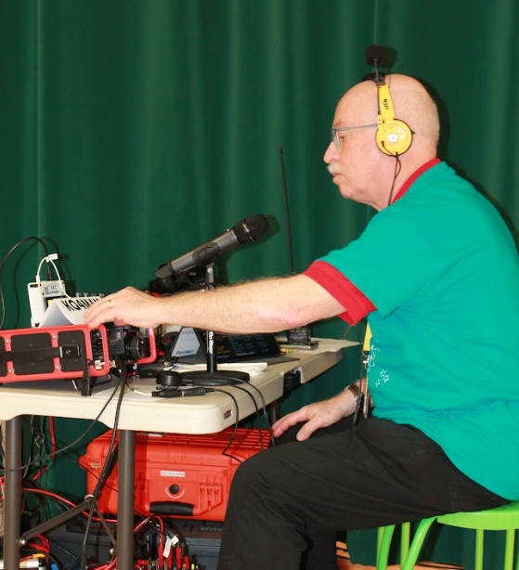
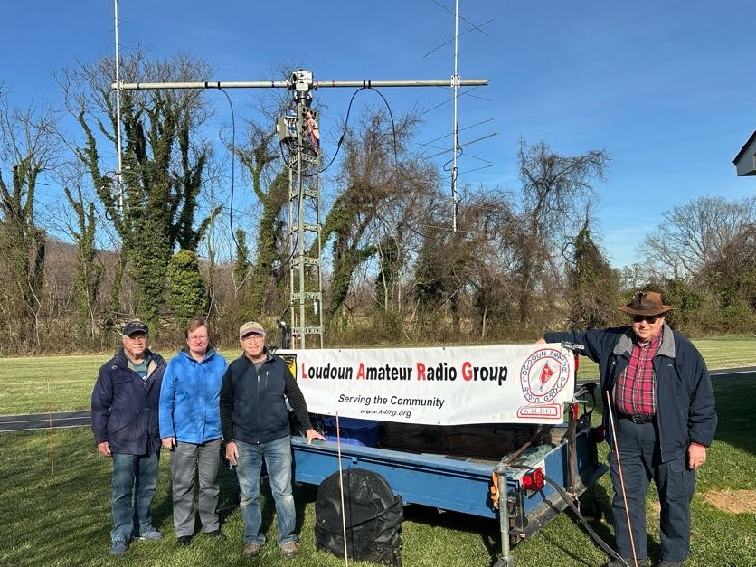
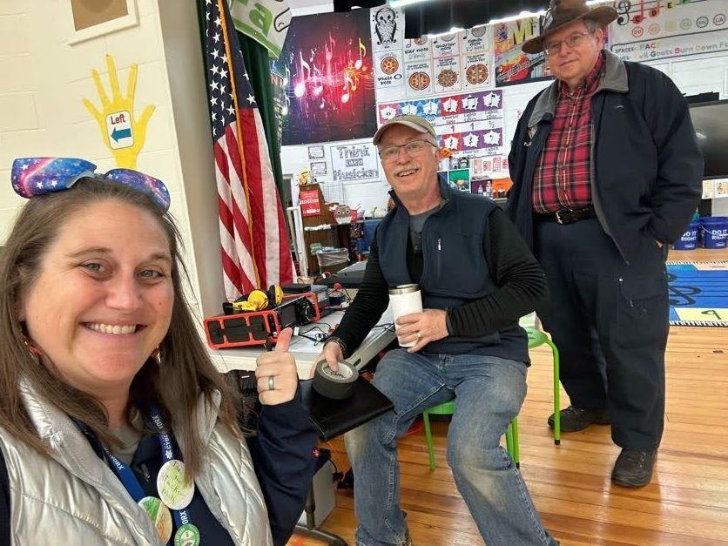
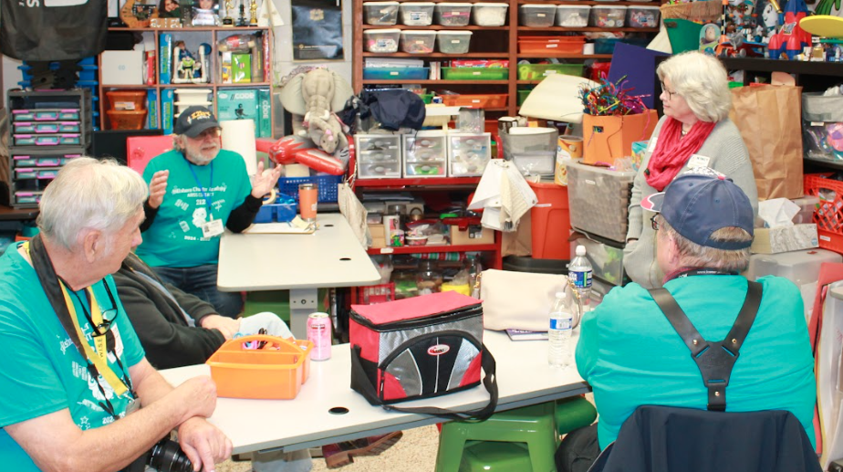
The BIG DAY Approaches
Trailer to HCA (Thank you AK2M!)
Exterior set up (trailer, antennas, outside cables) Sunday 12/8
Interior setup and testing
Run inside cables (Thank you KM4GC & XYL, N4PD, N4FAF, K2BFY)
Radio Table
A/V Hook Up and Testing
The Big Day – Final tests
ISS Repeater QSOs and Monitor 2M Digis

Slide 15
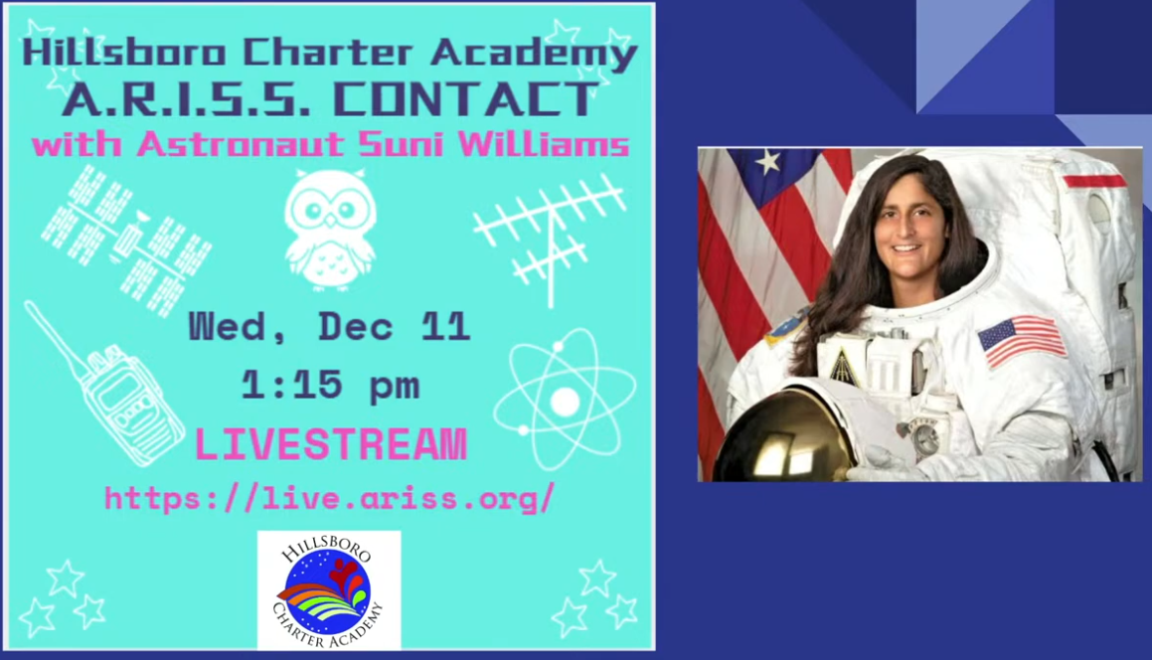

Slide 16
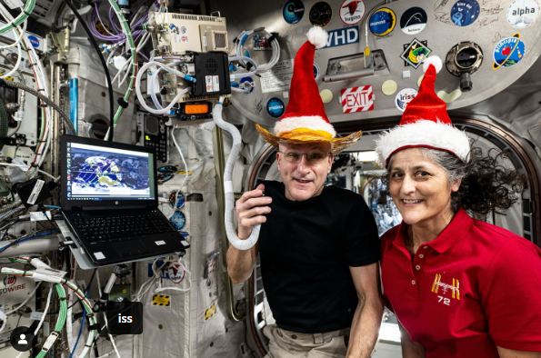
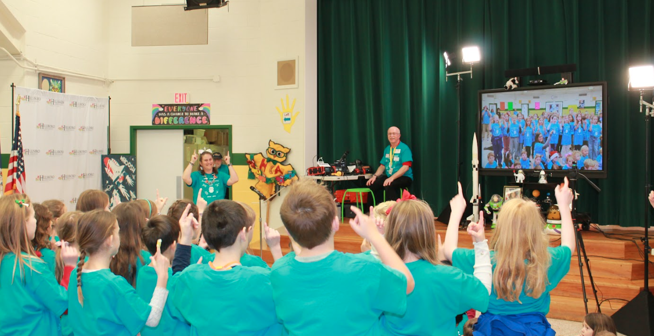
WE MAKE CONTACT!
Livestream through ARISS and YouTube
https://www.youtube.com/live/oqKx6ytN96k?si=itFpW6W0ojCK06vH
School Program
ARISS Contact 12.11.24 (HCA Google Slides)
The Contact
That was a LONG 1st Minute!
The execution was FABULOUS
We even GOT TO SAY THANK YOU! & 73s
Media
Local papers
Hams Give Hillsboro Charter Students a Space Station Hookup | News | loudounnow.com
Hillsboro students connect with International Space Station — by ham radio | 1local | loudountimes.com
Fox 5 DC
Loudoun County school wins chance to speak with astronaut in space | FOX 5 DC
DC News Now
Hillsboro Academy STEAM students get to chat with astronaut on orbiting space station | DC News Now
Social Media
https://www.facebook.com/share/p/18UxSYdyo3/
https://www.facebook.com/share/p/19pTnmohzB/
https://www.facebook.com/share/p/15JBPysDnq/
https://www.facebook.com/share/p/14fECbT1MM/
The ISS Radio (Kenwood TM-D710)

Slide 17
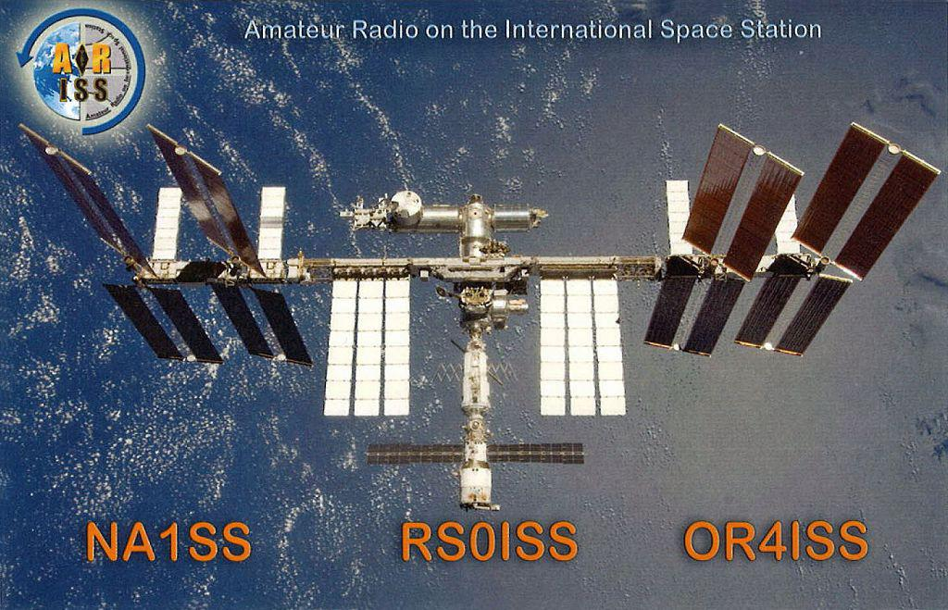
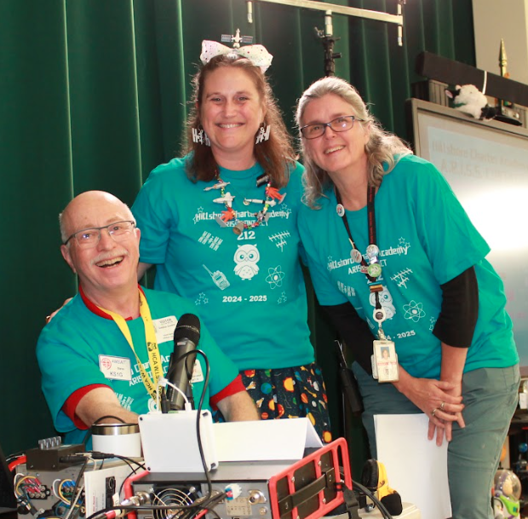
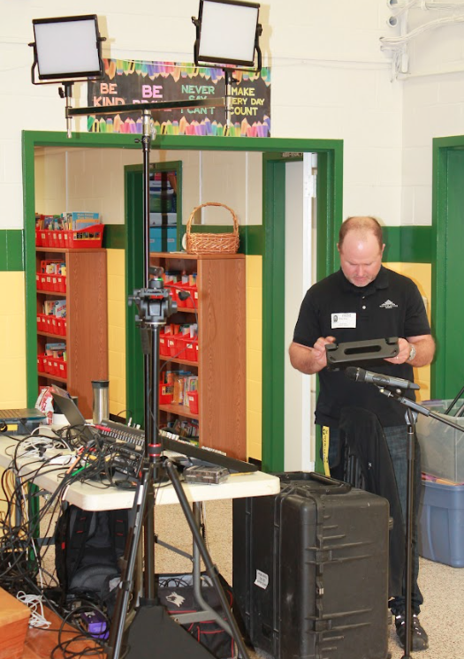
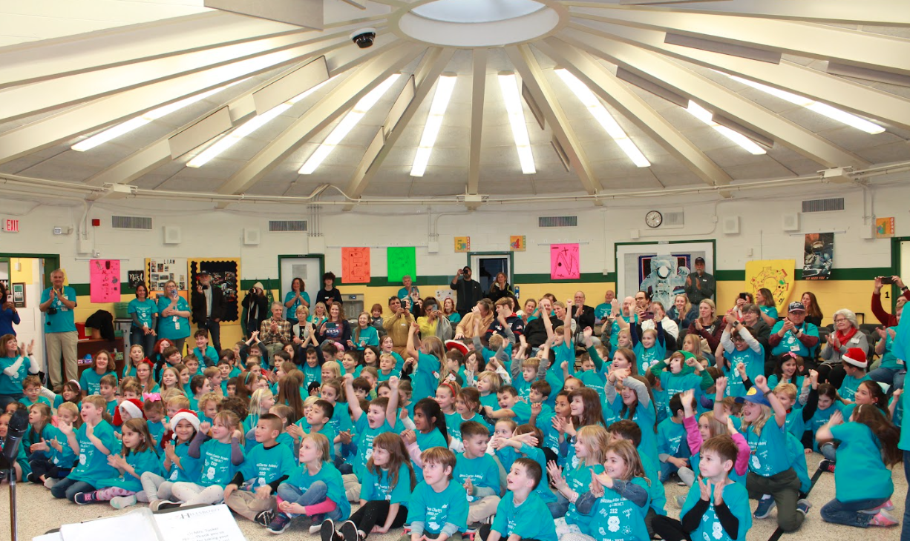
Afterwards
Report to ARISS
QSL & SWL Cards
Update the LARG Website, social media

Slide 18
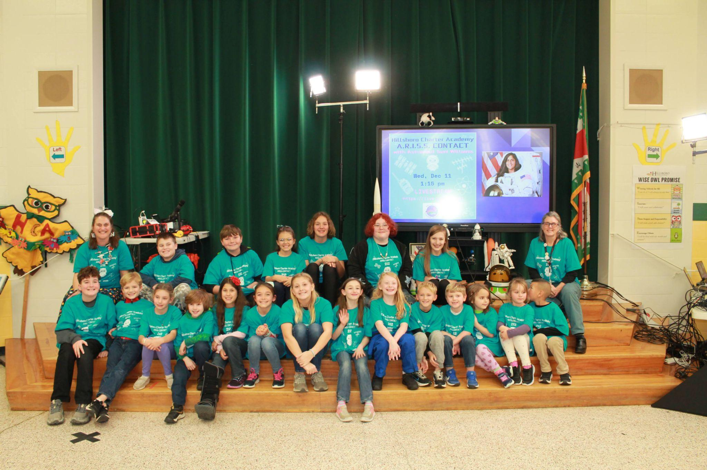
What’s Next
ARISS:
LCPS Interest
Middleburg Charter School?
Others?
Non-ARISS demos, public STEM events
Field Day, of course
LARG “Work a satellite” event?

Slide 19
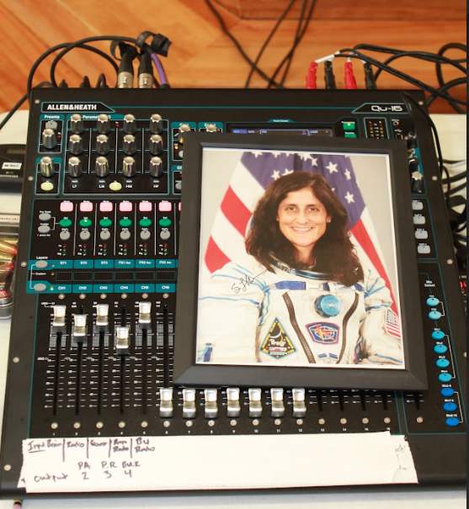
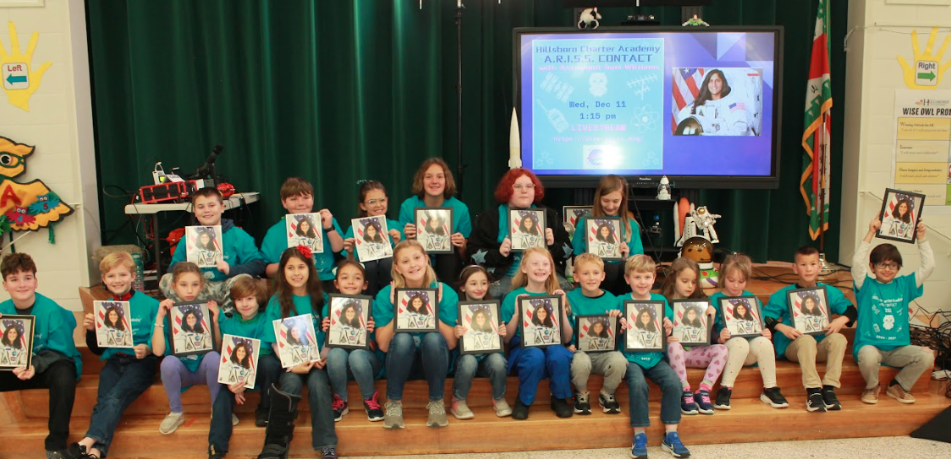
73s and THANK YOU!
LARG Radio Team
KS1G
AK2M
N4PD (& N1NCY)
KM4GC & XYL
K2BFY
N4FAF
HCA
KQ4MAM
KQ4MAL, KQ4YXB
Brian King, Superlative Events
Mrs. Tennant and Mrs. Dalton
Hillsboro Mayor Vance
ARISS & NASA
AA6TB
KM4TAY
And of course, KD5PLB!

