Slide 1
APRS Digipeater
Kevin, WA4KBM

Slide 2
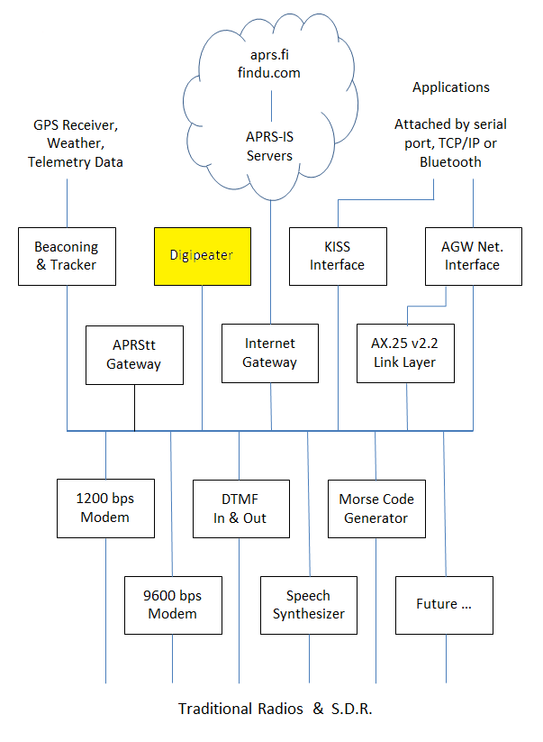
Digital Repeater “digipeater”
Extends range.
Usually single frequency.
Store and Forward.
Notes:
A digital repeater serves the same purpose as a voice repeater. It extends the range of a radio signal by retransmitting it from a different location.
A voice repeater receives on one frequency and simultaneously retransmits on a different frequency.
A digital repeater generally operates on a single frequency. A packet is stored in memory and then retransmitted when the channel is clear.
There is a provision for the maximum number of repeater hops. This is decremented each time so a packet does not go bouncing back and forth forever.

Slide 3
Parts:
1. Raspberry Pi Zero W
2. 4 Port USB HUB HAT for Raspberry Pi
3. GPS/GLASS U-Blox USB GPS
4. 32-bit Raspberry Pi OS Bullsey (Legacy) on a MicroSD
5. Retvis RA-86 HT
6. Digirig Mobile.
6a. Digirig Baofeng HT Digirig Cables Set
7. Portable Charger 50000mAh Power Bank - 22.5W Fast Charging External Battery Pack, LED Display USB-C
8. Electronics Coaxial Coax Cable Assembly SMA Male to BNC Female Bulkhead 15cm/6" Length - Pack of 2
9. QILIPSU Waterproof Junction Box, IP67 Outdoor ABS Plastic Electrical Enclosure with Mounting Plate, Wall Brackets, Weatherproof Hinged Grey Cover for Projects (11.2"x7.7"x5.1")
10. Assorted USB cables.
11. Ed Fong slim J-pole antenna (or other 2m capable antenna)

Slide 4
Software:
  a. Direwolf
  b. GPS
  c. GPSUpdate
  d. TMUX
  e. Auto hotspot

Slide 5
Configure RPI 0 W
1. Ensure wayland is disabled use raspi-config
2. Change hostname: APRSDigiPi0-0
3. Enable ssh
4. Enable VNC
5. Disable bluetooth (saves power):
sudo nano boot config.txt
Add this to the bottom of the file: dtoverlay=disable-bt
6. Install another browser: sudo apt-get install midori
7. Install Filezilla SFTP software: sudo apt install filezilla
8. Use 73Linux to install: https://github.com/km4ack/73Linux
git clone https://github.com/km4ack/73Linux.git $HOME/73Linux && bash $HOME/73Linux/73.sh
Install the following:
  a. Direwolf
  b. GPS
  c. GPSUpdate

Slide 6
Sound Configuration
1. Remove Pule Audio:
sudo apt-get remove pulseaudio
sudo apt-get autoremove
2. Configure alsamixer:
#run
alsamixer
Select audio Device: 3 USB Audio Device
Set Speaker and Mic to about 70
Make sure the small box shows 00 and no MM. MM indicates mute.
Set Autogain Control to MM.
Exit
#save alsamixer settings you just made
sudo alsactl store

Slide 7
TMUX
tmux is a terminal multiplexer. It lets you switch easily between several programs in one terminal, detach them (they keep running in the background) and reattach them to a different terminal.
Install tmux: sudo apt install libavutil-dev tmux

Slide 8
Auto hotspot
Aim:
When you're home: On starting the Raspberry Pi it connects to your home routers wifi
When you're out: On starting, if any known wifi connection is not found it will generate an access point so a direct wifi connection can be made to the Raspberry Pi by a tablet, phone or laptop.
While in access point mode: if an ethernet cable is connected the Raspberry Pi, then it will have network/internet access along with any wifi device connected to the access point.
Setting up the auto Hotspot
https://www.raspberryconnect.com/projects/65-raspberrypi-hotspot-accesspoints/183-raspberry-pi-automatic-hotspot-and-static-hotspot-installercrontab -e

Slide 9
Starting the Digipeater
start.sh: This configuration file automatically starts the Digipeater but waits until the GPS and the Audio device are functioning before starting up direwolf. This file goes in your home directory.
change start.sh to executable: chmod +x start.sh
#1 /bin/bash
sleep 20
gpspipe -r -n 5
ck=$( arecord -l | grep "USB Audio Device" )
while [ -z "${ck}" ]; do
ck=$( arecord -l | grep "USB Audio Device" )
sleep 1
Done
tmux new -d -s direwolf '/usr/local/bin/direwolf’

Slide 10
Final Config and Access to Digipeater
When you are sure the start.sh script is operational add the following command to the crontab.
crontab -e
Add the following: @reboot home/<your home Directory>/startup.sh
From a command window you can access the direwolf session;
#shows you the tmux sessions running.
tmux -ls
#This command opens the tmux direwold session
tmux a -t direwolf
#In order to get out of the session without shutting it down
ctrl+b followed by d

