Slide 1
An Introduction to LoRa & The Meshtastic Project
by Andy Z – K1RA
k1ra@k1ra.us

Slide 2
Presentation Overview
What is LoRa?
What does a LoRA signal look like?
Define Meshtastic. Hardware? Software?
COTS LoRa Radios
Why use Meshtastic?
Meshtastic Networking Details
View DIY Meshatastic nodes in NoVa
Review specific NoVa Meshtastic information
Basic Meshtastic Radio programming and usage
Setting expectations and real-world lessons learned
In conclusion and online resources

Slide 3
What is LoRa?
Long Range Radio and is designed and optimized for long-range, low-power IoT communications. DigiKey﻿
Uses unlicensed technology in the 433(EU/US), 868(EU), 915(US) MHz bands with channel bandwidths from 31.25-500 KHz wide.
A wireless modulation technique that encodes information on radio waves using chirp pulse and is based on Chirp Spread Spectrum (CSS) technology, which is similar to how dolphins and bats communicate. The Things Network﻿
Can be decoded up to 20 dB below noise floor, depending on Spreading Factor
Tends to be more robust against interference and can be received across great distances compared to other 3G/4G/5G technologies. techtarget.com﻿, The Things Network﻿
Developed by Cycleo (Grenoble, France), and was later acquired by Semtech (Camarillo, CA) and is closed-source technology. Wikipedia﻿

Slide 4
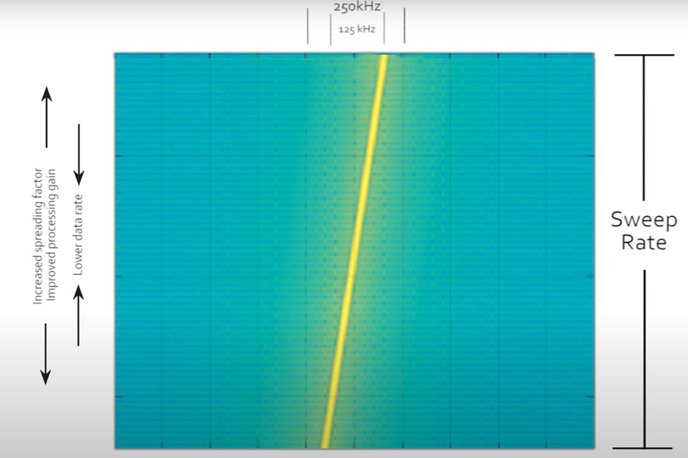
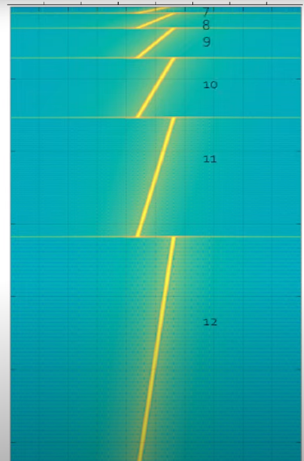
Viewing LoRa Signal in Time & Frequency
https://youtu.be/dxYY097QNs0
Spreading Factor

Slide 5
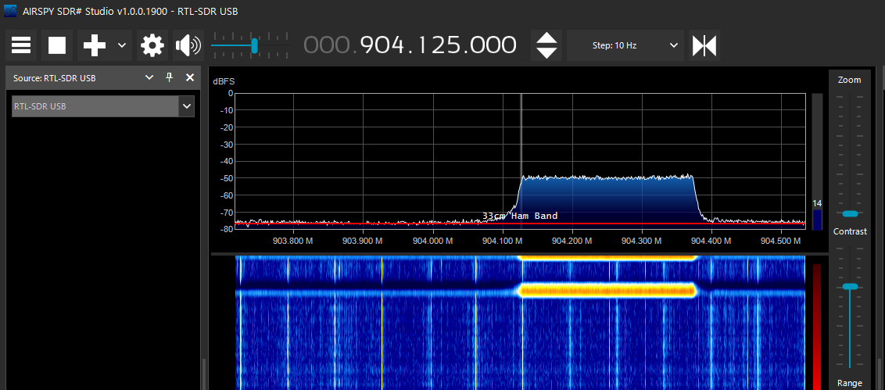
LoRa RF Viewed with SDRSharp & RTL-SDR

Slide 6
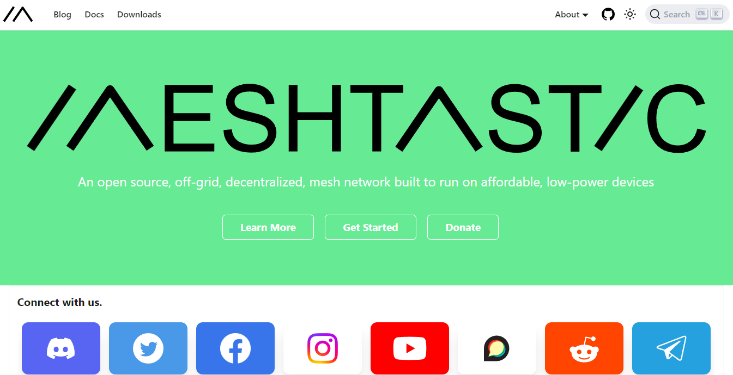
https://meshtastic.org/

Slide 7
What is Meshtastic?
A digital, texting app built on top of Semtech based LoRa radios
It does NOT rely on the Cellular Network or Internet (but can use later)
Implements encrypted Mesh Networking
Runs on ESP32 (Espressif) or nRF52 (RAK) based processors
Radios are using 902-928 MHz, ~250mw @ 31.25-500 KHz bandwidth
Radios have data rates anywhere from 90 bit/s –> 37.50 kbps
Radios are accessed via an iOS or Android device and app OR web or CLI
Requires Smartphones or PCs + BlueStacks that can run the Meshtastic app
App talks to the radio via BlueTooth or WiFi or Serial/USB
Radios/nodes act as relays/repeaters to build and extend a Mesh network

Slide 8
Meshtastic Definitions
Meshtastic = A message-based protocol running over LoRa
Mesh = A group of nodes that communicate and repeats packets
Node = A user consisting of a LoRa TX/RX and Mesh firmware & app
Preset = Modulation scheme
Roles = Client, Client-Mute, Router, etc.
Slot = Frequency
Hop = Relay, repeater count
Channel = Chat room, chat group
PSK = Pre-shared Key (for encryption of group and direct messages)
Device Metrics = Node health, location, telemetry info (SNR, RSSi, hops)

Slide 9
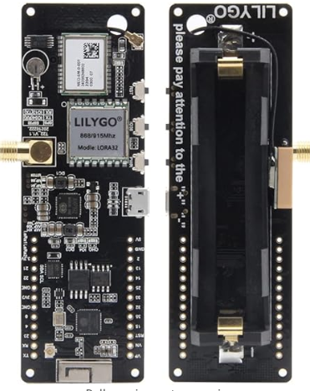
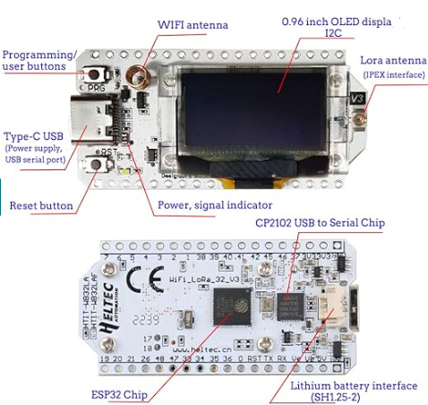
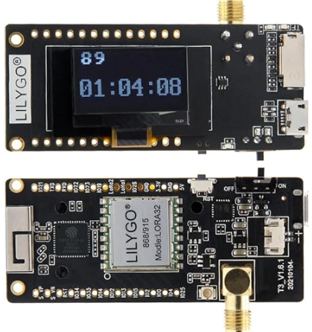
Common Meshtastic Radio Equipment Options
Heltec V3 (2” x 1”)
No GPS
LilyGo ESP32 (3” x 1”)
No GPS
LilyGo T-Beam v1.x (4” x 1.5”)
GPS

Slide 10
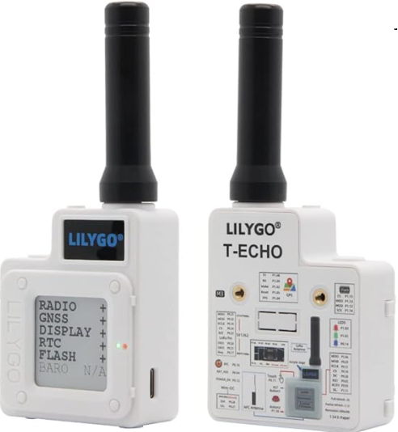
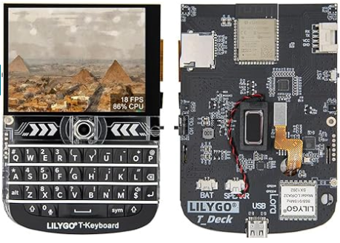
Other Meshtastic Radio Equipment Options
LilyGo T-Echo
GPS
LilyGo T-Deck

Slide 11
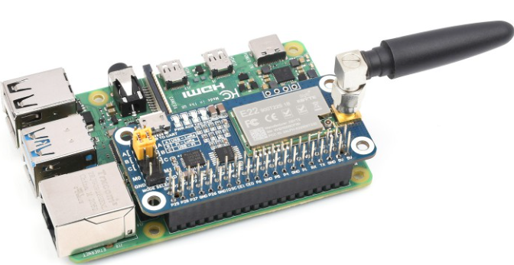
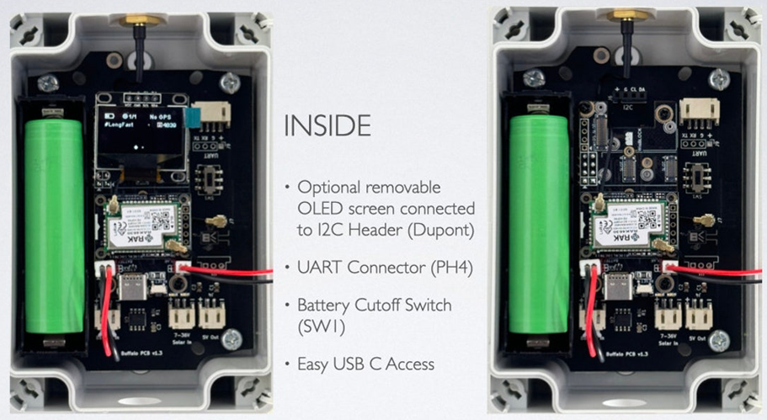
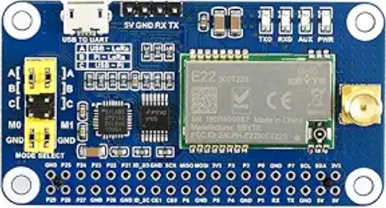
Other Meshtastic Radio Equipment Options
nRF52 RAK4361
Solar Node
Raspberry Pi & LoRa HAT

Slide 12
Why Use Meshtastic Radio Equipment?
Experiment with relatively inexpensive digital messaging radios
Attempt use of shorter wavelengths & higher freqs (33cm & 900 MHz)
Analyze usage of very wide bandwidth modes
DIY, build UHF antennas to observe extending local coverage
Contribute to the development and extension of open-source s/w
Involve non-hams in the radio frequency experimentation & hobby
Learn or use a programming language (Python) to interact with radios

Slide 13
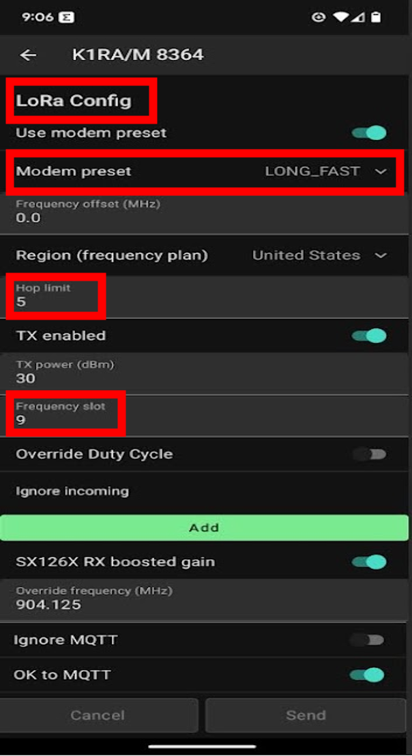
Meshtastic Networking Details
LoRa Region (Country/Continent) – dictates MHz band (433/868/915 MHz)
https://meshtastic.org/docs/overview/radio-settings/
LoRa Radio Modem Modulation Presets
(Coding Rate bps – Spread / BW Hz – Link SNR dB)
Short Fast (10.94k – 7 / 250K – 143dB), Short Slow (6.25k – 8 / 250K – 145.5dB)
Medium Fast (3.52k – 9 / 250K – 148dB), Medium Slow (1.95k – 10 / 250K – 150.5dB)
Long Fast (1.07k – 11 / 250K – 153dB), Long Mod (0.34k – 11 / 125K – 156dB)
Long Slow (0.18k – 12 / 125K – 158.5dB), Very Long Slow (0.09k – 12 / 62.5K – 161.5dB)
LoRa Hop Limit (# of relaying nodes, Not including Source and Destination)
LoRa Slot (Carrier Frequency)
https://meshtastic.org/docs/overview/radio-settings/#frequency-slot-calculator
ShortX & LongX = 104 slots
Very Long Slow = 416 slots (lower data rate = lower bandwidth = more slots)
Meshtastic Payload over Network
Preamble (wake) + 12-byte packet header
addressing, message number, ACK/NACK, encryption data
237-byte max message (unused bytes not transmitted)

Slide 14
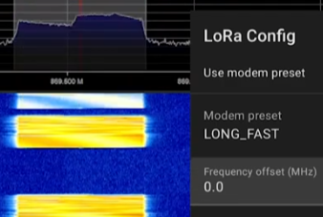
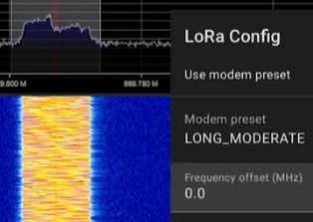
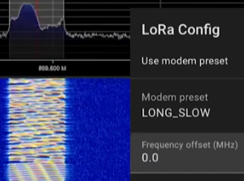
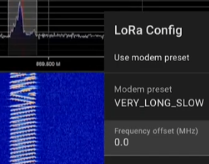
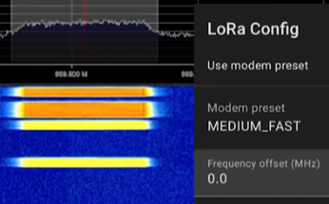
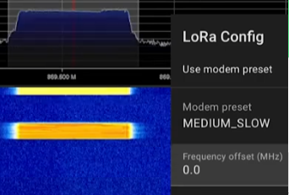
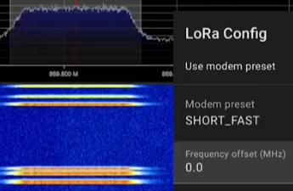
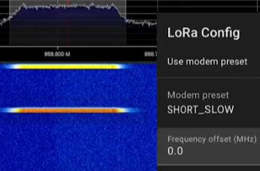
Meshtastic Signal Identification
Long Fast 1.07k/s – 11 / 250K
Long Mod 340b/s – 11 / 125K
Long Slow 180b/s – 12 / 125K
Vy Long Slow 90b/s – 12 / 62.5K
Medium Fast 3.52k/s – 9 / 250K
Medium Slow 1.95k/s – 10 / 250K
Short Fast 10.94k/s – 7 / 250K
Short Slow 6.25k/s – 8 / 250K
https://www.youtube.com/watch?v=ytr4yWl77NA&ab_channel=TechnologyMaster

Slide 15
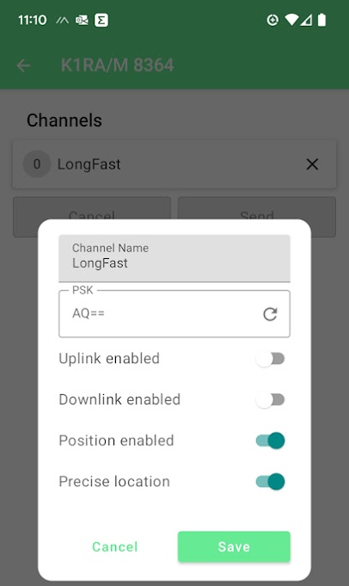
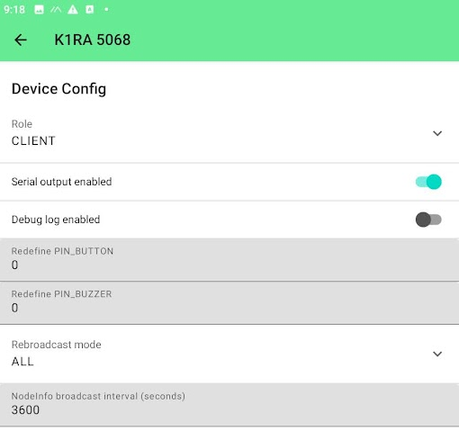
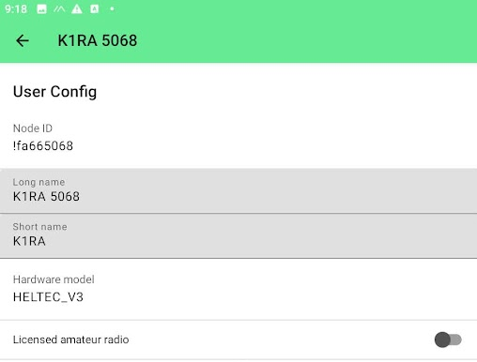
Meshtastic Networking Details
Device Role (Client, Client-Mute, Router, Router-Late)
Channel (Chat Group(s) - Default is Modulation Preset Name)
User Config “Ham” mode
Allows increased power
NO encryption

Slide 16
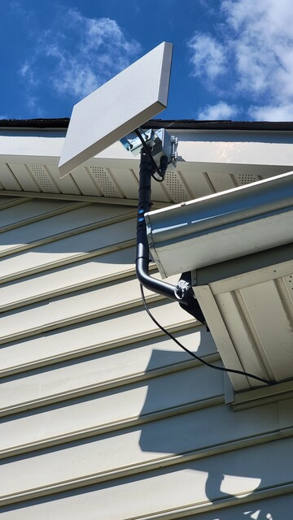
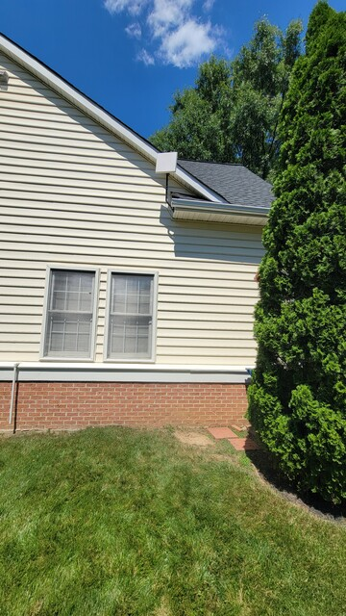
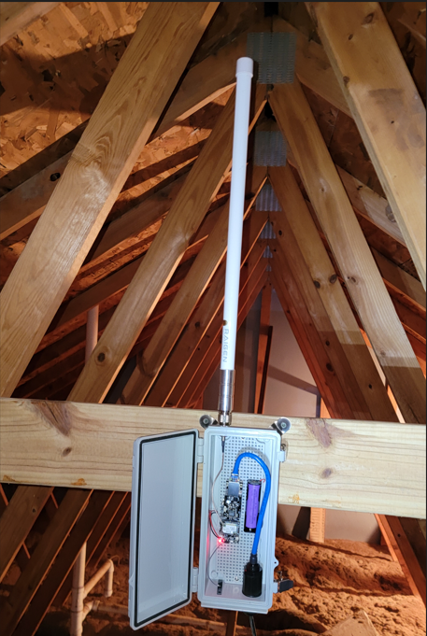
DIY Meshtastic Radio Nodes

Slide 17
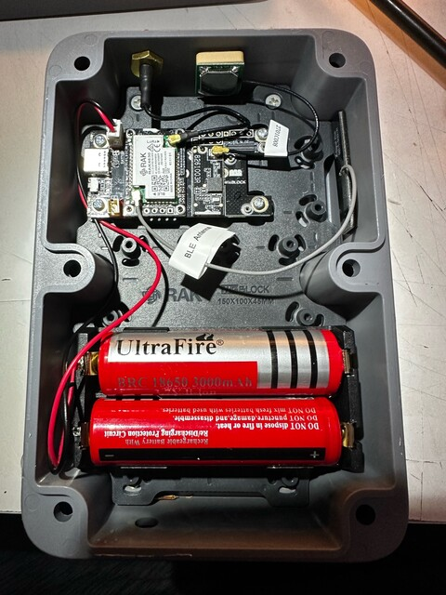
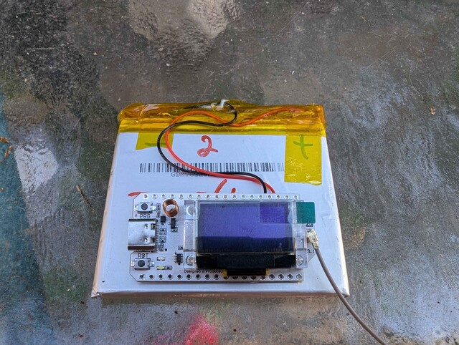
DIY Meshtastic Radio Nodes

Slide 18
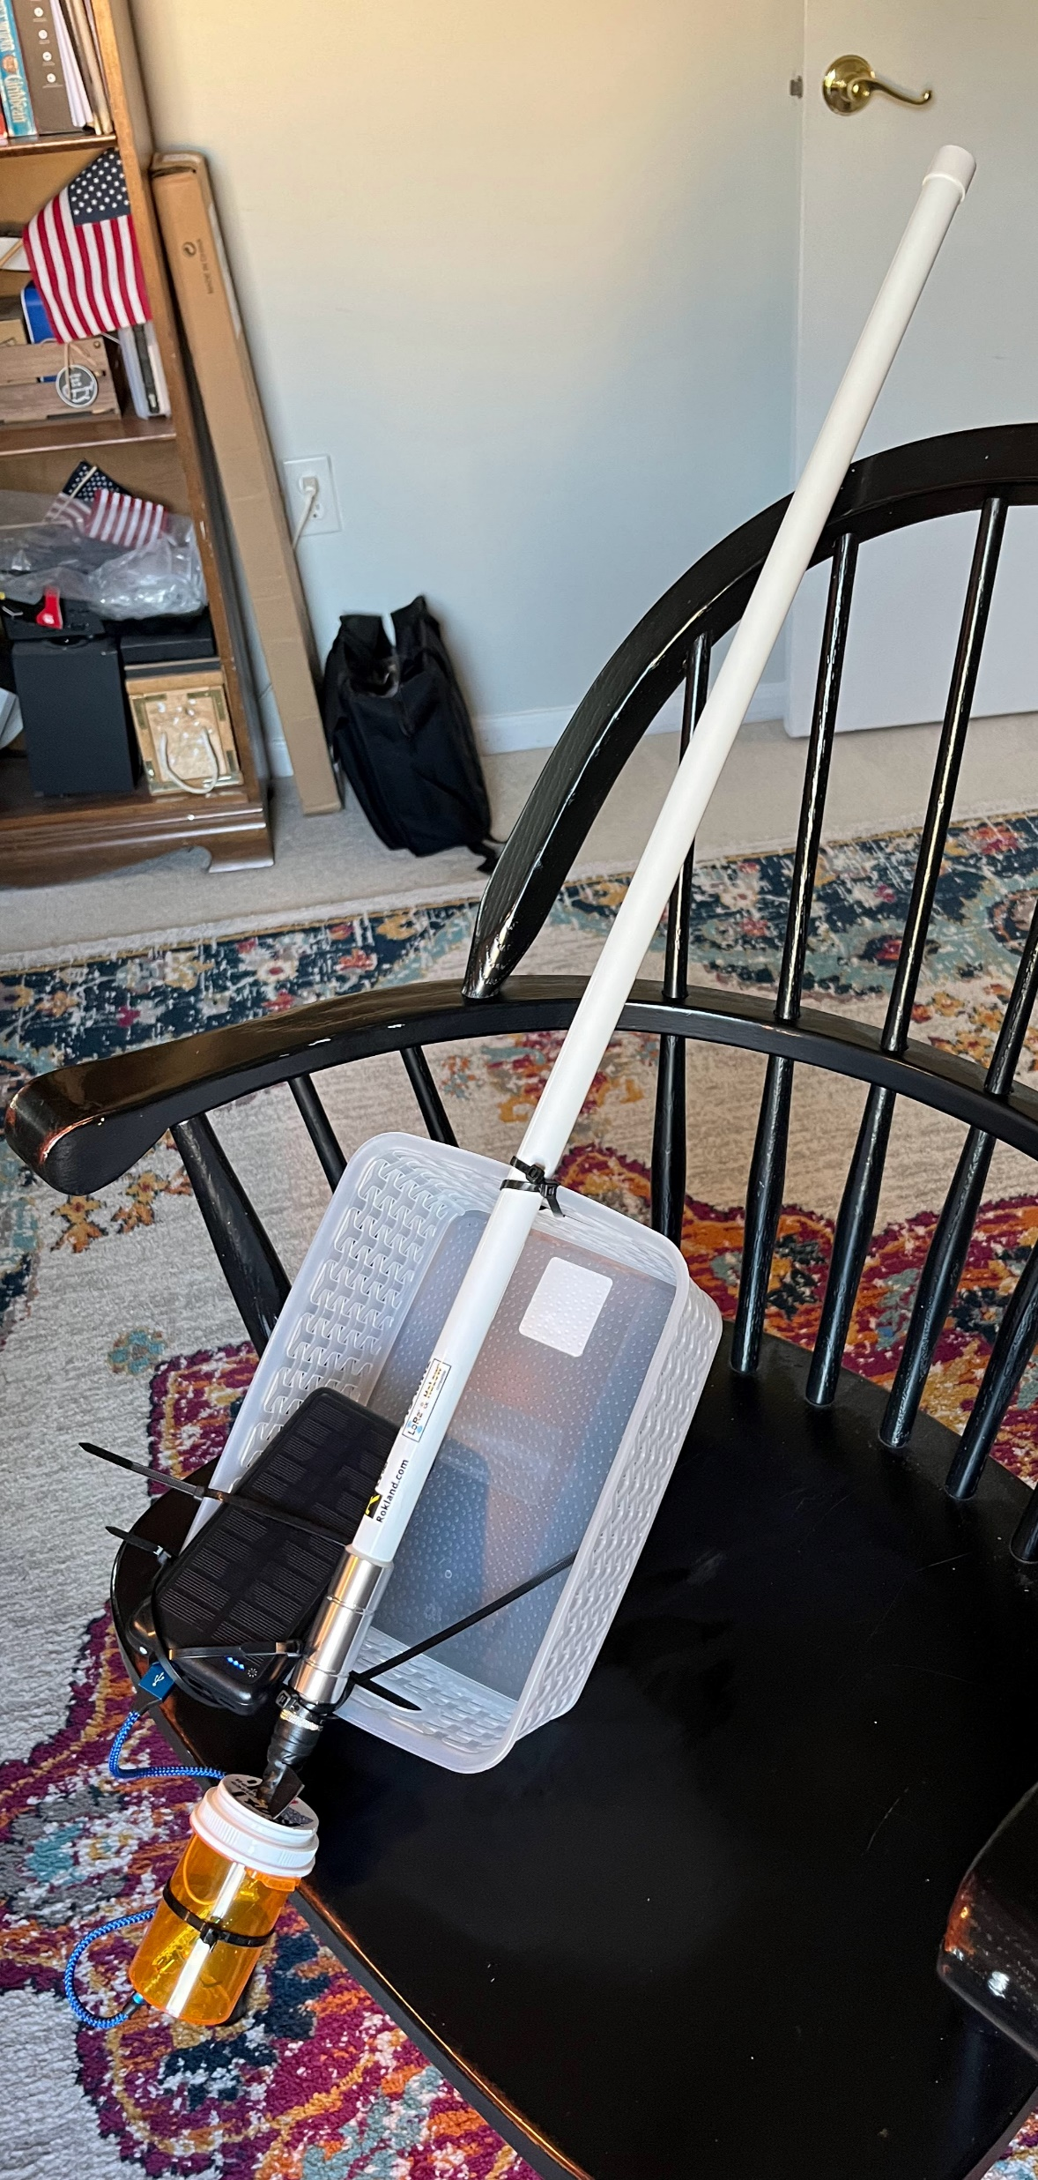
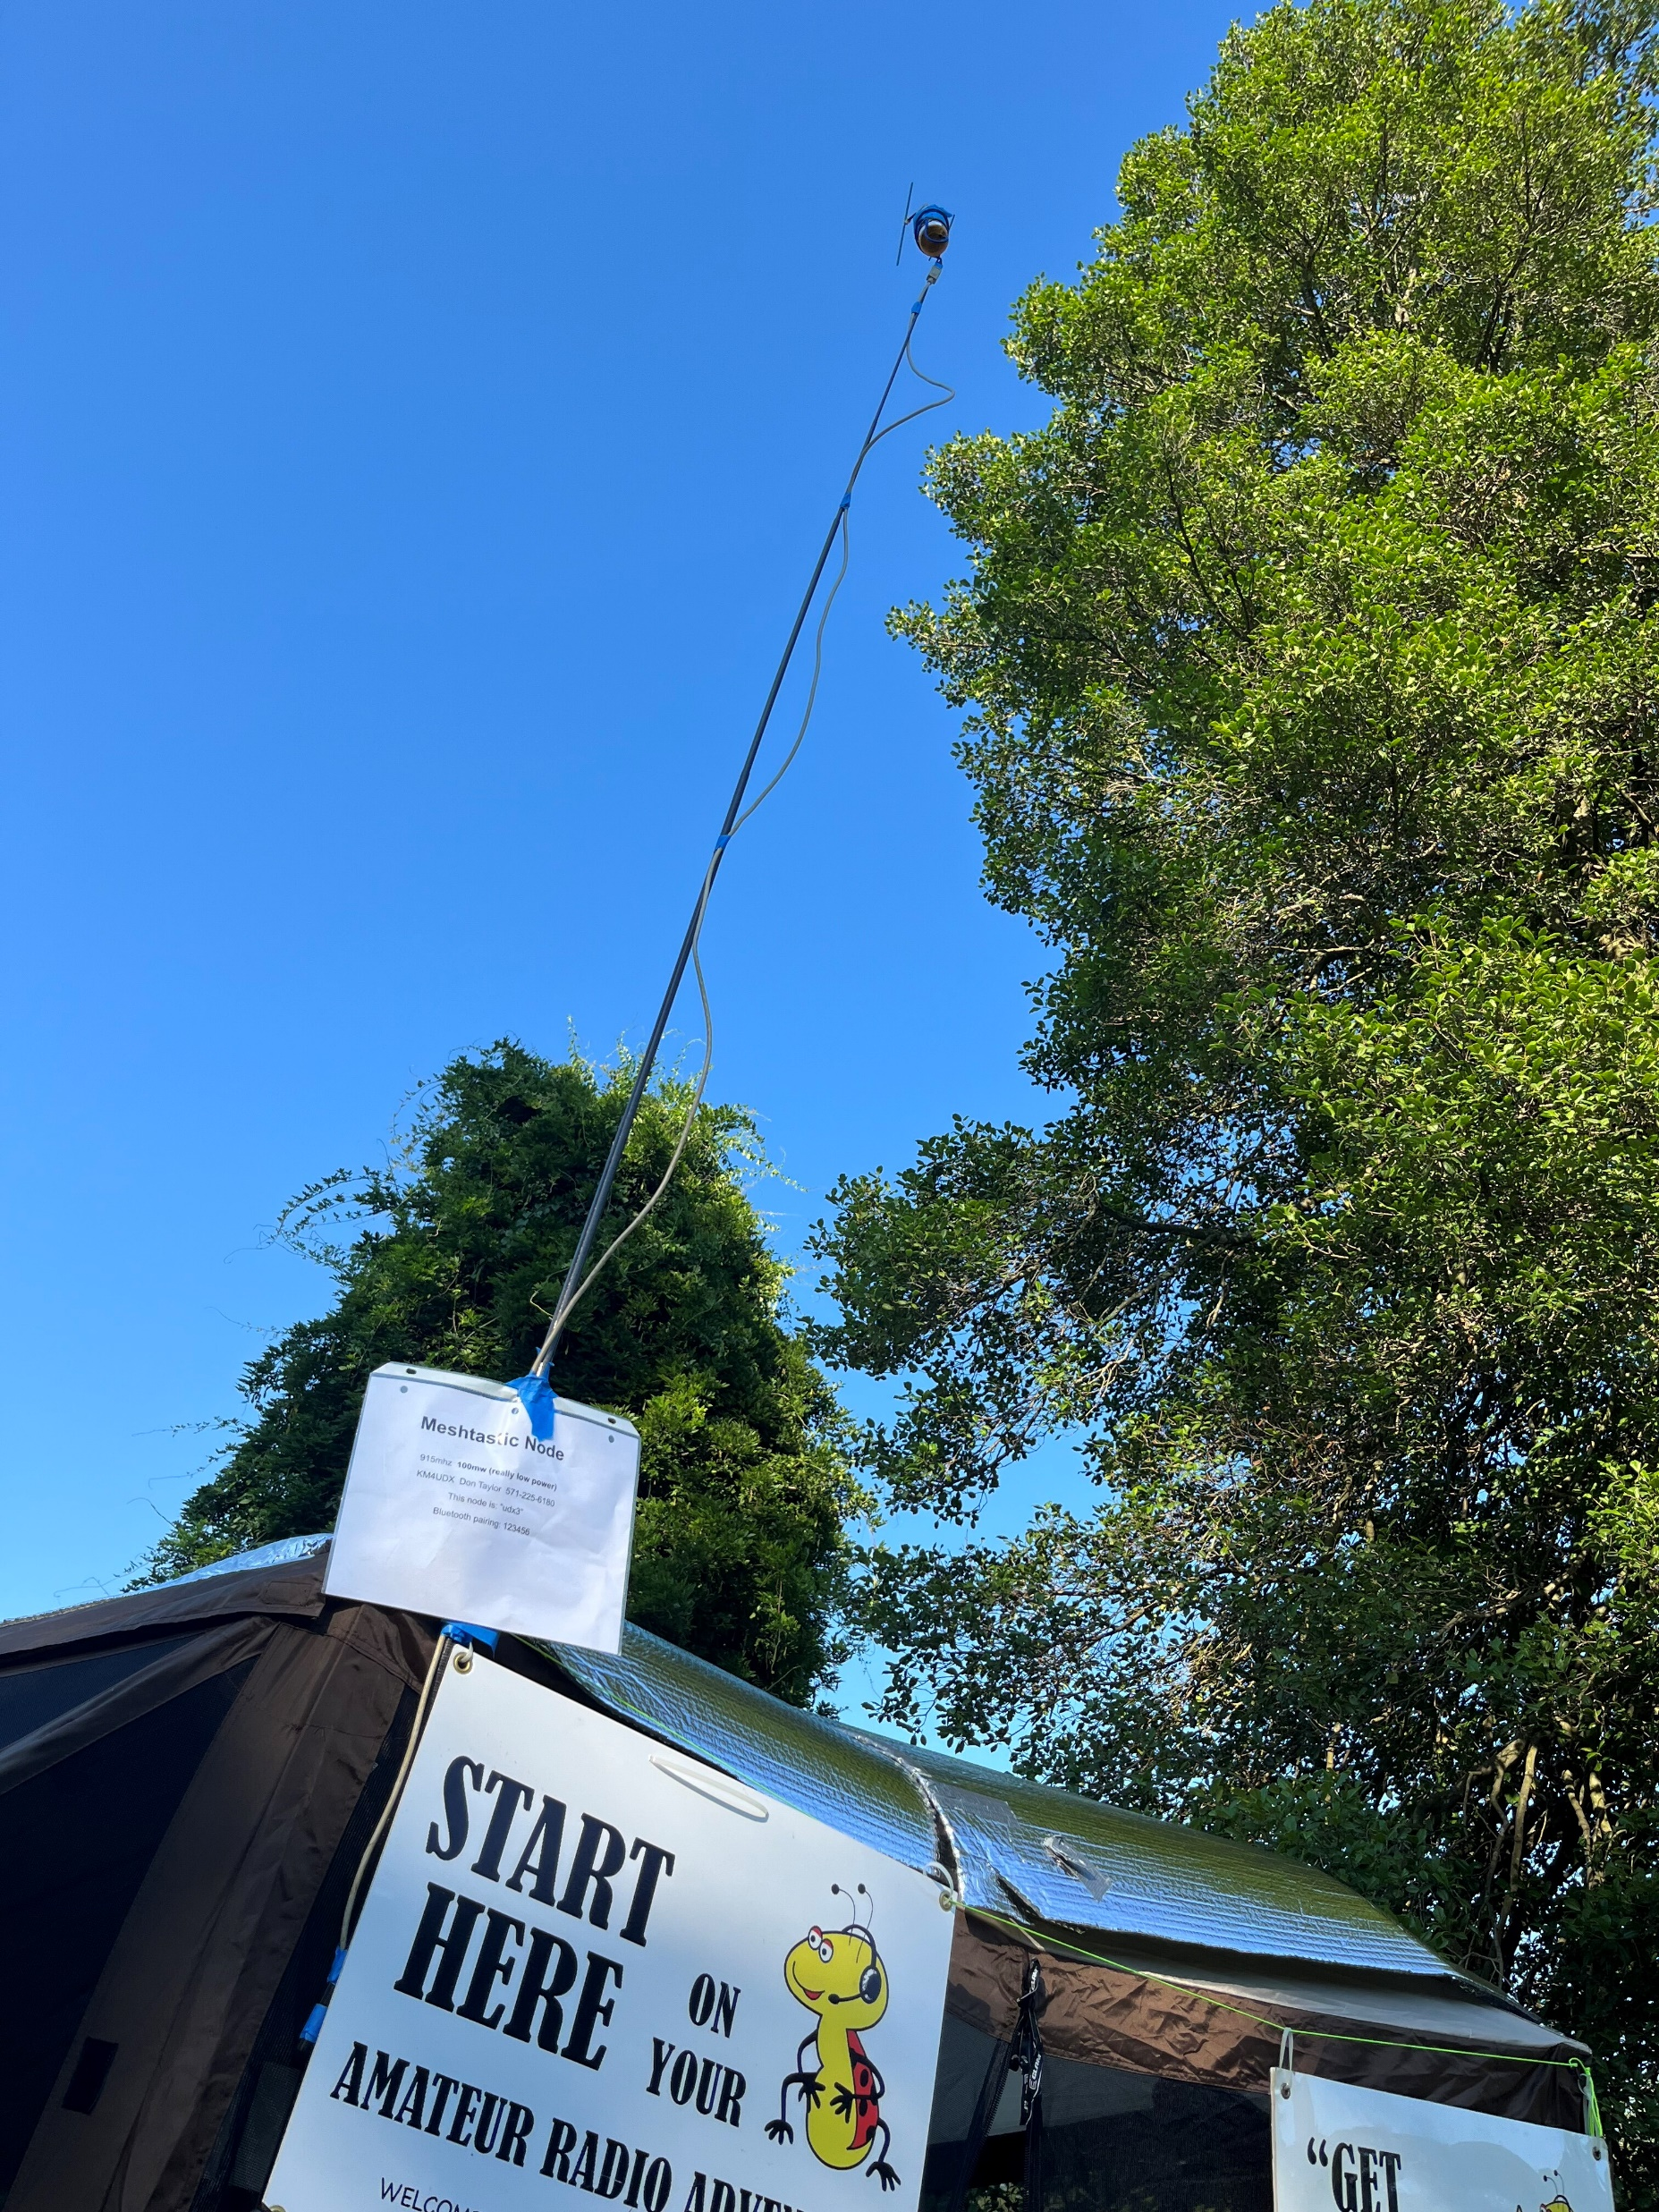
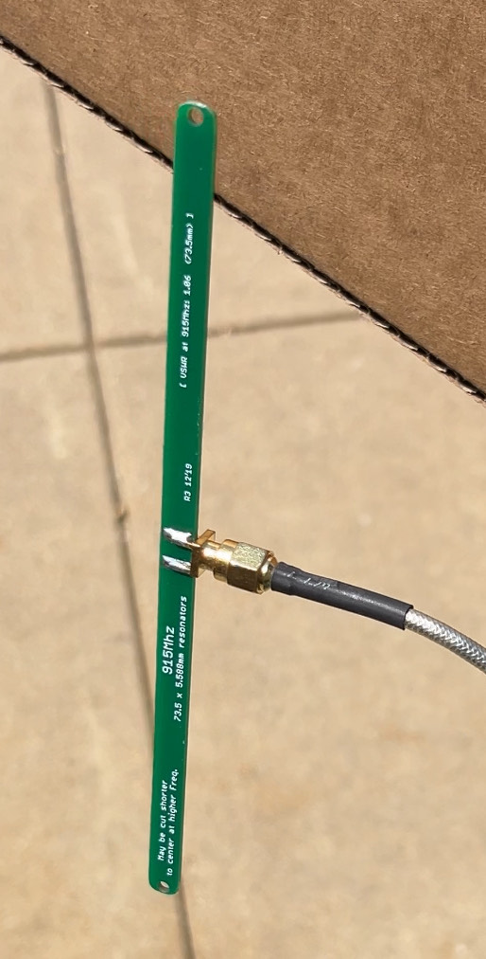
DIY Meshtastic Radio Nodes

Slide 19
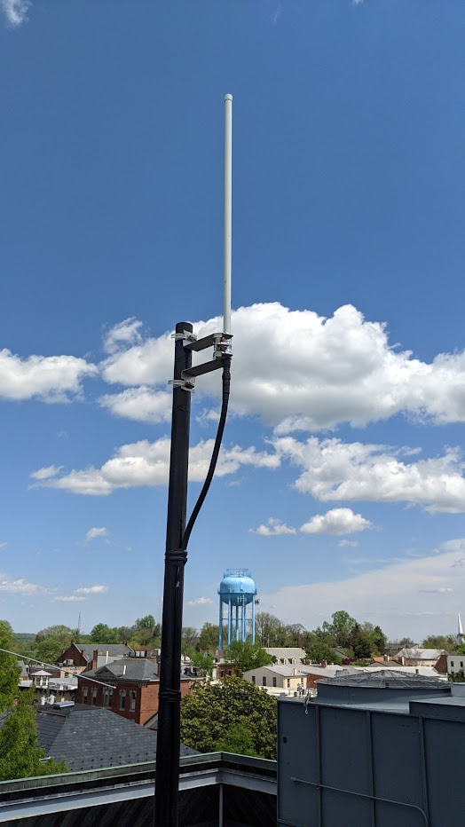
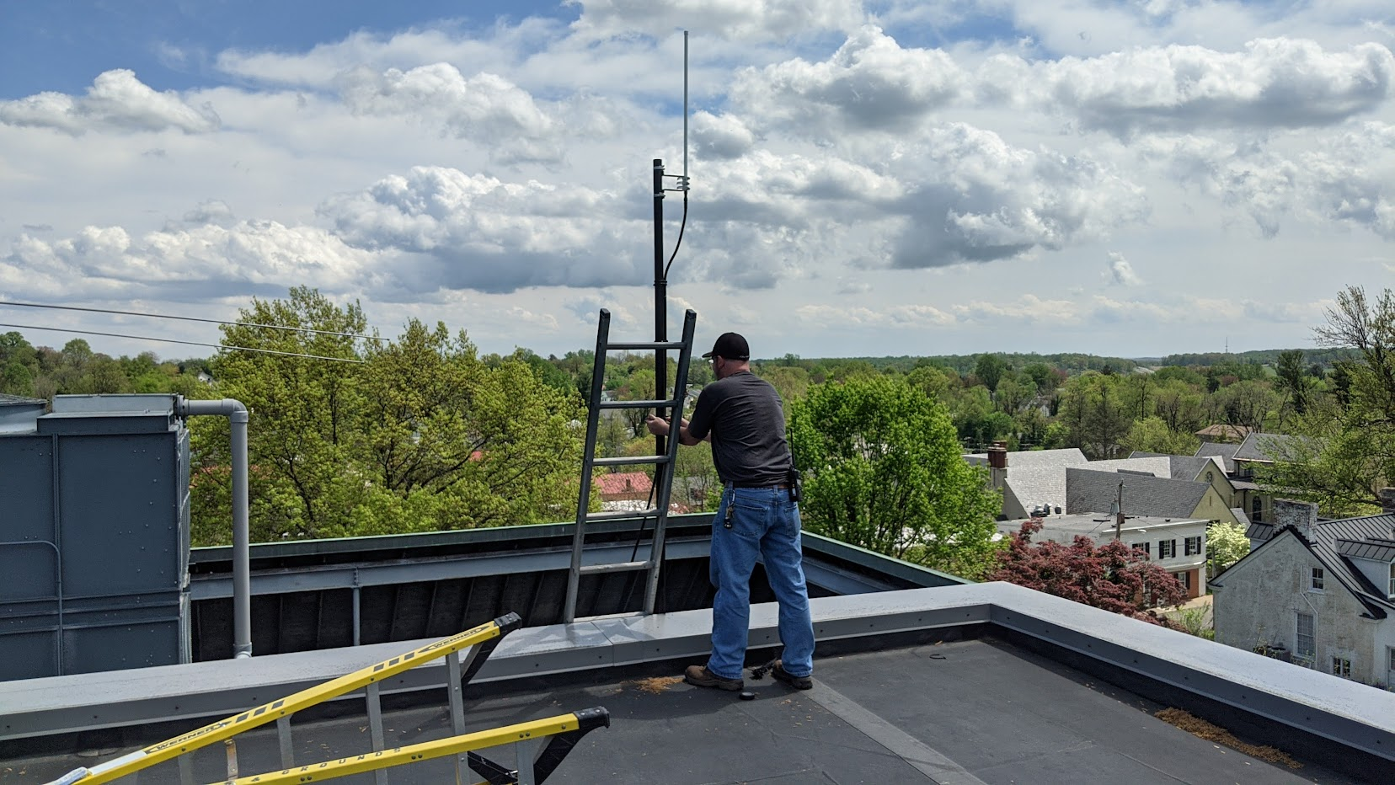
DIY Meshtastic Radio Nodes

Slide 20
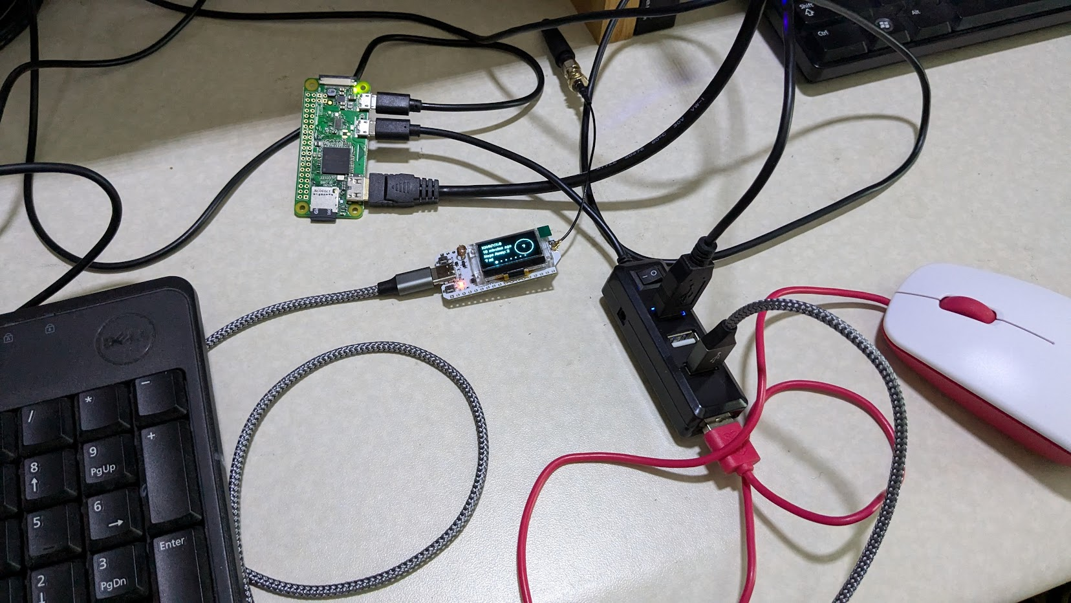
DIY Meshtastic Radio Nodes

Slide 21
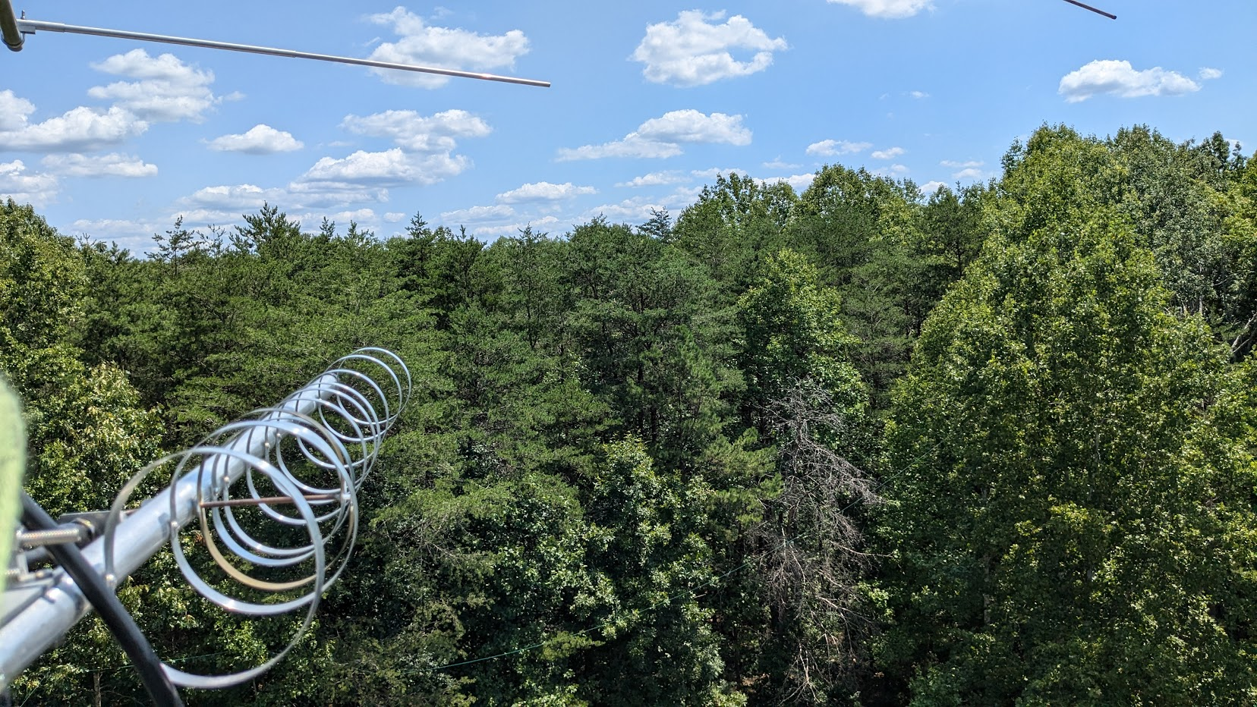
DIY Meshtastic Radio Nodes

Slide 22
NoVa Long Fast / Slot 9 - Meshtastic Network Stats
Mesh grew out of FARA/W4VA club, Harv K2PI & Andy K1RA July 2023
FARA member David KK4UYX leads area in node deployment
~100 Unique calls/names have participated on the Mesh since 2023
~300 Node names have been recorded on the Mesh @ K1RA FM18cr
~100 Nodes are active on any particular day
Many users have several nodes in service
Furthest edge nodes of network:
North = WLee – West Leesburg
South = K4PFE – Culpeper
East = F018 Attic Omni – McLean
West = W8ZN – Winchester

Slide 23
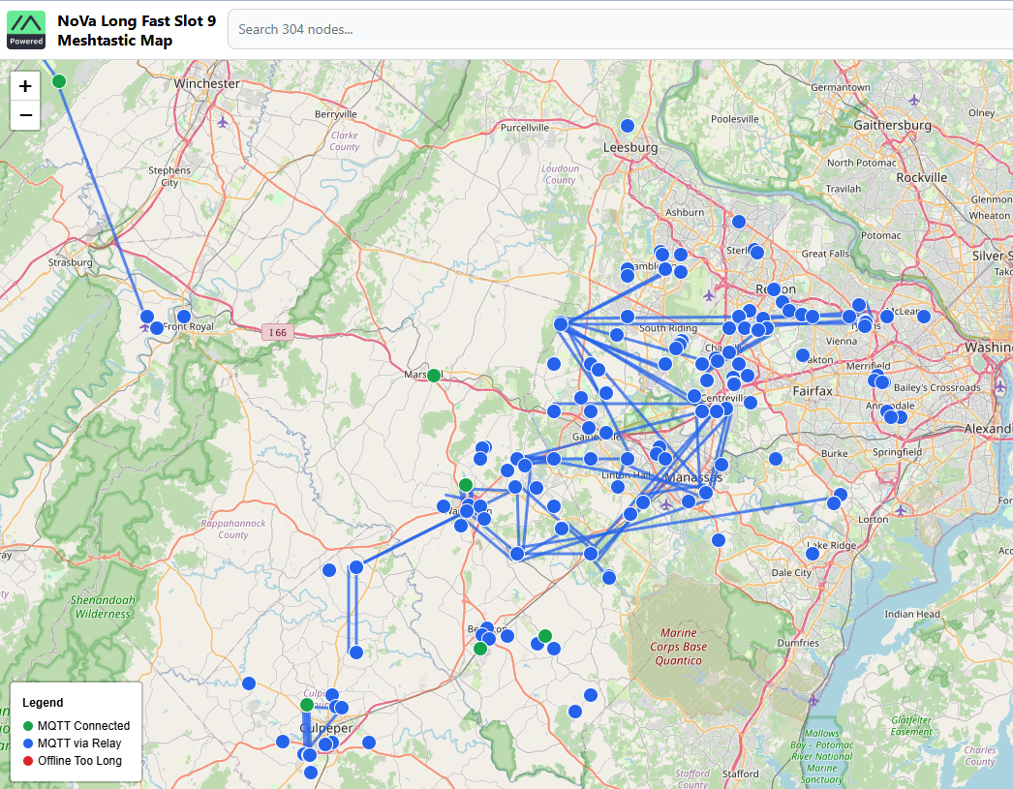
All time nodes
http://meshmap.k1ra.us:54321/

Slide 24
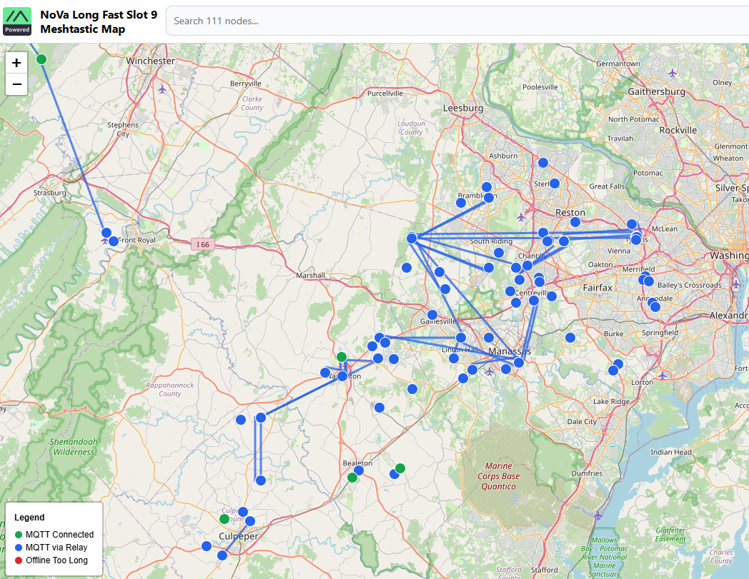
Nodes last 24 hours
http://meshmap.k1ra.us:54321/

Slide 25
First Time Configuring a Meshtastic Radio
Plug USB cable between radio and PC
Use Device Manager to find the radios corresponding COM# port
Using Chrome, go to the online Web flasher tool
Select your device (or attempt Auto-detect)
Select the firmware to upload (Beta/stable – Alpha/bleeding edge)
Select Erase and Upload firmware
Download Meshtastic App from Play Store/App Store to smart phone
Enable Bluetooth on Phone, start the app and click + to add radio
Look at radio screen for Bluetooth PIN pairing
Set up User, Device & LoRa Config screens at a minimum
Optionally set up Channels, Position/GPS, Network/Bluetooth & Display

Slide 26
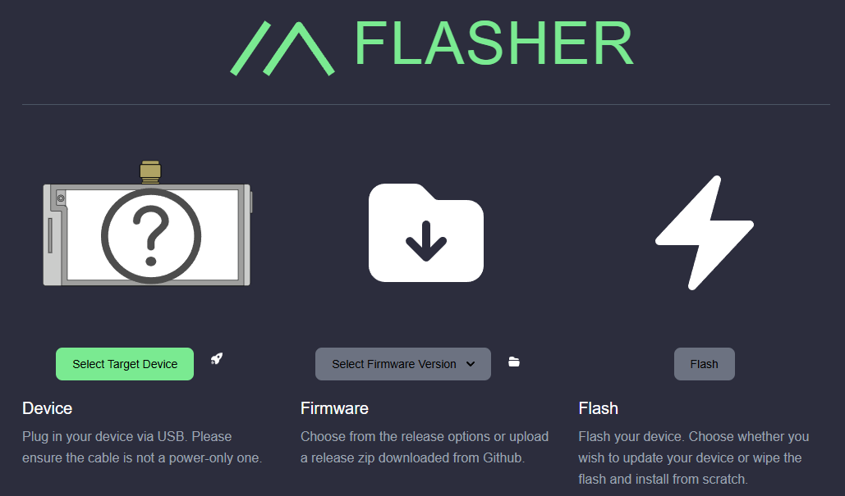
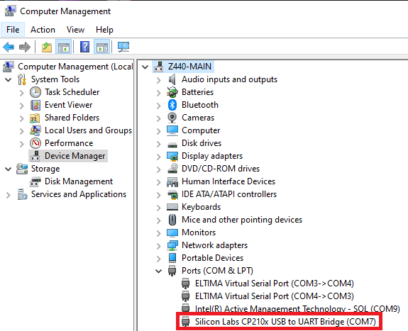
Meshtastic Radio Flashing / Programming
1.Open browser and go to URL
https://flasher.meshtastic.org/
2.Plug in USB LoRa Node to PC
3.Run Windows Device Manager
4.Find newly installed
LoRa USB COM port

Slide 27
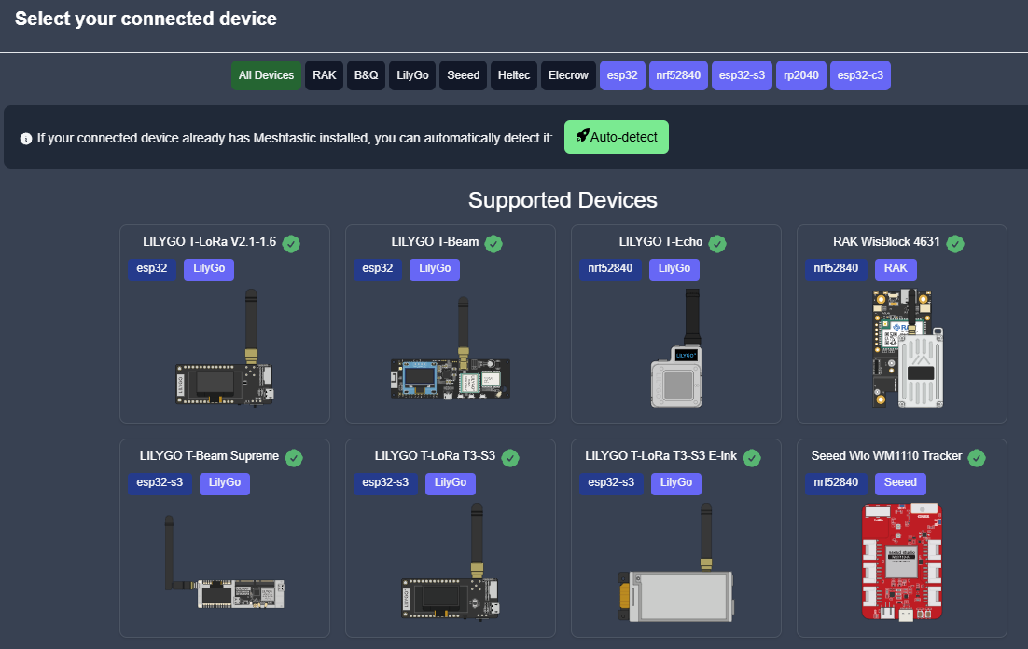
Meshtastic Radio Flashing / Programming
1.Select LoRa Radio Model

Slide 28
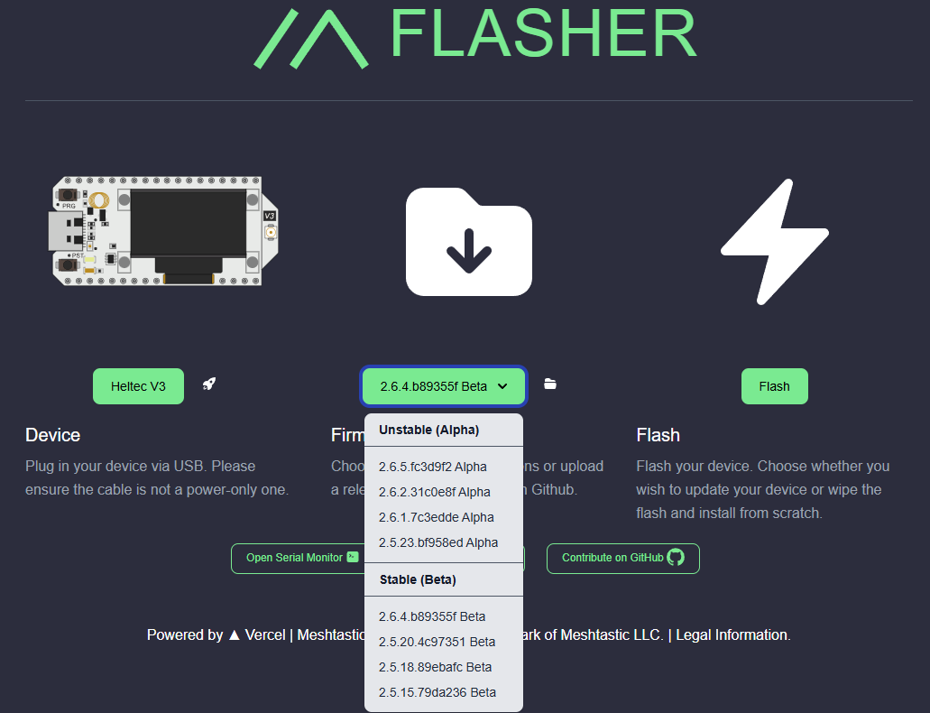
Meshtastic Radio Flashing / Programming
2.Select Latest Beta Firmware
3.Then Click Flash

Slide 29
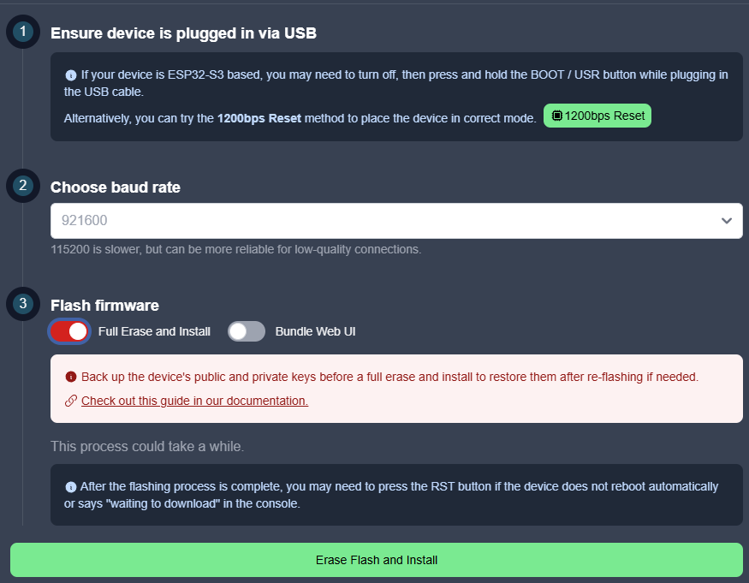
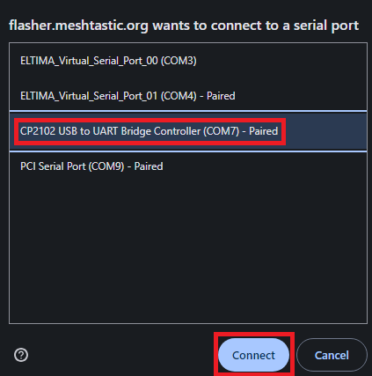
Meshtastic Radio Flashing / Programming
4.Select baud rate (all should work)
7.Choose COM port of LoRa
Radio found in Device Manager
5.Full Erase only first time out of the box (Web UI optional)
8.Click Connect
6.Click Install

Slide 30
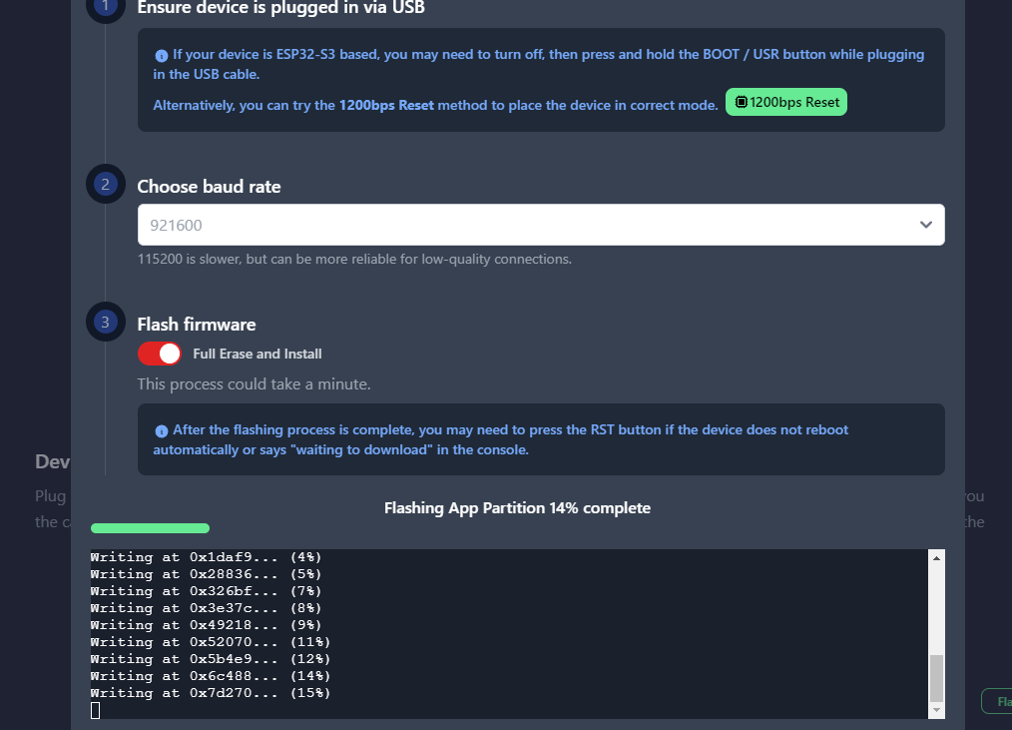
Meshtastic Radio Flashing / Programming
9.Wait for 100% Completion then close browser tab

Slide 31
Meshtastic Radio First Time Configuration
Short node naming conventions, only one node (4-character limit)
K1RA -> K1RA
K1HTV -> 1HTV
KD9ATF -> 9ATF
Short node naming conventions for calls with multiple nodes:
K1HTV Tower -> HTVt
K1HTV Mobile -> HTVm
K1HTV #3 -> HTV3
KD9ATF #2 -> ATF2
Long node names can be more verbose per names above on left

Slide 32
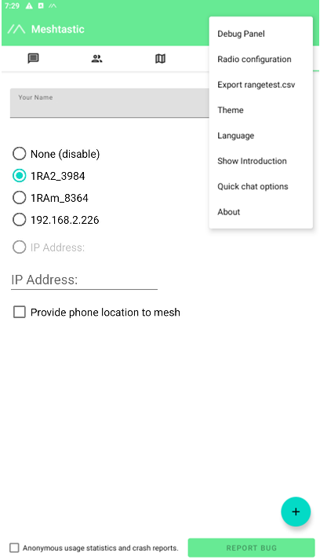
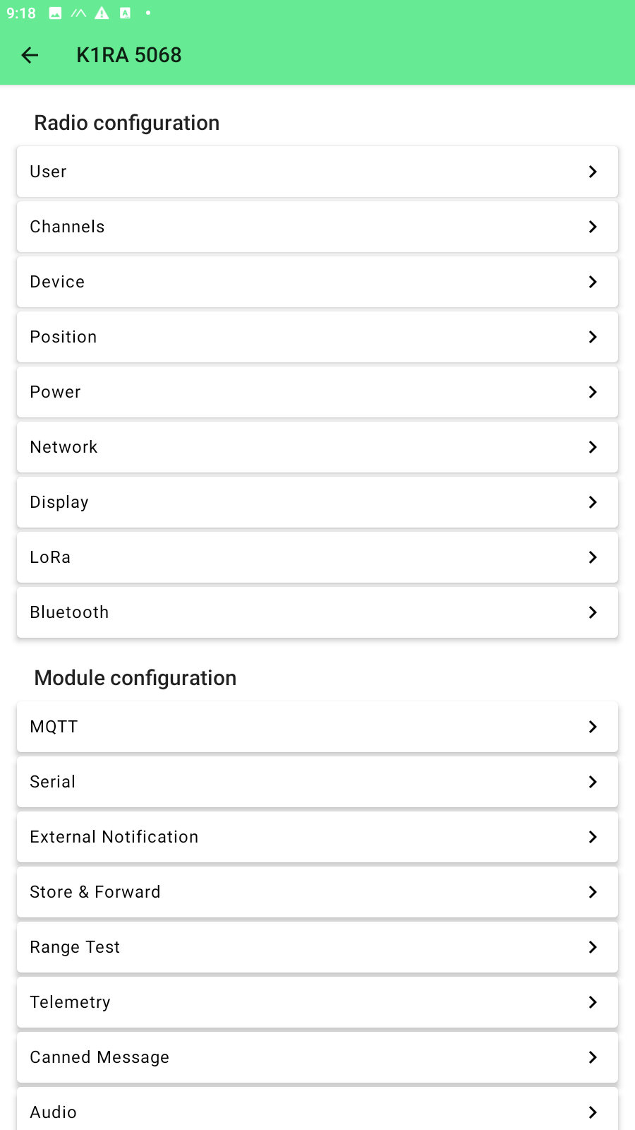
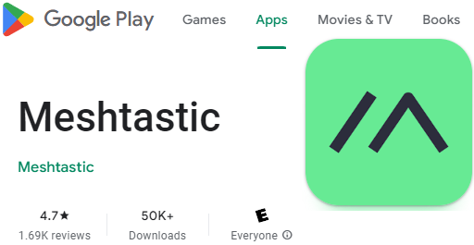
Meshtastic Phone App Configuration
Download Meshtastic App for
smartphone from Google Play
or Apple iOS Store
6.Click Device then see next page
4.Click triple-dots
in upper right open
menu and select
Radio configuration
5.Click LoRa then see next page
After installation open and run app
1.Ensure phone
Bluetooth is ON
2.Click +
3.Find LoRa device in pop
up, select and enter PIN
(see radio screen)

Slide 33
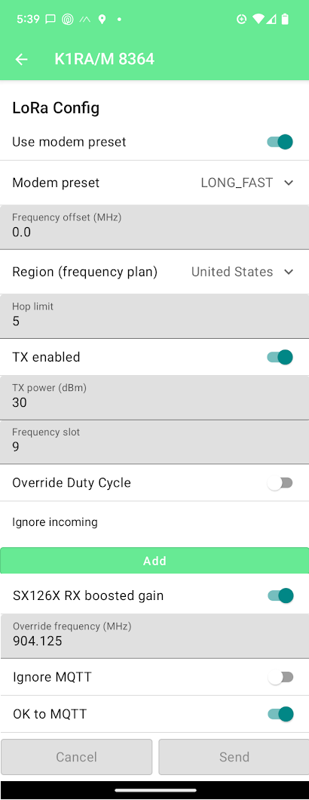
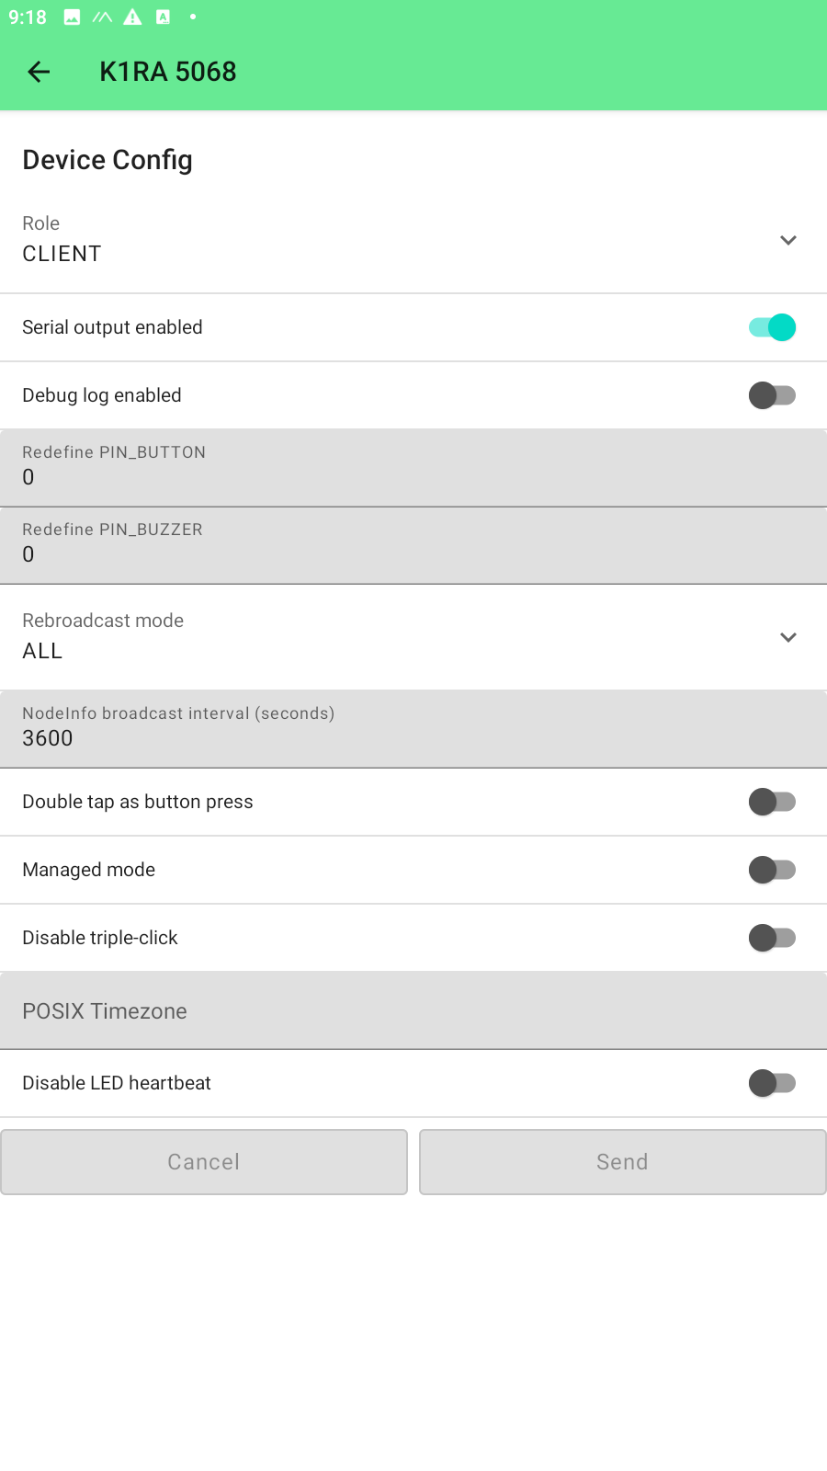
Meshtastic Phone App Configuration
From 6.->
From 5.->
Set Device Role
Set LoRa Preset
Set LoRa Region
Set LoRa Hops
Set Device Broadcast
Set LoRa Slot
Send when done
Wait for Reboot
Enable OK to MQTT
Send when done. Wait for Reboot watch radio screen
Then return to previous page using upper left <-. Goto 6. above

Slide 34
You Are On The Air! Navigating App
Remote Node Map
Remote Node List
Your local Node(s)
Connection Page
Cloud check = connected to radio
Cloud slash = disconnected

Slide 35
You Are On The Air! Traceroute / Hops
3.Wait for possible
response 1-30 secs
2.Tap
Traceroute
1. Tap
Short name
Color oval

Slide 36
You Are On The Air! Sending / Receiving
Chat groups (#) and direct node chats
Tap Long name to enter texting mode

Slide 37
Setting Expectation & Caveats
Mesh only effective when nodes stay powered on and always active
Height/altitude is key on UHF frequencies (radio LoS 1/3 past visual horizon)
Outside, high gain antennas are needed to greatly extend coverage
33cm more affected by attenuation of foliage, structures, terrain than 70cm
Interference issues - 902 MHz is ISM band the “Arm Pit” of the RF spectrum
Data passing is “best effort” broadcast and more like internet UDP
Open-source app is free and therefore at developers' leisure time
Frequent updates and bug fixes lead to manual re-flashing, no OTA updates
Android, iOS and Web apps differ substantially in UI and functionality

Slide 41
DSE 902 MHz (33cm) Loopers
https://directivesystems.com/902-mhz/

Slide 42
KK5UYX-5 Ashby St. Warrenton
Severe interference and overload issues due to line of site (<1 mi) cell tower and radiating signals in the 870-890 MHz band
LoRa radios little adjacent band filtering leading to poor receiver selectivity
Some form of bandpass filtering may be required depending on location
K1RA (LCOM & SigFox) & KK4UYX (Data Alliance) BPF filter analysis follows

Slide 43
BPF Filter Analysis
LCOM 900 MHz BPF
4-pole N Block ($275)
Frequency – Insertion Loss
904 MHz – 2.26 dB
950 MHz – 10 dB
890 MHz – 3 dB
885 MHz – 8 dB
880 MHz – 12 dB
870 MHz – 21 dB
860 MHz – 27 dB
@ >=40 dB insertion loss
BPF bandwidth = ~140 MHz
3
1
4
5
2
6
7

Slide 44
BPF Filter Analysis
Data Alliance 915 MHz
BPF SMA Bullet ($20)
Frequency – Insertion Loss
904 MHz – 2.93 dB
950 MHz – 40 dB
890 MHz – 42 dB
887 MHz – 24 dB
885 MHz – 43 dB
880 MHz – 37 dB
@ >=40 dB insertion loss
BPF bandwidth = ~70 MHz
1
4
6
2
5
3

Slide 45
BPF Filter Analysis
SigFox 900 MHz BPF
Block SMA ($775)
Frequency – Insertion Loss
904 MHz – 2.80 dB
950 MHz – 48 dB
890 MHz – 45 dB
885 MHz – 65 dB
880 MHz – 46 dB
870 MHz – 54 dB
860 MHz – 47 dB
@ >=40 dB insertion loss
BPF bandwidth = ~20 MHz
1
7
5
3
2
6
4

Slide 46
KK5UYX-5 After Filter Installation
Offending Cellular signal reduced more than 40 dB
Noise floor of 900 MHz band reduced.
Note other spread spectrum signals.

Slide 47
NB3A (escrap) Manassas

Slide 48
In Conclusion
Enjoy the fun of tinkering, discovering and radiating microwave signals
It’s a bit DIY that can save on the budget, but mostly COTS
Its a cool science project but may never replace other comms
Typical range coverage of stock equipment is 1-2 miles
COTS radios are $25-120 (Amazon, Rockland, AliExpress)
COTS antenna are $30-150 (omnis-yagis)
Using external antennas? Coax runs should be short and/or low loss
Radios tend to use SMA and coax and antennas tend to use N
Alternative text app that even XYL and kids can use with their phones

Slide 49
Discussion Groups & Resources
Getting Started
https://meshtastic.org/
https://meshtastic.org/docs/introduction/
https://flasher.meshtastic.org/
NoVa Meshtastic Discussion Groups & Resources
Groups.io - https://groups.io/g/NoVa-Meshtastic/
Signal - https://signal.group/#CjQKIC1ef3BaLuECuPQn-tJFVpBvNY0J0al7_k7mia8QlrauEhBFIAdQeWcg47cS3wxubFbF
NoVa Long Fast Slot 9 Mesh Map – http://meshmap.k1ra.us:54321/
Other Area Meshtastic Groups
DCMesh Discord - https://discord.com/channels/1265715107657289862/1265715107657289865
Global - https://meshtastic.discourse.group/
RF Path Line of Sight Mapping Tool
https://ispdesign.ui.com/
Meshtastic Application Programming Interfaces
https://github.com/meshtastic/api
https://github.com/meshtastic/python
https://github.com/pdxlocations/Meshtastic-Python-Examples
https://github.com/mkinney/Meshtastic-python
https://github.com/bmswens/Meshtastic-Web-API
Other LoRa Radio App Projects
LoRa-APRS-iGate - https://github.com/richonguzman/LoRa_APRS_iGate
Meshtastic SDR Receiver - https://gitlab.com/crankylinuxuser/meshtastic_sdr
TinyGS LoRa Satellites - https://tinygs.com/

Slide 50
The End
Thanks & 73
Andy Z – K1RA
k1ra@k1ra.us
https://k1ra.us/

Slide 51
https://tinygs.com/

Slide 52
40 Active 400-437 MHz sats.
9 Active 430 MHz balloons
4 Active 137 MHz sats. (Starlink)
5 Active 869-915 MHz sats.
4300+ world wide Ground Stations forward received telemetry packets
Server controls Ground Station’s reception by calculating satellite in range and tuning GS receiver to proper frequency
Server aggregates packets received from Ground Stations, decodes and makes data available thru Web UI and API
Telegram BOT provides registration, usernames and passwords thru text message interactions

Slide 53
TinyGS.com Satellite Map for K1RA FM18cr
https://tinygs.com/station/K1RA@6059973945

Slide 54
TinyGS.com Dashboard
Statistics for K1RA
https://tinygs.com/station/K1RA@6059973945

