Slide 1
What we don’t know about VHF/UHF FM
by
K2BFY

Slide 2
- History
- Narrow Band vs Wide Band
- Bandwidth
- Spacing
- Band Plans
- Regulations
- Carson’s Rule
- Antennas
- FM Nets
- A Taste of FM

Slide 3
Edwin Armstrong invented FM in 1933 and created the first FM radio station in 1940. He was born in New York City in 1890. He attended Columbia University’s engineering school. During World War I, he served in the U.S. Army Signal Corps.
“The Armstrong Method” was a ham radio colloquialism back around 1960. It referred to a system of ropes and pulleys to rotate an antenna.

Slide 4
Narrow Band vs Wide Band
- Mostly wide band in the USA
- Wide band fm is 5kHz deviation
with a 16 kHz bandwidth
- Narrow band fm is 2.5kHz deviation
with a 11 kHz bandwidth
- For digital modes in VHF/UHF amateur radio,
the bandwidth is up to 100 kHz for modes
like Packet and D-STAR.
- This includes 6m, 2m, 1.25m, and 70 cm

Slide 5
- Narrow Band will work with Wide Band Repeaters
- Transmitting Narrow Band on Wide Band Repeaters
will result in hard to copy audio under weak signal
and noisy conditions, so it is best to use wide band.
- Always consider that other stations may experience
difficulty hearing you.

Slide 6
Deviation Emission Code Bandwidth
2.5kHz 11K F3E 11kHz
5kHz 16K F3E 16kHz
F - Frequency modulation,
3 - a single channel containing analog information
E - Telephony (including sound broadcasting)

Slide 7
Carson's Rule:
The occupied bandwidth (BW) is 2 times the sum of the highest audio frequency of modulation (fM) and the FM deviation (fD).
For radio communications, fM is usually accepted to be 3000 Hz.
So, for +/- 5 kHz deviation, you have BW = 2 (3000 + 5000) = 16 kHz.
+/- 2.5 kHz deviation (aka narrowband) would be BW = 2 (3000 + 2500) = 11 kHz
Carson's Rule was formulated by John Renshaw Carson in 1922

Slide 8
- Spacing on 2m is 15 to 20 kHz
- Spacing on 1.25m is 40 kHz to 400 kHz
- Spacing on 70cm is 150 kHz

Slide 9
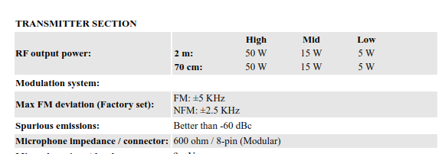
ICOM IC-2730A mobile vhf/uhf transceiver specifications

Slide 10
TYT 9000 mobile 1.25m transceiver specifications
 | Wide Band | Narrow Band
Power Output | 60w/25w/10w | 60w/25w/10w
Modulation | 16K F3E (5kHz deviation) | 11K F3E (2.5kHz deviation)

Slide 11
TYT 9000 mobile 1.25m transceiver settings
Selection | Receiver Bandwidth | FM Deviation | Emission
25 kHz WFM | 25 kHz | 5 kHz | 16K F3E
20 kHz FM | 20 kHz | 5 kHz | 16K F3E
12 kHz NFM | 12 kHz | 2.5 kHz | 11K F3E

Slide 12
TYT 9000 mobile 1.25m transceiver chirp programming file

Slide 13
- The east coast of the USA adheres to the ARRL
band plan and uses wide band fm.
- The west coast does not adhere to the ARRL
band plan and uses both wide and narrow band fm.
- Not sure about the middle of the USA.
- The UK and Europe use narrow band fm.
- Check with the local frequency coordinator.

Slide 14
On the VHF/UHF fm band segments are
we allowed to operate simplex on any frequency we choose?

Slide 15
NO

Slide 16
- Amateur radio band plans are self regulated
- The ARRL publishes basic band plans
- Frequency Coordinators assign and publish
repeater frequencies and band plans
- The FCC publishes power limits, bandwidth
limits, emission modes, and band
frequency limits

Slide 17
- Operating on a random chosen frequency
within the fm segment of a band could
interfere with repeater users.
- It might be OK if the repeater is down, but get
permission from the repeater owner.
- Other users may not have the random, chosen
frequency programmed into their radios.

Slide 18
- 2m is the most popular vhf band
- The fm segment ARRL band plan is shown
on the next slide

Slide 19
ARRL 2m FM Band Plan
144.60-144.90 FM repeater inputs
144.90-145.10 Weak signal and FM simplex (145.01,03,05,07,09 are widely used for packet)
145.10-145.20 Linear translator outputs
145.20-145.50 FM repeater outputs
145.50-145.80 Miscellaneous and experimental modes
145.80-146.00 OSCAR sub band
146.01-146.37 Repeater inputs
146.40-146.58 Simplex
146.52 National Simplex Calling Frequency
146.61-146.97 Repeater outputs
147.00-147.39 Repeater outputs
147.42-147.57 Simplex
147.60-147.99 Repeater inputs

Slide 20
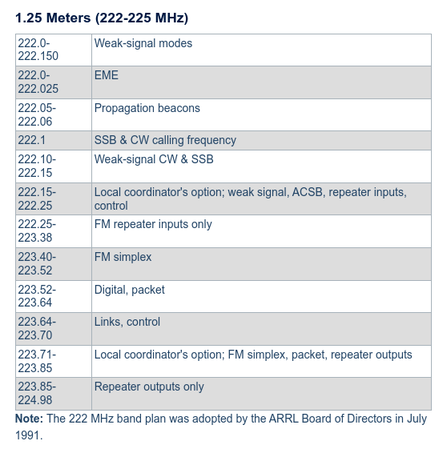
ARRL 1.25m Band Plan

Slide 21
T-MARC 1.25m Band Plan
Note that the T-MARC band plan has precedence over the ARRL band plan.

Slide 22
T-MARC Band Plan

Slide 23
Our frequency coordinator is T-MARC and may be found at tmarc.org

Slide 24
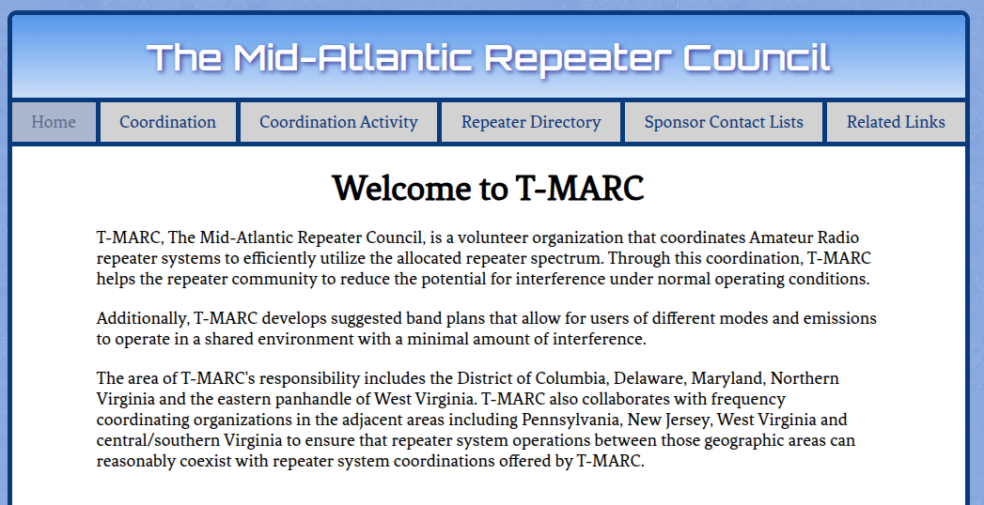

Slide 25
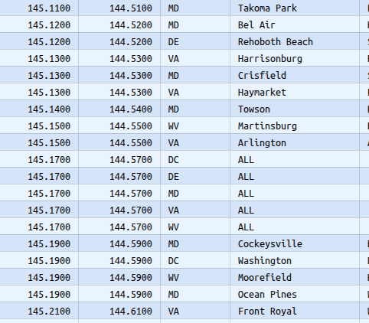
T-MARC has about 200 2m repeaters listed

Slide 26
T-MARC has about 50 1.25m repeaters listed

Slide 27
It should be obvious that there are many coordinated users on 2m FM and on other VHF/UHF bands, so we cannot simply choose a random frequency to operate on.
The K4LRG default 2m simplex frequency is
147.480 mHz

Slide 28
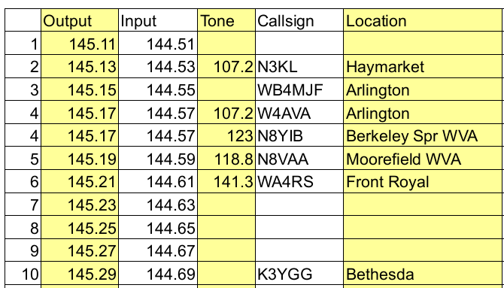
2m Frequencies with 20 kHz separation

Slide 29
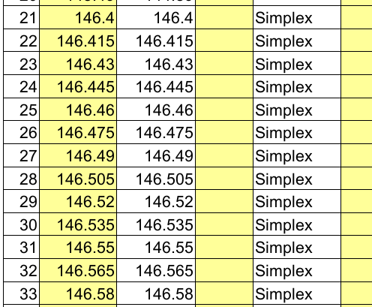
2m Frequencies with 15 kHz separation

Slide 30
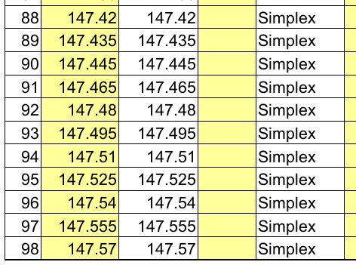
More 2m Simplex Frequencies

Slide 31
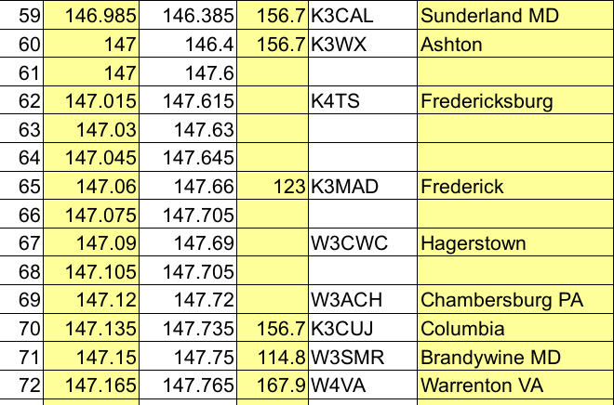
More 2m Repeater Frequencies

Slide 32
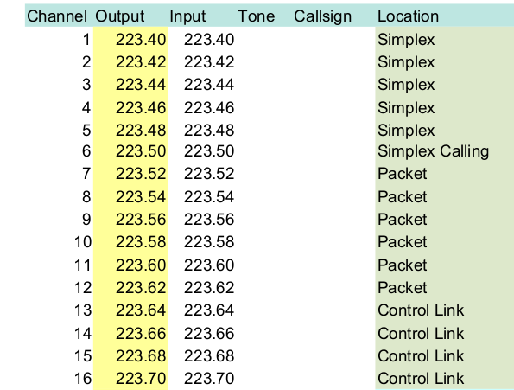
1.25m Simplex Frequencies

Slide 33
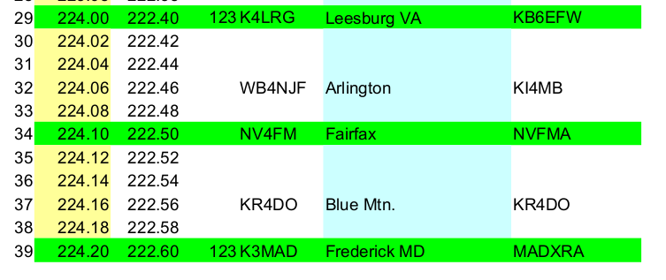
Some 1.25m Repeater Frequencies

Slide 34
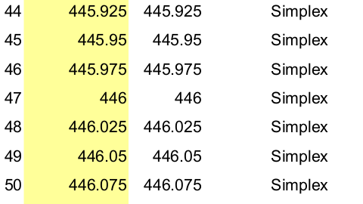
70cm Simplex Frequencies

Slide 35
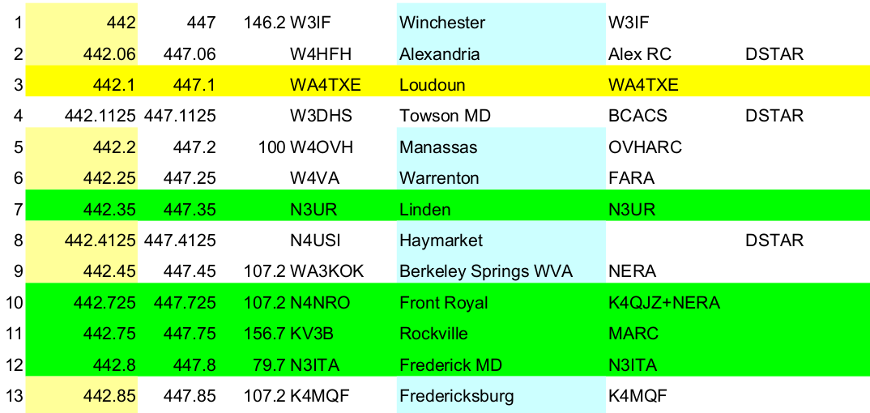
Some 70cm FM Repeater Frequencies

Slide 36
FM Nets
Sunday 2000 146.700 WA4TXE Leesburg Repeater
Monday 2000 224.200 PL 123Hz K3MAD Frederick MD Repeater
Starting OCT 2025:
Sunday 2000 146.700 WA4TXE Leesburg Repeater
Monday 2000 224.000 PL 123Hz K4LRG Leesburg VA Repeater
Tuesday 2000 224.200 PL 123Hz K3MAD Frederick MD Repeater
Why the VHF FM nets are important:
They are our primary local communications resource for emergency comms!!!

Slide 37
This is the Arrow Antennas 2m/70cm
jpole antenna.
It will also work on 1.25m because it is 5/8 wavelength on 2m.
See the extremely complicated math
below:
5/8 x 2m = 1.25m

Slide 38
A Taste of FM

