Slide 1
HT Exercise
Steve, N4RAF

Slide 2
HT Exercise
Verify handheld radios (HTs) are programmed correctly and function reliably on selected channels identified in the LARG ICS 205 spreadsheet.
Collect data to map where HTs can communicate with repeaters or other HTs

Slide 3
Locations
ID | Name | Primary Operator
Station 1 | Rust Nature Sanctuary (50w / mast) | N4RAF, Steve
Station 2 | Boat Ramp, Algonkian Regional Park | KQ4VZF, Patrick
Station 3 | 39.04515 N, 77.83385 W (Deer Hunting) | KQ4MHT, Jim
Station 4 | Trailside Park, Ashburn | Ron – KQ4IBI
Station 5 | Lovettsville Community Center | Kevin – WA4KBM
Station 6 | Brookfield Cir, Sterling | Rob – W3RJT
Station 7 | Dailey Pl SW, Leesburg | Jim – WA6TQA
Station 8 | Brockman Lane and Seneca Road, Great Falls, VA, 22066 | Bryce – KM6VRX
Bill, K3WD – desktop heard channels1,2,3. Only station 5 on simplex. HT heard channels 1, 2

Slide 4
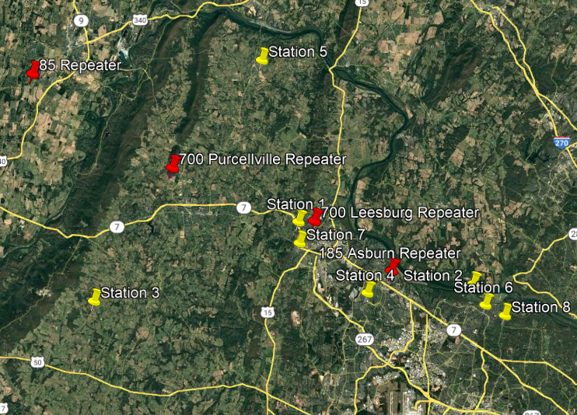
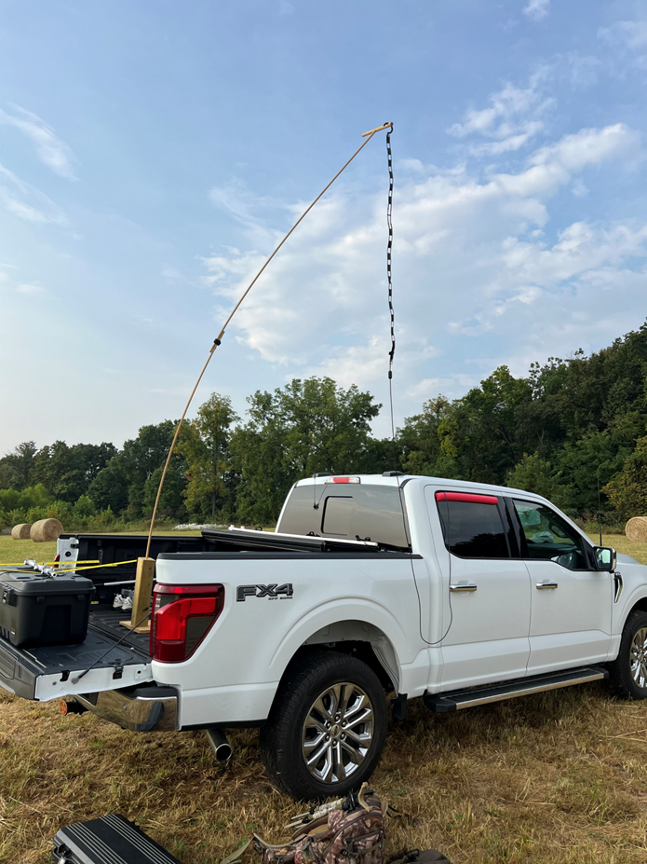

Slide 5
HT Test Frequencies and Results
Channel # | Name | Freq | General
1 | WA4TXE | 146.700 | 1 station did not hear one station –noisy or weak but readable reported by several stations
2 | WA4TXE | 146.850 | No reports (some stated they were hearing some transmissions on 700)
3 | WB6EFW | 145.185 | 1 station did not hear one station – best signal reports except for station 3
4 | LARG Simplex | 147.48 | Stations close to each other heard
5 | LARG Field Day | 445.975 | Stations close to each other heard

Slide 6
Initial Conclusion
All repeaters where not heard by all
145.185 – best signal reports and coverage – station 3 hit it
146.700 – good signal reports and coverage – station 3 hit it
146.850 – by itself – nothing heard
➔ BUT current antenna being replaced – so new test required
Many heard it on 146.700 – some hitting the repeater
Simplex – short haul worked better than expected – many heard net control (50 watts and antenna up 20ft)
More testing required – SET exercise will help with that
Need to test some more western remote locations on bike routes

