Slide 1


Virginia Defense Force

Slide 2
What is the VDF?
The Virginia Defense Force is authorized by Section 44-54.4 of the Code of Virginia as the all-volunteer reserve of the Virginia National Guard, and the VDF serves as a force multiplier integrated into all VNG domestic operations.
We are the third branch of the Virginia Department of Military Affairs (DMA), along with the Virginia National Guard and the Virginia Air National Guard.

Slide 3
VDF History:
Virginia State Volunteers / Virginia Volunteers: 1917-1921
In response to the 1917 federalization of the Virginia National Guard , the Commonwealth of Virginia created the Virginia State Volunteers to support civil authorities. Soon renamed the Virginia Volunteers, the group guarded bridges, waterways, fuel storage areas, and public buildings and facilities during the war years, armed with surplus weapons dating back to 1876. With the return of the National Guard units after World War I, the last company of the Virginia Volunteers was deactivated in 1921. A total of 1,300 Virginians served in the Virginia Volunteers from 1917 to 1921.
Virginia Protective Force / Virginia State Guard: 1941-1947
Following the 1940 Nazi defeat of the French army, Virginia Governor Price created the Virginia Defense Council to plan for the possibility that the Virginia National Guard could be federalized once again. Based on the recommendation of the council, Governor Price ordered the establishment of the Virginia Protective Force on January 2, 1941. Provided surplus M-1917 Enfield rifles and blue-grey wool uniforms made in the state’s penitentiaries, the Virginia Protective Force assumed the in-state missions of the Virginia National Guard when it was called to federal service. In 1944 the General Assembly changed the name of the Virginia Protective Force to the Virginia State Guard. With the return of the Virginia National Guard from overseas service, the Commonwealth deactivated the Virginia State Guard in June 1947. A total of 16,885 Virginians served in the Virginia Protective Force and Virginia State Guard from 1941 to 1947.
Virginia State Guard / Virginia Defense Force: 1985-Present
The Total Force policies of the Department of Defense prompted changes to federal law in the mid-1980s, allowing states to establish military forces designated to assume the missions of their state National Guards in the event they were called to federal service. With planning dating back to 1981, the Commonwealth created the first units of the new Virginia State Guard in 1985 with same mission as its predecessors: support of civil authority. In 1989 the General Assembly renamed the Virginia State Guard the Virginia Defense Force.

Slide 4
What does the VDF Do?
The VDF’s primary lines of effort are operations center augmentation, interoperable communication, agency liaison and cyber network defense as well as direct support to the VNG with logistics, medical, chaplain, legal and public information capabilities.
VDF Motto: “Virginians serving Virginians.”

Slide 5
What does the VDF Do?
First Regiment:
11th Civil Response Battalion:
Unarmed Security: Access Control, Traffic Control.
State Active Duty Logistics Support.
Communications: HF Radio and STARS
21st Liaison Battalion:
Virgina Department of Emergency Management integration and support.
eRetrograde Management System (ERMS): Human Resources administrative support.
31st Cyber Battalion:
Cyber support for the Commonwealth.
White hat vulnerability testing for state and local agencies.
Augmentation and support of the VANG’s 91st Cyber Brigade.

Slide 6
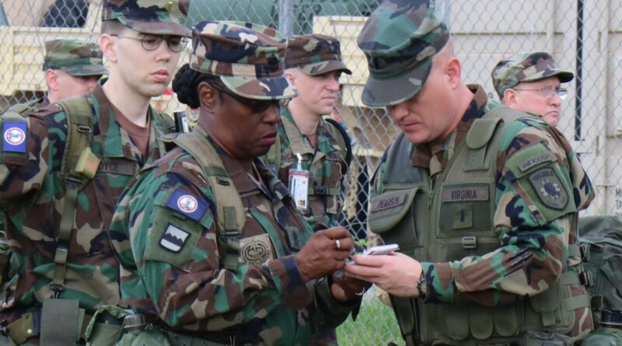
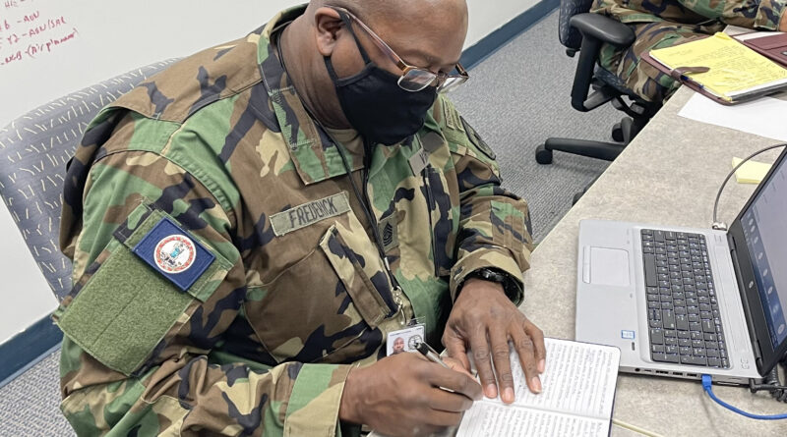
What does the VDF Do?

Slide 7
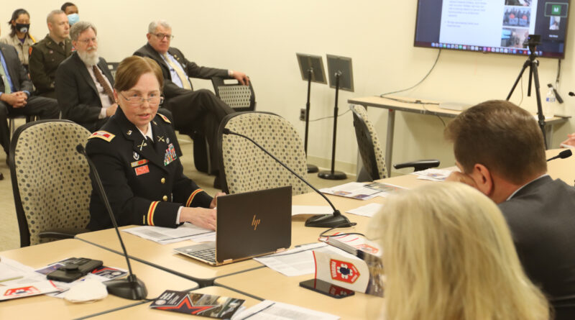
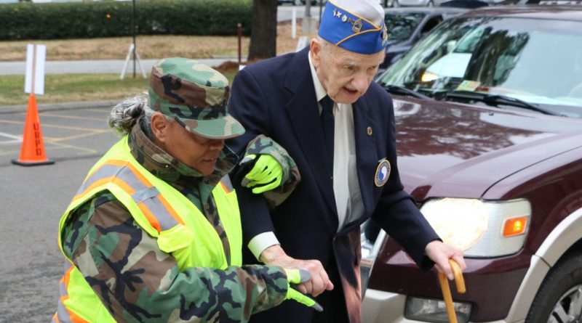
What does the VDF Do?

Slide 8
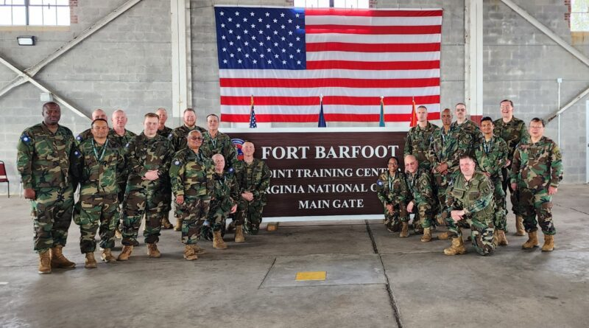
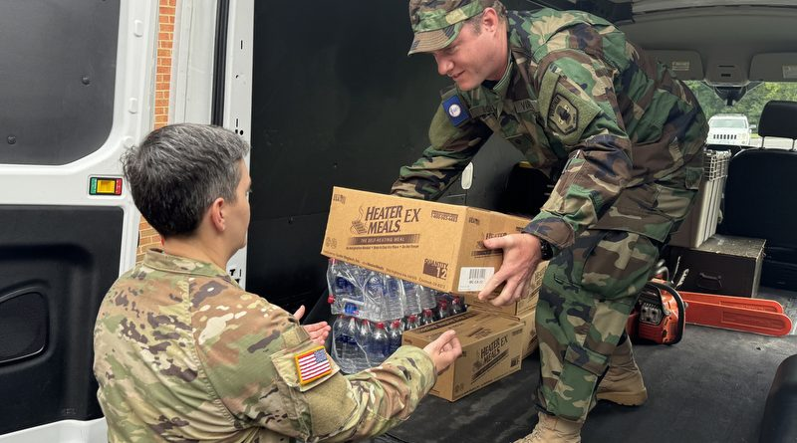
What does the VDF Do?

Slide 9
Benefits of Service:
An opportunity to serve your country, state, community and family.
Free training and networking opportunities.
Vehicle Personal Property Tax Exempt status (available in participating counties).
State Active Duty is paid at equivalent US Military rate, based on time in service and time in grade.
Purpose and camaraderie.

Slide 10
Enlistment Eligibility
Legal Resident of the United States and the Commonwealth of Virginia.
A valid Social Security number.
Age 16 to 65 (Minors require written consent of parent or legal guardian).
Physical ability to perform in any assigned billet.
No felony convictions.
Good moral character.
Height-Weight Requirements for Recruitment into the VDF

Slide 11
Virginia Defense Force
Resources:
1LT Patrick McCaul
patrick.mccaul.vdf@gmail.com
540-331-1353
Virginia Defense Force
Virginia Defense Force – Virginians Serving Virginians
VDF Recruit Information Form – Virginia Defense Force

Slide 12
Virginia Defense Force
Questions?

