Slide 1
2025 Loudoun County ARES (LCARES) Simulated Emergency Test (SET) Summary and Observations
Briefing to LARG Meeting of 18 October 2025
Doug McNulty KM4GC
datacomsys@comcast.net

Slide 2
Agenda
Participating Stations & Tactical Call Signs
Event Overview
Lessons Learned: Operating Procedures
Lessons Learned: Structure of Exercise
Lessons Learned: Data/Text Messaging
Lessons Learned: Future Activities
Questions

Slide 3
Participating Stations & Tactical Call Si
Tactical Call | Function | Location | Last Name | First Name | FCC Call
EC | Exercise Controller | Loudoun County EOC | Hiltner | Rob | K4BCN
Net Control | Net Control | EOC | McNulty | Doug | KM4GC
Net Control | Net Control | EOC | Radloff | Steve | N4RAF
Hospital | Operator | Inova Loudoun Hospital | Morse | Scott | WB6EFW
Tuscarora | Operator Station 1 | Tuscarora HS | Hawkins | Chris | KO4OZJ
Potomac Falls | Operator Station 2 | Potomac Falls HS | Begley | Jim | KQ4MHT
Briarwoods | Operator Station 3 | Briarwoods HS | White | Ronald | KQ4IBI
Parkview | Operator Station 4 | Sterling MS - to simulate Parkview HS | Babcock | Jim | N4FAF
Loudoun Valley | Operator Station 5 | Loudoun Valley HS | Diehl | Frank | K4FWD
Heritage | Operator Station 6 | WA4KBM QTH | Kevin | McCrory | WA4KBM

Slide 4
Event Overview (1 of 2)
Repeaters/ frequencies used (taken from LARG Freq Plan):
1 | Primary 2m Repeater | WA4TXE – Leesburg / Purcellville Linked | Primary Net Control | 146.7000 W | 146.1000 W | 77.0 | A | • Linked to Purcellville WA4TXE. • Tones optional
2 | Primary 2m Repeater | WA4TXE - Purcellville/ Charles Town,WV Linked | Primary Net Control | 146.8500 W | 146.2500 W | 77.0 | A | • Patched to Leesburg WA4TXE. • Tones optional
3 | Secondary 2m Repeater | WB6EFW - Lansdowne - ARES | Secondary Net Control | 145.1850 W | 144.5850 W | 103.5 | A | Repeater located at Inova Hospital Lansdown. FM, Fusinon, EchoLink, WIRES-X Use as additional net and for specialized discussions as needed
Primary Net was used for overall coordination and transmission of traffic to all stations
Channel 3 used to pass much of the traffic to off-load the primary net
Exercise used a script or Master Sequence of Events List (MSEL) of timed activities and messages to pass

Slide 5
Event Overview (2 of 2)
Comms checks were conducted before StartEX
  Primary and Secondary Nets had good connectivity to all sites
  Leesburg repeater at 442.1 MHz and simplex channel showed little to no connectivity to high school locations
Net Control went off-line during exercise
  All stations responded very well to shift to Secondary Net
  Hospital announced it was assuming Net Control on secondary net
  Heritage announced Net Control was off-line on Primary Net and all stations should shift to Secondary Net and Hospital was assuming Net Control
Three stations used WinLink to Net Control effectively

Slide 6
Lessons Learned: Operating Procedures
Note: I only plan to discuss items in green for following sldes
Loss of Net Control:
  Designate a station(s) to be Alternate Net Control
  Define fail over procedures if Net Control is not heard
  Include on LCARES Ops Plan
Cherry picking channels from previous established LARG and LCARS frequency plans worked well
Streamline ICS-205 frequency plan, use ICS-217 (comms resouce avail worksheet)
Define two operator positions in the EOC
  Use of electronic forms for activity logging, use a scribe, headsets, HF, VHF/UHF channels to cover

Slide 7
Lessons Learned: Operating Procedures
Define standard traffic handling voice procedures - consider NTS as example
  Names, text, numbers
  Acknowledgement of message receipt
  Define in LCARES Ops Plan and practice
Establish station roll call order and use for acknowledgement of “all station” messages
Shelter stations should consider capability to:
  Monitor primary net
  Monitor secondary net
  Operatate WinLink/digital messaging
  Include in LCARS Ops Plan

Slide 8
Lessons Learned: Operating Procedures
Consider moving Net Control from EOC to another location – potential use for LARG comms trailer
  Control and operation of the network
  Handle external communications to surrounding counties and Virginia-level ARES (HF and external repeaters (e.g. Bluemont – skywarn, NTS, other)
Local county emergency comms needs at least 3 nets:
  Primary voice net to coordinate all operations and wend “all station” traffic
  Secondary voice net to pass traffic between sites
  Digital/Text net
  Tertiary voice net as backup/overload would be nice

Slide 9
Lessons Learned: Structure of Exercise
MSEL worked well, stations were active throughout exercise
Deployment of stations to shelter locations matched support envisioned by the county
Get final documents out ealier

Slide 10
Lessons Learned: Data/Text Messaging
For WinLink: investigate use of autoconnect feature
  To same operator time
  Include in LCARES Ops Plan
Investigate use of other digital modes so we are not dependent on WinLink and/or outside networks
  Fldigi – keyboard to keyboard comms
    Flmsg – supports use of ICS forms
    Flamp – allows for sending error free messages (checksums)
  JS8CAll – based on FT8, additional signal processing may improve simplex connectivity
Define WinLink addresses for all WinLink capable stations in LCARES Frequency Plan

Slide 11
Lessons Learned: Future Activities
For shelters: investigate potential use of cross-band repeater in car so operator can be with shelter staff inside of building
Map connectivity between all candidate shelters to EOC, Hospital, and potential LARG comms trailer locations
  Modes (simplex, digital), repeaters, etc.
  Define a “reference” station configuration for test
Investigate ways to reduce dependency on repeaters and outside networks
Conduct periodic ARES nets – see questions slide
  Use of ICS forms, WinLink P2P, roll call, other training

Slide 12
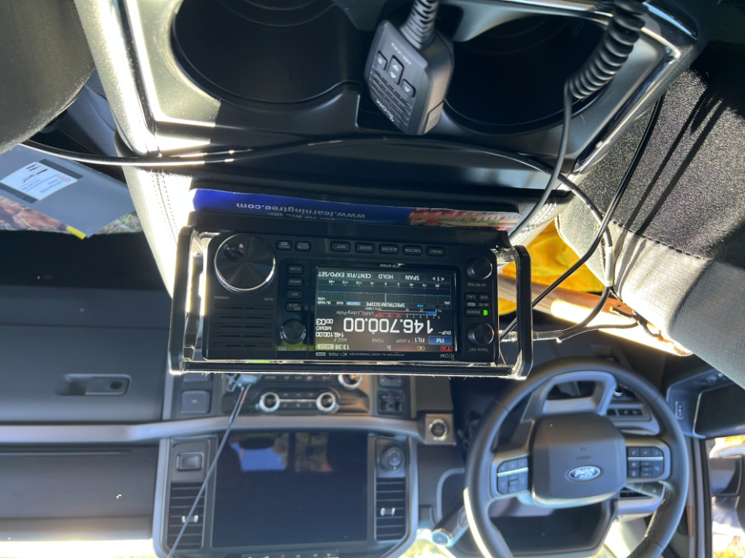
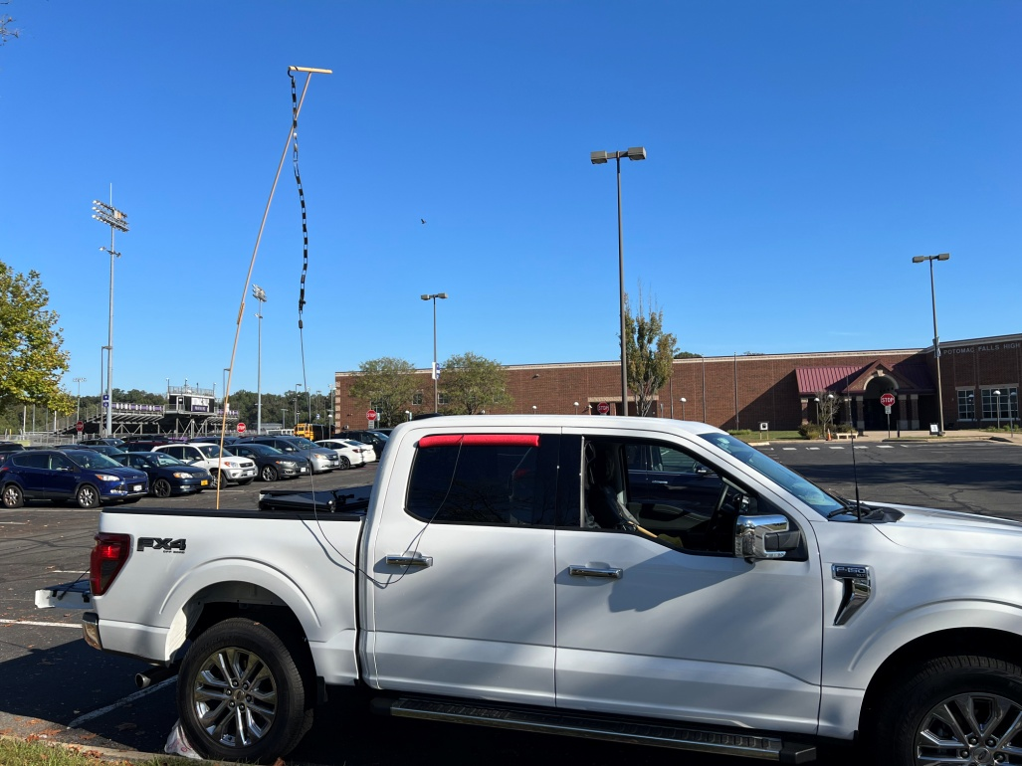
Pictures from Jim Begley’s Station

Slide 13
Qustions
What is good time/periodicity for LCARES net?
  Conduct over LCARS repeater (145.185)? In person?
  Weeknights are taken by other LARG weekly nets
  Sunday afternoon? Other?
  Weekly? Monthly? Ad hoc as folks are ready to discuss subjects?
Who would like to give a briefing on:
  Mobile cross-band set up in your car for voice and digital (e.g. to operate from within a shelter)?
  Fldigi, Flmsg, and Flamp and how they could be used for LCARES?
  JS9Call and how it could be used for LCARES?
  The National Traffic System (NTS), how it operates, how would LCARES interface with it, forms, procedures, nets, HF/VHF/UHF, inclusion in next SET, Etc?
  D-STAR and D-RATS and/or other digital modes and how they could be used for LCARES?
  AREDN mesh overview and how it could be used for LCARES?
  Virginia State level ARES and local surrounding counties ARES and how would LCARS interface with them? Points of contact? Coordination meetings for next SET (and/or practice SETs)?
  Other?

