Slide 1
Using Consumer Drones to Airdrop Antenna Pull Ropes
Bryan Schneiders (K1NSA)

Slide 2
Agenda
Goal: Purchase and use a consumer drone to perform controlled drops of weighted pull-ropes for antennas.
Equipment | Which equipment was selected and what was the cost.
Legal Requirements | What are the legal requirements for using this equipment.
Antennas | What types of antennas can we install.
Location | An overview of the location where the experiment was conducted.
Demonstration | Video demonstration of the attempts and photos of the results.
Lessons Learned | What went well, what went wrong and what could be done better next time.

Slide 3
01
Equipment
Which equipment was selected and what was the cost.

Slide 4
Equipment
01
02
03
04
Drone
Weights
DJI Mini 4K w/ Fly More Combo
CamJam XT Black
Airdrop Kit
Rope
Universal Drone Airdrop System
Mason Line

Slide 5
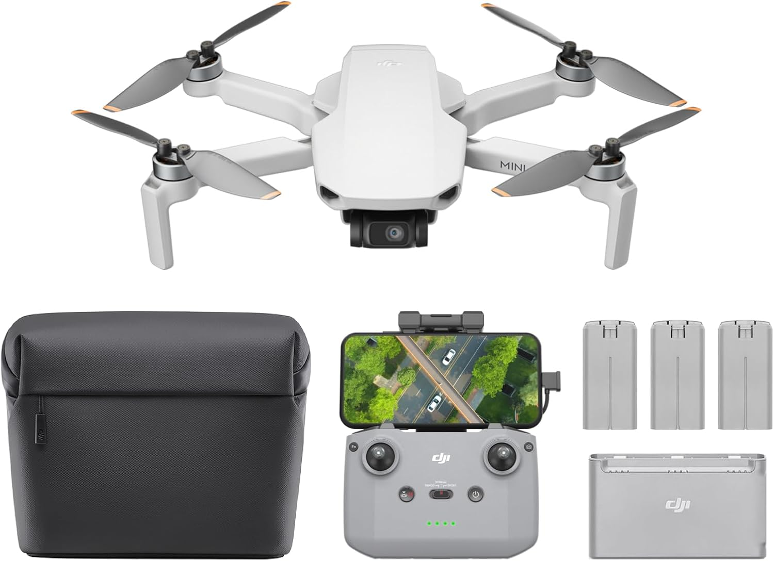
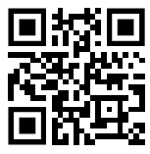
DJI Mini 4K Fly More Combo
Cost: $359 kit / $239 drone only
249 g Foldable Body
Regulation Friendly
3-Axis Gimbal
4K UHD Camera
Long Distance Control
One Button Return

Slide 6
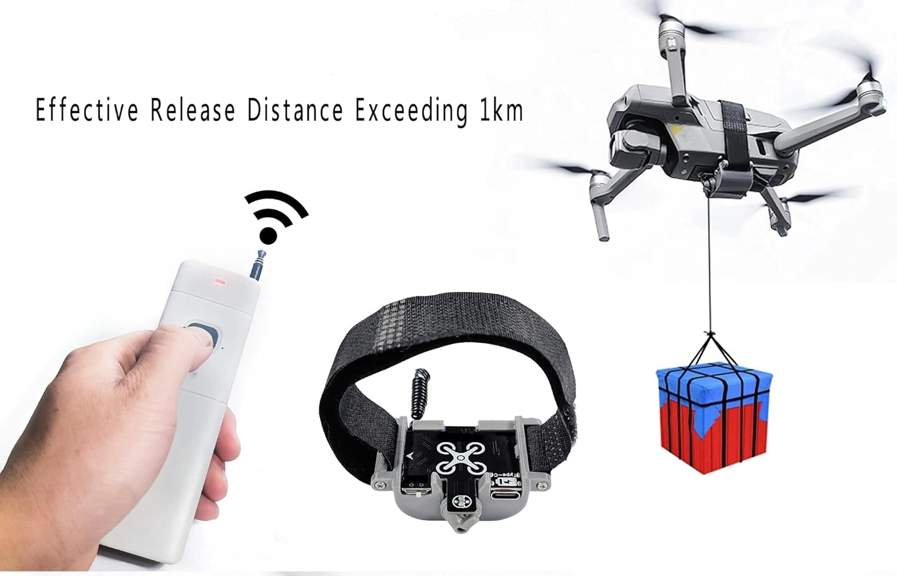
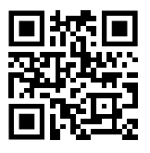
Universal Airdrop
Cost: $39.63
Weight: 30g
Simple Installation Method
Effective Release Distance Exceeding 1km
USB rechargeable
RF Shielding
Adjustable hook position
Dedicated remote

Slide 7
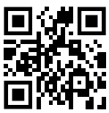
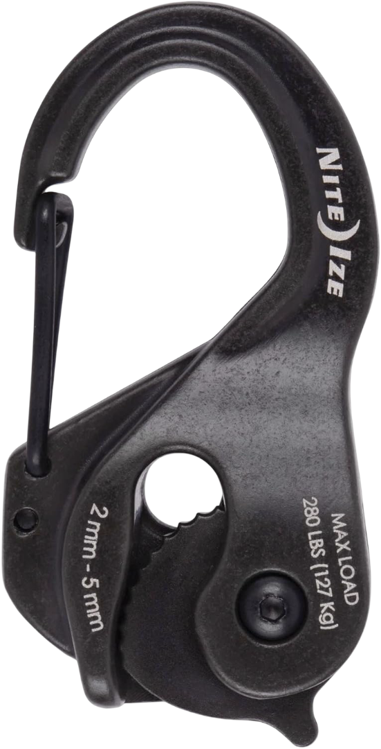
CamJam XT Black
Cost: $56.99 / 6-pack
Allows you to tighten by simply pulling your rope or cord through the cam mechanism
Easy to adjust and release
Two attachment methods
Achieve and maintain high tension without knots
Made of durable cast aluminum for heavy loads
Weight: 38 grams

Slide 8
Rope?
Mason String
Braided Nylon Twine String, 170 lbs strength, doesn’t stretch easily. Cheap and long.
Sticks to branches!
Paracord
100% nylon sheath with 7 type III twisted inner strands, 550 lbs strength. Black and green available. Slides through branches!

Slide 9
02
Legal Requirements
What are the legal requirements for using this equipment.

Slide 10
Legal Requirements
Recreational Drones (<250 g typical)
No FAA registration required if <250 g and for fun only
Must pass TRUST safety test
Fly under 400 ft AGL, within visual line-of-sight
No flying near airports or emergency scenes without authorization
Follow community safety guidelines
Remote ID not required if not registered
State rules: no flights in VA state parks; no harassment or spying over homes
Commercial / Heavier Drones (>250 g or for business use)
FAA registration required for all >250 g or any business use
Remote Pilot Certificate (Part 107) required
Remote ID mandatory
Must follow all FAA Part 107 rules (400 ft limit, VLOS, daylight or anti-collision lighting at night)
Over-people/vehicle flights need certified aircraft or FAA waiver
State limits still apply (parks, privacy, wildlife harassment)

Slide 11
TRUST Safety Test Summary
Name: The Recreational UAS Safety Test (TRUST)
Who: Required for all recreational drone pilots (any weight)
Where: Free online through FAA-approved test administrators (e.g. FAA Safety Team, Pilot Institute, UAV Coach)
Time: About 15–30 minutes
Format: Multiple-choice with unlimited retries until all correct
Topics:
Basic airspace rules and safe flying practices
Visual line-of-sight and altitude limits (400 ft max)
Respecting people, property, and manned aircraft
What to do if FAA or law enforcement request documentation
Proof: Printable or digital completion certificate; must carry while flying

Slide 12
Takeoff Weight
Drone classification is based on takeoff weight, not factory weight.
Under 250 g exemption applies only if total takeoff weight (drone + attachments + payload) is ≤ 250 g.
Adding an airdrop module or payload that pushes total mass above 250 g voids the exemption. It then:
Must be FAA-registered (even for recreation).
Triggers Remote ID requirements.
May fall outside “Category 1” for operations over people.
If you add a 68 g payload to a 245 g drone → total ≈ 313 g → it is legally a > 250 g aircraft at launch, even if the payload is released later. Classification is determined at takeoff, not mid-flight.

Slide 13
Legal Requirements Over 250g
Recreational Drones (>250 g typical)
Part 107 is not required for recreational use, regardless of weight.
If you fly for fun only: You operate under the Recreational Flyer rules (49 U.S.C. 44809), not Part 107.
You must:
Register the drone if it weighs over 250 g.
Comply with Remote ID.
Pass the TRUST test.
Follow FAA recreational operating limits (line-of-sight, ≤400 ft AGL, etc.).
Part 107 applies only if the flight has a commercial or non-recreational purpose, regardless of drone weight.

Slide 14
Remote ID
Registration: The DJI Mini 4K weighs about 246 g, so FAA registration is not required for recreational use unless you add accessories or payloads that push it over 250 g.
Remote ID:
The Mini 4K includes built-in Remote ID broadcast capability when flown with the DJI RC-N1 controller and DJI Fly app (v1.12+).
When active, it transmits the drone’s serial number, position, altitude, speed, and pilot takeoff location per FAA requirements.
The Remote ID is automatically enabled when the aircraft, controller, and app are properly linked and updated.
If you fly it unmodified and under 250 g for recreation, you’re exempt from registration—but the drone will still broadcast Remote ID data when connected through the DJI Fly system.

Slide 15
FAA Registration
Register at the FAA’s official portal: https://faadronezone.gov.
Steps:
Create an account with your legal name and email.
Choose Recreational Flyer or Part 107 (commercial).
Enter your drone’s make, model, and serial number (found in DJI Fly or on the aircraft label).
Pay $5 per drone (valid 3 years).
After payment, receive a registration number—label it clearly on the drone’s exterior (permanent marker, label, or engraving).
Note: If you operate several drones under Part 107, you can register them under one number; recreational flyers register each drone individually.

Slide 16
03
Antennas
What types of antennas can we install.

Slide 17
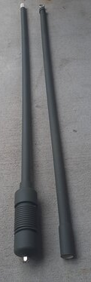
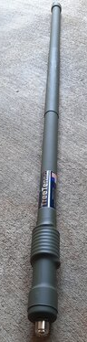
Antennas Used
6M Antenna
2M Antenna
6 Meter TreeTenna:
~3 MHz Bandwidth
Choose FT8/SSB/CW Version or FM Version
Either version can cover entire band with antenna tuner.
~9 Feet Long - Shipped in 2 pieces. Very easy to assemble.
450 Watts Power Handling
Higher Power Versions Available
Dual Band TreeTenna:
2 Meter and 70cm Ham Bands
About 43" Overall Length
<10 MHz Bandwidth on VHF
<30 MHz Bandwidth on UHF
100 Watts UHF Power Handling
250 Watts VHF Power Handling
(Higher Power Versions Available)
Dark Green Color
https://www.treetenna.com/order.htm

Slide 18
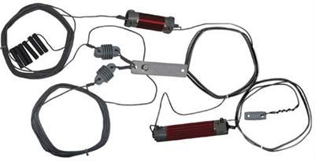
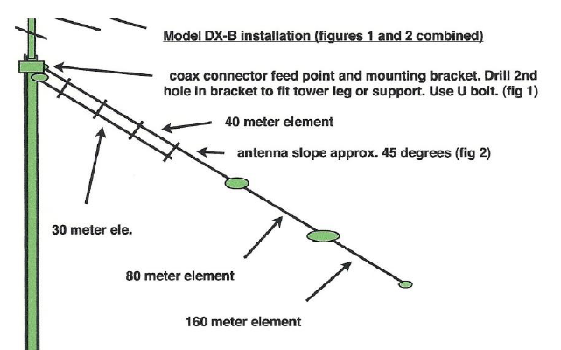
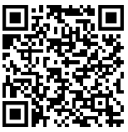
Antennas Used
HF Antenna
Alpha Delta Parallel Wire Sloper Antenna DX-B
Parallel Wire Sloper Antenna
Multi-Band
Resonant
1,000 W
160, 80, 40, 30, 20* meters
60 ft. Length

Slide 19
04
Location
An overview of the location where the experiment was conducted.

Slide 20
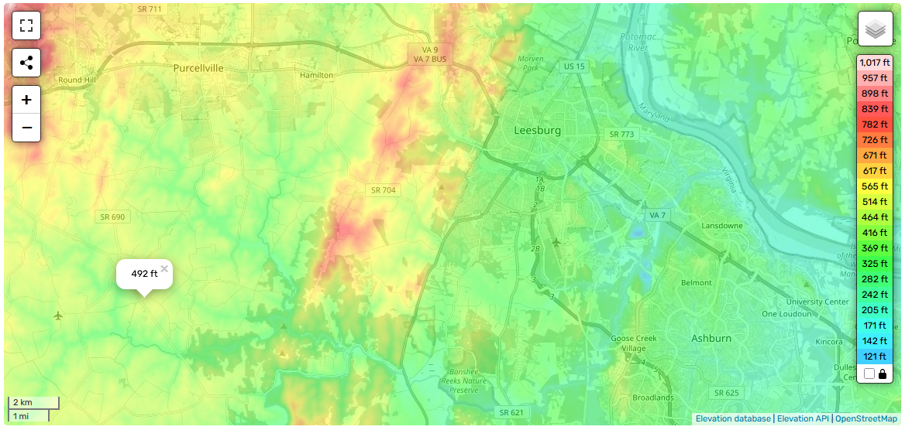
Location: Philomont, VA (FM19db)
https://en-us.topographic-map.com/map-8t6/United-States/

Slide 21
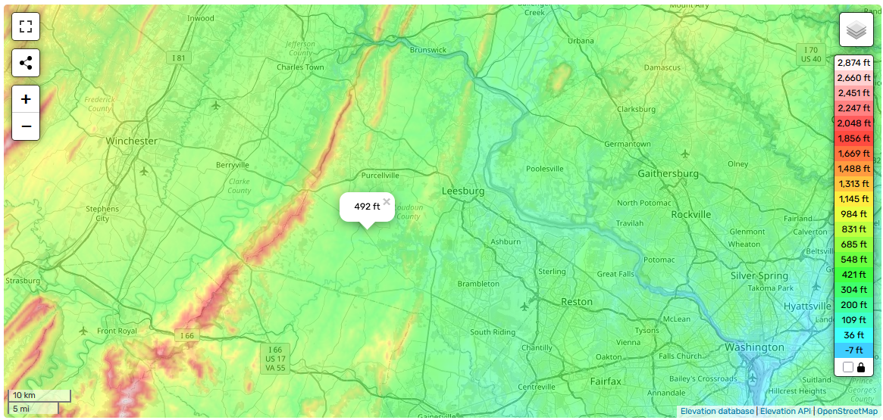
Location: DC Area
https://en-us.topographic-map.com/map-8t6/United-States/

Slide 22
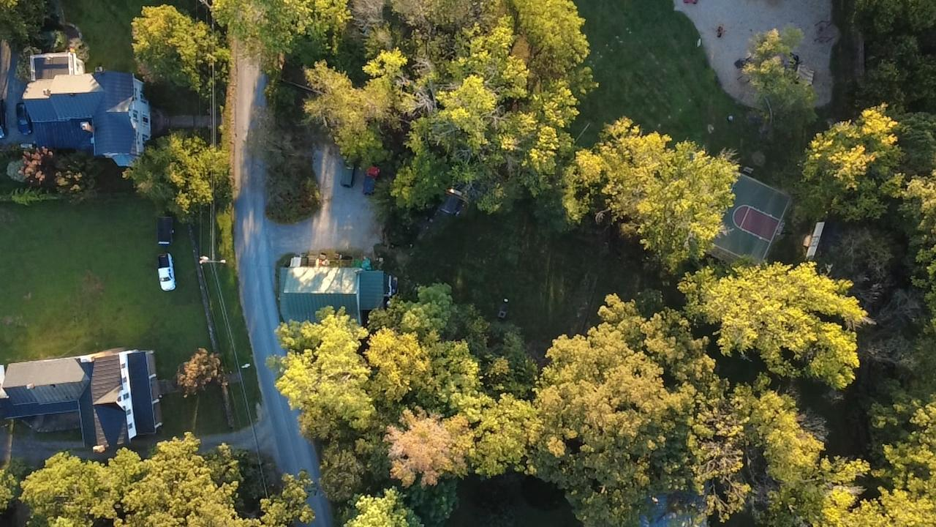
Location: Antenna Layout
https://en-us.topographic-map.com/map-8t6/United-States/

Slide 23
05
Demonstration
Video demonstration of the attempts and photos of the results.

Slide 24
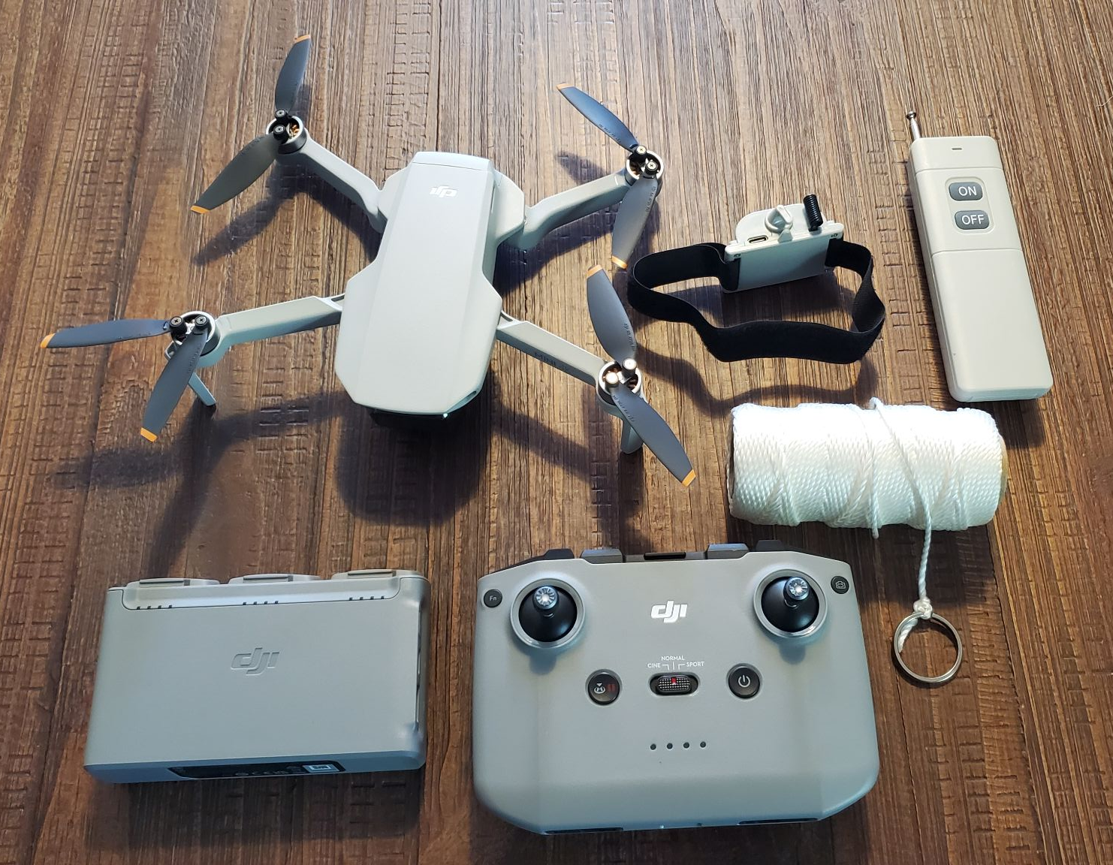
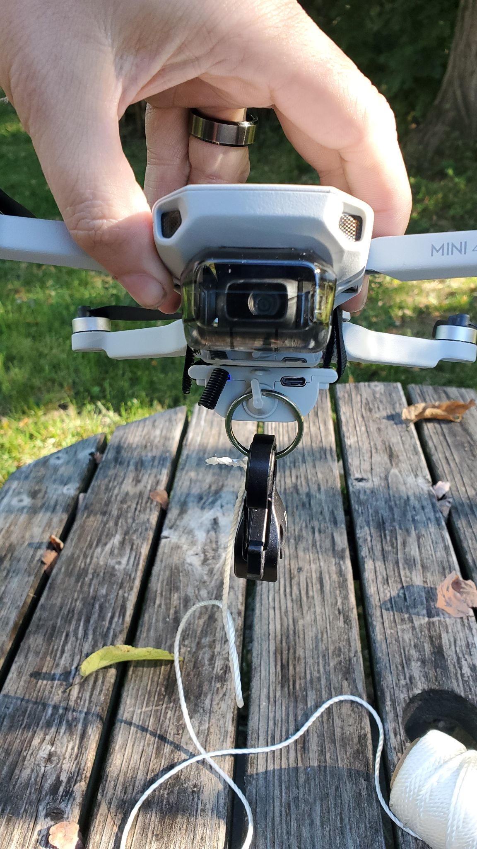

Slide 25
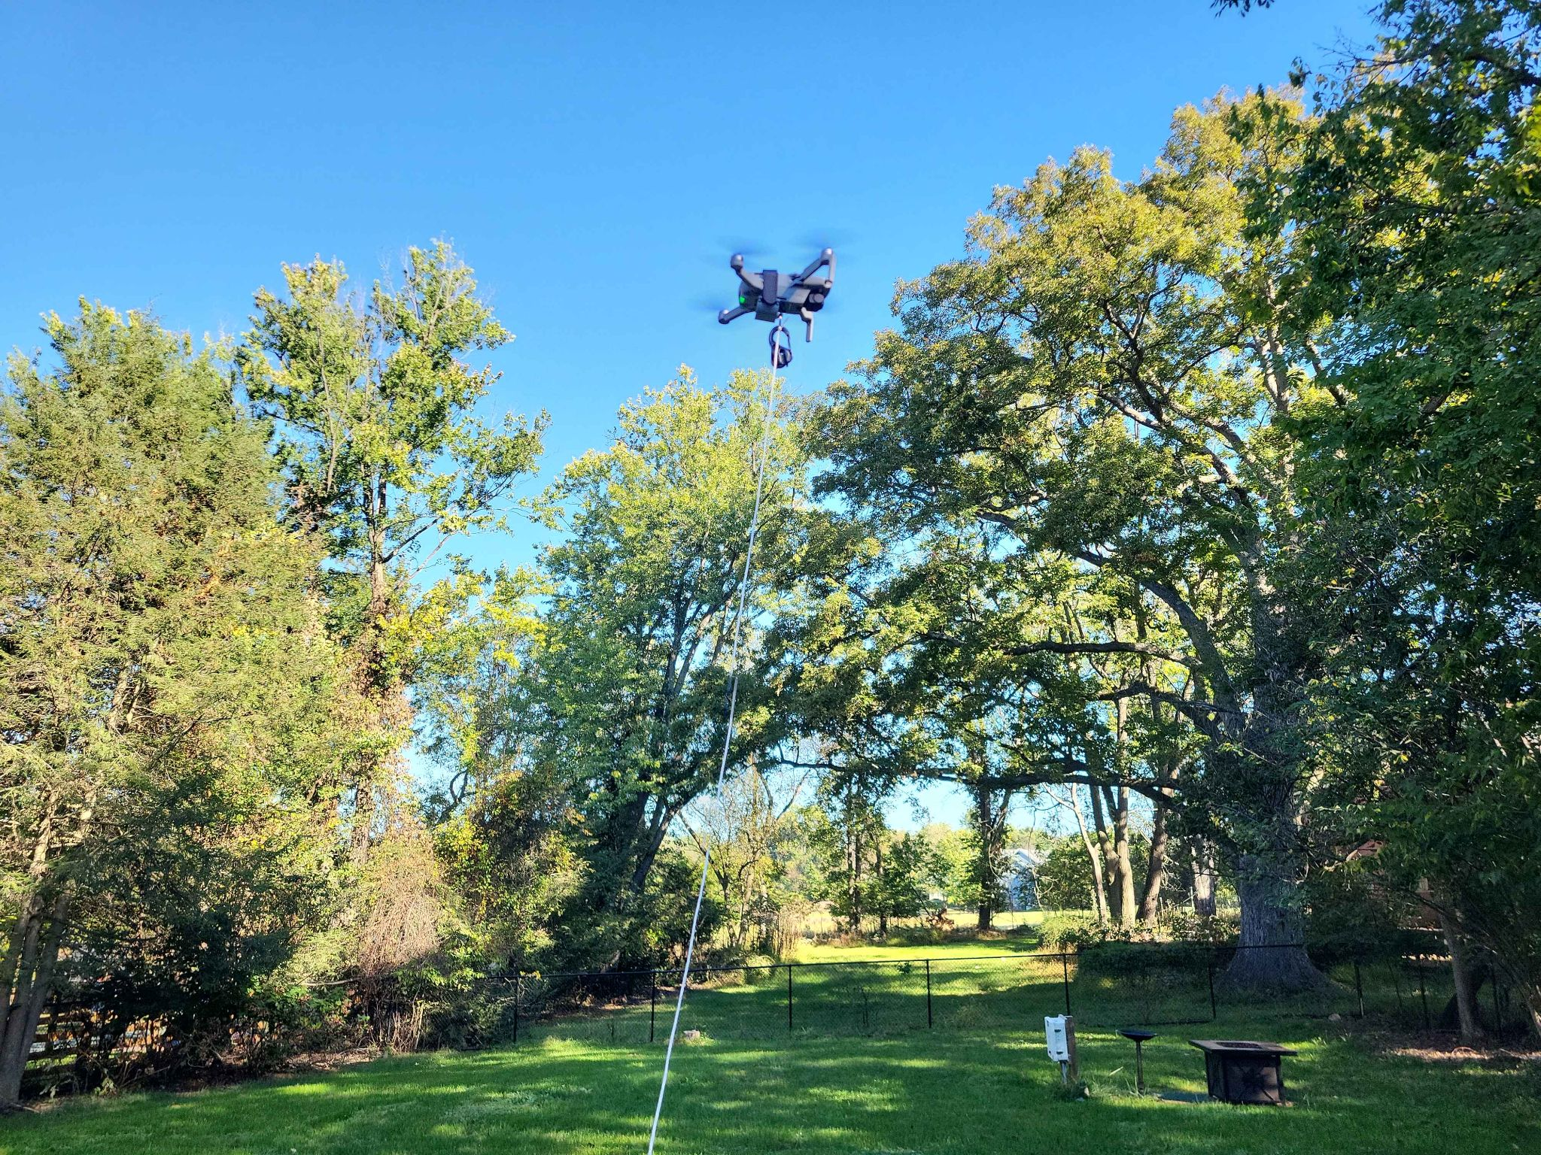

Slide 26
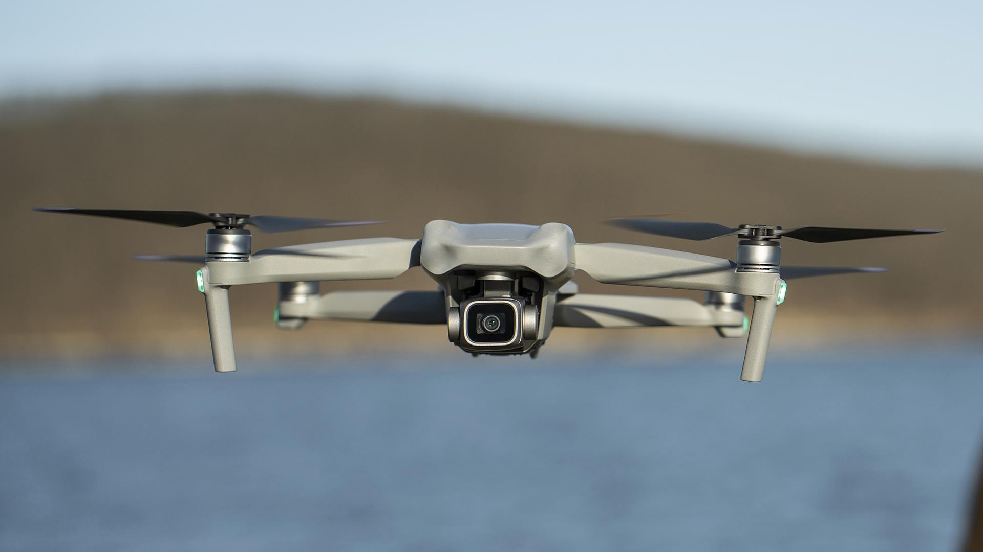
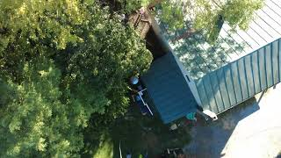
Attempt 1

Slide 27
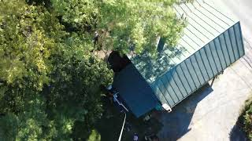
Attempt 2

Slide 28
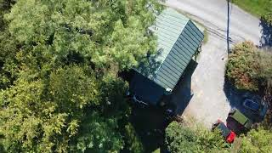
Attempt 3

Slide 29
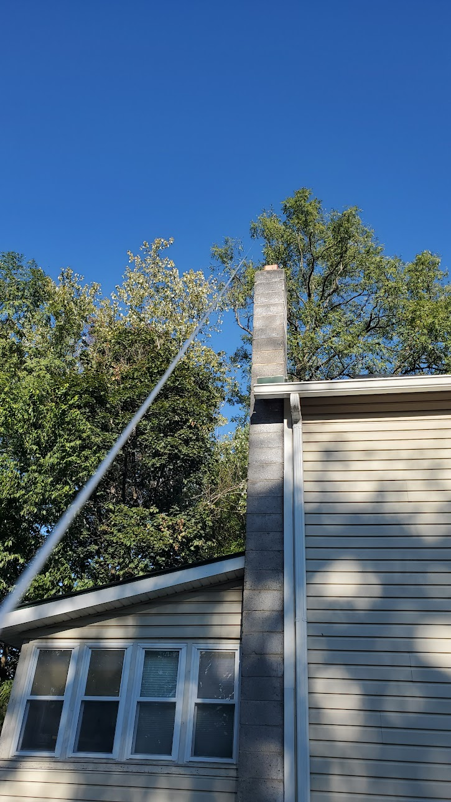
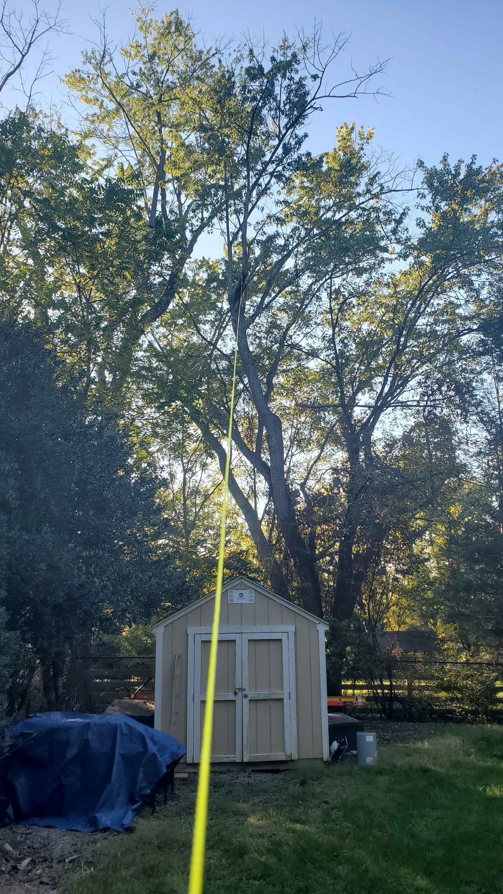
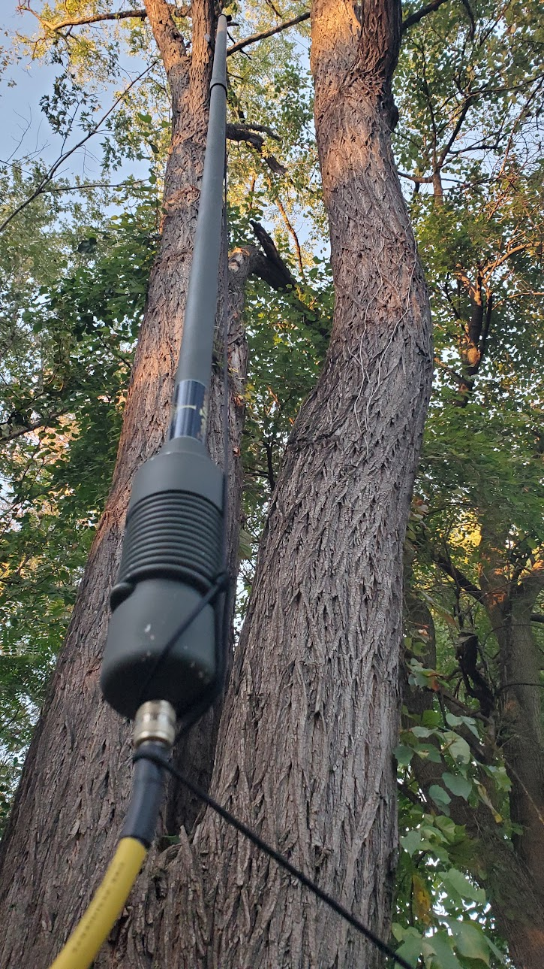

Slide 30
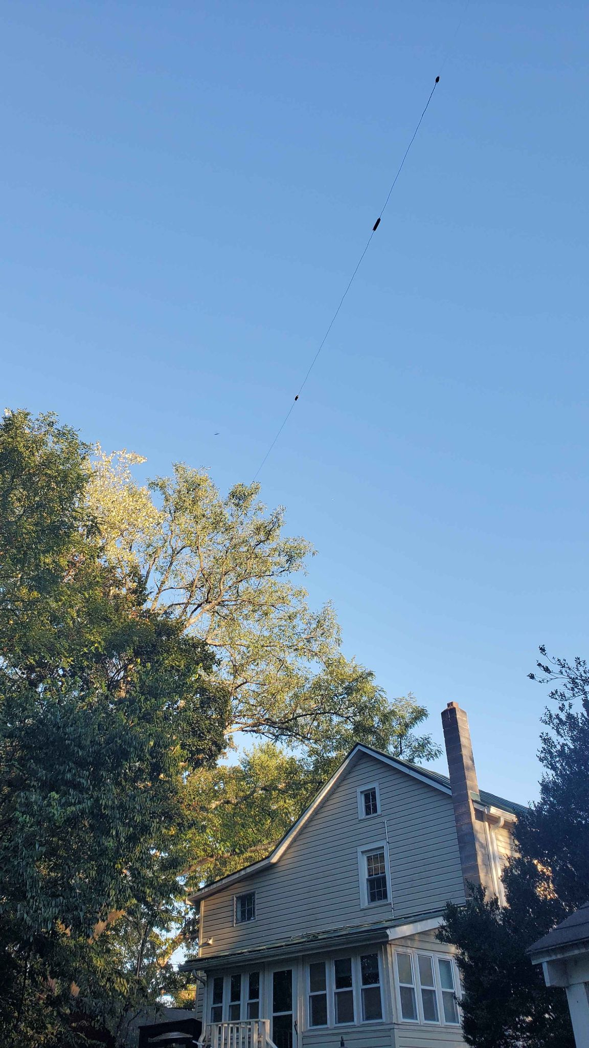
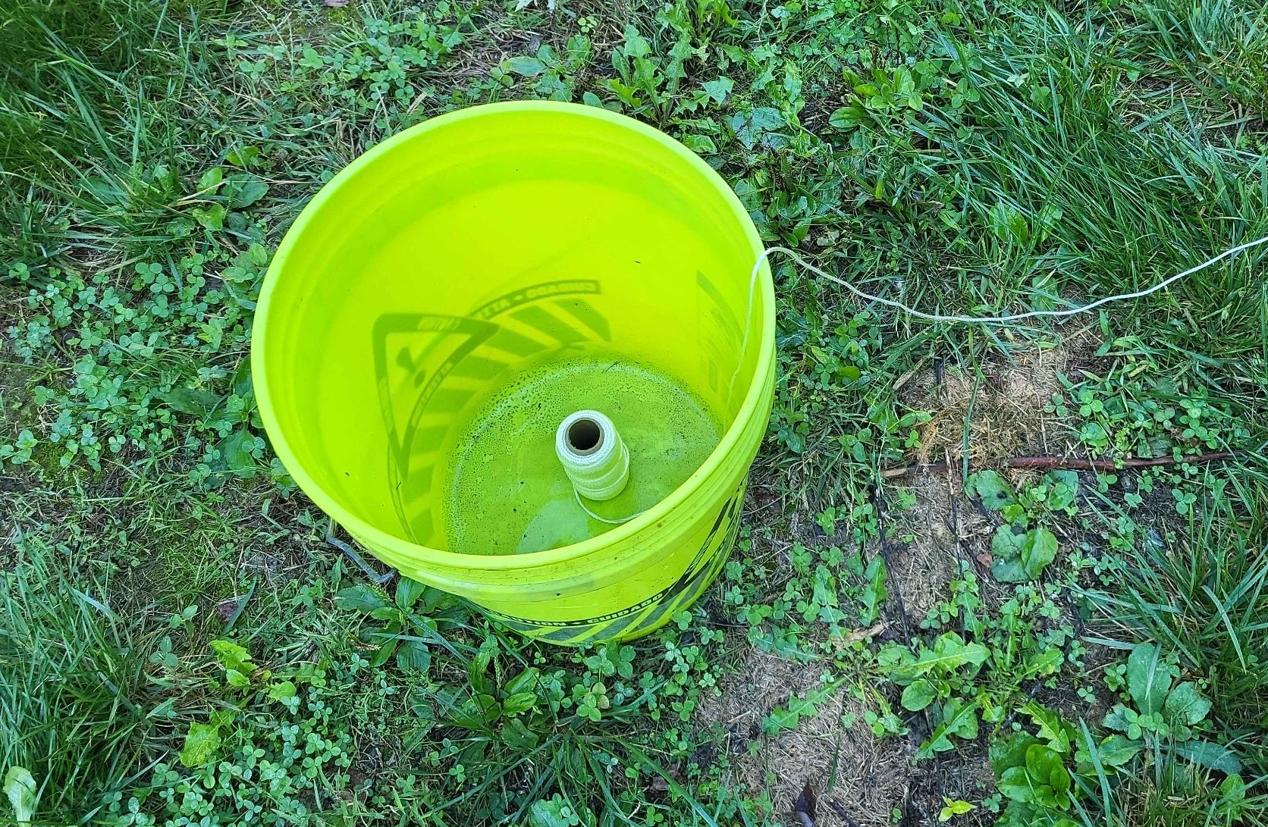

Slide 31
06
Lessons Learned
What went well, what went wrong and what could be done better next time.

Slide 32
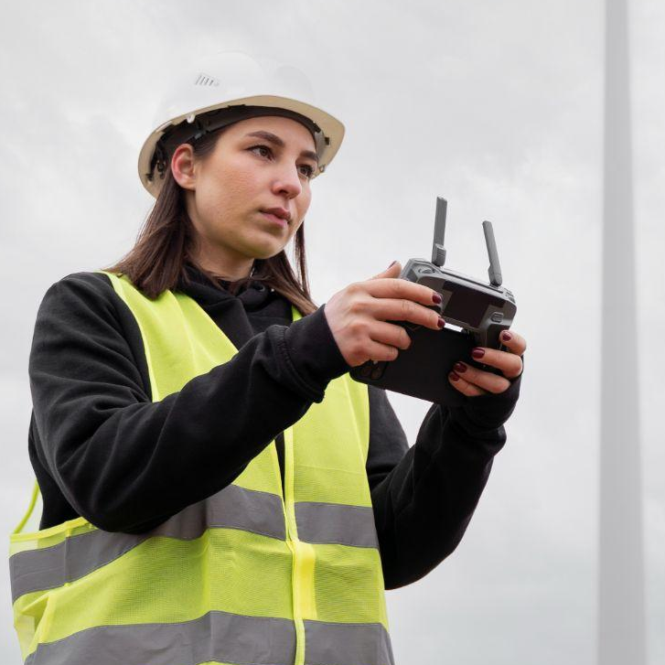
Lessons Learned
Do not use Mason String, it’s strong but snags every possible branch. Use paracord.
Drop from high above the target, this allows more rope to descend before it can grab lower branches.
Check wind conditions, we crashed the drone once due to wind.
Fly around branches instead of dropping from above if feasible.
A bucket works well for loose rope or spools.
Watch your take-off weight for legal reasons.

Slide 33
Thank you.
Bryan Schneiders
k1nsa@k4lrg.org
571-992-6600
CREDITS: This presentation template is a creation of Slidesgo, and includes icons from Flaticon, infographics, and images from Freepik.

Slide 34


