Slide 1
Support for BikeMS DC Ride - Debrief
Event date: Sept. 13, 2025, 6am-4pm
Event location: Start/finish at Reston Town Center, rest stops in Ashburn, Leesburg, Waterford, Lovettesville, Purcellville, a few others. There were 30, 60, 80, and 100 length routes.
Around 300 riders participating
Organized by the National MS Society
Ham support: 4 SAGs (All event SAGs were Hams), 6/8 rest stops had operators with SAGs covering the other 2 at peak times, and 3-5 operators at Net Control at all times
Operators were members of LARG, NERA, Shenandoah Valley, and other clubs, as well as individuals. I sent out calls for volunteers to all local clubs as well as via announcement on NVTN

Slide 2
MS Ride Continued
Net Control was run out of a 16 foot trailer built and owned by Don Goff, N4MDX. Photos attached on next slide. Worked incredibly well.
Primary net control was a 50w 2m mobile rig running off a generator and using a 30’ mast
Secondary radio was a 50w 2m/70cm mobile on generator and using a mag mount on top of the trailer
Primary frequency was WA4TXE 146.7 & 146.85.
Backup 1 was K4QJZ 145.21, backup 2 was the NERA system. Only Lovettsville needed to switch to backup
Net Control used 147.48, 445.975, and GMRS for local operations
Race Director was with us at Net Control for the full ride
Key race staff used LTEs to communicate, but Hams provided full comms for all SAG and rest stop operations. Only a few staff had LTEs and were only at two locations. Net Control was also direct on LTE comms. No group chats or phone calls were used.

Slide 3
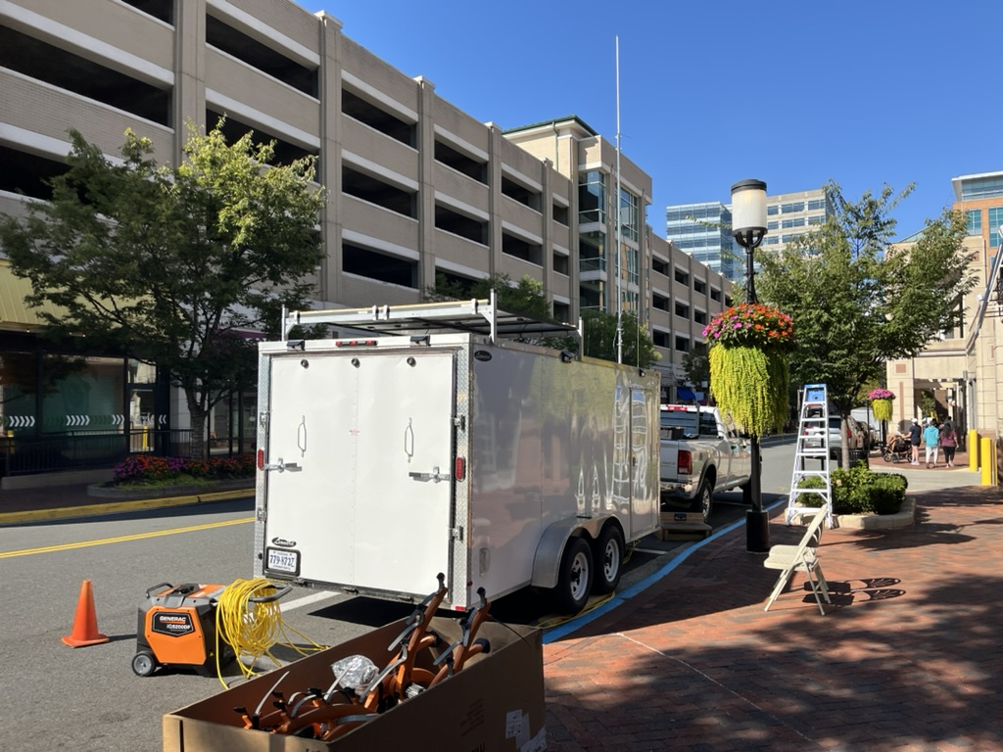
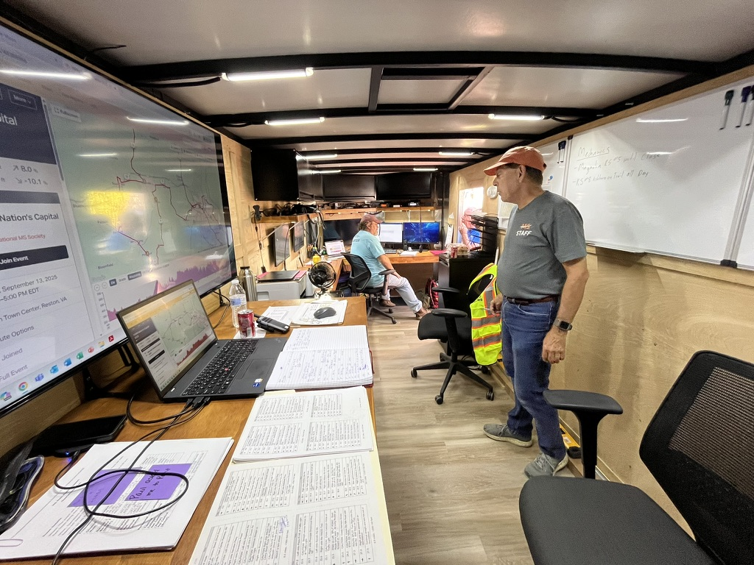
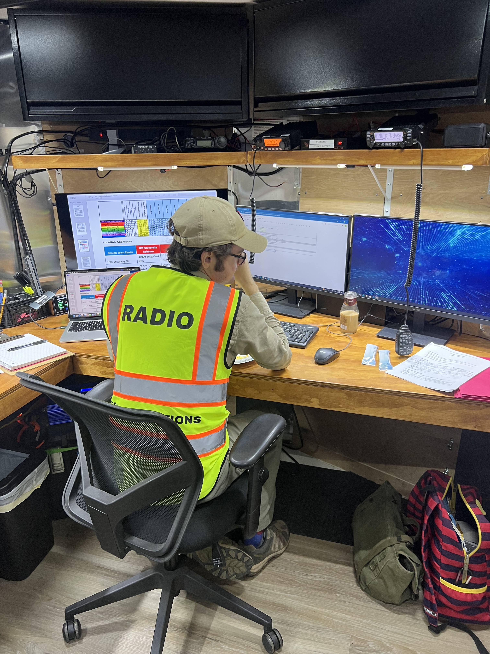
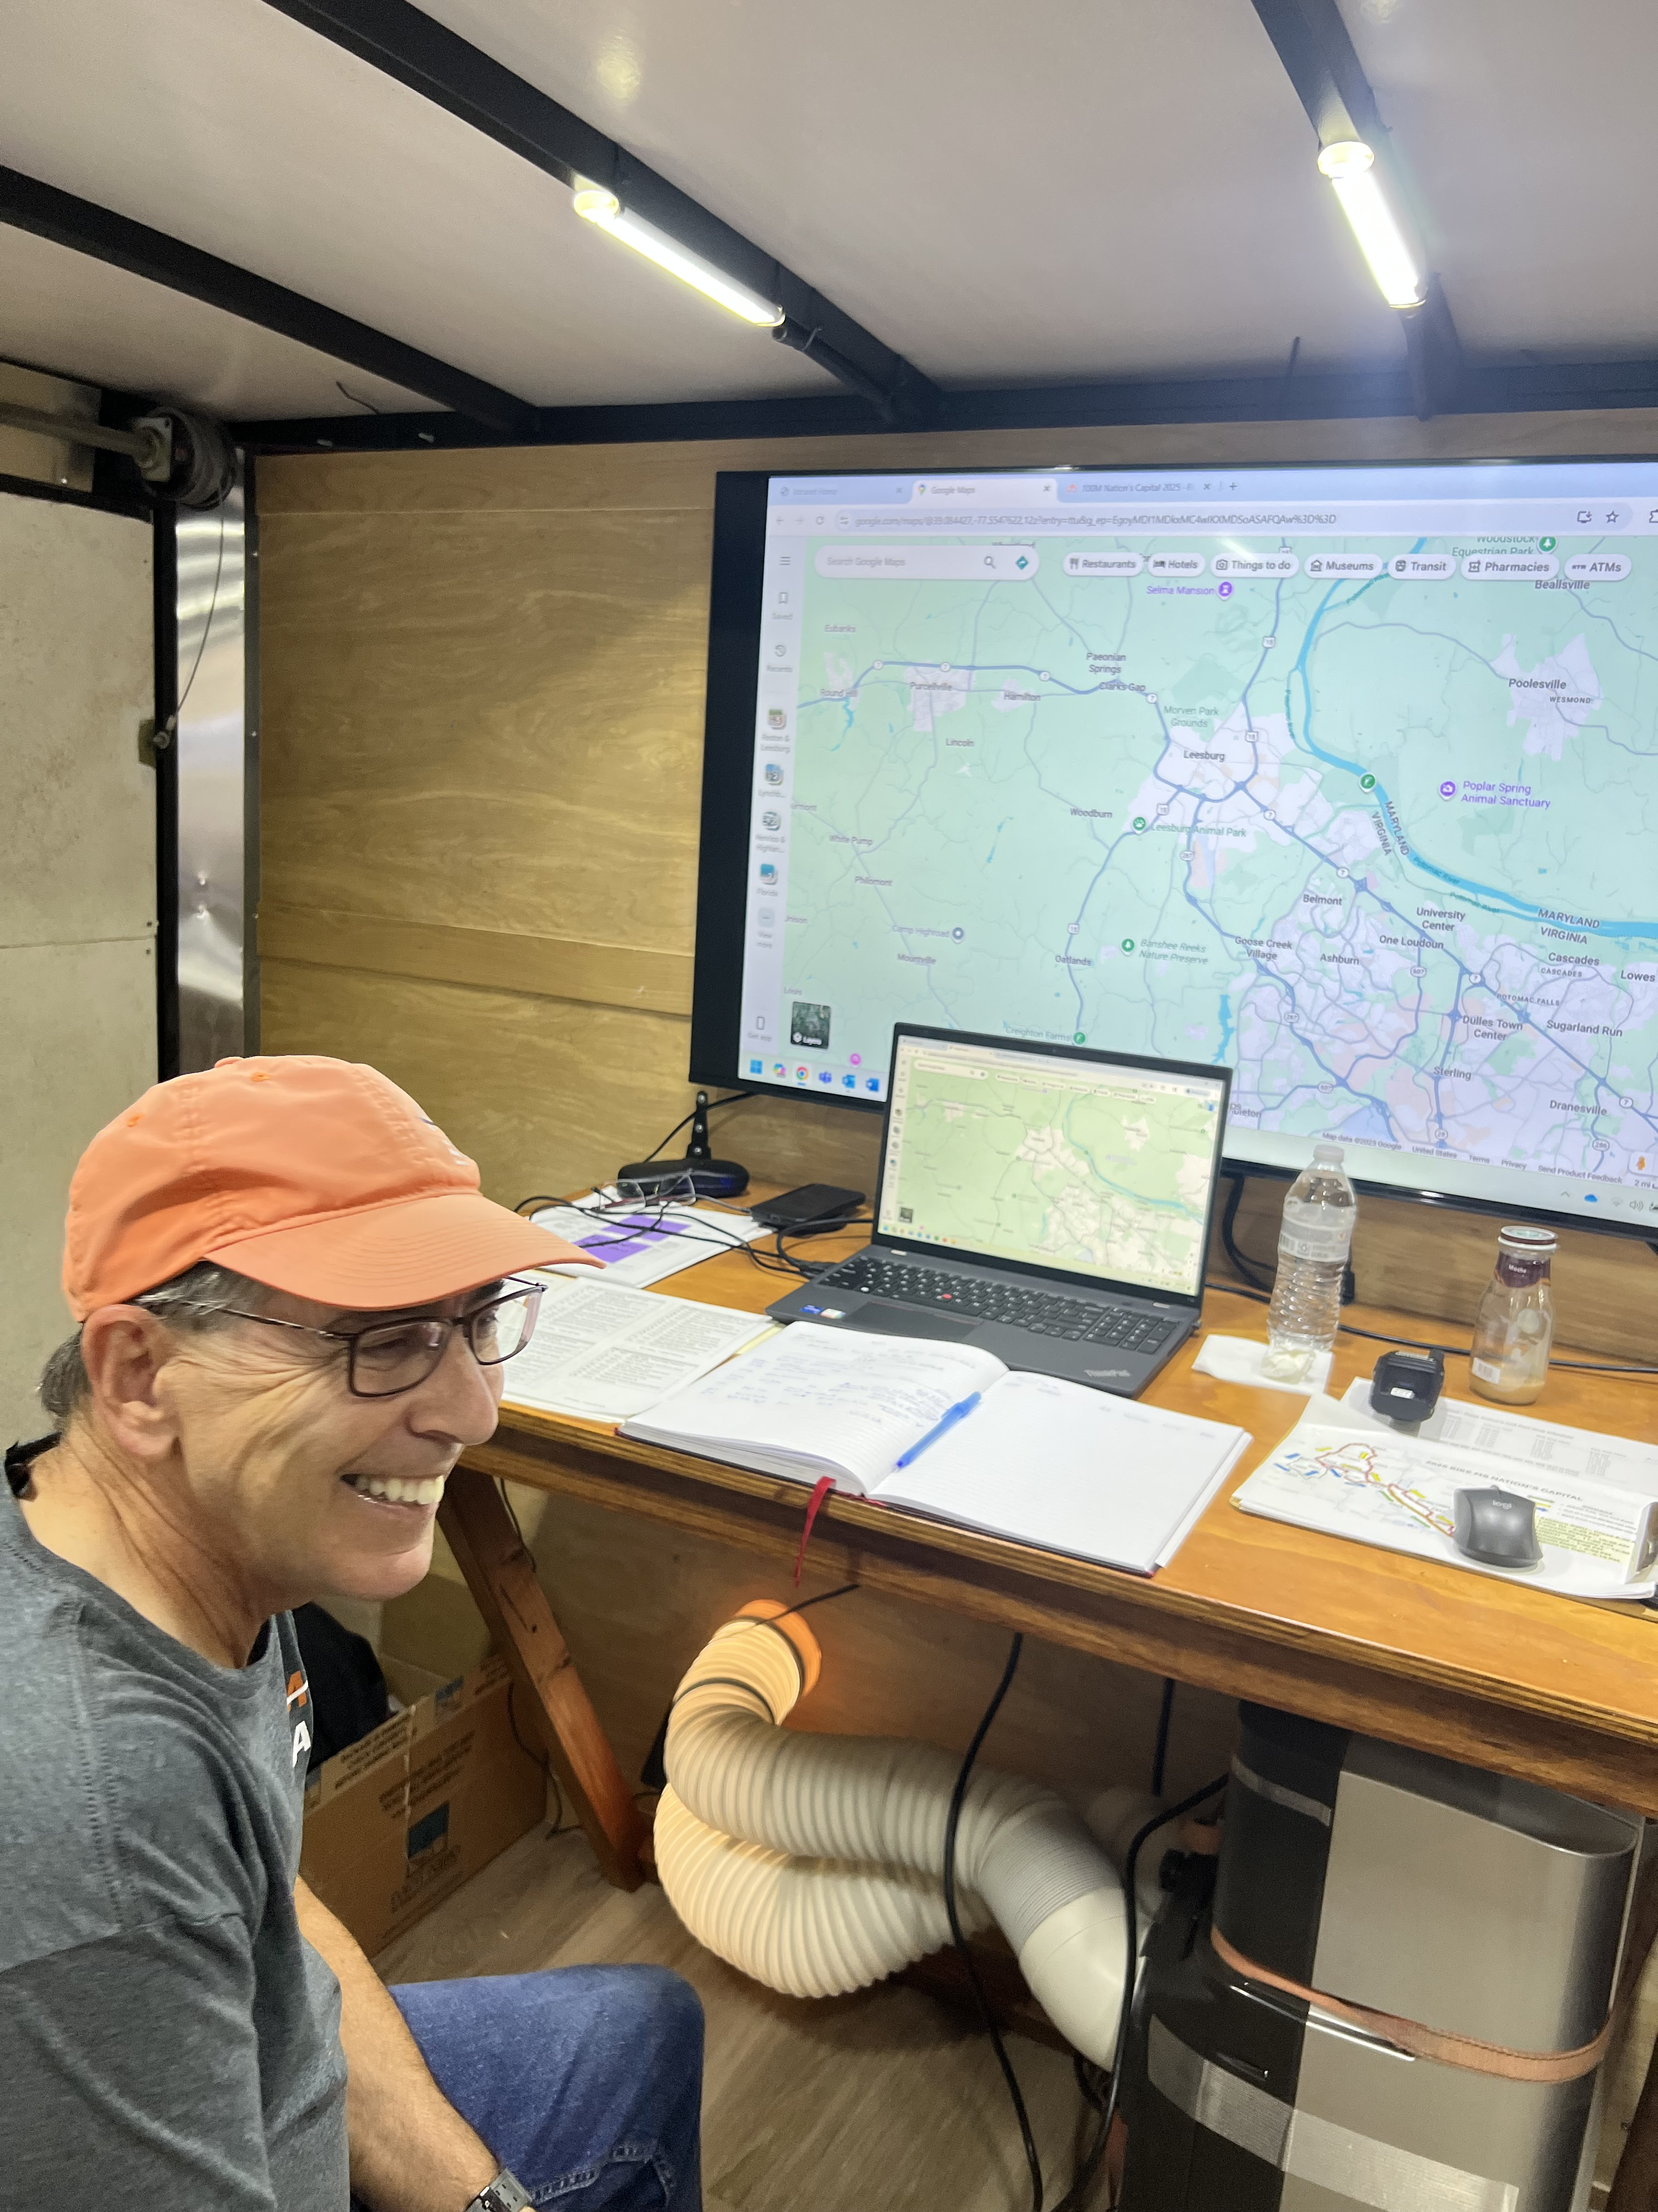
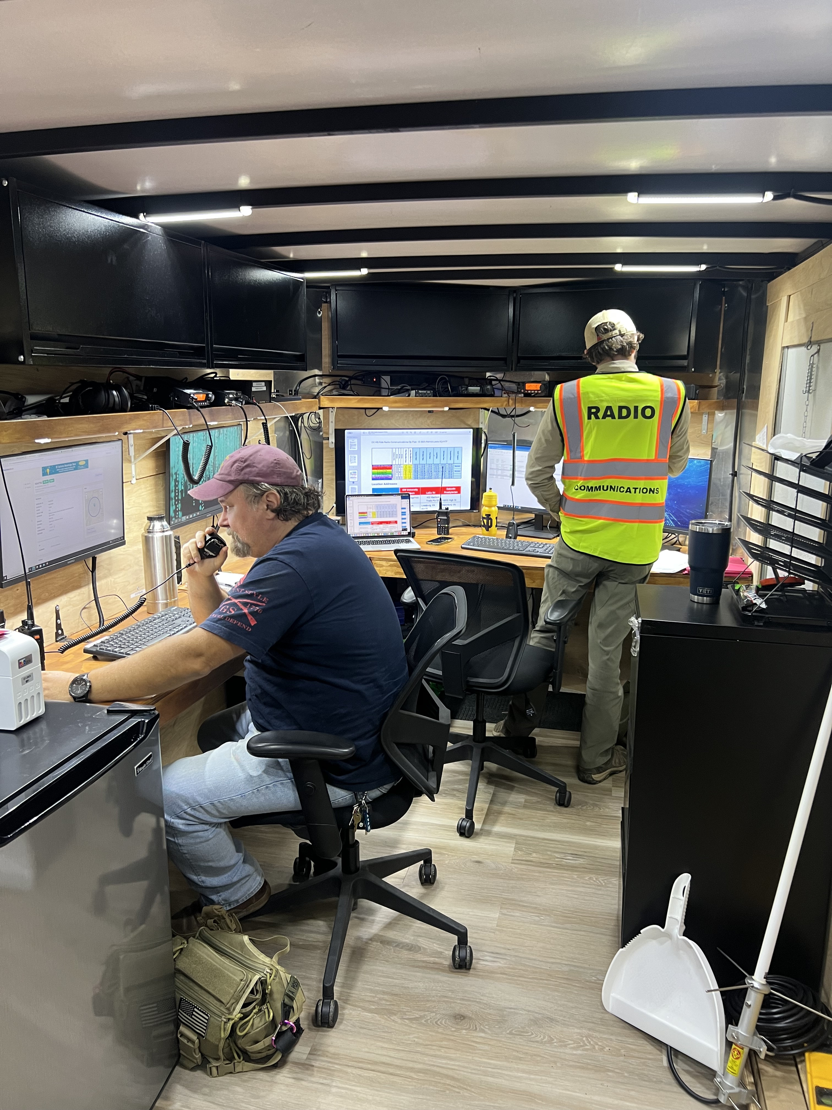
Photos

Slide 4
MS Ride Continued
Net Control did status checks on rest stops every 30-60 minutes and on SAGs every 30 minutes when unassigned and every 10-20 minutes when on assignment
No APRS was used, all locations and updates were relayed by voice
Several rest stops relayed requests for more supplies and rider questions via ham operators
SAGs fixed several flats, transported a few riders with more serious mechanical issues to the rest stops with mechanics, and transported several tired out and two riders with minor injuries to start/finish. EMS was not needed and medical waivers were signed.
MS Society staff were fully satisfied and have already asked us to help out next year.

Slide 5
MS Ride Continued
Patrick’s thoughts for club’s consideration…
  The trailer was incredibly helpful for net control. Note that Don has gone above and beyond in building it and it includes several computers, two generators, heat and AC, LED lighting, and many radios. It cost multiple tens of thousands of dollars to build.
  However, a simpler trailer would still be a great advantage in my mind
  Strongly suggest the club consider supporting this event as a club or in conjunction with Don’s non-profit (a search and rescue group) next year.
  MS Society expressed interest in making a donation to a club if it threw its full weight behind supporting the ride.
  Happy to chat more, don’t hesitate to reach out!

