Slide 1
EchoLink for Ham Radio Enthusiasts
Notes:
AI-generated content may be incorrect. ---

Slide 2
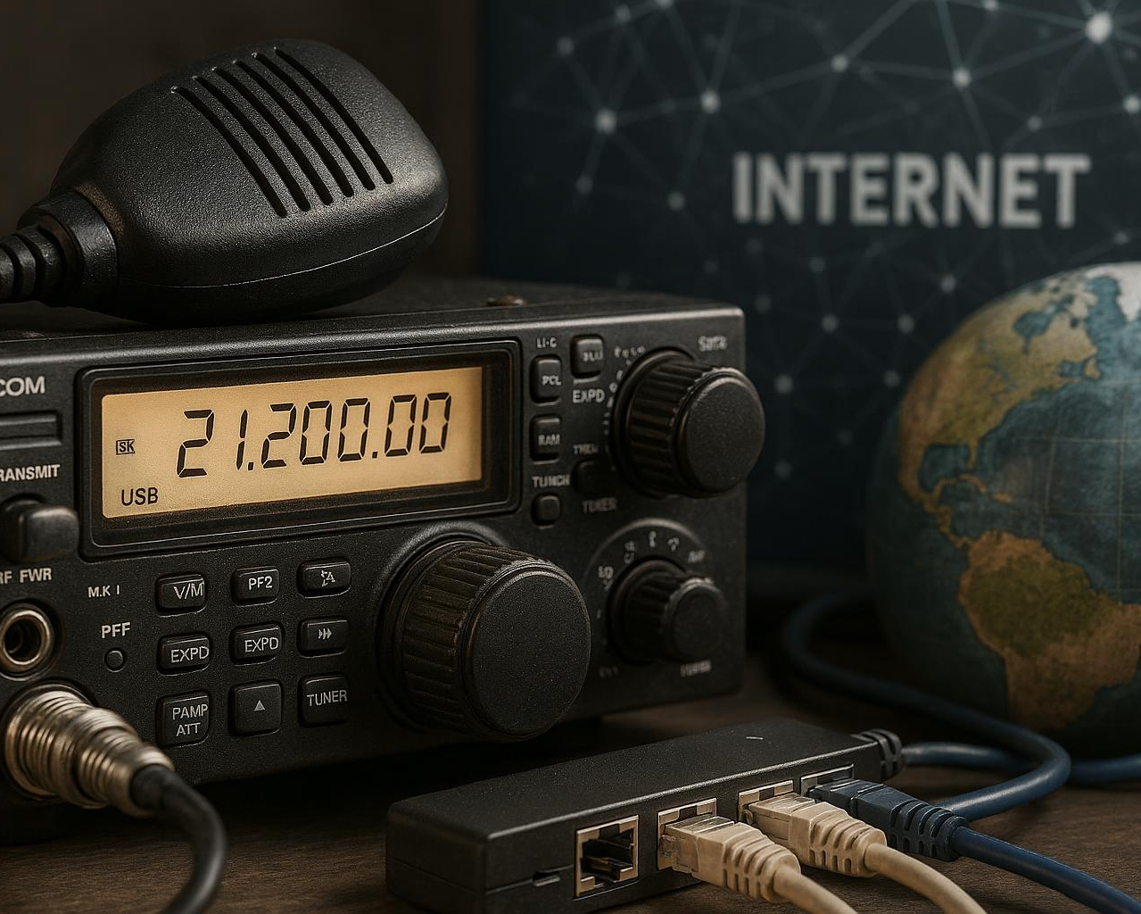
Purpose and History of EchoLink
Development and Purpose
Created to connect amateur radio operators worldwide using the internet and VoIP technology.
Global Communication
Enables licensed hams to communicate globally, overcoming limitations of traditional radio waves.
Bridging Analog and Digital
Bridges analog radio and digital internet technologies for seamless worldwide communication.
Notes:
--- EchoLink was developed in 2002 by Jonathan Taylor, K1RFD, with the aim to link amateur radio operators over the internet, overcoming the physical limitations of radio waves. It allows licensed hams to communicate globally by combining Voice over IP (VoIP) technology with traditional ham radio frequencies. Over two decades, its adoption has grown, bridging analog radio and internet technologies and enabling seamless worldwide communication. Image source: AI-generated

Slide 3
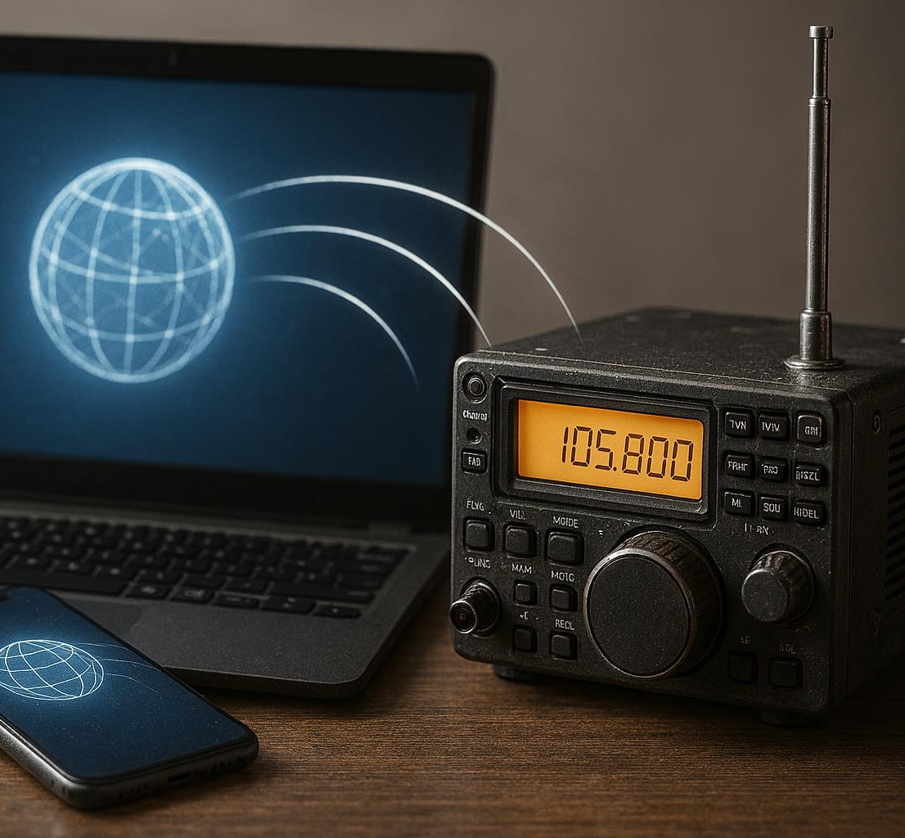
Key Features and Capabilities
Versatile Connection Types
Supports single-user, conference servers, and repeater links for diverse communication setups.
Multi-Platform Support
Compatible with both desktop and mobile platforms ensuring broad accessibility.
Audio Routing and Node Discovery
Routes audio between internet users and radio sites with automatic node detection for seamless communication.
Authentication over Encryption
Minimal encryption reflecting open communication ethos with authentication for operator legitimacy.
Notes:
--- EchoLink supports single-user connections, conference servers, and repeater links, enabling a versatile range of communication setups. It features low latency and supports both desktop and mobile platforms. Capabilities include routing audio between internet users and radio sites, automatic node discovery, and integration with standard amateur radio protocols. Its encryption is minimal due to ham radio's open communication ethos but includes authentication for operator legitimacy. Image source: AI-generated

Slide 4

Comparison to Traditional Ham Radio Methods
Limitations of Traditional Ham Radio
Traditional ham radio depends on line-of-sight and atmospheric conditions, limiting its communication range and effectiveness.
Advantages of EchoLink
Uses internet connectivity to enable global communication, overcoming geographical and atmospheric restrictions.
Power and Infrastructure Needs
Requires internet infrastructure and power, while traditional ham radio can operate off-grid without such dependencies.
Complementary Technologies
Combining traditional radio skills with modern internet technology creates a complementary approach to communication.
Notes:
--- Traditional ham radio relies on direct radio frequency propagation, limited by line-of-sight and atmospheric conditions, often restricting communication range. EchoLink overcomes these limitations by leveraging internet connectivity, allowing global communication regardless of geographic barriers. However, EchoLink requires internet infrastructure and power, whereas traditional methods can operate fully off-grid. The comparison highlights a complementary relationship, blending classic radio skills with modern connectivity. Image source: AI-generated

Slide 5
EchoLink System Architecture
Notes:
Client and Node Types (User, Sysop), Network Protocols and Data Flow, Integration with Analog and Digital Radio Equipment

Slide 6
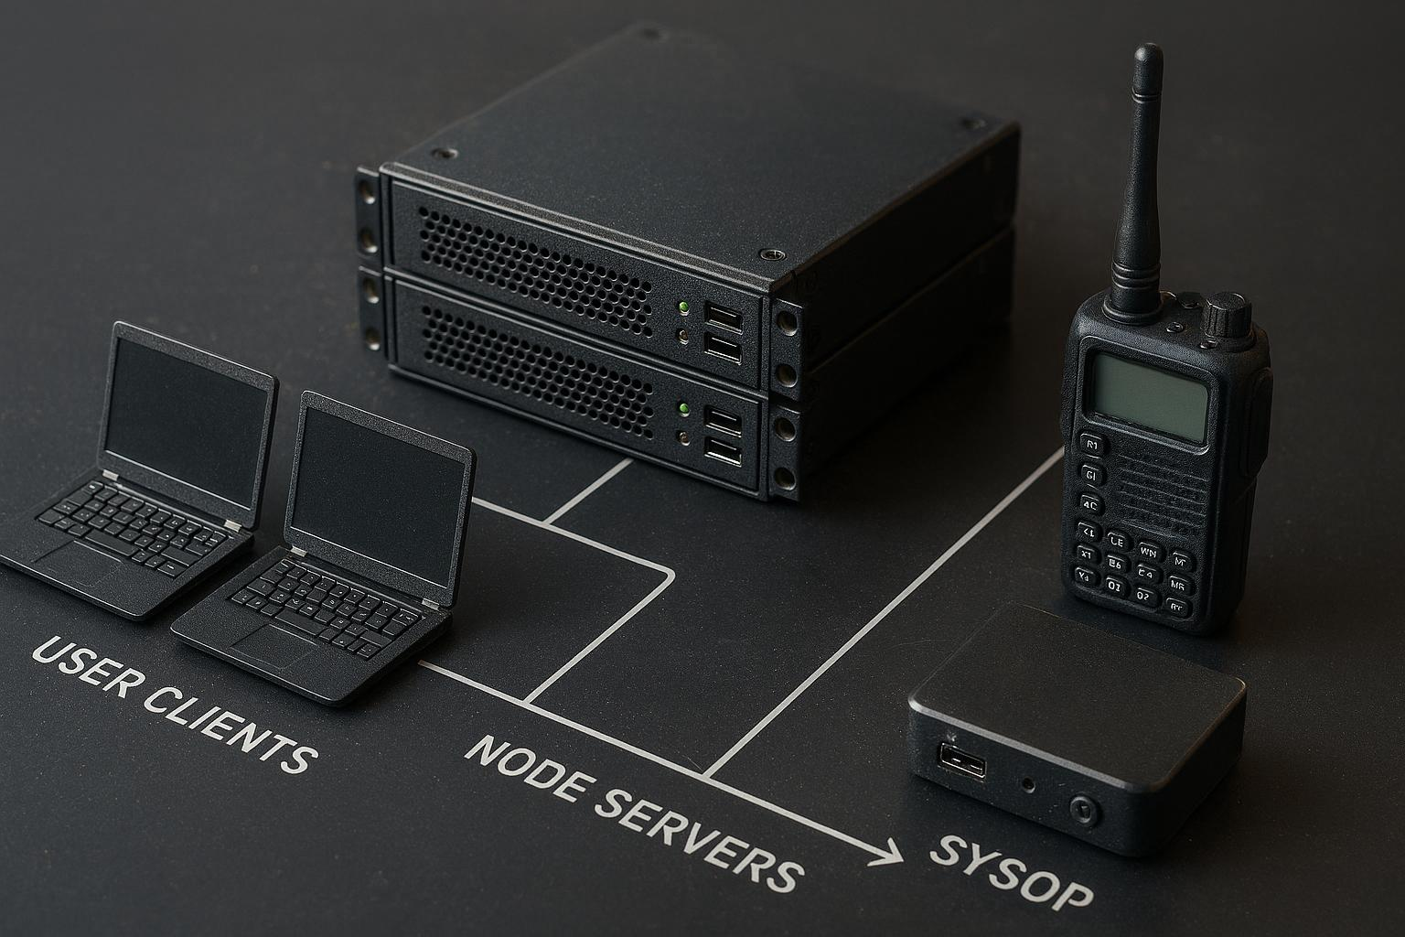
Client and Node Types (User, Sysop)
User Clients
User clients include desktop and mobile devices that connect to the EchoLink network for communication.
Node Servers
Node servers control radio interfaces bridging RF signals to the internet, facilitating network connectivity.
Sysop Responsibilities
Sysops manage node stability, registration, and enforce operating standards for reliable system function.
Hierarchical Network Control
The system supports thousands of nodes with hierarchical control to ensure scalable and reliable operation.
Notes:
--- EchoLink architecture distinguishes between user clients and node servers managed by system operators ('sysops'). User clients include desktops and mobiles connecting to the network, while nodes often control radio interfaces for bridging RF to internet. Sysops maintain node stability, registration, and enforcement of operating standards. The system supports thousands of nodes worldwide with hierarchical control to ensure scalable and reliable operation. Image source: AI-generated

Slide 7
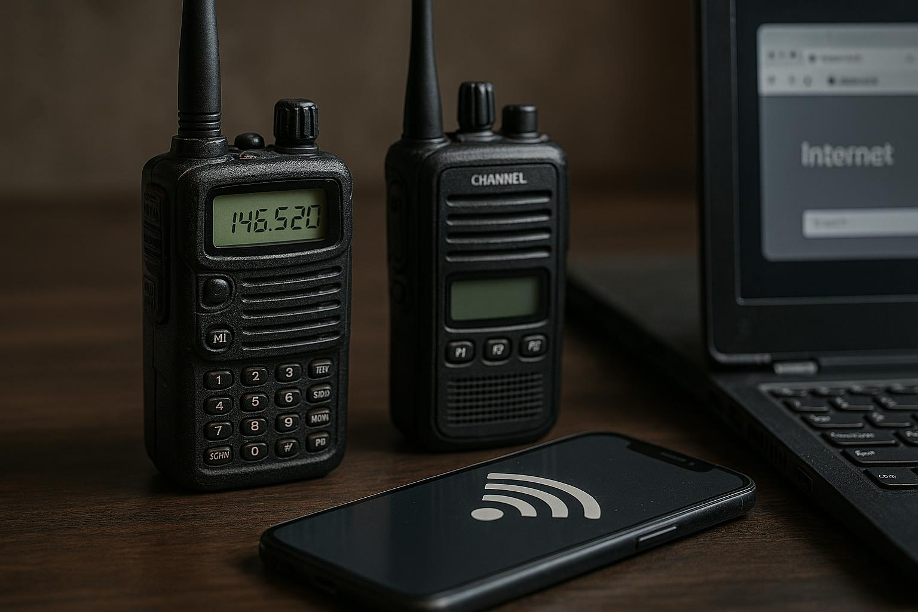
Integration with Analog and Digital Radio Equipment
Analog Radio Integration
Connects analog radios via transceivers and audio interfaces to link RF signals with the internet.
Digital Radio Compatibility
Supports digital radios using nodes and protocols like D-STAR and System Fusion in hybrid network setups.
Remote Station Operation
Enables remote control of physical radio stations, extending reach and functionality for amateur operators.
Notes:
--- EchoLink interfaces with conventional analog radios via transceiver and computer audio interfaces (sound cards or specialized hardware) allowing seamless connection of RF signals to the internet. It also supports digital radios through compatible nodes and protocols like D-STAR or System Fusion in hybrid setups. These integrations enable remote operation of physical stations and extend radio functionality to the digital realm, facilitating broader reach for amateur operators. Image source: AI-generated

Slide 8
Setup and Configuration
Notes:
System Requirements and Supported Platforms, Software Installation and User Registration, Connecting to EchoLink via Desktop and Mobile Devices

Slide 9
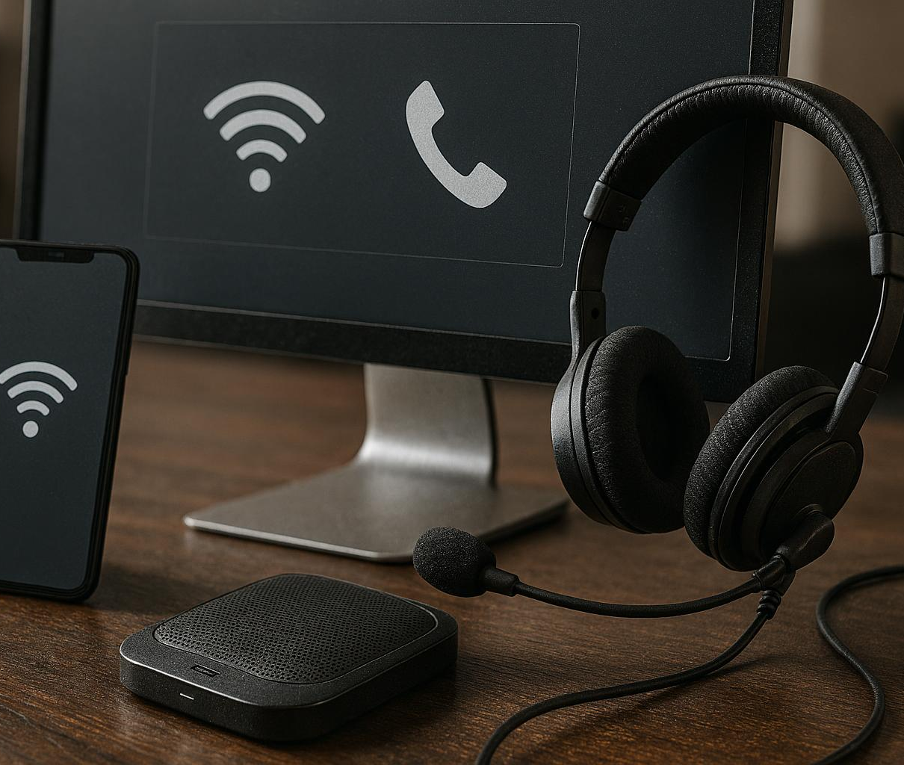
System Requirements and Supported Platforms
Supported Operating Systems
Supports Windows, macOS, iOS, and Android, ensuring wide device compatibility for users.
Hardware Requirements
Desktops need at least 1GHz CPU and 256MB RAM, while mobile apps require minimal storage and network capabilities.
Windows Vista and above
Network and Audio Compatibility
Broadband internet with minimum 256 Kbps speed is recommended, along with USB audio interfaces or soundcards for radio integration.
Notes:
--- EchoLink runs on Windows, macOS, iOS, and Android platforms, requiring modest hardware resources such as a 1GHz CPU and 256MB RAM for desktops, while mobile apps demand minimal storage and network access. Broadband internet with at least 256 Kbps upload/download is recommended for optimal audio quality. Compatibility with USB audio interfaces and typical soundcards is essential for radio integration. Image source: AI-generated

Slide 10
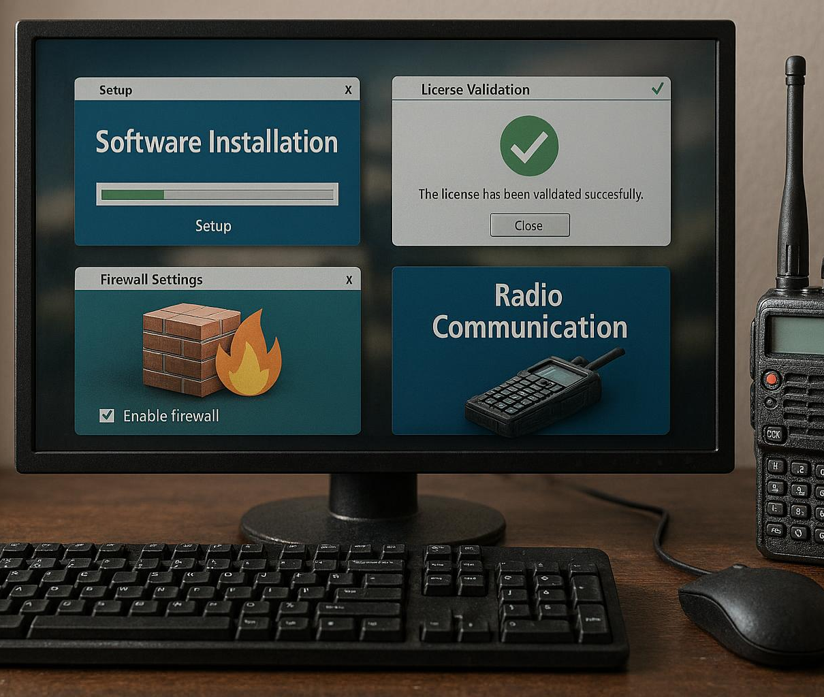
Software Installation and User Registration
Software Download and License Validation
Download official software and validate license keys linked to ham radio call signs for secure access.
User Registration and Verification
Register users by verifying amateur radio licenses to issue User IDs for proper operation.
Configuration and Security Setup
Set audio preferences, configure firewall for port forwarding, and optionally link nodes securely.
Notes:
--- Installation involves downloading official EchoLink software packages or app store versions, followed by license key validation tied to ham radio call signs. Registration requires proof of amateur license to obtain User IDs for operation. The process includes setting audio device preferences, firewall configuration for port forwarding, and optional node linking setup. This ensures secure, authorized access matching FCC and ITU amateur radio regulations. Image source: AI-generated

Slide 11
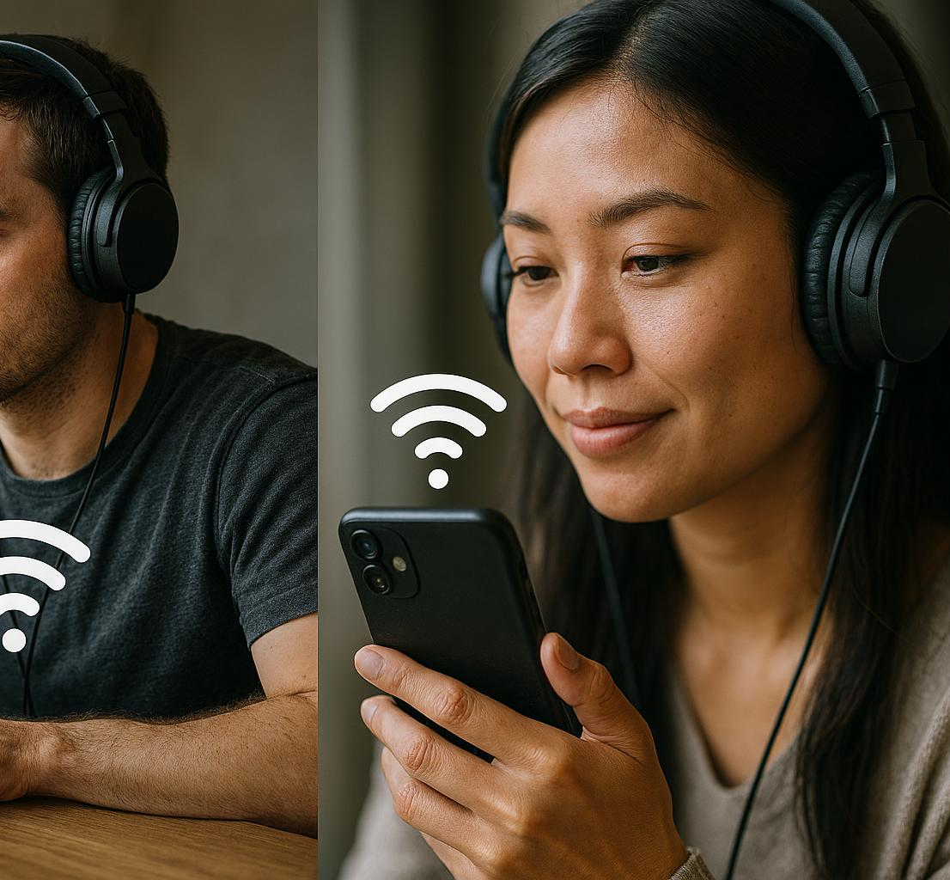
Connecting to EchoLink via Desktop and Mobile Devices
Accessing Worldwide Nodes
Users log in to access a global directory of nodes and peers for communication via GUI or app interface.
Audio Routing and PTT Control
Audio is routed through system sound devices or radios, controlled by push-to-talk functionality.
Mobile Features
Mobile apps provide location-based node discovery and push notifications for incoming calls.
Cross-Platform Synchronization
Synchronization enables seamless transitions between desktop and mobile platforms for continued communication.
Notes:
--- Once installed, users can log in and access a directory of worldwide nodes and peers, initiating connections via client GUI or app interface. Audio routing through system sound devices or external radios is controlled with PTT (push to talk) features. Mobile apps offer additional location-based node discovery and push notifications for incoming calls. Cross-platform synchronization allows seamless transitions between desktop and mobile use cases. Image source: AI-generated

Slide 12
Practical Applications and Use Cases
Notes:
Remote Station Operation, Emergency Communications, Global Networking for Amateur Radio Operators

Slide 13
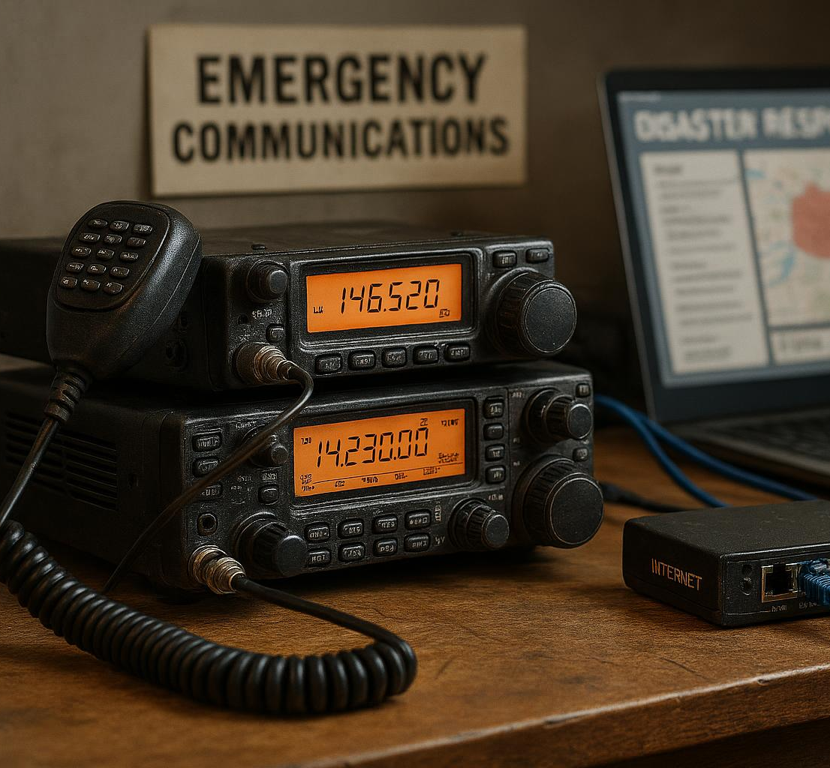
Emergency Communications
EchoLink as Backup
Provides reliable communication during emergencies, provided internet is available.
Ham Operators Coordination
Ham radio operators use EchoLink to connect response teams and manage relief efforts effectively.
Permanent EchoLink Nodes
Permanent EchoLink nodes are maintained to support ongoing disaster response and ensure readiness.
Interoperability with Analog Repeaters
Interoperability with analog repeaters enhances communication versatility across varied conditions.
Notes:
--- In emergencies where conventional radio or phone networks fail, EchoLink offers a resilient communication option if internet infrastructure is intact. Ham operators use it to link emergency response teams, coordinate relief efforts, and maintain situational awareness. Several amateur emergency groups maintain permanent EchoLink nodes to support disaster response, and interoperability with analog repeaters ensures versatility under varied conditions. Image source: AI-generated

Slide 14
Let's program some PHONEs
Notes:
Authentication and User Verification, Network Stability and Troubleshooting, Emerging Technologies and EchoLink Enhancements

Slide 15
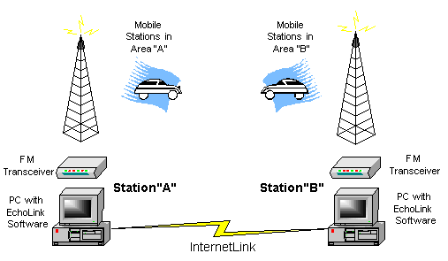
Linking Example
Computer – PC or Mac
Web based
Linux https://www.svxlink.org/
https://www.echolink.org/help_ex/hh_start.htm
Android
iPhone
https://www.echolink.org/download.htm or PlayStore / iOS App Store

Slide 16
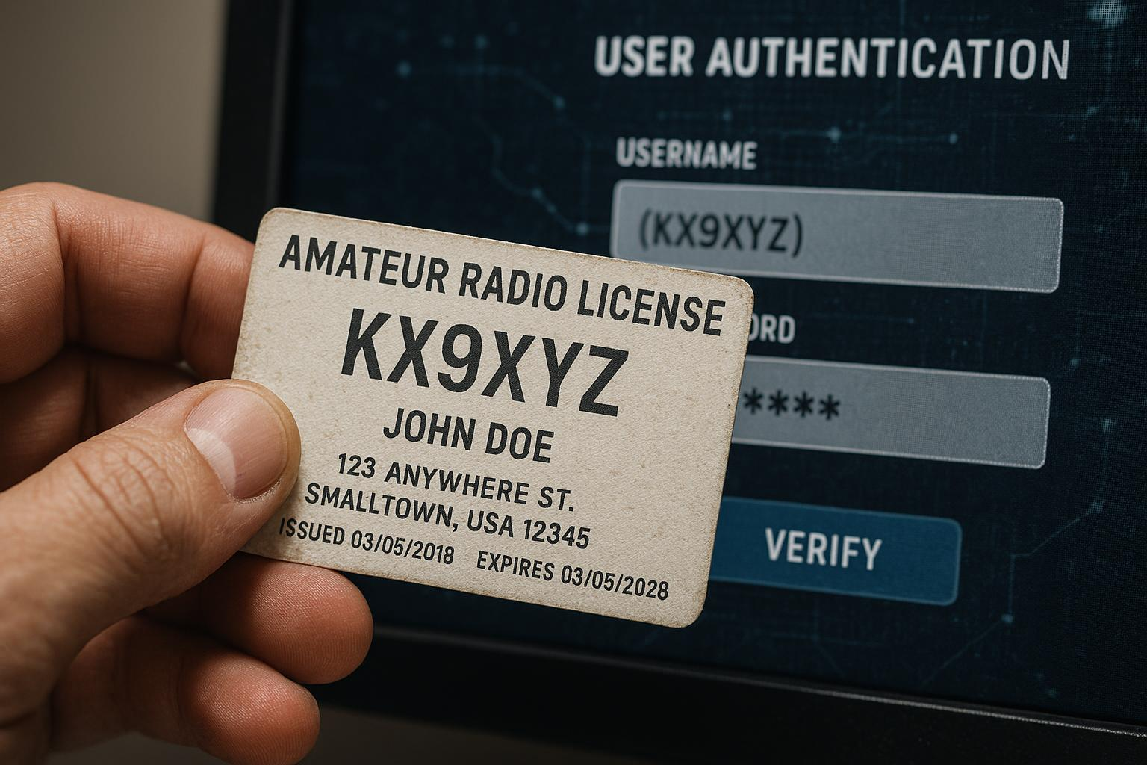
Authentication and User Verification
License Registration
Users must register their FCC or equivalent licenses linking call signs to user IDs ensuring authorized access.
License and Callsign Verification
Verification includes submission of licenses and validation of callsigns through online databases for authenticity.
Authentication Security Importance
Authentication is critical for node integrity despite limited encryption in amateur radio environments.
Notes:
--- EchoLink enforces authentication by requiring users to register their FCC or equivalent amateur radio licenses, linking their call signs to user IDs. This prevents unauthorized access and ensures compliance with amateur radio regulations. Verification processes include license submission and callsign validation via online databases. While encryption is limited due to amateur radio openness, authentication remains the key security pillar protecting node integrity. Image source: AI-generated

Slide 17
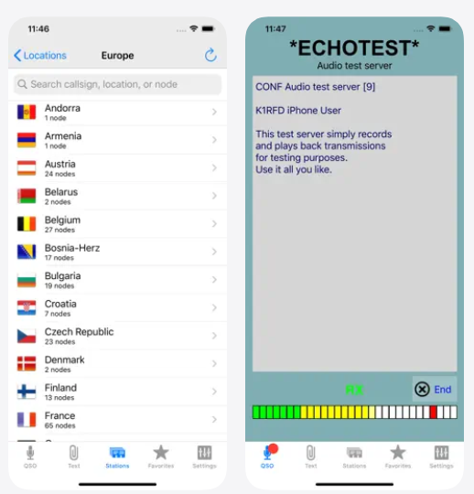
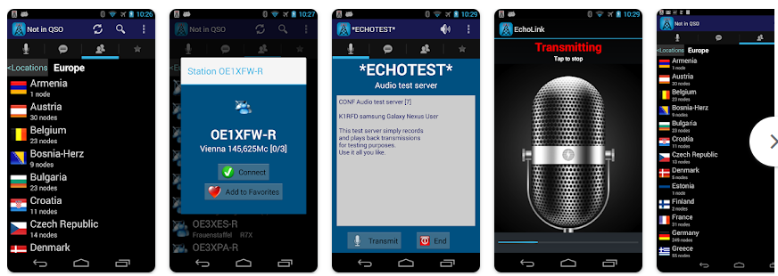
Phone Setup - android
Android but similar for iPhone
Tablets work as well
https://play.google.com/store/apps/details?id=org.echolink.android&hl=en
https://apps.apple.com/us/app/echolink/id350688562

Slide 18
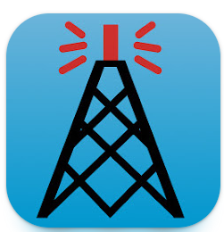
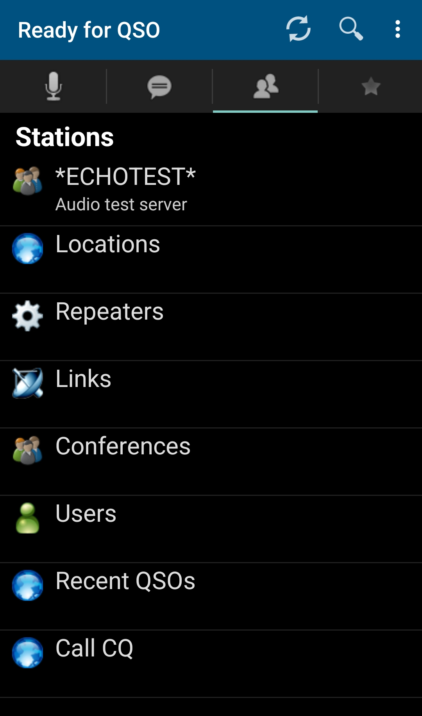
Open Application
Defaults to this window on the phone
Echo Test – to see if it’s working
Locations – find repeaters based on location
Repeaters – list of repeaters
Links - special radio gateways
Conferences – list of conference nodes
Users – who is registered
Recent QSOs – your recent connections
Call CQ – connects you to a station that is calling CQ

Slide 19

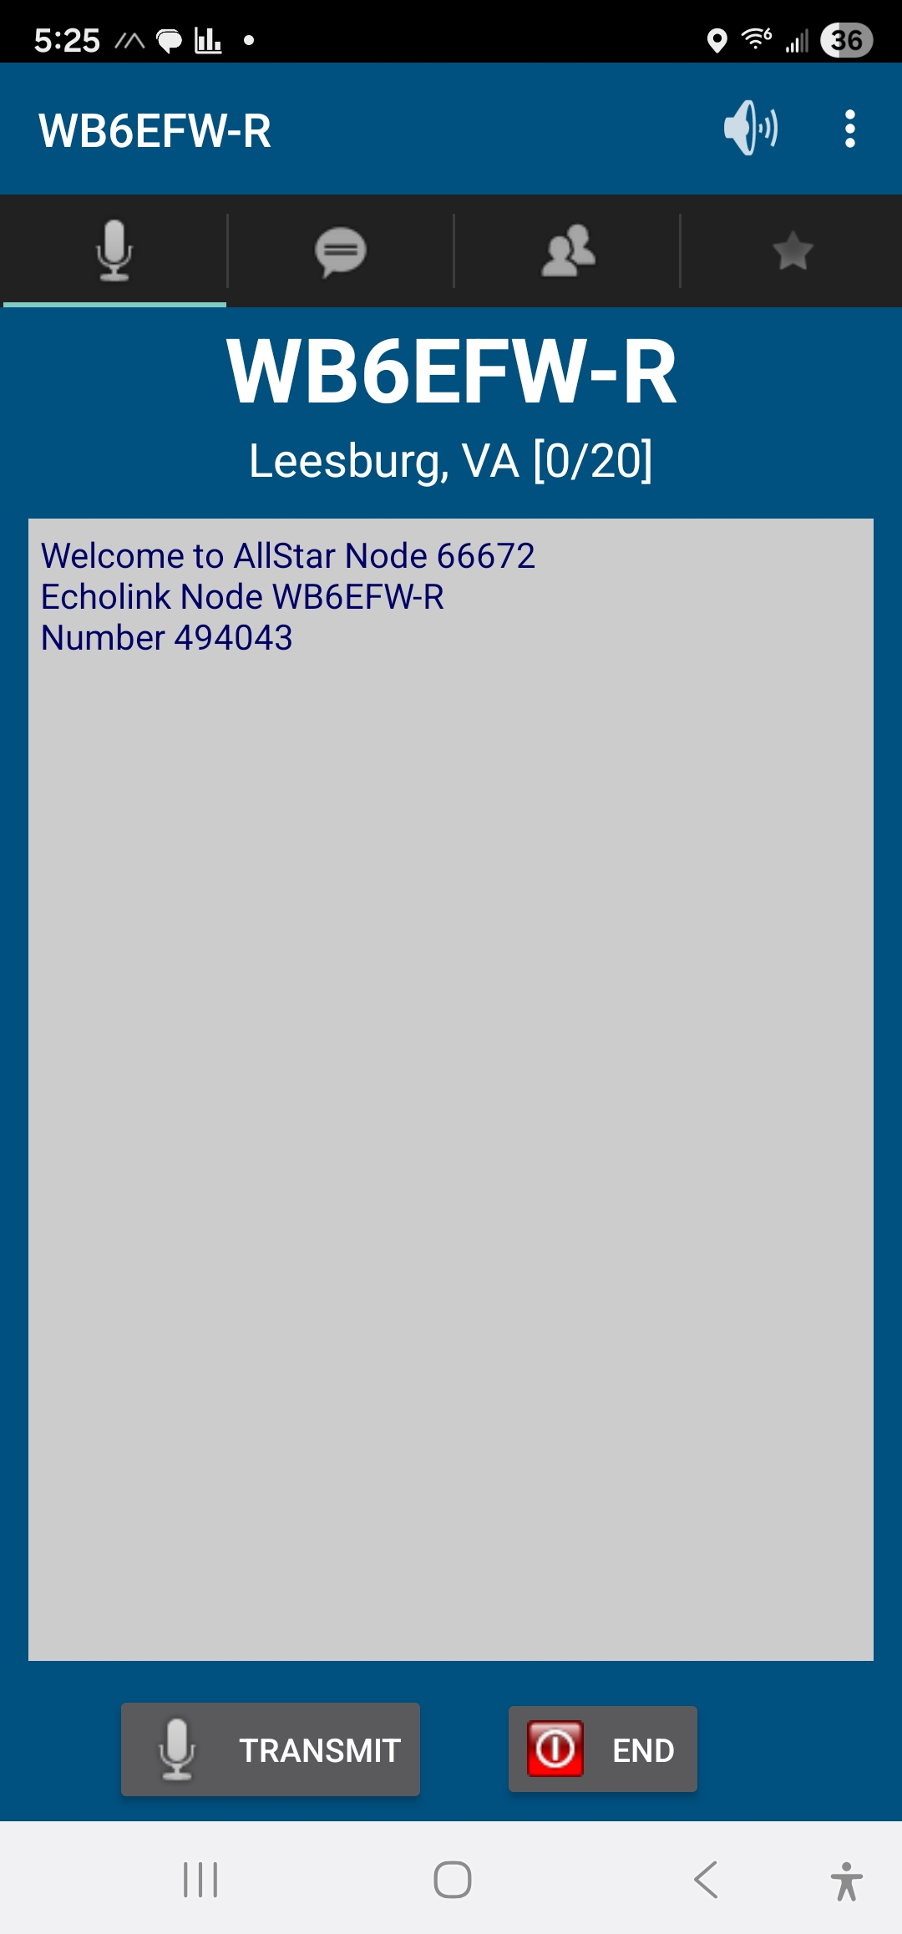
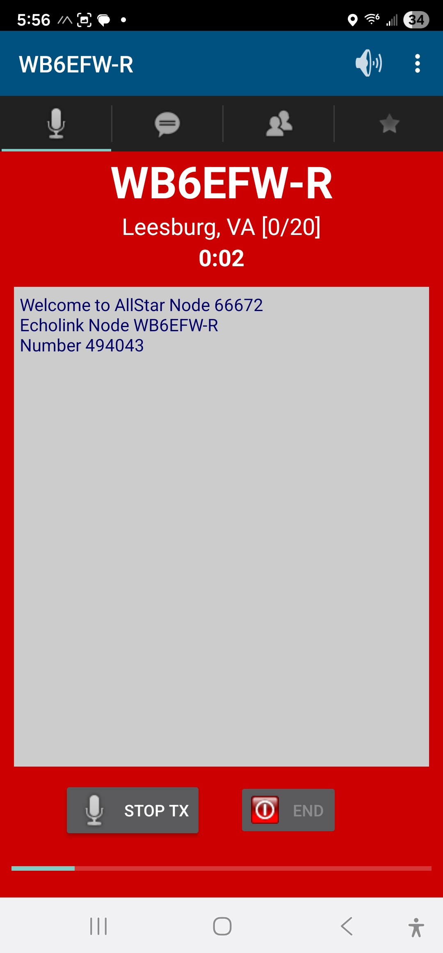
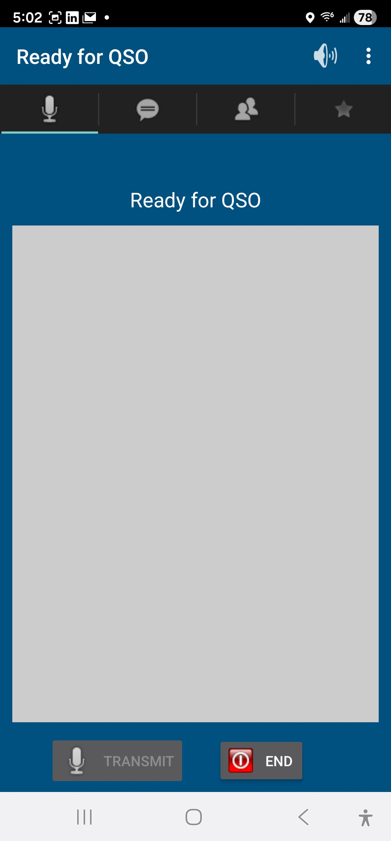
Press Transmit to start QSO
Remember to hit ‘STOP TX’ to end QSO – otherwise open mic
End - disconnects

Slide 20
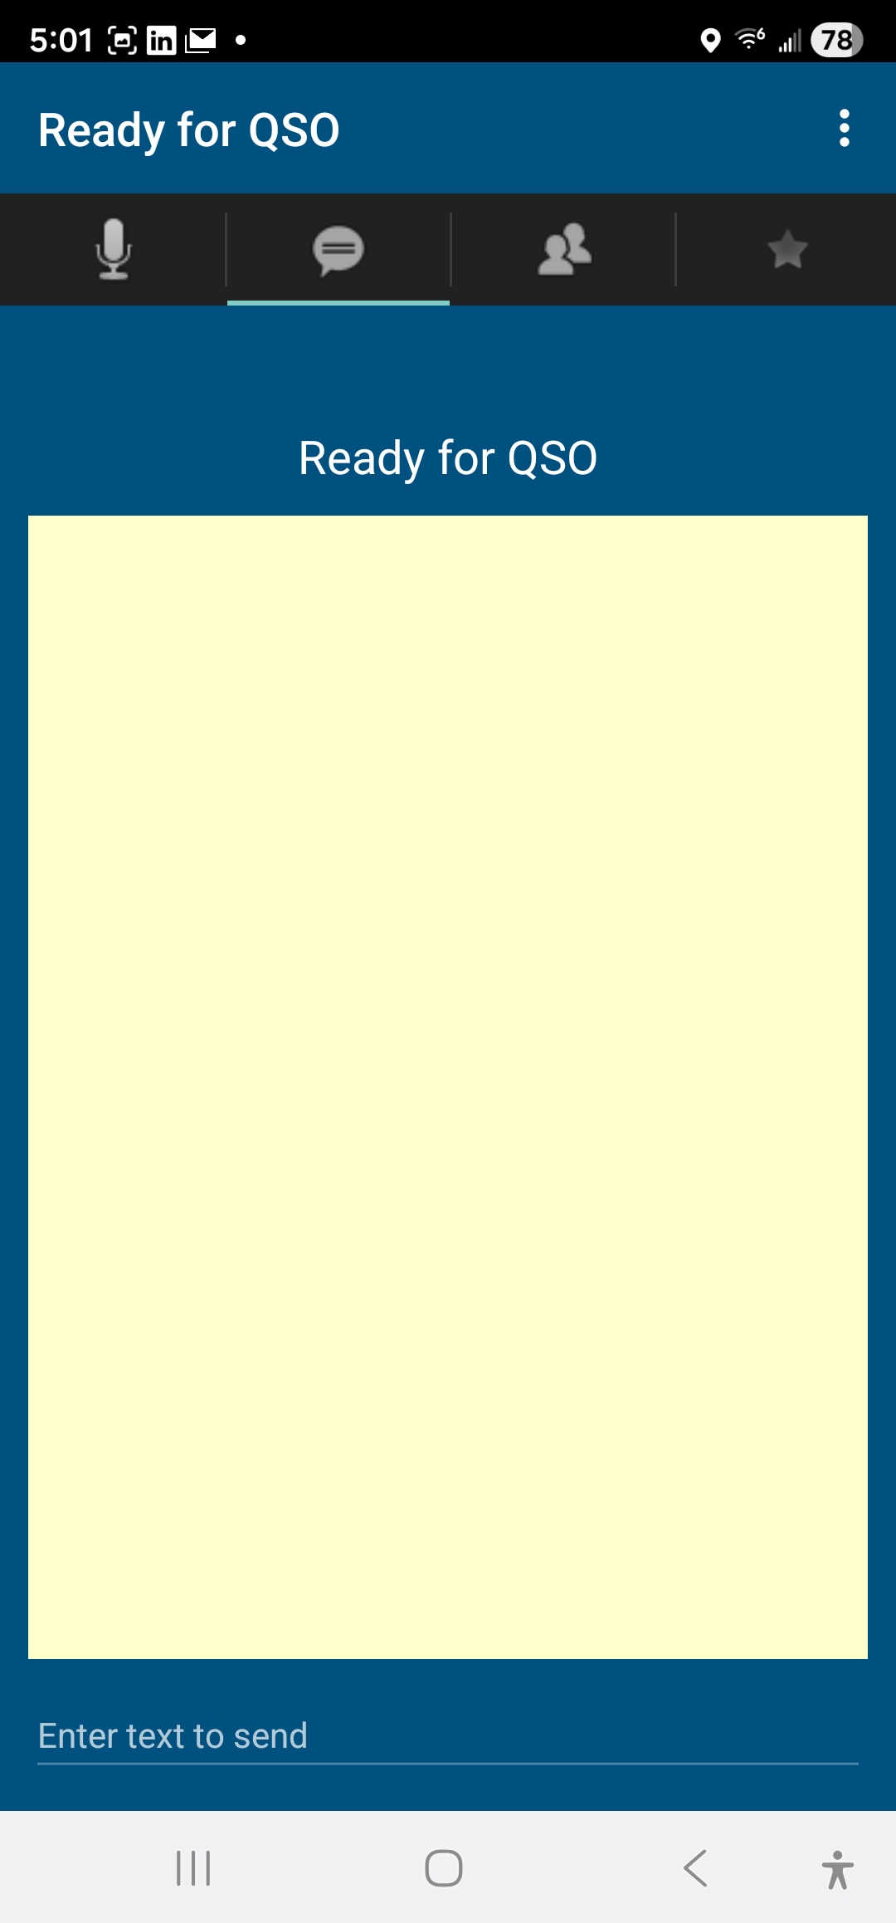
For text messages
I’ve never used it
Only works if connected to a node

Slide 21
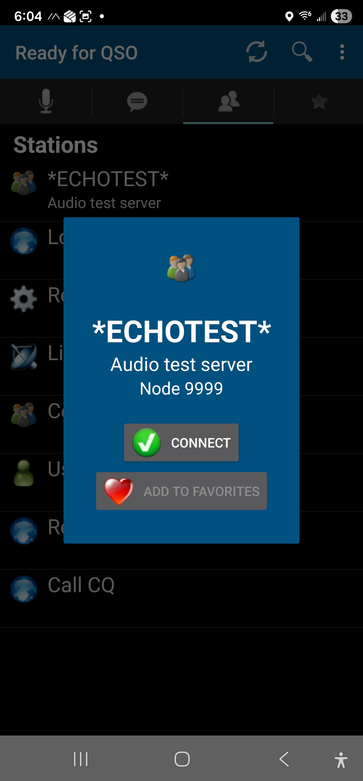
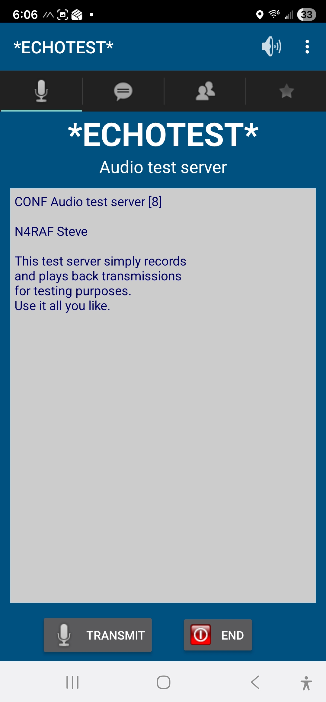

Slide 22
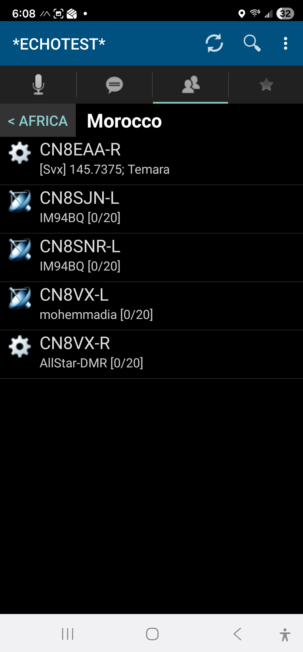
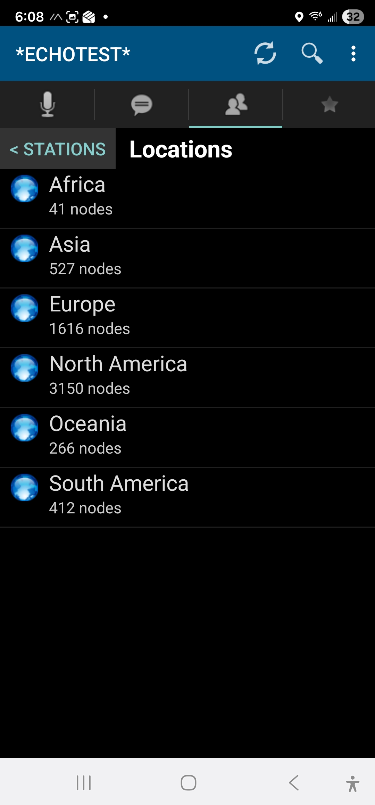
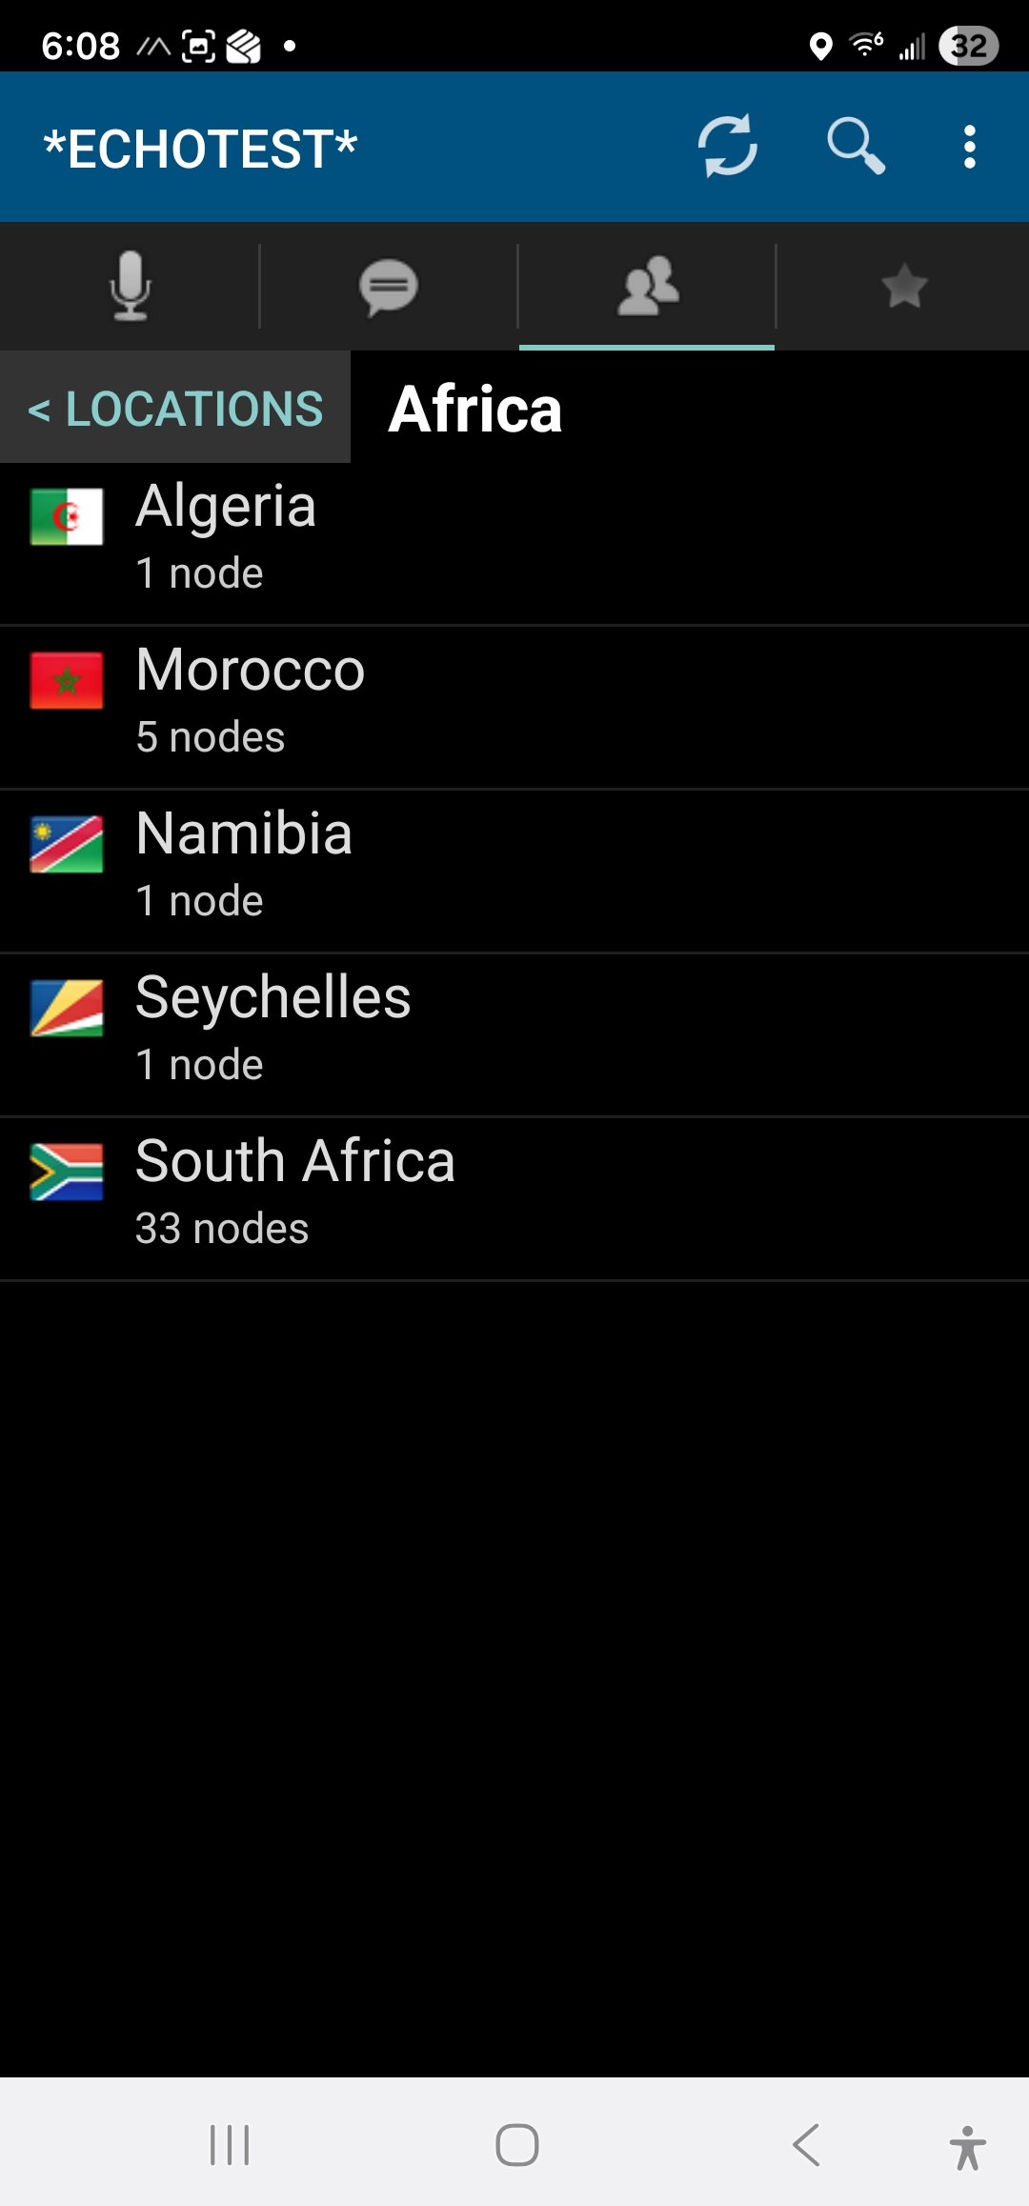

Slide 23
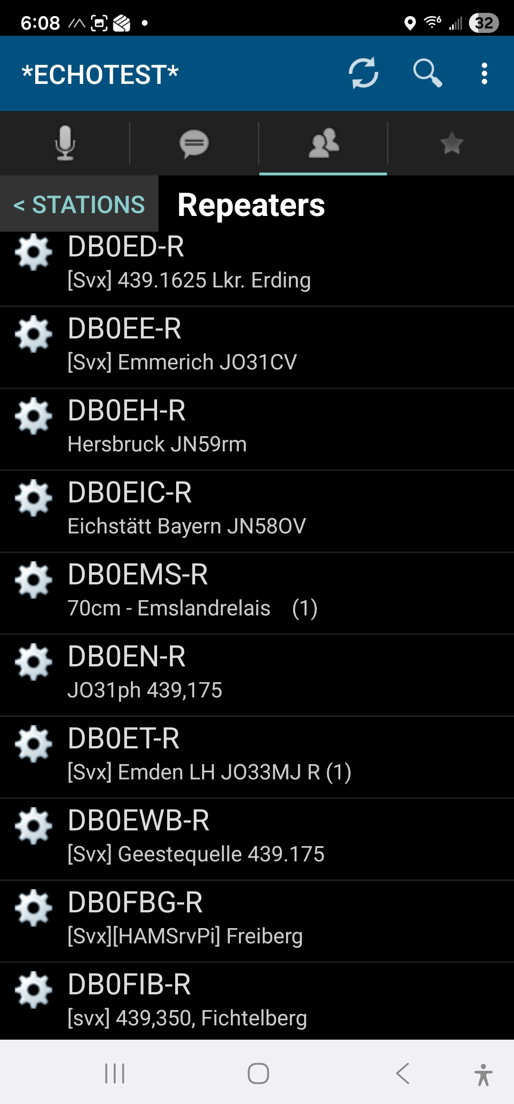
Satellite/Link Icon (Single Satellite/Dish): This icon indicates a Link or a Simplex Link.
Repeater Icon (Satellite with People/Nodes): This icon indicates a Repeater (-R callsign) that is linked to the internet via EchoLink. It is often used to show a station that allows multiple users to connect through it.
Person/User Icon: This icon represents a Single User who is logged in directly via the EchoLink app on a computer or mobile device

Slide 24

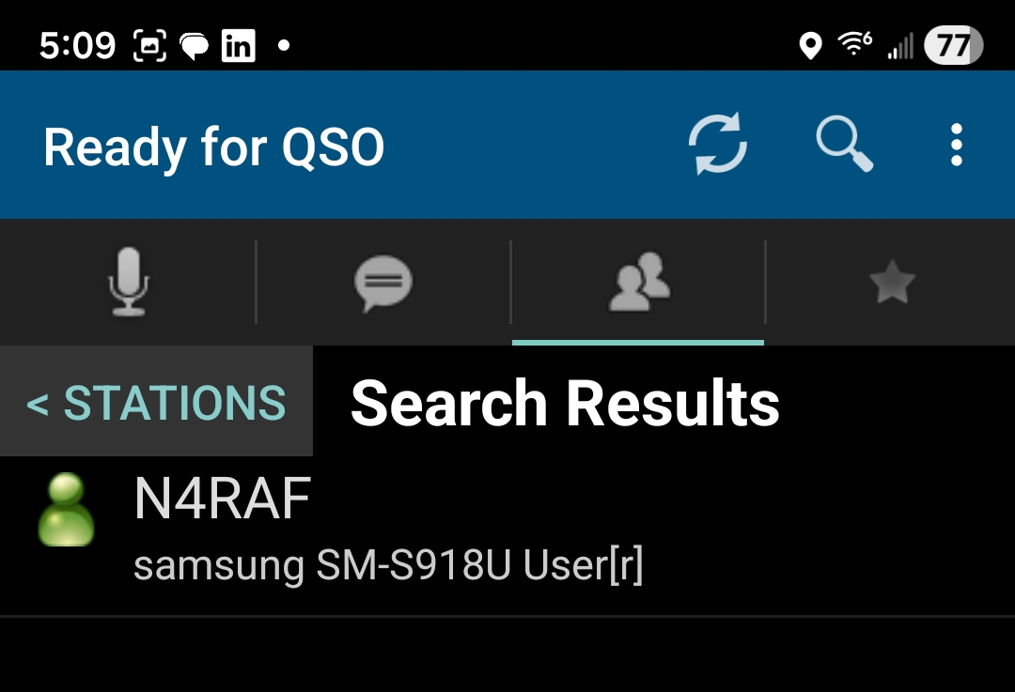
Links - special radio gateways
Conferences – list of conference nodes
Users – who is registered
Recent QSOs – your recent connections
Call CQ – connects you to a station that is calling CQ
All are searchable by using the

Slide 25
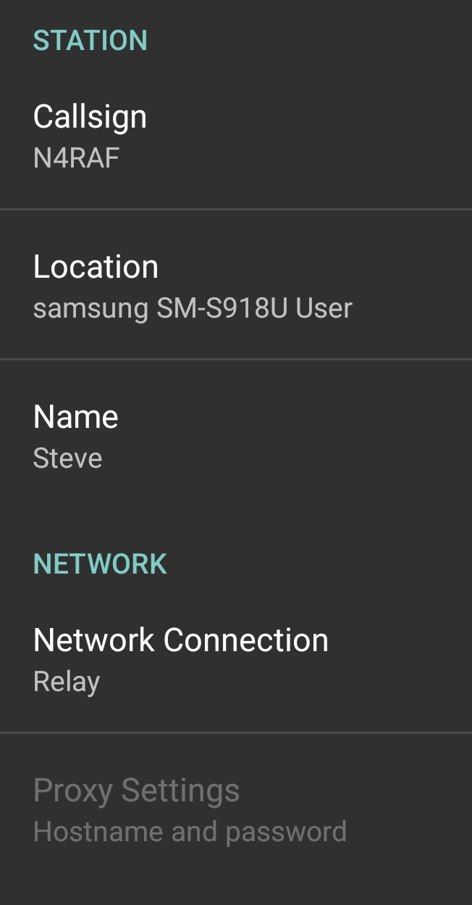
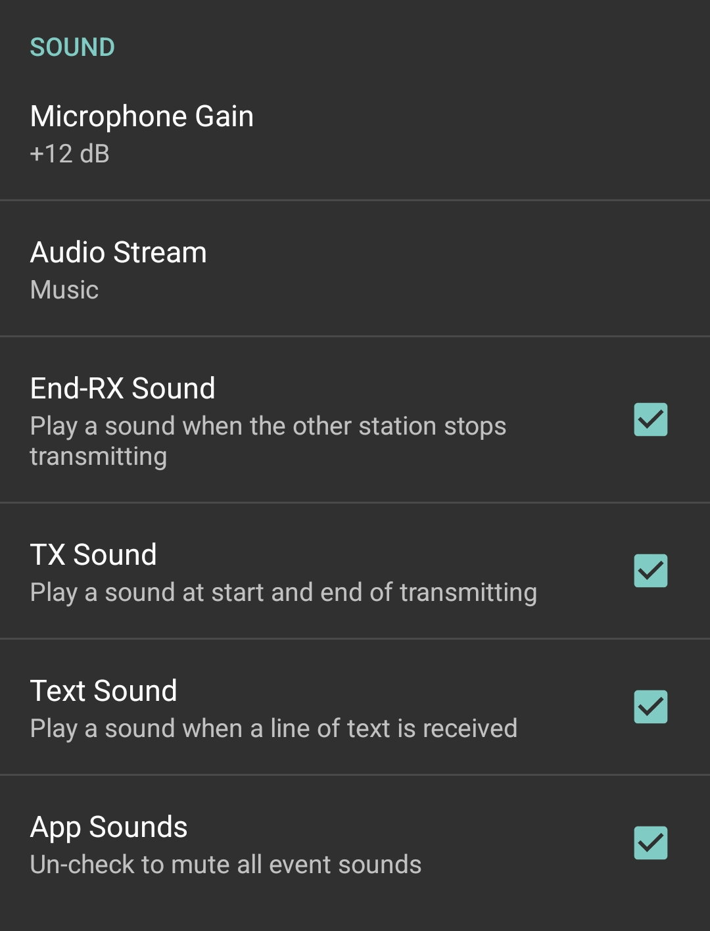
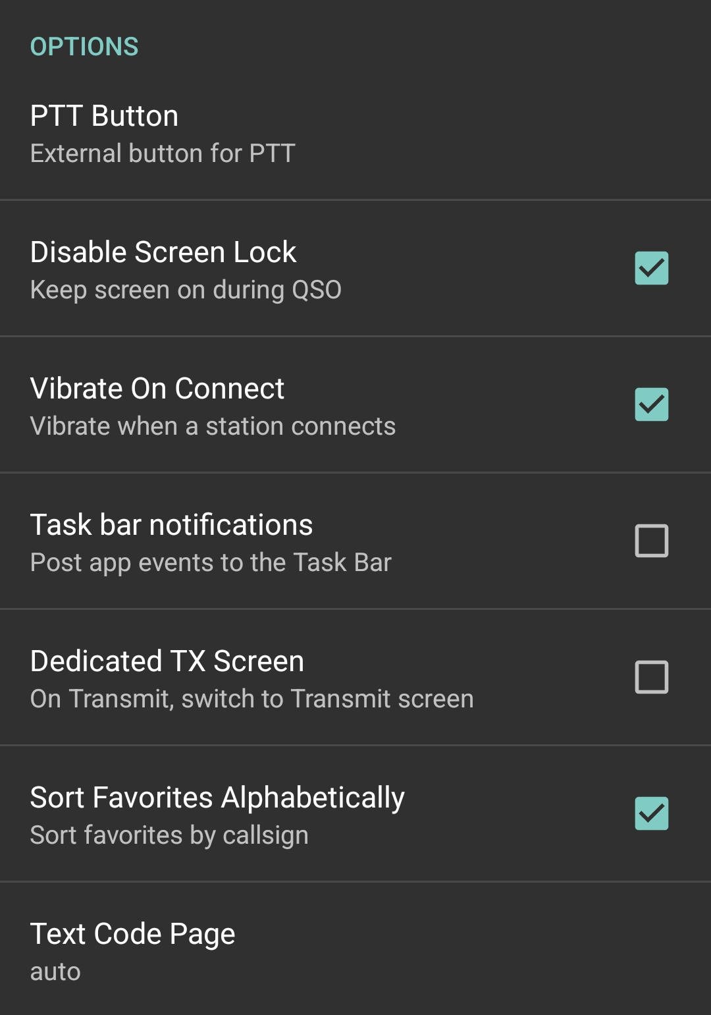
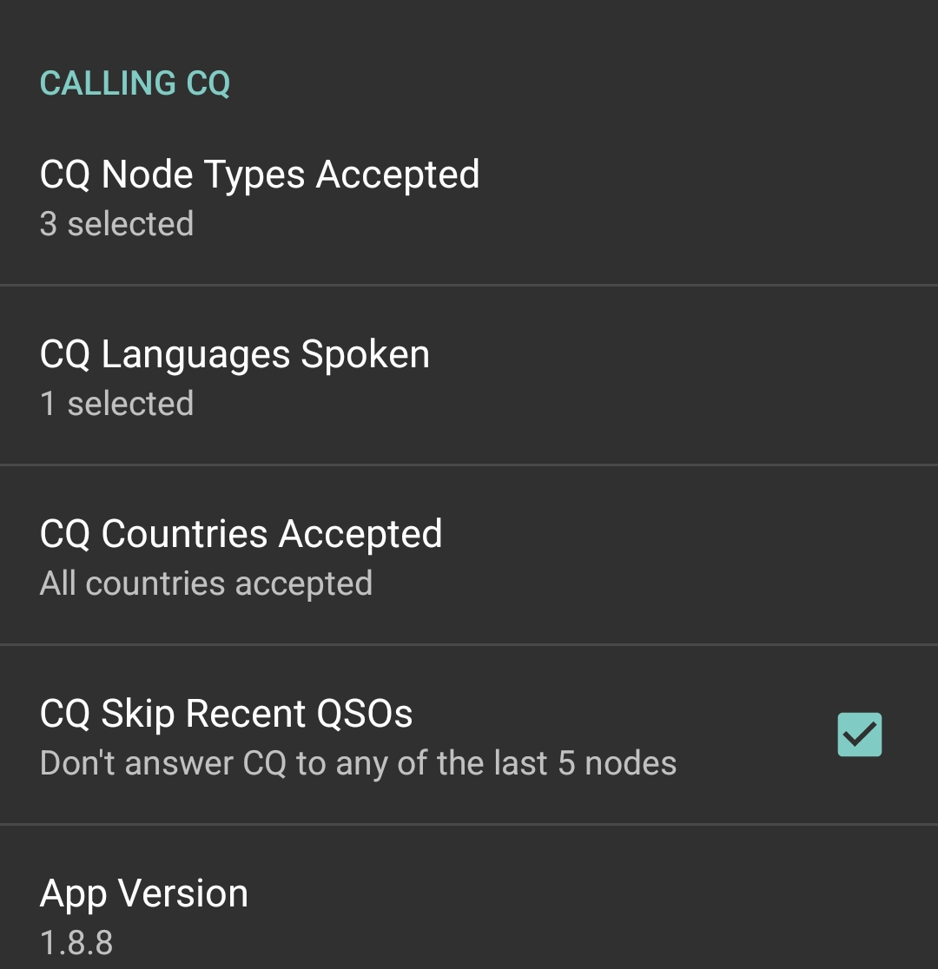
Refresh
Search
Settings
Audio Stream should be – Music – otherwise low volume

Slide 26
Known or observed issues
Not connected - restart app and/or close out other communications or audio applications
Low volume
Make sure you have music on in settings
Volume settings
Repeater / Node audio settings

Slide 27
Questions???

