Slide 1


Presentation to LCARES
Steve
N4RAF
7 Jan 26

Slide 2
What is Winlink?
Winlink Global Radio Email®️...
...is a network of amateur radio and authorized government stations that provide worldwide radio email using radio pathways where the internet is not present.
…is an all-volunteer project of the Amateur Radio Safety Foundation, Inc. (ARSFI), a non-profit public benefit corporation with no beneficial owners.
Aka Winlink 2000 Network
https://www.winlink.org/

Slide 3
What is Winlink?
Origins with sailing community in 1990s
Worldwide radio email service that uses RF
  HF
  VHF/UHF
Supports attachments, position reporting, weather and information
Used for emergency and disaster relief comms
  Some level of ‘protection’ since it isn’t voice
  Higher quality vs. voice
No internet required
  Using smart-network radio relays

Slide 4
Winlink Was There...
Lives and property saved, damage mitigated and training, training, training: Why Winlink volunteers do what they do. Here is a sampling of events and incidents in which the system was significantly involved.
Winter 2021 Texas Freeze
Fall 2020 Nationwide Red Cross Exercise
Fall 2020 Ohio Military Reserve "Black Swan" Exercise IPAWS Demonstration
2020 California Earthquakes
2019 Citadel Rumble CA Exercise
2019 Washington State EOC-EOC Exercise
2019 Mexican wildfires,
https://winlink.org/
An article describing how radio amateurs can help fill the information “donut hole” by providing post-earthquake “did you feel it” (DYFI) reports via Winlink HF radio email appeared on February 22 in the American Geophysical Union (AGU) magazine Eos.

Slide 5
Users
Amateur Radio Emergency Service® (ARES®)
Radio Amateur Civil Emergency Services (RACES)
CISA - SHAred RESources (SHARES) High Frequency (HF) Radio Program
American Red Cross
Hospitals
US Government – Dept of Homeland Security – FEMA
MARS
County Governments
AT&T
FedEx
Us Hams

Slide 6
Terms and Definitions
Client stations (radio operators) connect by RF to an RMS.
RMS: Radio Mail Server. An RMS Gateway is an RMS that is connected via the internet to the Common Message Server.
  Can connect to other RMS stations
CMS: Common Message Server. The CMS is the Winlink server that is situated in the ‘internet’.
Radio‐Only Operation: This consists of RMS stations that can auto‐forward by RF, independent of internet availability.
Peer-to-Peer: Direct contact between two client stations.
MID: Message ID. This is a unique alpha‐numeric code (e.g. YFYJDP7P2GFJ) that is assigned to each message.

Slide 7
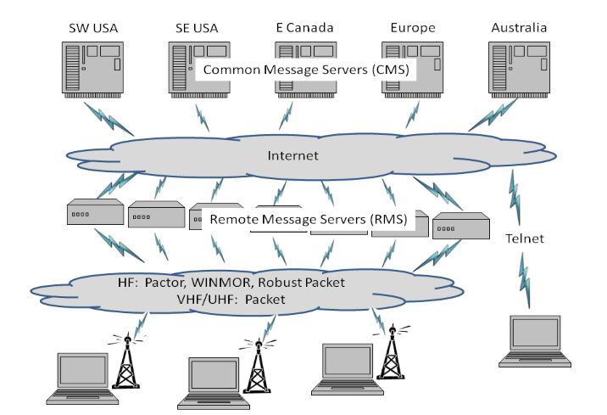
Architecture
CMS
RMS
(gateway)
Client
(you)

Slide 8
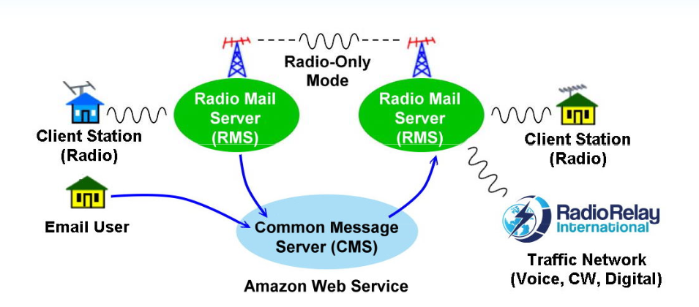
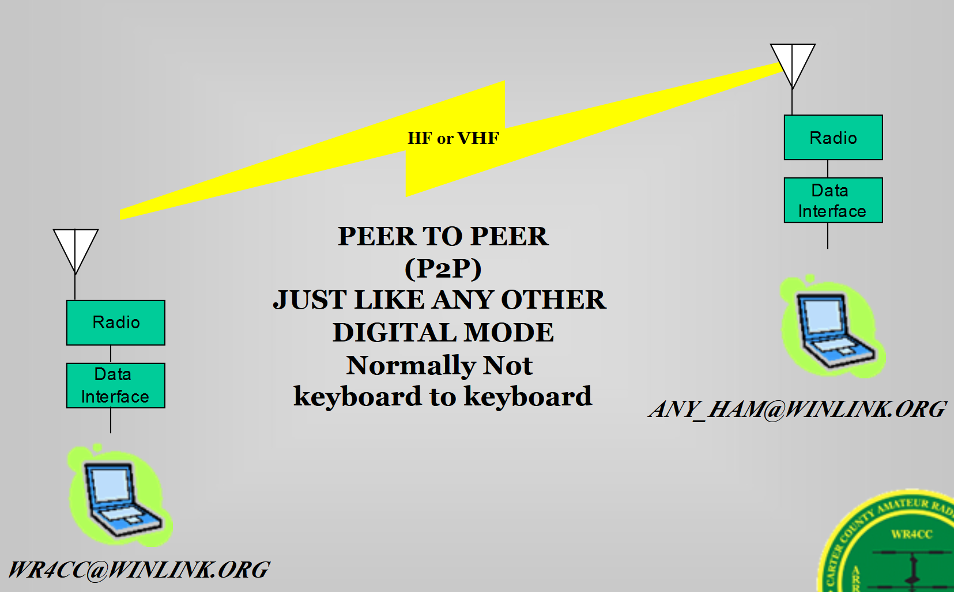
Paths
CMS / RMS
  Internet required
Radio-Only Mode
  No internet used
  RMS to RMS
Peer to Peer (P2P)
  Direct user to user
Mesh Networks
  Wireless access points
  Custom ham firmware
Telnet
  Direct to internet – skips radio

Slide 9
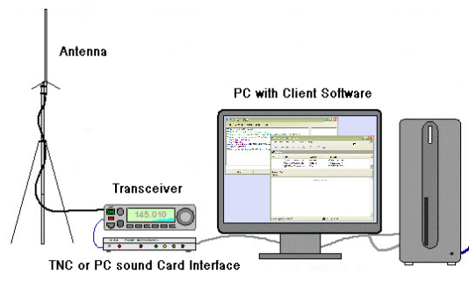
Shack Setup
Radio / Antenna
Audio Interface
  TNC or PC sound card interface
Computer
Winlink software

Slide 10
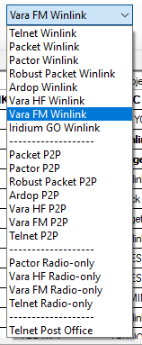
Communications Protocols
Telnet
Packet
Pactor
Ardop
VARA
Iridium GO
AX.25 (VHF/UHF)

Slide 11
How Does It Work?
Just like any email client you use
  But a few extra steps
Attachments
  Size should be limited
  At 300 baud (typical HF rate) or 1200 baud on VHF can take a while
  89kb
    VHF - 1 minute
    HF - 9+ minutes
    f(signal quality)
HTML forms

Slide 12
Costs
Winlink Express maintained by the Amateur Radio Safety Foundation:
  Free
  $24 to support but not required
  Donate to support
All others: Free
Vara:
  Free – limited data rate
  $69 – Unlimited data rate
  FM / HF / Satellite

Slide 13
Encryption
Yes per your radio service in your country
MARS and SHARES – yes
US ‘amateur’ radio – no
However, since it’s beeps and squeaks, a bit more sophistication is needed to listen in
  Hence why American Red Cross in MD likes to use it as it affords a bit more privacy

Slide 14
Winlink Tools – Traffic Activity
Apr 2023 – 92,804 msgs
Dec 2025 – 102,563
Vara most popular (Dec 25)
  HF - ~18,000 connections
  VHF - ~46,000
Avg size: 5,474 Bytes
https://winlink.org/RMSChannels
Traffic tab

Slide 15
Winlink Account
Download and install Client software
Winlink Express
  Normally when starting for the 1st time
Others follow their instructions
Email account: callsign@winlink.org
https://winlink.org/user

Slide 16
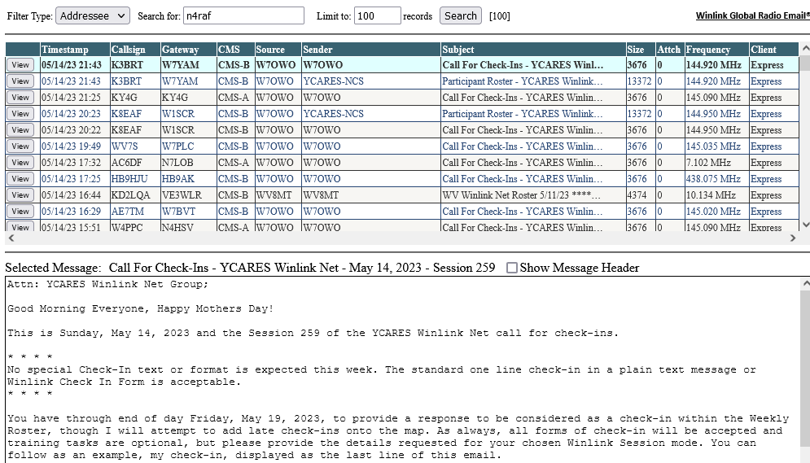
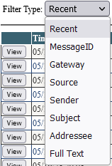
Winlink Message Viewer
Saved 21 days
Searchable
…assist users with US FCC amateur radio rules compliance
https://winlink.org/content/us_amateur_radio_message_viewer

Slide 17
Software Options
Programs | Outpost | AirMail | WoAD | Pat | RadioMail | Paclink-Unix | Paclink | Winlink Express
Supported OS, CPU | Any | Win95 & up | Android 4.1 & up | Linux, Mac OSX, Android Win64/32 | iOS | Linux, FreeBSD, x86, x86_64, MIPS, ARM | Windows 8 & up | Windows 8 & up
Recommended uses | Single-user, | Single-user, | Single-user, Routine, EmComm | Single-user, | Single-user | Casual single-user, | Single-user, | Single-user,
 | EmComm on packet networks | Routine, |  | Limited EmComm |  | Limited EmComm | Multi-user, | Multi-user/multi-account,
 |  | Maritime |  |  |  |  | Routine, | Routine,
 |  |  |  |  |  |  | EmComm | Maritime,
 |  |  |  |  |  |  |  | EmComm
Tactical address support | Yes | No | Yes | Yes | Yes | No | Yes | Yes
TELNET | Yes | Yes | Yes | Yes | Yes | Yes | Yes | Yes
AX.25 PACKET | Yes | Yes | Yes | Yes | Yes | Yes | Yes | Yes
ARDOP | No | No | Yes | Yes | No | No | No | Yes
VARA HF and VARA FM | No | No | Yes, limited | Yes, limited | Yes, limited | No | No | Yes.
Peer-to-peer contacts | Yes | Yes | Yes | Yes | Yes, outbound | No | No | Yes
https://winlink.org/ClientSoftware

Slide 18
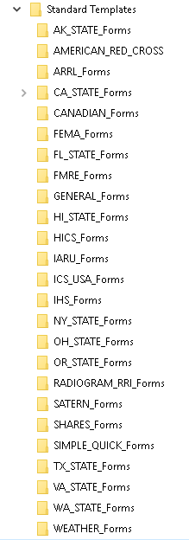
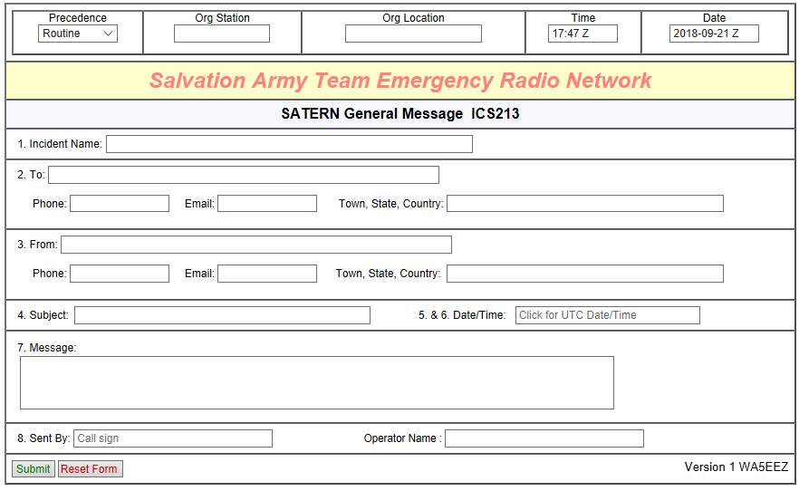
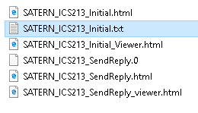
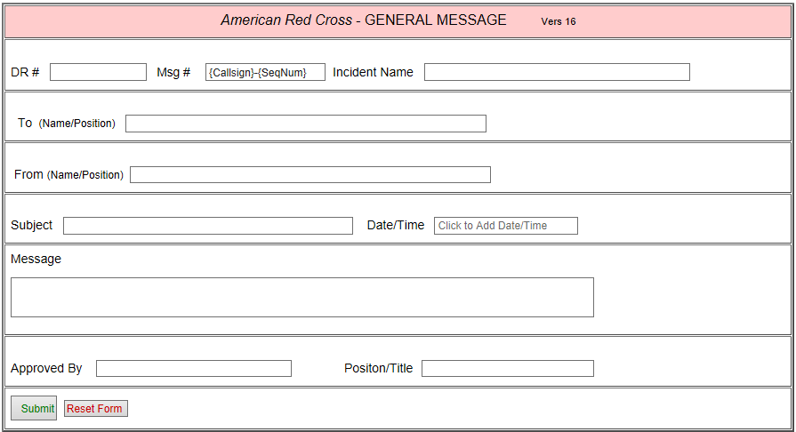
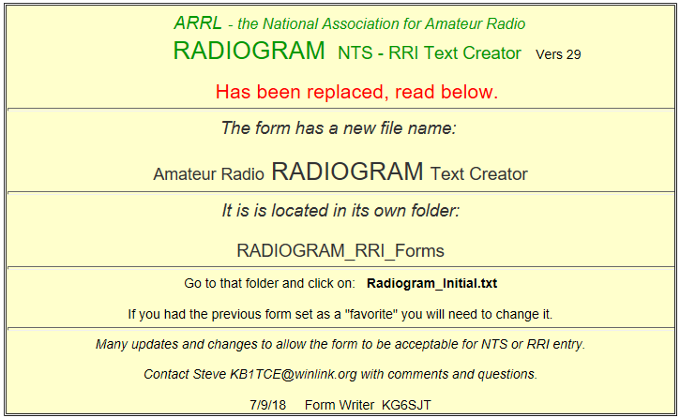
WINLINK
RMS Express Forms
Files common to all Forms

Slide 19
What Winlink Offers for EmComm
Flexibility:
  Internet-only (Telnet) direct connections to Winlink.
  Radio link bridge to Internet e-mail
  Radio-only store and forward messaging
  Peer-to-peer connections between radio end-users
  Various levels of security including message encryption
Interoperability: Connect different types of systems
  Bridge different radio capabilities (VHF/UHF/HF)
  Bridge protocols: Pactor, Winmor, Packet
  Seamless integration with Internet e-mail
Geographical dispersion and redundancy for reliability

Slide 20
What Winlink Offers for EmComm
Standard e-mail format with many features
  Binary file attachments (pictures, pdf, spreadsheets)
  Automatic message compression/decompression
Time independence (except for peer-to-peer)
Good operation at most power levels
Not limited by station-to-station propagation
Message logging, and ICS report generation
Wide adoption by EmComm related agencies

Slide 21
WinLink Express

Slide 22
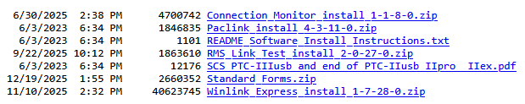
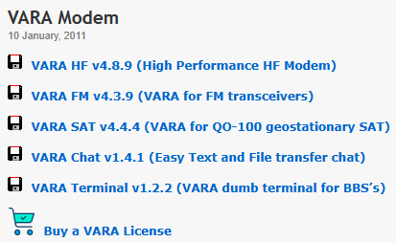
Download and Install
Winlink Express
  https://downloads.winlink.org/User%20Programs/
VARA HF and VARA VHF – EA5HVK
  https://rosmodem.wordpress.com/
  Look at files on page for ideas / manuals

Slide 23
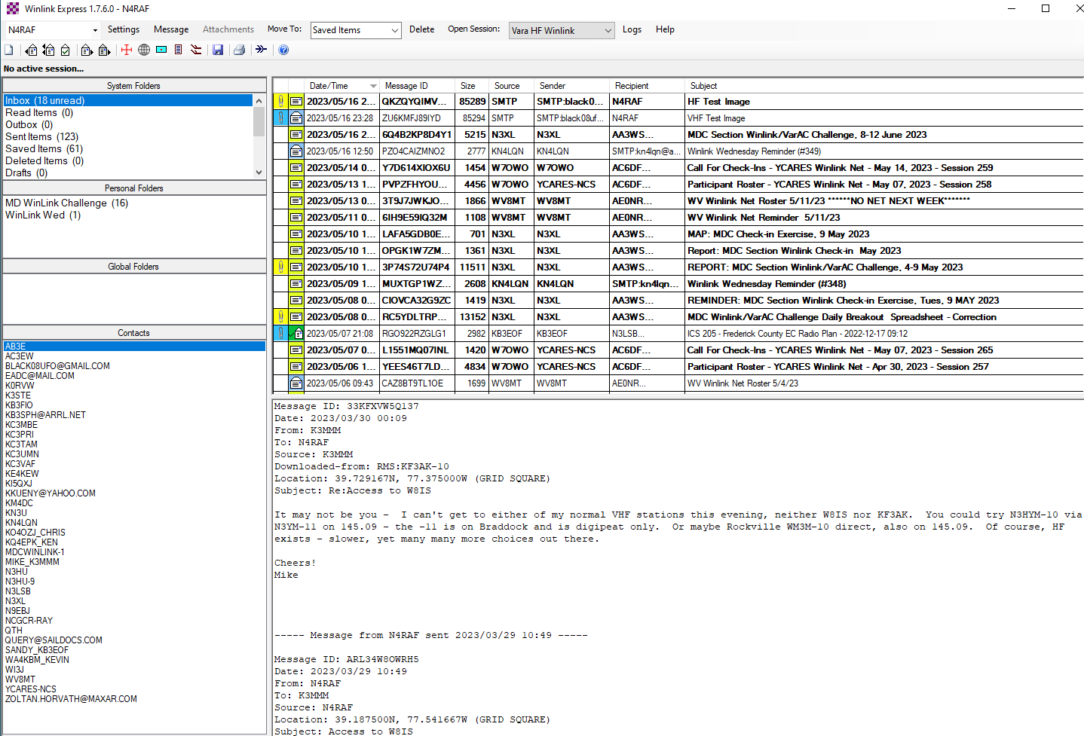
Winlink Express Landing Window

Slide 24
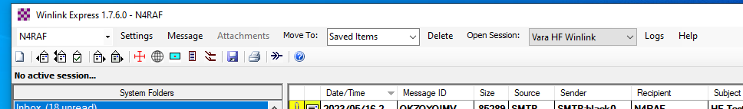
Top Tool Bar

Slide 25
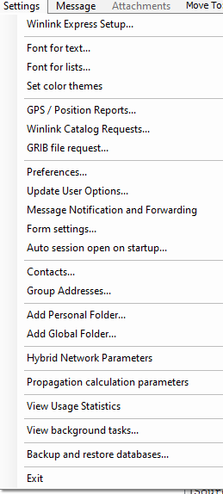
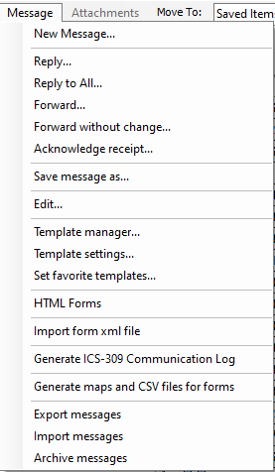
Settings
&
Message

Slide 26
Winlink Express Setup

Slide 27
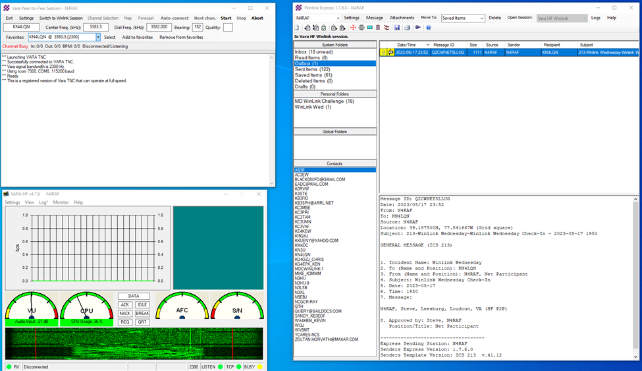
Winlink Express Initial Setup
3 Main Windows
  WinLink Express
  Vara HF Winlink Session (click open session)
  Vara
Setting in Winlink Express
  Basic User Info
Setting in Session
  Vara TNC Setup
  Radio Setup
Settings in VARA HF
  VARA Setup
  Sound Card
Winlink Express
VARA Session
VARA HF TNC

Slide 28
Winlink Express Operations

Slide 29
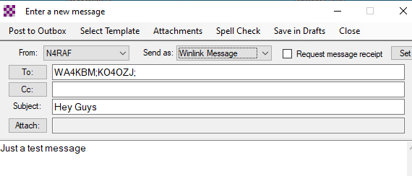
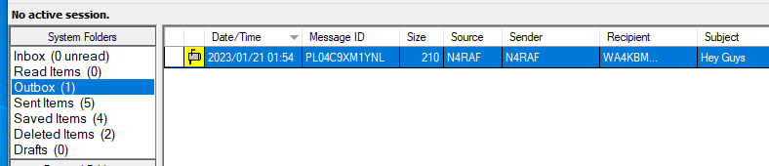
Composing Messages
In the main window select Message > New Message
TO: just the call sign or full email address
Subject
Free text in window
Just like a real email
Click post to outbox
Then open session for VARA HF Winlink or preferred session

Slide 30
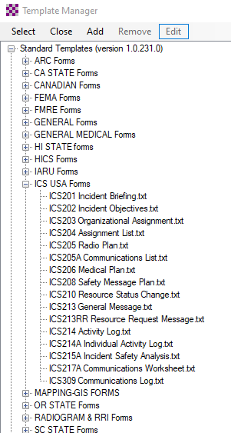
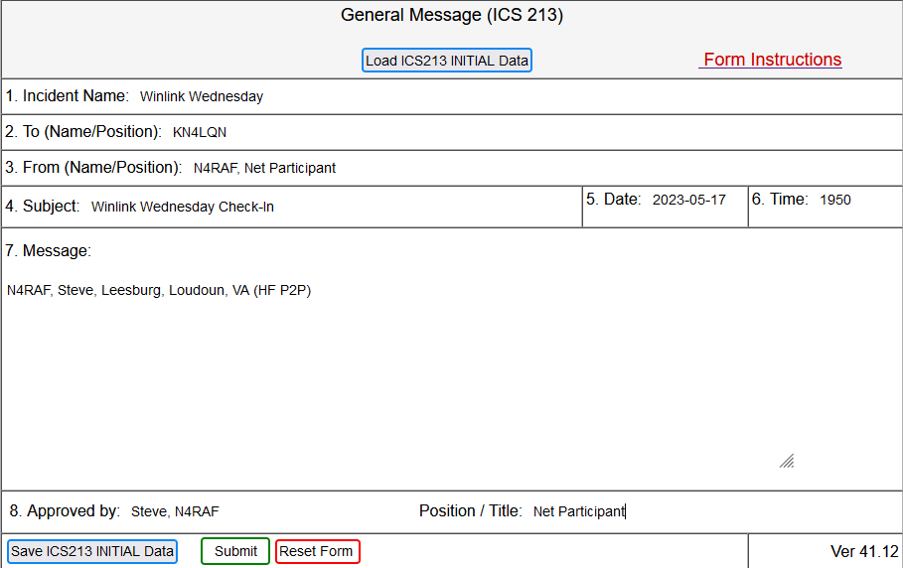
ICS-213 General Message
HTML Form in browser

Slide 31
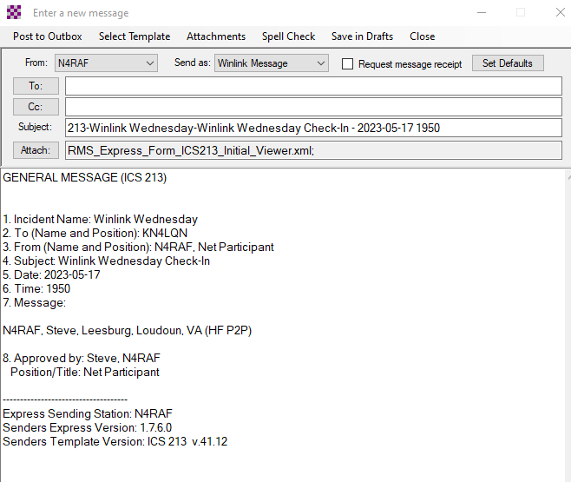

Slide 32
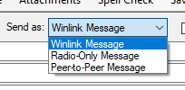
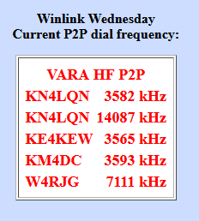
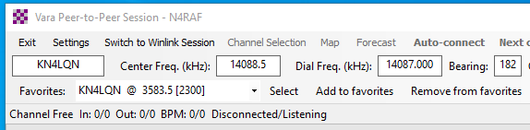
Send As
Winlink message default
Radio-only – all RF (Winlink message)
Peer-to-Peer only sends if connected to the receiving station and addressed to that receiving station

Slide 33
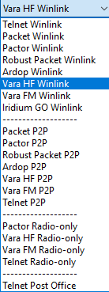
Open Session
Select session mode
Click “Open Session:”
Opens connection to radio

Slide 34
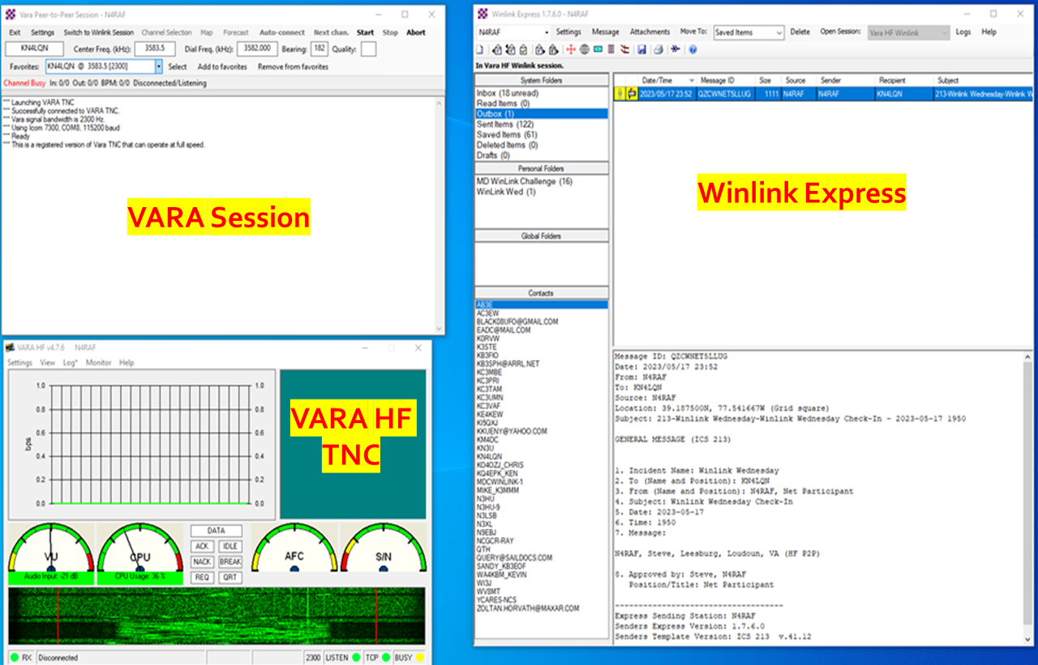
Open Session

Slide 35

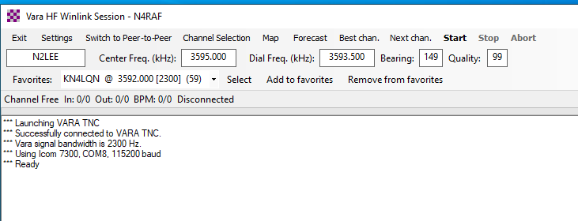
Vara HF Session
Indicates you’ve successfully connected to radio
Channel Selection

Slide 36
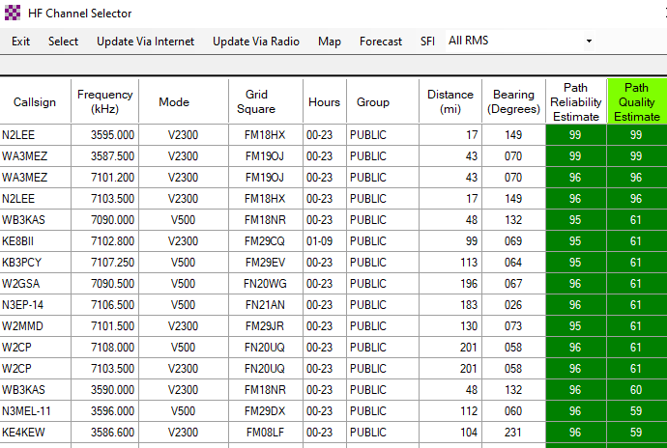
Find RMS (Gateway) To Send Message To
Click ‘Channel Selection’
Will take a while to populate
  I do via internet
Highlight and select
Will populate into VARA HF Winlink Session
  Can save as a favorite
  Will tune radio to right freq when you click ‘start’

Slide 37
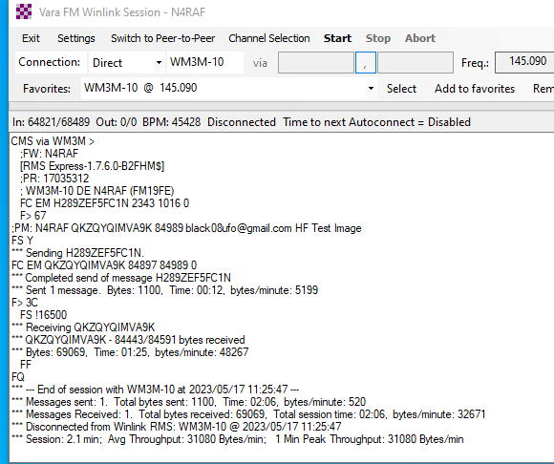
“Start” to connect

Slide 38
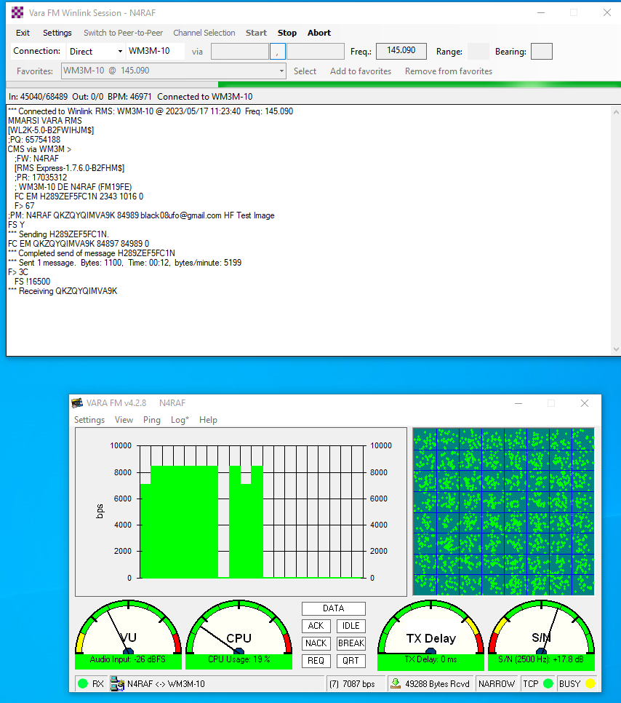
Progress Bar
L to R = TX
R to L = RX
Gap means no data
Note: 8000 bps
this is FM
HF normal for me is about 200bps
S/N in green during RX = good

Slide 39
Closing Thoughts
Fun to play with
Can impress non-Ham friends with emails
If you use other digital modes – easier to setup
Questions / Thoughts / Need Help Setting Up
  Email: N4RAF@winlink.org

Slide 40
Backups and Imported

Slide 41
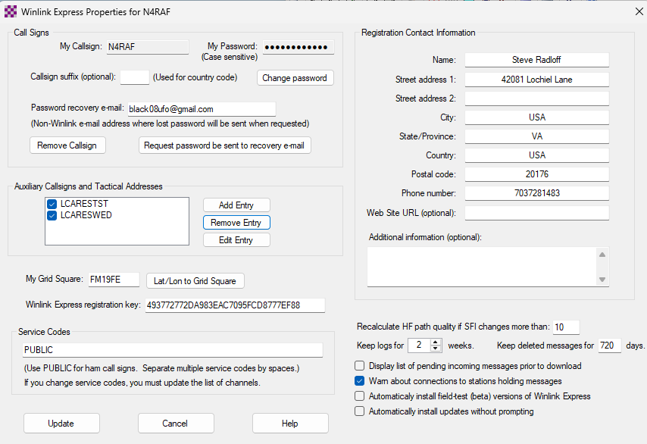
Settings – Winlink Express
Enter your data
Call sign
Grid Square
Contact info

Slide 42
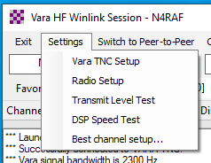
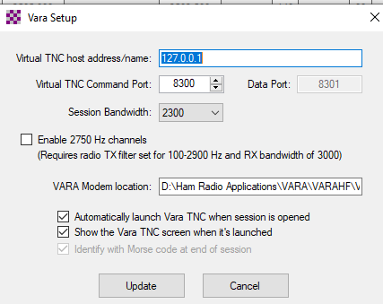
Settings – Vara HF Setup Radio Setup
Click settings
  VARA TNC Setup 1st
  Radio Setup 2nd
  Others not needed
In TNC only thing I changed was the modem location
  And 2nd check box – Show VARA TNC screen

Slide 43
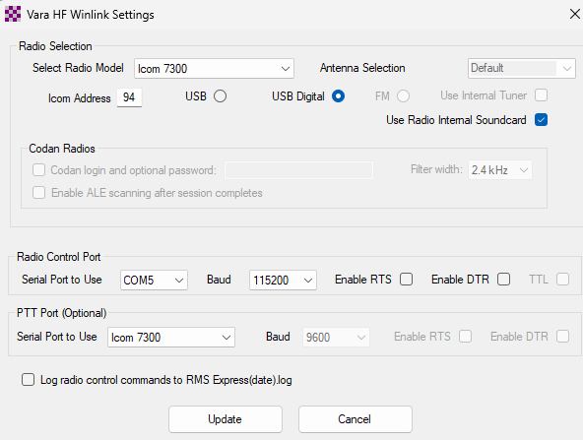
Settings – VARA HF Radio

Slide 44
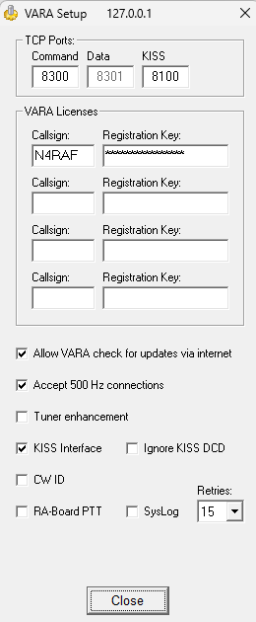
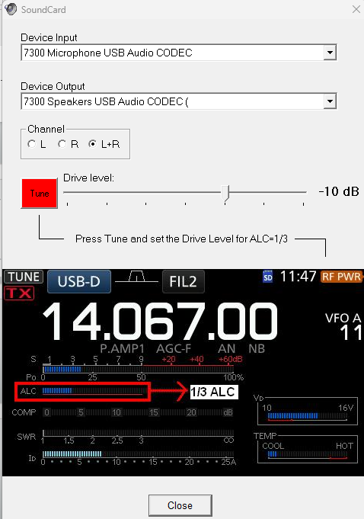
Settings – VARA HF TNC
VARA Setup
Sound Card

Slide 45
WINLINK Nets

Slide 46
My Favorites
Winlink Wed
  https://winlinkwednesday.net/
  Weekly and simple
East Coast
  Send winlink email to: east-coast and request to join weekly net
  Weekly a bit more advanced and entertaining – explores Winlinks capabilities
EmComm – Training aka Winlink Thurs
  https://emcomm-training.org/Winlink_Thursdays.html
  2026 – Weekly – you get graded – basically can you follow instructions
MDC Digital EmComm Challenge
  Send winlink email to: MDCWINLINK-1 and request to join
  Monthly – 3 tasks – VARA FM, P2P, VarAC email, Fldigi/Flmsg, etc…
  Aug 25 example: https://k3jsj.net/August-Challenge-Instructions/

Slide 47
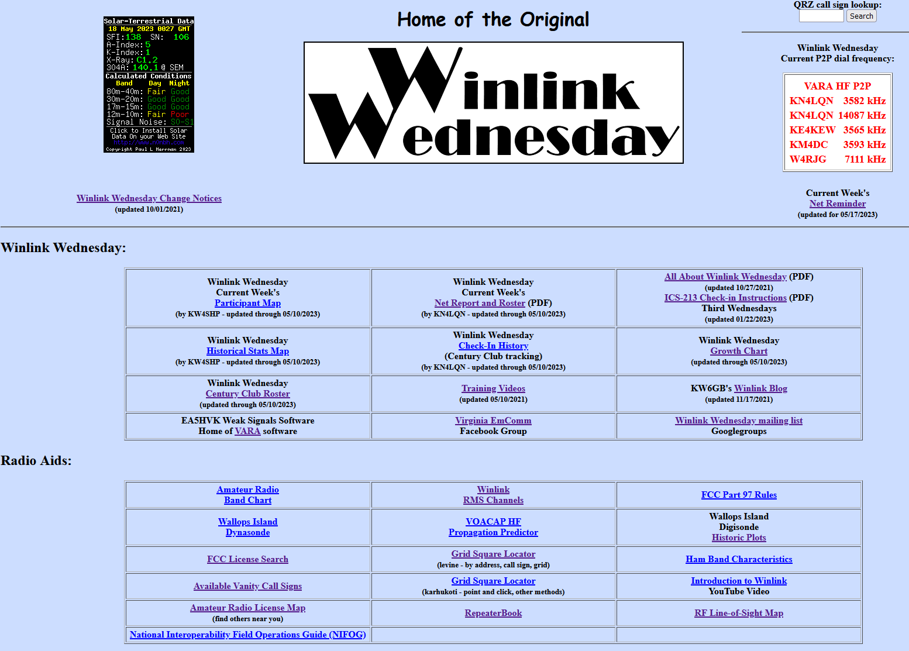
Winlink Wed
https://winlinkwednesday.net/

Slide 48
What is Winlink Wed
Weekly amateur radio digital net where check-ins are via Winlink
Purpose – practice using Winlink
Supports Virginia EmComm activities
HF and VHF/UHF
Formats
  Standard --- N4RAF, Steve, Leesburg, Loudoun, VA (HF P2P)
  Weather report --- above plus ‘rock is wet and swinging’
  ICS-213
Peer-to-Peer

Slide 49
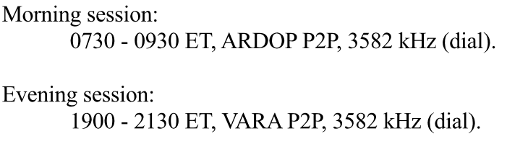
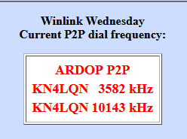
Peer-to-Peer

Slide 50
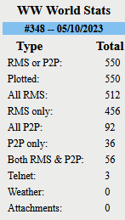
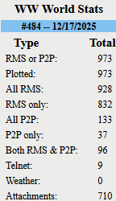
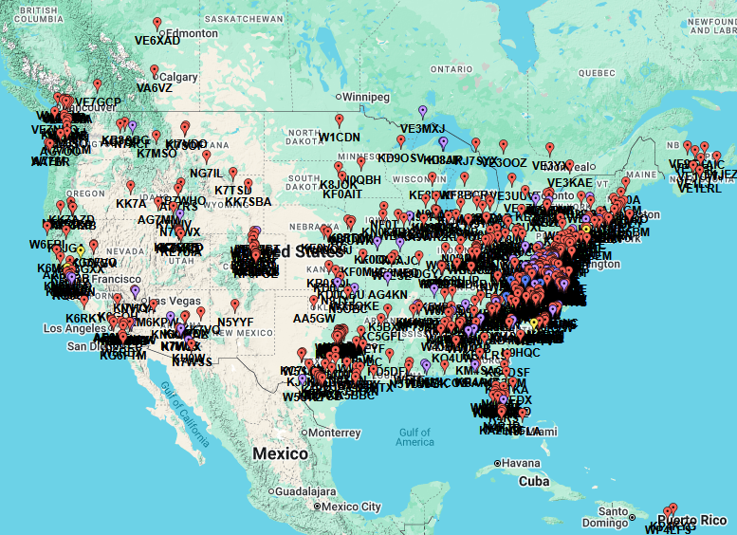
Winlink Wed Results

Slide 51
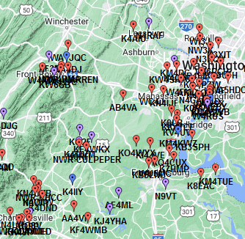
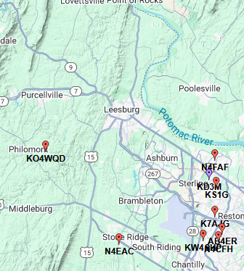
Winlink – Maps

Slide 52
BACKUP

Slide 53
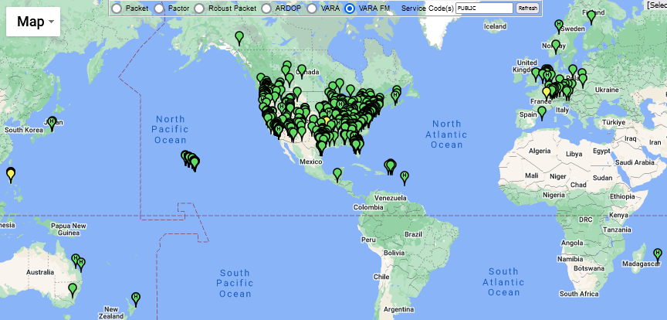
RMS – VARA Map
VARA displayed
Others selected from menu at top of map
https://winlink.org/RMSChannels

Slide 54
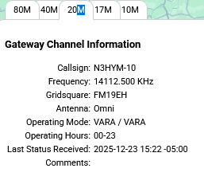
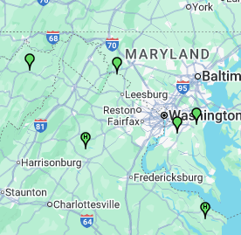
RMS – Vara Map – Local
HF RMS nodes
'H' markers - Winlink Hybrid Network participants. They offer RF message forwarding if local internet links are not available.

Slide 55
RMS Express Forms
HTML Form and Template Set
A full form set has three components:
  A template that displays the form and generates the text message to be sent.
  An input form that solicits input from the user.
  A display form that formats and displays the information on the recipient’s computer.
Input from a form is encapsulated in a compact XML file attached to the message.
The actual form HTML is not transmitted.
Input and display forms may be large, but the actual data transmitted is very compact.
Receiving station must have the display form installed.

Slide 56
Clients
Winlink Express - https://winlink.org/WinlinkExpress
Outpost - https://www.outpostpm.org/index.php
AirMail - http://www.siriuscyber.net/ham/
Pat - https://getpat.io/ (cross platform, written in Go)
WoAD - https://woad.sumusltd.com/ (Android)
Paclink - https://winlink.org/Paclink (gateway to normal e-mail clients)
Winlink FAQs: https://www.google.com/url?sa=t&rct=j&q=&esrc=s&source=web&cd=&ved=2ahUKEwi37ee5mYD_AhUfFlkFHRB4D38QFnoECBIQAw&url=https%3A%2F%2Fwinlink.org%2Fsites%2Fdefault%2Ffiles%2Fdownload%2Fwl2k_faq_20230311.pdf&usg=AOvVaw3uO-QgLPwRUD0h5pCQ2uQ-

