Slide 1
LCARES P2P WinLink Exercise Summary & Ride to End Alzheimer’s Planning
Doug McNulty KM4GC
datacomsys@comcast.net

Slide 2
Approach for P2P Exercise
Purpose:
Gain experience setting up WinLink to operate VARA FM simplex peer-to-peer (P2P) operation
Decrease LCARES reliance on Internet for transfer of text-based data
Sequence of activities: (note: event was fairly unstructured)
Check in via Google Meet and the 145.185 repeater
Try simplex connections between participants on VHF & assign operator pairs and frequencies to QSY to
Participants exchange WinLink P2P emails with VARA FM
Trouble shooting via Google Meet and/or 145.185 repeater as needed

Slide 3
Results P2P Exercise
Steve (N4RAF) & Doug (KM4GC)
Successful WinLink exchange at 147.48 simplex from home QTHs
Ron (KQ4IBI) & Doug (KM4GC)
Successful WinLink exchange at 147.54 simplex
Stations needed to be very close – potential RF or sound card configuration issue
Steve (N4RAF) & Jim (N4FAF)
Configuration issue
Frank (W4FWD) & Doug (KM4GC)
Coordinated separate session
Potential CAT configuration issue

Slide 4
Observations P2P Exercise
Computer interface to radio sometimes is challenging
Having good RF connection between stations is important
Steve (N4RAF) & Doug (KM4GC)
Demonstrated P2P over a repeater
Extends WinLink coverage over most of the county - better than standard simplex
Also conducted P2P over HF – also extends WinLink coverage over much of county and outside of county (see following slides)
Steve (N4RAF) & Ron (KQ4IBI) & Doug (KM4GC)
Gained experience using “ping” and “auto-tune” tools in VARA FM (see following slides)

Slide 5
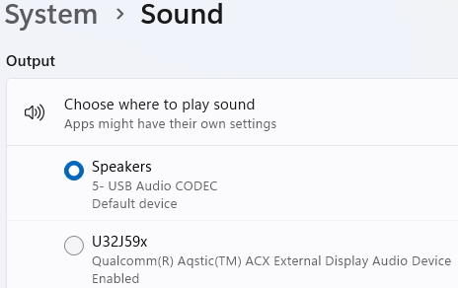
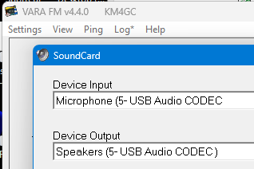
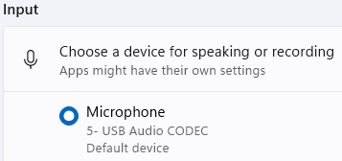
Observations P2P Exercise
Computer and VARA sound card and settings must match
Computer
VARA FM

Slide 6
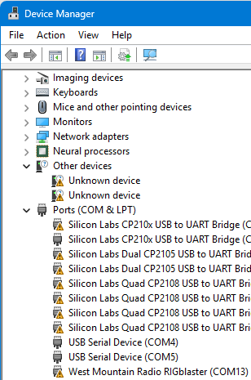
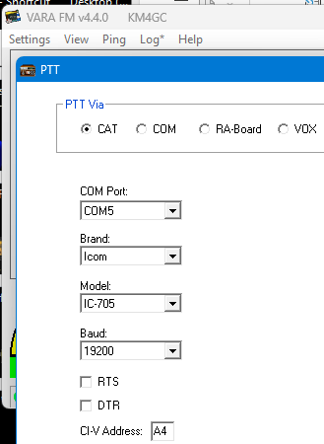
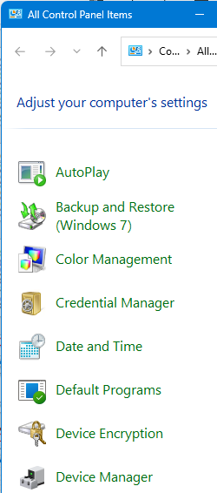
Observations P2P Exercise
For PTT computer USB and VARA PTT (e.g. CAT) comm ports must match for your rig (my usual problem area)
VARA FM
Computer

Slide 7
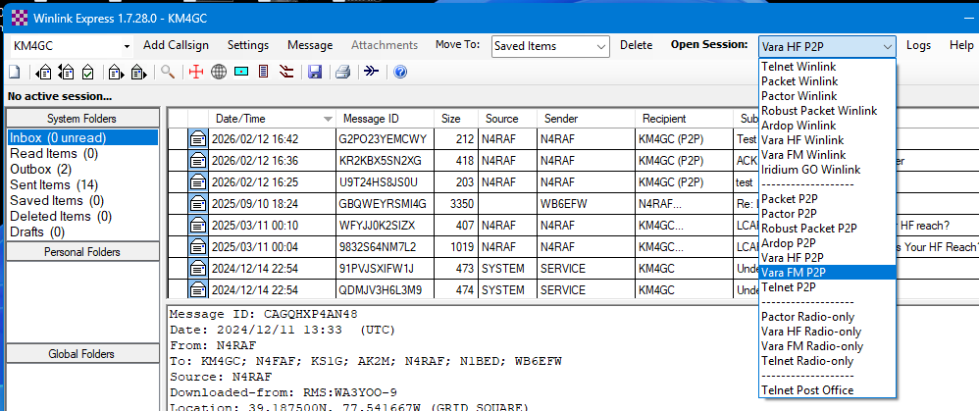
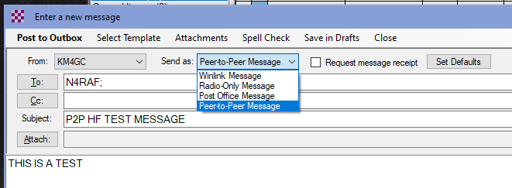
Observations P2P Exercise
Must remember to start VARA FM P2P session and make “Send As” message P2P (default is always set to Winlink Message)

Slide 8
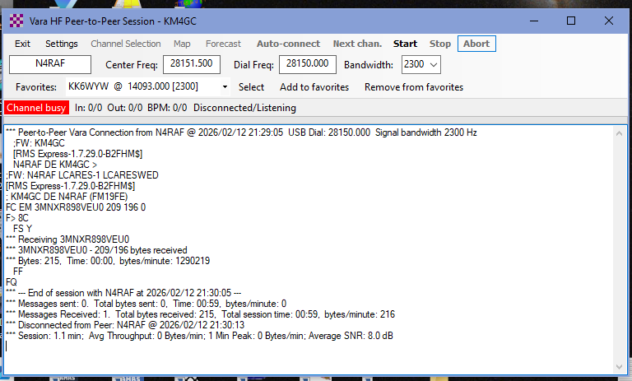
Observations P2P Exercise
VARA HF frequency setting in kHz not MHz

Slide 9
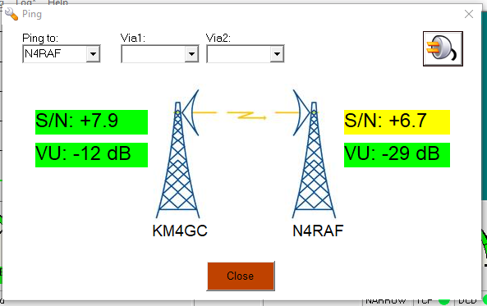
Observations P2P Exercise
Example use of “ping” tool

Slide 10
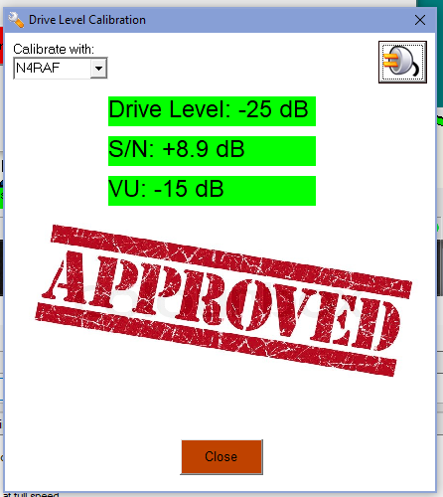
Observations P2P Exercise
Example use of “Auto-Tune” tool

Slide 11
Recommendations Before Using Winlink
Install and set up VARA FM, VARA HF, and WinLink Express, test with external gateways
Obtain WinLink account if needed
Consider $75 VARA license for higher data rate
VARA software: EA5HVK | Weak signals Software
WinLink: Winlink Global Radio Email
Steve’s (N4RAF) WinLink overview: https://k4lrg.org/wp-content/uploads/2026/01/Winlink-LCARES-Presenation-Jan26-final.pptx
Setting up P2P messages: Winlink P2P Session

Slide 12
Ride to End Alzheimer’s Fundraising Event
Date: 16 May 2026
Recruiting to fill positions – see following slide
Would like to increase number of APRS digipeaters and possibly gateways
To increase tracking accuracy of SAG vehicles
Effort in work to improve map presentation of bike routes, SAG, and rest stop locations
Investigating possibility of large screen display at NCC location – additional visibility and value added to customer – ideas on where to get (borrow) one?

Slide 13
2025 ALZ SAG and Rest Stop Operators:
SAG # | Name | Position | Ham Radio Call Sign
1 | Valerie Beaudoin | Driver/Operator | Non-Ham
2 | Dave Putman | Driver/Operator | KE4S
2 | Al Carlson | Communicator | NA1N
3 | Katie Lee | Driver | KT1LEE
3 | Glenn Fitzpatrick | Communicator | KB3UFH
4 | John Whisler | Driver | Non-Ham
4 | Marylou Whisler | Communicator | Non-Ham
5 | Steve Palmer | Driver/Operator | KW4SHP
6 | Jim Babcock | Driver/Operator | N4FAF
Location | Operators
Net Control | Doug McNulty KM4GC Scott Morse, WB6EFW
Fairgrounds | Jack Cochran, WC4J Tareck Elass, K9TRE
Waterford Elementary | Steve Greene, KS1G Jim Begley, KQ4MHT
Lovettsville Community Center | Steve Radloff, N4RAF Ron White, KQ4IBI
Hillsboro Charter Academy | Harry Kidder, KI2H
Philomont Community Center | Jack Cochran, WC4J (relocated after close of Fairgrounds)
Lincoln Elementary | Doug Coulter, K4AIU Patrick Lewis, KQ4VZF

