Slide 1
Tricks and Items to Operate Win 11
Kevin McCrory, WA4KBM

Slide 2
Programs
1. Device Manager
2. Regedit
3. Settings: Sound
4. Command Prompt
5. Settings: Firewall

Slide 3
Com Ports

Slide 4
Add Labels to USB Audio
Use Device Manager: Find the Hardeware IDs
Use Regedit:
Computer\HKEY_LOCAL_MACHINE\SYSTEM\ControlSet001\Enum\USB\
Edit Friendly Name and DeviceDesc to match your sound device.

Slide 5
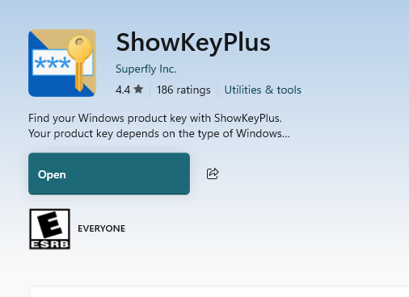
Get your OEM License from your Win 11 Machine
In a Powershell Window:
(Get-WmiObject -query 'select * from SoftwareLicensingService').OA3xOriginalProductKey
ShowKeyPlus located in MS Store

