Slide 1




Welcome TO THE LOUDOUN AMATEUR RADIO GROUP MONTHLY MEETING
^{February 2026}

Slide 2

PLEASE JOIN IN THE PLEDGE OF ALLEGIANCE

Slide 3
Any Newcomers?

Slide 4
LCARES P2P WinLink Exercise Summary & Ride to End Alzheimer’s Planning
Doug McNulty KM4GC
datacomsys@comcast.net

Slide 5
Approach for P2P Exercise
Purpose:
Gain experience setting up WinLink to operate VARA FM simplex peer-to-peer (P2P) operation
Decrease LCARES reliance on Internet for transfer of text-based data
Sequence of activities: (note: event was fairly unstructured)
Check in via Google Meet and the 145.185 repeater
Try simplex connections between participants on VHF & assign operator pairs and frequencies to QSY to
Participants exchange WinLink P2P emails with VARA FM
Trouble shooting via Google Meet and/or 145.185 repeater as needed

Slide 6
Results P2P Exercise
Steve (N4RAF) & Doug (KM4GC)
Successful WinLink exchange at 147.48 simplex from home QTHs
Ron (KQ4IBI) & Doug (KM4GC)
Successful WinLink exchange at 147.54 simplex
Stations needed to be very close – potential RF or sound card configuration issue
Steve (N4RAF) & Jim (N4FAF)
Configuration issue
Frank (W4FWD) & Doug (KM4GC)
Coordinated separate session
Potential CAT configuration issue

Slide 7
Observations P2P Exercise
Computer interface to radio sometimes is challenging
Having good RF connection between stations is important
Steve (N4RAF) & Doug (KM4GC)
Demonstrated P2P over a repeater
Extends WinLink coverage over most of the county - better than standard simplex
Also conducted P2P over HF – also extends WinLink coverage over much of county and outside of county (see following slides)
Steve (N4RAF) & Ron (KQ4IBI) & Doug (KM4GC)
Gained experience using “ping” and “auto-tune” tools in VARA FM (see following slides)

Slide 8
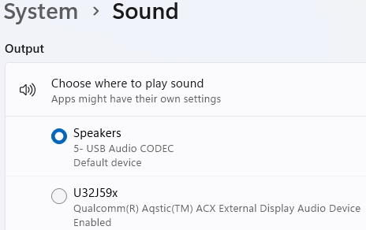
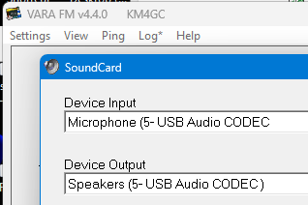
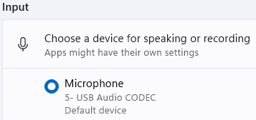
Observations P2P Exercise
Computer and VARA sound card and settings must match
Computer
VARA FM

Slide 9
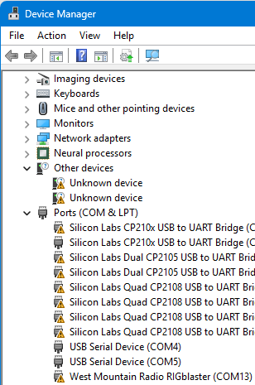
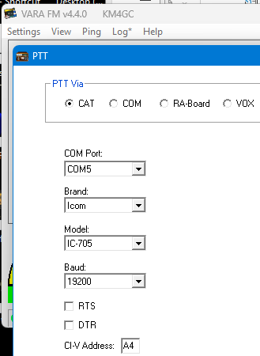
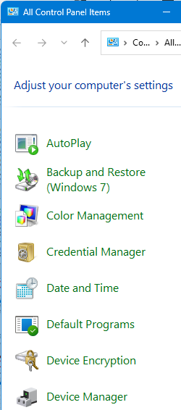
Observations P2P Exercise
For PTT computer USB and VARA PTT (e.g. CAT) comm ports must match for your rig (my usual problem area)
VARA FM
Computer

Slide 10
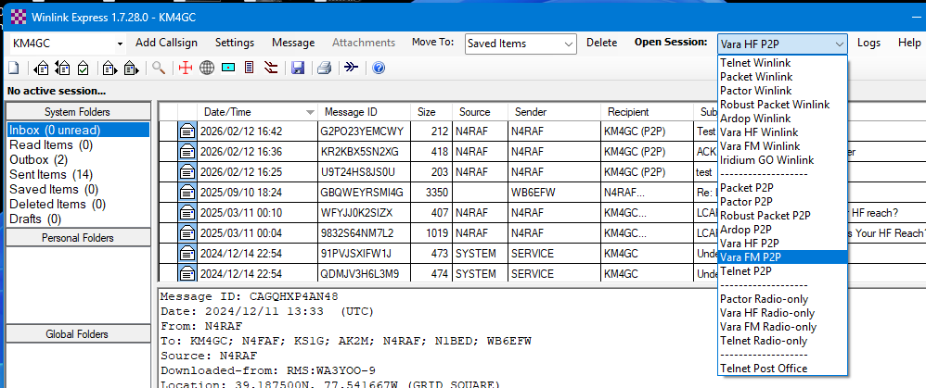
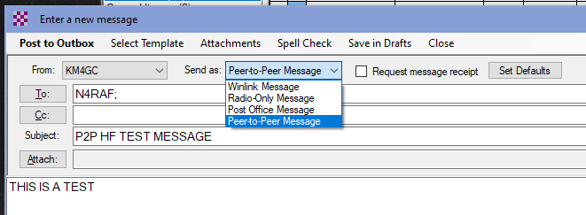
Observations P2P Exercise
Must remember to start VARA FM P2P session and make “Send As” message P2P (default is always set to Winlink Message)

Slide 11
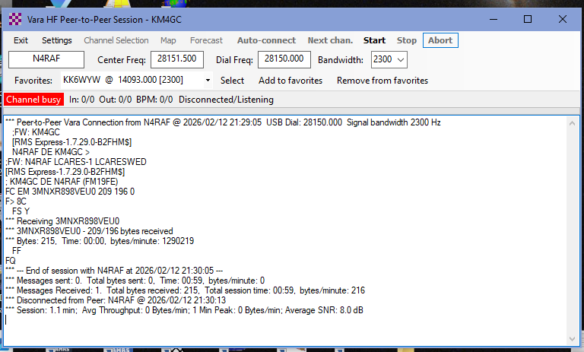
Observations P2P Exercise
VARA HF frequency setting in kHz not MHz

Slide 12
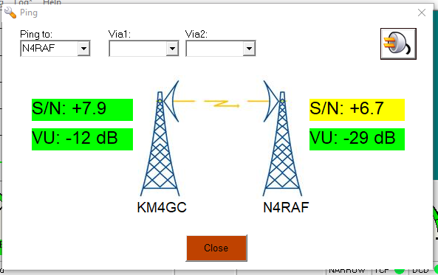
Observations P2P Exercise
Example use of “ping” tool

Slide 13
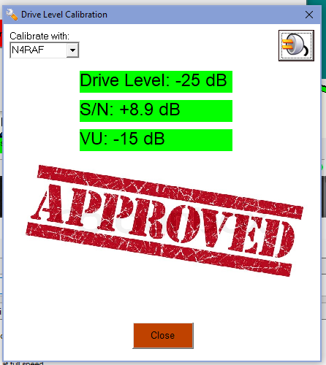
Observations P2P Exercise
Example use of “Auto-Tune” tool

Slide 14
Ride to End Alzheimer’s Fundraising Event
Date: 16 May 2026
Recruiting to fill positions – see following slide
Would like to increase number of APRS digipeaters and possibly gateways
To increase tracking accuracy of SAG vehicles
Effort in work to improve map presentation of bike routes, SAG, and rest stop locations
Investigating possibility of large screen display at NCC location – additional visibility and value added to customer – ideas on where to get (borrow) one?

Slide 15
2025 ALZ SAG and Rest Stop Operators:
SAG # | Name | Position | Ham Radio Call Sign
1 | Valerie Beaudoin | Driver/Operator | Non-Ham
2 | Dave Putman | Driver/Operator | KE4S
2 | Al Carlson | Communicator | NA1N
3 | Katie Lee | Driver | KT1LEE
3 | Glenn Fitzpatrick | Communicator | KB3UFH
4 | John Whisler | Driver | Non-Ham
4 | Marylou Whisler | Communicator | Non-Ham
5 | Steve Palmer | Driver/Operator | KW4SHP
6 | Jim Babcock | Driver/Operator | N4FAF
Location | Operators
Net Control | Doug McNulty KM4GC Scott Morse, WB6EFW
Fairgrounds | Jack Cochran, WC4J Tareck Elass, K9TRE
Waterford Elementary | Steve Greene, KS1G Jim Begley, KQ4MHT
Lovettsville Community Center | Steve Radloff, N4RAF Ron White, KQ4IBI
Hillsboro Charter Academy | Harry Kidder, KI2H
Philomont Community Center | Jack Cochran, WC4J (relocated after close of Fairgrounds)
Lincoln Elementary | Doug Coulter, K4AIU Patrick Lewis, KQ4VZF

Slide 16
Recommendations Before Event
Install and set up VARA FM, VARA HF, and WinLink Express, test with external gateways
Obtain WinLink account if needed
Consider $75 VARA license for higher data rate
VARA software: EA5HVK | Weak signals Software
WinLink: Winlink Global Radio Email
Steve’s (N4RAF) WinLink overview: https://k4lrg.org/wp-content/uploads/2026/01/Winlink-LCARES-Presenation-Jan26-final.pptx
Setting up P2P messages: Winlink P2P Session

Slide 17
Win11
Kevin, WA4KBM

Slide 18
Tricks and Items to Operate Win 11
Kevin McCrory, WA4KBM

Slide 19
Programs
1. Device Manager
2. Regedit
3. Settings: Sound
4. Command Prompt
5. Settings: Firewall

Slide 20
Com Ports

Slide 21
Add Labels to USB Audio
Use Device Manager: Find the Hardeware IDs
Use Regedit:
Computer\HKEY_LOCAL_MACHINE\SYSTEM\ControlSet001\Enum\USB\
Edit Friendly Name and DeviceDesc to match your sound device.

Slide 22
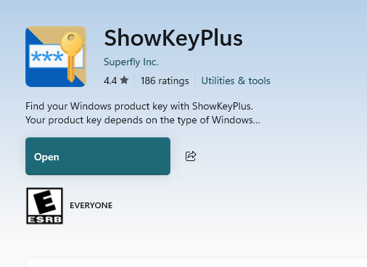
Get your OEM License from your Win 11 Machine
In a Powershell Window:
(Get-WmiObject -query 'select * from SoftwareLicensingService').OA3xOriginalProductKey
ShowKeyPlus located in MS Store

Slide 23
Club Business

Slide 24
LARG 2025-2026 Programs & Events
What do YOU WANT TO SEE? What is of INTEREST TO YOU?
Antennas & Feedlines
Digital Modes
Shack automation/software
Portable Stations/Go Boxes
Public Service/ARES/RACES
Test Equipment Kits, Soldering, …
Solar & Emergency Power
DXing, QSLing
POTA, SOTA, IOTA, …
Road Trips
Satellites
and much, much more…
Which topic excites YOU? Prepare a talk for the next LARG Meeting!
Meeting | Topic | Speaker | Other Events
17 January | ECHO Link | Steve, N4RAF | LARG Elections January VHF Contest
21 February | Winlink P2P and ALZ Ride Win11 | Doug, KM4GC Kevin, WA4KBM | LCARES Meeting
14 March (2nd Sat) | VA QSO Party | Henry, K2BFY | VA QSO Party 21-22 Mar
18 April | Build a Flowerpot 2m Antenna | Kevin, WA4KBM | ALZ Ride Comm Check POTA Weekend – 18-19 Apr
16 May | VOTE TO MOVE OR CANCEL |  | Alzheimer’s Ride 16 May LCARES meeting
20 June | Field Day Prep | Steve, N4RAF | June VHF Contest Field Day 6/27-28
18 July |  |  | 13 Colonies Event 1- 7 Jul POTA Weekend – 18-19 Jul
15 August |  |  | Reston Century – 16 Aug LCARES Meeting
19 September |  |  | Sep VHF Contest Ocktoberfest – 25-27 Sep MS Ride (TBD)
17 October |  |  | ARES SET POTA Weekend – 17-18 Oct
21 November |  |  | LCARES Meeting
20 December | NO MEETING |  | Holiday Party (TBD)
Motion to Change May Meeting
Motion Ref Dec Meeting

Slide 25
LARG Events Support
Date | Day | Event | LARG Lead | Notes
16 May | Sat | Alzheimer’s Ride | Doug, KM4GC
27-28 Jun 26 | Sat-Sun | Field Day 2026 | Steve, N4RAF | Sheriff’s Station
16 Aug | Sun | Reston Century | David, WA4TXE | Net Control Location?
Sept | Fri – Sun | Ocktoberfest | VOLUNTEERS? | Support and Booth
Sept | Sat | MS Ride (Tentative) |  | Need to VOTE on
Motion to Support or not Support MS Ride

Slide 26
LARG AdHoc Events
Date | Day | Event | LARG Lead | Notes
11 Apr | Sat | LARG POTA | Steve, N4RAF
May | TBD | Fox Hunt | Steve, N4RAF
18-19 Jul | Sat or Sun | LARG POTA | Steve, N4RAF | National POTA Weekend
18-19 Oct | Sat or Sun | LARG POTA | Steve, N4RAF | National POTA Weekend
Nov | TBD | Fox Hunt

Slide 27
State QSO Parties & Challenge https://stateqsoparty.com/
Start Date | Start Time | End Date | End Time | Contest Name/Link
2/28/2026 | 1500Z | 3/1/2026 | 0159Z | South Carolina QSO Party
3/1/2026 | 1500Z | 3/2/2026 | 0100Z | North Carolina QSO Party
3/14/2026 | 1500Z | 3/15/2026 | 0200Z | Oklahoma QSO Party
3/14/2026 | 1600Z | 3/15/2026 | 0400Z | Idaho QSO Party
3/15/2026 | 1400Z | 3/16/2026 | 0200Z | Idaho QSO Party
3/15/2026 | 1500Z | 3/15/2026 | 2200Z | Oklahoma QSO Party
3/15/2026 | 1800Z | 3/16/2026 | 0100Z | Wisconsin QSO Party
3/21/2026 | 1400Z | 3/22/2026 | 0400Z | Virginia QSO Party
3/22/2026 | 1200Z | 3/22/2026 | 2400Z | Virginia QSO Party
4/4/2026 | 1400Z | 4/5/2026 | 0200Z | Louisiana QSO Party
4/4/2026 | 1400Z | 4/5/2026 | 0200Z | Mississippi QSO Party
4/4/2026 | 1400Z | 4/5/2026 | 0400Z | Missouri QSO Party
4/5/2026 | 1400Z | 4/5/2026 | 2000Z | Missouri QSO Party
4/11/2026 | 1400Z | 4/12/2026 | 0200Z | New Mexico QSO Party
4/11/2026 | 1800Z | 4/12/2026 | 1800Z | North Dakota QSO Party
4/11/2026 | 1800Z | 4/12/2026 | 0359Z | Georgia QSO Party
4/12/2026 | 1400Z | 4/12/2026 | 2359Z | Georgia QSO Party
4/19/2025 | 1100Z | 4/20/2025 | 2259Z | Nebraska QSO Party
4/18/2026 | 1800Z | 4/19/2026 | 0500Z | Ontario QSO Party
4/18/2026 | 1600Z | 4/19/2026 | 0400Z | Michigan QSO Party
4/19/2026 | 1200Z | 4/19/2026 | 1800Z | Ontario QSO Party
4/20/2025 | 1200Z | 4/20/2025 | 2200Z | Quebec QSO Party
4/25/2026 | 1600Z | 4/26/2026 | 0159Z | Florida QSO Party
4/26/2026 | 1200Z | 4/26/2026 | 2159Z | Florida QSO Party
5/2/2026 | 1300Z | 5/3/2026 | 0700Z | 7th Call Area QSO Party
5/2/2026 | 1500Z | 5/3/2026 | 0259Z | Indiana QSO Party
5/2/2026 | 2000Z | 5/3/2026 | 0500Z | New England QSO Party
5/2/2026 | 1700Z | 5/3/2026 | 2359Z | Delaware QSO Party
5/3/2026 | 1300Z | 5/3/2026 | 2400Z | New England QSO Party
5/9/2026 | 1700Z | 5/10/2026 | 0300Z | Canadian Prairies QSO Party
5/16/2026 | 1400Z | 5/17/2026 | 0200Z | Arkansas QSO Party
6/6/2026 | 1200Z | 6/7/2026 | 0200Z | Atlantic Canada QSO Party
6/6/2026 | 1300Z | 6/7/2026 | 0100Z | Kentucky QSO Party
6/20/2026 | 1600Z | 6/21/2026 | 0400Z | West Virginia QSO Party
7/25/2026 | 1500Z | 7/26/2026 | 0300Z | Alabama QSO Party
8/8/2026 | 1400Z | 8/9/2026 | 0359Z | Maryland-DC QSO Party
8/22/2026 | 0400Z | 8/24/2026 | 0359Z | Hawaii QSO Party
8/22/2026 | 1600Z | 8/23/2026 | 0400Z | Ohio QSO Party
8/29/2026 | 1400Z | 8/30/2026 | 0200Z | Kansas QSO Party
8/30/2026 | 1400Z | 8/30/2026 | 2000Z | Kansas QSO Party
9/5/2026 | 1300Z | 9/6/2026 | 0400Z | Colorado QSO Party
9/6/2026 | 1700Z | 9/7/2026 | 0300Z | Tennessee QSO Party
9/19/2026 | 1400Z | 9/20/2026 | 0200Z | Texas QSO Party
9/19/2026 | 1400Z | 9/20/2026 | 0200Z | Iowa QSO Party
9/19/2026 | 1400Z | 9/20/2026 | 0200Z | New Jersey QSO Party
9/19/2026 | 1600Z | 9/20/2026 | 0400Z | New Hampshire QSO Party
9/20/2025 | 1600Z | 9/21/2025 | 0700Z | Washington St Salmon Run
9/20/2026 | 1400Z | 9/20/2026 | 2000Z | Texas QSO Party
9/20/2026 | 1200Z | 9/20/2026 | 2200Z | New Hampshire QSO Party
9/19/2026 | 1600Z | 9/21/2025 | 2400Z | Washington St Salmon Run
10/4/2025 | 1600Z | 10/5/2025 | 2200Z | California QSO Party
10/11/2025 | 1500Z | 10/12/2025 | 0500Z | Arizona QSO Party
10/11/2025 | 1600Z | 10/12/2025 | 0400Z | Pennsylvania QSO Party
10/11/2025 | 1800Z | 10/12/2025 | 1800Z | South Dakota QSO Party
10/11/2025 | 0300Z | 10/12/2025 | 2100Z | Nevada QSO Party
10/12/2025 | 1300Z | 10/12/2025 | 2200Z | Pennsylvania QSO Party
10/18/2025 | 1400Z | 10/19/2025 | 0200Z | New York QSO Party
10/19/2025 | 1700Z | 10/20/2025 | 0100Z | Illinois QSO Party

Slide 28
Other Events
Date | Event | Location
15 Mar, Sun | Winterfest | Vienna, VA
15 Mar, Sun | ARRL VA Section Convention | Vienna VA
21 Mar, Sat | FredFest | Amvets Post #2, Frederick, MD
2 May, Sat | Great Hagerstown Hamfest | Maugansville, MD
15 May to 17 May | Hamvention | Xenia, OH
20 Jun, Sat | Ole VA Hams Club Hamfest / Tailgate | Manassas, VA

Slide 29
ARRL Year of the Club (YOTC)
Club WAS250
Club callsign
Work all 50 states
All modes
All bands
Validated in LOTW
Operate as W1ASW/4
11-17 Mar 26
2nd week of July
From QTH
Club Website Contest
Club Newsletter Contest
Marconi Program
Club Photo
Amateur Radio Activity Report
Anybody interested in leading one or several or all of these?

Slide 30


CLUB SECRETARIES REPORT
JIM, N4FAF
Motion to approve minutes

Slide 31
Treasurer Report 20 Feb 2026
Activity since last meeting:
INCOME: $ 390.00
EXPENSES: $ 254.84
Bank balance as of 20 Feb 26: $10,983.07
Notes:
Income: dues received in cash or via Paypal (1 family, 2 individuals) + $24 from KE4S when coffee fund closed
Expenses: month Amazon Web Services charge
Future expenses:
Jim N4FAF found a lower-cost license of samedatabase software used to maintain club member records; he will investigate some open-source or lower-cost options given our relatively small membership base of around 100?
K0ZR advised by email he has received notice that our insurance premium is due by June; he is still getting these notices as former president. Recommended changing notice to go to Treaurer@k4lrg.org and he is working with ARRL insurance group to sort this out so he doesn’t become a chokepoint.

Slide 32
Treasurer Report 20 Feb 2026
Notes:
Past month’s expenses
website fees (26.50)
Ship mug Gary Quinn (12.34)
Income from dues & donations: 390.00
2. One member paid dues in cash last month but not recorded – please see me after the meeting
Notes:
Income: dues received in cash or via Paypal (1 family, 2 individuals) + $24 from KE4S when coffee fund closed
Expenses: month Amazon Web Services charge
Future expenses:
Jim N4FAF found a lower-cost license of samedatabase software used to maintain club member records; he will investigate some open-source or lower-cost options given our relatively small membership base of around 100?
K0ZR advised by email he has received notice that our insurance premium is due by June; he is still getting these notices as former president. Recommended changing notice to go to Treaurer@k4lrg.org and he is working with ARRL insurance group to sort this out so he doesn’t become a chokepoint.

Slide 33
Treasurer Report 20 Feb 2026
Club Mugs available after the meeting:
$6 cash (pay, take 1 & go)
OR
$6.25 via PayPal (sign, take 1 & go)
Notes:
Income: dues received in cash or via Paypal (1 family, 2 individuals) + $24 from KE4S when coffee fund closed
Expenses: month Amazon Web Services charge
Future expenses:
Jim N4FAF found a lower-cost license of samedatabase software used to maintain club member records; he will investigate some open-source or lower-cost options given our relatively small membership base of around 100?
K0ZR advised by email he has received notice that our insurance premium is due by June; he is still getting these notices as former president. Recommended changing notice to go to Treaurer@k4lrg.org and he is working with ARRL insurance group to sort this out so he doesn’t become a chokepoint.

Slide 34
Education Committee
Steve G., K1SG

Slide 35
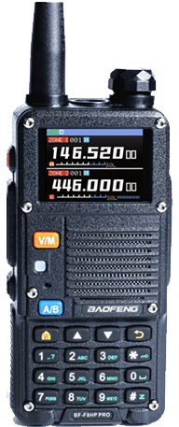
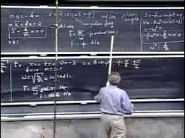
Education Committee – Feb 2026
Email me if interested in:
Education Committee
Elmers
Help Build List of Resources for:
Study for License (Tech, General, Extra)
Exams
Skill Development: CW, Digital Modes, etc.
What Are Your Ideas? What Do YOU Want?:
Demonstrations, events
Lend-a-Rig?
Host VE sessions?
Contesting for Beginners
VA QSO Party (March), 13 Colonies Event (July)
Contact Steve KS1G, ks1g04@gmail.com

Slide 36
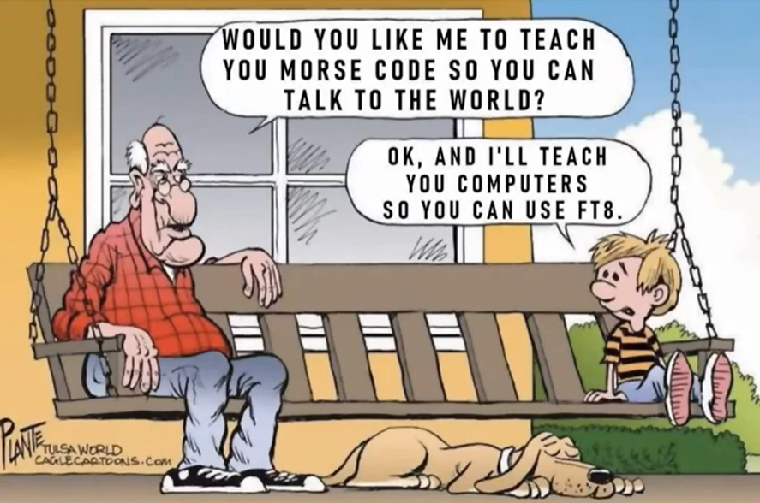
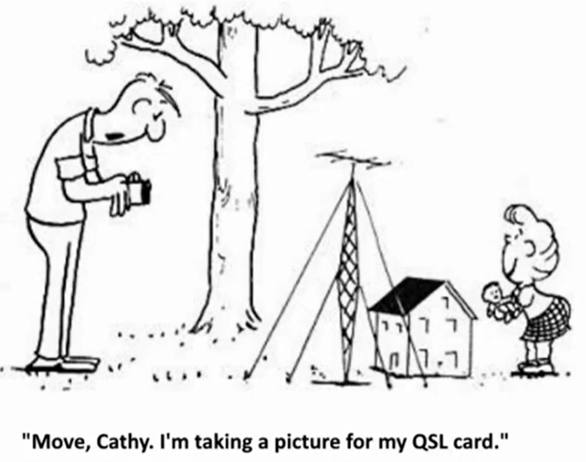
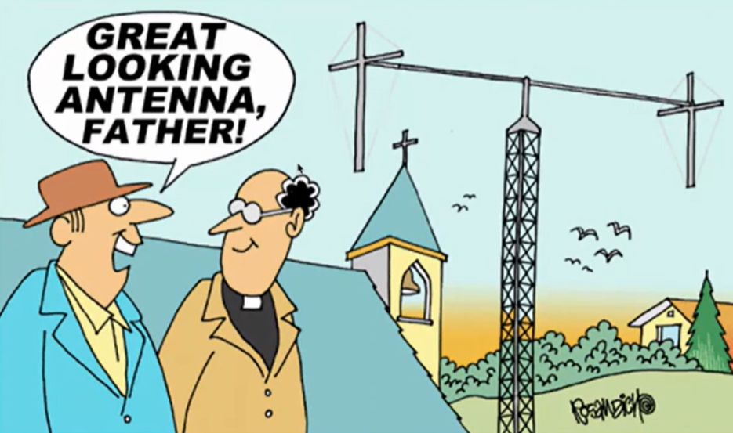
MEMBERS SHOUT OUT
ANYTHING HAM RADIO RELATED YOU WOULD LIKE TO SHARE WITH THE CLUB? PROJECTS, EXPERIMENTS, ACHIEVEMENTS, ETC.

Slide 37
Any Last Thoughts?

Slide 38


THANK YOU FOR ATTENDING!
OUR NEXT MEETING WILL BE 14 Mar 26
Motion to Adjourn

Slide 39
LCARES Meeting

Slide 40


