Slide 1






Virginia QSO Party Logging and Scoring
K2BFY
SVWCC

Slide 2
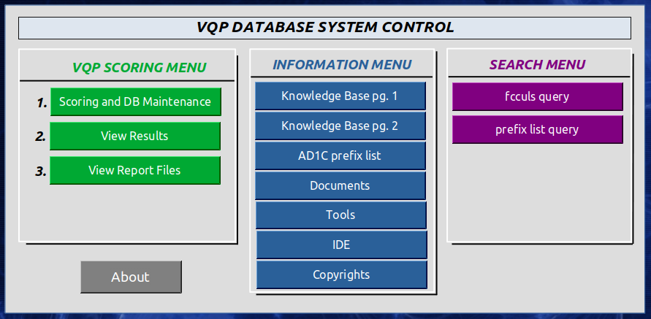
The scoring software GUI

Slide 3
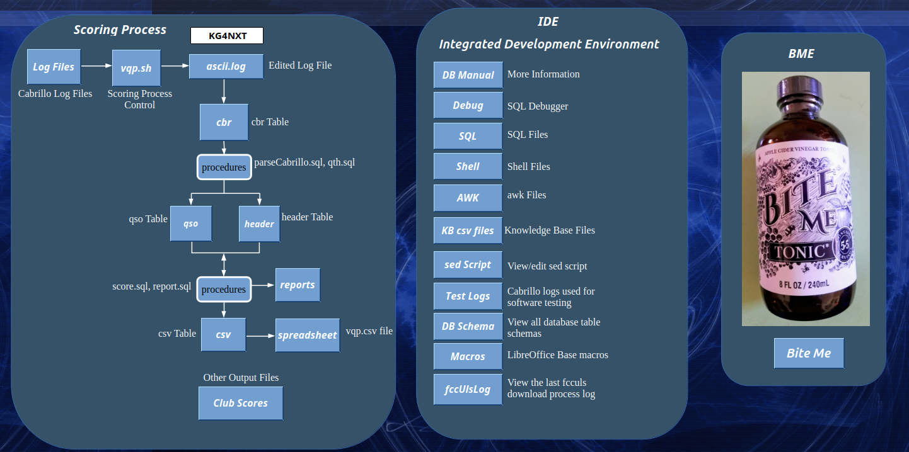

Slide 4
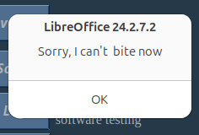

Slide 5
Virginia QSO Party Mission
Enable participants to have an enjoyable experience and get the highest possible scores.
Therefore, the log scoring process is in line with what the majority of participants put into their logs, and what the QSO Party committee wants.

Slide 6
Virginia QSO Party Goal
Our goal is to beat PA and FL by having more participation in Virginia.
Last year PA received 683 logs and Virginia received 570 logs making Virginia the number 4 QSO party.
FL received 776 logs last year

Slide 7


Slide 8
There will be six 1 by 1 bonus stations that will spell LOVERS. Each bonus station initial contact will be worth 50 points and stations that contact all six bonus stations will receive a special certificate. The six bonus stations will be:
K4L, K4O, K4V, K4E, K4R, K4S

Slide 9
Dates and Times
Saturday, 21 MAR 2026, 1400 to 0400 UTC
Sunday, 22 MAR 2026, 1200 to 2400 UTC

Slide 10
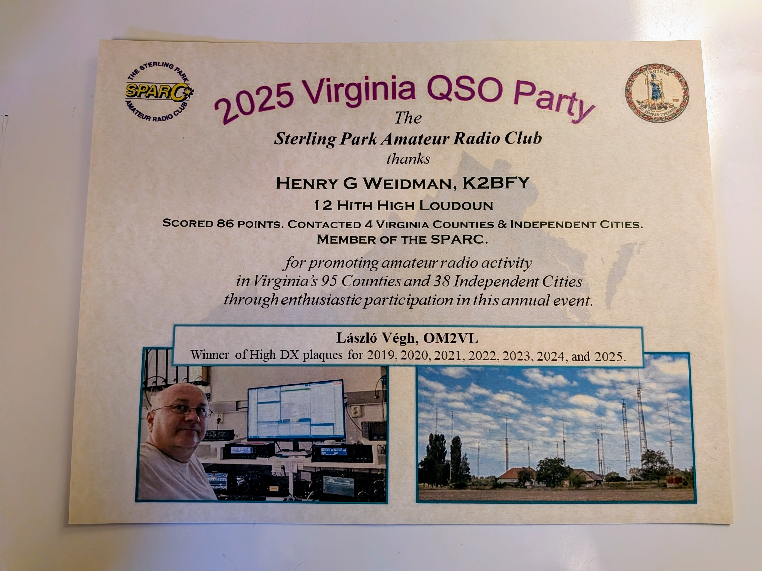

Slide 11
Virginia QSO Party Logging and Scoring
The contest is not over when you power off your transmitter.
What about the accuracy of your log?

Slide 12
GIGO
“I know my log file will be correct because I am using logging software”

Slide 13
Read the contest rules
qsl.net/sterling
SPARC Website

Slide 14
This is from the SPARC website for the 2023 QSO Party
Cabrillo Notes:
For Virginia Stations, mobiles, expeditions and rovers shall indicate LOCATION as VA MOBILE.
For example:
LOCATION: VA MOBILE
The CATEGORY-STATION shall be MOBILE, EXPEDITION, or ROVER.
For example:
CATEGORY-STATION: MOBILE
CATEGORY-STATION: EXPEDITION
CATEGORY-STATION: ROVER

Slide 15
Read the Cabrillo log format
https://wwrof.org/cabrillo/
Cabrillo Website

Slide 16
LOG FILE NAME
K2BFY.log
Note that valid log file names may be:
K2BFY.log Fixed station
K2BFY.LOG Fixed station
K2BFY-M.log Mobile
K2BFY-E.log Expedition
K2BFY-R.log Rover
K2BFY-WVA.log In West Virginia
Note that invalid log file names are:
K2BFY.log2
K2BFY.LOG1
K2BFY-M.logA
K2BFY-E.yule-log
K2BFY-R.ships-log
PhoebeCat.log

Slide 17
EXCHANGE
K2BFY 001 LDN
N5TEX 003 TX

Slide 18
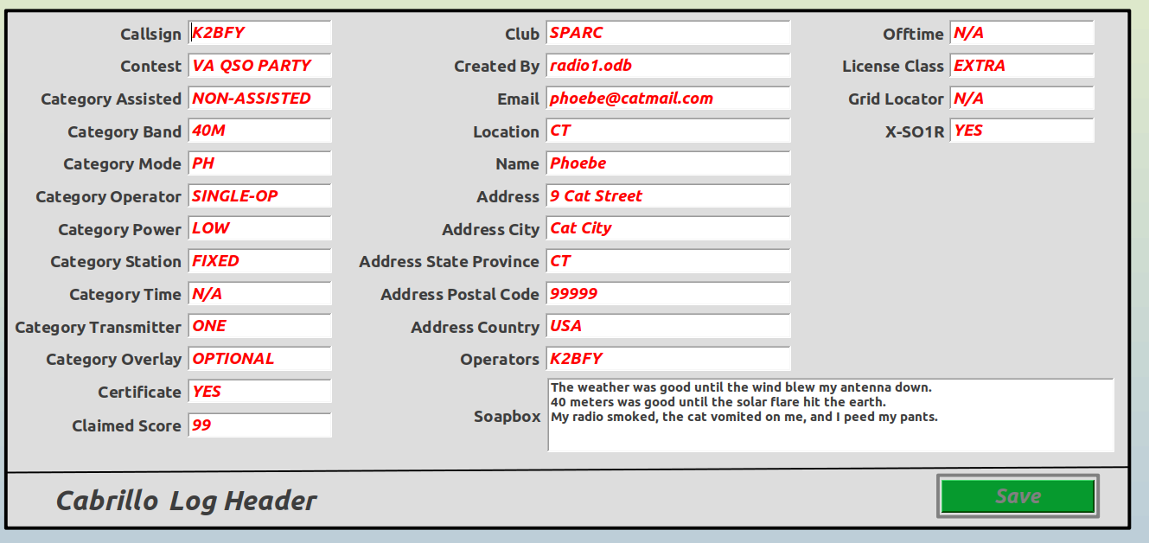

Slide 19
LOG HEADER ENTRIES
CATEGORY-STATION: MOBILE, EXPEDITION, ROVER
LOCATION: VA MOBILE
CATEGORY-STATION: FIXED
LOCATION: LDN
CATEGORY-STATION: FIXED (even if mobile)
LOCATION: WVA
CATEGORY-STATION: FIXED (even if mobile)
LOCATION: MD

Slide 20
LOG HEADER ENTRIES
CATEGORY-ASSISTED: ASSISTED, NON-ASSISTED
CATEGORY-BAND: 80M, 40M ... 2M, 70CM, ALL
CATEGORY-MODE: PH, CW, DG
CATEGORY-OPERATOR: SINGLE-OP, MULTI-OP, CHECKLOG
CATEGORY-POWER: QRP, LOW, HIGH
CATEGORY-STATION: FIXED, MOBILE, EXPEDITION, ROVER
CATEGORY-TRANSMITTER: ONE, TWO, LIMITED, UNLIMITED
LOCATION: LDN, NY, HI, AK, DX, VA MOBILE
X-SO1R: YES, NO
Note that most logs CATEGORY TRANSMITTER are ONE or UNLIMITED

Slide 21
CATEGORY-TRANSMITTER:
ONE:
Only one transmitter and one receiver can be used at a time, with only one signal transmitted on any band.
TWO:
Two transmitters and receivers can be used simultaneously, often for a single operator to run and hunt, or in a multi-operator setup.
LIMITED:
This category allows for more flexibility than single-transmitter categories, but with fewer hardware requirements than unlimited multi-transmitter categories.
UNLIMITED:
Allows for an unlimited number of transmitters and operators, with only one transmitted signal allowed per band.
SWL:
This category is for shortwave listeners who only listen to transmissions but do not transmit.

Slide 22
START-OF-LOG: 3.0
CALLSIGN: K2BFY
CONTEST: VA QSO PARTY
CATEGORY-ASSISTED: NON-ASSISTED
CATEGORY-BAND: 40M
CATEGORY-MODE: CW
CATEGORY-OPERATOR: SINGLE-OP
CATEGORY-POWER: LOW
CATEGORY-STATION: FIXED
CATEGORY-TIME: N/A
CATEGORY-TRANSMITTER: ONE
CATEGORY-OVERLAY: OPTIONAL
CERTIFICATE: YES
CLAIMED-SCORE: 99

Slide 23
CLUB: SPARC
CREATED-BY: radio1.odb
EMAIL: phoebe@catmail.com
LOCATION: CT
NAME: Phoebe
ADDRESS: 9 Cat Street
ADDRESS-CITY: Cat City
ADDRESS-STATE-PROVINCE: CT
ADDRESS-POSTAL-CODE: 99999
ADDRESS-COUNTRY: USA
OPERATORS: K2BFY
OFFTIME: N/A
LICENSE-CLASS: EXTRA

Slide 24
GRID-LOCATOR: N/A
X-SO1R: YES
SOAPBOX: The weather was good until the wind blew my antenna down.
SOAPBOX: 40 meters was good until the solar flare hit the earth.
SOAPBOX: My radio smoked, the cat vomited on me, and I peed my pants.
SOAPBOX: END
QSO: 40M CW 2024-06-18 0819 K2BFY 1 LDN K3MAD 1 MD
QSO: 40M CW 2024-06-18 0820 K2BFY 2 LDN K4ABC 1 NC
QSO: 40M CW 2024-06-18 0820 K2BFY 3 LDN K5TXN 1 TX
END-OF-LOG:

Slide 25
Column Number | Description
1 | QSO:
2 | Band
3 | Mode
4 | Date
5 | Time
6 | Your Call
7 | Your Number
8 | Your Location
9 | Other Call
10 | Other Number
11 | Other Location
QSO record columns
Some logs do not conform to this format. We have software that will reformat those logs.

Slide 26
Check your log for errors
START-OF-LOG: 3.0
X-SO1R: YES
LOCATION: LDN
CALLSIGN: K2BFY
CATEGORY-BAND: 40M
CATEGORY-MODE: PH
CATEGORY-OPERATOR: SINGLE-OP
CATEGORY-POWER: LOW
(or NY or WV, etc. or DX or VA MOBILE)
(This should match your callsign in the QSO: records)
(or ALL or some other band)

Slide 27
Check your log for errors
CATEGORY-STATION: FIXED
(or MOBILE or ROVER or EXPEDITION)
IF CATEGORY-STATION is missing, we cannot score the log.
This is a fatal error!

Slide 28
CATEGORY-OVERLAY: YOUTH
( or ROOKIE or TECH or EXTRA, etc. )
CATEGORY-TRANSMITTER: ONE
CERTIFICATE: YES
CLAIMED-SCORE: 42
CLUB: SPARC, LARG
CONTEST: Virginia QSO Party
CREATED-BY: warp-drive
NAME: Phoebe Cat
ADDRESS: 9 Cat Street
ADDRESS: Cat City, CT, 99999
EMAIL: K1CAT@catmail.com
OPERATORS: K1CAT
For US stations, we get the address from the fcculs “database.”

Slide 29
Punctuation allowed in the Cabrillo file
: - / @
Space Colon Dash Slash At
Use anything else at your own risk because it could result in your log not being scored due to the fact that the scoring software may not handle any other punctuation.

Slide 30
Club Name Entries for LARG
LARG
Loudoun Amateur Radio Group
Loudoun Amateur Radio Group (LARG)
Loudoun Amateur Radio Group LARG
Loudoun ARC
Loudoun ARG
Loudoun ARG LARG
Loudoun County ARC
K4LRG
Could we just use LARG ???

Slide 31
Other Local Club Name Entries
CARA Culpepper Amateur Radio Club
CVCC Central Virginia Contest Club
FARA Fauquier Amateur Radio Assoc.
LARG Loudoun Amateur Radio Group
OVH Ole Virginia Hams
PVRC Potomac Valley Radio Club
SPARC Sterling Park Amateur Radio Club
SVARC Shenandoah Valley Amateur Radio Club
SVWCC Shenandoah Valley Wireless

Slide 32
QSO RECORDS
Note: Some callsigns in the following partial logs
have been changed, in order to protect
the people who submitted the logs.
I only want to show some log errors so that
we will not repeat these log errors.

Slide 33
QSO RECORDS
QSO: 40M PH 2023-03-18 1420 K2BFY 1 LDN W1AW 20 LDN
QSO: 40M PH 2023-03-18 1425 K2BFY 2 LDN K4CGY 33 ALB
QSO: 40M PH 2023-03-18 1430 K2BFY 3 LDN NX3A 47 SHE
QSO: 40M PH 2023-03-18 2022 K2BFY 4 LDN W4EO 510 FAU
QSO: 40M PH 2023-03-19 1422 K2BFY 5 LDN WB4MJF 446 ARL
QSO: 40M PH 2023-03-19 1429 K2BFY 6 LDN AJ4LN 329 LDN
QSO: 40M PH 2023-03-19 1435 K2BFY 7 LDN W4RKC 148 WIX
END-OF-LOG:
Note: US callsigns are searched for in the fcculs database, and callsigns that are
not found there, probably due to a typing error, will be
rejected. Last year, there were 396 callsign errors.

Slide 34
QSO RECORDS
Note: The Cabrillo log standard states that the fields of data in the
QSO records must start and end at specific character
locations. We do not require that for the Virginia QSO Party.
However we do require that the 11 fields of data are in the
order shown here.
freq/ ------your---------- --------other-----------
tag band mode date time call num qth call num qth
QSO: 40M PH 2023-03-19 1435 K4ABC 7 PAG K2BFY 148 LDN

Slide 35
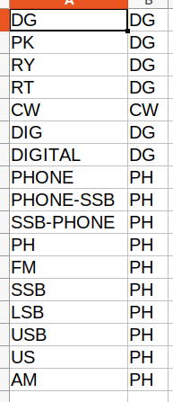
CATEGORY-MODE: Should be PH, CW, or DG
The mode table contains the data shown in the screenshot.
Note that the correct modes are CW, DG, and
PH.

Slide 36
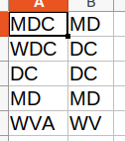
Note that DC and MD are now separate entities.
The preferred log entries are DC, MD, or the
special case for WV is WVA.
This is just another one of the 28 VA QSO Party specific knowledge base files.

Slide 37
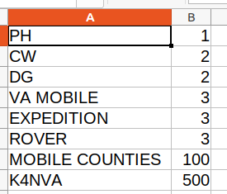
Note that MOBILE, EXPEDITION, and ROVER
have the same number of points.
Bonus station K4NVA is worth 500 points.
(not this year)
MOBILE, EXPEDITION, and ROVER stations receive 100 points for each city/county they
operate from.
From a scoring perspective, MOBILE, EXPEDITION, and ROVER stations are scored the same.

Slide 38

Note that AK and HI are considered countries.

Slide 39
QSO RECORDS
QSO: 40M PH 2023-03-18 1420 K2BFY 1 LDN W1AW 20 LDN
QSO: 40M PH 2023-03-18 1425 K2BFY 2 LDN K4CGY/AE 33 ALB
QSO: 40M PH 2023-03-18 1430 K2BFY 3 LDN NX3A/9 47 IL
QSO: 40M PH 2023-03-18 2022 K2BFY 4 LDN W4EO/R 510 FAU
QSO: 40M PH 2023-03-19 1422 K2BFY 5 LDN WB4MJF/E 446 ARL
QSO: 40M PH 2023-03-19 1429 K2BFY 6 LDN AJ4LN 329 LDN
QSO: 40M PH 2023-03-19 1435 K2BFY 7 LDN W4RKC/M 148 WIX
END-OF-LOG:
We don’t care if a station is /AE or /9.
/R and /E stations are scored the same as /M.

Slide 40
QSO RECORDS
QSO: 40M PH 2023-03-18 1420 K2PFF 1 LDN KP4ABO 20 NC
QSO: 40M PH 2023-03-18 1425 K2PFF 2 LDN KP4AAM 33 HI
QSO: 40M PH 2023-03-18 1430 K2PFF 3 LDN KP4AI 47 AK
QSO: 40M PH 2023-03-18 2022 K2PFF 4 LDN KP4AAC 510 DX
QSO: 40M PH 2023-03-19 1422 K2PFF 5 LDN KP4AA 446 DX
QSO: 40M PH 2023-03-19 1429 K2PFF 6 LDN KP4ANG 329 MA
QSO: 40M PH 2023-03-19 1435 K2PFF 7 LDN KP4AIC 148 LDN
END-OF-LOG:
KP4 Calls are Puerto Rico, however some KP4 calls are now located in the US

Slide 41
EXAMPLE QTH ERRORS
VE3KOT 60 DX (Canadian Province)
K4Z 155 DUM (Invalid city/county abbreviation)
K4CGY 3 003 (003 is not a city/county abbreviation)
VE9VIC 90 NX (NX is not a valid state abbreviation)
BK1BIF 14 VT (BK1BIF is not in Vermont)
W4CA 124 BATH (Invalid city/county abbreviation)
CF3A 774 DX (Canadian Province)
NOTE: CF3A is a Canadian call sign therefore the QTH
should be the province abbreviation. This also
applies to VE3KOT.
In 570 logs, there were 64 QTH errors and 396
CALLSIGN errors.

Slide 42
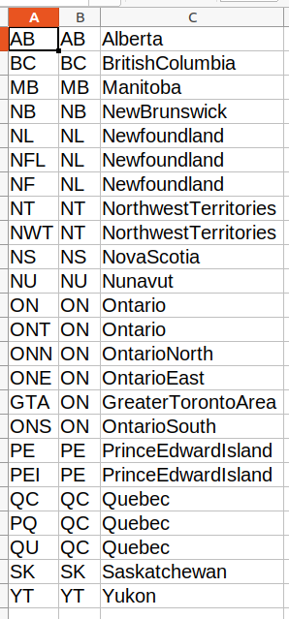
Canadian Province Abbreviations
A: Logged Abbreviation
B: Correct Abbreviation
C: Province Name

Slide 43
K4BAD
category FIXED
club NONE
Score Calculation
qso 1178
cw 205
ph 779
va mobile 194
bad 82
qso points 1771
Multipliers
counties 106
states 43
provinces 4
countries 5
city_county_10 0
mult 158
Bonus Points
mobile_counties ( 00) 0
bonus Stations 0
This station lost points due to bad QSO records. A large number of the QSO records had
a Virginia county abbreviation of PWC, probably instead of PRW. There were also a large number of duplicate QSO records. Most logs used the N1MM logging program.

Slide 44
QSO: 14000 CW 2023-03-19 2041 W?XXX 1942 CRA LA8OM 0049 LA
Note that LA8OM is not a Lousiana station, it is DX located in Norway
This is another good example of a QSO entry that could have been easily fixed if someone had checked their log file.
Don’t forget to check the log header items:
CATEGORY MODE: CW
Also, even though this station stated that the mode was CW, there was one phone
contact in the log so the mode should have been MIXED.

Slide 45
QSO: 21018 CW 2023-03-18 1813 A9XX/4 0321 LDN HK4/KC1XX 0227 DX
Notes:
(1) There is no reason to enter your callsign/4. The log header already states
your location.
(2) The correct method to enter someone working in a foreign state is shown.

Slide 46
QSO: 21018 CW 2023-03-18 1813 A9XX 0321 LDN KC1XX 0227
Notes:
(1) What is wrong with this QSO: record?

Slide 47
QSO: 21018 CW 2023-03-18 1813 A9XX 0321 LDN KC1XX 0227 QTH
Notes:
(1) What is wrong with this QSO: record?
(2) The qth column is missing

Slide 48
Notes:
Last year there were a total of 70,379 QSOs.
Scoring Data For All Logs:
Score = Claimed Score 187 logs
Score > Claimed Score 222 logs
Score < Claimed Score 161 logs
570 eLogs Received

Slide 49
LOG ERRORS:
Duplicate Records 389 QSO records (Not scored)
Invalid Callsign 396 QSO records (Lower score)
wrong Other QTH 64 QSO records (Lower score)
*Callsign Mismatch 1 log
(QSO record callsigns do not match header callsign)

Slide 50
Invalid Call Possible Call
N4YCK KN4YCK
WA1AXY WA1AYY
WB4SRS WB4SSR
N4BVG KN4BVG
K34WMF K4WMF
Many other callsigns had no possible match in the fcculs database

Slide 51
NumQso 70379
Counties 42629
States 24601
Provinces 1229
dx 1920
cw 28972
ph 41179
dg 228
Fixed 64918
Mobile 5461
80M 7090
40M 37857
20M 18730
15M 2764
10M 1192
2M 1505
220 301
440 698
2025 Number of QSOs
Transmitter Power
QRP 29
LOW 413
HIGH 128

Slide 52
Some QRP Scores Were Very High
WU4G 1 St High QRP Scored 109080 Points, Contacted 64 Virginia Counties & Cities
N4RP 2 Nd High QRP Scored 85269 Points, Contacted 98 Virginia Counties & Cities
K2PI 3 Rd High QRP Scored 24991 Points, Contacted 35 Virginia Counties & Cities
WR4I 4 Th High QRP Scored 22360 Points, Contacted 35 Virginia Counties & Cities
K2YG 5 Th High QRP Scored 18774 Points, Contacted 63 Virginia Counties & Cities
NI8W 6 Th High QRP Scored 10812 Points, Contacted 51 Virginia Counties & Cities

Slide 53
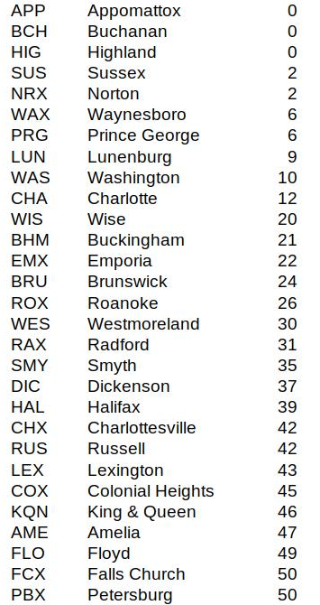
Some Counties with the fewest contacts last year.

Slide 54
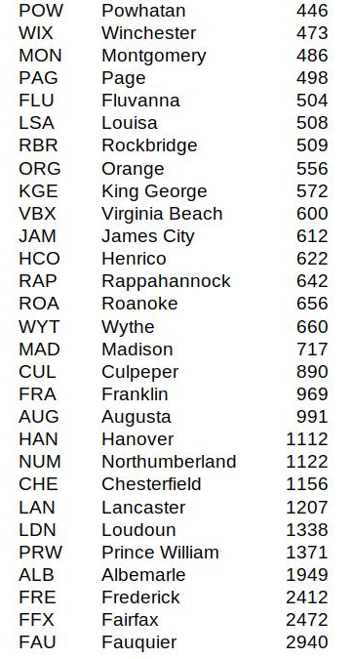
Some Counties with the most contacts last year.

Slide 55
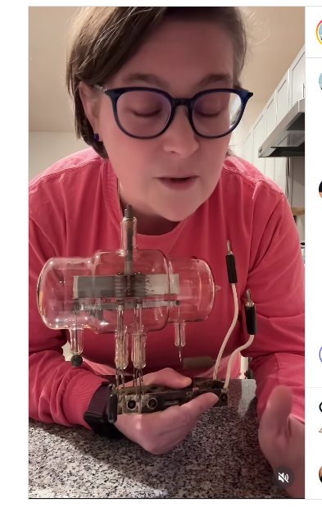
This is a radioactive piece of military technology that belongs in a museum and I found it in a thrift store for $3.99. Coolest thrift ever! #thrift #ww2 #military #tech #thriftfinds
The VT-158, also known as the Zahl tube, was a vacuum tube invented by American physicist Harold A. Zahl in the 1930s and used during World War II and the Korean War. It allowed the radar technology at the time to detect low-flying planes by generating enough power to produce ultrahigh frequency energy.

Slide 56
Virginia QSO Party
73

