Slide 1
Loudoun Amateur Radio Group
"Flowerpot" 1/2 Wave 2m/70cm Antenna Build

Slide 2
1/2 Wave 2m/70cm Antenna Build
The flowerpot antenna is a simple, end-fed half-wave coaxial dipole antenna, commonly used for VHF/UHF amateur radio bands (e.g., 2m at 144-148 MHz or 70cm at 430-450 MHz).
It is constructed from coaxial cable (typically RG58 with a velocity factor VF ≈ 0.66) housed in a PVC pipe for protection and rigidity.
The design consists of an upper radiating element (the exposed inner conductor),
a lower sleeve (the outer braid of the coax acting as the other half of the dipole.
Terminated with a PL-259 connector at one end.

Slide 3
1/2 Wave 2m/70cm Antenna Build
Bill of Materials
Company | Model | Total | Price
Lowes | 1/2inx10ft 315PSI PRSR Pipe | 1 | $3.35
Lowes | 1/2in Sch40 Coupling 429005 | 1 | $0.70
Lowes | 1/2in SCH40 Cap 447005 | 2 | $0.67
DX Engineering | RG-58A/U 52-ohm Bulk Coaxial Cable DXE-58AU | 6 | $3.30
DX Engineering | DX Engineering Next Generation Crimp/Solder 8U PL-259 Connectors DXE-PL259CS8U-6 | 1 | $32.99
Walmart | Reynolds Wrap Pre-Cut Pop-Up Heavy Duty Aluminum Foil Sheets 14x10.25 inches, | 1 | $3.36
$44.37

Slide 4
1/2 Wave 2m/70cm Antenna Build
PVC Pipe Prep
Cut PVC pipe to length.
Drill two holes using a 5/16” drill bit near the bottom for the choke coil make the hole a bit oblong so the coax fits in nicely without binding.
Top hole position: ≈ 1 1/2 Inches from the top end of the smaller pipe
(Hole spacing: ≈ 2 inches apart (adjust so 11 tight turns fit evenly).
File the holes smooth to avoid cutting the coax.

Slide 5
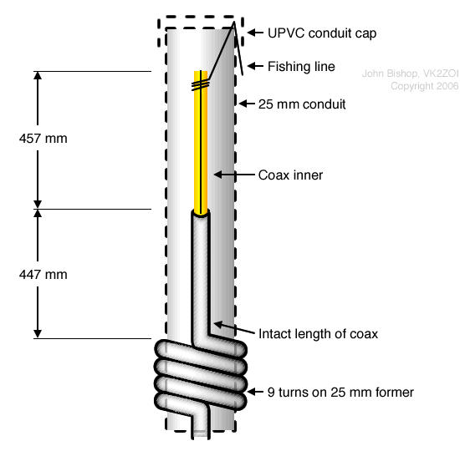
1/2 Wave 2m/70cm Antenna Build
COAX Measurements
Strip 457mm of the outer cover and shield.
447 mm of intact coax fit through the top hole of the former. At that point begin 11 tight wraps around the 1/2” PVC former.
Note: Do not use 9 turns for the rf choke. it is 11 turns
due to the 1/2” PVC pipe.

Slide 6
1/2 Wave 2m/70cm Antenna Build
RF Choke Build
Wind 11 tight, even turns of the coax on the outside of the 1/2" PVC pipe.
This number is adjusted specifically for the smaller 1/2” diameter and DXE-58A/U’s outercoax diameter (standard designs use 9 turns on 25 mm pipe).
Insert the remaining coax through the bottom hole and pull it down inside the pipe.
Secure the coil tightly with tape or zip ties so turns cannot shift.

Slide 7
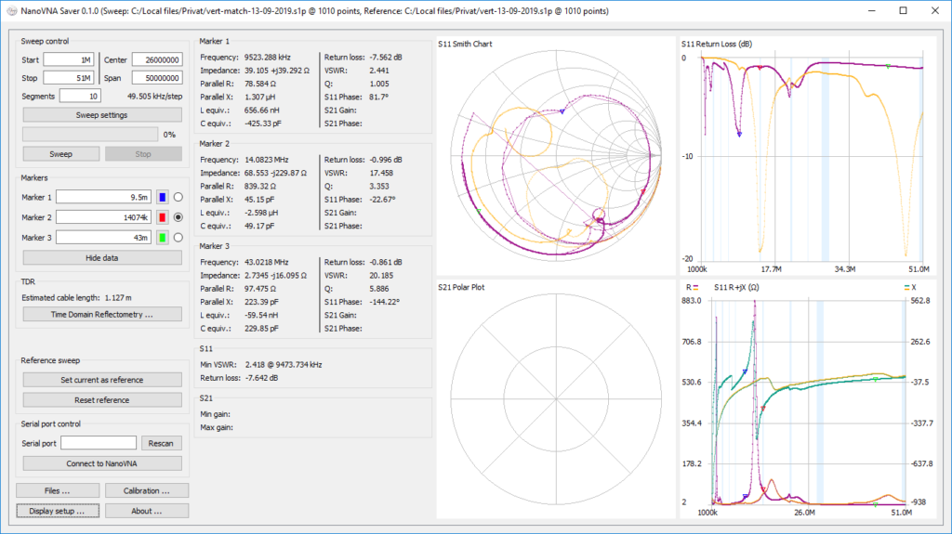
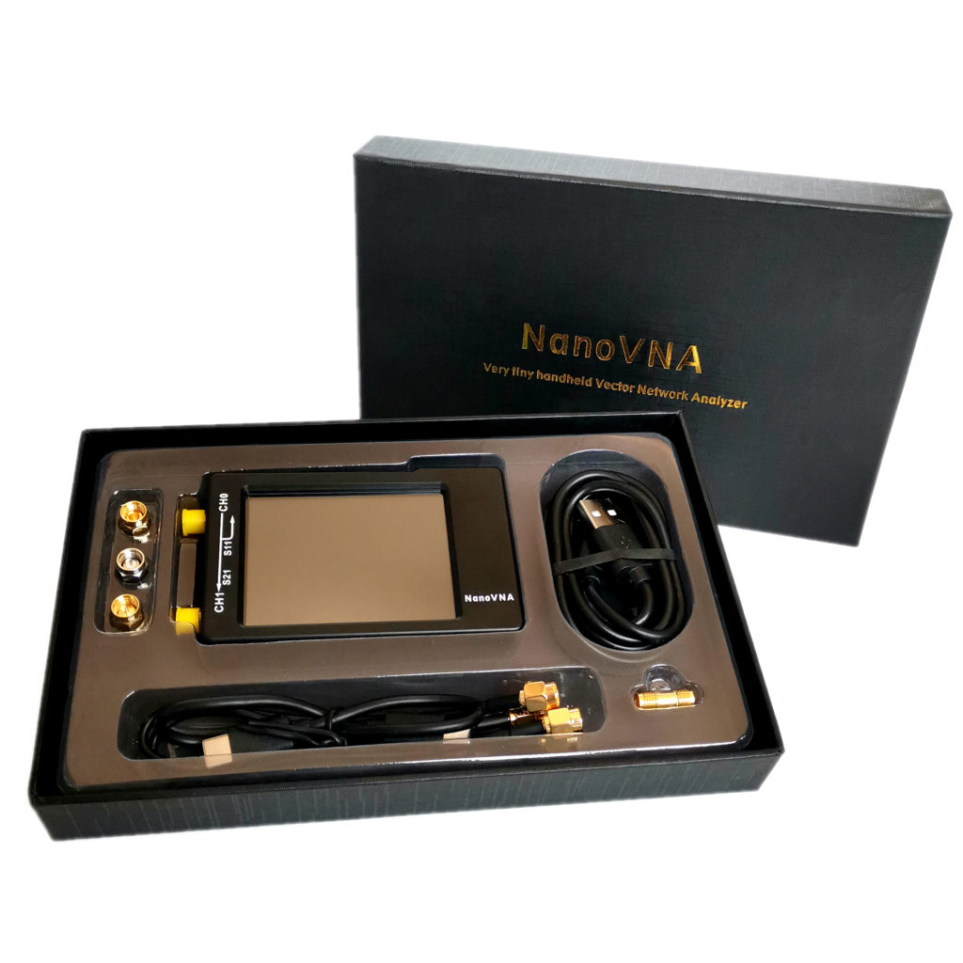
1/2 Wave 2m/70cm Antenna Build
Tuning the antenna
I use a NanvoVNA device and NanoVNA Saver Software for tuning the antenna.

Slide 8
1/2 Wave 2m/70cm Antenna Build
Tuning the antenna for 2m
Ensure the NanoVNA is properly calibrated using NanoVNA Saver for both
2m band 144MHz to 148MHz and 7cm band 420MHz to 450MHz.
Set the NanoVNA Saver for 2m band.
Connect the antenna to the NanoVNA and run a sweep to determine the antenna SWR. The goal is to get the center frequency of 146MHz close to 1.0 with the ends not more than 2.0. Usually the measurements will be 1.5 ish or so.

Slide 9
1/2 Wave 2m/70cm Antenna Build
Tuning the antenna
You will need to adjust the amount of coax pushed through the top hole to adjust the SWR reading.
If the dip is close to the 144MHz side, pull the coax from the hole. This shortens the antenna and test again.
If the dip is close to the 148MHz side, push more coax into the hole and test again.
After you complete this portion you move onto making the antenna dual band by setting it up for 70cm.

Slide 10
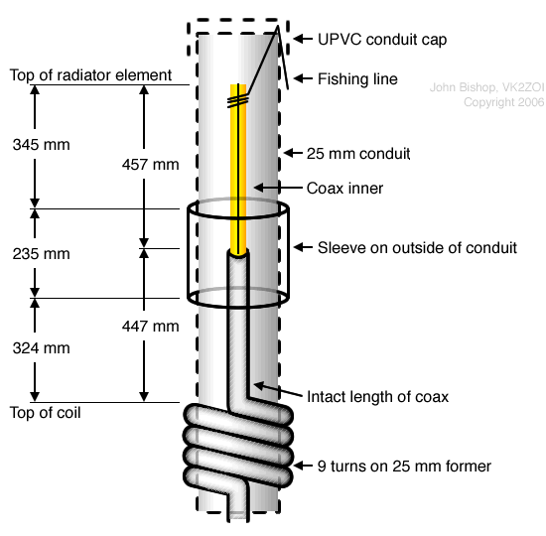
1/2 Wave 2m/70cm Antenna Build
Setting up the 70cm band
Take tinfoil 235mm tall and wrap is around the PVC. Use tape around the foil so it stays tightly wrapped.
The tuning process is moving this foil up and down in short moves along the outside of the PVC pipe until the SWR readings are at their lowest level. Tape the foil in place and fully wrap it with packing tape so it won’t rip.

