Slide 1
Wrap-Up of LARG Communications Support for the Ride To End Alzheimer’s Fundraiser
16 May 2026
Doug McNulty KM4GC
LARG Meeting 20 June 2026

Slide 2
Outline
Quick Summary
Coverage: ALZ Ride vs. Repeaters & APRS Assets
SAG and Rest Stop Operators
Pictures

Slide 3
Quick Summary
The Ride to End Alzheimer's event was a smashing success
About 200 riders took part
The ALZ group raised about $540,000
Primary Net repeaters (146.700 and 146.850 WA4TXE) provided excellent coverage over the course – thanks to WA4TXE for use of repeaters
  Only noticed outage was with SAG 3 on mountain road north of Round Hill – but APRS coverage was good
  Thanks to WB6EFW (Loudoun hospital) and N3JLT (Bluemont) repeater owners for use as backups

Slide 4
Quick Summary
Deployed APRS digipeaters improved APRS coverage – noticed very few outages
  Lovettsville Community Center Rest stop – Ron White
  Philomont Community Center Rest Stop – Bryan Schneiders
  Other fixed station Igate additions from last year
YAAC with large screen display at Net Control
  Included course routes and Rest Stop locations in addition to real-time SAG locations
  The event organizer liked display and having a backup
  Thanks to Kevin McCrory for files and for generating persistent uploads to APRS.fi to update icons
This is my last year leading the ALZ comms effort

Slide 5
Special Thanks to the SAG and Rest Stop Operators:
SAG # | Name | Call Sign
1 | Steve Palmer | KW4SHP
2 | John L Whisler Jr, | Non-Ham
2 | Hugh Forsythe | Non-Ham
3 | Dave Putman | KE4S
3 | Al Carlson | NA1N
4 | Justin Ferrante | KR4IZY
Location | Operators
Net Control | Doug McNulty, KM4GC
Waterford Elementary | Steven Greene, KS1G Jim Begley, KQ4MHT
Lovettsville Community Center | Ron White, KQ4IBI Bill Daniels,, K3WD
Hillsboro Charter Academy | Harry Kidder, KI2H Kevin Maxson, AK2M
Philomont Community Center | Bryan Schneiders, K1NSA Rob Carnaroli, KC3SWZ
Lincoln Elementary | Patrick Lewis, KQ4VZF Tareck Elass, K9TRE

Slide 6
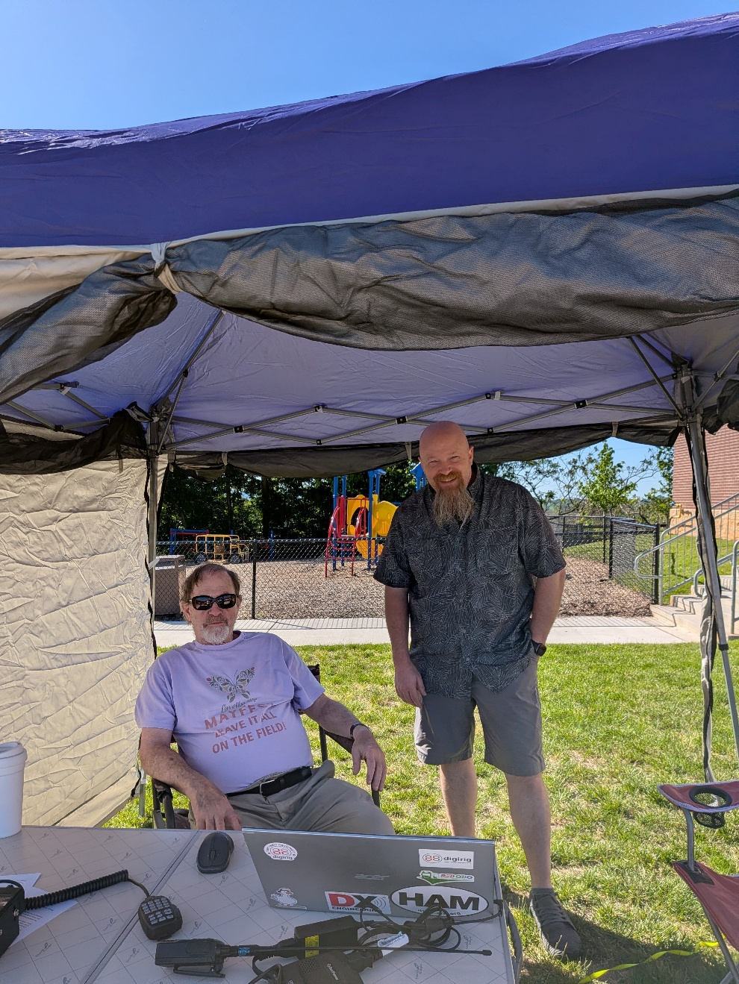
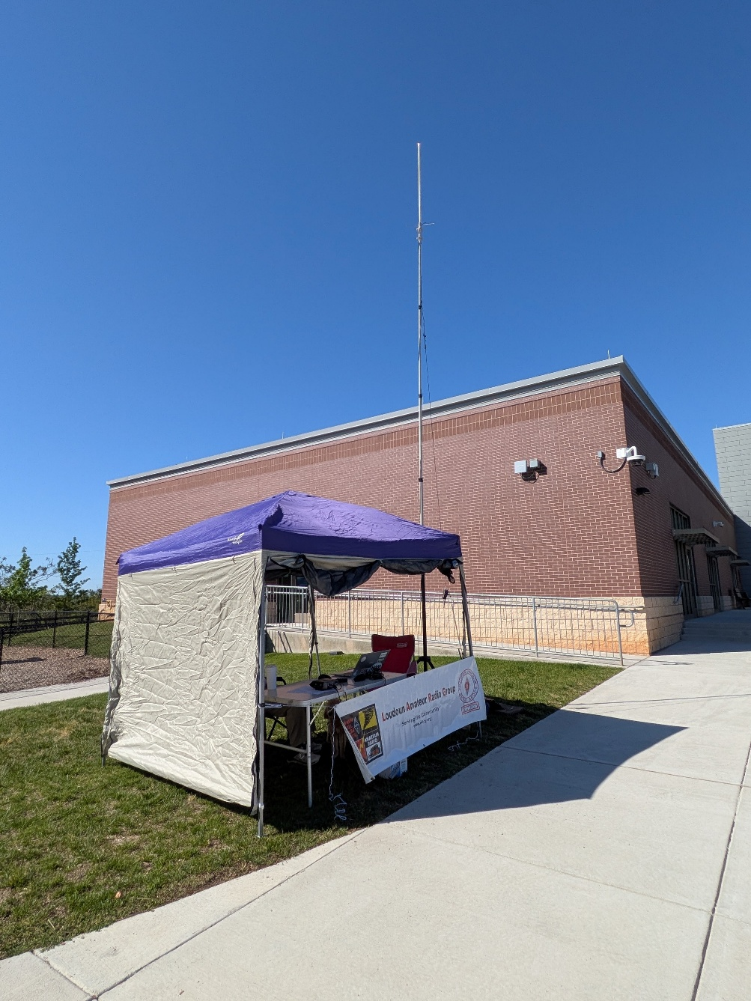
Lovettsville Community Center: Ron White, KQ4IBI & Bill Daniels, K3WD

Slide 7
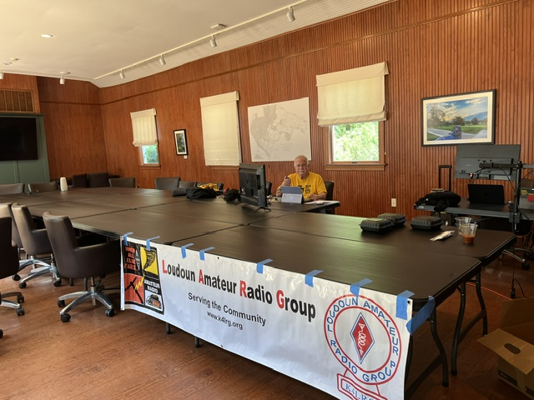
Net Control: Doug McNulty KM4GC

Slide 8
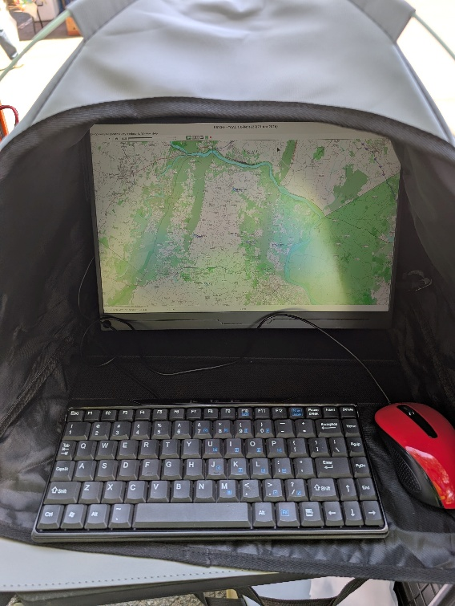
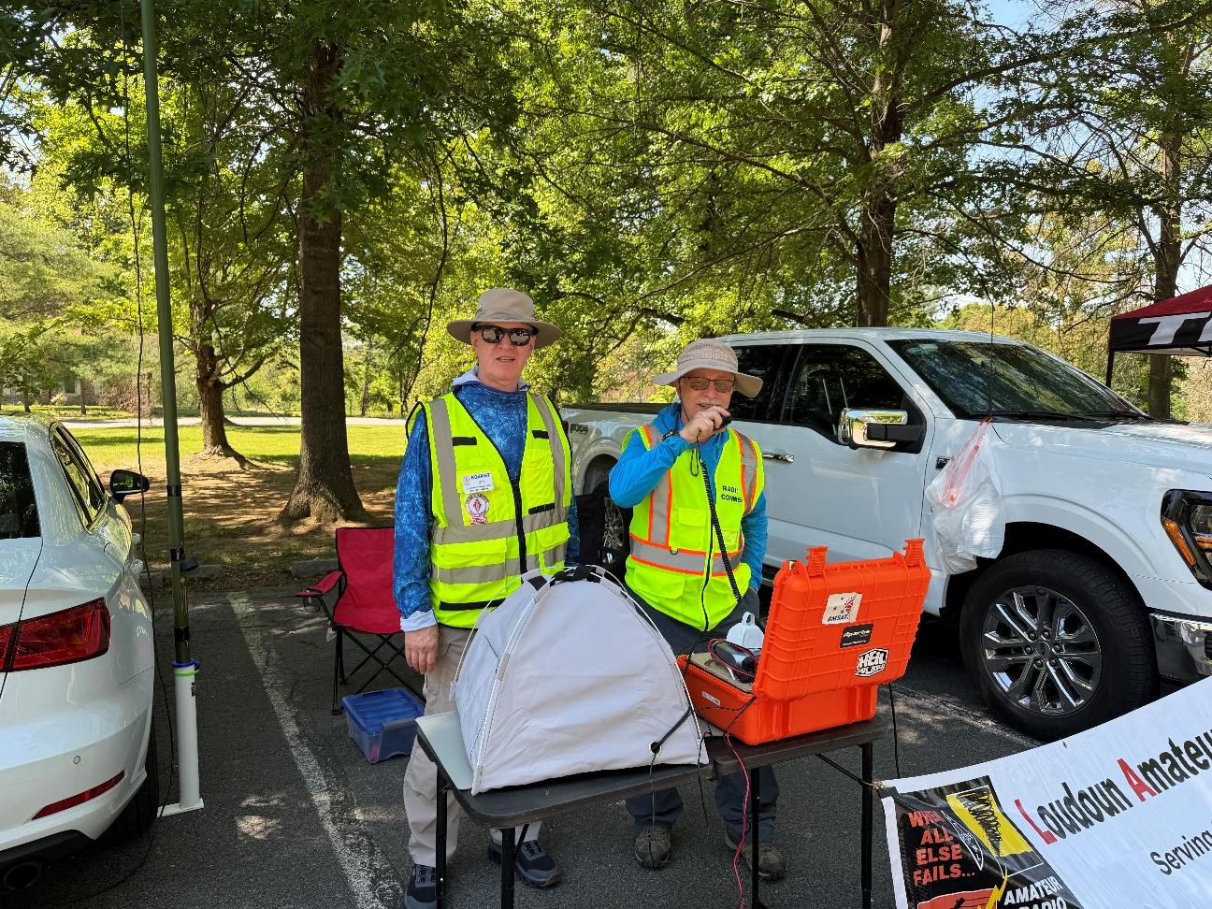
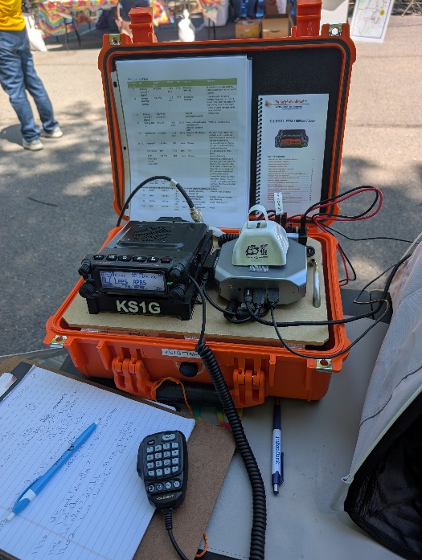
Waterford Elem: Steven Greene, KS1G &
Jim Begley, KQ4MHT

Slide 9
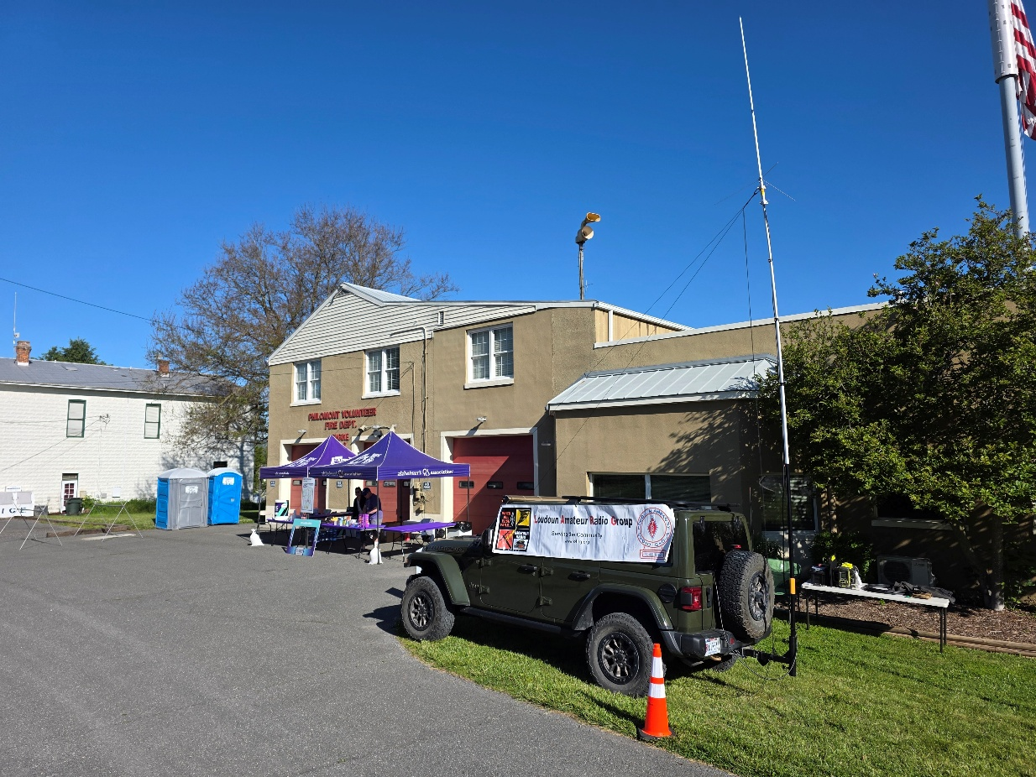
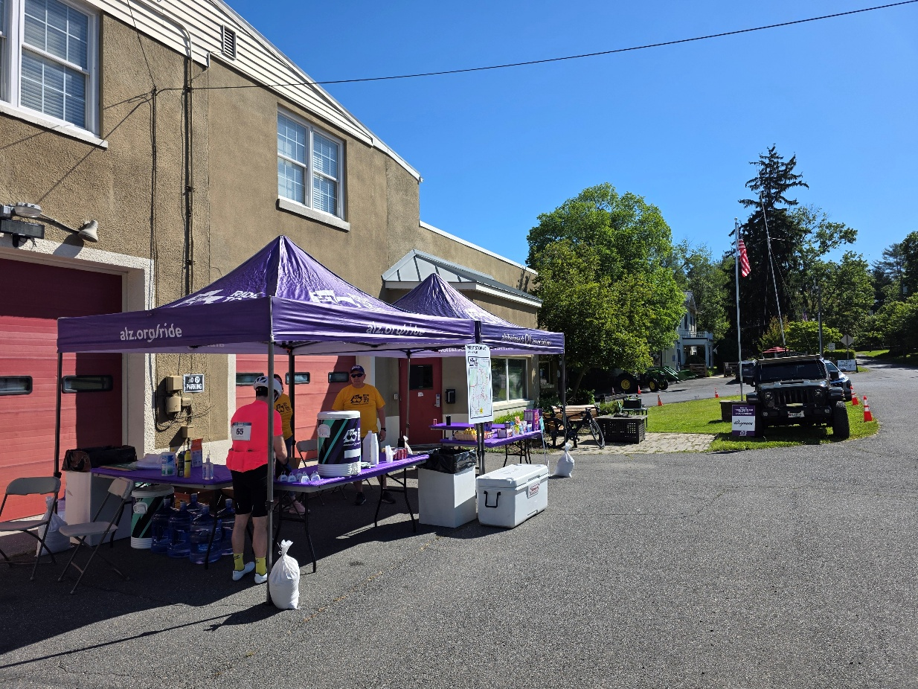
Philomont Community Center: Bryan Schneiders, K1NSA & Rob Carnaroli, KC3SWZ

Slide 10
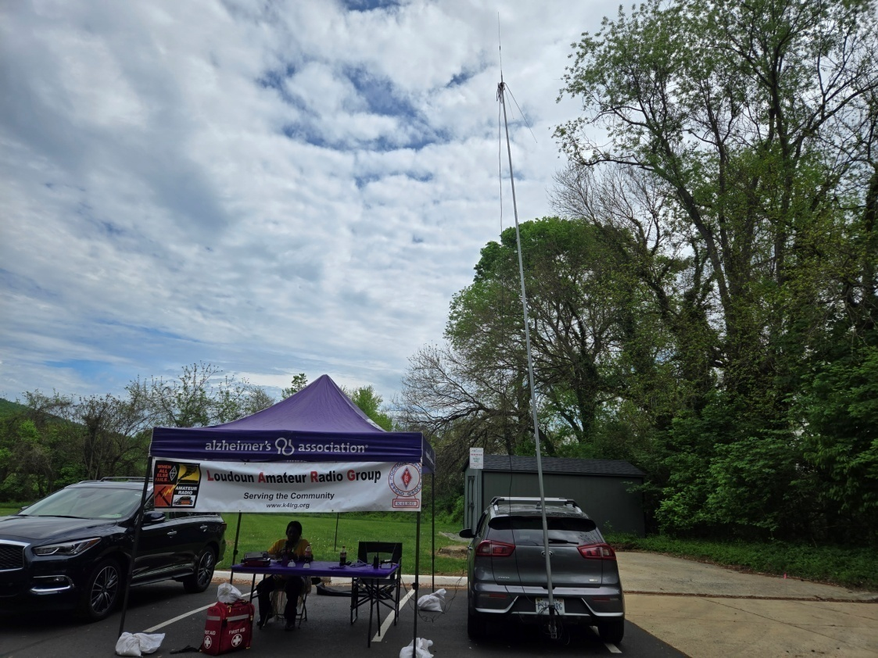
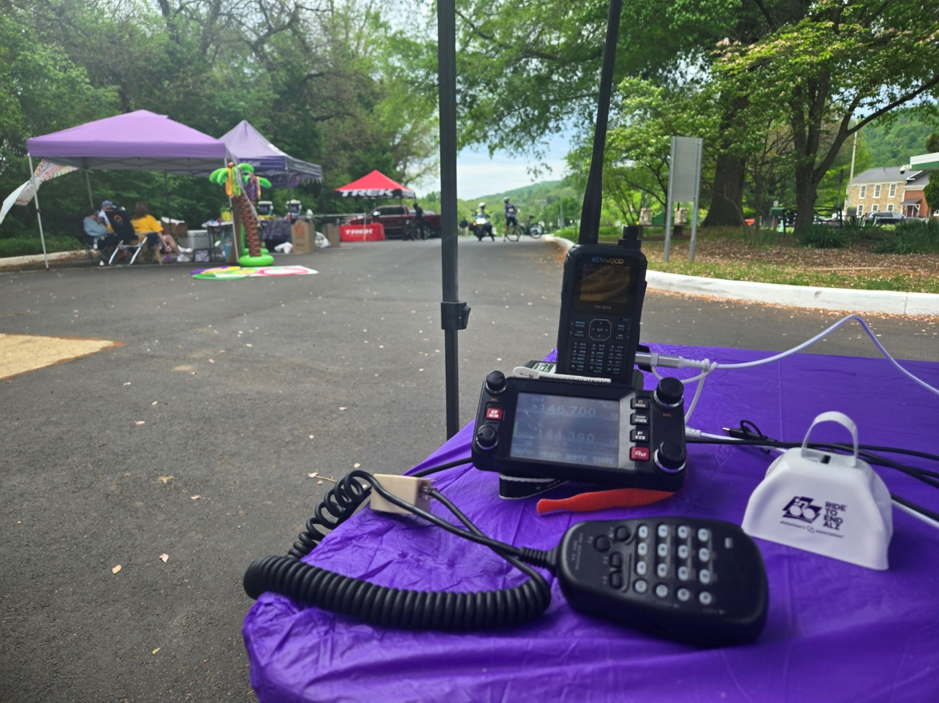
Hillsboro Academy: Harry Kidder, KI2H & Kevin Macxson, AK2M (last year)

Slide 11
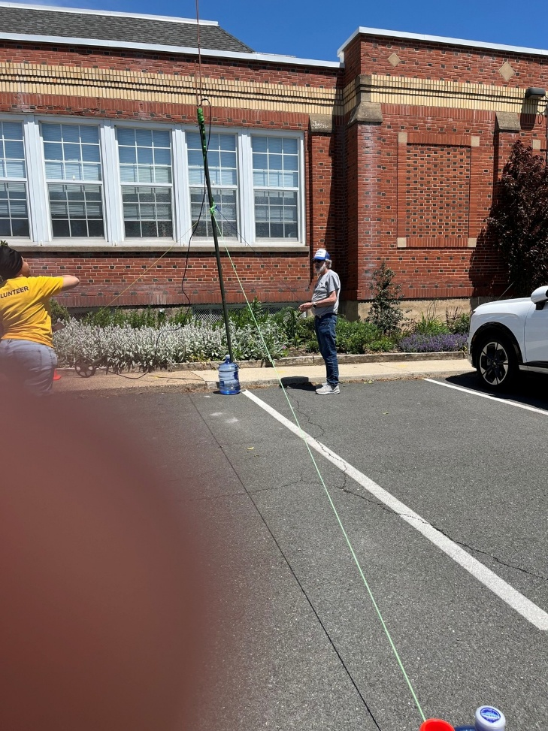
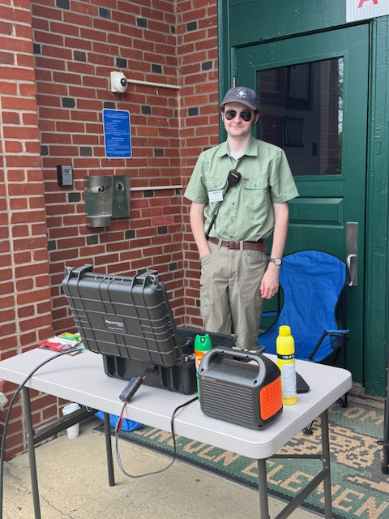
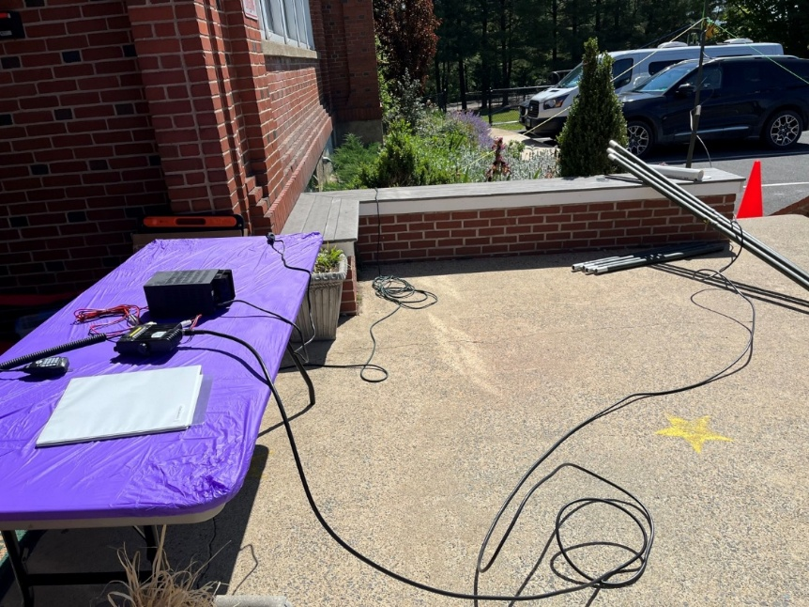
Lincoln Academy: Patrick Lewis, KQ4VZF & Tareck Elass, K9TRE

Slide 12
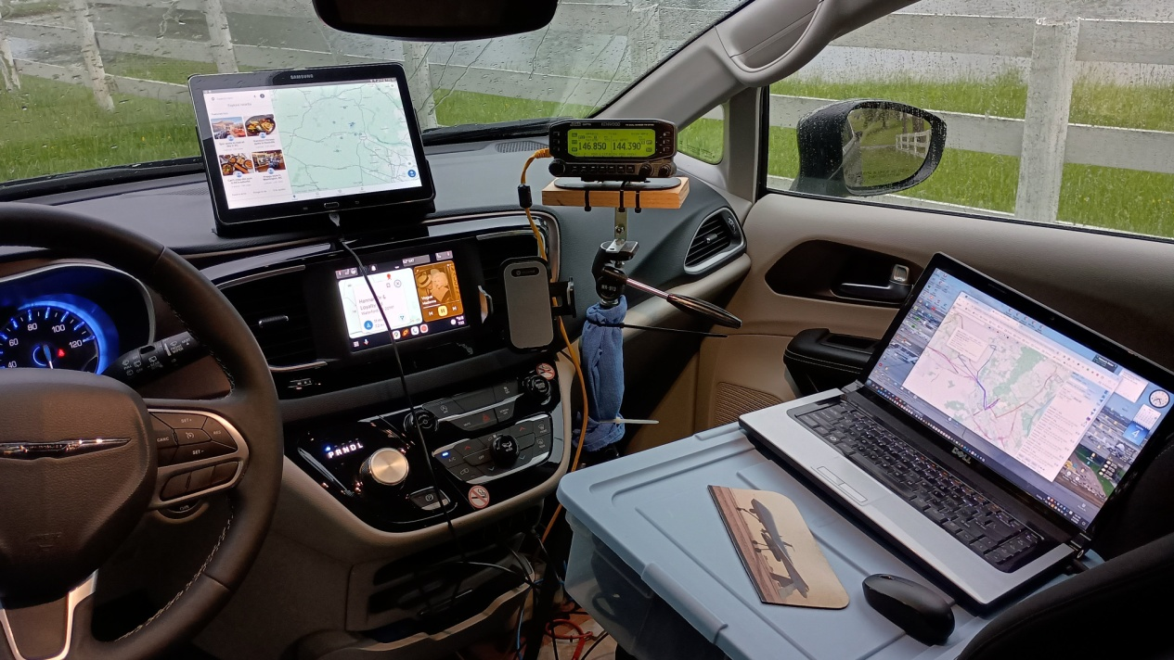
SAG-1
Steve Palmer KW4SHP (from 2024)
So here is a pic of my SAG rig.
Able to monitor aprs.fi site, Roger's GPS tracking, and group texting.
My cell phone is missing (mount is on center vent) as I needed it to take the pic.
But it was tied into the van's Android Auto system.
I used a tripod (secured with wire ties to the bottom of passenger chair) for my radio head.

