Slide 1
青森
AOMORI-KEN, JAPAN · AMATEUR RADIO FIELD REPORT
Japan - Aomori
SOTA and POTA Adventure
POTA & SOTA in Japan's Northern Frontier
AMATEUR RADIO FROM PARKS & SUMMITS OF AOMORI-KEN, JAPAN
JQ7FWB
—
FIELD REPORT
POTA
SOTA

Slide 2
AGENDA
What I'll Cover
01
02
Getting Licensed to Operate in Japan
The Portable Station: Lab599 TX-500
JARL reciprocal license, permits & pre-trip prep
HF radio, antennas & power packed for the field
03
04
Aomori Prefecture: Geography & Culture
POTA & SOTA: How the Programs Work
Location, terrain, climate & heritage of Aomori-ken
JP- park & JA/AM summit refs, rules & points
05
06
Targets & Activations Across Aomori
Results, Contacts & Takeaways
Five goals, three 2-fers & on-air field logs
Stations worked, QSO totals & lessons learned
AOMORI-KEN FIELD REPORT
POTA & SOTA — JAPAN'S NORTHERN FRONTIER

Slide 3

OPERATING IN JAPAN — VISITING HAMS — BEFORE YOU GO
Reciprocal License Documents & Application
STATION INFO FORM — JARL-96-04Rev1
REQUIRED DOCUMENTS
Station Info Form JARL-96-04
Completed station information form
Letter of Authorization JARL-04-09A
Signed — lets JARL file for you
Operator Certificate
Photocopy of your amateur radio license
Identity Copy
Passport (photo + visa page) or Residence Card, both sides
Travel Proof — non-residents
Booking showing your arrival date in Japan
Payment Proof
Bank transfer or PayPal receipt to JARL
APPLY jarl.org/English/3_Application/A-3.htm
CONTACT intl@jarl.org
OPERATING IN JAPAN · JARL

Slide 4
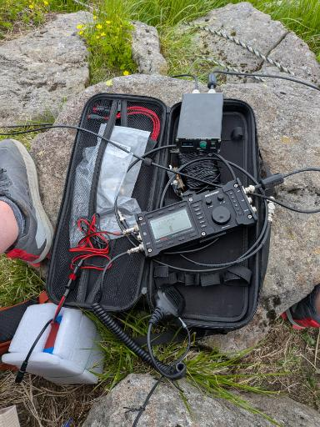
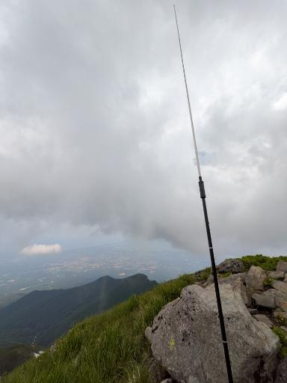
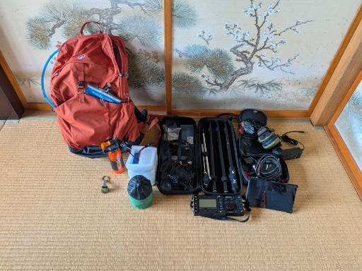
The Gear I Took
LAB599 TX-500 PORTABLE HF STATION ·
POTA & SOTA Field Kit
EQUIPMENT CARRIED
IN THE FIELD
Lab599 TX-500 Discovery
Transceiver · rugged QRP HF radio
Radioddity HF-009 Portable HF Antenna
Antenna · telescoping portable HF
Radioddity ATU-100 Automatic Tuner
Tuner · automatic antenna tuner
Bioenno LiFePO4 Battery BLF-1209A
Power · GigaParts · 12V 9Ah
TX-500 Digirig and Cables Set
Data · DRG-DRMOB-TX500 · digital modes
Amazon Portable HF End-Fed Antenna
Antenna · EFHW wire
Windows 11 Acer Laptop
Compute · digital modes & logging
Android Tablet
Compute · · digital modes & logging
Portable HF station carried for POTA & SOTA activations across Aomori-ken — centred on the Lab599 TX-500 Discovery.

Slide 5
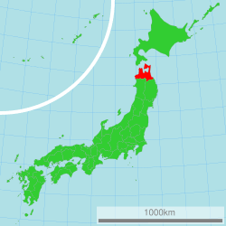
Aomori Prefecture 青森県
NORTHERNMOST PREFECTURE
Honshū · Tōhoku · 青森
JAPAN'S NORTHERN FRONTIER — TŌHOKU REGION, HONSHŪ
LOCATION
Northernmost prefecture of Honshū, Tōhoku region. Borders the Tsugaru Strait to the north, separating it from Hokkaidō, the Sea of Japan to the west and the Pacific Ocean to the east.
CLIMATE
Subarctic winters with some of Japan's heaviest snowfall. Pacific and Sea of Japan coastlines create distinct climatic zones across the prefecture with heavy snow fall in the west and rainy early summer monsoons on the east.
TERRAIN
Iwaki Volcano (1,625 m), Hakkōda Range, Shimokita Peninsula, Tsugaru Peninsula & the stunning caldera of Lake Towada. Much of the lowlands are utilized for agriculture.
Aomori's location within Japan
Area: 9,646 km² · Population: ~1.18M

Slide 6
Parks on the Air (POTA)
Parks On The Air
pota.app — A Worldwide Amateur Radio Program
ACTIVATORS
Set up portable stations inside designated parks and make QSOs — contacts with other amateur radio operators
HUNTERS
Contact activators from home or any location worldwide — no need to be in a park to participate and log contacts
GLOBAL REACH
Over 80,000 park references worldwide across dozens of entities — including Japan's JP- prefix references
AWARDS
Earn certificates and awards for activating or hunting parks — milestone awards at 10, 25, 50, 100+ parks
PARK-TO-PARK (P2P)
Contacts between two activators each operating from a park — earns extra credit for both activators simultaneously
JAPAN — JP- PREFIX
Japan uses JP- references covering national parks, quasi-national parks, and prefectural natural parks across all 47 prefectures
Minimum 10 QSOs required per UTC day for a valid POTA activation
Free to participate — any amateur radio license, any band, any mode
Log & upload ADIF via pota.app
pota.app

Slide 7
POTA Activation Process
5-STEP WORKFLOW
From park selection to log submission — every activation follows this process
KEY GOAL
01
02
03
04
05
Find a Park
Set Up In-Park
Make 10 QSOs
Spot Yourself
Submit ADIF Log
Browse pota.app/map for JP- references in your area. Confirm park boundaries before heading out.
All equipment must be within park boundaries. Activations from vehicles, RVs, etc., parked on public property within the park’s boundary are permissible
Minimum 10 contacts within a single UTC day for a valid activation. Any mode, any band counts.
Use pota.app or ask someone to spot you so hunters worldwide can find your frequency.
Upload your log to pota.app after activation. No time limit — but sooner is courteous to hunters.
All ops must be within the park boundary — GPS verify if uncertain
10 QSOs must fall within a single UTC calendar day
Japan parks use the JP- prefix — verify on pota.app before each activation
SOURCE:
pota.app

Slide 8
SUMMITS ON THE AIR
What is
SOTA?
SOTA.ORG.UK
ACTIVATION ZONE
PORTABLE POWER ONLY
Hike to qualifying summits and operate within 25 vertical metres of the peak to earn points.
Batteries or solar only. No generators, no vehicle power, no mains electricity permitted.
Hiking & Amateur Radio
Combined — the global
program for portable
summit operations.
HUMAN-POWERED ACCESS
POINTS SYSTEM
Final approach must be hiking or cycling — no motorized access to the Activation Zone.
1
2
4
6
8
10
AWARDS PROGRAMM
JAPAN — JA ASSOCIATION
Mountain Goat — 1,000 activator pts | Shack Sloth — 1,000 chaser pts.
Aomori summits fall under the JA/AM regional prefix in the SOTA Association Reference Manual.
Verify summit eligibility and ARM details at sota.org.uk before planning activations.
JAPAN ASSOCIATION
JA / AM
Aomori-ken Regional
Summit Prefix

Slide 9
SOTA Activation Process
Summits on the Air
sota.org.uk · JA/AM — Aomori Summits · Human-powered operation from summit to database
1
2
3
4
5
Find a Summit
Alert in Advance
Hike In
Make 4 QSOs
Log Your Activation
Check sotadata.org.uk for JA/AM summits. Confirm elevation, points value, and Activation Zone location before your trip.
Post your planned activation on SOTAwatch3 so chasers worldwide can prepare. Include summit ref, date, time & band.
Human-powered access only. Carry all gear. Operate within 25 m vertical of the summit — the Activation Zone.
Minimum 4 valid two-way contacts earn activator points. Exchange callsign, signal report, and SOTA summit reference.
Submit your log via the SOTA database. Points credited to your activator score. Counts toward Mountain Goat award.
sotadata.org.uk
sotawatch.sota.org.uk
No motorized access
Min. 4 QSOs required
database.sota.org.uk
Activation Zone = within 25 m vertical of summit
Portable power only — no mains, no generators
JA/AM summits: 1–10 points based on elevation
Mountain Goat = 1,000 activator points
⛰️ SOTA — SUMMITS ON THE AIR · SOTA.ORG.UK
Aomori-ken Field Operations

Slide 10
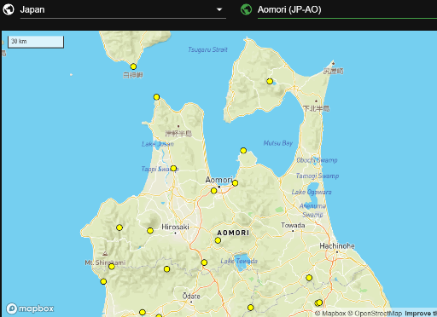
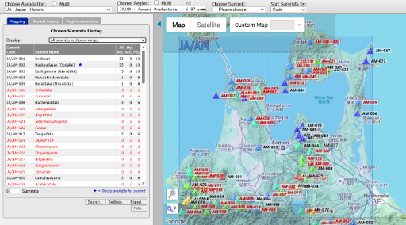
AOMORI · FIELD GUIDE
POTA & SOTA Sites in Aomori
A quick look at where to activate across the prefecture
🌲 POTA · Parks on the Air
⛰️ SOTA · Summits on the Air
300+ listed JA/AM summits · 1–10 points across the Hakkōda & Iwaki ranges and beyond.
National & quasi-national parks · forest & coastal reserves — all valid POTA entities under JP-AO.

Slide 11
AOMORI PREFECTURE — MY TARGETS
My Goals: Aomori SOTA & POTA Targets
SOTA
SOTA + POTA
SOTA + POTA
SOTA + POTA
POTA
JA/AM-001
JA/AM-002
JA/AM-020
JA/AM-087
JP-1024
SOTA
SOTA
SOTA
SOTA
POTA Only
Mt. Iwaki · 岩木山
Mt. Hakkōda Odake · 八甲田大岳
Mt. Kamabuse · 釜臥山
Mt. Ozaki · 尾崎山
Asamushi-Natsudomari Prefectural Natural Park
1,625 m · 10 pts
1,584 m · 10 pts
878 m · 6 pts
230 m · 1 pts
POTA
POTA
POTA
JP-1028 · Kuroishi Onsenkyō Prefectural Nature Park
JP-0106 · Shimokita Hantō Quasi-Nat’l Park
JP-0107 · Tsugaru Quasi-National Park
SOTA
2-FER
2-FER
2-FER
POTA
FIVE GOALS · THREE 2-FERS
POTA · SOTA · AOMORI-KEN 青森県
HONSHŪ'S NORTHERN FRONTIER

Slide 12
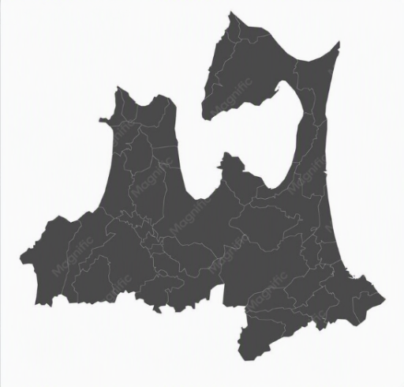
AOMORI PREFECTURE — MY TARGETS
On the Map: SOTA & POTA Locations
TARGET LOCATIONS
1
Mt. Kamabuse · 釜臥山
JA/AM-020 · SOTA + POTA · 878 m
JP-0106 · Shimokita Hantō Quasi-Nat'l Park
1
5
2
Asamushi-Natsudomari
JP-1024 · POTA · Prefectural Natural Park
2
3
Mt. Hakkōda Odake · 八甲田大岳
JA/AM-002 · SOTA + POTA · 1,584 m
JP-1028 · Kuroishi Onsenkyō Prefectural Nature Park
3
4
Mt. Iwaki · 岩木山
JA/AM-001 · SOTA · 1,625 m
4
5
Mt. Ozaki · 尾崎山
JA/AM-087 · SOTA + POTA · 230 m
JP-0107 · Tsugaru Quasi-National Park
Marker numbers match the legend · positions approximate

Slide 13
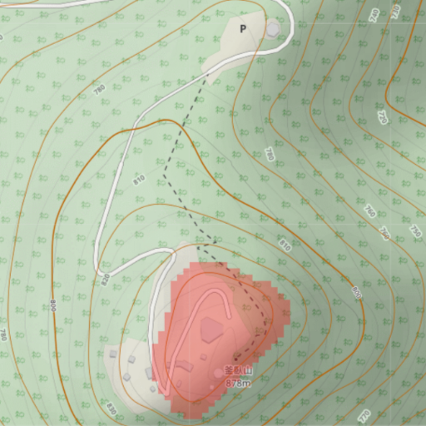
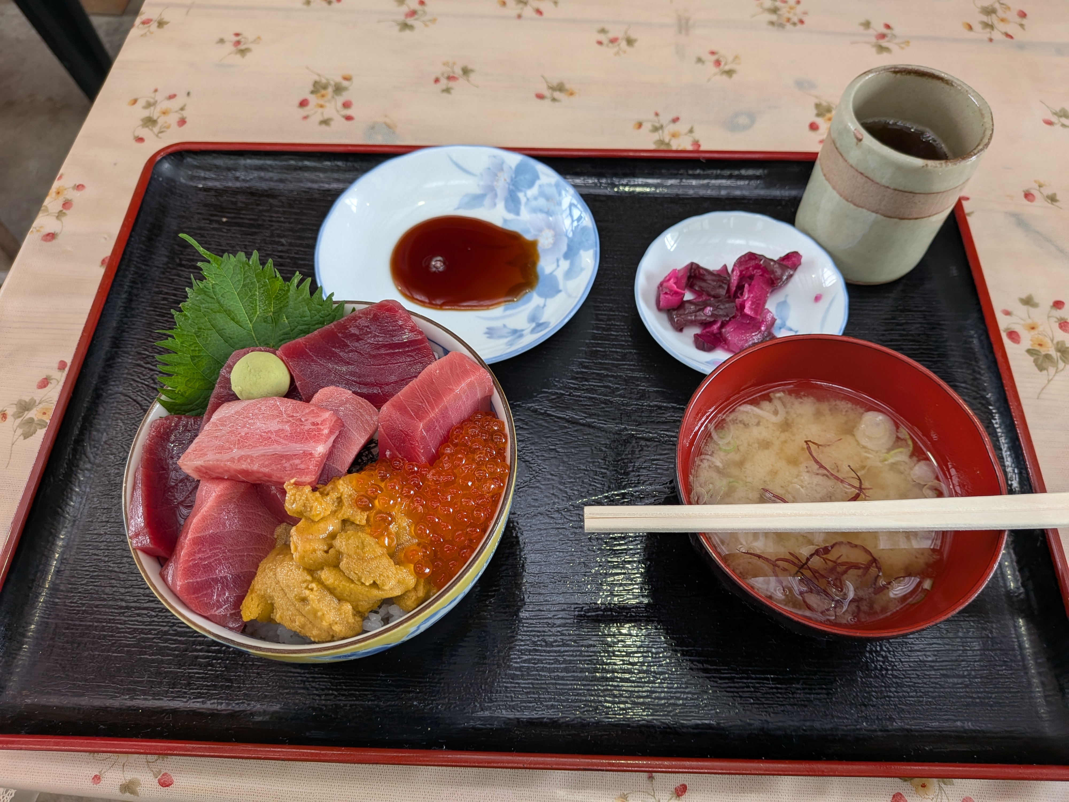
⛰️ Activation Attempt — Mt. Kamabuse · 釜臥山 – 7/15
SOTA + POTA FIELD LOG
01
06:00 Local [2026 Jul 15 21:00]z
02
Depart Home
[08:40]
[clear and sunny]
Reached Park
Informed that Armature Radio operation was not allowed at the summit.
SOTA rules stipulated that you must be within 25 m of the summit
03
[09:30]
Reached the summit
Short climb. Took some photos and return to the parking lot.
04
[10:30]
05
Began operations in the parking lot for the POTA
[14:00]
Pack Up Station
06
Band conditions were poor.
Pore weather moved in. Packed it up and went to lunch.
SOTA and POTA attempts were unsuccessful

Slide 14
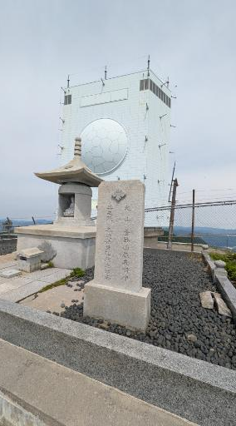
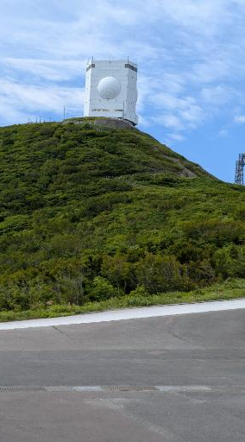
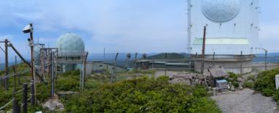
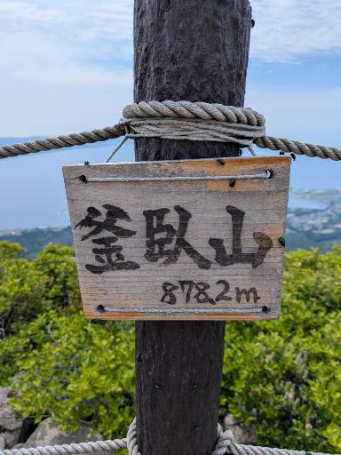
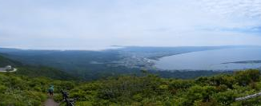
SUMMIT PHOTO GALLERY
SOTA JA/AM-020 · 878 m · 6 pts
POTA JP-0106 · Shimokita Hantō Quasi-Nat'l Park · 2-FER
Mt. Kamabuse · 釜臥山
Summit monument · radar dome station · views across Mutsu Bay from the 878 m summit.

Slide 15
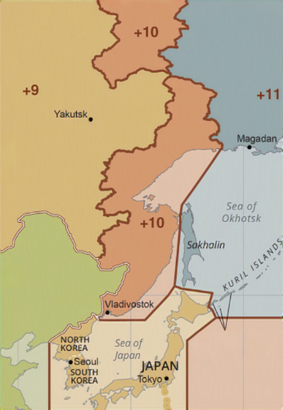
⛰️ Activation Attempt — Asamushi-Natsudomari - 07/15
POTA FIELD LOG
01
18:20 Local · 2026 Jul 16 09:20z
Arrived at the Park
Evening arrival at the coastal park
02
18:45 Local
Began Operations
Weather cleared up · band conditions still poor
03
19:45 Local
Halted Operations
Poor propagation · packed up the station
04
20:00 Local
Called It a Night
Bands never opened · slept in the car
POTA attempts were unsuccessful

Slide 16
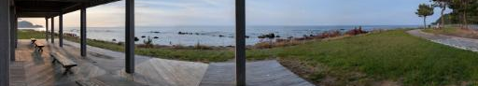
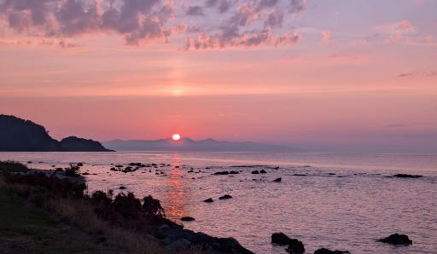
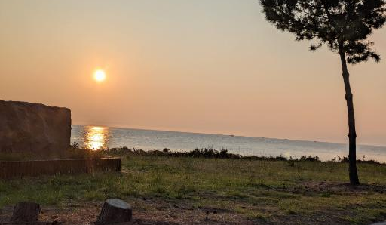

POTA PHOTO GALLERY
POTA JP-1024 · Prefectural Natural Park
DATE 2026-06-15 · Aomori-ken, Japan
Asamushi-Natsudomari
7:00 p.m.
3:04 a.m.
Coastal park deck at arrival · sunset over Mutsu Bay · overnight in the car after the bands stayed quiet.

Slide 17
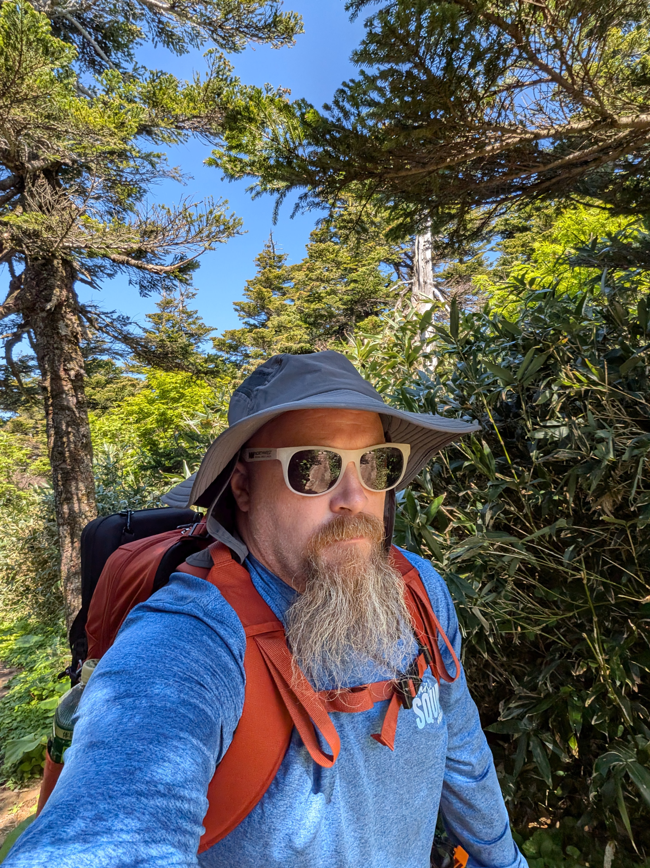
⛰️ Activation Attempt — Mt. Hakkōda Ōdake · 八甲田大岳
SOTA + POTA FIELD LOG
01
09:00 Local
Arrived at Ropeway Base
Start of the traverse toward Ōdake
02
12:00
Crossed Two Summits
Crossed two summits and reached a view of the third and final summit.
Trail to the third summit was still covered in ice — did not attempt and hiked back.
03
15:30
Returned to Parking Lot
Hiked back down and returned to the parking lot. SOTA and POTA activations not completed.
SOTA and POTA attempts were unsuccessful

Slide 18
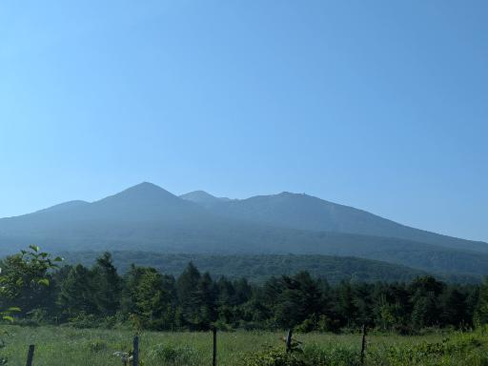
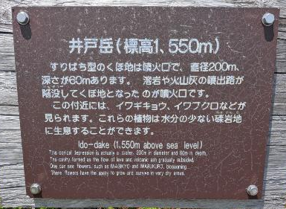
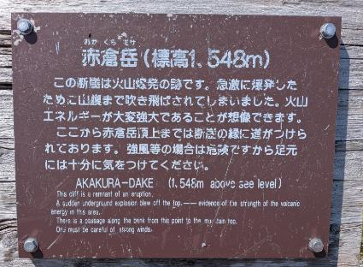
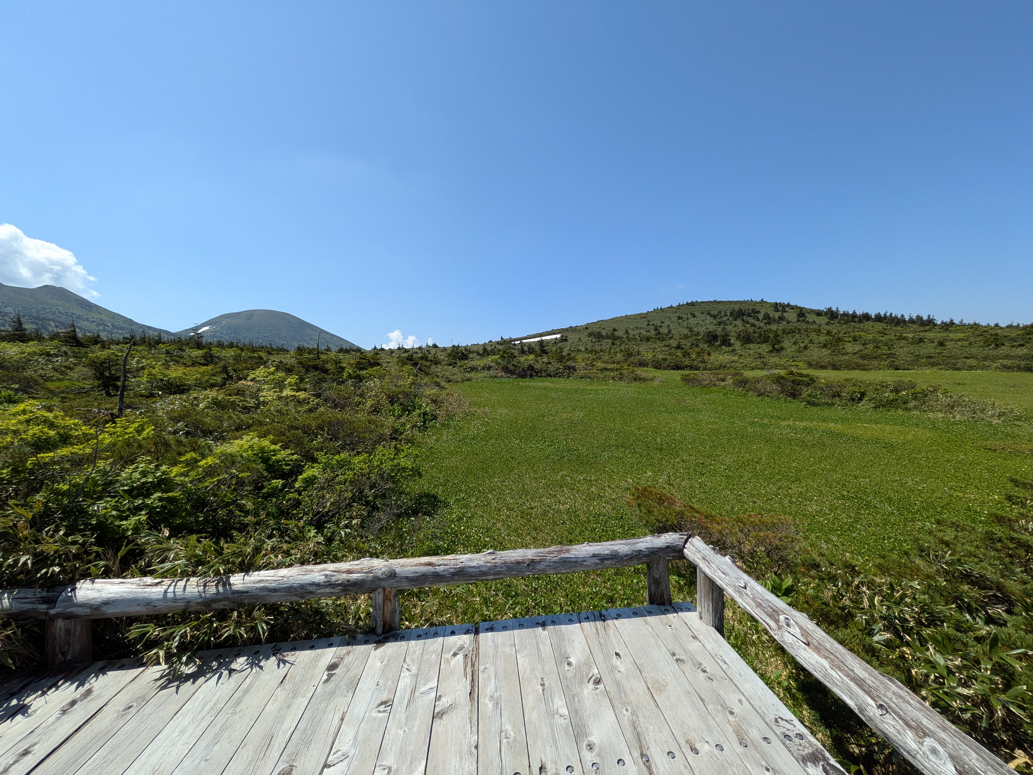
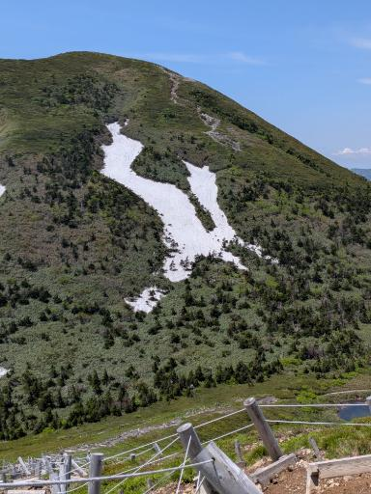
SOTA + POTA PHOTO GALLERY
SOTA JA/AM-002 · 1,584 m
POTA JP-1028 · Kuroishi Onsenkyō Prefectural Nature Park
Mt. Hakkōda Ōdake 八甲田大岳
The Hakkōda massif from the approach · Ido-dake (1,550 m) and Akakura-dake (1,548 m) crossed on the traverse · snow still blocking the final climb to Ōdake.

Slide 19
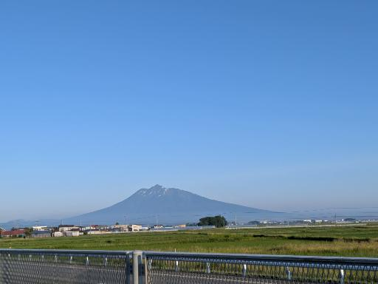
⛰️ Activation Attempt — Mt. Iwaki · 岩木山
SOTA FIELD LOG
01
09:00 Local
Arrived at Ropeway Base
Start of the ascent toward the Mt. Iwaki summit.
02
10:00 Local
Reached the Summit
Summited Mt. Iwaki (1,625 m) and set up the station.
03
10:15 Local
Began Operating
SOTA activation on the air from the summit of Mt. Iwaki.
04
12:30 Local
Ended Operation
Ended operation early as bad weather rolled in over the summit.
SOTA activation completed successfully

Slide 20
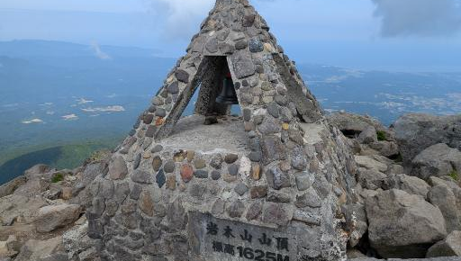
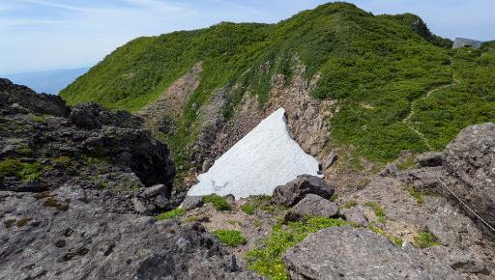
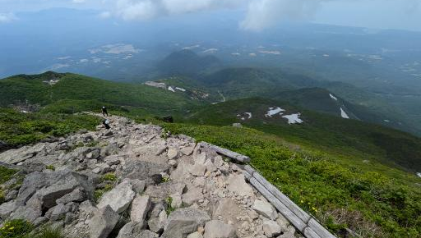
SOTA PHOTO GALLERY
SOTA JA/AM-001 · 1,625 m
DATE 2026-06-18 · Aomori-ken, Japan
Mt. Iwaki · 岩木山
Summit marker at 1,625 m · lingering snowfield along the ridge · descent as the weather began to move in.

Slide 21
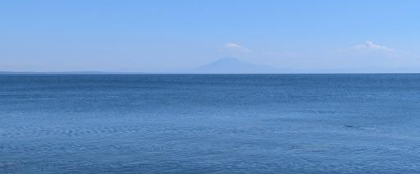
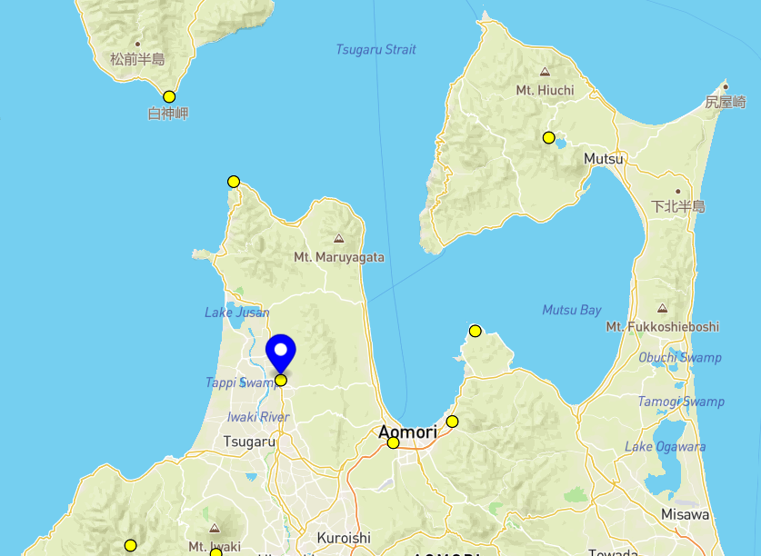
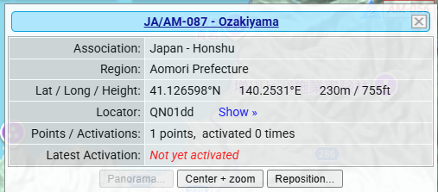
SOTA FIELD LOG · ATTEMPT 05
Mt. Ozaki · 尾崎山
SOTA JA/AM-087 · 230 m
PARK JP-0107 · Tsugaru Quasi-Nat'l Park
✕ TARGET 5 INACCESSIBLE — no viable route to the Mt. Ozaki summit; SOTA activation stood down.
WHAT HAPPENED
The approach to Mt. Ozaki (JA/AM-087) was completely inaccessible — no safe route into the activation zone. The SOTA attempt was called off, and the summit remains unactivated in the database.
PLAN B — POTA PIVOT
Ashino Chishōgun Prefectural Natural Park
芝野池沼群県立自然公園 · JP-1027 · POTA
Tsugaru Peninsula · Goshogawara & Nakadomari
Est. 1958 · 612 ha · Lake Ashino & Osawanai reservoir
One of Japan’s 100 Best Sakura spots · Tsugaru Railway
Target location (Tsugaru) SOTA log: not yet activated

Slide 22
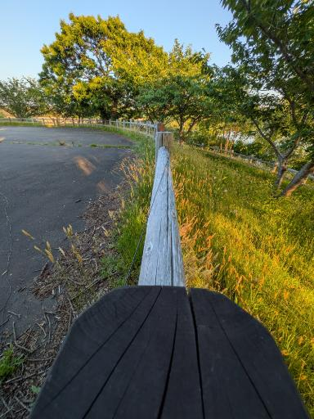
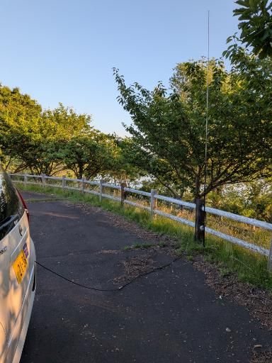
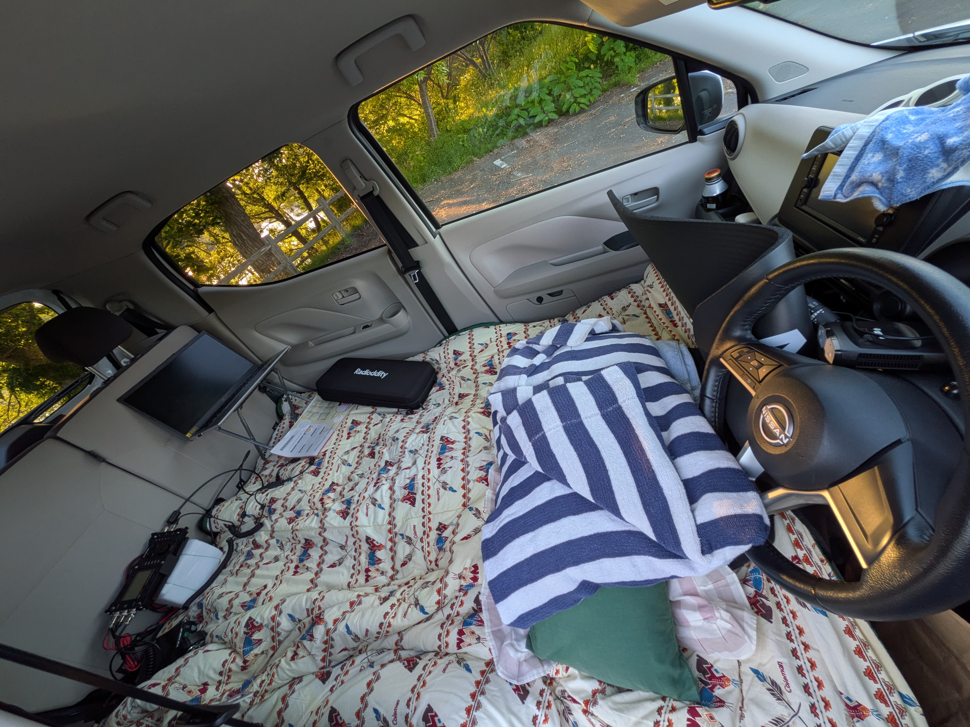
POTA PHOTO GALLERY
POTA JP-0107 · Quasi-National Park
DATE 2026-06-17 · Aomori-ken, Japan
Tsugaru · 津軍
Evening light in the park · vertical antenna on the car · clamp mount on the rail fence · operating from inside the vehicle.

Slide 23



PERSONAL FIELD LOG
Activation Summary
Aomori-ken Field Operations
[ 6 ]
[ 0 ]
[ 0 ]
TOTAL ACTIVATION ATTEMPTS
POTA PARKS ACTIVATED
SOTA SUMMITS ACTIVATED
POTA + SOTA combined
JP- references logged
JA/AM region summits
[ 6 ]
[ 0 ]
[ 15-18 Jun 2026 ]
TOTAL QSOS MADE
SOTA POINTS EARNED
OPERATING PERIOD
All modes & bands
Activator score — JA/AM
UTC activation window

Slide 24
CONTACTS LOGGED · WHO I WORKED
Stations Worked in Aomori
JA/AM-020 · MT. KAMABUSE 釜臥山 · JP-0106 · SHIMOKITA HANTŌ QUASI-NAT'L PARK
JH5HDA
Hisashi Sekioka
MODE
Japan
FT-8
SSB
JP-0107 · TSUGARU QUASI-NATIONAL PARK · 5 CONTACTS
JA2KVB
UA0LQE
JK1UWJ
Yoshihiro Nakamura
Malinkin VASILY
Tadashi Sato
Japan
Asiatic Russia
Japan
FT-8
FT-8
SSB
JA9OJM
JJ1HHJ
Soji Yamagishi
MATSUURA, Kyo
Japan
Japan
SSB
SSB

Slide 25
FIELD REPORT — AOMORI-KEN
Key Takeaways
4 CORE INSIGHTS
01
Combine two things you enjoy and achieving just one can still satisfy — pairing two passions means the trip still feels worthwhile even if only one goal works out.
02
Don't spread across too many sites — too many activations meant ~1,300 km of driving between locations; one or two 'twofer' spots with a focused day or two each would have netted more contacts than constant relocating.
03
Learn the radio lingo, even in a language you know — missing the amateur-radio phrasing and Q-codes can limit how many contacts you make.
04
Two call signs are still tricky — I'm still unsure how to handle two different call signs across QRZ.com, POTA.app, and SOTAdata (sotadata.org.uk).
POTA · SOTA · AOMORI-KEN, JAPAN
Keep the parks & summits on the air

Slide 26
AOMORI POTA & SOTA FIELD REPORT · 青森県
73 de JQ7FWB
KQ4IBI
Keep the parks and summits on the air!
🌲📻⛰️
JA/AM SOTA
JP- POTA
青森県

